Slide 1

Randomized Algorithms
Lecturer: Moni Naor
Lecture 10

Slide 2
Recap and Today
Recap
The non constructive proof of the local lemma
Today
Algorithmic Local Lemma
Cuckoo Hashing

Slide 3
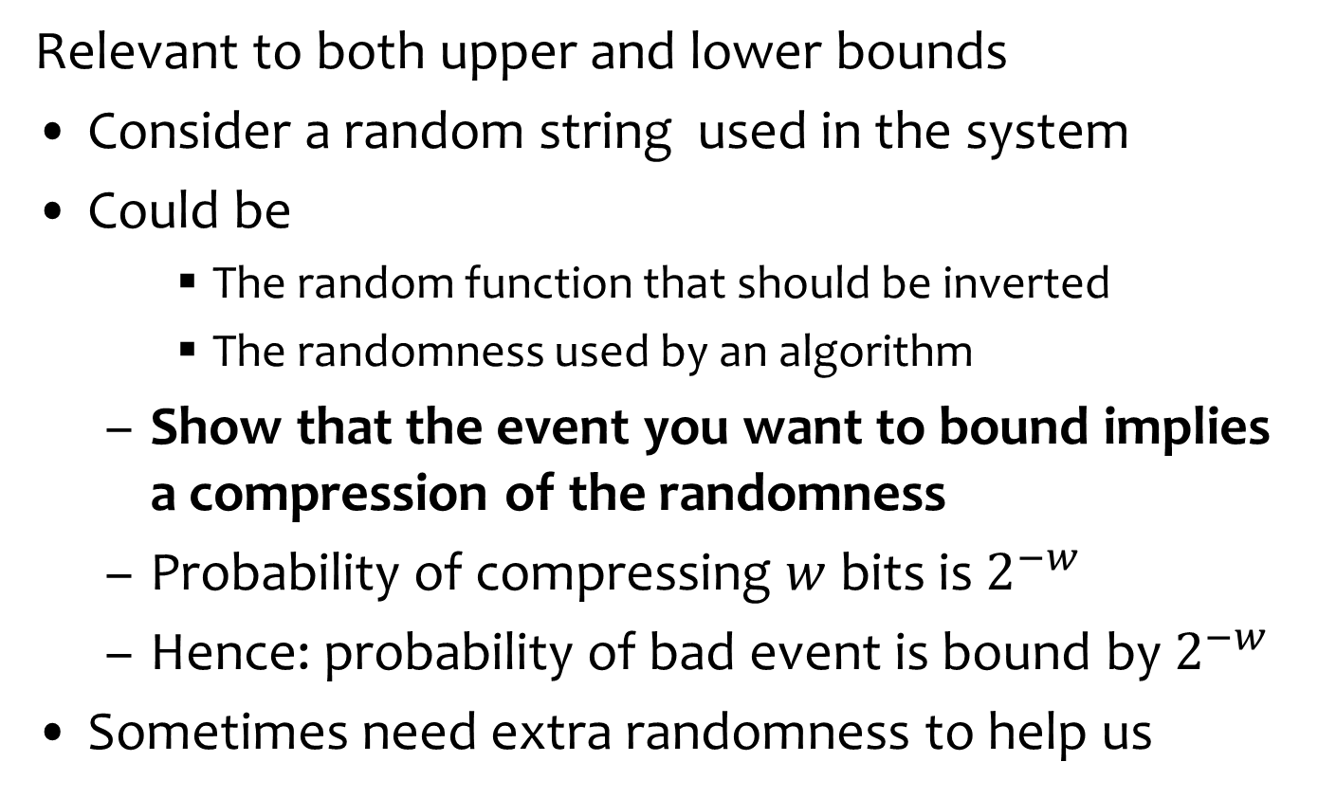
Structure of Proofs by Compression or Encoding
Relevant to both upper and lower bounds
Consider a random string used in the system
Could be
The random function that should be inverted
The randomness used by an algorithm
Show that the event you want to bound implies a compression of the randomness
Probability of compressing $w$ bits is $2^{−w}$
Hence: probability of bad event is bound by $2^{−w}$
Sometimes need extra randomness to help us

Slide 4
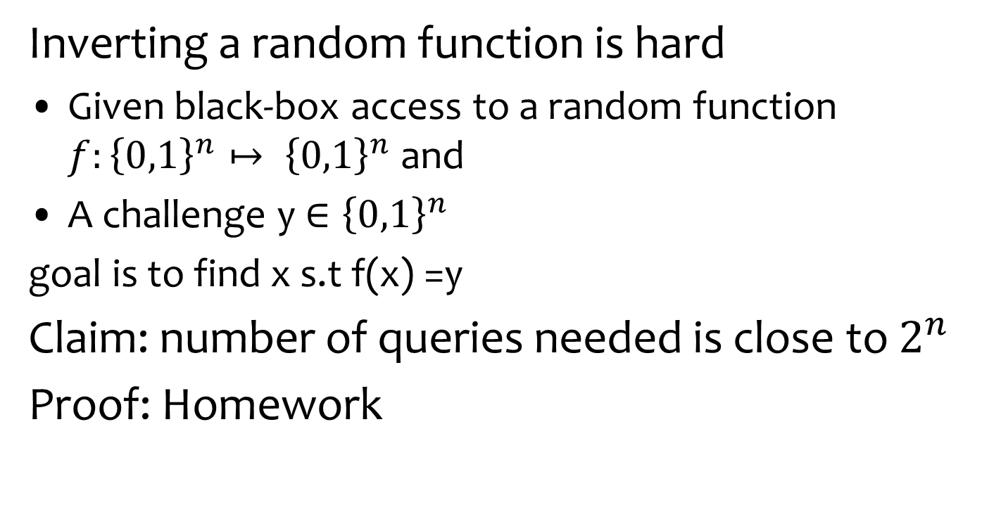
Proof by Encoding
Inverting a random function is hard
Given black-box access to a random function $f:{\left\{0,1\right\}}^{n}↦ {\left\{0,1\right\}}^{n}$and
A challenge y${∈\left\{0,1\right\}}^{n}$
goal is to find x s.t f(x) =y
Claim: number of queries needed is close to $2^{n}$
Proof: Homework

Slide 5
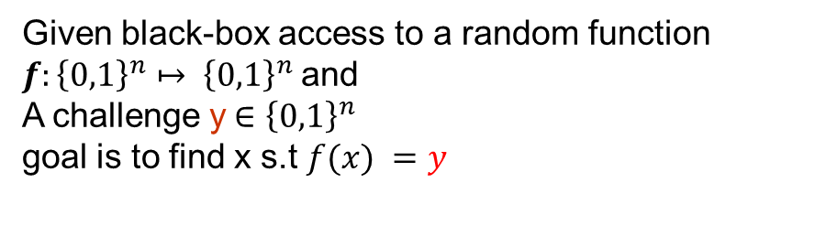
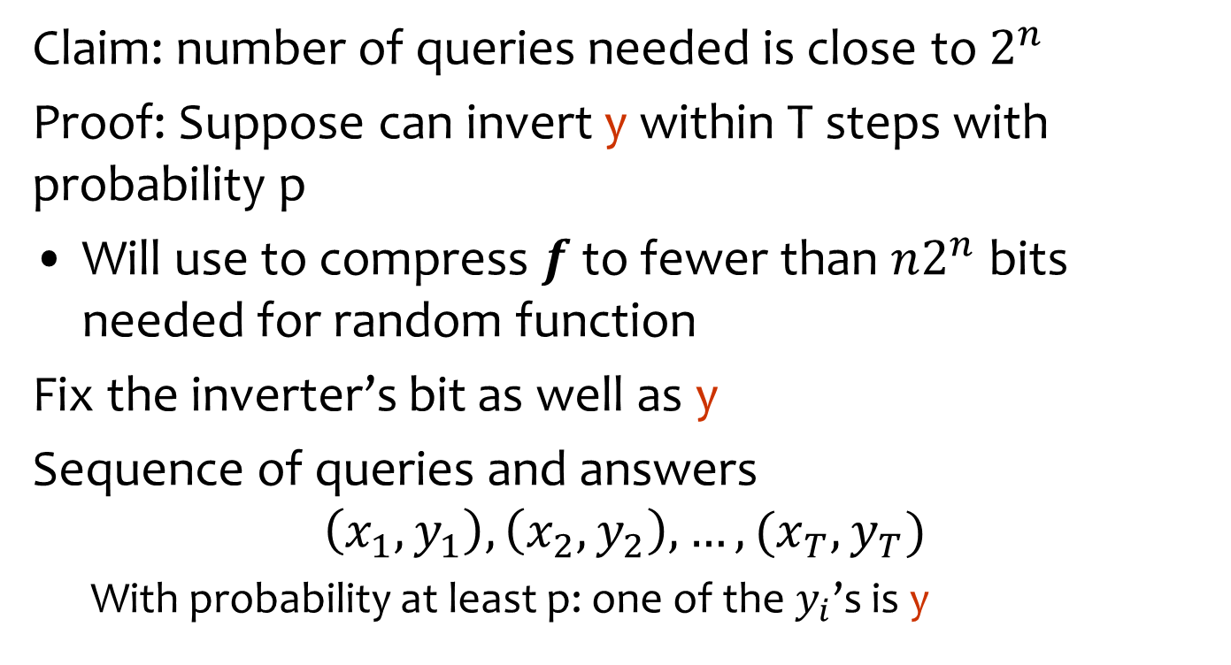

Proof by Encoding
Given black-box access to a random function $f:{\left\{0,1\right\}}^{n}↦ {\left\{0,1\right\}}^{n}$and
A challenge y${∈\left\{0,1\right\}}^{n}$
goal is to find x s.t $f(x) =y$
Claim: number of queries needed is close to $2^{n}$
Proof: Suppose can invert y within T steps with probability p
Will use to compress $f$ to fewer than $n2^{n}$ bits needed for random function
Fix the inverter’s bit as well as y
Sequence of queries and answers
$$\left(x_{1},y_{1}\right), \left(x_{2},y_{2}\right), …, (x_{T},y_{T})$$
With probability at least p: one of the $y_{i}$’s is y
Savings: $n−log⁡T$
Only log T
Bit to record
Which one
Only these recorded

Slide 6
The Lovasz Local Lemma
Statement
Application
“Constructive”
“Algorithmic”

Slide 7
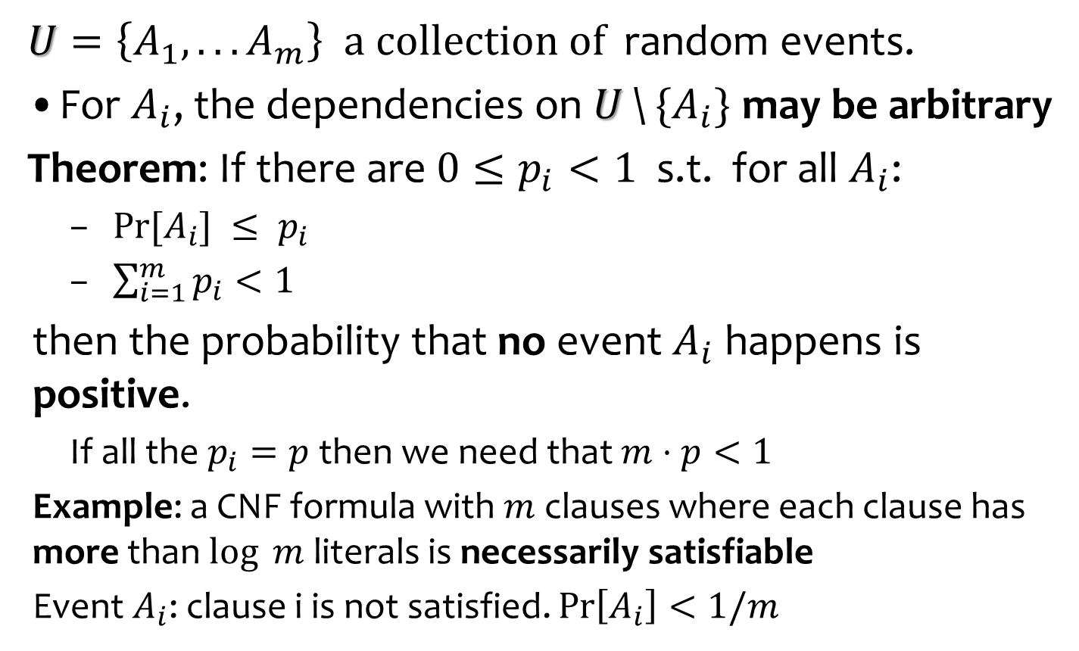
The Union Bound
$U=\left\{A_{1},. . . A_{m}\right\}$ $a collection of$ random events.
For $A_{i}$, the dependencies on $U$\${ \{A}_{i}\}$ may be arbitrary
Theorem: If there are $0≤p_{i}<1$ s.t. for all $A_{i}$:
$Pr⁡[A_{i}] ≤ p_{i}$
$\sum_{i=1}^{m}{p_{i}}<1$
then the probability that no event $A_{i}$ happens is positive.
If all the $p_{i}=p$ then we need that $m$ $⋅p<1$
Example: a CNF formula with $m$ clauses where each clause has more than $log ⁡m$ literals is necessarily satisfiable
Event $A_{i}$: clause i is not satisfied. $Pr\left[A_{i}\right]<1/m$
For a uniformly
random assignment

Slide 8
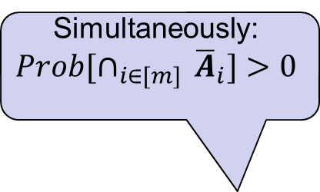
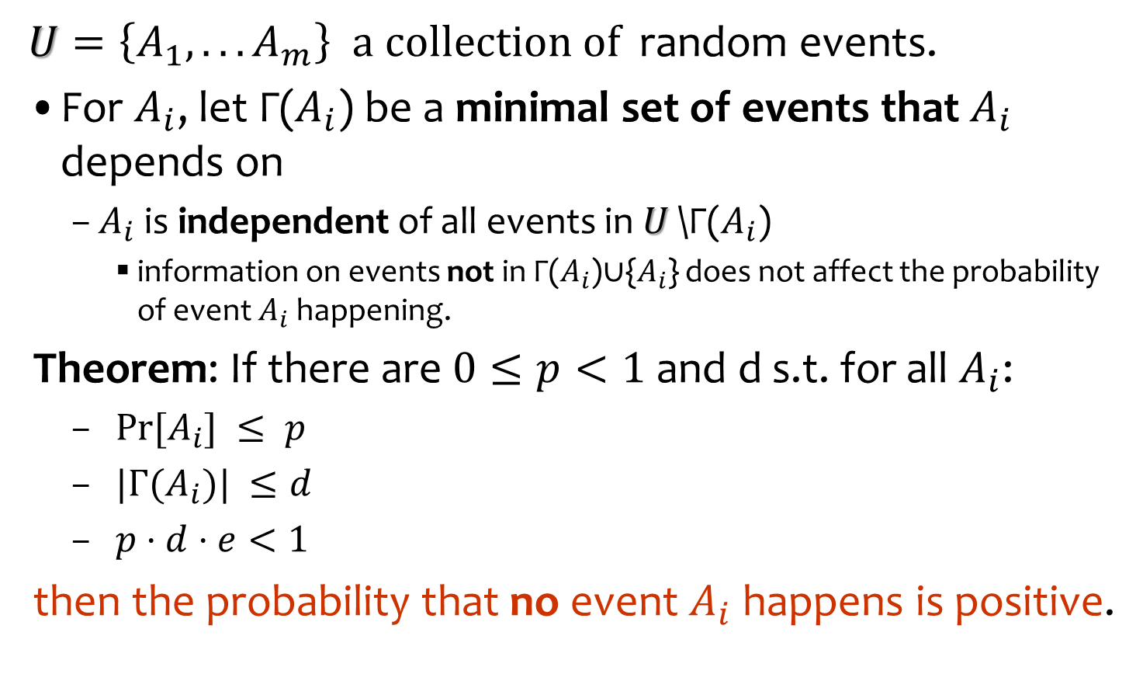
The (Lovasz) Local Lemma
Question: what happens with k-wise independent events?
$U=\left\{A_{1},. . . A_{m}\right\}$ $a collection of$ random events.
For $A_{i}$, let Γ($A_{i}$) be a minimal set of events that $A_{i}$ depends on
$A_{i}$ is independent of all events in $U$\Γ($A_{i}$)
information on events not in Γ($A_{i}$)∪{$A_{i}$} does not affect the probability of event $A_{i}$ happening.
Theorem: If there are $0≤p<1$and d s.t. for all $A_{i}$:
$Pr⁡[A_{i}] ≤ p$
$|Γ(A_{i})| ≤d$
$p⋅d⋅e<1$
then the probability that no event $A_{i}$ happens is positive.
Not symmetric
Simultaneously:
$${Prob[∩}_{i∈[m] }{\overline{A}}_{i}]>0$$

Slide 9
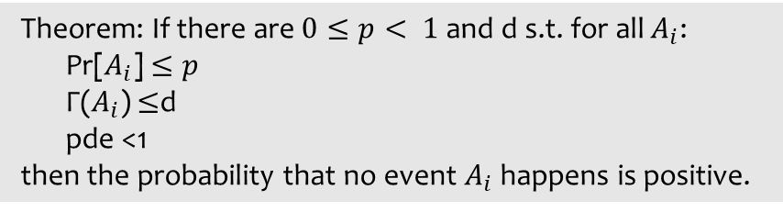
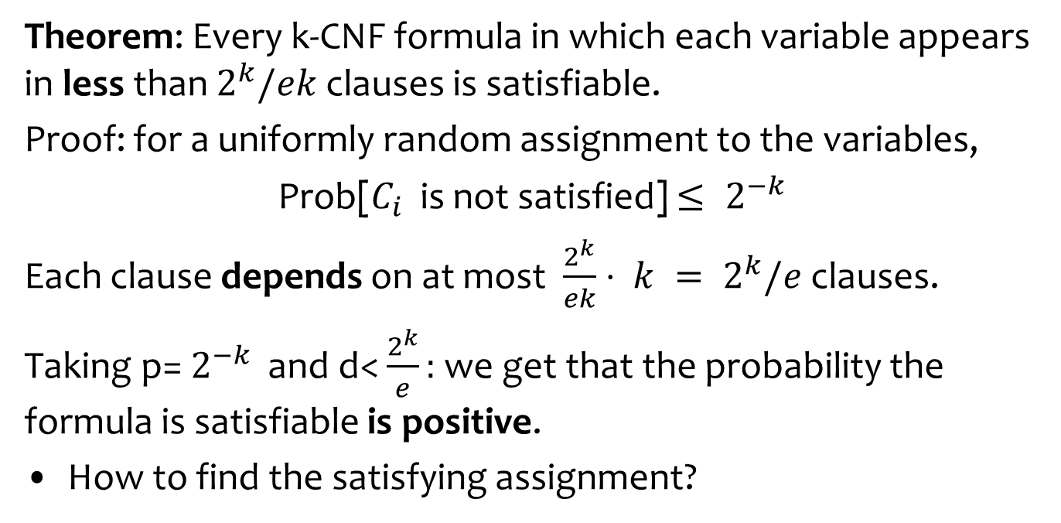
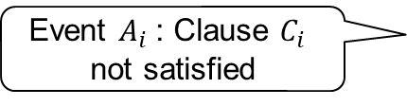
Applying The Local Lemma for k-CNF
Theorem: If there are $0≤p< 1$and d s.t. for all $A_{i}$:
Pr[$A_{i}$] $≤p$
Γ($A_{i}$) $≤$d
pde <1
then the probability that no event $A_{i}$ happens is positive.
No dependency on the
number of variables n
or number of clauses m
Theorem: Every k-CNF formula in which each variable appears in less than $2^{k}/ek$clauses is satisfiable.
Proof: for a uniformly random assignment to the variables,
Prob[$C_{i}$ is not satisfied] $≤ 2^{−k}$
Each clause depends on at most $\frac{2^{k}}{ek}⋅ k = 2^{k}/e$clauses.
Taking p= $2^{−k}$ and d< $\frac{2^{k}}{e}:$ we get that the probability the formula is satisfiable is positive.
How to find the satisfying assignment?
Event $A_{i}$ : Clause $C_{i}$
not satisfied
If two clauses do not
share a variable, their
satisfiability is independent

Slide 10
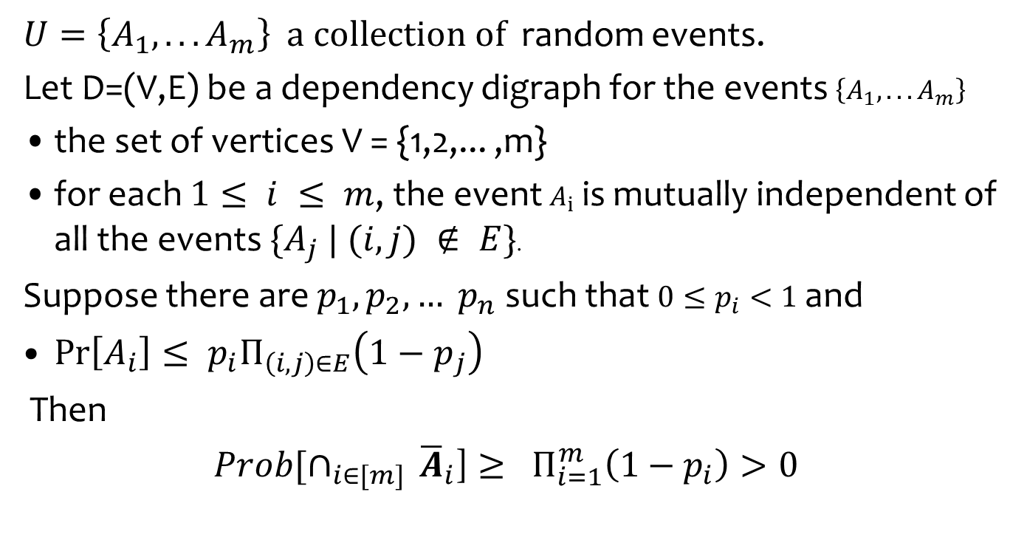
The (Lovasz) Local Lemma: General
$U=\left\{A_{1},. . . A_{m}\right\}$ $a collection of$ random events.
Let D=(V,E) be a dependency digraph for the events $\left\{A_{1},. . . A_{m}\right\}$
the set of vertices V = {1,2,... ,m}
for each $1≤ i ≤ m$, the event $A_{i}$ is mutually independent of all the events $\{A_{j} | (i,j) ∉ E\}$.
Suppose there are $p_{1}, p_{2}, … p_{n}$such that $0≤p_{i}<1$ and
$\operatorname{Pr}\left[A_{i}\right]≤ p_{i}Π_{\left(i,j\right)∈E}\left(1−p_{j}\right)$
Then
${Prob[∩}_{i∈[m] }{\overline{A}}_{i}$] $≥ Π_{i=1}^{m}\left(1−p_{i}\right)>0$

Slide 11

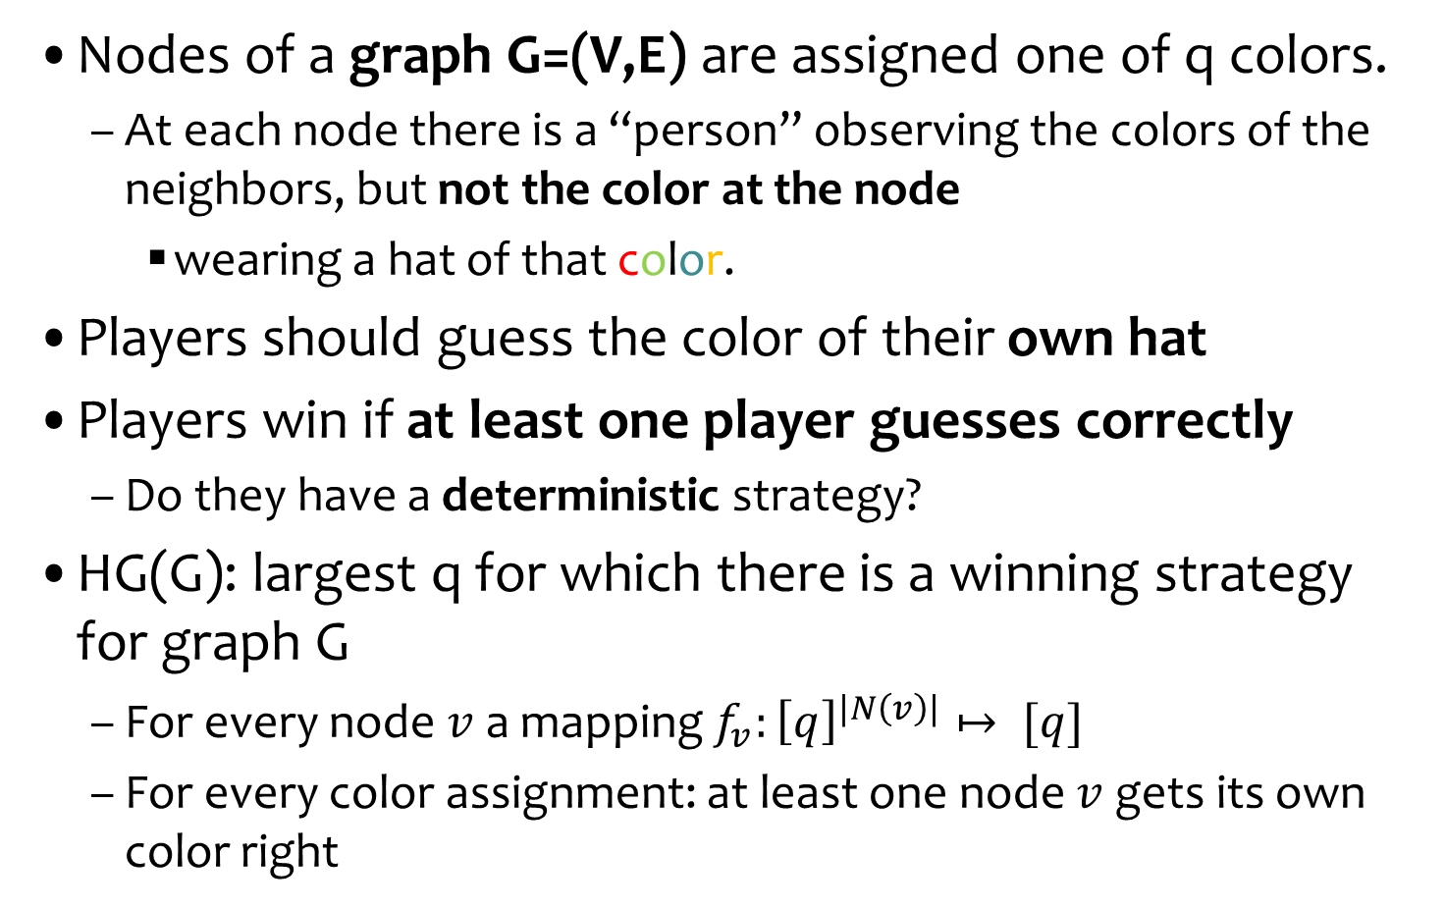

Example: LLL and the Hat Game
Nodes of a graph G=(V,E) are assigned one of q colors.
At each node there is a “person” observing the colors of the neighbors, but not the color at the node
wearing a hat of that color.
Players should guess the color of their own hat
Players win if at least one player guesses correctly
Do they have a deterministic strategy?
HG(G): largest q for which there is a winning strategy for graph G
For every node $v$ a mapping $f_{v}:{\left[q\right]}^{|N\left(v\right)|}↦ [q]$
For every color assignment: at least one node $v$ gets its own color right
$N\left(v\right)$: neighbors of $v$

Slide 12
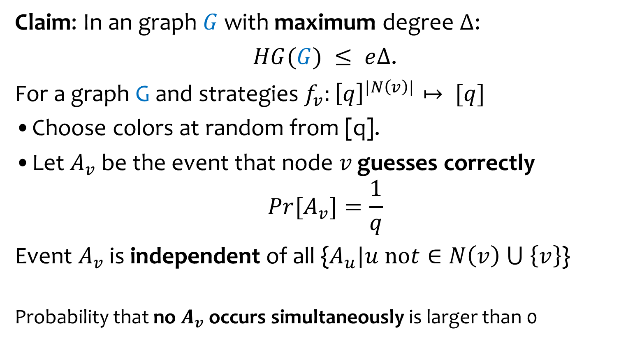
…LLL and the Hat Game
Claim: In an graph $G$ with maximum degree ∆:
$HG(G) ≤ e∆$.
For a graph G and strategies $f_{v}:{\left[q\right]}^{|N\left(v\right)|}↦ [q]$
Choose colors at random from [q].
Let $A_{v}$ be the event that node $v$ guesses correctly
$${Pr[A}_{v}]=\frac{1}{q}$$
Event $A_{v}$ is independent of all {$A_{u}|u not∈N\left(v\right) ⋃ \left\{v\right\}$}
Probability that no $A_{v}$ occurs simultaneously is larger than 0
Why not distance 2?
There are ∆ of these
pde <1

Slide 13
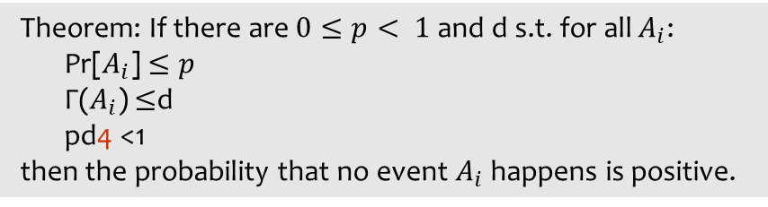
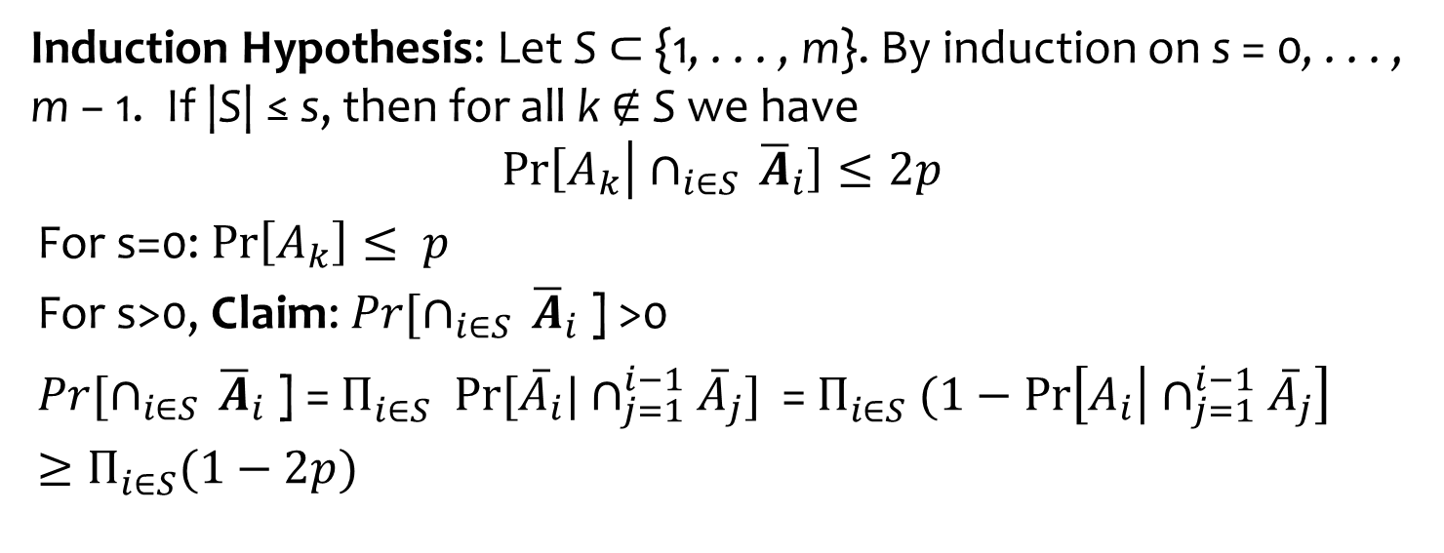
Proof of The Local Lemma
Theorem: If there are $0≤p< 1$and d s.t. for all $A_{i}$:
Pr[$A_{i}$] $≤p$
Γ($A_{i}$) $≤$d
pd4 <1
then the probability that no event $A_{i}$ happens is positive.
Induction Hypothesis: Let S ⊂ {1, . . . , m}. By induction on s = 0, . . . , m − 1. If |S| ≤ s, then for all k $∉$ S we have
$$\operatorname{Pr}\left[A_{k} | ∩_{i∈S }{\overline{A}}_{i}\right]≤2p$$
For s=0: $\operatorname{Pr}\left[A_{k}\right]≤ p$
For s>0, Claim: ${Pr[∩}_{i∈S }{\overline{A}}_{i}$] >0
${Pr[∩}_{i∈S }{\overline{A}}_{i}$] = $Π_{i∈S}^{} Pr⁡[{\overline{A}}_{i}|∩_{j=1}^{i−1}{\overline{A}}_{j}]$ = $Π_{i∈S}^{} (1−\operatorname{Pr}\left[A_{i} | ∩_{j=1}^{i−1}{\overline{A}}_{j}\right]$
$$≥Π_{i∈S}^{}(1−2p)$$
By induction hypothesis

Slide 14
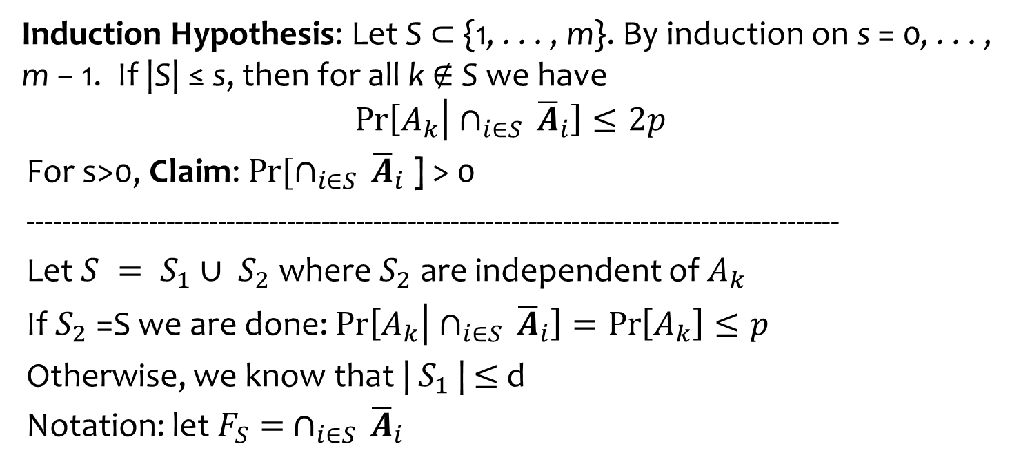
Proof of The Local Lemma
Theorem: If there are $0≤p< 1$and d s.t. for all $A_{i}$:
Pr[$A_{i}$] $≤p$
Γ($A_{i}$) $≤$d
pd4 <1
then the probability that no event $A_{i}$ happens is positive.
Induction Hypothesis: Let S ⊂ {1, . . . , m}. By induction on s = 0, . . . , m − 1. If |S| ≤ s, then for all k $∉$ S we have
$$\operatorname{Pr}\left[A_{k} | ∩_{i∈S }{\overline{A}}_{i}\right]≤2p$$
For s>0, Claim: ${Pr[∩}_{i∈S }{\overline{A}}_{i}$] > 0
----------------------------------------------------------------------------------------------
Let $S = S_{1}∪ S_{2}$ where $S_{2}$ are independent of $A_{k}$
If $S_{2}$ =S we are done: $\operatorname{Pr}\left[A_{k} | ∩_{i∈S }{\overline{A}}_{i}\right]=\operatorname{Pr}\left[A_{k}\right]≤p$
Otherwise, we know that | $S_{1}$| $≤$d
Notation: let $F_{S}= ∩_{i∈S }{\overline{A}}_{i}$
The event added
From independence

Slide 15




Proof of The Local Lemma
manipulation
$$S = S_{1}∪ S_{2}$$
$$F_{S}= ∩_{i∈S }{\overline{A}}_{i}$$
Want to prove
$$\operatorname{Pr}\left[A_{k} | ∩_{i∈S }{\overline{A}}_{i}\right]≤2p$$
Pr$\left[A_{k} | F_{S}\right]=\frac{Pr⁡[A_{k}∩F_{S}]}{Pr⁡[F_{S}]}$ $=$ $\frac{\operatorname{Pr}\left[A_{k}∩F_{S_{1}} \right|F_{S_{2}}]}{Pr\left[F_{S_{1}} \right|F_{S_{2}}]}$
$\operatorname{Pr}\left[A_{k}∩F_{S_{1}} \right|F_{S_{2}}]$ $≤$Pr[$A_{k}$ | $F_{S_{2}}$] = Pr[$A_{k}$] $≤$ p
Since |S_2| < |S|=s can apply induction hypothesis to
$\operatorname{Pr}\left[A_{i}\right|F_{S_{2}}]=$ $\operatorname{Pr}\left[A_{i} | ∩_{j∈S_{2} }{\overline{A}}_{j}\right]$ $≤2p$
Now
${\begin{aligned}Pr\left[F_{S_{1}} \right|F_{S_{2}}\text{]}=Pr\left[{∩_{i∈S_{1}}\overline{A}}_{i} | ∩_{j∈S_{2} }{\overline{A}}_{j}\right] \\ ≥1 −\sum_{i∈S_{1}}{\operatorname{Pr}\left[A_{i} | ∩_{j∈S_{2} }{\overline{A}}_{j}\right]} \\ ≥1−\sum_{i}{2p≥1−2pd≥\frac{1}{2}}\end{aligned}}$
$$≤\frac{p}{1/2}$$
Independence of $S_{2}$
Induction hypothesis

Slide 16
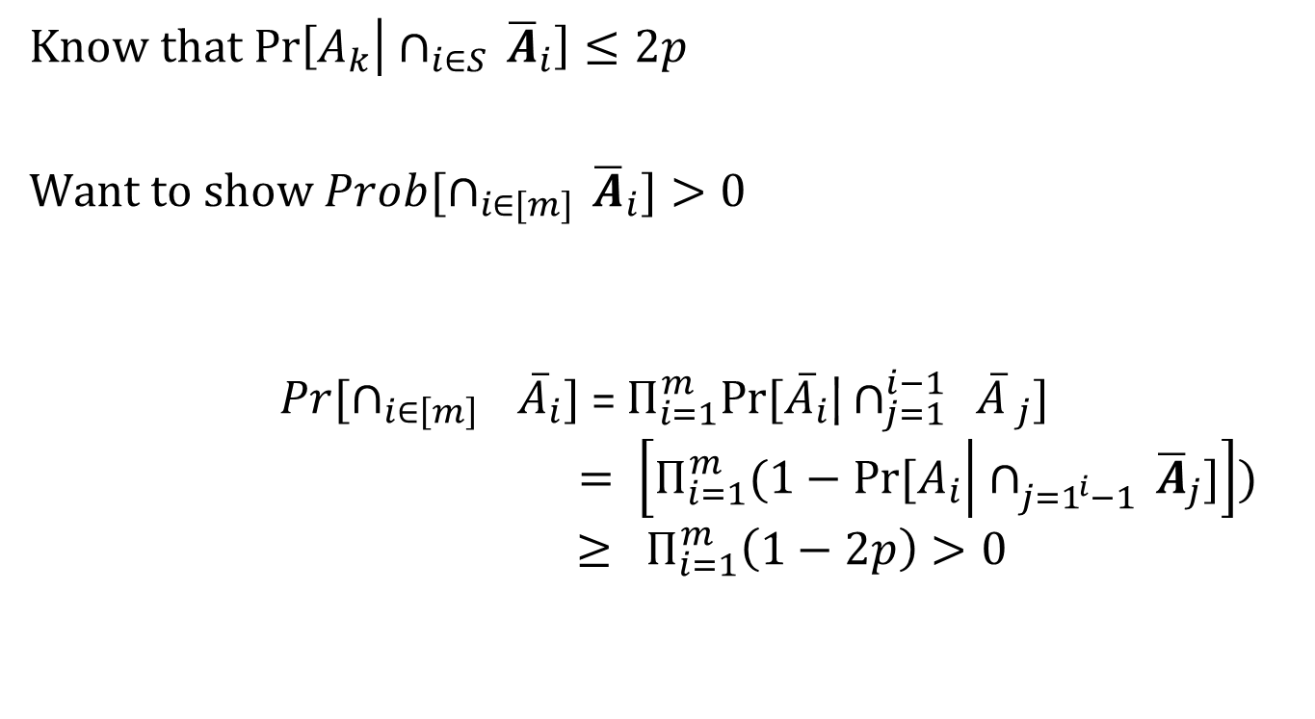
…Proof of The Local Lemma
Know that $\operatorname{Pr}\left[A_{k} | ∩_{i∈S }{\overline{A}}_{i}\right]≤2p$
Want to show ${Prob[∩}_{i∈[m] }{\overline{A}}_{i}]>0$
$${{Pr[∩}_{i∈{\left[m\right]}_{}}\overline{A}}_{i}]\text{ = }Π_{i=1}^{m}Pr⁡[{\overline{A}}_{i}\text{|}∩_{j=1}^{i−1 } \overline{A} _{j}]$$
$$= \left[Π_{i=1}^{m}(1−Pr⁡[A_{i} | ∩_{j=1^{i}−1 }{\overline{A}}_{j}]\right])$$
$$≥ Π_{i=1}^{m}\left(1−2p\right)>0$$

Slide 17
On Making the Local Lemma Constructive
The proof does not give an algorithm to find the point in space that makes all the bad events disappear.
Approach for finding them:
Partition instance problem into smaller ones
Logarithmic in size
By partial assignment.
Then do an exhaustive search on each part
Each variable is either true, false or undefined
If clause not satisfied, make sure enough free variables
We know it exists

Slide 18
Constructive vs. Algorithmic
For the algorithm to work we need a base case that relies on the (non-constructive) LLL
Suggested by József Beck
Suboptimal dependency on k
Moser and Tardos suggested an algorithmic version of the LLL

Slide 19
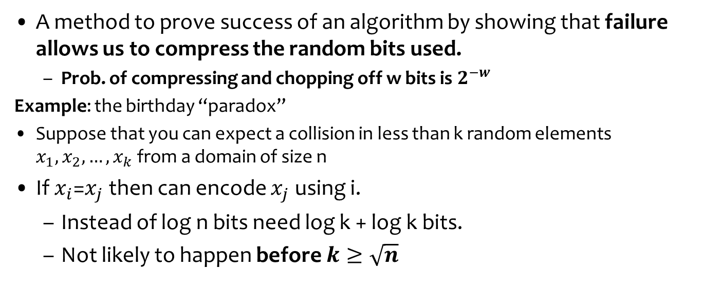
Recall: Proof by Encoding: A general method for analyzing probabilistic events
A method to prove success of an algorithm by showing that failure allows us to compress the random bits used.
Prob. of compressing and chopping off w bits is $2^{−w}$
Example: the birthday “paradox”
Suppose that you can expect a collision in less than k random elements $x_{1}, x_{2}, …, x_{k}$from a domain of size n
If $x_{i}$=$x_{j}$then can encode $x_{j}$ using i.
Instead of log n bits need log k + log k bits.
Not likely to happen before $k≥\sqrt{n}$
For i
LZ style
For j

Slide 20
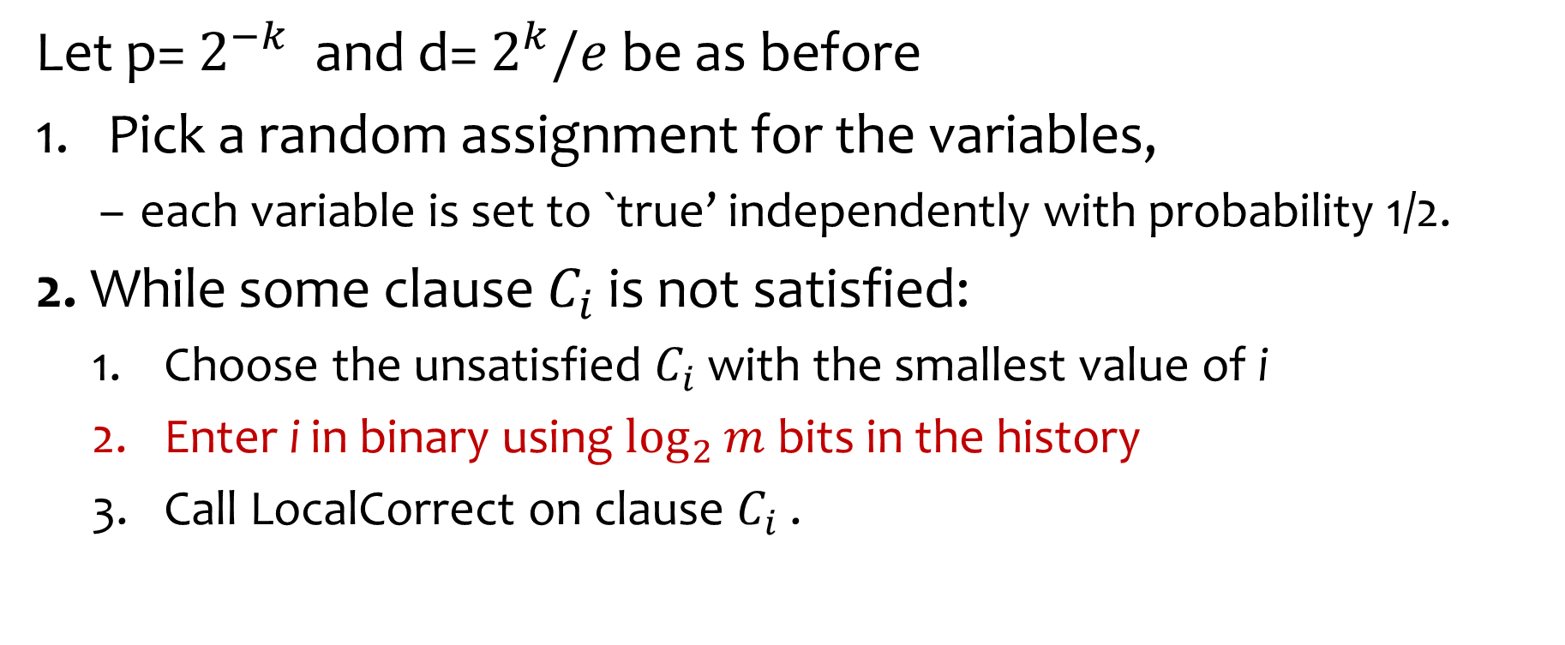
Algorithm and History Generator
Let p= $2^{−k}$ and d= $2^{k}/e$be as before
Pick a random assignment for the variables,
each variable is set to `true’ independently with probability 1/2.
2. While some clause $C_{i}$ is not satisfied:
Choose the unsatisfied $C_{i}$ with the smallest value of i
Enter i in binary using $\log_{2}{m}$bits in the history
Call LocalCorrect on clause $C_{i}$ .

Slide 21
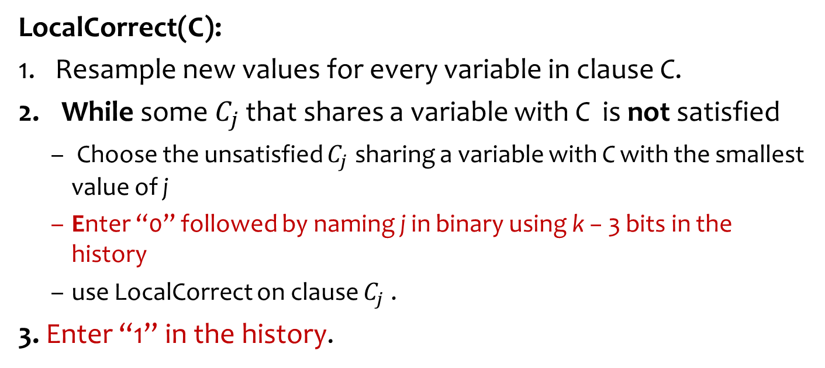
LocalCorrect
LocalCorrect(C):
Resample new values for every variable in clause C.
While some $C_{j}$ that shares a variable with C is not satisfied
Choose the unsatisfied $C_{j}$ sharing a variable with C with the smallest value of j
Enter “0” followed by naming j in binary using k − 3 bits in the history
use LocalCorrect on clause $C_{j}$ .
3. Enter “1” in the history.
including possibly
C itself
Need only k-3 bits to specify it, since
this is the number of neighbors!

Slide 22
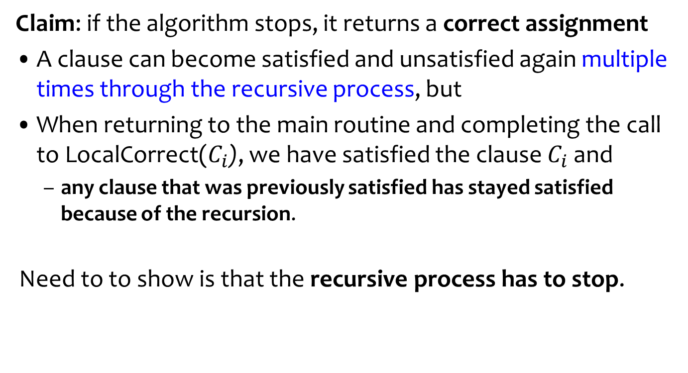
Correctness
Claim: if the algorithm stops, it returns a correct assignment
A clause can become satisfied and unsatisfied again multiple times through the recursive process, but
When returning to the main routine and completing the call to LocalCorrect($C_{i}$), we have satisfied the clause $C_{i}$ and
any clause that was previously satisfied has stayed satisfied because of the recursion.
Need to to show is that the recursive process has to stop.

Slide 23
The Algorithm Stops
Claim: the algorithm stops in expected O(m log m) time
Expectation is taken over the random coin tosses of the algorithm.
Proof by compressing the random coins
Imagine that the random decisions come from a stream.
First n bits for the initial assignment
Then each call to LocalCorrect k bits to the assignment
Show how to compress stream if running time J is too large
1 1 0 0 1 0 0 0 1 1 1 0 1 0 1 0 0 …

Slide 24
History
The history includes a list of the clauses that LocalCorrect is called on by the main routine.
Also includes a list of the recursive calls to LocalCorrect,
Using the neighbors of current clause
The algorithm uses a flag bit “0” and a flag bit “1” to mark the start and end of recursive calls
Suppose there were J calls altogether to LocalCorrect

Slide 25

Tracing Back the Randomness Used
Claim: given the (a) final assignment and the history as recorded by the algorithm it is possible to trace back the randomness used
n
Final Assignment
1 1 0 1 0 0 … 1
History
1 1 0 1
0 1 0 1
0 1 1 0
initial Assignment
1 1 0 1 0 0 … 1
J
n
1 1 1 0
k

Slide 26
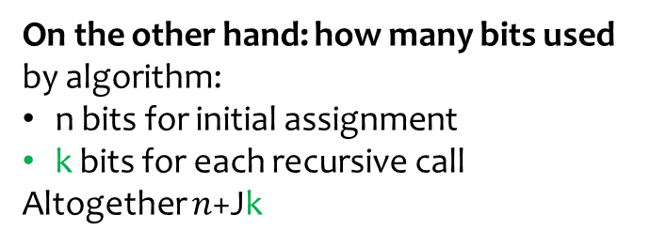
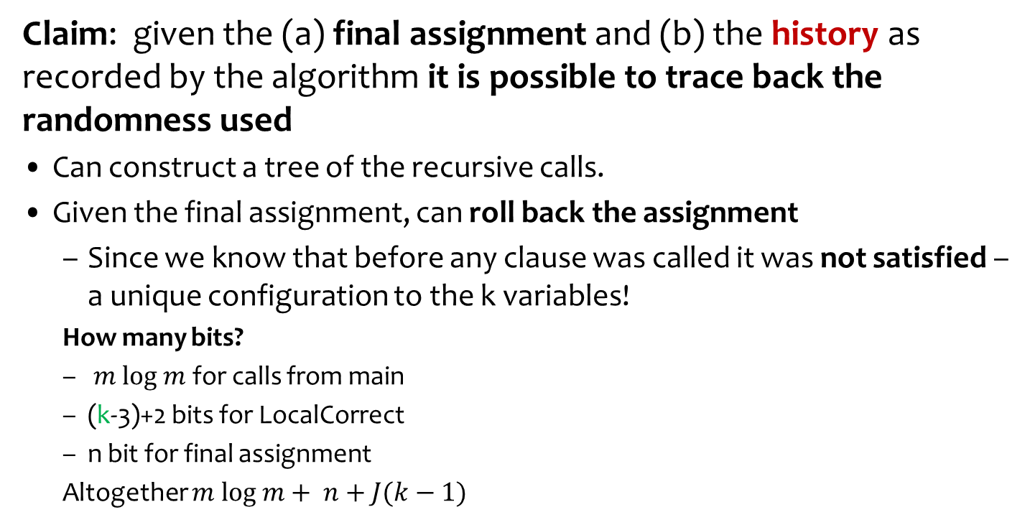



Tracing Back the Randomness Used
Claim: given the (a) final assignment and (b) the history as recorded by the algorithm it is possible to trace back the randomness used
Can construct a tree of the recursive calls.
Given the final assignment, can roll back the assignment
Since we know that before any clause was called it was not satisfied – a unique configuration to the k variables!
How many bits?
$m log m$for calls from main
(k-3)+2 bits for LocalCorrect
n bit for final assignment
Altogether $m log m+ n+J(k−1)$
On the other hand: how many bits used by algorithm:
n bits for initial assignment
k bits for each recursive call
Altogether $n$+Jk
$$If J > m log m$$
$Compression$!
$$n+m log m+J\left(k−1\right)< n+Jk$$

Slide 27
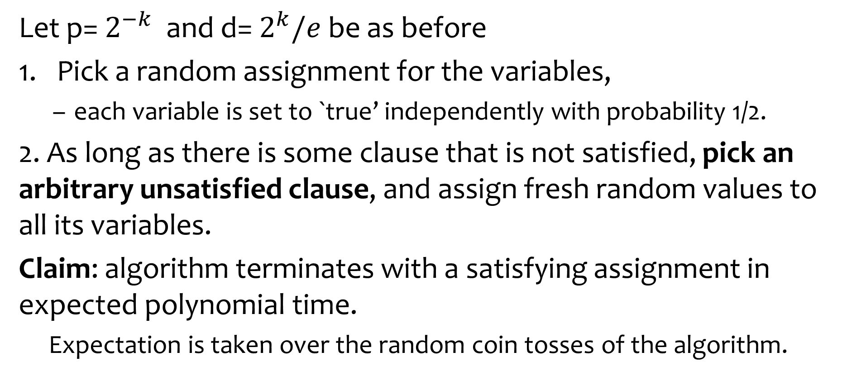
Variant on the Algorithm
Let p= $2^{−k}$ and d= $2^{k}/e$be as before
Pick a random assignment for the variables,
each variable is set to `true’ independently with probability 1/2.
2. As long as there is some clause that is not satisfied, pick an arbitrary unsatisfied clause, and assign fresh random values to all its variables.
Claim: algorithm terminates with a satisfying assignment in expected polynomial time.
Expectation is taken over the random coin tosses of the algorithm.

Slide 28



The Setting
Dynamic dictionary:
Lookups, insertions and deletions
Dynamic vs. static
Performance:
Lookup time
Update time
Memory utilization
Related problems:
Approximate set membership (Bloom Filter)
Retrieval

Slide 29
Major Problem in Hashing Based Schemes: Collisions
Hash Tables
Hash Function h Table T
Direct access to memory
Element x should be in T[h(x)]
Collision: two different elements with the same value under h
Unless |T| ≥ |U|
...
U
T

Slide 30

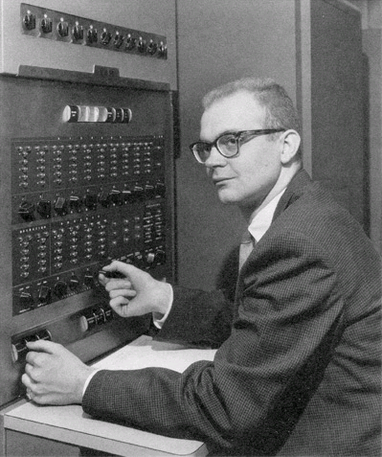
Dealing with Collisions
Lots of methods
Common one: :Linear Probing
Proposed by Amdahl
Analyzed by Donald Knuth 1963
“Birth” of analysis of algorithms
Probabilistic analysis

Slide 31
Linear Probing
To insert x: try location h(x) in table T
If occupied try h(x)+1
and if occupied try h(x)+2
Until we find a vacant place
Looking for x:
Similar to insert: search until finding x or a vacant place.
••••••• •••••• ••••••••••• ••••••• •

Slide 32
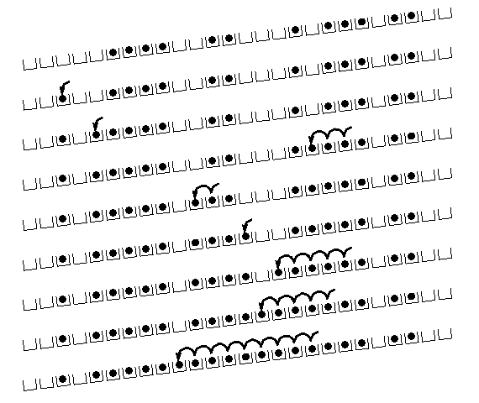
Linear Probing: situation after a while

Slide 33
Cuckoo Hashing: Basics
Introduced by Pagh and Rodler (2001)
Extremely simple:
2 tables: T₁ and T₂
Each of size r = (1+ε)n
2 hash functions: h₁ and h₂
Lookup:
Check in T₁ and T₂
d
t
h₂(x)
c
y
x
h₁(x)
x
b
a
Where is x?
...
...
z
T₁
T₂

Slide 34
Cuckoo Hashing: Insertion Algorithm
To insert element x, call Insert(x, 1)
Insert(x, i):
1. Put x into location h_{i}(x) in T_{i}
2. If T_{i}[h_{i}(x)] was empty: return
3. If T_{i}[h_{i}(x)] contained element y: do Insert(y, 3–i)
Example:
To insert x:
Put in first location and displace residing element if needed
Put displaced element in its other location
Until finding a free spot
d
t
c
y
h₂(y) = h₂(a)
x
b
h₁(e) = h₁(a)
a
e
...
...
h₁(y)
z
T₁
T₂

Slide 35
Cuckoo Hashing: Insertion
What happens if we are not successful?
Unsuccessful stems from two reasons
Not enough space
The path goes into loops
Too long chains
Can detect both by a time limit.

Slide 36
Cuckoo Hashing: Deletion
Extremely simple:
2 tables: T₁ and T₂
Each of size r = (1+ε)n
2 hash functions: h₁ and h₂
As in Lookup:
Check in T₁ and T₂
Remove wherever found
d
t
h₂(x)
c
y
x
h₁(x)
x
b
a
Where is x?
...
...
z
T₁
T₂

Slide 37
The Cuckoo Graph
Set S ⊂ U containing n elements
h₁,h₂ : U {0,...,r-1}
Insertion algorithm achieves this
Bipartite graph with |L|=|R|=r
Edge (h₁(x), h₂(x)) for every x∈S
Claims:
S is successfully stored
Every connected component in the cuckoo graph has at most one cycle
Expected insertion time: O(1)
occupied
vacant

