Slide 1

Randomized Algorithms
Lecturer: Moni Naor
Lecture 6

Slide 2
Recap and Today
Recap
Multiset equality
Communication Complexity
Streaming - Frequencies
Today
Streaming
Proof by encoding

Slide 3

Memory Checking Model
Secure zone
CPU needs to make sure what it read is what it wrote
Accesses addresses q₁, q₂…
q_{i}
CPU
Main memory
Small private memory
M[q_{i}]

Slide 4
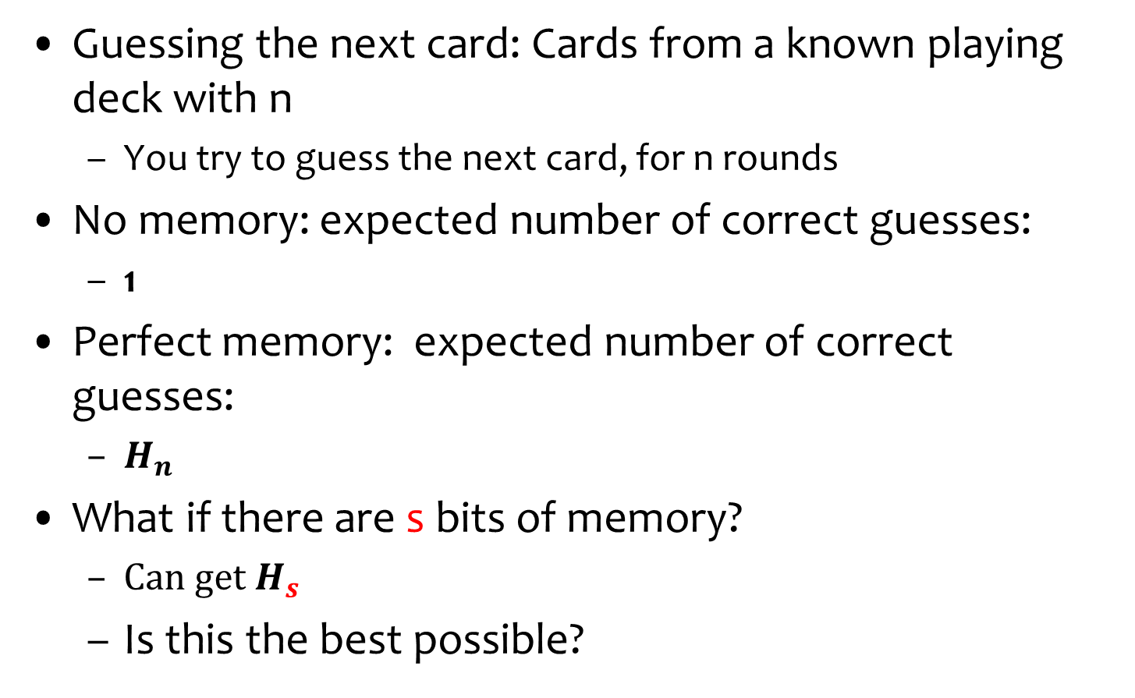
Guess the card
Guessing the next card: Cards from a known playing deck with n
  You try to guess the next card, for n rounds
No memory: expected number of correct guesses:
  1
Perfect memory: expected number of correct guesses:
  $H_{n}$
What if there are s bits of memory?
  ${Can get H}_{s}$
  Is this the best possible?
Idea: remember the first s (in terms of face value)
cards and ignore the rest
No! Can do almost
twice as better

Slide 5
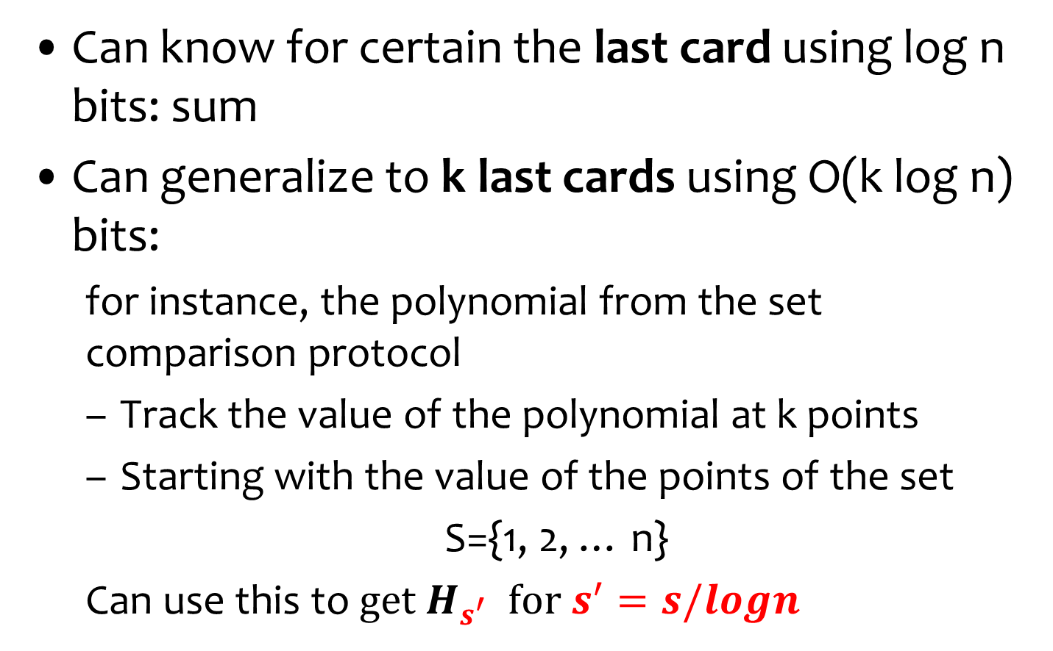
Idea: Encoding the last cards
Can know for certain the last card using log n bits: sum
Can generalize to k last cards using O(k log n) bits:
  for instance, the polynomial from the set comparison protocol
  Track the value of the polynomial at k points
  Starting with the value of the points of the set
  S={1, 2, … n}
  Can use this to${ get H}_{s^{′}} {for s}^{′}=s/logn$

Slide 6
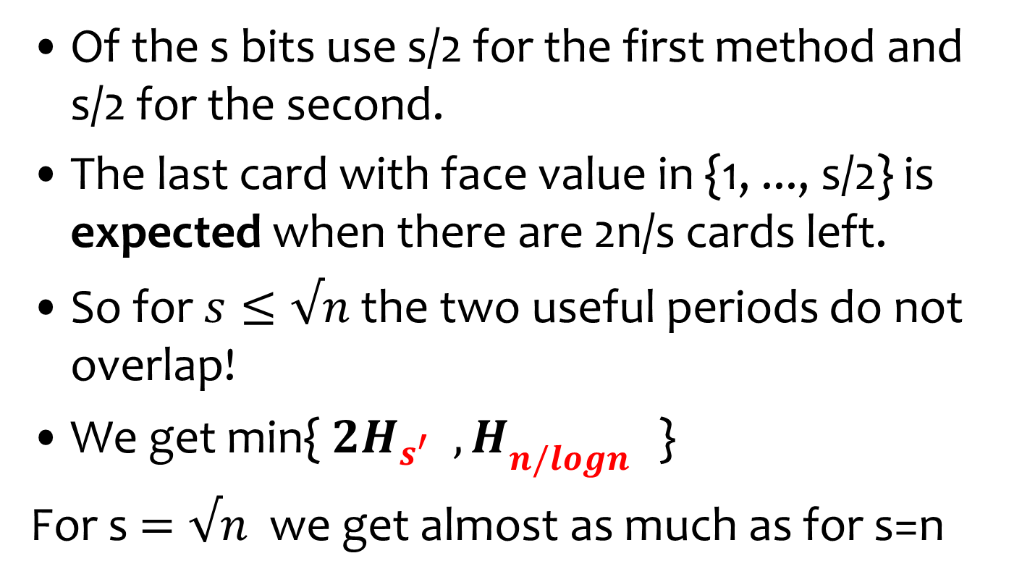
Idea: two methods are compatible!
Of the s bits use s/2 for the first method and s/2 for the second.
The last card with face value in {1, ..., s/2} is expected when there are 2n/s cards left.
So for $s≤√n$the two useful periods do not overlap!
We get min{${ 2H}_{s^{′}} { ,H}_{{n/logn}^{}}$}
For s $=√n$ we get almost as much as for s=n
Best split?

Slide 7
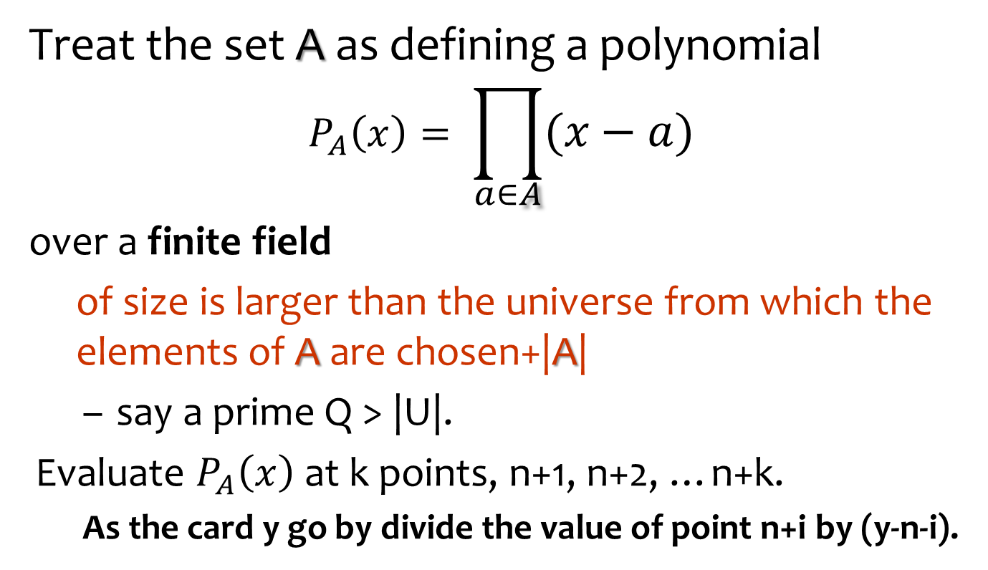
Encoding the last k cards
Use the setting of the multi-set comparison
In our case: {1,2,...,n}
Treat the set A as defining a polynomial
$$P_{A}\left(x\right)= \prod_{a∈A}{(x−a)}$$
over a finite field
  of size is larger than the universe from which the elements of A are chosen+|A|
  say a prime Q > |U|.
Evaluate $P_{A}\left(x\right)$ at k points, n+1, n+2, …n+k.
  As the card y go by divide the value of point n+i by (y-n-i).

Slide 8
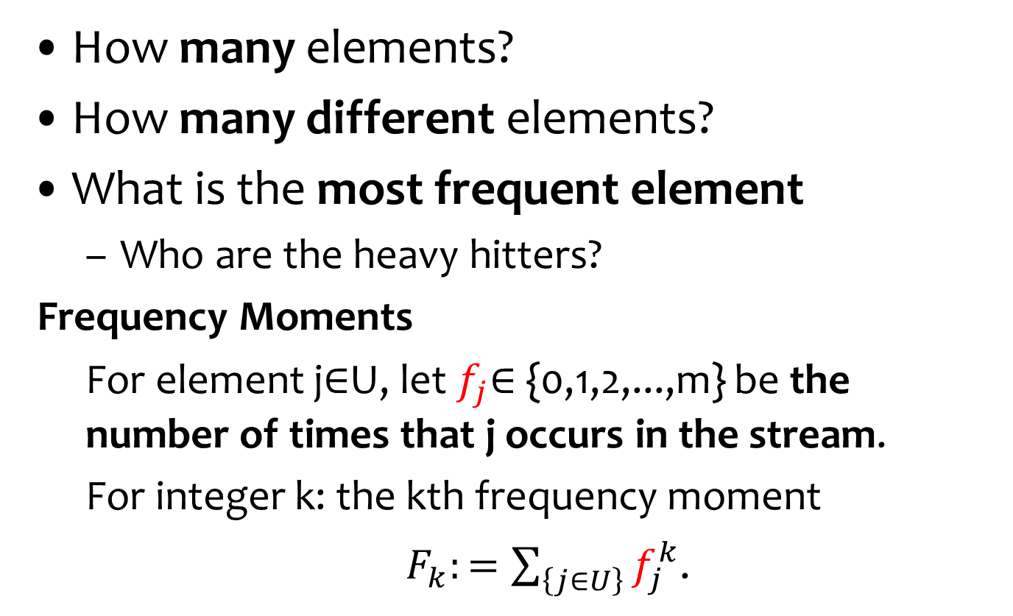
Computing on streams
How many elements?
How many different elements?
What is the most frequent element
  Who are the heavy hitters?
Frequency Moments
  For element j∈U, let $f_{j}$∈ {0,1,2,...,m} be the number of times that j occurs in the stream.
  For integer k: the kth frequency moment
  $F_{k}:=\sum_{\left\{j∈U\right\}}{f_{j}^{k}}$.

Slide 9
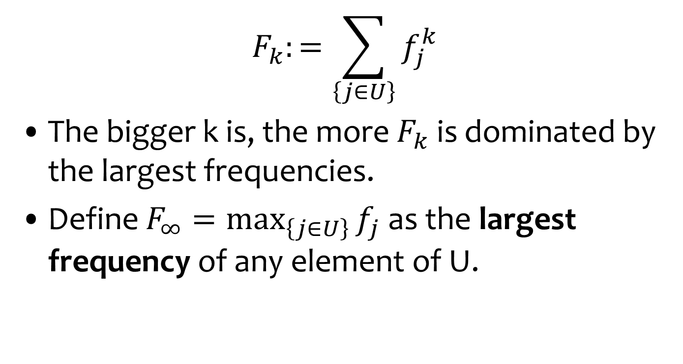
Frequency Moments
$$F_{k}:=\sum_{\left\{j∈U\right\}}{f_{j}^{k}}$$
The bigger k is, the more $F_{k}$ is dominated by the largest frequencies.
Define $F_{∞}=\max_{\left\{j∈U\right\}}{f_{j}}$ as the largest frequency of any element of U.

Slide 10
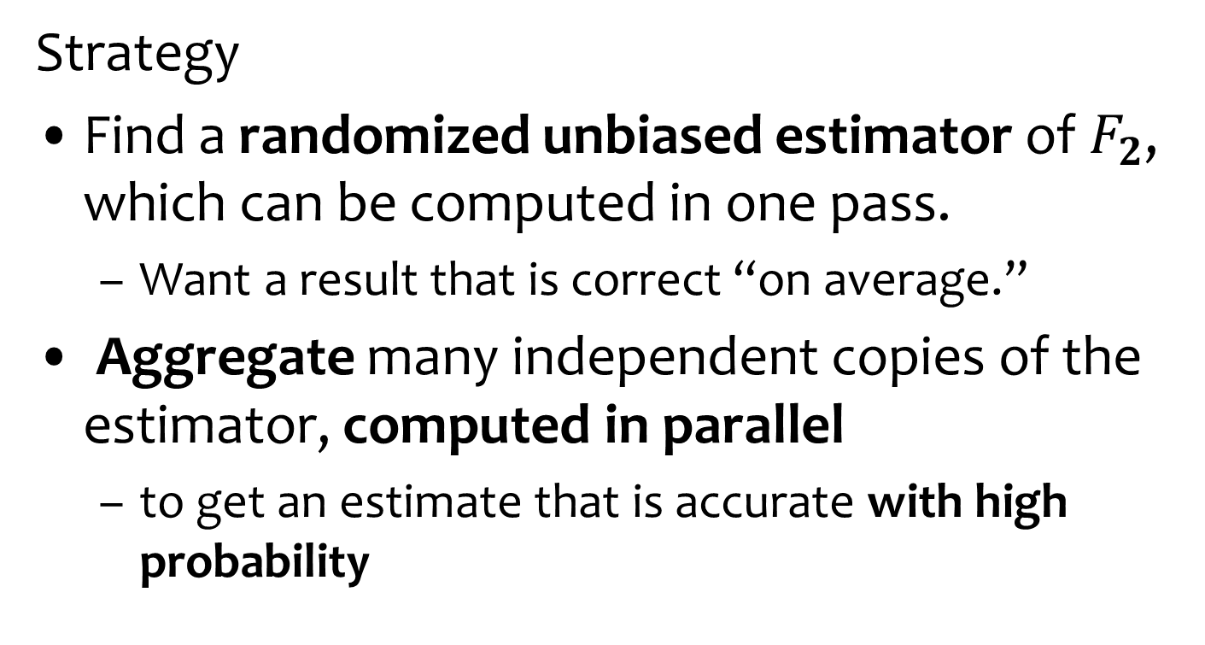

Estimating $F_{2}$
Strategy
Find a randomized unbiased estimator of $F_{2}$, which can be computed in one pass.
  Want a result that is correct “on average.”
Aggregate many independent copies of the estimator, computed in parallel
  to get an estimate that is accurate with high probability
How to aggregate?

Slide 11
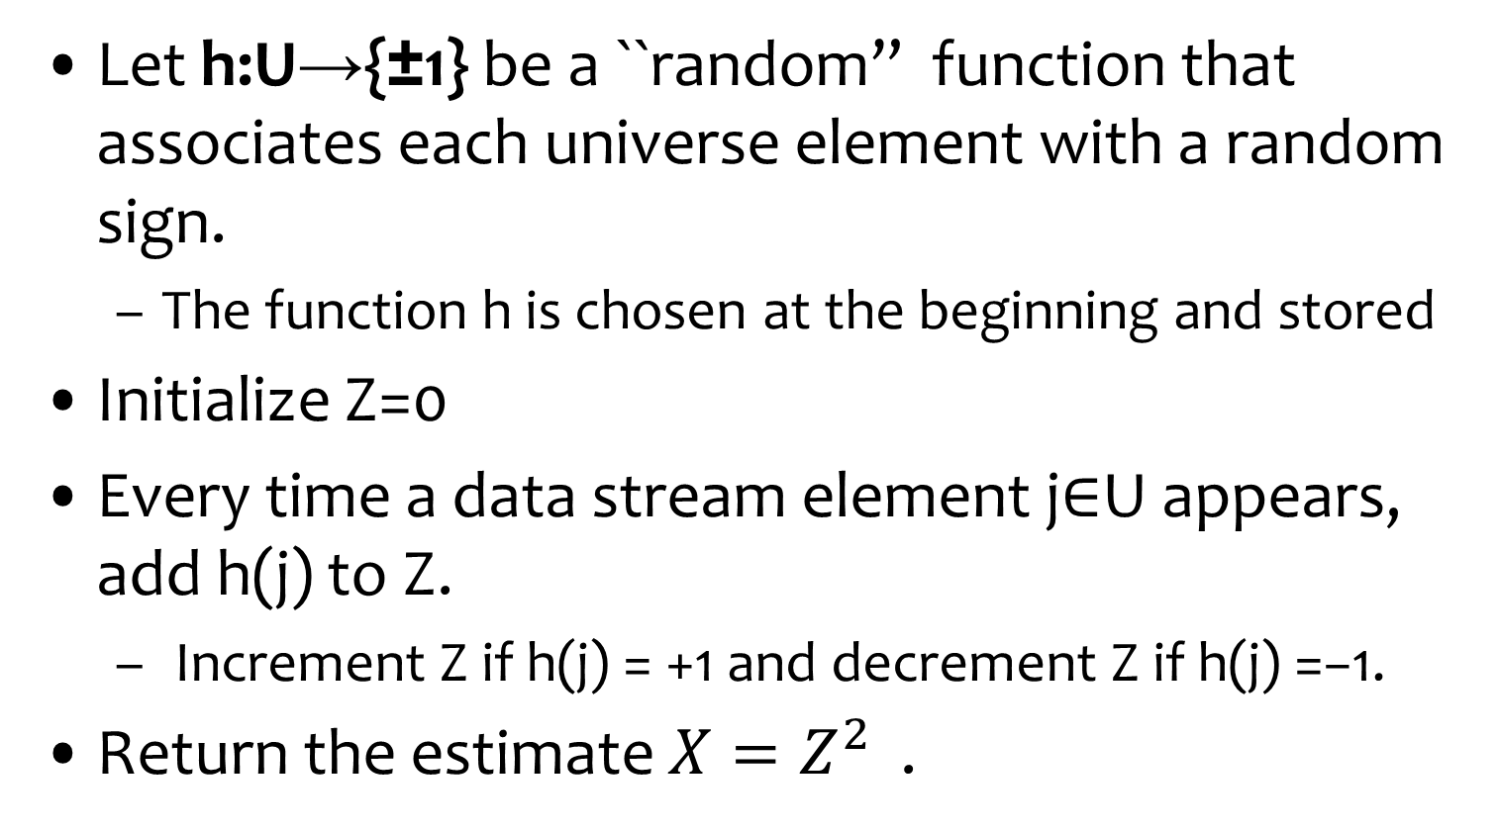

Estimating $F_{2}$
Should be independent of the stream.
We will see that 4-wise ind. Is enough
Let h:U→{±1} be a ``random” function that associates each universe element with a random sign.
  The function h is chosen at the beginning and stored
Initialize Z=0
Every time a data stream element j∈U appears, add h(j) to Z.
  Increment Z if h(j) = +1 and decrement Z if h(j) =−1.
Return the estimate $X=Z^{2}$ .

Slide 12
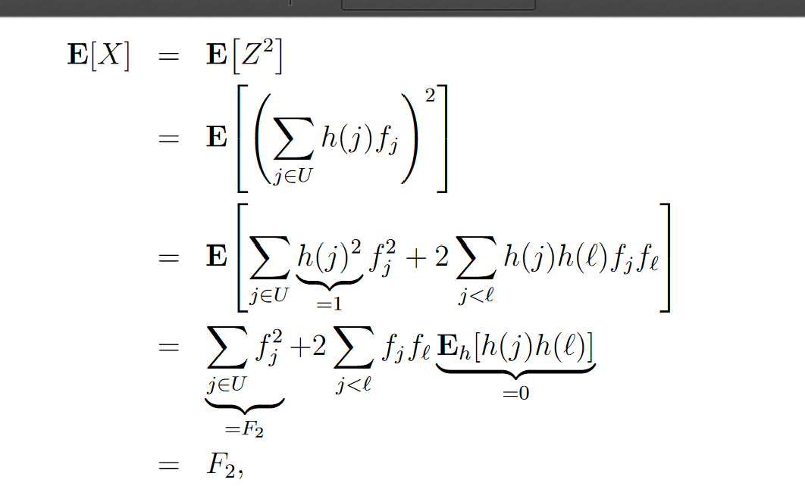

Good Estimator
Claim: For every data stream
$E_{h}$[X] =$F_{2}$
Linearity of
expectations
Ind. of the values of h
Pairwise is enough!

Slide 13
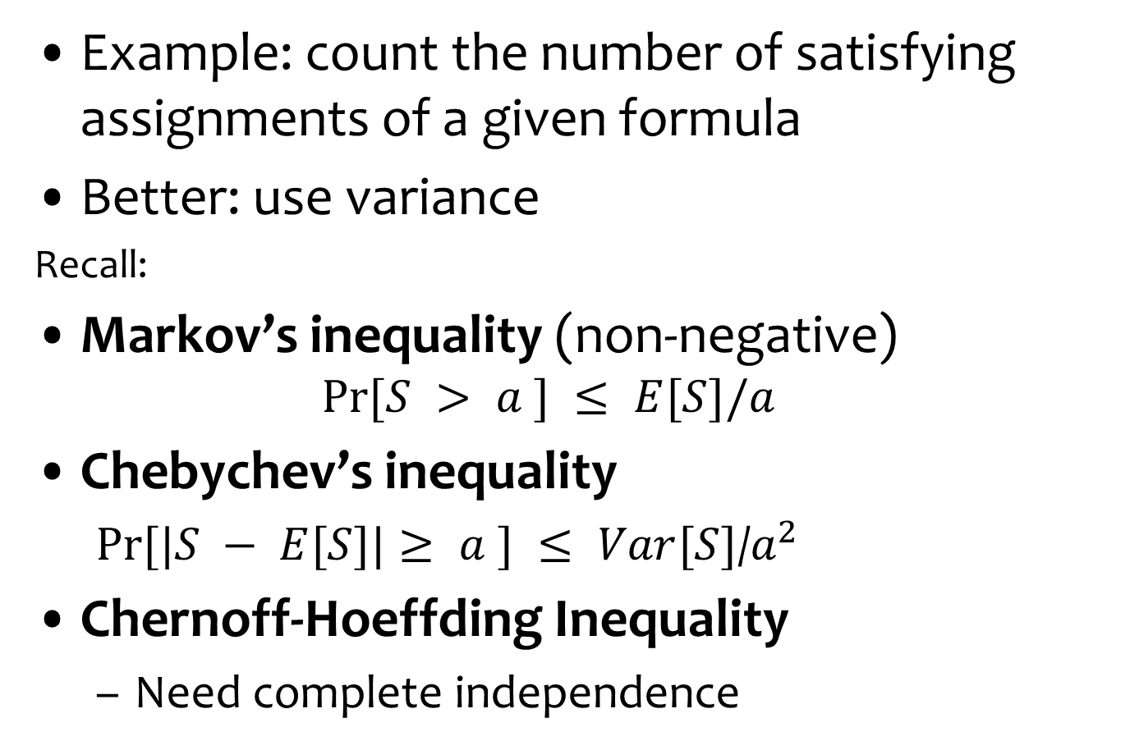
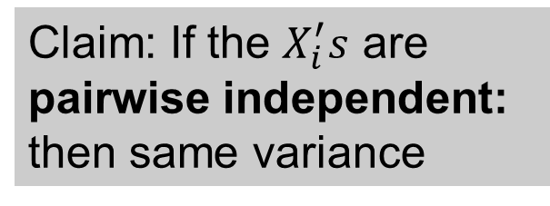
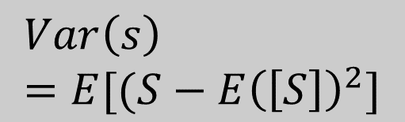
Are Great Expectations Good Enough?
Example: count the number of satisfying assignments of a given formula
Better: use variance
Recall:
Markov’s inequality (non-negative)
  $$Pr⁡[S > a ] ≤ E[S]/a$$
Chebychev’s inequality
  $Pr⁡[|S − E[S]|≥ a ] ≤ Var[S]$/$a^{2}$
Chernoff-Hoeffding Inequality
  Need complete independence
$$Var\left(s\right)=E[(S−E{\left(\left[S\right]\right)}^{2}]$$
Claim: If the $X_{i}^{′}s$ are pairwise independent: then same variance

Slide 14
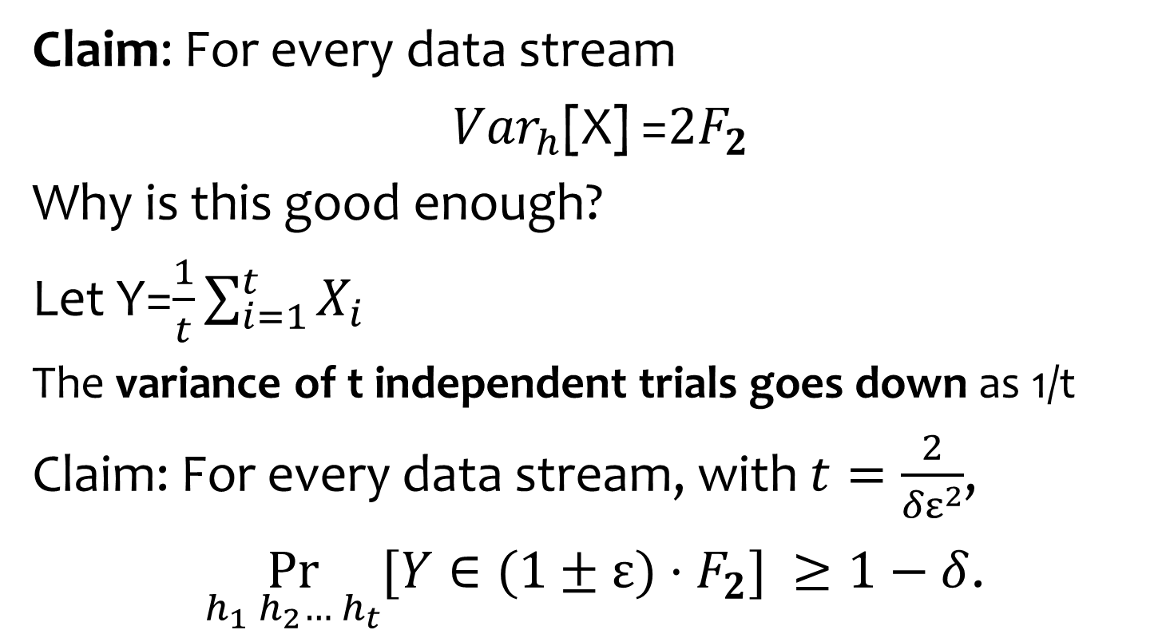
Good Variance
Claim: For every data stream
${Var}_{h}$[X] =${2F}_{2}$
Why is this good enough?
Let Y=$\frac{1}{t}\sum_{i=1}^{t}{X_{i}}$
The variance of t independent trials goes down as 1/t
Claim: For every data stream, with $t=\frac{2}{{δε}^{2}}$,
$\underset{h_{1} h_{2}… h_{t}}{Pr}{[Y∈(1±ε)·F_{2}]} ≥1−δ$.
4-wise independence
sufficient

Slide 15
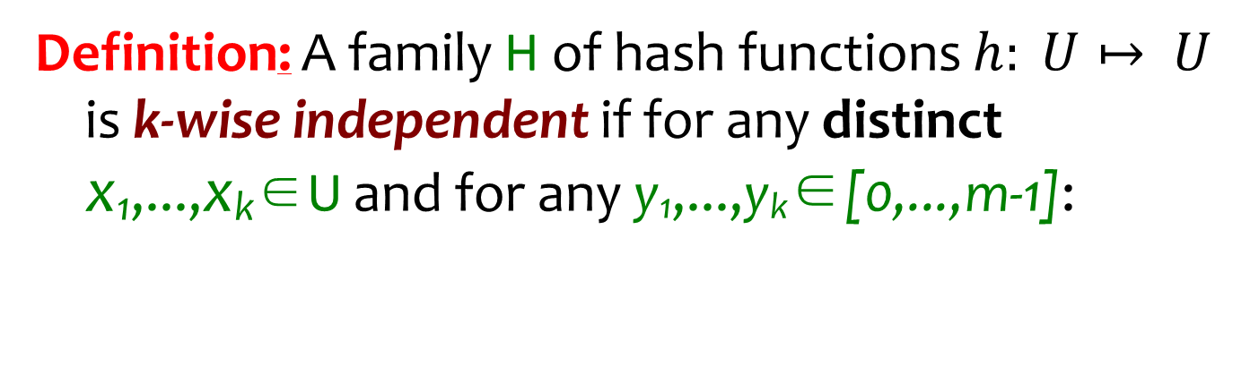
k-wise independence
Approach: use k-wise independence for smallest k possible
Definition: A family H of hash functions $h: U↦ U$ is k-wise independent if for any distinct x₁,...,x_{k}∈U and for any y₁,...,y_{k}∈[0,...,m-1]:
Pr [h(x₁)=y₁ ^ h(x₂)=y₂ ^ ... ^ h(x_{k})=y_{k}] = 1/|U|^{k}
_{h∈H}
Exactly as what happens with
a truly independent function

Slide 16
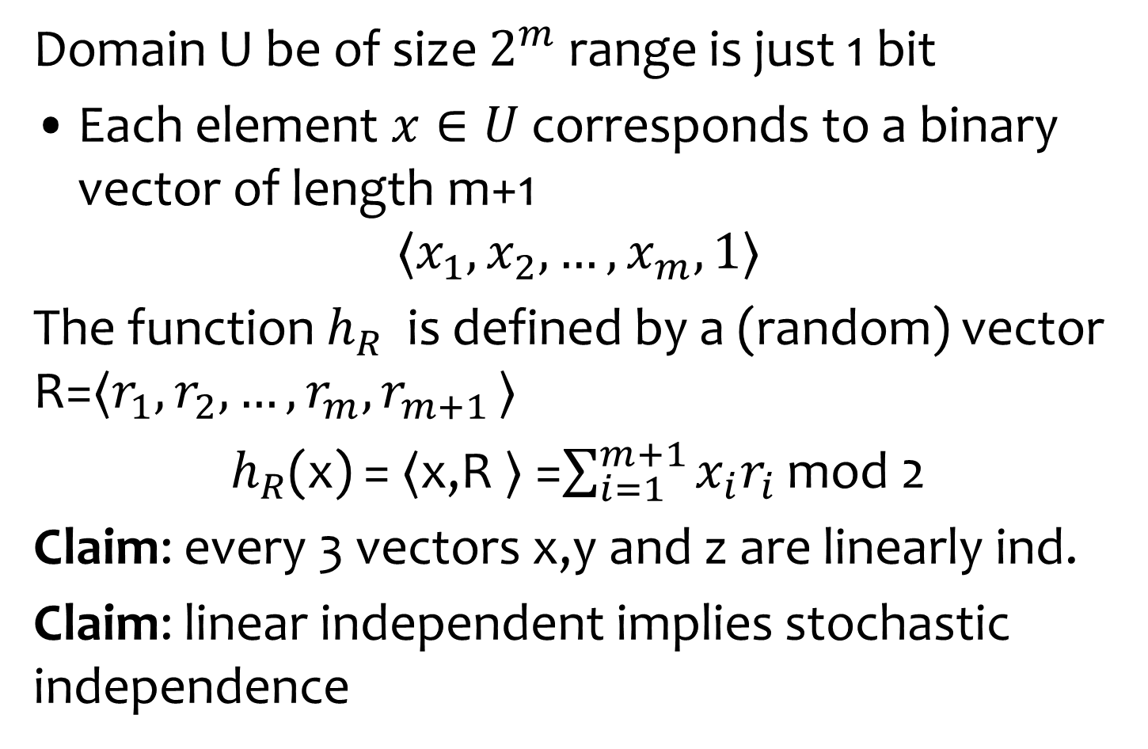
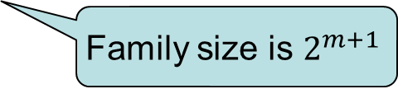
Constructing 3-wise independence
Domain U be of size $2^{m}$ range is just 1 bit
Each element $x∈U$ corresponds to a binary vector of length m+1
$$〈x_{1},x_{2}, …, x_{m},1〉$$
The function $h_{R}$ is defined by a (random) vector R=$〈r_{1},r_{2}, …, r_{m}{,r}_{m+1}〉$
$h_{R}$(x) = $〈$x,R $〉$ =$\sum_{i=1}^{m+1}{x_{i}r_{i}}$ mod 2
Claim: every 3 vectors x,y and z are linearly ind.
Claim: linear independent implies stochastic independence
Family size is $2^{m+1}$
True for any k: if any k vectors are linearly ind,
then the resulting product is k-wise independent

Slide 17
Homework: Guess the card
Half of the cards are red half black
Cards turned one by one
At any point can stop and guess that the next card is red
What is the probability of success of best algorithm?
Note: look at exercise 2.32 in the book
The Secretary problem
These are not the same problems

