Slide 1

Foundations of Privacy
Lecture 6
Lecturer: Moni Naor

Slide 2
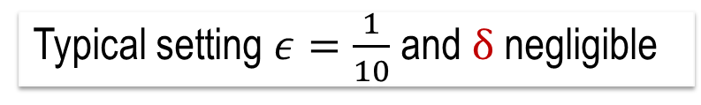
(ε, δ) - Differential Privacy
Sanitizer M gives (ε, δ) -differential privacy if:
for all adjacent D₁ and D₂, and all A µ range(M):
Pr[M(D₁) 2 A] ≤ e^{ε} Pr[M(D₂) 2 A] + δ
ratio bounded
Pr [response]
Bad Responses:
Z
Z
Z
Typical setting $ε=\frac{1}{10}$ and $δ$ negligible
This course: δ negligible

Slide 3
Example: NO Differential Privacy
U set of (name,tag 2{0,1}) tuples
One counting query: #of participants with tag=1
Sanitizer A: choose and release a few random tags
Bad event T: Only my tag is 1, my tag released
Pr_{A}[A(D+I) 2 T] ≥ 1/n
Pr_{A}[A(D-I) 2 T] = 0
Not ε diff private for any ε!
It is (0,1/n) Differential Private
Pr_{A}[A(D+I) 2 T]
e^{-ε} ≤
≤ e^{ε} ≈ 1+ε
Pr_{A}[A(D-I) 2 T]

Slide 4

Counting Queries
Database x of size n
Counting-queries
Q is a set of predicates q: U  {0,1}
Query: how many x participants satisfy q?
Relaxed accuracy:
  answer query within α additive error w.h.p
Not so bad: some error anyway inherent in statistical analysis
Query q
n individuals, each contributing
a single point in U
U
Sometimes talk about fraction

Slide 5
Bounds on Achievable Privacy
Want to get bounds on the
Accuracy
  The responses from the mechanism to all queries are assured to be within α except with probability β
Number of queries t for which we can receive accurate answers
The privacy parameter ε for which ε differential privacy is achievable
  Or (ε,δ) differential privacy is achievable

Slide 6
Composition: t-Fold
Suppose we are going to apply a DP mechanism t times.
  Perhaps on different databases
Want: the combined outcome is differentially private
A value b 2 {0,1} is chosen
In each of the t rounds:
  adversary A picks two adjacent databases D₀^{i} and D₁^{i} and an ε-DP mechanism M_{i}
  receives result z_{i} of the ε-DP mechanism M_{i} on D_{b}^{i}
Want to argue: A‘s view is within ε’ for both values of b
A‘s view: (z₁, z₂, …, z_{t}) plus randomness used.

Slide 7
Adversary’s view
A’s view: randomness + (z₁, z₂, …, z_{t})
  Distribution with b: V^{b}
A
D₀¹, D₁¹
D₀², D₁²
…
D₀^{t}, D₁^{t}
  M₁(D_{b}¹)
  M₂(D_{b}²)
  M_{t}(D_{b}^{t})
M₁
M₂
M_{t}
z₁
z₂
z_{t}

Slide 8
Differential Privacy: Composition
Last week:
If all mechanisms M_{i} are ε-DP, then for any view the probability that A gets the view when b=0 and when b=1 are with e^{εt}
    t releases , each ε-DP, are t¢ε -DP
Today:
  t releases, each ε-DP, are (√tε+t ε²,δ)-DP (roughly)
Therefore results for a single query translate to results on several queries

Slide 9
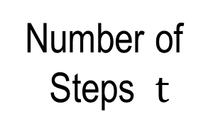
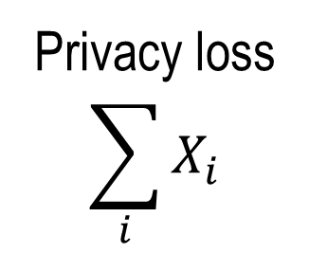
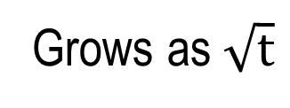


Privacy Loss as a random walk
Grows as $\sqrt{t}$
$$100ϵ\sqrt{t}$$
Privacy loss
$$\sum_{i}{X_{i}}$$
Privacy loss behaves like $±ε$ random variable
Number of
Steps $t$

Slide 10
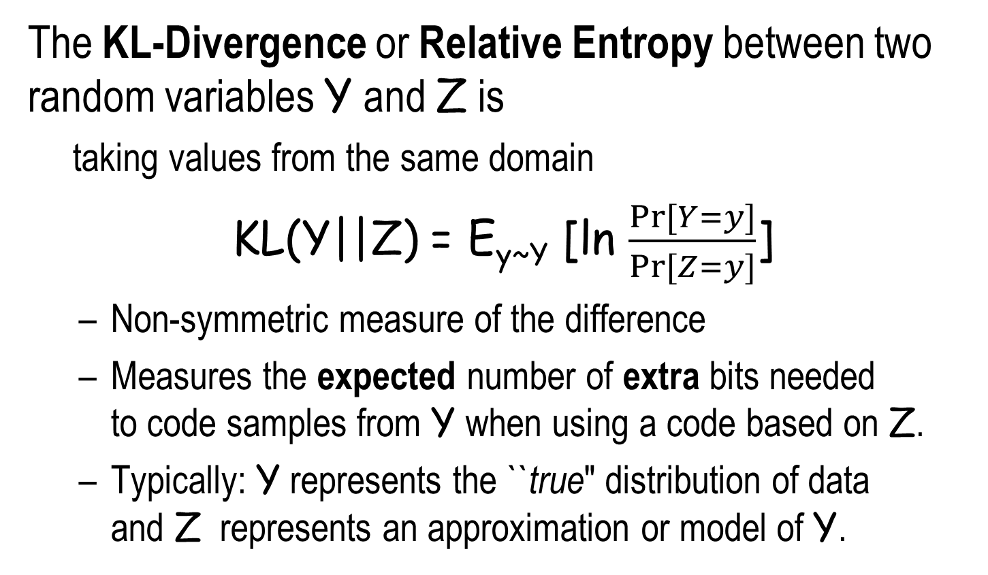
Kullback–Leibler Divergence or Relative Entropy
The KL-Divergence or Relative Entropy between two random variables Y and Z is
  taking values from the same domain
KL(Y||Z) = E_{y~Y} [ln $\frac{Pr⁡[Y=y]}{Pr⁡[Z=y]}$]
  Non-symmetric measure of the difference
  Measures the expected number of extra bits needed to code samples from Y when using a code based on Z.
  Typically: Y represents the ``true" distribution of data and Z represents an approximation or model of Y.
Not a metric

Slide 11
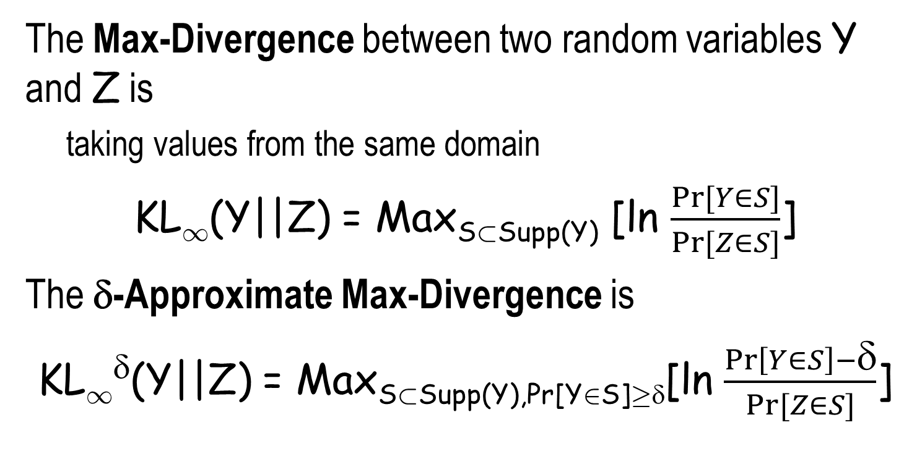
The Max Divergence
The Max-Divergence between two random variables Y and Z is
  taking values from the same domain
KL₁(Y||Z) = Max_{S½Supp(Y)} [ln $\frac{Pr⁡[Y∈S]}{Pr⁡[Z∈S]}$]
The δ-Approximate Max-Divergence is
KL₁^{δ}(Y||Z) = Max_{S½Supp(Y),Pr[Y2S]¸δ}[ln $\frac{\operatorname{Pr}\left[Y∈S\right]−\text{δ}}{Pr⁡[Z∈S]}$]

Slide 12
Differential Privacy and Max Divergent
Mechanism M is ε-differentially private if and only if on every two neighboring databases x and x’
  KL₁(M(x)||M(x’)) · ε
  KL₁(M(x’)||M(x)) · ε
M is (ε, δ)-differentially private if and only if
  KL₁^{δ}(M(x)||M(x’)) · ε
  KL₁^{δ}(M(x’)||M(x)) · ε

Slide 13
Connecting Max and Average Divergence
If maximum privacy loss is bounded by e^{ε}, then the expected privacy loss is actually quite a bit lower.
Lemma: If for random variables Y and Z we have
KL₁(Y||Z) · ε
KL₁(Z||Y) · ε
then
KL(Y||Z) · ε(e^{ε}-1)
Small worst difference in both ways
  Implies even smaller average difference
For 0 · ε · 1 we have e^{ε} · 1 + 2ε, so
KL(Y||Z) · 2ε²

Slide 14
Martingales and Azuma’s Inequality
A sequence of random variables X₀, X₁ …, X_{m} is a martingale if for 0 · i · m-1
E[X_{i+1} |X_{i} ] = X_{i}
Example: sum a gambler has in series of fair bets
Azuma’s Inequality: Let X₀=0, X₁ …, X_{m} be a martingale with |X_{i+1} -X_{i}| · 1
Then for any λ > 0 we have
Pr [X_{m} ¸ λ √m] · e^{-λ2/2}
High concentration
around expectation

Slide 15
Applying Azuma’s Inequality
Suppose we have m random variables C₁, C₂ …, C_{m}
E[C_{i}|C_{i-1}] · α and |C_{i} |· β
Then
Pr[|∑_{i=1}^{m} C_{i}]| ¸ λ(α+ β) √m+ mα] · e^{-λ2/2}
Proof: set Z_{i} = C_{i}–E[C_{i}]. Now |Z_{i}| · α+β
Using Azuma's inequality
Pr[∑_{i=1}^{m} Z_{i}] ¸ λ (α+β) √m ] · e^{-λ2/2}
|∑_{i=1}^{m} C_{i}]| = |∑_{i=1}^{m} Z_{i} +∑_{i=1}^{m} E[C_{i}]| · |∑_{i=1}^{m} Z_{i}|+mα.
expectation

Slide 16
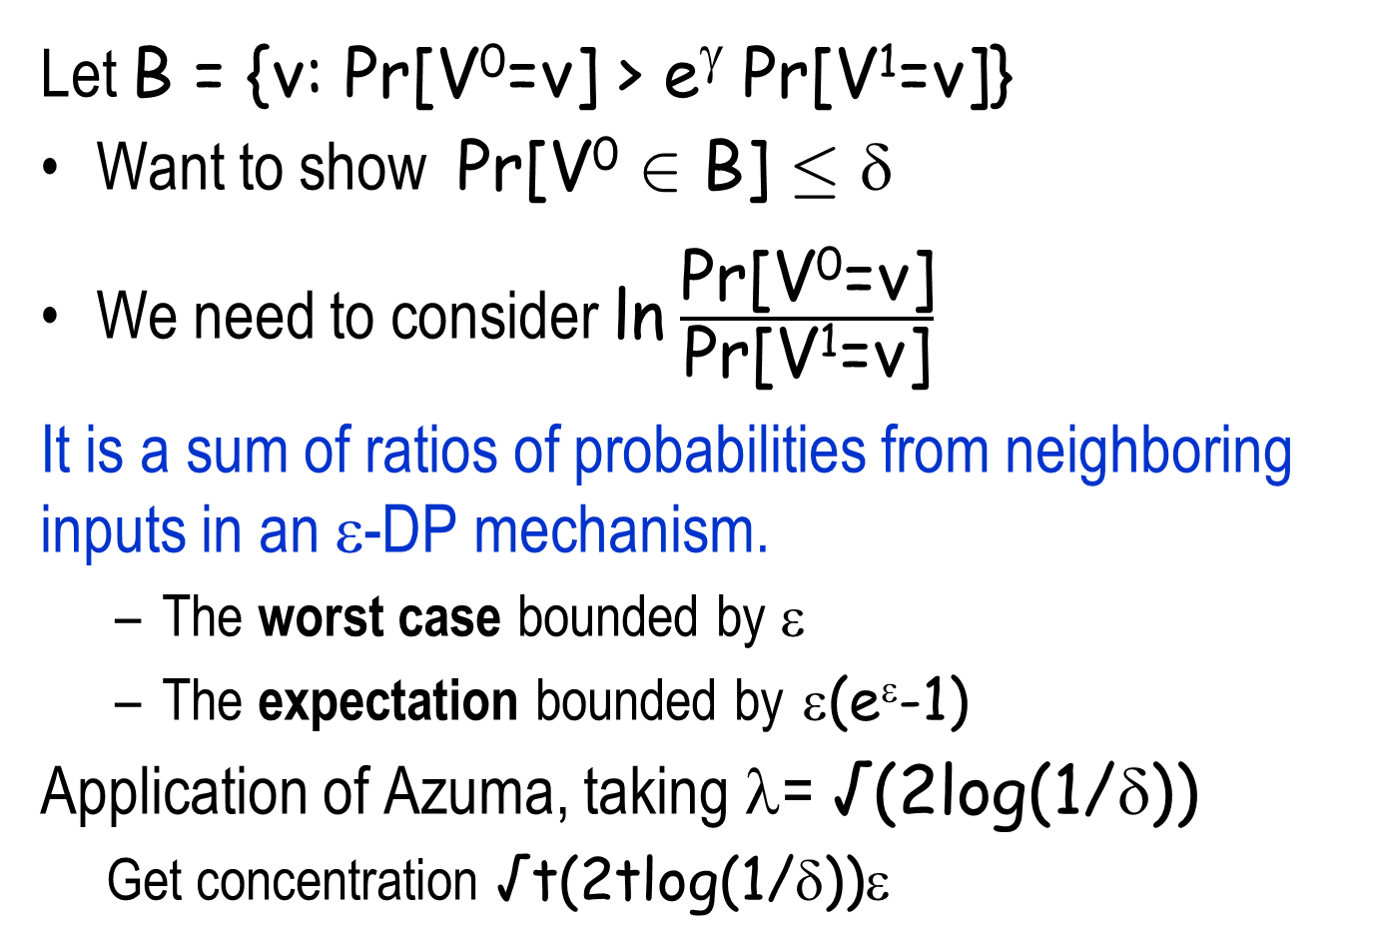
The Composition
Let B = {v: Pr[V⁰=v] > e^{γ} Pr[V¹=v]}
Want to show Pr[V⁰ 2 B] · δ
We need to consider ln $\frac{\text{Pr}\text{[}\text{V}\text{0}\text{=}\text{v}\text{]}}{\text{Pr}\text{[}\text{V}\text{1}\text{=}\text{v}\text{]}}$
It is a sum of ratios of probabilities from neighboring inputs in an ε-DP mechanism.
  The worst case bounded by ε
  The expectation bounded by ε(e^{ε}-1)
Application of Azuma, taking λ= √(2log(1/δ))
  Get concentration √t(2tlog(1/δ))ε
Choose
γ= tε(e^{ε}-1) + √t(2tlog(1/δ))ε

Slide 17
Scaling Noise to Sensitivity
[0,n]
Global sensitivity of query q:U^{n}→R
GS_{q} = max_{D,D’} |q(D) – q(D’)|
For a counting query q: GS_{q}=1
Previous argument generalizes:
For any query q:U^{n}→ R
release q(D) + Lap(GS_{q}/ε)
  ε-private
  error Õ(GS_{q}/ε)
Notes:
Utility

Slide 18
Scaling Noise to Sensitivity
Many dimensions
Global sensitivity of query q:U^{n}→R^{d}
GS_{q} = max_{D,D’} ||q(D) – q(D’)||₁
Previous argument generalizes:
For any query q:U^{n}→ R^{d}
release q(D) + (Y₁, Y₂, … Y_{d})
  Each Y_{i} independent Lap(GS_{q}/ε)
ε-private
error Õ(GS_{q}/ε)
Notes:
Utility

Slide 19
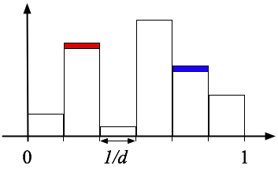
Histograms
Inputs x₁, x₂, ..., x_{n} in domain U
Domain U partitioned into d disjoint bins S₁,…,S_{d}
q(x₁, x₂, ..., x_{n}) = (n₁, n₂, ..., n_{d}) where
n_{j} = #{i : x_{i} in j-th bin}
Can view as d queries: q_{i} counts # points in set S_{i}
For adjacent D,D’, only one answer can change -
it can change by 1
Global sensitivity of answer vector is 1
Sufficient to add Lap(1/ε) noise to each
query, still get ε-privacy

Slide 20
Distance to DP with Property
Suppose P = set of “good” databases
  well-clustered databases
Distance to P = # points in x that must be changed to put x in P
Always has GS = 1
Example:
  Distance to data set with
  “good clustering”
x
P

Slide 21
Median
Median of x₁, x₂, ..., x_{n} 2 [0,1]
X= 0,…,0,0,1,…,1 X’= 0,…,0,1,1,…,1
median(X) = 0 median(X’) = 1
GSmedian = 1
Noise magnitude: 1. Too much noise!
But for “most” neighbor databases X, X’
|median(X) − median(X’)| is small.
  Can we add less noise on ”good” instances?
(n-1)/2
(n-1)/2
(n-1)/2
(n-1)/2

Slide 22
Global Sensitivity vs. Local sensitivity
Global sensitivity is worst case over inputs
Local sensitivity of query q at point D
LS_{q}(D) = max_{D’} |q(D) – q(D’)|
• Reminder: GS_{q}(D) = max_{D} LS_{q}(D)
Goal: add less noise when local sensitivity is small
Problem: can leak information by amount of noise

Slide 23
Local sensitivity of Median
For X = x₁, x₂, ..., x_{n}
LSmedian(X) = max(x_{m} − x_{m−1}, x_{m+1} − x_{m})
x₁, x₂, ..., x_{m-1}, x_{m}, x_{m+1}, ..., x_{n}

Slide 24
Sensitivity of Local Sensitivity of Median
Median of x₁, x₂, ..., x_{n} 2 [0,1]
X= 0,…,0,0,0,0,1,…,1 X’= 0,…,0,0,0,1,1,…,1
LS(X) = 0 LS(X’) = 1
Noise magnitude must be an insensitive function!
(n-3)/2
(n-3)/2
(n-3)/2
(n-3)/2

Slide 25
Smooth Upper Bound
Compute a “smoothed” version of local sensitivity
Design sensitivity function S(X)
S(X) is an ε-smooth upper bound on LS_{f}(X) if:
  for all x: S(X) ¸ LS_{f}(X)
  for all neighbors X and X’: S(X) · e^{ε}S(X’)
Theorem: if a response
A(x) = f(x) + Lap(S(x)/ε)
is given, then A is 2ε-differentially private.
Gives ε-DP about
f(x) and about S(x)

Slide 26
Smooth sensitivity
Smooth sensitivity
S_{f}*(X)= max_{Y} {LS_{f}(Y)e^{-ε dist(x,y)} }
Claim: S(X) is an ε-smooth upper bound on LS_{f}(X) for Smooth sensitivity

Slide 27
Sensitivity and Differential Privacy
Differential Privacy
Sensitivity:
  Global sensitivity of query q:U^{n}→R^{d}
  GS_{q} = max_{D,D’} ||q(D) – q(D’)||₁
  Local sensitivity of query q at point D
  LS_{q}(D)= max_{D’} |q(D) – q(D’)|
  Smooth sensitivity
  S_{f}*(X)= max_{Y} {LS_{f}(Y)e^{-ε dist(x,y)} }
Histograms
Differential privacy of median

Slide 28
The Exponential Mechanism
[McSherry Talwar]
A general mechanism that yields
Differential privacy
May yield utility/approximation
Is defined and evaluated by considering all possible answers
The definition does not yield an efficient way of evaluating it
Application/original motivation:
Approximate truthfulness of auctions
Collusion resistance
Compatibility

Slide 29
Side bar: Digital Goods Auction
Some product with 0 cost of production
n individuals with valuation v₁, v₂, … v_{n}
Auctioneer wants to maximize profit
Key to truthfulness: what you say should not affect what you pay
What about approximate truthfulness?

Slide 30
Example of the Exponential Mechanism
Data: x_{i} = website visited by student i today
Range: Y = {website names}
For each name y, let q(y, X) = #{i : x_{i} = y}
Goal: output the most frequently visited site
Procedure: Given X, Output website y with probability proportional to e^{εq(y,X)}
Popular sites exponentially more likely than rare ones
  Website scores don’t change too quickly
Size of subset

Slide 31
Setting
For input D 2 U^{n} want to find r2R
Base measure μ on R - usually uniform
Score function q’: U^{n} £ R  R
  assigns any pair (D,r) a real value
  Want to maximize it (approximately)
The exponential mechanism
  Assign output r2R with probability proportional to
  e^{εq’(D,r)} μ(r)
  Normalizing factor: ∑r e^{εq’(D,r)} μ(r)

Slide 32
The exponential mechanism is private
Let Δ = max_{D,D’,r} |q’(D,r)-q’(D’,r)|
Claim: The exponential mechanism yields a 2¢ε¢Δ differentially private solution
  Prob[output = r on input D]
  = e^{εq’(D,r)} μ(r)/∑r e^{εq’(D,r)} μ(r)
  Prob[output = r on input D’]
  = e^{εq’(D’,r)} μ(r)/∑r e^{εq’(D’,r)} μ(r)
adjacent
Ratio is
bounded by
e^{εΔ} e^{εΔ}

Slide 33
Laplace Noise as Exponential Mechanism
On query q:U^{n}→R let q’(D,r) = -|q(D)-r|
Prob noise = y
  e^{-εy} / 2 ∑y e^{-εy} = ε /2 e^{-εy}
Laplace distribution Y=Lap(b) has density function
Pr[Y=y] =1/2b e^{-|y|/b}
y
-4
-3
-2
-1
0
1
2
3
4
5

Slide 34
Any Differentially Private Mechanism is an instance of the Exponential Mechanism
Let M be a differentially private mechanism
Take q’(D,r) to be log (Prob[M(D) =r])
Remaining issue: Accuracy

Slide 35
Private Ranking
Each element i 2 {1, … n} has a real valued score S_{D}(i) based on a data set D.
Goal: Output k elements with highest scores.
Privacy
Data set D consists of n entries in domain D.
  Differential privacy: Protects privacy of entries in D.
Condition: Insensitive Scores
  for any element i, for any data sets D, D’ that differ in one entry:|S_{D}(i)- S_{D’}(i)| · 1

Slide 36
Approximate ranking
Let S_{k} be the k^{th} highest score in on data set D.
An output list is τ -useful if:
  Soundness: No element in the output has score · S_{k} - τ
  Completeness: Every element with score ¸ S_{k} + τ is in the output.
Score · S_{k} - τ
S_{k} + τ · Score
S_{k} - τ · Score · S_{k} + τ

Slide 37
Two Approaches
Each input affects all scores
Score perturbation
  Perturb the scores of the elements with noise
  Pick the top k elements in terms of noisy scores.
  Fast and simple implementation
  Question: what sort of noise should be added?
  What sort of guarantees?
Exponential sampling
  Run the exponential mechanism k times.
  more complicated and slower implementation
  What sort of guarantees?

Slide 38
Exponential Mechanism: (almost free) private lunch
Database of n individuals, lunch options {1…k},
each individual likes or dislikes each option (1 or 0)
Goal: output a lunch option that many like
For each lunch option j2 [k]:
  ℓ(j) is # of individuals who like j
Exponential Mechanism:
Output j with probability e^{εℓ(j)}
Actual probability: e^{εℓ(j)}/(∑_{i} e^{εℓ(i)})
Normalizer

