Slide 1

Foundations of Privacy
Lecture 7+8
Lecturer: Moni Naor

Slide 2
Bounds on Achievable Privacy
Bounds on the
Accuracy
  The responses from the mechanism to all queries are assured to be within α except with probability β
Number of queries t for which we can receive accurate answers
The privacy parameter ε for which ε differential privacy is achievable
  Or (ε,δ) differential privacy is achievable

Slide 3
Composition: t-Fold
Suppose we are going to apply a DP mechanism t times.
  Perhaps on different databases
Want: the combined outcome is differentially private
A value b 2 {0,1} is chosen
In each of the t rounds:
  adversary A picks two adjacent databases D₀^{i} and D₁^{i} and an ε-DP mechanism M_{i}
  receives result z_{i} of the ε-DP mechanism M_{i} on D_{b}^{i}
Want to argue: A‘s view is within ε’ for both values of b
A‘s view: (z₁, z₂, …, z_{t}) plus randomness used.

Slide 4
Adversary’s view
A’s view: randomness + (z₁, z₂, …, z_{t})
  Distribution with b: V^{b}
A
D₀¹, D₁¹
D₀², D₁²
…
D₀^{t}, D₁^{t}
  M₁(D_{b}¹)
  M₂(D_{b}²)
  M_{t}(D_{b}^{t})
M₁
M₂
M_{t}
z₁
z₂
z_{t}

Slide 5
Differential Privacy: Composition
Last week:
If all mechanisms M_{i} are ε-DP, then for any view the probability that A gets the view when b=0 and when b=1 are with e^{εt}
    t releases , each ε-DP, are t¢ε -DP
Today:
  t releases, each ε-DP, are (√tε+t ε²,δ)-DP (roughly)
Therefore results for a single query translate to results on several queries

Slide 6
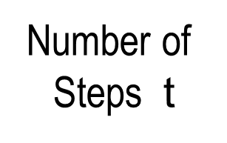

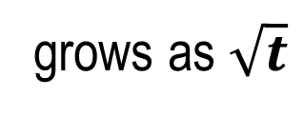
Privacy Loss as a Random Walk
$O(t)$ potentially dangerous rounds
Number of
Steps t
Privacy loss
1
-1
1
1
-1
1
1
-1
grows as $\sqrt{t}$

Slide 7
The Exponential Mechanism
[McSherry Talwar]
A general mechanism that yields
Differential privacy
May yield utility/approximation
Is defined and evaluated by considering all possible answers
The definition does not yield an efficient way of evaluating it
Application/original motivation:
Approximate truthfulness of auctions
Collusion resistance
Compatibility

Slide 8
Side bar: Digital Goods Auction
Some product with 0 cost of production
n individuals with valuation v₁, v₂, … v_{n}
Auctioneer wants to maximize profit
Key to truthfulness: what you say should not affect what you pay
What about approximate truthfulness?

Slide 9
Example of the Exponential Mechanism
Data: x_{i} = website visited by student i today
Range: Y = {website names}
For each name y, let q(y, X) = #{i : x_{i} = y}
Goal: output the most frequently visited site
Procedure: Given X, Output website y with probability proportional to e^{εq(y,X)}
Popular sites exponentially more likely than rare ones
  Website scores don’t change too quickly
Size of subset

Slide 10
Setting
For input D 2 U^{n} want to find r2R
Base measure μ on R - usually uniform
Score function w: U^{n} £ R  R
  assigns any pair (D,r) a real value
  Want to maximize it (approximately)
The exponential mechanism
  Assign output r2R with probability proportional to
  e^{εw(D,r)} μ(r)
  Normalizing factor ∑r e^{εw(D,r)} μ(r)
The reals

Slide 11
The exponential mechanism is private
Let Δ = max_{D,D’,r} |w(D,r)-w(D’,r)|
Claim: The exponential mechanism yields a 2¢ε¢Δ differentially private solution
  For adjacent databases D and D’ and
  for all possible outputs r 2R
  Prob[output = r when input is D]
  = e^{εw(D,r)} μ(r)/∑r e^{εw(D,r)} μ(r)
  Prob[output = r when input is D’]
  = e^{εw(D’,r)} μ(r)/∑r e^{εw(D’,r)} μ(r)
sensitivity
adjacent
Ratio is
bounded by
e^{εΔ} e^{εΔ}

Slide 12
Laplace Noise as Exponential Mechanism
On query q:U^{n}→R let w(D,r) = -|q(D)-r|
Prob noise = y
  e^{-εy} /2 ∑y e^{-εy} = ε /2 e^{-εy}
Laplace distribution Y=Lap(b) has density function
Pr[Y=y] =1/2b e^{-|y|/b}
y
-4
-3
-2
-1
0
1
2
3
4
5

Slide 13
Any Differentially Private Mechanism is an instance of the Exponential Mechanism
Let M be a differentially private mechanism
Take w(D,r) to be log (Prob[M(D) =r])
Remaining issue: Accuracy

Slide 14
Private Ranking
Each element i 2 {1, … n} has a real valued score S_{D}(i) based on a data set D.
Goal: Output k elements with highest scores.
Privacy
Data set D consists of n entries in domain D.
  Differential privacy: Protects privacy of entries in D.
Condition: Insensitive Scores
  for any element i, for any data sets D and D’ that differ in one entry:
  |S_{D}(i)- S_{D’}(i)| · 1

Slide 15
Approximate ranking
Let S_{k} be the k^{th} highest score in on data set D.
An output list is τ -useful if:
  Soundness: No element in the output has score · S_{k} - τ
  Completeness: Every element with score ¸ S_{k} + τ is in the output.
Score · S_{k} - τ
S_{k} + τ · Score
S_{k} - τ · Score · S_{k} + τ

Slide 16
Two Approaches
Each input affects all scores
Score perturbation
  Perturb the scores of the elements with noise
  Pick the top k elements in terms of noisy scores.
  Fast and simple implementation
  Question: what sort of noise should be added?
  What sort of guarantees?
Exponential sampling
  Run the exponential mechanism k times.
  more complicated and slower implementation
  What sort of guarantees?

Slide 17
Exponential Mechanism: Simple Example (almost free) private lunch
Database of n individuals, lunch options {1…k},
each individual likes or dislikes each option (1 or 0)
Goal: output a lunch option that many like
For each lunch option j2 [k], ℓ(j) is # of individuals who like j
Exponential Mechanism:
Output j with probability e^{εℓ(j)}
Actual probability: e^{εℓ(j)}/(∑_{i} e^{εℓ(i)})
Normalizer

Slide 18
The Net Mechanism
Idea: limit the number of possible outputs
  Want |R| to be small
Why is it good?
  The good (accurate) output has to compete with a few possible outputs
  If there is a guarantee that there is at least one good output, then the total weight of the bad outputs is limited

Slide 19
α Nets
A collection N of databases is called an α-net of databases for a class of queries C if:
for all possible databases x there exists a y2N such that
Max_{q2C} |q(x) –q(y)| · α
  If we use the closest member of N instead of the real database
    lose at most α
In terms of worst query

Slide 20
The Net Mechanism
For a class of queries C, privacy ε and accuracy α, on data base x
Let N be an α-net for the class of queries C
Let w(x,y) = - Max_{q2C} |q(x) –q(y)|
Sample and output according to exponential mechanism with x, w, ε and R=N
  For y2N: Prob[y] proportional to e^{εw(x,y)}
  Prob[y] = e^{εw(x,y)} / ∑_{z2N} e^{εw(x,z)}

Slide 21
Privacy and Utility
Sensitivity of w(x,y)
Claims:
Privacy: the net mechanism is ε¢Δ differentially private
Utility: the net mechanism is (α+γ, β) accurate for any α, γ and β such that
γ ¸ log (|N|/β)/ε
  Proof:
  there is at least one good solution: gets weight at least e^{-εα}
  there are at most |N| (bad) outputs: each get weight at most e^{-ε(α+γ)}
  Use the Union Bound
Accuracy less than α+γ
|N|e^{-ε(α+γ) ·} β e^{-εα}

Slide 22
  The Union Bound
For any collection of events A₁, A₂ … A_{ℓ}
Prob[no event A_{i} occurs] · ∑_{i=1}^{ℓ} Prob[A_{i}]
If Prob[A_{i}] · γ then
Prob[no event A_{i} occurs] · ℓ ¢ γ
  In constructions: if Prob[no event A_{i} occurs] < 1 then there is the possibility that the good case occurs.

Slide 23
Accuracy ¸ α + γ
Accuracy · α
α · Accuracy · α + γ

Slide 24
Synthetic DB: Output is a DB
answer 1
Sanitizer
answer 3
answer 2
query 1,
query 2,
. . .
?
Database
Synthetic DB: output is always a DB
Of entries from same universe U
User reconstructs answers to queries by evaluating the query on output DB
Software and people compatible
Consistent answers

Slide 25
Counting Queries
Database x of size n
Queries with low sensitivity
Counting-queries
C is a set of predicates q: U  {0,1}
Query: how many x participants satisfy q?
Relaxed accuracy:
  Answer query within α additive error w.h.p
Not so bad: error anyway inherent in statistical analysis
Assume all queries given in advance
Query q
U
Non-interactive

Slide 26
α-Net For Counting Queries
If we want to answer many counting queries C with differential privacy:
  Sufficient to come up with an α-Net for C
  Resulting accuracy α + log (|N|/β) /ε
Claim: the set N consisting of all databases of size m where m = log|C|/α²
    Consider each element in the set to have weight n/m
is an α-Net for any collection C of counting queries
Error is Õ(n^{2/3} log|C|)

Slide 27

…α-Net For Counting Queries
Claim: the set N consisting of all databases of size m is an α-Net for any collection C of counting queries
  where m = log|C|/α²
Proof:
  Fix database x 2 U^{n} and query q2C
  Let s be a random subset of x of size m
  Prob[s_{i} 2 q] = |q Å x|/|x|
  E[|S Å x| = ∑_{i=1}^{m} Prob[s_{i} 2 q] = |q Å x| ¢ m/n
S = {s₁, s₂, …, s_{m}}
s
x
q
U

Slide 28
Chernoff Bounds
  E[|S Å x| = ∑_{i=1}^{m} Prob[s_{i} 2 q] = |q Å x| ¢ m/n
Chernoff bound:
If x₁, x₂, …, x_{m} are independent {0,1} r.v.
Prob[|∑_{i=1}^{m} x_{i} – E[∑_{i=1}^{m} x_{i} ]| ¸ d] · 2e^{-2d2/m}
Therefore: Prob[s bad for q] · 2e^{-2α2m}
Union Bound:
Prob[s bad for some q2C] · |C|¢2e^{-2α2m}
Relative error is larger than α, d=αm

Slide 29
Fixing the parameters
  Recall:
  Accuracy max{α, log (|N|/β) /ε }
  log |N| = m log |U|
  Set:
  m = n^{2/3} log|C|
  Set α = n^{-1/3}
  We get accuracy n^{2/3} log|C| log|U| - log β

Slide 30
Remarkable
Hope for rich private analysis of small DBs!
Quantitative: #queries >> DB size,
Qualitative: output of sanitizer -synthetic DB-
output is a DB itself

Slide 31
Conclusion
Offline algorithm, 2ε-Differential Privacy for any
set C of counting queries
Error α is Õ(n^{2/3} log|C|/ε)
Super-poly running time: |U|^{Õ((n\α)2·log|C|)}

Slide 32
Interactive Model
query 1
query 2
?
Sanitizer
Data
Multiple queries, chosen adaptively

Slide 33
Maintaining State
Query q
State = Distribution D
Sequence of distributions D₁, D₂, …, D_{t}

Slide 34
General structure
Maintain public D_{t} (distribution, data structure)
On query q_{i}:
  try to answer according to D_{t}
  If answer is not accurate enough:
    Answer q_{i} using another mechanism
    Update: D_{t+1} as a function of D_{t} and q_{i}
Lazy Round
Update Round

Slide 35

The Multiplicative Weights Algorithm
Powerful tool in algorithms design
Learn a Probability Distribution iteratively
In each round:
  either current distribution is good
  or get a lot of information on distribution
    Update distribution

Slide 36
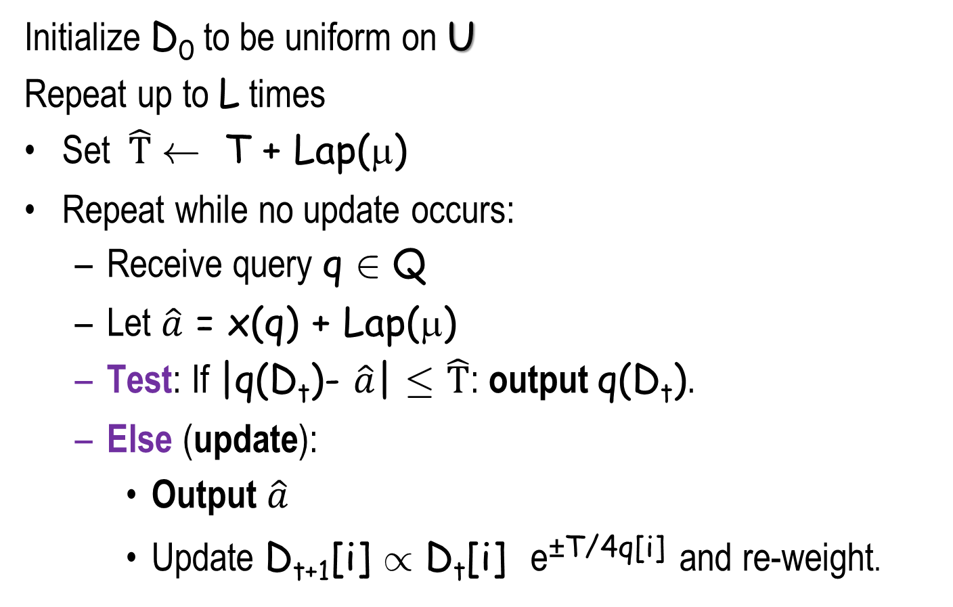
The PMW Algorithm
Maintain a distribution D_{t} on universe U
This is the state.
Is completely public!
Initialize D₀ to be uniform on U
Repeat up to L times
Set $\hat{T}$ Ã T + Lap(μ)
Repeat while no update occurs:
  Receive query q 2 Q
  Let $\hat{a}$ = x(q) + Lap(μ)
  Test: If |q(D_{t})- $\hat{a}$| · $\hat{T}$: output q(D_{t}).
  Else (update):
    Output $\hat{a}$
    Update D_{t+1}[i] / D_{t}[i] e^{±T/4q[i]} and re-weight.
Algorithm fails if more than L updates
The true value
the plus or minus are according
to the sign of the error
New dist.
is D_{t+1}

Slide 37
Overview: Privacy Analysis
For the query family Q = {0,1}^{U} for (β, δ, ε) and t the PMW mechanism is
(ε, δ) –differentially private
(α,β) accurate for up to t queries where
α = Õ(1/(ε n)^{1/2})
State = Distribution is privacy preserving for individuals (but not for queries)
accuracy
Log dependency on |U|, δ, β and t

Slide 38
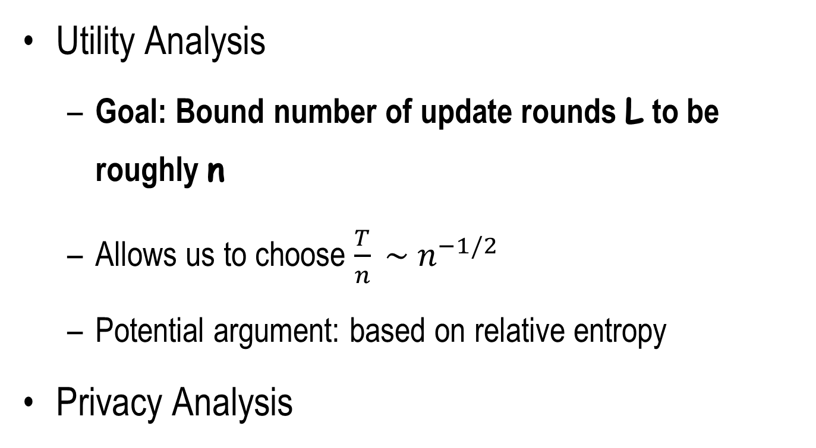
Analysis
Utility Analysis
  Goal: Bound number of update rounds L to be roughly n
  Allows us to choose $\frac{T}{n} \sim n^{−1/2}$
  Potential argument: based on relative entropy
Privacy Analysis
Important for both utility and privacy

Slide 39
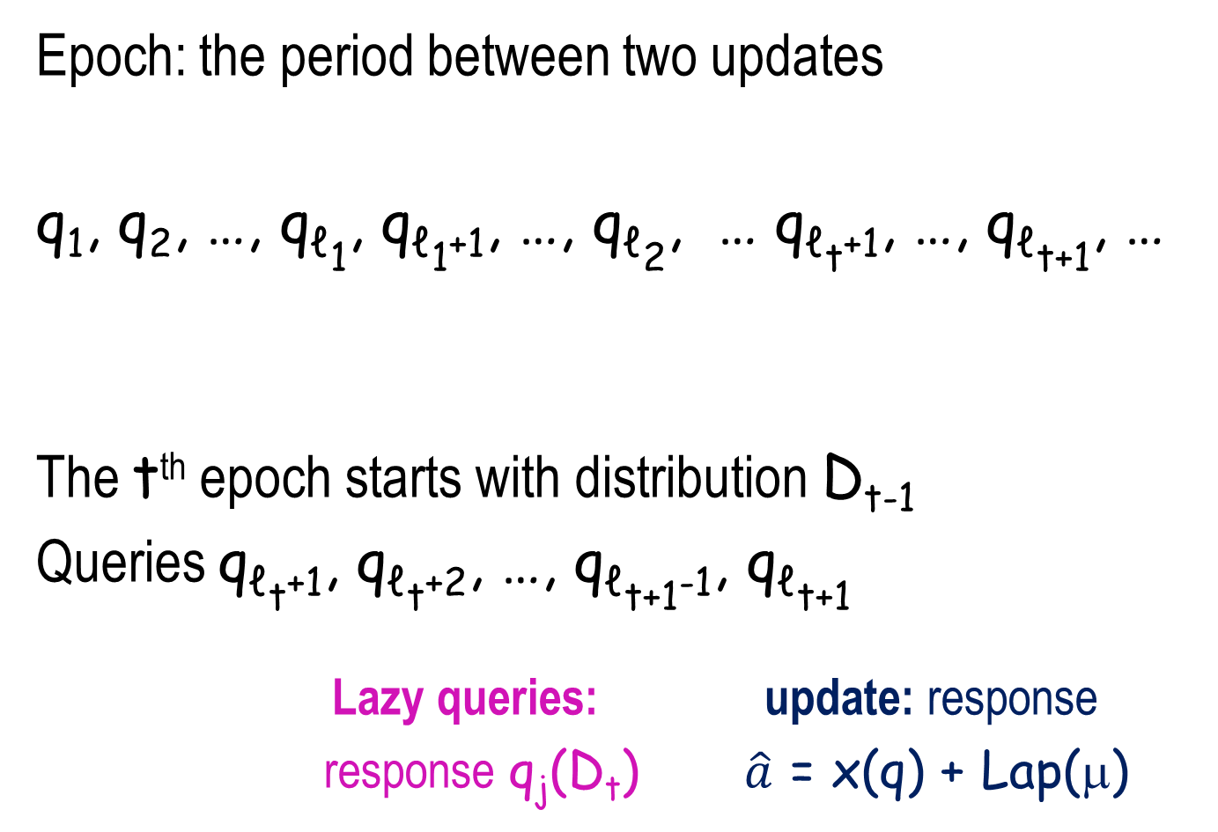
Epochs
Epoch: the period between two updates
q₁, q₂, …, q_{ℓ1}, q_{ℓ1+1}, …, q_{ℓ2}, … q_{ℓt+1}, …, q_{ℓt+1}, …
The t^{th} epoch starts with distribution D_{t-1}
Queries q_{ℓt+1}, q_{ℓt+2}, …, q_{ℓt+1-1}, q_{ℓt+1}
  Lazy queries: update: response
  response q_{j}(D_{t}) $\hat{a}$ = x(q) + Lap(μ)
D₀
D₁
D_{t-1}
1st epoch
2nd epoch
t^{th} epoch

Slide 40
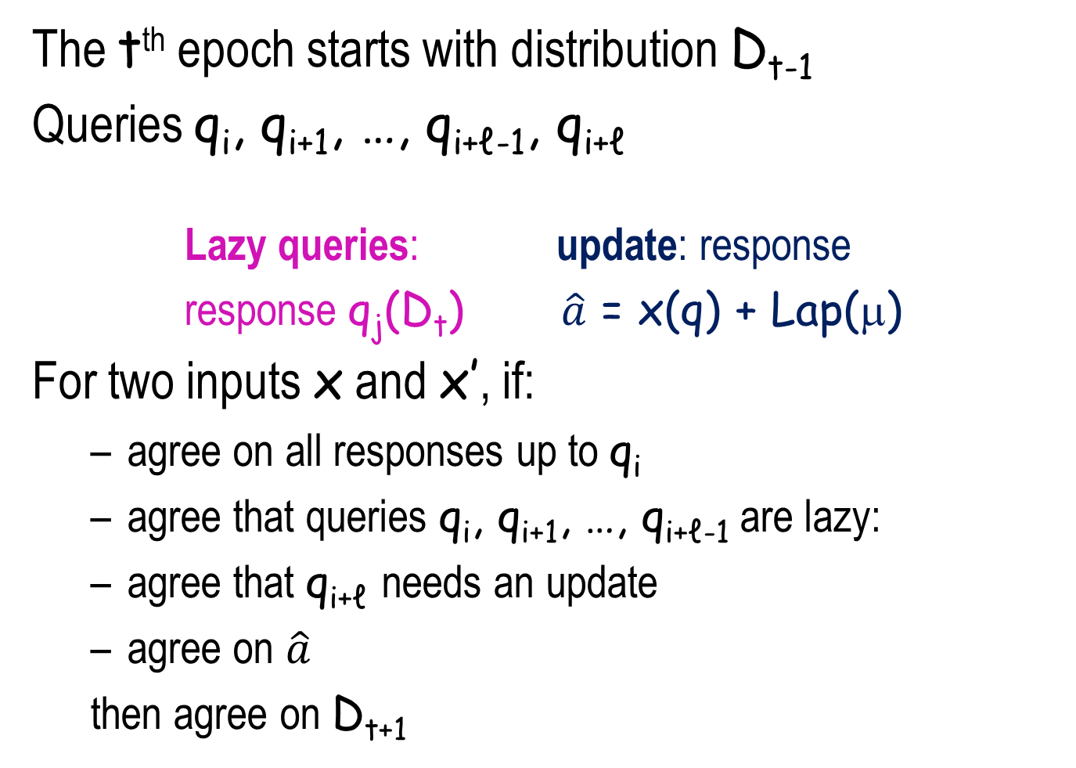
Epochs
The t^{th} epoch starts with distribution D_{t-1}
Queries q_{i}, q_{i+1}, …, q_{i+ℓ-1}, q_{i+ℓ}
  Lazy queries: update: response
  response q_{j}(D_{t}) $\hat{a}$ = x(q) + Lap(μ)
For two inputs x and x’, if:
  agree on all responses up to q_{i}
  agree that queries q_{i}, q_{i+1}, …, q_{i+ℓ-1} are lazy:
  agree that q_{i+ℓ} needs an update
  agree on $\hat{a}$
  then agree on D_{t+1}

Slide 41
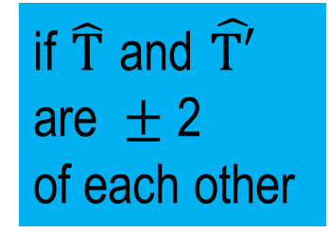
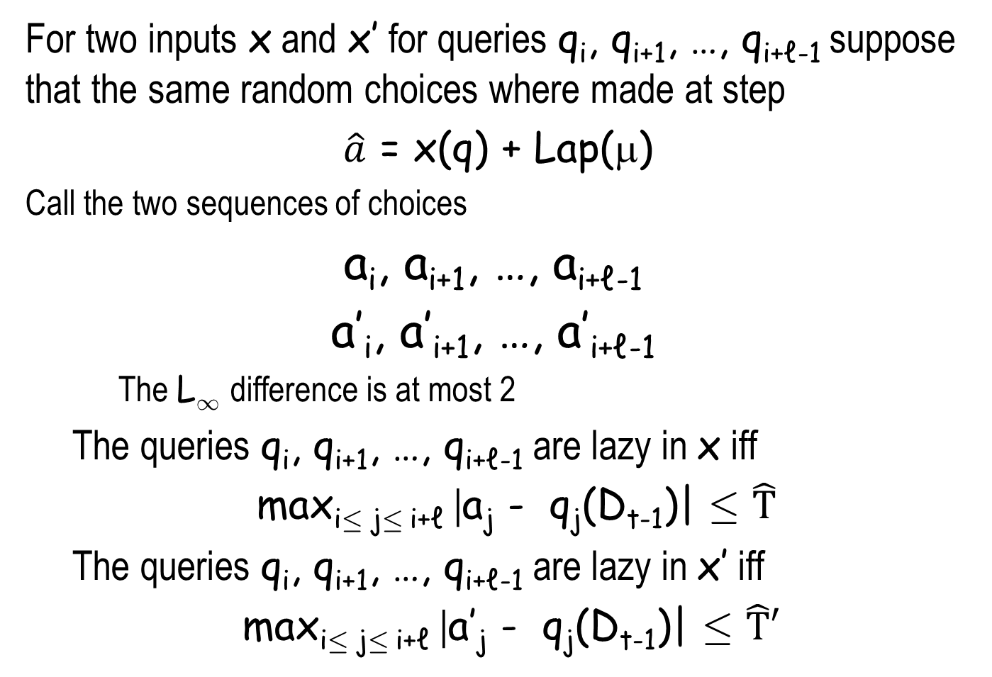
Epochs
  For two inputs x and x’ for queries q_{i}, q_{i+1}, …, q_{i+ℓ-1} suppose that the same random choices where made at step
  $\hat{a}$ = x(q) + Lap(μ)
Call the two sequences of choices
a_{i}, a_{i+1}, …, a_{i+ℓ-1}
a’_{i}, a’_{i+1}, …, a’_{i+ℓ-1}
    The L₁ difference is at most 2
  The queries q_{i}, q_{i+1}, …, q_{i+ℓ-1} are lazy in x iff
  max_{i· j· i+ℓ} |a_{j} - q_{j}(D_{t-1})| · $\hat{T}$
  The queries q_{i}, q_{i+1}, …, q_{i+ℓ-1} are lazy in x’ iff
  max_{i· j· i+ℓ} |a’_{j} - q_{j}(D_{t-1})| · $\hat{T}′$
if $\hat{T}$ and $\hat{T′}$
$$\text{are} ±\text{2}$$
of each other

Slide 42
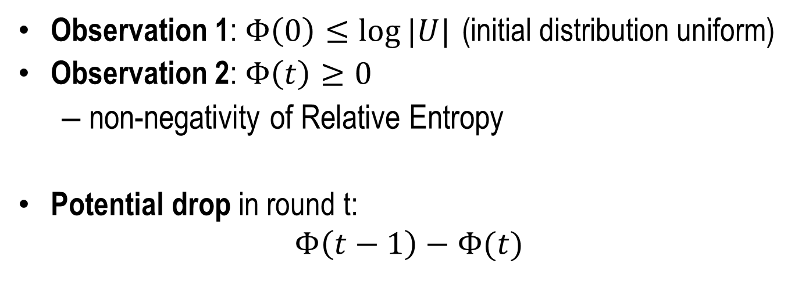
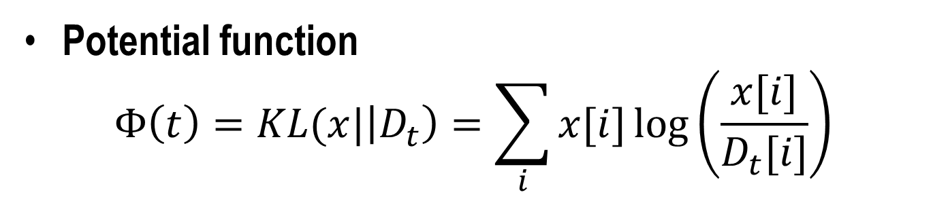
Utility Analysis
Kullbeck Liebler Divergence
Potential function
$$Φ\left(t\right)=KL(x|\left|D_{t}\right)=\sum_{i}{x[i]\log\left(\frac{x[i]}{D_{t}[i]}\right)}$$
Observation 1: $Φ\left(0\right)≤\log{|U|}$ (initial distribution uniform)
Observation 2: $Φ\left(t\right)≥0$
  non-negativity of Relative Entropy
Potential drop in round t:
$$Φ\left(t−1\right)−Φ(t)$$

Slide 43
… Utility Analysis
By the high concentration properties of the Laplacian mechanism,
  with probability at least 1- β all the noise added is of magnitude at most μ log(t/β)
  Set T ¸ 6 μ log(t/β)and μ ¸ α₀. Suppose no such exception occurred.
β upper bound on the failure probability
t – number of rounds

Slide 44
  If an update step occurs, then
  |q(D) - q(x)| ¸ T - 2μ log{t/β} ¸ T/2
  The argument is based on the fact that each update reduces KL(x|| D) by Ω(T²).
  Since the initial value of KL(x|| D) is at most log |U|, the maximum number of update is bounded by O(log|U|/T²).
  The bound L on the number of epochs, should to be this value.

Slide 45
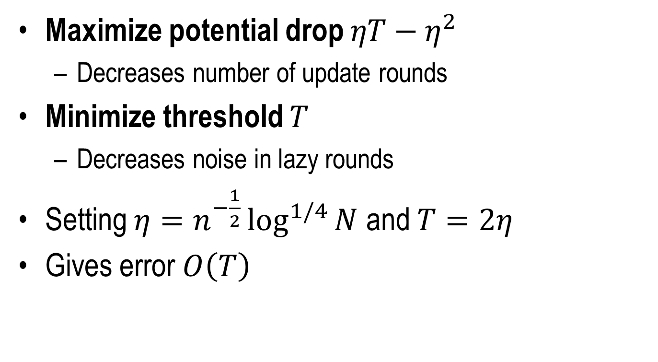
Setting the parameters
Maximize potential drop $ηT−η^{2}$
  Decreases number of update rounds
Minimize threshold $T$
  Decreases noise in lazy rounds
Setting $η=n^{−\frac{1}{2}}\log^{1/4}{N}$ and $T=2η$
Gives error $O\left(T\right)$

Slide 46
Azuma’s Inequality
Suppose we have m random variables X₁, X₂ …, X_{m}
Will compute a function f on them s.t.
E[f] is bounded.
We have c_{i} denote the maximum effect of X_{i} on f:
  for all a_{i} and a’_{i} 2 A_{i}
E[f| X₁, …, X_{i-1} , X_{i} = a_{i}] - E[f| X₁, …, X_{i-1} , X_{i} = a’_{i}] · c_{i}
Then:
Pr [f(X₁, X₂ …, X_{m} ) ¸ E[f] + t] ·
exp(-2t²/∑_{i=1}^{m} c_{i}²)

