Slide 1
Concurrent Security,
A Survey
Abhishek Jain Boston University and MIT
Huijia (Rachel) Lin University of California, Santa Barbara
Huijia
Huijia
Abhishek
Huijia
Abhishek
Abhishek

Slide 2


Composition of Protocols
Relaxed Security
Weaker Models
Trusted Set-ups
Universal Composition [Canetti 00]
General-Composition
Self-Composition of Multi-Party Computation
Concurrent ZK [Dwork-Naor-Sahai 98]
Security against MIM [Dolev-Dwork-Naor 91]
Composition of ZK protocols [Goldreich-Krawcyzk 90]

Slide 3
Secure Multiparty Computation (MPC)
Allow multiple parties to jointly compute any F securely
SMC Protocol π for computing F = (F₁, F₂)
input x₁
input x₂
output y₁=F₁ (x₁,x₂)
output y₂=F₂ (x₁,x₂)
Security Goal: Correctness and Privacy

Slide 4
REAL
input x₁
input x₂
output y’₁
output z’
output y’₂
≈
Theorem [Yao82, Goldreich-Micali-Wigderson87]:
Every function can be securely computed
assuming factoring is hard.
“as correct & private as”
IDEAL
input x₁
input x₂
x₁
x₂
Simulator
F
y₁=F₁ (x₁,x₂)
y₂=F₂ (x₁,x₂)
output y₁
output y₂
output z
For every Adv, there is a Sim that launch the “same attack”

Slide 5
A fundamental question:
Composition
Protocol B
Protocol A
Protocol C
Is security preserved under protocol composition?

Slide 6
Security under composition
Why Care?
1. Composition occurs in real life
---Need concurrent security
“Concurrently
Secure” MPC
Chosen Message
Attack Secure
Concurrent ZK
2. Composition occurs in system design
---Want modular, simpler, solutions
Multi-instance
Security
Non-Malleable
Commitments
Sequential WH
3. Better understanding of security notions
---Various applications
MPC
PKE Signature Commitments ZK WH ….

Slide 7
Self-Composition
P1
P2 / P1
P1
P2
P2
An unbounded number of instances of the same protocol
Examples: Self-Composable MPC ….
Non-Malleable Encryption
Concurrent Non-Malleable (NM) ZK
CMA-secure signature
Password authenticated key exchange (PAKE)

Slide 8
Universal-Composition (UC) [Can00]
Z
Composition with arbitrary protocols
in a potentially adversarial, execution environment

Slide 9
UC security [Can00]
REAL
The UC Composition Theorem:
If π UC-implements F and
ρ^{F} UC-implements G,
then ρ^{π} UC-implements G.
Z
≈
“as correct & private as”
IDEAL
x₁
x₂
F
Z
y₁=F₁ (x₁,x₂)
y₂=F₂ (x₁,x₂)

Slide 10

UC security [Can00]
The UC Composition Theorem:
If π UC-implements F and
ρ^{F} UC-implements G,
then ρ^{π} UC-implements G.
Impossible in PLAIN model [CF01,CKL03,Lin04,BPS06,PR08,
Goy12,AGJPS12,GKOV12]
The strongest model of composition
1. Concurrent Security
2. Modular analysis
3. Environmental Friendly
UC-secure protocols does not hurt the security of other, unknown protocols

Slide 11

In wonderland: UC with TRUST
— Honest Majority [DM00,BGW88,BR89]
— Public Key Registration [BCNP04,LPV09,DNO10,LPV12]
— Tamper-Proof Hardware [Kat07,CGS08,LPV09,GISVW10,LPV12]
— CRS [Can01,CLOS02,CPS07,CDPW07,GO07,LPV09,DNO10,LPV12]
— Timing Model [DNS98,KLP05,LPV09,LPV12]
— Physically Uncloneable Functions [BFSK11,OSVW13]
Many parameters
  Timing coordination:
  Sequential, parallel, concurrent
  Input coordination:
  Fixed, statically or adaptively chosen inputs
  Corruption patterns:
  Static v.s. adaptive corruption
  Fixed-role v.s. mixed-role corruption
  Number of instances:
  Bounded, unbounded executions
  Additional Properties:
  fairness, leakage resilience,…
On earth: relaxed security notions
— Input Indistinguishable Computation [MPR06,GGJS12]
— Super-Polynomial-time Simulation [Pas03,BS05,LPV09,LPV12,GGJS12]
— Angel-based security [PS04,MMY06,CLP10,LP12,GLPPS13,KMO14]
— Multiple-ideal query security [GJO10,GJ13,GGJ13,CGJ13]

Slide 12

The Attempt of This Talk:

Slide 13


The Attempt of This Talk:
A brief explanation of impossibility results
The scope of this talk is restricted to
static corruption, computational security, no guaranteed output delivery (no fairness), synchronous network …
Focus on showing feasibility,
not showing various optimizations on efficiency, simplicity, black-box construction ….
Simple UC impossibility, extending to much weaker models
TALK
An intuition behind the constructions of most models
Elucidate the key elements behind the constructions
An order between different models
Why different models exist? How do they compare?

Slide 14
Impossibility Results in Plain Model
[CF01,CKL03,Lin04,BPS06,PR08,Goy11,AGJPS12,GKOV12]
Impossibility of General Composition
Impossibility of Self Composition

Slide 15


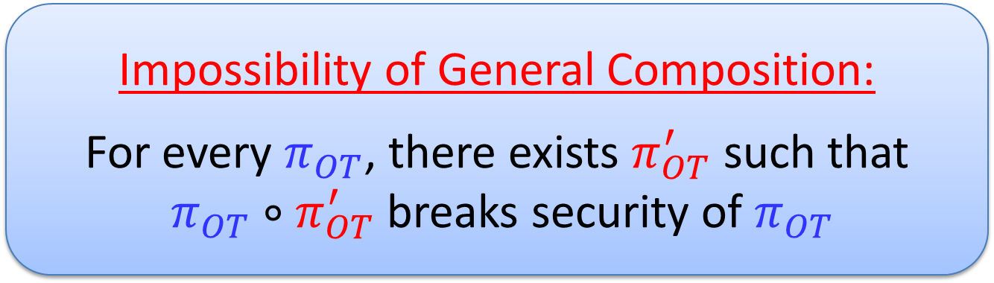




Chosen Protocol Attack for OT
[BPS06,AGJPS12,GKOV12]
$$F_{OT}$$
Real Adv can learn honest party’s input, but Simulator cannot
$$s_{0},s_{1}$$
$$b$$
$$s_{b}$$
input (s₀ , s₁)
input b
Impossibility of General Composition:
For every $π_{OT}$, there exists $π_{OT}^{′}$ such that
$π_{OT}∘π_{OT}^{′}$ breaks security of $π_{OT}$

Slide 16



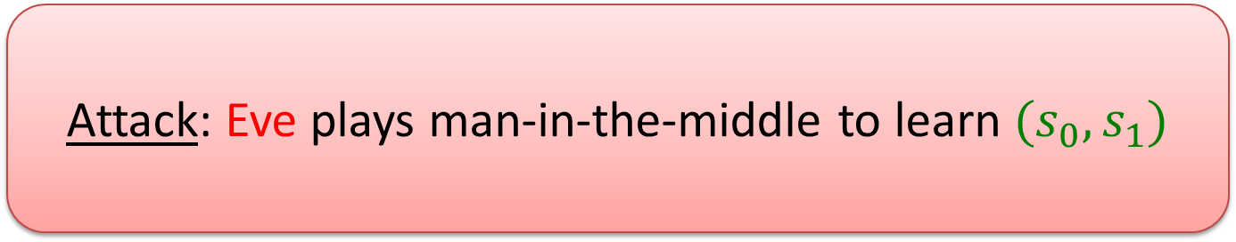


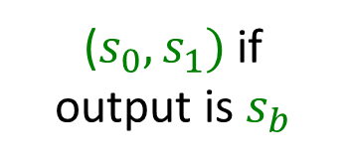


Chosen Protocol Attack: Real World
$$π_{OT}^{′}$$
$$π_{OT}$$
$$π_{OT}$$
($s_{0},s_{1})$ if
output is $s_{b}$
$$s_{0},s_{1}$$
$$b, s_{0},s_{1}$$
Attack: Eve plays man-in-the-middle to learn ${(s}_{0},s_{1})$

Slide 17


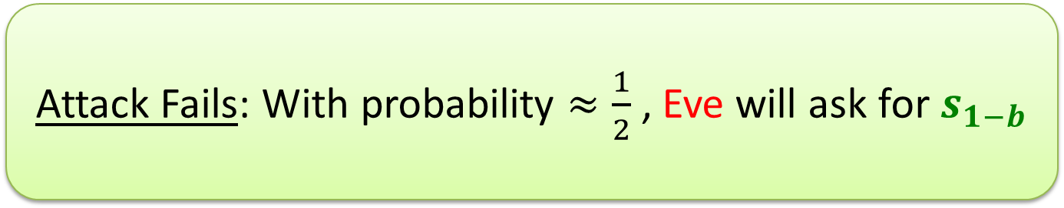






Chosen Protocol Attack: Ideal World
$$F_{OT}$$
$$π_{OT}^{′}$$
$$b^{′}$$
$$s_{b^{′}}$$
$$π_{OT}$$
($s_{0},s_{1})$ if
output is $s_{b}$
$$s_{0},s_{1}$$
$$b, s_{0},s_{1}$$
Attack Fails: With probability $≈\frac{1}{2}$, Eve will ask for $s_{1−b}$

Slide 18
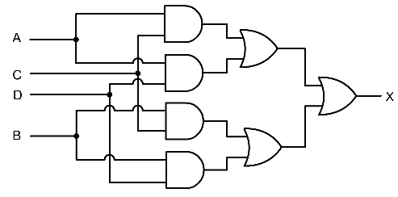





From Impossibility of General Composition to Impossibility of Self-Composition
Want: Executions of $π_{OT}$ only (no $π_{OT}^{′}$)
$$GC_{1}$$
with Garbled Circuits computing his
Next-Message Functions
.
.
Replace
.
$$b, s_{0},s_{1}$$
$$GC_{n}$$
Give Garbled Circuits to Eve as Aux. Input
$$<b, s_{0},s_{1}>$$

Slide 19





Who gets the GC Keys?
Eve should have keys to execute GCs on Alice’s messages, but can’t give her ALL keys
$$s_{0},s_{1}$$
$$GC_{1}$$
.
$$π_{OT}$$
.
.
$$GC_{n}$$
$$<b, s_{0},s_{1}>$$

Slide 20
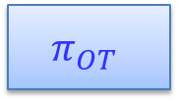
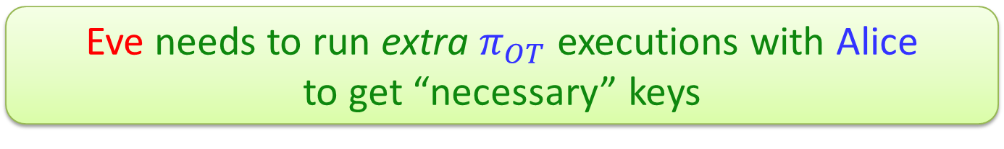
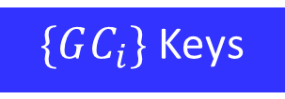
Alice gets the GC Keys as input
Impossibility extends to all “non-trivial” functions by a reduction (in the concurrent setting) to OT [AGJPS12,GKOV12]
Concurrent OT Executions
$$s_{0},s_{1}$$
$$GC_{1}$$
$$π_{OT}$$
.
$$π_{OT}$$
.
.
.
.
.
$\{GC_{i}\}$ Keys
$$GC_{n}$$
$$<b, s_{0},s_{1}>$$
Eve needs to run extra $π_{OT}$ executions with Alice
to get “necessary” keys

Slide 21
Intuition of Constructions

Slide 22
Concurrent Security
in a Generalized UC model
Feasible in weaker models !
Honest Majority
[DM00,BGW88,BR89]
Honest Majority
[DM00,BGW88,BR89]
Timing
[DNS98,G06,LKP05]
Tamper Proof Hardware
[K07,NW07,CGS08,MS08]
Public-Key Infrastructure
[JSI96,DN03,BCNP04,DNO10]
Common Reference String [BFM88,D00,CLOS02,MGY03,
GO07,CPS07,DNO10]
Augmented CRS (GUC)
[CDPW07]
Augmented CRS (GUC)
[CDPW07]
Super-Polynomial Time Simulation
[Pas03,BS05,LPV09,LPV12,GGJS12]
Angel-Based Security
[PS04,MMY06,CLP10,LP12,GLPPS13,KMO14]
Angel-Based Security
[PS04,MMY06,CLP10,LP12,GLPPS13,KMO14]
Multiple-ideal Query Model
[GJO10,GJ13,GGJ13]
Multiple-ideal Query Model
[GJO10,GJ13,GGJ13]

Slide 23

Generalized Framework for UC [LPV09]
IDEAL
x₁
Z
x₂
⌃
F
F
1. Augmented
Real World
y₁=F₁ (x₁,x₂)
y₂=F₂ (x₁,x₂)
A framework of models
Embeds most weaker models
2. Flexible
Comp. Classes
G
No need for composition theorem
REAL
Z
C_{Sim}=C_{Adv}=C_{Env}
Close to UC, leverage previous results
3. Multi-session
Ideal/Real World

Slide 24
Generalized Framework for UC
Compilation for UC
by [GMW87,BMR90,CLOS02,Pas04]
assuming Semi-Honest OT
Implement multi-session ZK functionality
x, w
R(x, w)
⌃
P
x’, w’
F_{ZK}
R(x’, w’)
V
x’’, w’’
R(x’’, w’’)

Slide 25
Implement multi-session ZK functionality
x, w
R(x, w)
⌃
P
x’, w’
F_{ZK}
R(x’, w’)
V
x’’, w’’
R(x’’, w’’)
≈
Design a “special” ZK protocol (P,V), s.t.
Z

Slide 26
x, w
⌃
x, w
F_{ZK}
R(x, w)
Simulate w/o witness (ZK)
⌃
x, w
F_{ZK}
R(x, w)
Extract witness (AOK)
Z
S
S(E)
w1
wk
Concurrent ZKAOK (Concurrent Simulation-Extractability)
Extract witnesses from adv even when receiving simulated proofs

Slide 27



Z
S
S(E)
w1
wk
Concurrent ZKAOK
Extract witnesses from adv even when receiving simulated proofs
Have been studied a LOT !
in Concurrent ZK [DNS98,RK99,PRS02…]
Sophisticated Rewinding Strategies
rewinding
Straight-line non-black-box simulation [Bar01…]
But, rewinding is possible
in self-composition.
See later.
Non-BB

Slide 28
Z
S
S(E)
w1
wk
Concurrent ZKAOK
Extract witnesses from adv even when receiving simulated proofs
How to get straight-line simulation?
By giving S certain SUPER-POWER over Adv
= The ability to get a trapdoor
+
UC-puzzle
Non-Malleability

Slide 29
Z
S
S(E)
Sound!
w1
wk
Concurrent ZKAOK
Extract witnesses from adv even when receiving simulated proofs
Compilation from ZKA to ZKAOK [BL02,PR03,Pas04,DNO10,MPR10,LPV13]
⌃
X
X true or false
F_{WZK}
A weaker notion: Fully concurrent ZKA (conc. simulation soundness)
Adv cannot cheat even when receiving simulated proofs

Slide 30
Z
S
Sound!
A weaker notion: Fully concurrent ZKA
Adv cannot cheat even when receiving simulated proofs
Decompose
Concurrent Simulation
⬅ UC-puzzles
Security against MIM attacks
⬅ Non-Malleable Commitment

Slide 31
A weaker notion: Fully concurrent ZKA
Adv cannot cheat even when receiving simulated proofs
UC puzzles
NM Commitments
Feige-Shamir Paradigm for ZK
P(x, w)
V(x)
2 Simple Modification:
S
UC Puzzle:
A simulator can simulate many puzzle-executions and output trapdoors online.
trapdoor
Puzzle
Puzzle
➔ Concurrent Simulation
WI arg.
NM WI:
When the prover changes witness,
the MIM does not.
Statement y:
Either, x is true
Or, knows a trapdoor

Slide 32
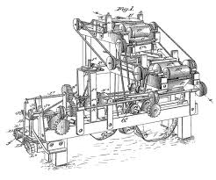
Concurrent MPC
in Generalized UC
Unified Framework [LPV09,LPV12]
assuming SH-OT against C_{Sim}
UC-puzzle
NM Commitment
How to Cook Up Concurrent Security
in Your Favorite Model X (CRS,PKA,SPS…)?
    Instantiate a UC-puzzle using model X
    Plug in
One-Way Func
Easy!

Slide 33
Different Models

Slide 34
Trusted Set-ups---An approach from sky
From wonderland (say CRS)
Towards the “bare bones” of trust --- Canetti
minimal, simple, implementable
UC
Relaxed Security---An approach from earth
From earth,
“Approximate” UC security and quality tighter and tighter
Super-Polynomial Time Simulation
Angel-Based Security
Multiple-ideal Query Model

Slide 35
Super-Polynomial time Simulation[Pas03,PS04,BS05]
Generalized UC with Super-Polynomial Time Simulator
x₁
x₂
Z
⌃
F
F
y₁=F₁ (x₁,x₂)
y₂=F₂ (x₁,x₂)
Sim runs in
Sub-Exp time
Z

Slide 36
A puzzle in the SPS model
OWF f
y=f(x) for random n^{ε}-bit x
y
y
S
solution
solution
Challenger
Solver
Challenger
Solver
Solution = pre-image of y
Easy!
S inverts y in 2^n^{ε} time
Sound by one-wayness

Slide 37
Thm[PS04,BP05,LPV09,LPV12]:
UC-secure protocols for all functionalities in SPS model
⬅ Sub-Exp OT
Chimera Protocols:
Have properties of diff simulation technique
(Separate final simulator from simulator in proof)
Sub-Exp time
Arbitrary Protocol
⌃
F
SPS
Thm[CLP10,LP12,GGJS12,LPV12]:
UC-secure protocols for all functionalities in SPS model
⬅ OT
In Proof!
Sub-Exp time
PPT Rewinding
OT
OT
Optimal Rounds: O(1) protocols in all models ⬅ O(1)-round OT
Tight Assumptions [LPV12]

Slide 38


How much weaker than UC?
x₁
x₂
Z
⌃
F
F
y₁=F₁ (x₁,x₂)
y₂=F₂ (x₁,x₂)
Sim runs in
Sub-Exp time
Security
Weaker Privacy: Adv can learn what’s efficiently computable in sub-exp time
Quality
Concurrent security
Modular analysis
Environmental friendliness

Slide 39

Angel: Super-poly, but
w/ a specific interface
Angel based security [PS04]
Sim
Adv
>
=
Super-poly
PPT
PPT Relativized
PPT Relativized
Security
Better Privacy: Adv can learn what’s efficiently computable with a super-poly oracle
Quality
Concurrent security
Modular analysis
Environmental friendliness
[PS04,MMY06] Non-standard Assumptions
[CLP10,LP12,GLPPS13] OT

Slide 40
So Far
Concurrent Security is impossible in Plain Model
General Recipe for UC
Relaxed Security in Plain Model: Super-Polynomial Time Simulation

Slide 41
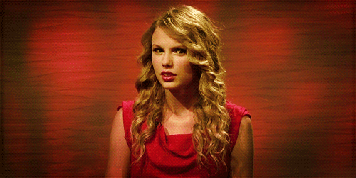
What Security are we losing due to Concurrent Attacks?
Super-Polynomial Time Simulation:
Security Loss = “Information computable in super-poly time”
?

Slide 42
Can We Quantify What Information Concurrent Adversary Can Learn?
(more concretely)
Let’s consider Concurrent Self-Composition
Step 1: Understanding Core Problem in Concurrent Self-Composition
Step 2: Multiple Ideal Query Model [Goyal-J-Ostrovsky10]

Slide 43

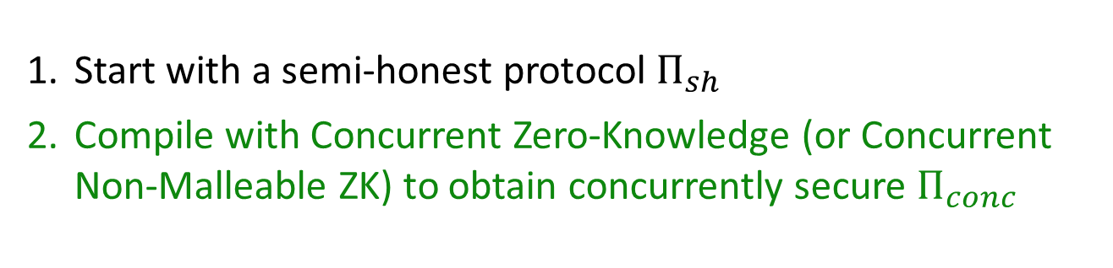



Apply GMW Paradigm to Concurrent Setting?
Many cZK protocols known
[RK99,KP01,PRS02,...]
$$m_{A}$$
$$+ cZK$$
$$+ cZK$$
$$m_{B}$$
Why doesn’t this give concurrent self-composition for every function?
Start with a semi-honest protocol $Π_{sh}$
Compile with Concurrent Zero-Knowledge (or Concurrent Non-Malleable ZK) to obtain concurrently secure $Π_{conc}$

Slide 44






How Simulators Work
(Stand-Alone Setting)
Extract Adv’s input
Get output from trusted party
Continue simulation using the output
x
In Concurrent Setting, must extract Adv’s input in EVERY session
y
f(x,y)
S
$$m_{1}$$
$$m_{2}$$
$$m_{2}^{′}$$
y
$$m_{3}$$
$$m_{3}^{′}$$
$$m_{4}$$
y

Slide 45
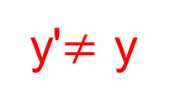
Core Problem of Concurrent Self-Composition
[Lindell04]
outer session
inner sessions
S
A
y
y'$≠$ y
S must compute output for y’ to complete rewinding
How does S compute outputs for both y and y’ ?
(can only make ONE query to trusted party)
A controls scheduling of messages across
different sessions

Slide 46
Core Problem of Concurrent Self-Composition (contd.)
Key to a positive result lies in overcoming this problem
Note: For ZK “like” functions, there is no problem
More generally, GMW paradigm already works for functions where:
  Adv has no input or
  Adv does not get any output
Impossibility results for other functions
[Lindell04,BPS06,AGJPS12,GKOV12]

Slide 47


Multiple Ideal Query (MIQ) Model
[Goyal-J-Ostrovsky10]
f(x,y₁)
f(x,y₂)
x
y₁
y₂
S

Slide 48
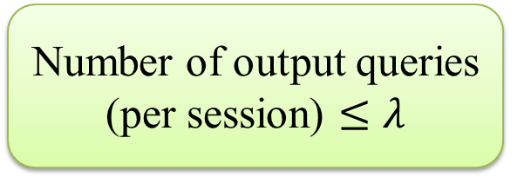
λ - Output Security
Number of output queries (per session) $≤λ$
f(x,y_{i})
x
y_{i}
S

Slide 49
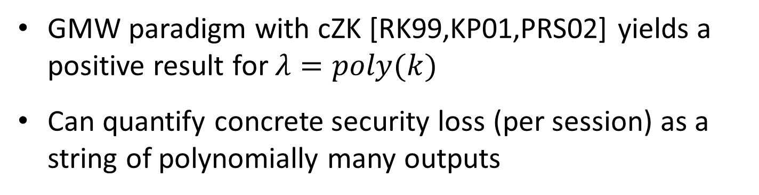
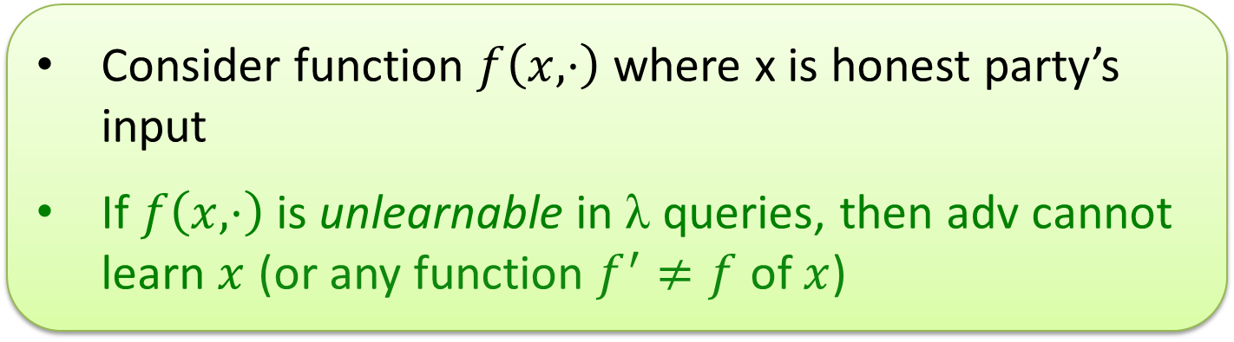
Achieving Positive Result in MIQ Model
GMW paradigm with cZK [RK99,KP01,PRS02] yields a positive result for $λ=poly(k)$
Can quantify concrete security loss (per session) as a string of polynomially many outputs
Consider function $f\left(x,⋅\right)$ where x is honest party’s input
If $f\left(x,⋅\right)$ is unlearnable in λ queries, then adv cannot learn $x$ (or any function $f^{′}≠f$ of $x$)

Slide 50

Have we done anything interesting?

Slide 51
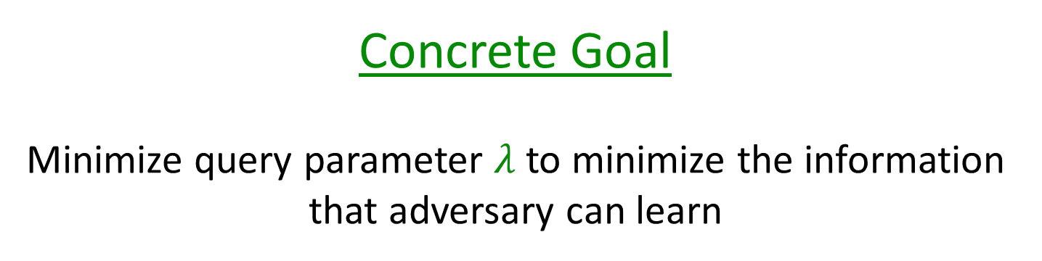
Concrete Goal
Minimize query parameter $λ$ to minimize the information that adversary can learn

Slide 52
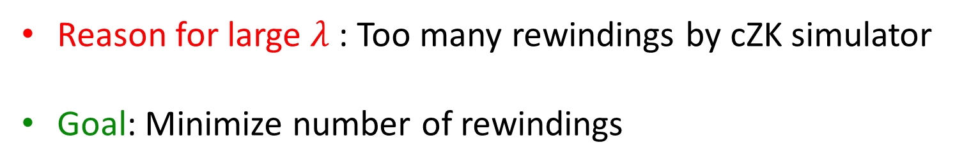
Improving Security Loss
Reason for large $λ$ : Too many rewindings by cZK simulator
Goal: Minimize number of rewindings

Slide 53
Standard Rewinding Strategies
[RK99,KP01,PRS02]

Slide 54
What we want
Precise Simulation [Micali-Pass06]

Slide 55
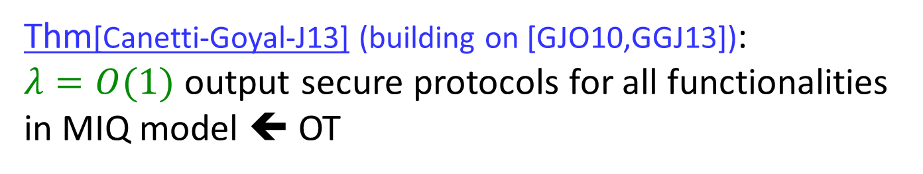
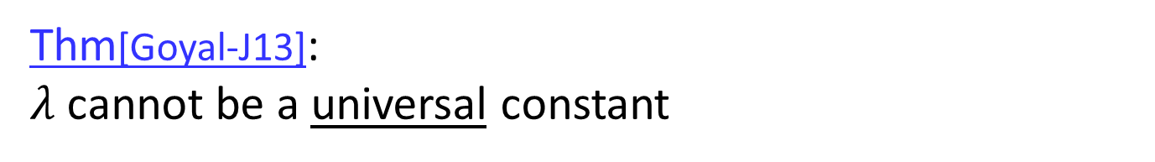
Upper Bound
Thm[Canetti-Goyal-J13] (building on [GJO10,GGJ13]):
$λ=O(1)$ output secure protocols for all functionalities in MIQ model ⬅ OT
Constant is adversary dependant
Precise Simulation via (approximate) set covering
Lower Bound
Thm[Goyal-J13]:
$λ$ cannot be a universal constant

Slide 56
What Next?
Can we precisely quantify what information a concurrent adversary can always learn for any functionality
  Some progress [GGJ13]
Understanding Composition

Slide 57


So far, all feasibility results focus on:
Design the most “robust” MPC protocols
secure when run w/ arbitrary, potentially unknown, protocols

Slide 58
But… what happens to these OTHER protocols?
Could robust MPC protocols
hurt security of other, potentially unknown, protocols?
They might, want Environmental Friendliness [CLP13]

Slide 59
Next phase of composition?
So far, composition as a feature and an end
Successful!
Composition as an operator (or family of op’s)?
Focused on design specific protocols that composes
More conditions?
Go beyond, remove specific protocols.
Under what conditions that composition works?
E.g., hybrid argument,
complexity leveling, short v.s. long,
black-box provable v.s. black-box unprovable
More operators?

Slide 60
Thank You

