Slide 1
Products of Functions, Graphs, Games & Problems
Irit Dinur
Weizmann

Slide 2
Products
Why would anyone want to multiply two functions ?
graphs ?
problems ?
For fun: to “see what happens”
For “Hardness Amplification”
(holy grail = prove that things are hard)
Given f that is a little hard
construct f’ that is very hard
Circuit complexity, average case complexity, communication complexity,
Hardness of approximation

Slide 3
Products
Why would anyone want to multiply two functions ?
graphs ?
problems ?
For fun: to “see what happens”
For “Hardness Amplification”
(holy grail = prove that things are hard)
Given f that is a little hard
construct f’ that is very hard
Circuit complexity, average case complexity, communication complexity,
Hardness of approximation
By taking
f’ = f x f x … x f

Slide 4
P₁ x P₂
We can multiply many different objects
Numbers
Strings
Functions
Graphs
Games
Computational Problems

Slide 5
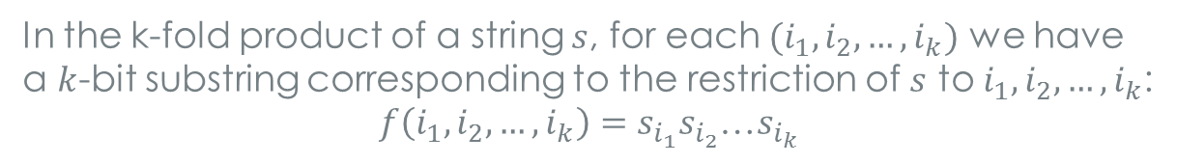
Direct Products of Strings / Functions
For example, here is how to multiply two strings:
0 | 1 | 1 | 0 | 1 | 1
1
1
0
1
1
0
10 | 11 | 11 | 10 | 11 | 11
10 | 11 | 11 | 10 | 11 | 11
00 | 01 | 01 | 00 | 01 | 01
10 | 11 | 11 | 10 | 11 | 11
10 | 11 | 11 | 10 | 11 | 11
00 | 01 | 01 | 00 | 01 | 01
In the k-fold product of a string $s$, for each $(i_{1},i_{2},…,i_{k})$ we have a $k$-bit substring corresponding to the restriction of $s$ to $i_{1},i_{2},…,i_{k}$:
$f\left(i_{1},i_{2},…,i_{k}\right)=s_{i_{1}}s_{i_{2}}$…$s_{i_{k}}$
Notes:
For example, here is how to “multiply” two strings, by concatenation
Here, the table is easier to grasp than the notation,
but the notation wins when we move to k-fold products or to multiplying more complicated objects
Also observe that strings = (finite) functions, so we know how to multiply those too.

Slide 6
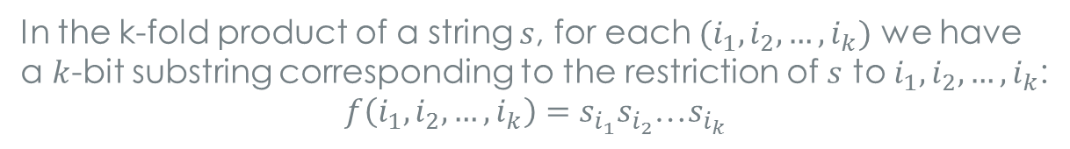

Direct Products of Strings / Functions
For example, here is how to multiply two strings:
0 | 1 | 1 | 0 | 1 | 1
1
1
0
1
1
0
10 | 11 | 11 | 10 | 11 | 11
10 | 11 | 11 | 10 | 11 | 11
00 | 01 | 01 | 00 | 01 | 01
10 | 11 | 11 | 10 | 11 | 11
10 | 11 | 11 | 10 | 11 | 11
00 | 01 | 01 | 00 | 01 | 01
sum
In the k-fold product of a string $s$, for each $(i_{1},i_{2},…,i_{k})$ we have a $k$-bit substring corresponding to the restriction of $s$ to $i_{1},i_{2},…,i_{k}$:
$f\left(i_{1},i_{2},…,i_{k}\right)=s_{i_{1}}s_{i_{2}}$…$s_{i_{k}}$
$s_{i_{1}}{+ s}_{i_{2}}+$…${+ s}_{i_{k}}$
(the alphabet stays the same, but harder to analyze)

Slide 7
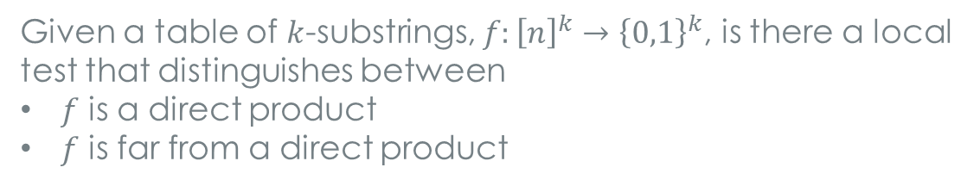
Testing Direct Products
Given a table of $k$-substrings, $f:{\left[n\right]}^{k}→{\left\{0,1\right\}}^{k}$, is there a local test that distinguishes between
$f$ is a direct product
$f$ is far from a direct product
In [GGR] terms: is the property of being a direct product locally testable ?
(answer: yes, with 2 queries)
Notes:
This question might appear esoteric, but actually it lies at the heart of many questions about products, including the parallel repetition theorem, and other graph product questions.

Slide 8



Local to Global
Given: a very large and difficult problem (e.g. 3sat)
We will solve it together, by splitting the work into many small sub-problems, each of (constant) size $k$
On average, the local value is > $val$
On average, consistent with > $cons$ fraction of neighbors
Question: is there a consistent global solution with value > $gval$
$k$-sub-problem

Slide 9
Local to Global
Given: a very large and difficult problem (e.g. 3sat)
We will solve it together, by splitting the work into many small sub-problems, each of (constant) size $k$
On average, the local value is > $val$
On average, consistent with > $cons$ fraction of neighbors
Question: is there a consistent global solution with value > $gval$
How does $gval$depend on $cons$ and on $val$ and on $k$ ?
What is the dependence on the “graph topology” ?
(i.e. which pairs of neighbors are being compared)
Notes:
Related to “property testing” in that local views are to imply a global phenomenon;
But, here it is a “distributed computing” question, but where each “agent” is autonomous to do what they please, and the correlation is through a joint global “goal” or “problem”

Slide 10
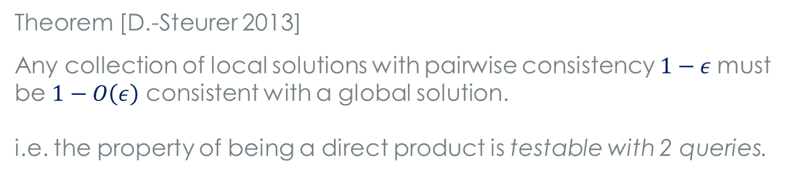
Testing Direct Products
[Goldreich-Safra,D.-Reingold, D.-Goldenberg, Impagliazzo-Kabanets-Wigderson]
Theorem [D.-Steurer 2013]
Any collection of local solutions with pairwise consistency $1−ε$must be $1−O\left(ε\right)$ consistent with a global solution.
i.e. the property of being a direct product is testable with 2 queries.
Theorem [David-D.-Goldenberg-Kindler-Shinkar 2013]
The property of being a direct sum is testable with 3 queries.
k-substring
Notes:
Design question: what are good graph topologies?
Currently understand the “full” graph, and one other “plane-vs.-plane” graph, and that’s it!

Slide 11
Multiplying Graphs
There are several natural graph products
In the “strong direct product”:
V(G₁ x G₂) = V(G₁) x V(G₂)
u₁u₂ ~ v₁v₂ iff u₁~v₁ and u₂ ~ v₂
( u ~ v means u=v or u is adjacent to v )
1
2
3
11
12
13
1
2
21
22
23
3
31
32
33
Notes:
Graph products have been well-studied
Strong –DP : Move from u₁u₂ to v₁v₂ by stepping along an edges in at least one coordinate
For example: Given a graph G1 with max-clique k1 and G2 with maxclique k2, what is the size of the maxclique of G1xG2 ?
Sometimes the answer is easy: k1 x k2
Not always.
In some situations, the best solution isn’t necessarily of product type.

Slide 12
Multiplying Graphs
Basic question: how do natural graph properties
(such as: chromatic number, max-clique, expansion, …)
Behave wrt the product operation
If clique ( G₁ ) = m₁ and clique ( G₂ ) = m₂
then clique ( G₁ x G₂ ) = m₁m₂
If independent-set ( G₁ ) = m₁ and independent-set ( G₂ ) = m₂
then independent-set ( G₁ x G₂ ) = ?
Generally, the answer is easy if the maximizing solution is itself a product,
but often this is not true. Then, the analysis is challenging

Slide 13
Definition : The Shannon capacity of G
is the limit of ( a(G^{k}) )^{1/k} as k → infty [Shannon 1956]
a(G) – stands for maximum independent set
Consider a transmission scheme of one symbol at a time, and draw a graph with an edge between each pair of symbols that might be confusable in transmission.
a(G) = number of symbols transmittable with zero error
a(G^{k}) = set of such words of length k
(a(G^{k}))^{1/k} = effective alphabet size
Lovasz 1979 computed the Shannon capacity of several graphs, e.g. C₅, by introducing the theta function
C₇ is still open – (one of the most notorious problems in extremal combinatorics)
Notes:
Detour – Shannon Capacity

Slide 14
Multiplying Games
Notes:
Define game
Constraint graph

Slide 15

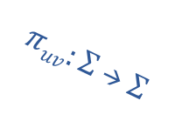

Games (2-player 1-round)
U
V
Alice
u
Bob
$$πuv:Σ → Σ$$
$$A :U → Σ$$
…
…
$$B : V → Σ$$
v
Referee: random u ← v
u
v
Alice
Bob
A(u)
B(v)
Notes:
A game is specified by a bi-partite graph, whose edges are “decorated” with constraints. AKA constraint graph.
The semantics are as follows:
The referee chooses a random edge uv,
sends u to Alice and v to Bob,
they reply with answers and win if constraint is happy.
Optimal: Alice has a (deterministic) function A, Bob B

Slide 16
Games (2-player 1-round)
U
V
Alice
u
Bob
$$πuv:Σ → Σ$$
$$A :U → Σ$$
…
…
$$B : V → Σ$$
v
Value ( G ) = maximal success probability, over all possible strategies
Notes:
“ Given a game, find its value “ = a basic optimization problem called LABEL-COVER, that turns out to be fundamental in the study of
Hardness of approximation
It captures an important gap between local and global solutions:
The problem is defined locally (every constraint is between a small number of bits of the solution)
And finding a local solution is easy
But, finding the entire (“global”) solution is hard
PCP: this tension can be pushed further: hard to find a solution that looks good even on an “average local view”.
Satisfying an average local view is as hard as satisfying the entire system

Slide 17
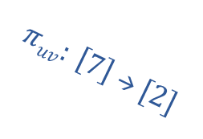
Games (2-player 1-round)
U
The 3SAT game
V
Alice
u
Bob
U = set of variables
$$πuv: \left[7\right] → [2]$$
V = set of 3sat clauses
…
…
v
FGLSS
Value ( G ) = maximal success probability, over all possible strategies
Label-Cover Problem : Given a game G, find value ( G )
Strong PCP Theorem: Label Cover is NP-hard to approximate
[AS, ALMSS 1991] + [Raz 1995]
Notes:
FGLSS – Feige Goldwasser Lovasz Safra Szegedy

Slide 18


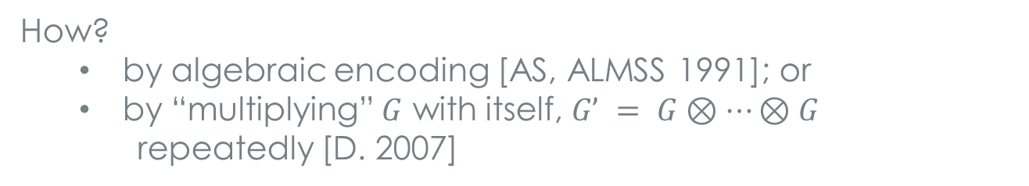

The PCP Theorem [AS, ALMSS]
PCP theorem: “gap-3SAT is NP-hard”
Proof: By reduction from small gap to large gap,
aka amplification
Start with $G$ and end up with $G’$, s.t.
If $val(G) = 1$then $val(G’) = 1$
If $val(G) < 1$then $val(G’)< ½$
How?
by algebraic encoding [AS, ALMSS 1991]; or
by “multiplying” $G$ with itself, $G’ = G⊗⋯⊗G$
repeatedly [D. 2007]

Slide 19
Multiplying Games
A game is specified by its constraint-graph,
so a product of two games can be defined by a product of
two constraint graphs
Notes:
Define game
Constraint graph

Slide 20
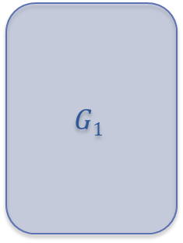
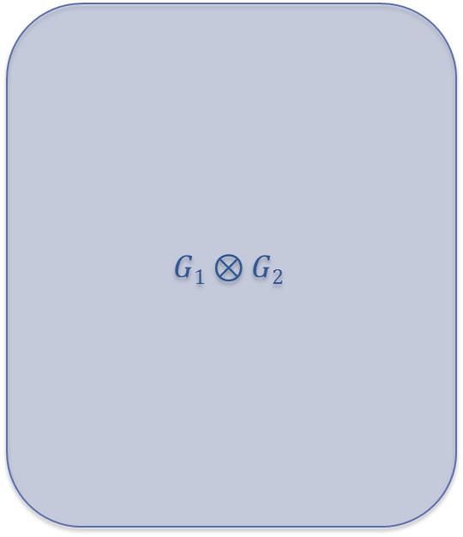

$$G1$$
$$G2$$
X
=
$$G1⊗G2$$
Notes:
Define game
Constraint graph

Slide 21
U₁
V₁
U₂
V₂
u₁
X
u₂
=
Π₁: Σ₁→ Σ₁
Π₂: Σ₂→ Σ₂
…
…
…
…
v₁
v₂
$$G1⊗G2$$
Notes:
Define game
Constraint graph

Slide 22
U₁
V₁
U₂
V₂
u₁
X
u₂
=
Π₁: Σ₁→ Σ₁
Π₂: Σ₂→ Σ₂
…
…
…
…
v₁
v₂
U₁ x U₂
V₁ x V₂
Alice
Bob
u₁u₂
A : U₁ x U₂ → Σ₁ x Σ₂
B : V₁ x V₂ → Σ₁ x Σ₂
…
Π₁ Π₂
…
v₁v₂
Notes:
Define game
Constraint graph

Slide 23
k-fold product of a game
U x … x U
V x … x V
Alice
u₁u₂…u_{k}
Bob
A : U^{k} → Σ^{k}
B : V^{k} → Σ^{k}
…
Π₁ Π₂ … Π_{k}
…
v₁v₂…v_{k}
Also called: the k-fold parallel repetition of a game
Notes:
K-fold parallel repetition – semantics:
Referee chooses k independent random edges u1v1 … ukvk
Sends in parallel u1…uk to Alice and v1..vk to Bob
Receives k answers from each player, and accepts if all constraints accept

Slide 24


Q1: If $value ( G1 ) =α1$and $value ( G2 ) =α2$
then what is $value ( G1⊗G2 )$?
Q2: If $value ( G ) =α$, then what is $value ( G^{⊗k} )$for $k > 1$ ?
One obvious candidate is the direct product strategy.
But it is not, in general, the best strategy.
Notes:
Q2: conjectured to go down to zero with k, proven by verbitsky, then FK, then
Raz proved an exponential bound on val(G^k) and this is the celebrated parallel repetition theorem
Q1: [D.-Steurer] is, I think, the first to give bounds on this question (for collision-value)

Slide 25
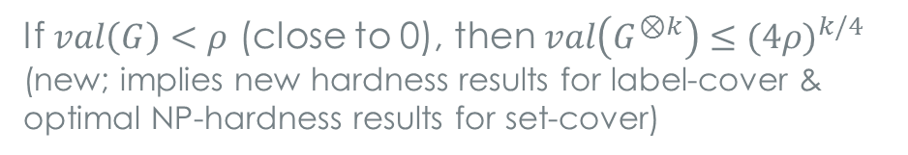
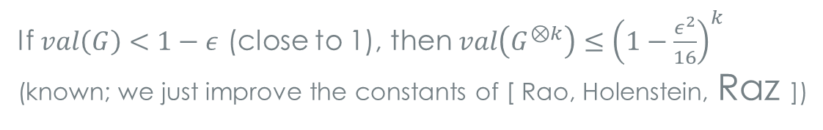
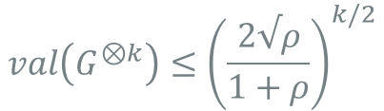
Theorem [D.-Steurer 2013]: Let $G$ be a projection game.
If $val\left(G\right)<ρ,$then
$$val\left(G^{⊗k}\right)≤{\left(\frac{2√ρ}{1+ρ}\right)}^{k/2}$$
BGLR “sliding scale”conjecture
If $val\left(G\right)<ρ$ (close to 0), then $val\left(G^{⊗k}\right)≤{(4ρ)}^{k/4}$
(new; implies new hardness results for label-cover &
optimal NP-hardness results for set-cover)
If $val\left(G\right)<1−ε$ (close to 1), then $val\left(G^{⊗k}\right)≤{\left(1−\frac{ε^{2}}{16}\right)}^{k}$
(known; we just improve the constants of [ Rao, Holenstein, Raz ])
Also: short proof for “strong PCP theorem” or “hardness of label-cover”
Ideas extend to give a parallel repetition theorem for entangled games, i.e. when the two players share a quantum state [with Vidick & Steurer]
Notes:
BGLR – Bellare Goldwasser Russel Lund

Slide 26

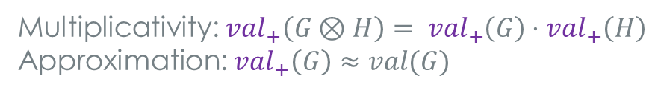
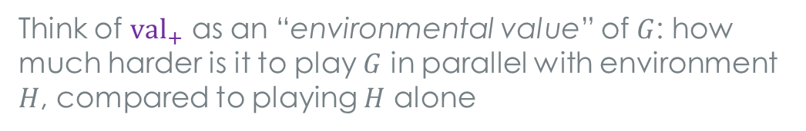
One slide about the new proof
1. View a game as a linear operator acting on (Bob)-assignments
The game value $≈$ a natural norm of this operator
$${val}_{+}\left(G\right)≔\sup_{H}{\frac{|\left|G⊗H\right||}{\left|\left|H\right|\right|} }$$
2. Define:
( $\left|\left|G\right|\right|$ is the collision value of $G$, closely related to $val(G)$ )
Think of ${val}_{+}$ as an “environmental value” of $G$: how much harder is it to play $G$ in parallel with environment $H$, compared to playing $H$ alone
3. Show:
Multiplicativity: $val_{+}\left(G⊗H\right)= {val}_{+}\left(G\right)⋅val_{+}\left(H\right)$
Approximation: $val_{+}\left(G\right)≈val(G)$
So: $val\left(G^{⊗k}\right)≈val_{+}\left(G^{⊗k}\right)= val_{+}{\left(G\right)}^{k}≈val{\left(G\right)}^{k}$
Approximation is proven by expressing $val_{+}$ as an “eigenvalue”, enabled by factoring out H; easy for expanders
Notes:
Express the game as a linear operator, strategies as functions on the label extended graph
Remark: this def of val+ is not the one we really use in the paper for proving approximation (rather, in the paper we use a vector relaxation definition that equals this one)

Slide 27
Summary
Direct product of strings & functions
and a related local-to-global lifting theorem
Direct product of games
and new parallel repetition theorem
Direct products of computational problems ??
e.g. for graph problems (max-cut, vertex-cover, ... )

