Slide 1
On Doubly-Efficient Interactive Proof Systems
Oded Goldreich
Weizmann Institute of Science
Notes:
Having turned sixty in February, I now belong to the elders. So I may be pardoned for promoting a good old vision, and arguing that it is still relevant, and maybe even more relevant than before.
But apologies come first...

Slide 2
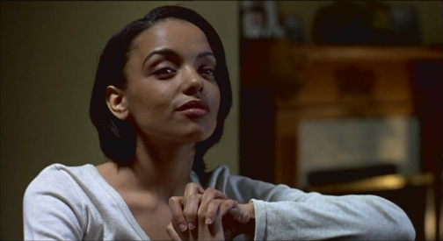
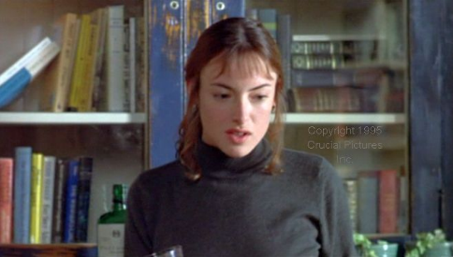
Interactive Proof Systems [GMR]
Prover Verifier
I love you (and you love me too)
What would we do, as friends?
Have fun.
Fun - sounds like a buddy movie.
Yes, exactly. Like Thelma and Louise. But... without the guns.
Oh, well, no guns, I don't know...
Petra Camille (not Venus)
“When Night is falling” (Canada, 1995).
Notes:
When Night is Falling (CA 1995): Petra and Camille (not Venus). The claim is “I love you (and you love me)”. And they interact throughout the movie to prove it.

Slide 3
Interactive Proof Systems [GMR]
Prover Verifier
X (common input)
THM [LFKN,S]: IP = PSPACE
Computationally unbounded
PPT
Completeness: If X is in the set, then the verifier always accepts (under a suitable prover strategy)
Soundness: If X is not in the set, then the verifier rejects w.p. at least ½, no matter what strategy the (cheating) prover employs.
THM [LFKN,S]: Every set in PSPACE has an interactive proof system.
Notes:
Interactive proof systems (for claims of membership). The IP=PSPACE Thm has overshadowed the notion and the existence of natural questions. In particular, Petra is NOT computationally unbounded – can interactive proof systems help her?

Slide 4
Doubly-Efficient Interactive Proof Systems [GKR]
Prover Verifier
X (common input)
Prescribed prover is PPT
Almost linear time
(or just o(deciding)).
Completeness: If X is in the set and the prover follows the prescribed strategy, then the verifier always accepts .
Soundness: If X is not in the set, then the verifier reject w.p. at least ½, no matter what strategy the (cheating) prover employs.
N.B.: As before; that is, soundness hold wrt computationally unbounded cheaters!
Notes:
N.B.: Soundness is information theoretic as before (as opposed to computational-soundness). You may hear of computationally-sound proof in the Friday workshop.

Slide 5
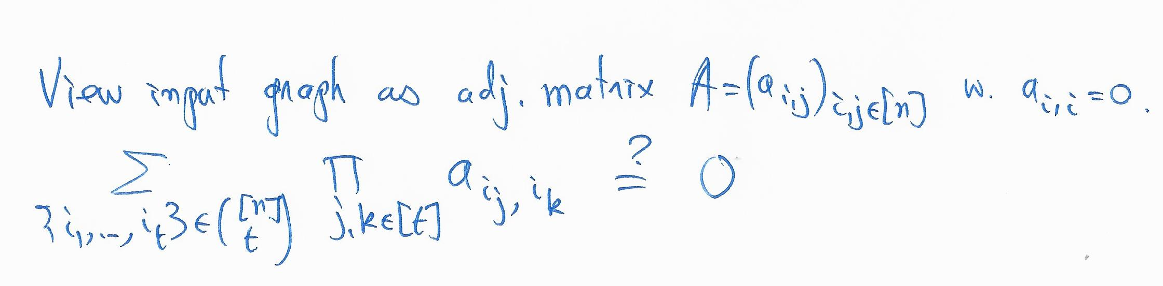
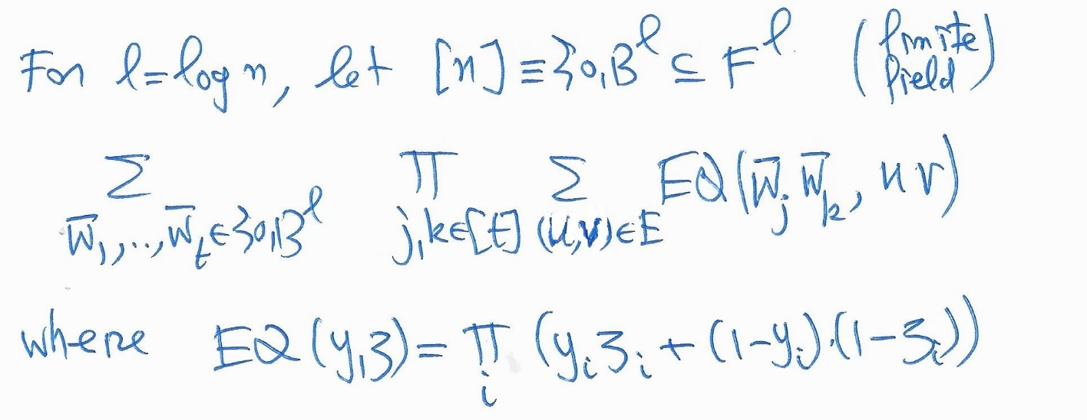
Simple doubly-Efficient Interactive Proof Systems
Ex 1: In some cases, (almost linear-time verifiable) NP-witnesses can be found in polynomial-time (e.g., perfect matching, primality, t-Clique for constant t>2).
Ex 2 [GR17]: no-t-Clique for constant t>2.
EQ Is a poly of indiv-deg. t²
|F| > 2^{l}
Apply the sum-check protocol.
Verify the residual.
Notes:
Ex1 “goes back” to discussions with Silvio and Shafi in 1985. Our favorite examples at the time were computational problems in permutation groups (and strong generating sets). There is a typo in the slide: a_{I,i} should be set to 1, not to 0.

Slide 6
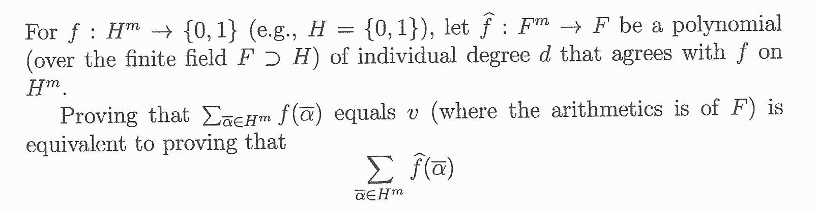
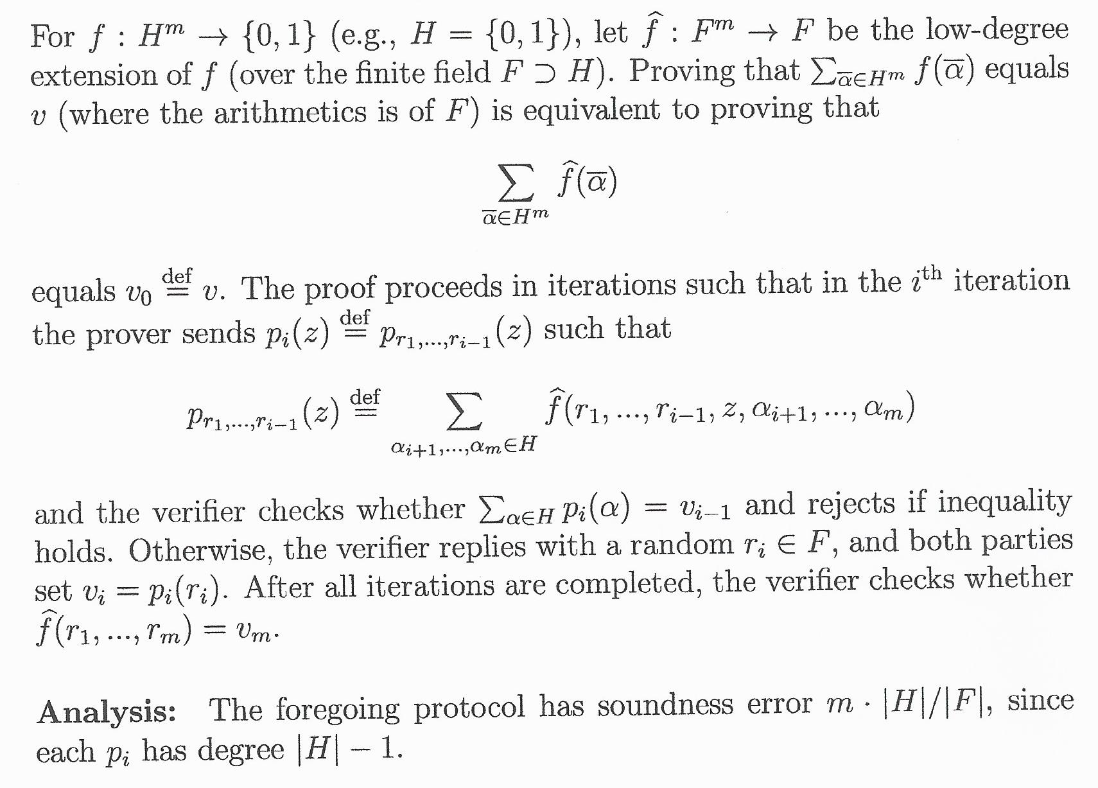
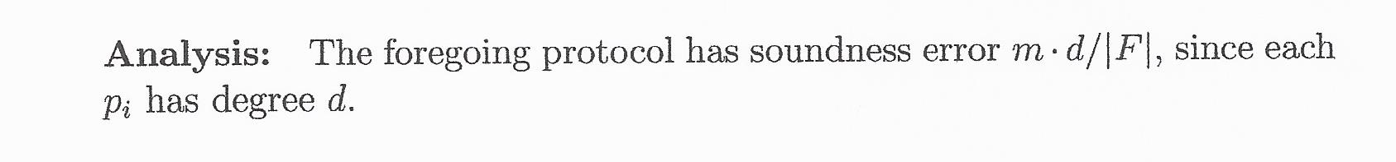
The Sum-Check Protocol [LFKN]
m-variate polynomial of individual degree |H|-1
univariate polynomial of degree |H|-1
Evaluate the polynomial at a single point.
Notes:
Lund-Fortnow-Karloff-Nisam (1990).

Slide 7
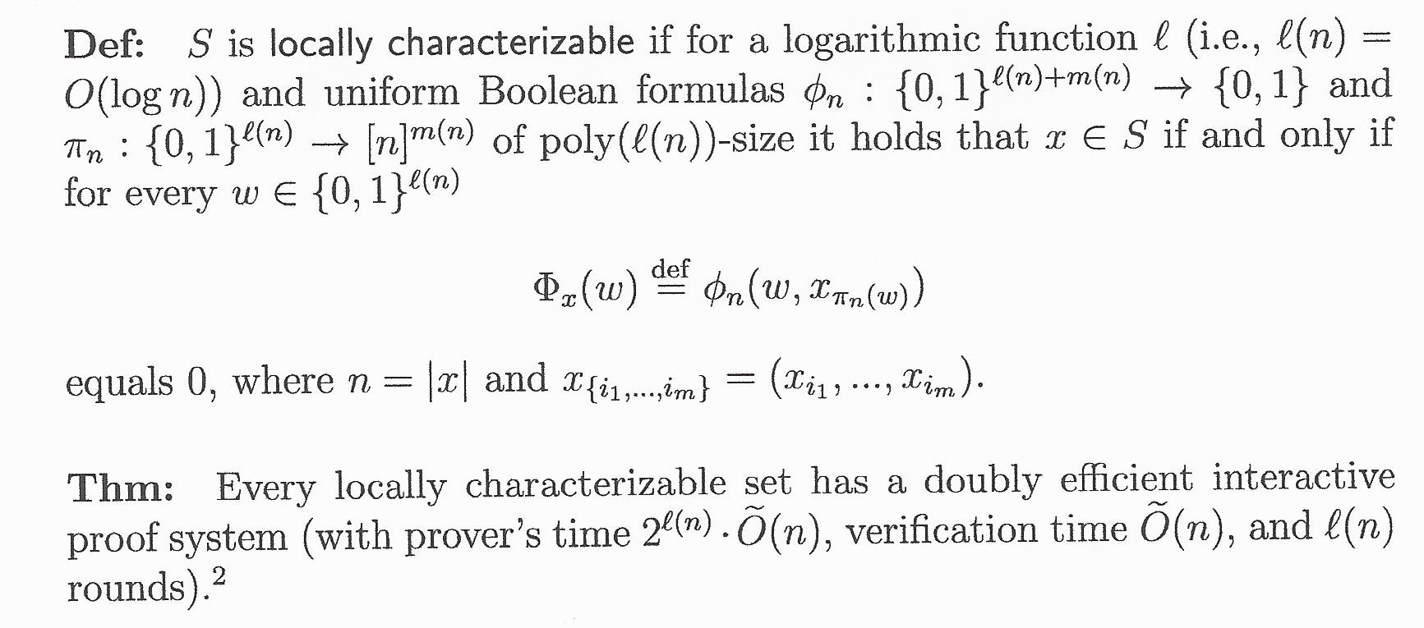
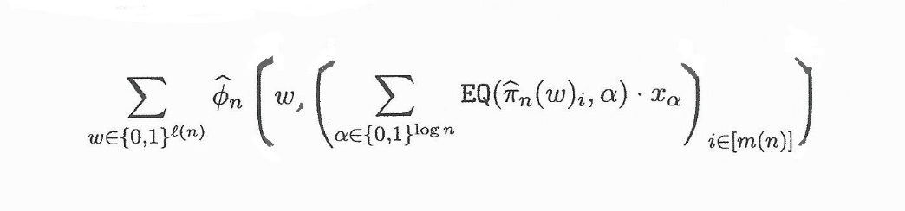
Simple doubly-Efficient IPs for Local. Char. Sets [GR17]
In case of no-t-Clique,
φ_{n}(i₁,…,i_{t}) = ∏_{j,k} x_{i_j,i_k}
View π_{n}(w)_{i} ∈ [n] as a (log n)-long binary sequence. Consider the (log n) corresp. low-deg polys over F.
Proof Idea: For a finite field F, consider low degree ``extensions’’ of the Boolean formulas.
EQ is the “equality” polynomial of the penultimate slide.
All polys have small Arithmetic formulas.
Apply the Sum Check to the sum over w.
Notes:
Having small formulas implies having low degree and being easy to evaluate. Now, apply the Sum-Check protocol.
Note that the verifier needs to evalue \phi_n at one point, which is dominated by the computation of the internal sum of $n$ terms.

Slide 8
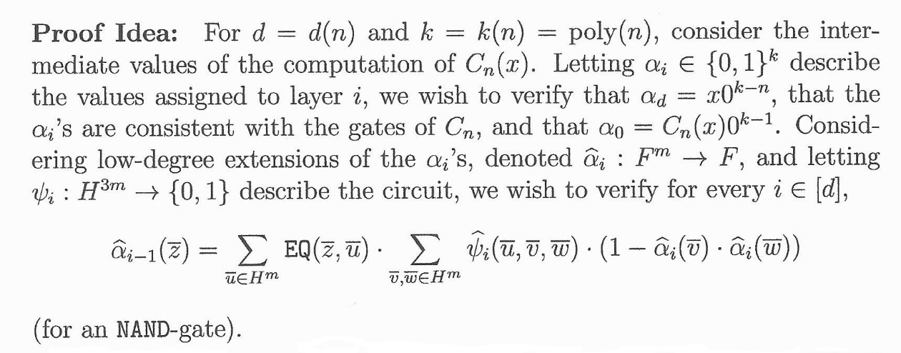
Doubly-Efficient IPs for log-space uniform NC [GKR]
THM: Every set in log-space uniform NC has a doubly efficient interactive proof system. For depth d(n), we get d(n)⋅poly(log n) rounds.
Can easily verify the first and last conditions.
Verify at random point by using the Sum-Check Protocol. Problems: After the Sum-Check we need to
evaluate Ψ_{i} in almost linear time.
evaluate α_{i} on two points.
∧
k = |H|^{m} with |H|=log n
∧
Notes:
Now, apply the Sum-Check protocol: The verification of the value of alpha_{i-1} at $r_{i-1}$ is reduced to verifying the value of alpha_i at some new random point.

Slide 9
Doubly-Efficient (constant-round) IPs for SC [RRR]
THM: Every set in SC has a doubly efficient interactive proof system with constant number of rounds. Ditto for TimeSpace(poly,n^{0.5}).
One of the proof ideas: Batch verification; that is, verifying t claims at cost of o(t) verifications. Used to reduce the verification of the existence of a L-long path to the existence of t paths, each of length=L/t.
A sanity check: Possible if you don’t care of prover time (via IP=PSPACE).
Warm-up: Batch verification for UP (i.e., NP with unique witnesses).
 | Single instance | t=t(n) instances
Prover time | p(n) | t(n) ⋅ p(n)
Verification time | v(n) | t(n)^{1/O(1)} ⋅ v(n) + t(n)
Communication | c(n) | t(n)^{1/O(1)} ⋅ c(n) + t(n)
Notes:
Re the warm-up: It is relatively easy only when compared to the needed batching of IPs…

Slide 10
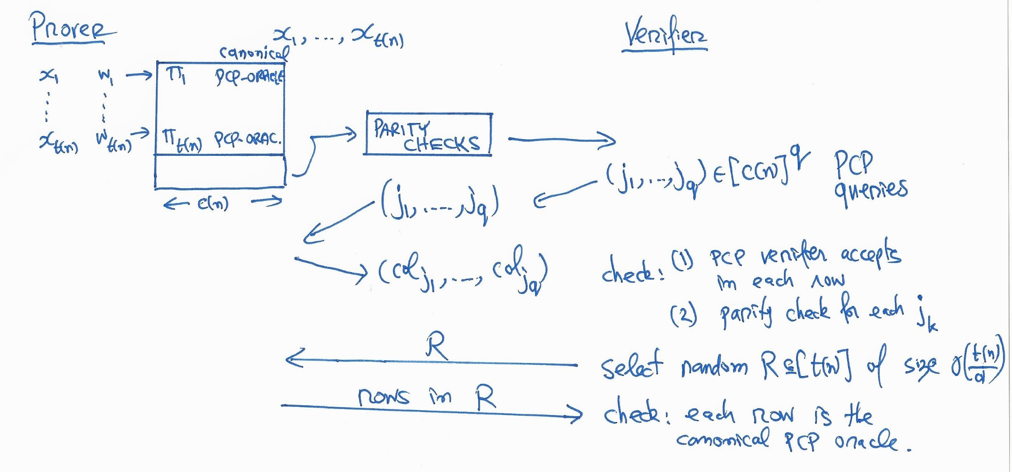
Batch verification for UP [RRR]
For d = t(n)^{1/2} and d’ = d log n, consider the parity check F:{0,1}^{t(n)} →{0,1}^{d’} such that for each v, each Hamming ball of radius d contains at most one pre-image of v under F.
*) input-oblivious queries, recognizable canonical proofs.
Notes:
N.B.: The decision is input-dependent, the queries are not. The canonical proof contains the unique witness.

Slide 11
Wider Perspective: the source of proofs
Proofs do not fall out of thin air.
Setting 1: The prover’s on-line work (de-IP, reviewed here).
Setting 2: Provided by the (high-level) application/user + PPT. E.g., NP-witness provided to a prover in a zero-knowledge system.
Setting 3: Constructed in PPT with oracle access to deciding.
⇒ Different notions of relatively efficient provers. They deserve further study.
“A Taxonomy of Proof Systems” (1995).
Notes:
Sec 2.1.3 “How efficient should the prover be?” In Complexity Theory Retrospective II

Slide 12
END
Related papers available at
http://www.wisdom.weizmann.ac.il/~oded/de-ip.html
Notes:
links

