Slide 1
On Environmental Security
A tribute to Ran Canetti on his 60th B-day
Oded Goldreich
Weizmann Institute of Science

Slide 2
What is ingenuity?
Ingenuity is discovering something that, in retrospect, is self-evident.
Q: Why do idiots think the opposite?
That is, why do they confuse the a posteriori appeal of the discovery, which is reflected in its becoming fully-internalized to the level of becoming invisible (or self-evident) once understood,
with the a priori evasiveness of and opposition to the discovery?
A: Because they are idiots!

Slide 3
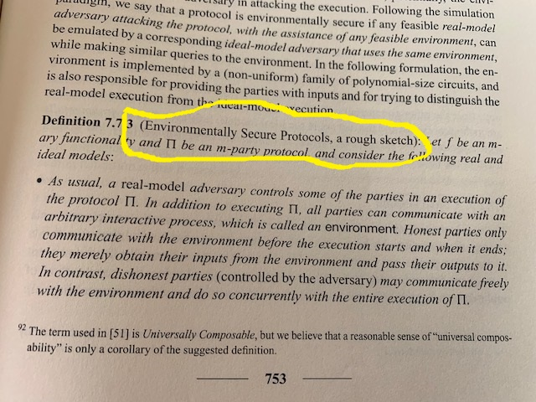
The term “environmental security” was not invented for the current occasion
FoC, Vol 2, 2004 .
FN92 reads: The term used in [51] is Universal Composability, but we believe that a reasonable sense of “universal composability” is only a corollary of the suggested definition.

Slide 4
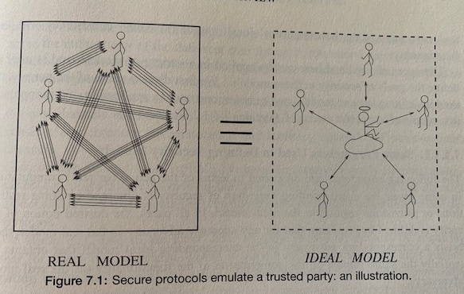
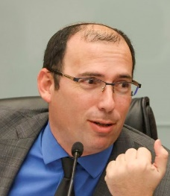
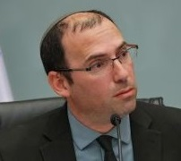
Secure MPC (stand-alone)
For every (feasible) real-model adversary that attacks the protocol, there exists a (feasible) ideal-model adversary that attacks the functionality and obtains (essentially) the same effect.
Hence, perceived weaknesses of the protocol are actually due to the functionality; that is, the protocol itself has no additional weaknesses.
Notes:
For every real-model adversary that attacks the protocol, there exists an ideal-model adversary that attacks the functionality and obtains the same effect.

Slide 5
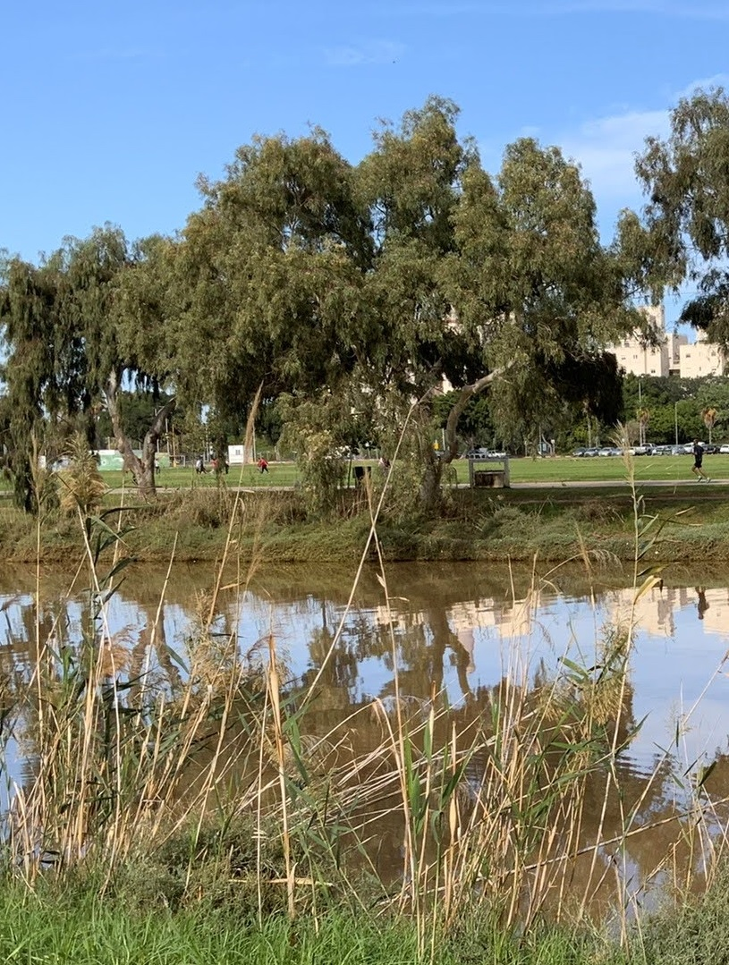

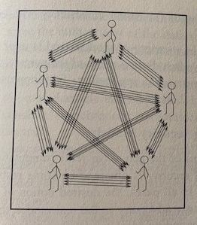
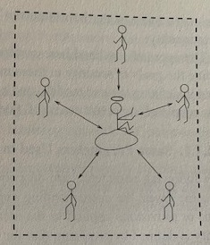

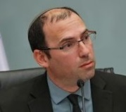
Environmental Security
Notes:
For every real-model adversary that attacks the protocol, there exists an ideal-model adversary that attacks the functionality and gets the same effect *in any environment*.
The ingenious idea is that the external environment can be modeled by a feasible oracle that both adversaries access.

Slide 6
Environmental Security
Pivotal idea: Provide the adversaries with an oracle
that performs an arbitrary polynomial-time computation.
Balances considerations (or a priori critiques):
An oracle will allow the adversary to break any complexity-based cryptography.
What’s the point of giving oracle access to an efficient computation?
The point is that both adversaries are given the same oracle.
Plugging this in the real-vs-ideal simulation paradigm:
For every real model adversary A there exists an ideal model adversary B such that, for every efficient oracle Z, whatever harm A can do in reality when given oracle access to Z, can be done by B in the ideal world when given oracle access to Z.
Notes:
For every real-model adversary that attacks the protocol, there exists an ideal-model adversary that attacks the functionality and gets the same effect *in any environment*.
The ingenious idea is that the external environment can be modeled by a feasible oracle that both adversaries access.

Slide 7
Environ.-Security implies general concurrent composition
Suppose A attacks t concurrent executions of the protocol П, which computes the functionality F in an environmentally-secure manner.
Decompose into a single-session adversary A’ and a coordinator A’’.
Let B’ be an ideal-model adversary that simulates A’ (wrt env.-sec.).
Replace the t copies of (A’,П) by t copies of (B’,F).
Hybrids: The i^{th} hybrid uses i copies of (A’,П) and t-i of (B’,F).
Indistinguishability of i-1st and i^{th} hybrids follows by considering the environment that emulates i-1 copies of (A’,П) and t-i copies of (B’,F), where the i^{th} copy is the actual execution to be distinguished.

Slide 8
Digest: main message
I can stop here. The most important points were made.
Environmental security is ingenious and great.
The pivotal idea is to consider oracle access
to an arbitrary efficient computation.
N.B.: A fixed (efficient oracle) machine (i.e., ∃) is given access
to an oracle that is universally quantified (i.e., ∀) as efficient.
Lesson: The order ∃∀ is important
also when both objects come from the same domain.
- “We know this!” [Alternation]
- So why forget it when doing modeling?

Slide 9
An Example: Auxiliary inputs (a precursor)
Def: A strategy P is auxiliary-input ZK if for every efficient adversary A interactive with P, there exists an efficient simulator S such that,
for every main input x and auxiliary input z, it holds that
{(P,A(z))(x)}_{x,z} is computationally indistinguishable from {S(x,z)}_{x,z}
∀A∃S∀x,z
A bad simplification: every poly-sized adversary {A_{n}} interactive with P,
there exists a poly-sized simulator {S_{n}} such that, for every input x, it holds that
{(P,A_{n})(x)}_{x} is computationally indistinguishable from {S_{n}(x)}_{x}
∀A_{n}∃S_{n}∀x
Notes:
“practically injective” = negligible fraction of images have more than poly-many preimages.

Slide 10
An Example: Leonid Levin’s proposal
Conjecture (badly stated). Let f:{0,1}^{n} →{0,1}^{n} be a OWF,
and h be taken from a family of hashing functions
(from 2n bits to n bits, and description length m).
Then, F:{0,1}^{n+m} →{0,1}^{n+m} such that F(x,<h>)=(<h>,h(f(x),x))
is a OWF. [The point being that F is “practically injective”.]
Counterexample: Suppose h(yz)=h’(z) if f(z)=y and h’’(yz) otherwise.
Then h is a “good” hashing but F(x,<h>)=(<h’,h’’>,h’(x)) is easy to invert.
∀f,h∃F
Conjecture (better stated (+ replacing hashing by randomness extractor)).
F^{f}:{0,1}^{n+m} →{0,1}^{n+m} such that F^{f}(x,s)=(s,E_{s}(f(x),x)) is a OWF.
∃F,E∀f
Notes:
“practically injective” = negligible fraction of images have more than poly-many preimages.

Slide 11
The term “environmental security” was not invented for the current occasion
FoC, Vol 2, 2004 .
FN92 reads: The term used in [51] is Universal Composability, but we believe that a reasonable sense of “universal composability” is only a corollary of the suggested definition.

