Slide 1

When Can Limited Randomness
Be Used in Repeated Games?
Moni Naor
Weizmann Institute of Science
Joint work with Pavel Hubáček and Jon Ullman
Columbia University

Slide 2
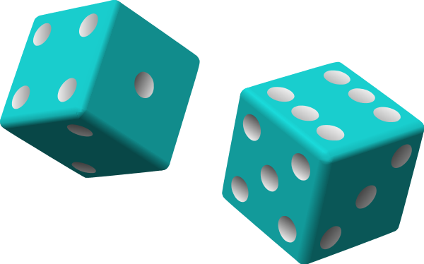
Randomness in Algorithms
Using Randomness is extremely useful:
Algorithms
  Faster algorithms: MCMC
  Simpler design
Combinatorial constructions
Distributed computing
Cryptography
But before that:
randomness in games!
Important question:
Do we actually need randomness and how much?

Slide 3
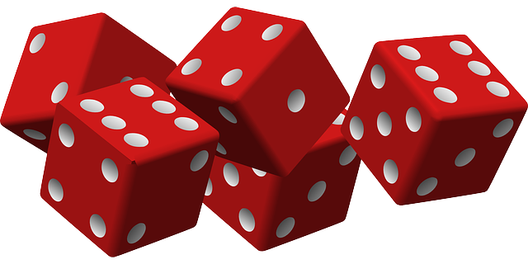
Randomness in Equilibria
Randomness facilitates equilibria in single-shot games:
  2-player 0-sum games (von Neumann 1928)
  finite strategic games (Nash 1951)
  correlated randomness (Aumann 1976)
What importance has randomness in repeated games?
What about parallel games?

Slide 4

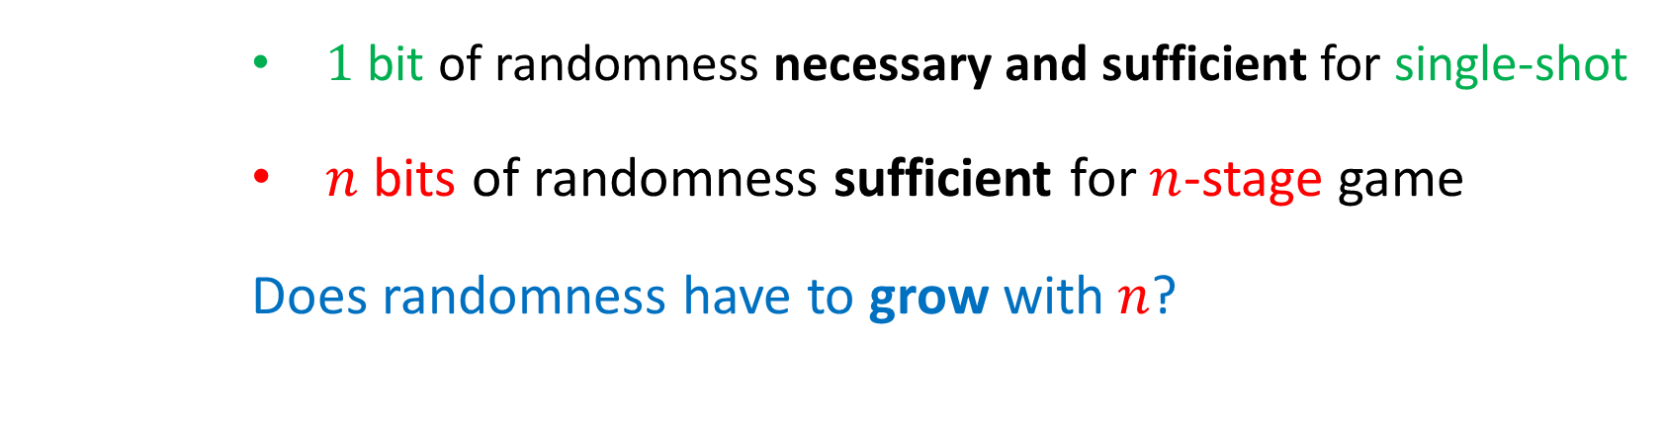
Randomness in Finitely Repeated Games
 | Heads | Tails
heads | 1, -1 | -1, 1
tails | -1, 1 | 1, -1
$1$ bit of randomness necessary and sufficient for single-shot
$n$ bits of randomness sufficient for $n$-stage game
Does randomness have to grow with$n$?

Slide 5
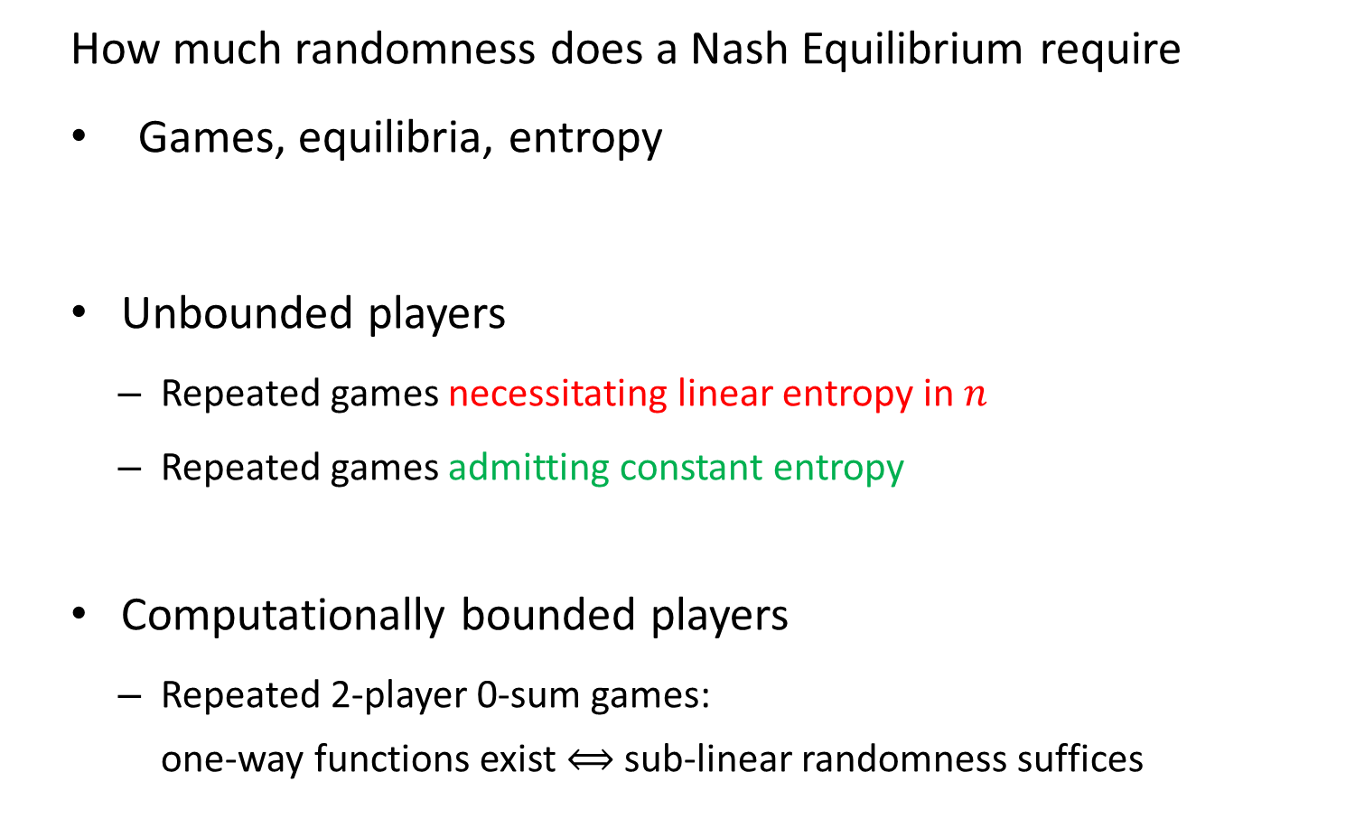
Talk Plan
How much randomness does a Nash Equilibrium require
Games, equilibria, entropy
Unbounded players
  Repeated games necessitating linear entropy in $n$
  Repeated games admitting constant entropy
Computationally bounded players
  Repeated 2-player 0-sum games:
  one-way functions exist $⟺$ sub-linear randomness suffices

Slide 6
Related Work
Neyman and Okada [GEB’00]:
  Strategic entropy in 2-player 0-sum games
Budinich and Fortnow [EC’11]:
  Limited randomness in repeated matching pennies
Halpern and Pass [JET’15]:
  Costly randomness in machine games
Halprin and Naor [SOUPS’09]:
  Randomness generated by human players

Slide 7
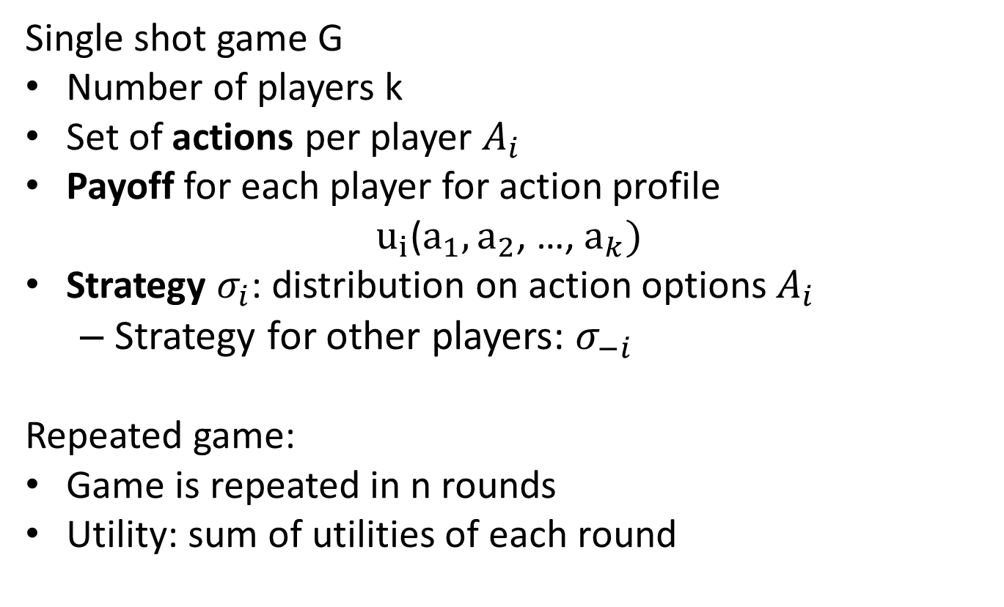
Game G
Single shot game G
Number of players k
Set of actions per player $A_{i}$
Payoff for each player for action profile
$u_{i}$($a_{1}, a_{2}$, …, $a_{k})$
Strategy $σ_{i}$: distribution on action options $A_{i}$
  Strategy for other players: $σ_{−i}$
Repeated game:
Game is repeated in n rounds
Utility: sum of utilities of each round

Slide 8

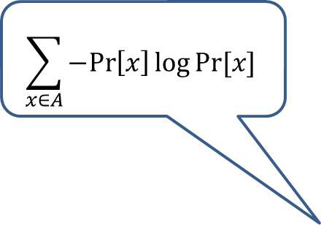








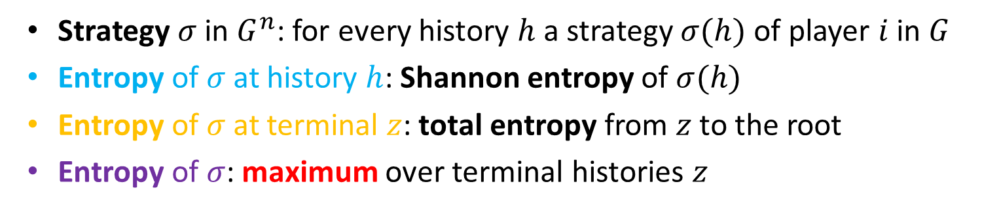
Entropy of Strategy
$$ε$$
$$σ(ε)$$
$$h′$$
$$σ(h′)$$
$$…$$
$$…$$
$$h$$
$$σ(h)$$
$$\sum_{x∈A}{−Pr\left[x\right]\log{Pr⁡[x]}}$$
$$z$$
Strategy $σ$ in $G^{n}$: for every history $h$ a strategy $σ(h)$ of player $i$ in $G$
Entropy of $σ$ at history $h$: Shannon entropy of $σ(h)$
Entropy of $σ$ at terminal $z$: total entropy from $z$ to the root
Entropy of $σ$: maximum over terminal histories $z$

Slide 9

Nash Equilibrium
Set of strategies where no player can profit from deviating.
$E\left[u_{i}\left(σ_{i},σ_{−i}\right)\right]≥E\left[u_{i}\left({σ^{′}}_{i},σ_{−i}\right)\right]$for all ${σ′}_{i}$

Slide 10
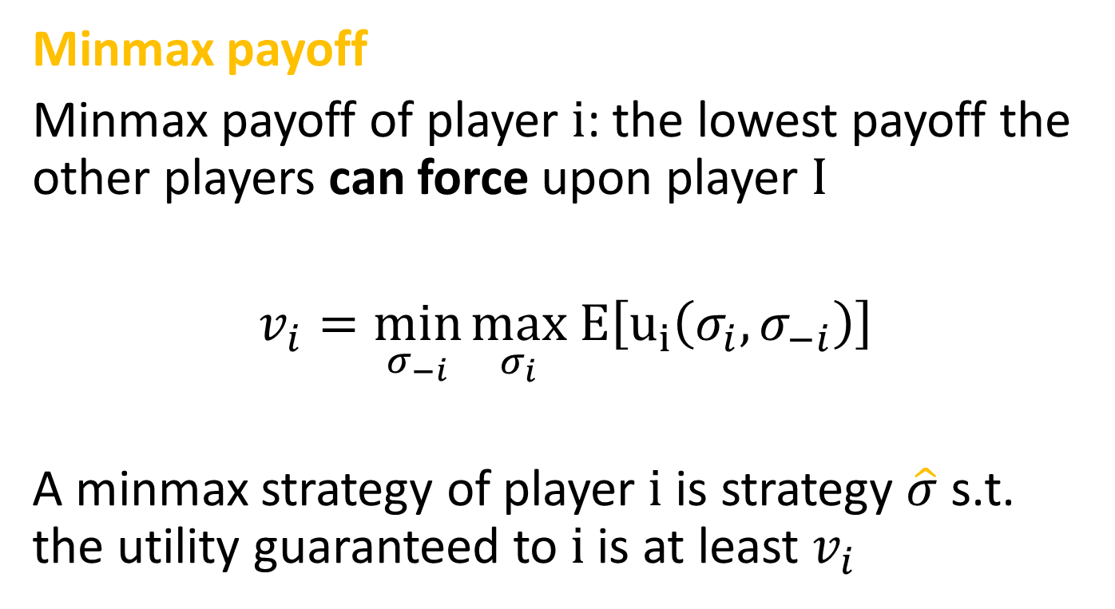
Enforceable Payoff
Minmax payoff
Minmax payoff of player i: the lowest payoff the other players can force upon player I
$v_{i}=\min_{σ_{−i}}{\max_{σ_{i}} E\left[u_{i}\left(σ_{i},σ_{−i}\right)\right]}$
A minmax strategy of player i is strategy $\hat{σ}$ s.t. the utility guaranteed to i is at least $v_{i}$

Slide 11

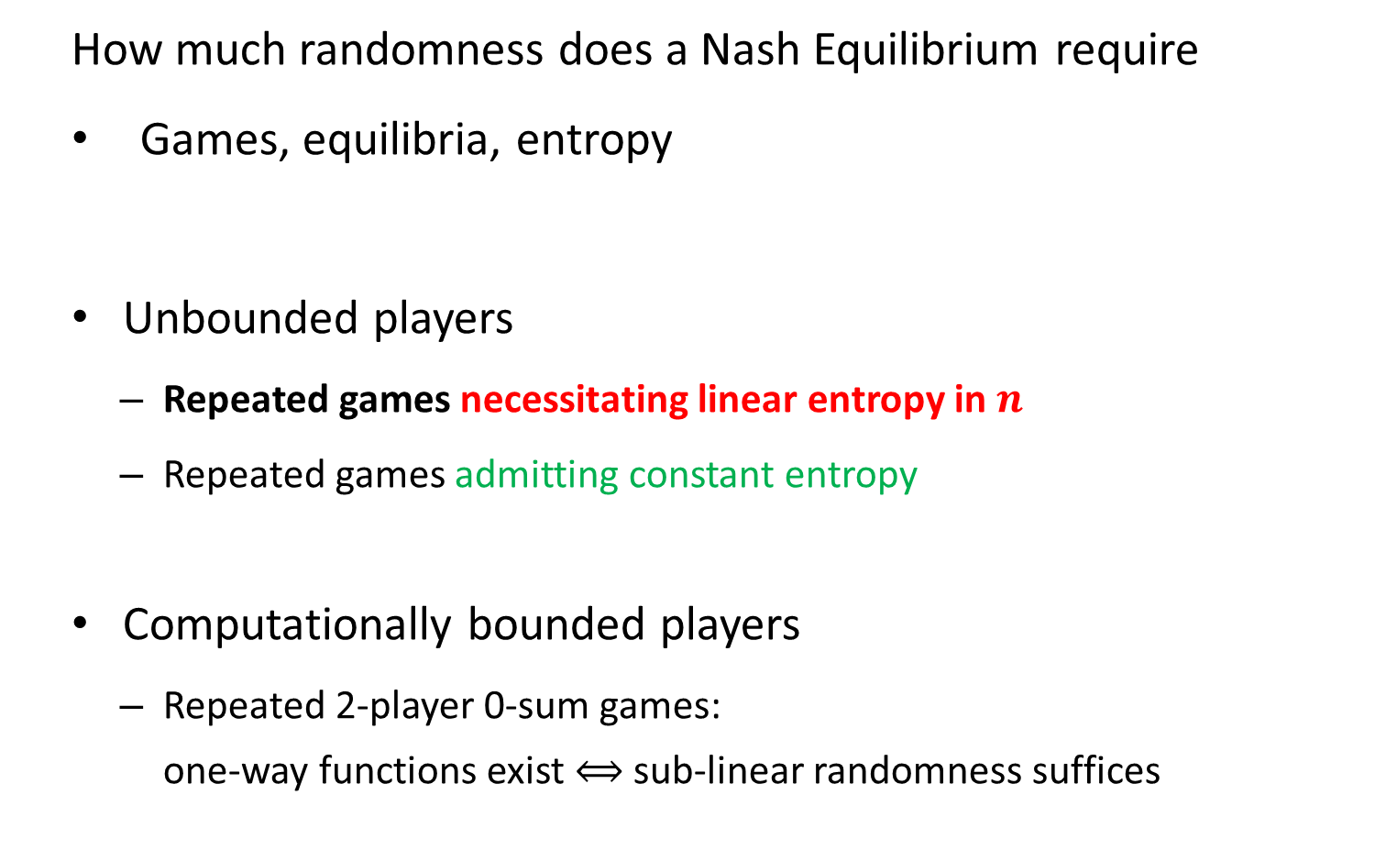
Talk Plan
How much randomness does a Nash Equilibrium require
Games, equilibria, entropy
Unbounded players
  Repeated games necessitating linear entropy in $n$
  Repeated games admitting constant entropy
Computationally bounded players
  Repeated 2-player 0-sum games:
  one-way functions exist $⟺$ sub-linear randomness suffices

Slide 12
Games with Linear entropy

Slide 13
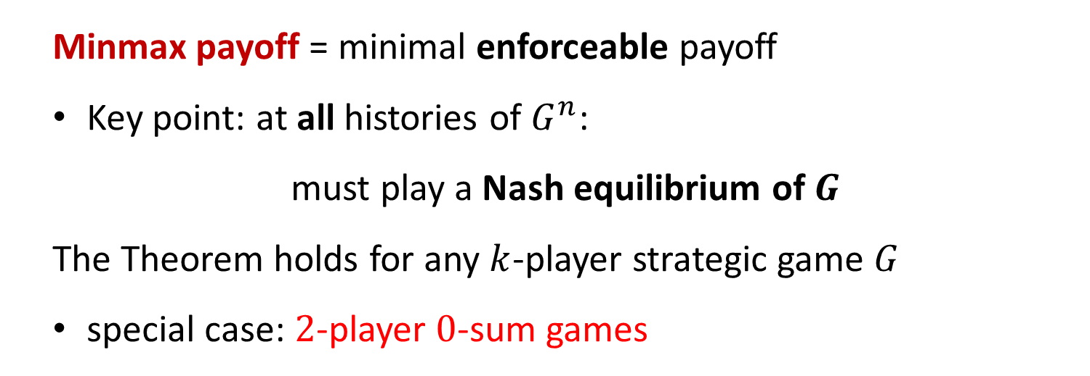
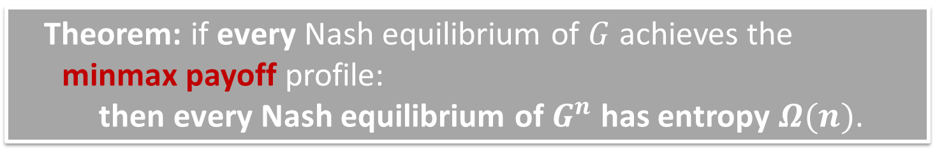
Repeated Games with Linear Entropy
Theorem: if every Nash equilibrium of $G$ achieves the minmax payoff profile:
then every Nash equilibrium of $G^{n}$ has entropy $Ω(n)$.
Minmax payoff = minimal enforceable payoff
Key point: at all histories of $G^{n}$:
must play a Nash equilibrium of $G$
The Theorem holds for any $k$-player strategic game $G$
special case: $2$-player $0$-sum games

Slide 14
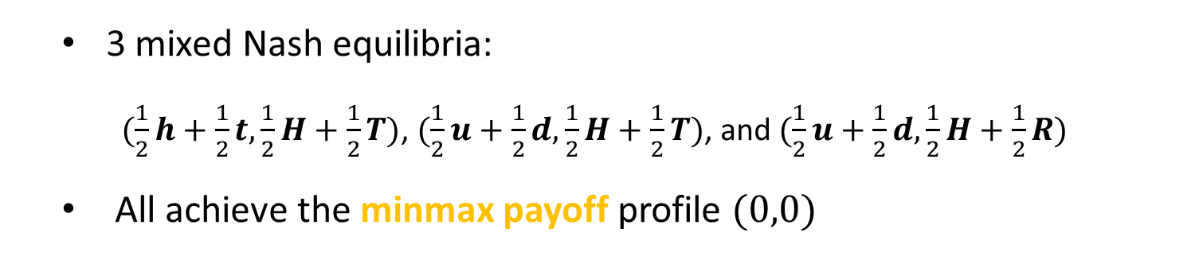
Non-0-Sum Game with Linear Entropy
 | Left | Heads | Tails | Right
up | 0, -1 | 0, -1 | 0, -1 | 0, 0
heads | 0, -1 | 1, -1 | -1, 1 | -1, 0
tails | 0, -1 | -1, 1 | 1, -1 | -1, 0
down | 0, 0 | -1, 1 | -1, 1 | 1, 0
Row can force 0
Column can force 0
3 mixed Nash equilibria:
  $(\frac{1}{2}h+\frac{1}{2}t,\frac{1}{2}H+\frac{1}{2}T)$, $(\frac{1}{2}u+\frac{1}{2}d,\frac{1}{2}H+\frac{1}{2}T)$, and $(\frac{1}{2}u+\frac{1}{2}d,\frac{1}{2}H+\frac{1}{2}R)$
All achieve the minmax payoff profile $(0,0)$

Slide 15
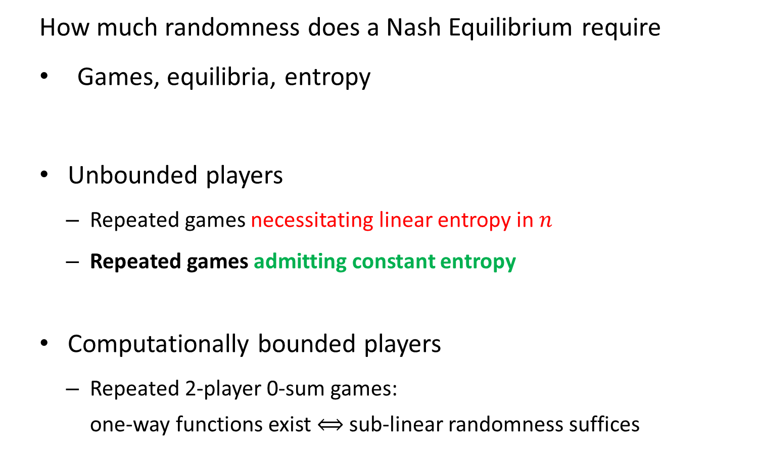
Talk Plan
How much randomness does a Nash Equilibrium require
Games, equilibria, entropy
Unbounded players
  Repeated games necessitating linear entropy in $n$
  Repeated games admitting constant entropy
Computationally bounded players
  Repeated 2-player 0-sum games:
  one-way functions exist $⟺$ sub-linear randomness suffices

Slide 16
Games with Constant entropy

Slide 17
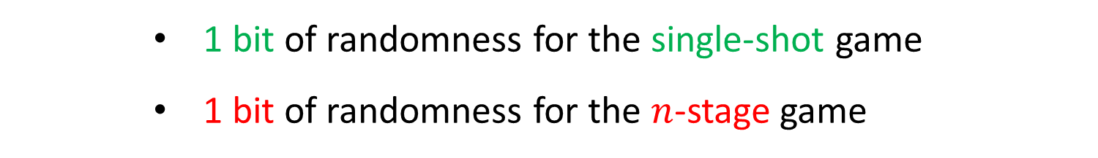
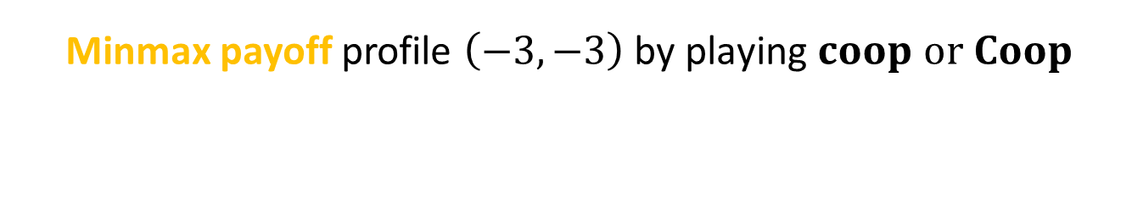
Repeated Game with Constant Entropy
 | Coop. | Heads | Tails | Punish
coop. | 3, 3 | -3, 6 | -3, 6 | -3, -3
heads | 6, -3 | 1, -1 | -1, 1 | -3, -3
tails | 6, -3 | -1, 1 | 1, -1 | -3, -3
punish | -3, -3 | -3, -3 | -3, -3 | -4, -4
Minmax payoff profile $\left(−3,−3\right) \text{by} \text{playing} coop or Coop$
1 bit of randomness for the single-shot game
1 bit of randomness for the $n$-stage game

Slide 18
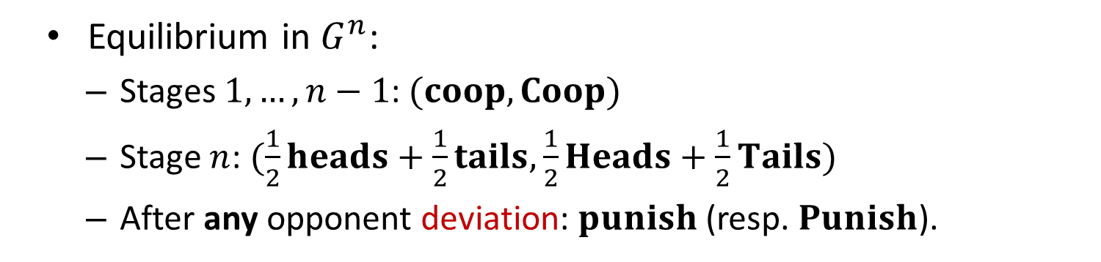
Repeated Game with Constant Entropy
 | Coop. | Heads | Tails | Punish
coop. | 3, 3 | -3, 6 | -3, 6 | -3, -3
heads | 6, -3 | 1, -1 | -1, 1 | -3, -3
tails | 6, -3 | -1, 1 | 1, -1 | -3, -3
punish | -3, -3 | -3, -3 | -3, -3 | -4, -4
Equilibrium in $G^{n}$:
  Stages $1,…,n−1$: $(coop,Coop)$
  Stage $n$: $(\frac{1}{2}heads+\frac{1}{2}tails,\frac{1}{2}Heads+\frac{1}{2}Tails)$
  After any opponent deviation: $punish$ (resp. $Punish$).
1 bit of entropy

Slide 19
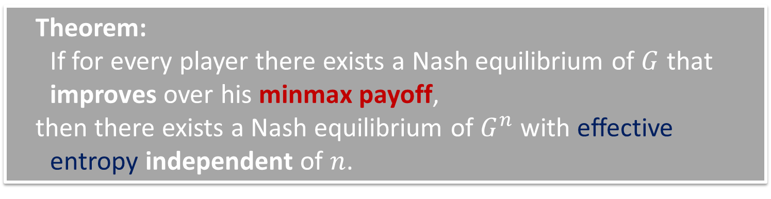
Repeated Games with Constant Entropy
Theorem:
If for every player there exists a Nash equilibrium of $G$ that improves over his minmax payoff,
then there exists a Nash equilibrium of $G^{n}$ with effective entropy independent of $n$.
Related to the finite horizon Folk Theorem
Effective entropy: the punishment might be randomized

Slide 20
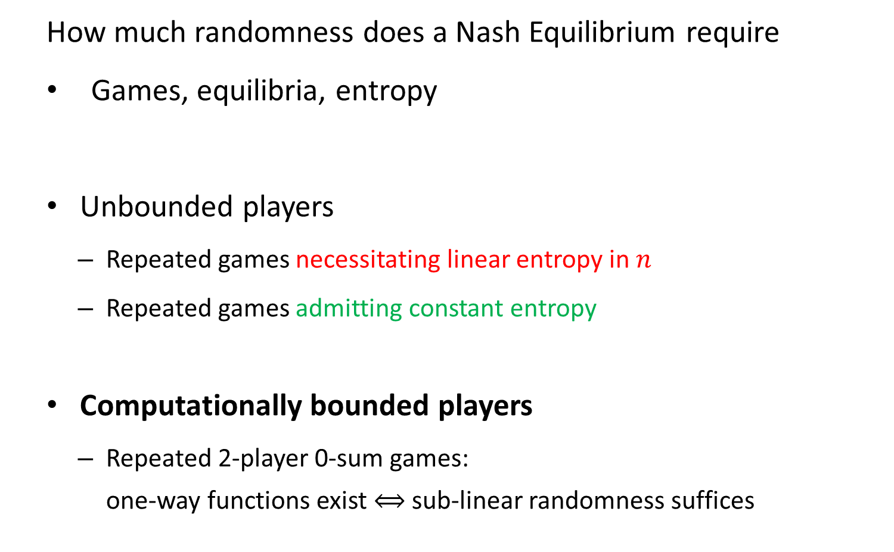
Talk Plan
How much randomness does a Nash Equilibrium require
Games, equilibria, entropy
Unbounded players
  Repeated games necessitating linear entropy in $n$
  Repeated games admitting constant entropy
Computationally bounded players
  Repeated 2-player 0-sum games:
  one-way functions exist $⟺$ sub-linear randomness suffices

Slide 21
Efficient players

Slide 22
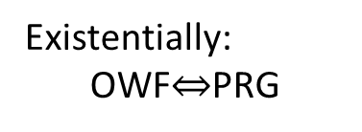
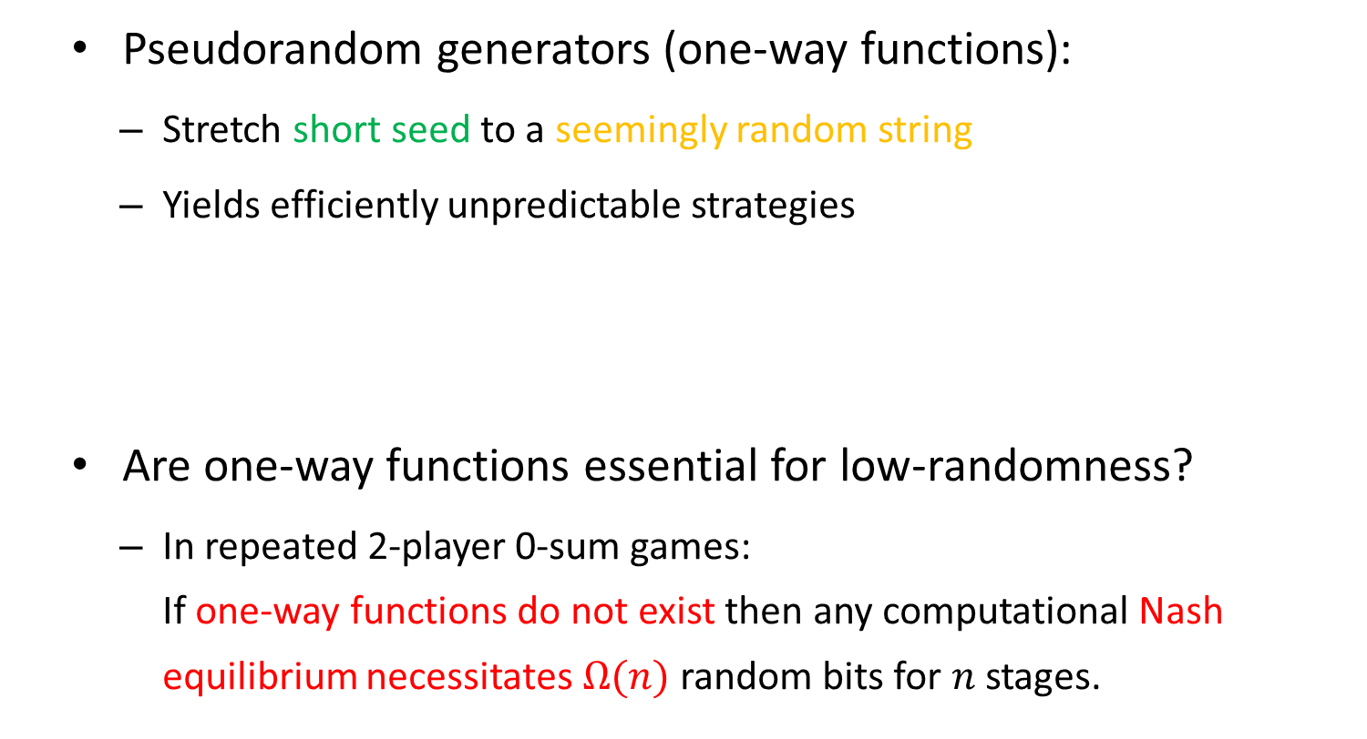

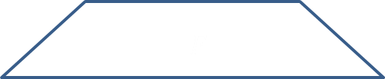


Computationally Bounded Players
Pseudorandom generators (one-way functions):
  Stretch short seed to a seemingly random string
  Yields efficiently unpredictable strategies
Are one-way functions essential for low-randomness?
  In repeated 2-player 0-sum games:
  If one-way functions do not exist then any computational Nash equilibrium necessitates $Ω(n)$ random bits for $n$ stages.
$$r$$
$$F$$
$$F$$
Existentially:
OWF$⇔$PRG
By Yao 82: notions are equivalent
$$F(r)$$

Slide 23
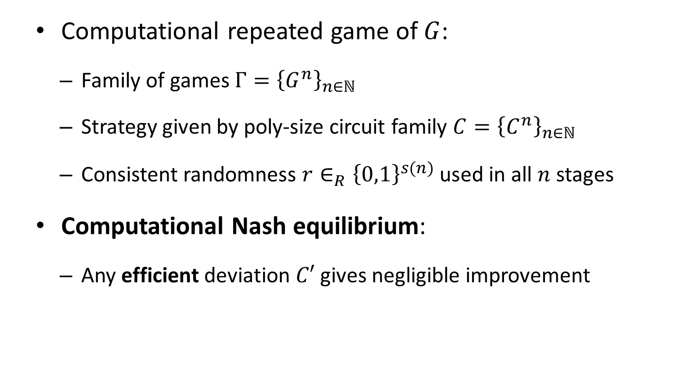
Computational Nash Equilibrium
[Dodis-Halevi-Rabin 2000]
Computational repeated game of $G$:
  Family of games $Γ={\left\{G^{n}\right\}}_{n∈ℕ}$
  Strategy given by poly-size circuit family ${C=\left\{C^{n}\right\}}_{n∈ℕ}$
  Consistent randomness $r∈_{R}{\left\{0,1\right\}}^{s(n)}$ used in all $n$ stages
Computational Nash equilibrium:
  Any efficient deviation $C′$ gives negligible improvement

Slide 24
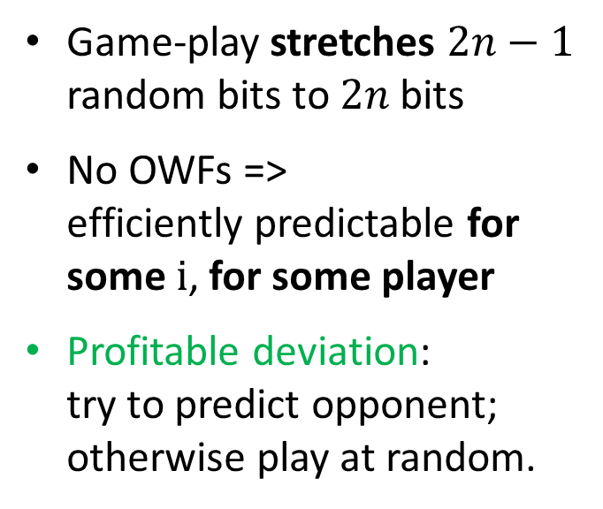





Repeated Matching Pennies
$$≤2n−1$$
Game-play stretches $2n−1$ random bits to $2n$ bits
No OWFs =>
efficiently predictable for some i, for some player
Profitable deviation:
try to predict opponent; otherwise play at random.
$$r_{a},r_{b}$$
$$(C_{a},C_{b})$$
$$\left(a_{1},b_{1}\right),…,\left(a_{n},b_{n}\right)$$
OWF
$$2n$$

Slide 25

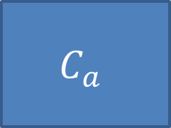

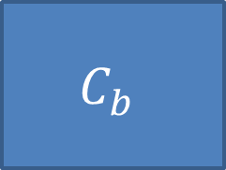



Repeated 2-player 0-Sum Games
$$r_{a}$$
$$C_{a}$$
$$a_{i+1}$$
$$∅,\left(a_{1},b_{1}\right),…,\left(a_{i},b_{i}\right)$$
$$C_{b}$$
$$b_{i+1}$$
$$r_{b}$$
Reduce predicting to learning adaptively changing distributions

Slide 26






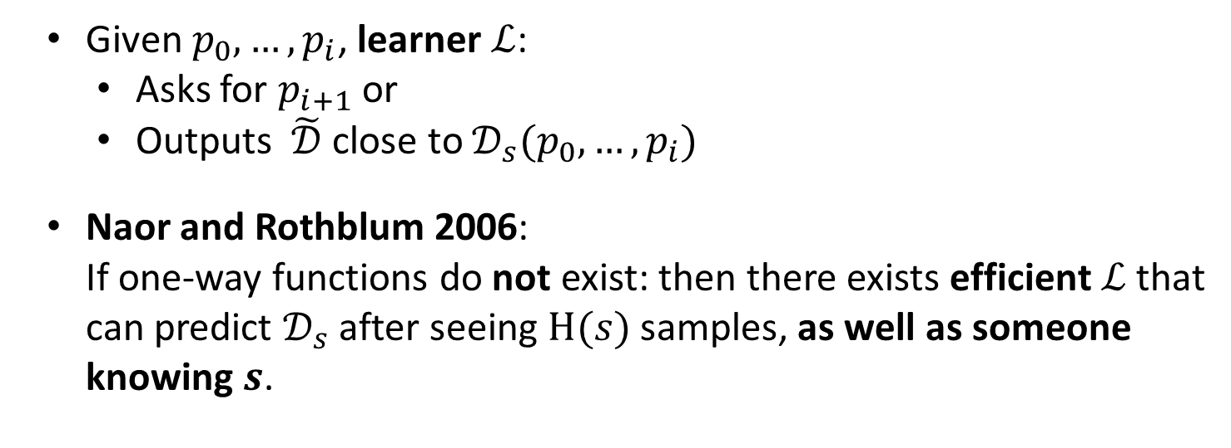
Learning Adaptively Changing Distributions
$$s$$
$$𝒟$$
$$p_{i+1}$$
$${p_{0},…,p}_{i}$$
$$ℒ$$
$$\tilde{𝒟}$$
Given $p_{0},…,p_{i}$, learner $ℒ$:
  Asks for $p_{i+1}$or
  Outputs $\tilde{𝒟}$ close to $𝒟_{s}(p_{0},…,p_{i})$
Naor and Rothblum 2006:
If one-way functions do not exist: then there exists efficient $ℒ$that can predict $𝒟_{s}$ after seeing $H(s)$ samples, as well as someone knowing $s$.

Slide 27
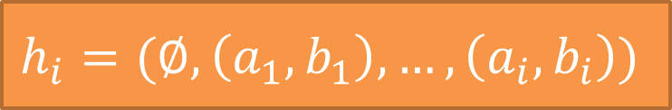
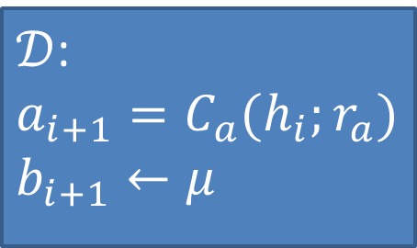




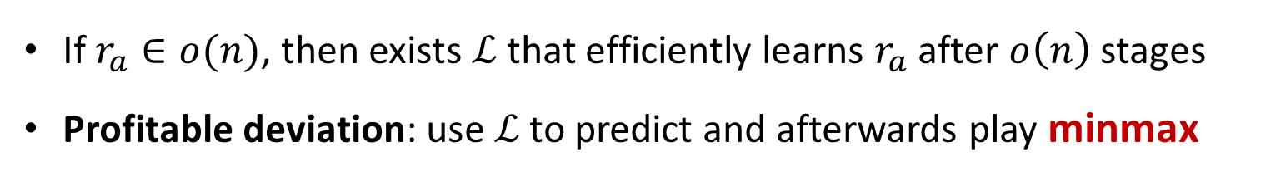
ACD for Game-Play
$$r_{a}$$
$𝒟$:
$$a_{i+1}=C_{a}(h_{i};r_{a})$$
$$b_{i+1}←μ$$
$$h_{i}||{(a}_{i+1},b_{i+1})$$
$$h_{i}=(∅,\left(a_{1},b_{1}\right),…,\left(a_{i},b_{i}\right))$$
$$ℒ$$
$$\tilde{𝒟}$$
If $r_{a}∈o(n)$, then exists $ℒ$ that efficiently learns $r_{a}$ after $o\left(n\right)$ stages
Profitable deviation: use $ℒ$ to predict and afterwards play minmax

Slide 28
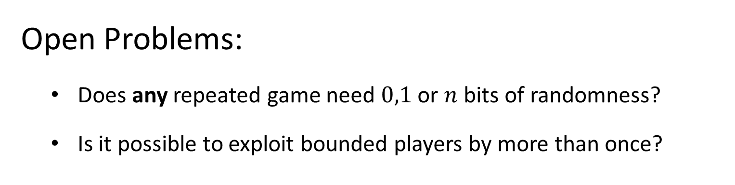
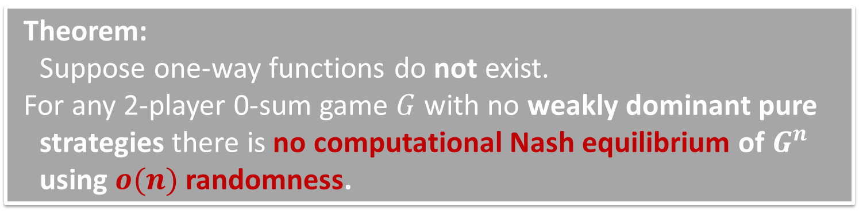
Repeated 2-Player 0-Sum Games
Theorem:
Suppose one-way functions do not exist.
For any 2-player 0-sum game $G$ with no weakly dominant pure strategies there is no computational Nash equilibrium of $G^{n}$ using $o(n)$ randomness.
Open Problems:
Does any repeated game need $0,1$ or $n$ bits of randomness?
Is it possible to exploit bounded players by more than once?
OWF
Thanks!

Slide 29
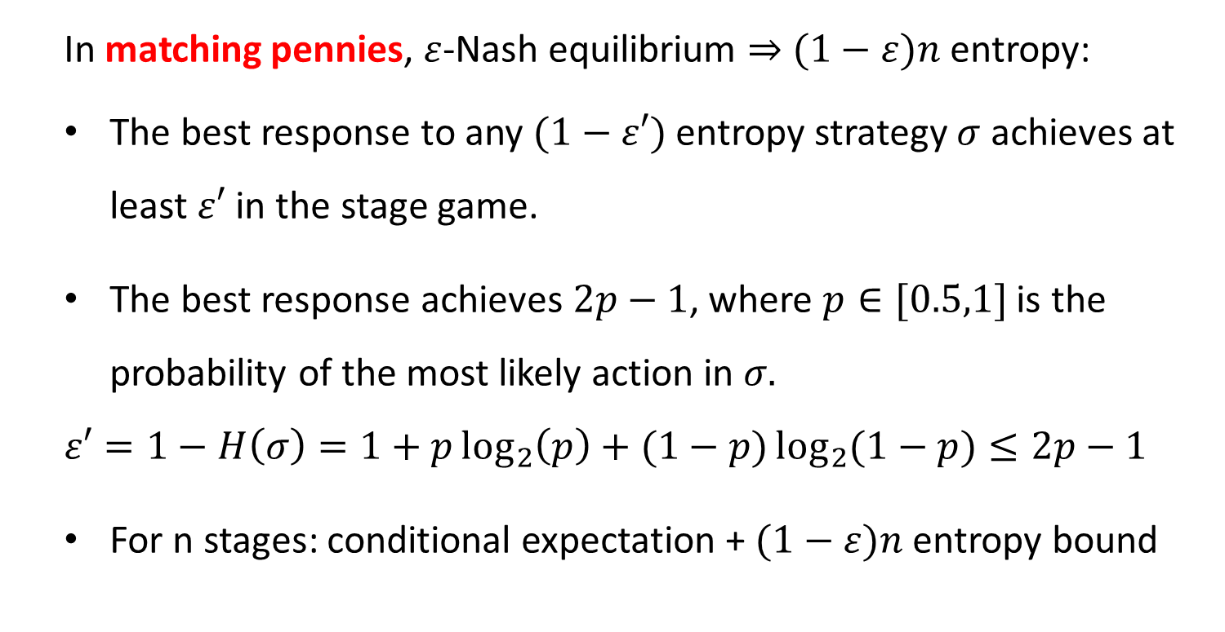
Exploiting Limited Randomness
In matching pennies, $ε$-Nash equilibrium $⇒$ $(1−ε)n$ entropy:
The best response to any $(1−ε′)$ entropy strategy $σ$ achieves at least $ε′$ in the stage game.
The best response achieves $2p−1$, where $p∈[0.5,1]$ is the probability of the most likely action in $σ.$
$$ε′=1−H\left(σ\right)=1+p\log_{2}\left(p\right)+(1−p)\log_{2}{(1−p)}≤2p−1$$
For n stages: conditional expectation + $(1−ε)n$ entropy bound

Slide 30
Exploitation in Non-0-Sum Games
 | Left | Heads | Tails | Right
up | 0, -1 | 0, -1 | 0, -1 | 0, 0
heads | 0, -1 | 1, -1 | -1, 1 | -1, 0
tails | 0, -1 | -1, 1 | 1, -1 | -1, 0
down | 0, 0 | -1, 1 | -1, 1 | 1, 0
Cannot always exploit limited randomness in non-0-sum games

Slide 31
Exploiting Limited Randomness
In two-player zero-sum games, can exploit in all rounds proportionally to the randomness deficiency [NO’00].
  Not efficiently!
Our results for computational players exploit the limited randomness only in a single round.
Can we efficiently exploit up to the randomness deficiency?

