Slide 1

Spooky Interaction and its Discontents: Compilers for Succinct Two-Message Argument Systems
Cynthia Dwork Moni Naor Guy Rothblum
Micorsoft Research Weizmann Institute Samsung Research

Slide 2
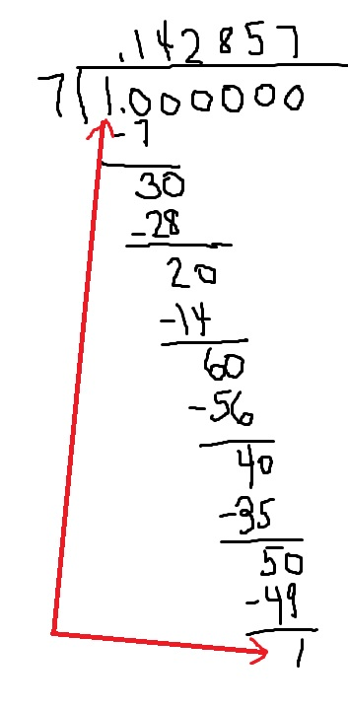

Verification of work
Mowing the Lawn
Lengthy Computation
Goal:
Get succinct two (short) message argument for computation based on falsifiable assumptions
Much shorter than the computation

Slide 3
His and Her Story
Aiello, Bhatt, Ostrovsky and Rajagopalan, 2000: made a tantalizing suggestion:
Get 2 round succinct verification from PCP + cPIR
Dwork, Langberg, Naor, Nissim and Reingold, 2000: problems with such proofs and the techniques used
Kalai Raz and Kalai, Raz and R. Rothblum: you can provably achieve the dream,
Interactive proofs*
No signaling
Subexponential assumptions

Slide 4
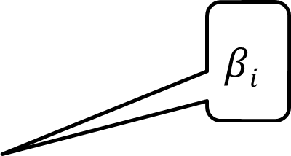
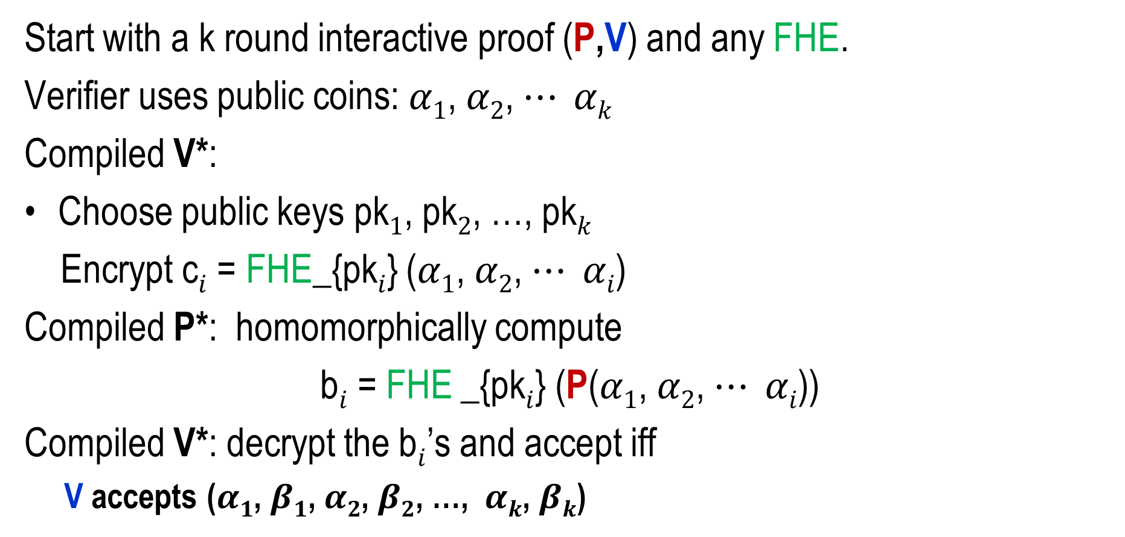
The Compiler
Start with a k round interactive proof (P,V) and any FHE.
Verifier uses public coins: $α1$, $α2$, $⋯ αk$
Compiled V*:
Choose public keys pk$1$, pk$2$, …, pk$k$
Encrypt c$i$ = FHE_{pk$i$} ($α1$, $α2$, $⋯ αi$)
Compiled P*: homomorphically compute
b$i$ = FHE _{pk$i$} (P($α1$, $α2$, $⋯ αi$))
Compiled V*: decrypt the b$i$’s and accept iff
V accepts ($α1$, $β1$, $α2$, $β2$, …, $αk$, $βk$)
$$βi$$

Slide 5
Our Results
With any FHE with poly security
If the verifier V is log space with no secret storage: compiler works
Corollary: can adapt Goldwasser, Kalai and G Rothblum’s interactive proof for NC: obtain two round verification for any NC language
Size of proof proportional to depth
The compiled protocol fails if the FHE instantiated before protocol is chosen
V: commit to r (by encryption)
P: guess r
V: open commitment and accept if guess was correct
For every instantiation of the compiler
there exists a protocol that is bad

Slide 6

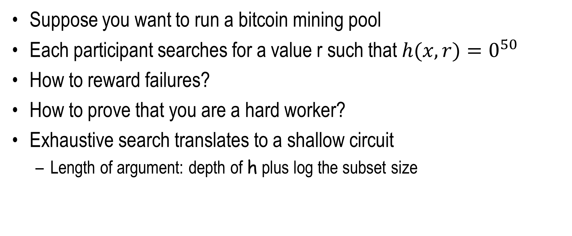
Verifying Exhaustive Search Application: Bitcoin Mining
From blockchain
Nonce
Suppose you want to run a bitcoin mining pool
Each participant searches for a value r such that $h(x,r)=0^{50}$
How to reward failures?
How to prove that you are a hard worker?
Exhaustive search translates to a shallow circuit
Length of argument: depth of h plus log the subset size

