Slide 1
The Complexity of Differential Privacy
Salil Vadhan
Harvard University
TexPoint fonts used in EMF.
Read the TexPoint manual before you delete this box.: AAAAA

Slide 2
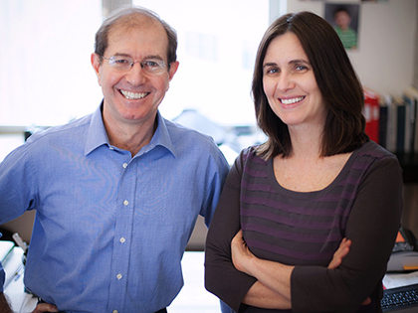

Thank you Shafi & Silvio
For...
inspiring us with beautiful science
challenging us to believe in the “impossible”
guiding us towards our own journeys
And Oded for
organizing this wonderful celebration
enabling our individual & collective development

Slide 3
Data Privacy: The Problem
Given a dataset with sensitive information, such as:
Census data
Health records
Social network activity
Telecommunications data
How can we:
enable others to analyze the data
while protecting the privacy of the data subjects?
open data
privacy

Slide 4
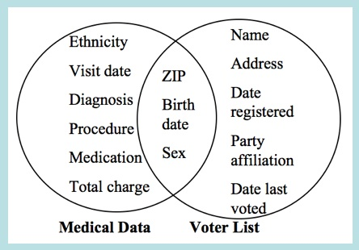
Data Privacy: The Challenge
Traditional approach: “anonymize” by removing “personally identifying information (PII)”
Many supposedly anonymized datasets have been subject to reidentification:
Gov. Weld’s medical record reidentified using voter records [Swe97].
Netflix Challenge database reidentified using IMDb reviews [NS08]
AOL search users reidentified by contents of their queries [BZ06]
Even aggregate genomic data is dangerous [HSR+08]
utility
privacy

Slide 5
Differential Privacy
A strong notion of privacy that:
Is robust to auxiliary information possessed by an adversary
Degrades gracefully under repetition/composition
Allows for many useful computations
Emerged from a series of papers in theoretical CS: [Dinur-Nissim `03 (+Dwork), Dwork-Nissim `04, Blum-Dwork-McSherry-Nissim `05, Dwork-McSherry-Nissim-Smith `06]

Slide 6
Differential Privacy
q₁
a₁
C
q₂
a₂
q₃
a₃
Database D∈X^{n}
data analysts
D‘
curator
Def [DMNS06]: A randomized algorithm C is ε-differentially private iff ∀ databases D, D’ that differ on one row 8 query sequences q₁,…,q_{t}
∀ sets T⊆ R^{t},
Pr[C(D,q₁,…,q_{t})∈ T] ≤ e^{ε} ⋅ Pr[C(D’,q₁,…,q_{t})∈T] + δ
≈ (1+ε) ⋅ Pr[C(D’,q₁,…,q_{t})∈T]
ε small constant, e.g. ε = .01, δ cryptographically small, e.g. δ = 2⁻⁶⁰
cf. indistinguishability
[Goldwasser-Micali `82]
Distribution of C(D,q₁,…,q_{t}) $≈$Distribution of C(D’,q₁,…,q_{t})
“My data has little influence on what the analysts see”

Slide 7
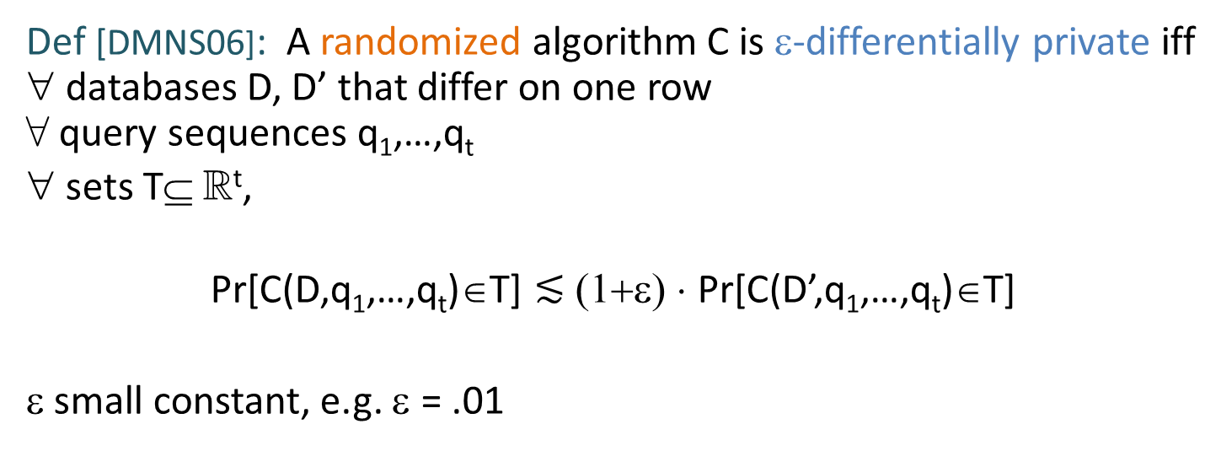
Differential Privacy
q₁
a₁
C
q₂
a₂
q₃
a₃
Database D∈X^{n}
data analysts
D‘
curator
Def [DMNS06]: A randomized algorithm C is ε-differentially private iff ∀ databases D, D’ that differ on one row 8 query sequences q₁,…,q_{t}
∀ sets T⊆ R^{t},
Pr[C(D,q₁,…,q_{t})∈T] $≲$ (1+ε) ⋅ Pr[C(D’,q₁,…,q_{t})∈T]
ε small constant, e.g. ε = .01

Slide 8

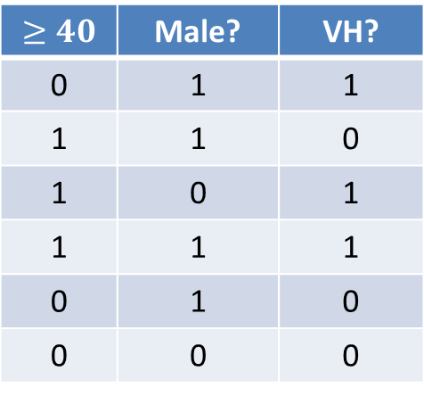
Differential Privacy: Example
D = (x₁,…,x_{n})∈ X^{n}
Goal: given q : X! {0,1} estimate counting query
q(D):= ∑_{i} q(x_{i})/n
within error ± α
Example: X = {0,1}^{d}
q = conjunction on ≤ k variables Counting query = k-way marginal e.g. What fraction of people in D are over 40 and were once fans of Van Halen?
$$≥40$$ | Male? | VH?
0 | 1 | 1
1 | 1 | 0
1 | 0 | 1
1 | 1 | 1
0 | 1 | 0
0 | 0 | 0

Slide 9
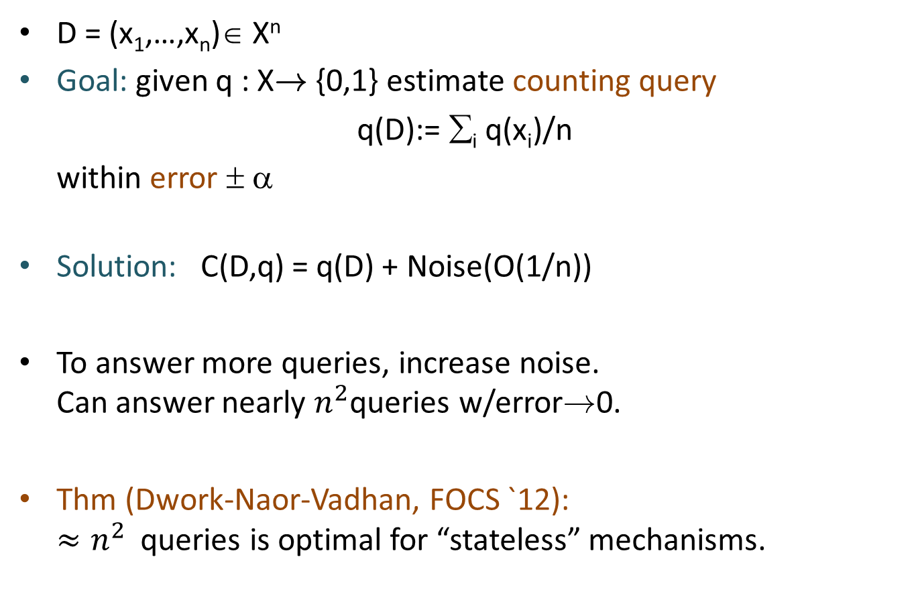
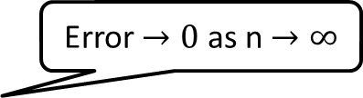
Differential Privacy: Example
D = (x₁,…,x_{n})∈ X^{n}
Goal: given q : X! {0,1} estimate counting query
q(D):= ∑_{i} q(x_{i})/n
within error ± α
Solution: C(D,q) = q(D) + Noise(O(1/n))
To answer more queries, increase noise. Can answer nearly $n^{2}$queries w/error!0.
Thm (Dwork-Naor-Vadhan, FOCS `12): $≈n^{2}$ queries is optimal for “stateless” mechanisms.
Error $→0$ as n $→∞$

Slide 10
Other Differentially Private Algorithms
histograms [DMNS06]
contingency tables [BCDKMT07, GHRU11],
machine learning [BDMN05,KLNRS08],
logistic regression & statistical estimation [CMS11,S11,KST11,ST12]
clustering [BDMN05,NRS07]
social network analysis [HLMJ09,GRU11,KRSY11,KNRS13,BBDS13]
approximation algorithms [GLMRT10]
singular value decomposition [HR13]
streaming algorithms [DNRY10,DNPR10,MMNW11]
mechanism design [MT07,NST10,X11,NOS12,CCKMV12,HK12,KPRU12]
…

Slide 11
Differential Privacy: More Interpretations
Whatever an adversary learns about me, it could have learned from everyone else’s data.
Mechanism cannot leak “individual-specific” information.
Above interpretations hold regardless of adversary’s auxiliary information.
Composes gracefully (k repetitions ) kε differentially private)
But
No protection for information that is not localized to a few rows.
No guarantee that subjects won’t be “harmed” by results of analysis.
Distribution of C(D,q₁,…,q_{t}) $≈_{ε}$Distribution of C(D’,q₁,…,q_{t})
cf. semantic security [Goldwasser-Micali `82]

Slide 12
This talk: Computational Complexity in Differential Privacy
Q: Do computational resource constraints change what is possible?
Computationally bounded curator
Makes differential privacy harder
Exponential hardness results for unstructured queries or synthetic data.
Subexponential algorithms for structured queries w/other types of data representations.
Computationally bounded adversary
Makes differential privacy easier
Provable gain in accuracy for multi-party protocols (e.g. for estimating Hamming distance)

Slide 13
A More Ambitious Goal: Noninteractive Data Release
C
Original Database D
Sanitization C(D)
Goal: From C(D), can answer many questions about D, e.g. all counting queries associated with a large family of predicates Q = {q : X ! {0,1}}

Slide 14
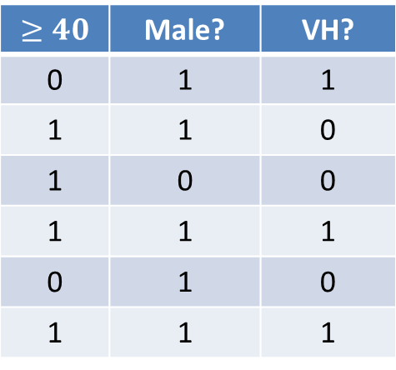
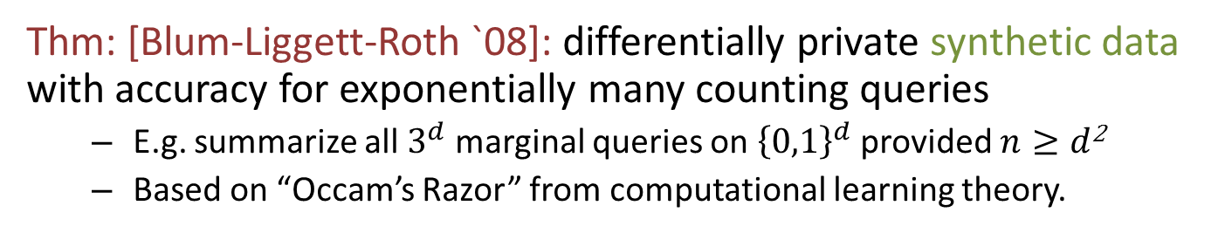

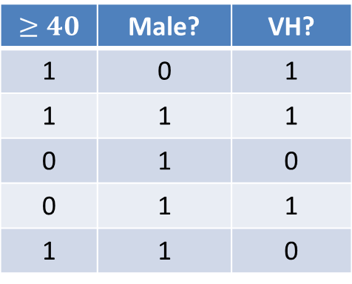
Noninteractive Data Release: Possibility
Thm: [Blum-Liggett-Roth `08]: differentially private synthetic data with accuracy for exponentially many counting queries
E.g. summarize all $3^{d}$ marginal queries on ${\left\{0,1\right\}}^{d}$ provided $n≥d$²
Based on “Occam’s Razor” from computational learning theory.
$$≥40$$ | Male? | VH?
0 | 1 | 1
1 | 1 | 0
1 | 0 | 0
1 | 1 | 1
0 | 1 | 0
1 | 1 | 1
$$≥40$$ | Male? | VH?
1 | 0 | 1
1 | 1 | 1
0 | 1 | 0
0 | 1 | 1
1 | 1 | 0
C
“fake” people
$$d$$
Problem: running time of C exponential in $d$

Slide 15
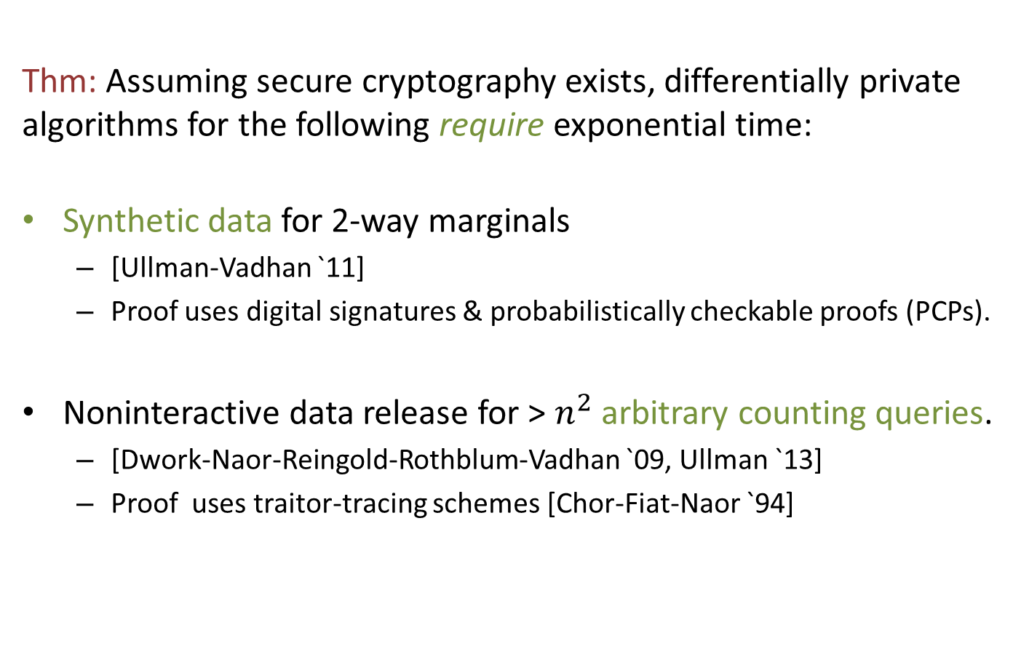
Noninteractive Data Release: Complexity
Thm: Assuming secure cryptography exists, differentially private algorithms for the following require exponential time:
Synthetic data for 2-way marginals
[Ullman-Vadhan `11]
Proof uses digital signatures & probabilistically checkable proofs (PCPs).
Noninteractive data release for > $n^{2}$ arbitrary counting queries.
[Dwork-Naor-Reingold-Rothblum-Vadhan `09, Ullman `13]
Proof uses traitor-tracing schemes [Chor-Fiat-Naor `94]
[Goldwasser-Micali-Rivest `84]
Connection to inapproximability [FGLSS `91, ALMSS `92]

Slide 16
Noninteractive Data Release: Complexity
Thm: Assuming secure cryptography exists, differentially private algorithms for the following require exponential time:
Synthetic data for 2-way marginals
[Ullman-Vadhan `11]
Proof uses digital signatures & probabilistically checkable proofs (PCPs).
Noninteractive data release for > $n^{2}$ arbitrary counting queries.
[Dwork-Naor-Reingold-Rothblum-Vadhan `09, Ullman `13]
Proof uses traitor-tracing schemes [Chor-Fiat-Naor `94]

Slide 17


















Traitor-Tracing Schemes [Chor-Fiat-Naor `94]
A TT scheme consists of (Gen,Enc,Dec,Trace)…
$$sk_{1}$$
$$b=Dec(sk_{1},c)$$
$$c$$
$$sk_{2}$$
$$c$$
$$b=Dec(sk_{2}^{};c)$$
$$bk$$
$$c$$
$$c←Enc(bk;b)$$
$$sk_{n}$$
broadcaster
$$b=Dec(sk_{n},c)$$
users

Slide 18



Traitor-Tracing Schemes [Chor-Fiat-Naor `94]
A TT scheme consists of (Gen,Enc,Dec,Trace)…
$$sk_{1}$$
Q: What if some users try to resell the content?
$$sk_{2}$$
$$bk$$
$$c$$
$$c←Enc(bk;b)$$
$$sk_{n}$$
pirate decoder
broadcaster
$$b$$
users

Slide 19



Traitor-Tracing Schemes [Chor-Fiat-Naor `94]
A TT scheme consists of (Gen,Enc,Dec,Trace)…
$$sk_{1}$$
Q: What if some users try to resell the content?
A: Some user in the coalition will be traced!
$$sk_{2}$$
$$c_{1},…, c_{t}$$
$$b_{1},…, b_{t}$$
$$tk$$
$$sk_{n}$$
pirate decoder
accuse user i
tracer
users

Slide 20
Traitor-tracing vs. Differential Privacy [Dwork-Naor-Reingold-Rothblum-Vadhan `09, Ullman `13]
Traitor-tracing: Given any algorithm P that has the “functionality” of the user keys, the tracer can identify one of its user keys
Differential privacy: There exists an algorithm C(D) that has the “functionality” of the database but no one can identify any of its records
Opposites!

Slide 21
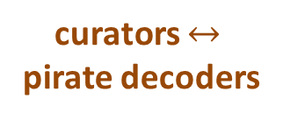
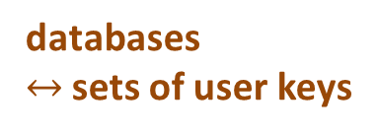
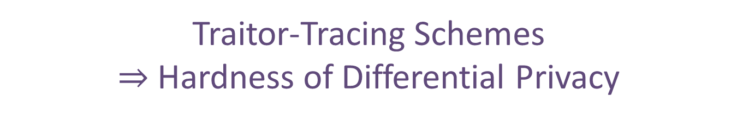
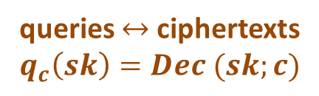
Traitor-Tracing Schemes $⇒$ Hardness of Differential Privacy
$$sk_{1}$$
$$sk_{2}$$
queries $↔$ ciphertexts
$$q_{c}\left(sk\right)=Dec (sk;c)$$
$$bk$$
$$c$$
$$c←Enc(bk;b)$$
$$sk_{n}$$
curators $↔$ pirate decoders
broadcaster
$$b$$
databases $↔$ sets of user keys

Slide 22
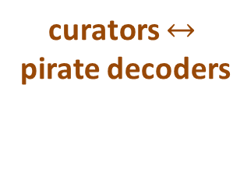
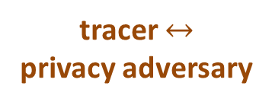
Traitor-Tracing Schemes $⇒$ Hardness of Differential Privacy
$$sk_{1}$$
$$sk_{2}$$
queries $↔$ ciphertexts
$$q_{c}\left(sk\right)=Dec (sk;c)$$
$$c_{1},…, c_{t}$$
$$b_{1},…, b_{t}$$
$$tk$$
$$sk_{n}$$
curators $↔$ pirate decoders
accuse user i
tracer $↔$ privacy adversary
databases $↔$ sets of user keys

Slide 23
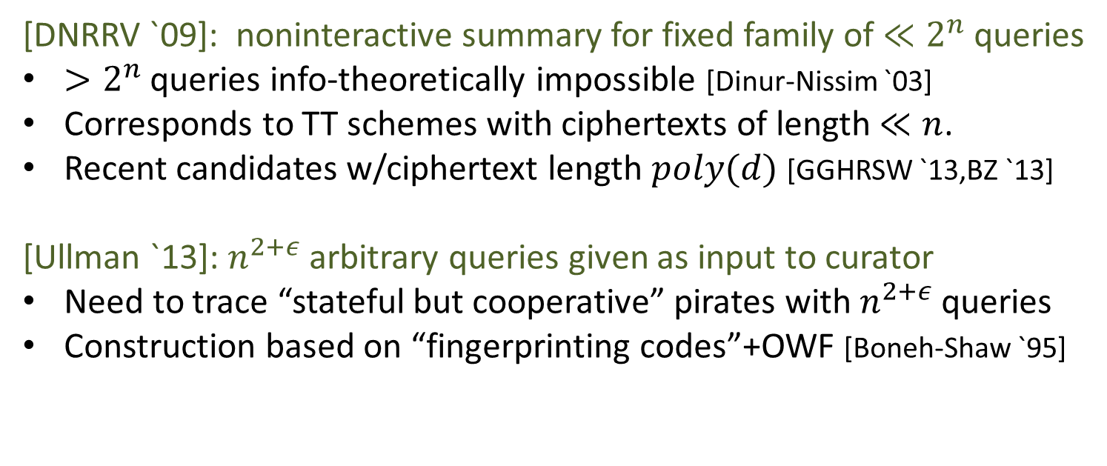

Differential Privacy vs. Traitor-Tracing
Database Rows $↔$
Queries $↔$
Curator/Sanitizer $↔$
Privacy Adversary $↔$
User Keys
Ciphertexts
Pirate Decoder
Tracing Algorithm
[DNRRV `09]: noninteractive summary for fixed family of $≪2^{n}$ queries
$>2^{n}$ queries info-theoretically impossible [Dinur-Nissim `03]
Corresponds to TT schemes with ciphertexts of length $≪n$.
Recent candidates w/ciphertext length $poly(d)$ [GGHRSW `13,BZ `13]
[Ullman `13]: $n^{2+ε}$ arbitrary queries given as input to curator
Need to trace “stateful but cooperative” pirates with $n^{2+ε}$ queries
Construction based on “fingerprinting codes”+OWF [Boneh-Shaw `95]

Slide 24
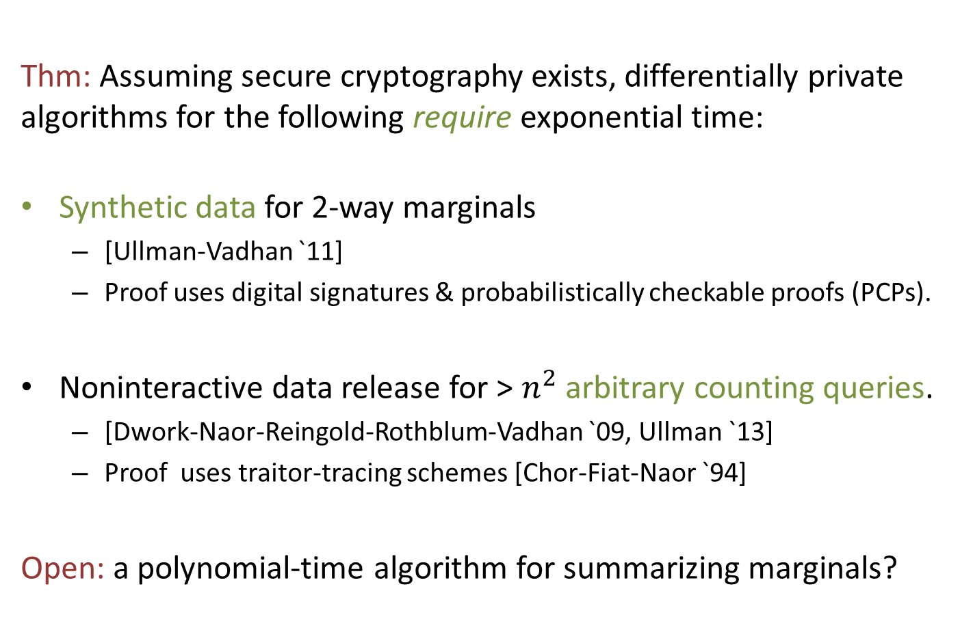
Noninteractive Data Release: Complexity
Thm: Assuming secure cryptography exists, differentially private algorithms for the following require exponential time:
Synthetic data for 2-way marginals
[Ullman-Vadhan `11]
Proof uses digital signatures & probabilistically checkable proofs (PCPs).
Noninteractive data release for > $n^{2}$ arbitrary counting queries.
[Dwork-Naor-Reingold-Rothblum-Vadhan `09, Ullman `13]
Proof uses traitor-tracing schemes [Chor-Fiat-Naor `94]
Open: a polynomial-time algorithm for summarizing marginals?

Slide 25
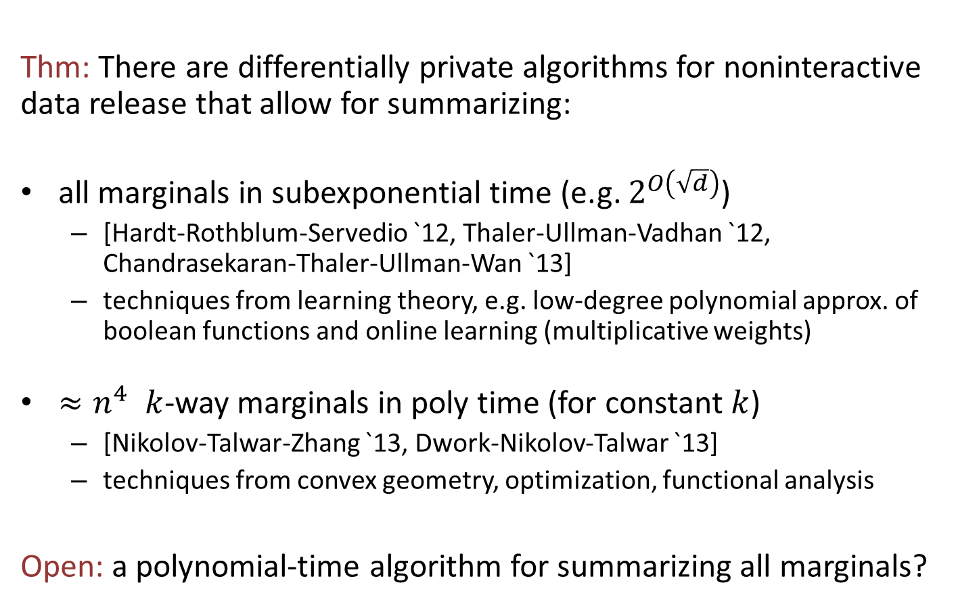
Noninteractive Data Release: Algorithms
Thm: There are differentially private algorithms for noninteractive data release that allow for summarizing:
all marginals in subexponential time (e.g. $2^{O\left(\sqrt{d}\right)}$)
[Hardt-Rothblum-Servedio `12, Thaler-Ullman-Vadhan `12, Chandrasekaran-Thaler-Ullman-Wan `13]
techniques from learning theory, e.g. low-degree polynomial approx. of boolean functions and online learning (multiplicative weights)
${≈n}^{4} k$-way marginals in poly time (for constant $k$)
[Nikolov-Talwar-Zhang `13, Dwork-Nikolov-Talwar `13]
techniques from convex geometry, optimization, functional analysis
Open: a polynomial-time algorithm for summarizing all marginals?

Slide 26

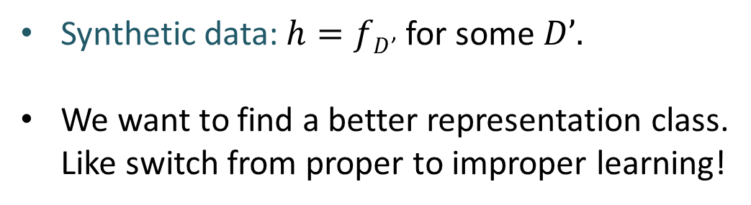



How to go beyond synthetic data?
Change in viewpoint [GHRU11]: define $fD(q) := q(D)$
$$q$$
$$fD$$
C
$$h$$
$$h(q)≈fD(q)$$
Database D
Sanitization
Synthetic data:$h=fD$’ for some $D’.$
We want to find a better representation class. Like switch from proper to improper learning!

Slide 27
Conclusions
Differential Privacy has many interesting questions & connections for complexity theory
Computationally Bounded Curators
Complexity of answering many “simple” queries still unknown.
We know even less about complexity of private PAC learning.
Computationally Bounded Curators & Multiparty Differential Privacy
Connections to communication complexity, randomness extractors, crypto protocols, dense model theorems.
Also many basic open problems!

