Slide 1
Every set in P is strongly testable under a suitable encoding
Oded Goldreich
Weizmann Institute of Science
Joint work with Irit Dinur and Tom Gur.
Notes:
I’ll have to spell out “strongly testable” (akin PT) and a “suitable encoding” (i.e., some unnatural but legit encoding).

Slide 2
Property Testing: informal definition
A relaxation of a decision problem:
For a fixed property P and any given object O,
determine whether O has property P
or is far from having property P (i.e., O is far from any other object having P).
Objects viewed as functions.
Inspecting = querying the function/oracle.
?
?
?
?
?
Focus: sub-linear time algorithms = performing the task by inspecting the object at few locations.
Notes:
Objects viewed as functions, inspecting == querying the function/orcale

Slide 3
Property Testing: a strong version – Proximity Oblivious Tester
Let P = ∪_{n} P_{n} , where P_{n} is a set of functions with domain D_{n}.
A (PO) tester T gets explicit input n, and makes a constant number of queries to a function f with domain D_{n}.
If f ∈ P_{n} then Prob[T^{f}(n) accepts] = 1.
If f is at dist. δ from P_{n} then Prob[T^{f}(n) rejects] = Ω(δ). (Distance is defined as fraction of disagreements.)
Note: Standard tester are given a proximity parameter ε, and their complexity depends on n and ε.
A POT implies a tester of query complexity O(1/ε)
Notes:
N.B.: rejection probability is linearly related to the distance, rather than arbitrarily related.

Slide 4
Property Testing is extremely sensitive to representation
Every property in P can be strongly testable (i.e., via a POT) under a suitable (unnatural but legitimate) encoding.
THM (main): For every set S in P, there exist polynomial-time encoding and decoding algorithms, E and D, such that the set {E(x): x∈S} has a proximity oblivious tester.
Note: There exists P-sets that do not have sub-linear testers (under their natural encoding); e.g., 0.01n-wise independent hash functions.
Notes:
This phenomenon (i.e., sensitivity) was known before for some properties: E.g., BIPARTITE in the DENSE vs BDG models. The current result is more general.

Slide 5
On the proof of the main theorem
THM (main): For every set S in P, there exist polynomial-time encoding and decoding algorithms, E and D, such that the set S’={E(x): x∈S} has a proximity oblivious tester.
Idea: Let E(x)=(C(x),Π(x)), where Π(x) is the PCPP proof that C(x) encodes x in S.
Assumes a unique (valid) proof for each valid stmt.
Notion: canonical proofs.
C is an error correcting code with constant relative distance
For POT: We need to reject strings not in S’ with probability proportional to their distance from a valid encoding. This should hold for the proof-part too.
Notion: strong (canonical) PCPP (of polynomial length).
PCPP = PCP of Proximity, rejecting input oracle if far from the property/set.
Notes:
PCPP == PCP of Proximity. PCP = PCP of constant query and polynomial length.

Slide 6
Secondary theorems
THM 2: Every set S’ in P has a strong canonical PCPP.
Furthermore, the proof oracle can be constructed in poly-time.
THM 3: A set has a strong canonical PCP of logarithmic randomness if and only if it is in UP.
THM 4: A set has a strong canonical PCP (of polynomial length) if and only if it is in UMA (i.e., “unambiguous MA”).
PCPP = PCP of Proximity, rejecting input oracle if far from the property/set.
Notes:
PCPP == PCP of Proximity

Slide 7
On the proofs of Theorems 2-4: Constructing strong canonical PCPs
Let S’ be in UP, let x be in S’, and y be the unique witness.
Dinur maps unique NP-witnesses to canonical PCP oracles such that any other oracle is rejected with positive probability.
Pad the PCP-oracle with many zeros (i.e., (2^{r}-1)L many zeros, when the proof length is L and randomness is r). Note: strings that are not canonical proofs are rejected with probability at least 2^{-r} (only), yet they take (only) a 2^{-r} fraction of length. (We also check that the padding is proper.)
Objection: This construction is artificial/trivial/idiotic.
(The verifier queries padded with much smaller frequently.)
We don’t care per the stated theorems.
Still, can we get these results with smooth PCPs?
Answer: Yes [Orr Paradise, MSc, to appear soon]
Smooth PCP = all locations are queried with equal probability.
Notes:
Def: smooth = all locations are queried with the same probability.
Orr proves stronger results re the RM-based and Had-based PCPs, and a refined proof-composition theorem.

Slide 8
END
Slides available at http://www.wisdom.weizmann.ac.il/~oded/T/dgg.pptx
Paper available at
http://www.wisdom.weizmann.ac.il/~oded/p_dgg.html

Slide 9
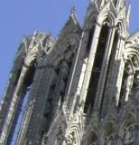
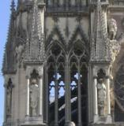
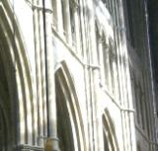
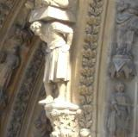
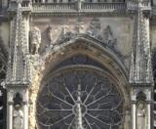
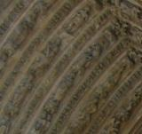
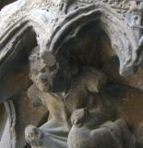
Property Testing (super-fast approximate decision): an illustration
Gothic cathedral ?
One Motivation: Real objects are far apart.
Other motivations: Approx. per se, or a preliminary step.
Deciding by inspecting few locations in the object.
Notes:
Compare to learning/deciding which cathedral this is…

