Slide 1
1. Non-Technical: advice and critique 2. Technical: On Doubly-Efficient Interactive Proof Systems
Oded Goldreich
Weizmann Institute of Science
Notes:
Having turned sixty in February, I now belong to the elders. So I may be pardoned for promoting a good old vision, and arguing that it is still relevant, and maybe even more relevant than before.
But apologies come first...

Slide 2
Apologies
For lying (cf., finance ministers before the monetarization coup).
For not declining the award (as some might have hoped…). I do maintain that awards serve no common good and create an artificial hierarchy, still given that they exist it seems wrong to decline them. (Cf., advocates of progressive taxation not volunteering…)
For not being a good speaker (e.g., unclear pronunciation, undisciplined, moody, PP-challenged, using dense slides as an anchor.
Notes:
Lying to those who asked me about my attending STOC’17.

Slide 3
Part 1: advice to some aspiring scientists and critique of some privileged scientists
Notes:
Having turned sixty in February, I now belong to the elders.
So I may be pardoned for talking of a good old vision, and arguing that it is still relevant,
and maybe even more relevant than before. But apologies first….

Slide 4
Advice to some aspiring (i.e., non-tenured) scientists
For starters: Don’t be “humbled” by past research, let alone researchers.
On myself (Part 1): Proof of immodesty.
On myself (Part 2): Lacking extraordinary skills of any type.
Possessing and guided by good attitudes towards research.
Good attitudes can be learned, adopted, and internalized.
The main attitude: A commitment to Science. It is not a sacrifice (to some transcendental God) but a life choice. Submitting to it is being true to yourself (your choice). Betraying it for temporal benefits is pathetic.
Re the gap in skills. Consider:
creating a scientific work (e.g., one presented in STOC'17),
understanding such a work (when clearly presented),
knowing a specific natural language (e.g., English),
knowing no language.
Conclusion: Take yourself (and your research) seriously, adopt a commitment towards science.
Notes:
The proof: I think I made some important research contributions.
Lacking extraordinary skills, I attribute the importance of my contributions to my attitudes.

Slide 5
Critique of some privileged (i.e., tenured) scientists
Failing to materialize the commitment to Science. E.g., superficial reviews and evaluations. (See details below.)
The duty of the privileged: Serve the scientific aspirations (esp., of the less privileged).
Superficial reviews: Some underlying bad attitudes: Insisting on applications (to practice, to theory). Referring to what is missing rather to what is present. Confusing what is obvious a posteriori with the a priori. Complaining that “proofs are elementary, and have no new ideas.” In general, not listening, rushing to grade.
Superficial evaluations: Reduction to content-oblivious measures.
Notes:
The unprivileged may invoke the defense of necessity, but not the privileged. The duty – a main one.

Slide 6
Careerism vs the Vocation of Science
Careerism = Focus on personal benefits (obtained by doing research).
Kant (2nd formulation of the categorical imperative, 1785). ”Act in such a way that you treat humanity, whether in your own person or in the person of any other, never merely as a means to an end, but always at the same time as an end.”
Max Weber (Science as a Vocation, 1919). While focusing on one's career may generate some temporal benefits, it cannot generate true Science. Thus, in the long term, careerism will even fail to serve the careerist. Needless to say, it will always fail to give a feeling of responding to the vocation of Science, which means that the careerist is doomed to a meaningless pursuit. Such a person will be better off selecting less frustrating careers, since a "scientific career" is worthy its frustration only when the vocation of Science is present in it.
MacIntyre (After Virtue, Chap. 14 (“the nature of the virtues”), 1981). External goods = contingently attached to the research activity by social circumstance; such goods include prestige, status and money. Can be obtain in alternative ways. Internal goods = can be obtained only by performing research, can only be specified in terms of the research activity itself and by means of examples from this activity, and can only be identified and recognized by the experience of participating in the activity in question. When external goods are achieved, they are always some individual's property and possession. Moreover, typically, the more someone has of them, the less there is for others. Hence, they are typically objects of competition in which there must be losers as well as winners. Internal goods are indeed the outcome of competition to excel, but it is characteristic of them that their achievement is a good for the whole community that participates in the activity.
Notes:
Careerism = focus on personal benefits (actually “external goods”) obtained by research, vs focus on the contents of research. The tension between careerism and the vocation of science underlies prior slides.
Note that it is not required to eliminate careerism, only not to let it domain (cf Kant’s). N.B.: The careerists treat themselves as means. I quote MacIntyre, although his focus is on a moral theory, since he gives nice definitions of the external goods (which are the aim of the careerist) and the internal goods (which correspond to the vocation).

Slide 7
Surviving bad times: The community and Society at large
The sour state of affairs reflected in “careerism” is part of the Zeitgeist.
Vulgar individualism (vs human as a social creature).
Elimination of meaning (vs the human need for meaning [V. Frankl]).
(Related: meaning arises in interaction within a community.)
A small community (e.g., the ToC community) can resist the fate of society at large and create an island of meaning and social solidarity.
*) Vulgar individualism = the fantasy of fully autonomous humans.
Notes:
Escape from Freedom [Erich Fromm].
Well, that’s the vision.

Slide 8
Part 2: On Doubly-Efficient Interactive Proof Systems

Slide 9


Interactive Proof Systems [GMR]
Prover Verifier
I love you (and you love me too)
What would we do, as friends?
Have fun.
Fun - sounds like a buddy movie.
Yes, exactly. Like Thelma and Louise. But... without the guns.
Oh, well, no guns, I don't know...
Petra Camille (not Venus)
“When Night is falling” (Canada, 1995).
Notes:
When Night is Falling (CA 1995): Petra and Camille (not Venus). The claim is “I love you (and you love me)”. And they interact throughout the movie to prove it.

Slide 10
Interactive Proof Systems [GMR]
Prover Verifier
X (common input)
THM [LFKN,S]: IP = PSPACE
Computationally unbounded
PPT
Completeness: If X is in the set, then the verifier always accepts (under a suitable prover strategy)
Soundness: If X is not in the set, then the verifier rejects w.p. at least ½, no matter what strategy the (cheating) prover employs.
THM [LFKN,S]: Every set in PSPACE has an interactive proof system.
Notes:
Interactive proof systems (for claims of membership). The IP=PSPACE Thm has overshadowed the notion and the existence of natural questions. In particular, Petra is NOT computationally unbounded – can interactive proof systems help her?

Slide 11
Doubly-Efficient Interactive Proof Systems [GKR]
Prover Verifier
X (common input)
Prescribed prover is PPT
Almost linear time
(or just o(deciding)).
Completeness: If X is in the set and the prover follows the prescribed strategy, then the verifier always accepts .
Soundness: If X is not in the set, then the verifier reject w.p. at least ½, no matter what strategy the (cheating) prover employs.
N.B.: As before; that is, soundness hold wrt computationally unbounded cheaters!
Notes:
N.B.: Soundness is information theoretic as before (as opposed to computational-soundness). You may hear of computationally-sound proof in the Friday workshop.

Slide 12
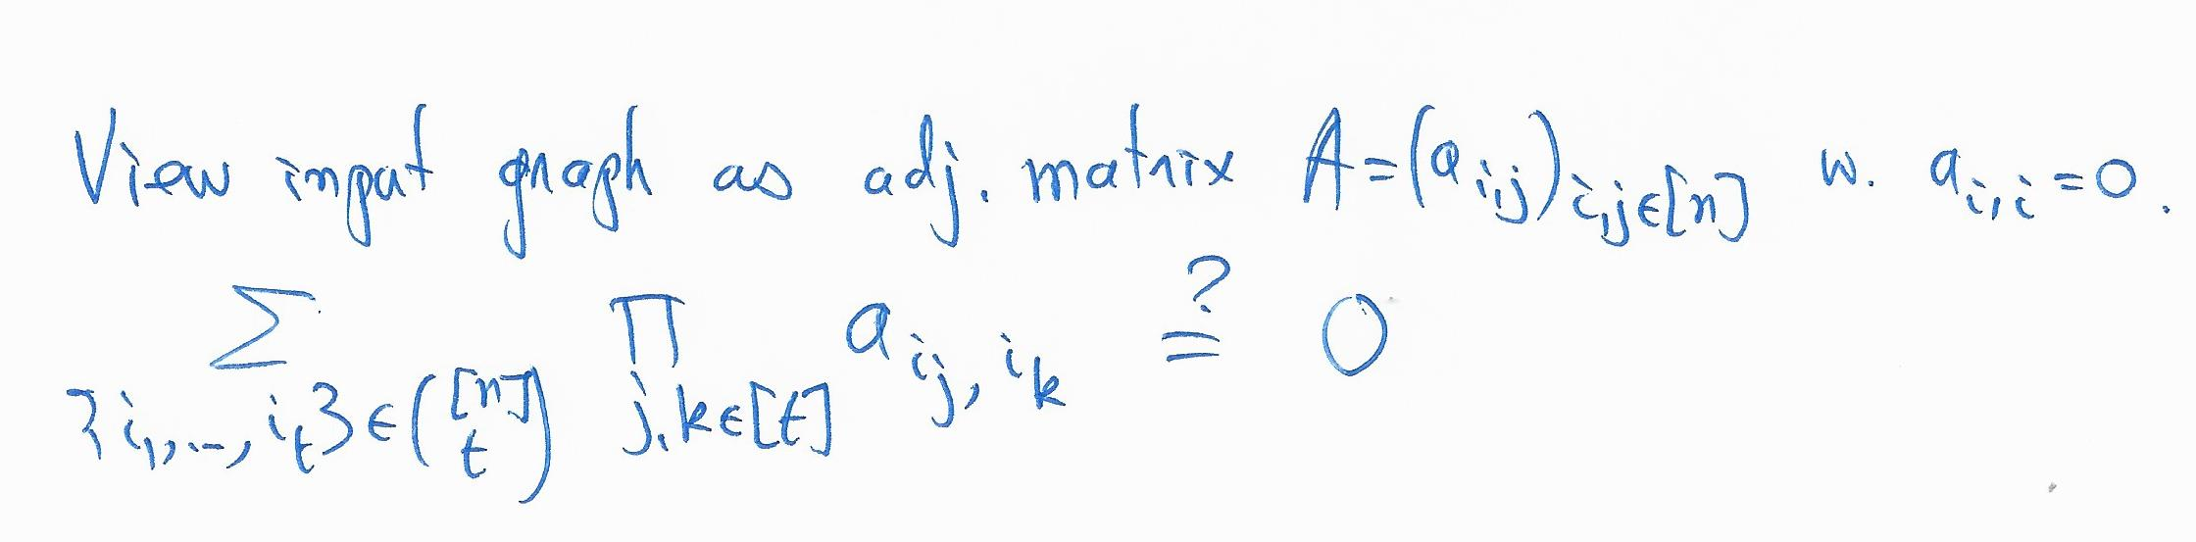
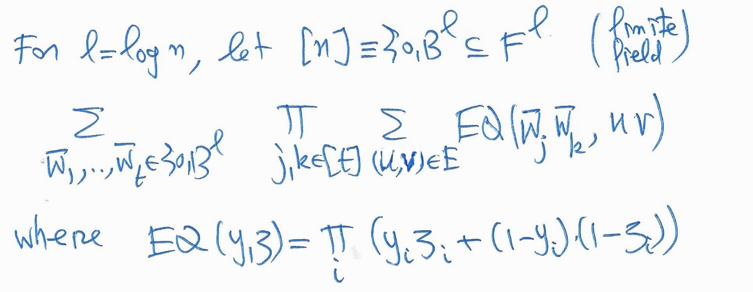
Simple doubly-Efficient Interactive Proof Systems
Ex 1: In some cases, (almost linear-time verifiable) NP-witnesses can be found in polynomial-time (e.g., perfect matching, primality, t-Clique for constant t>2).
Ex 2 [GR17]: no-t-Clique for constant t>2.
EQ Is a poly of indiv-deg. t²
|F| > 2^{l}
Apply the sum-check protocol.
Verify the residual.
Notes:
Ex1 “goes back” to discussions with Silvio and Shafi in 1985. Our favorite examples at the time were computational problems in permutation groups (and strong generating sets)

Slide 13
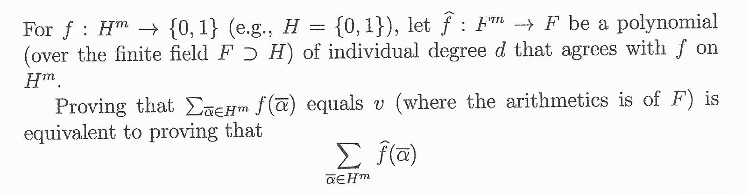
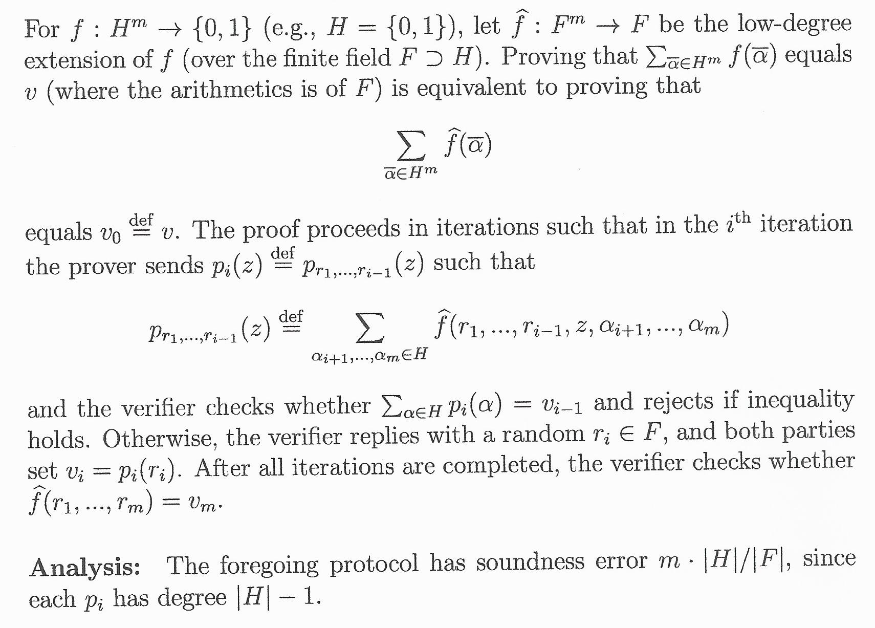
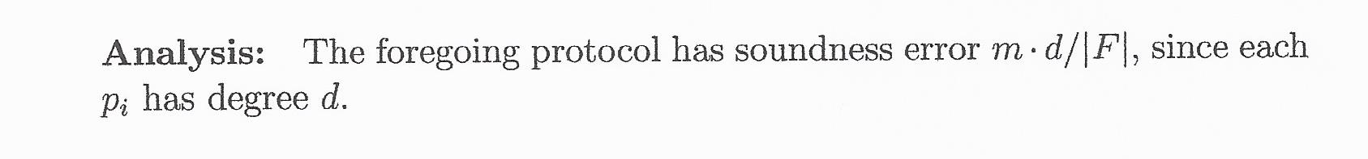
The Sum-Check Protocol [LFKN]
m-variate polynomial of individual degree |H|-1
univariate polynomial of degree |H|-1
Evaluate the polynomial at a single point.
Notes:
Lund-Fortnow-Karloff-Nisam (1990).

Slide 14
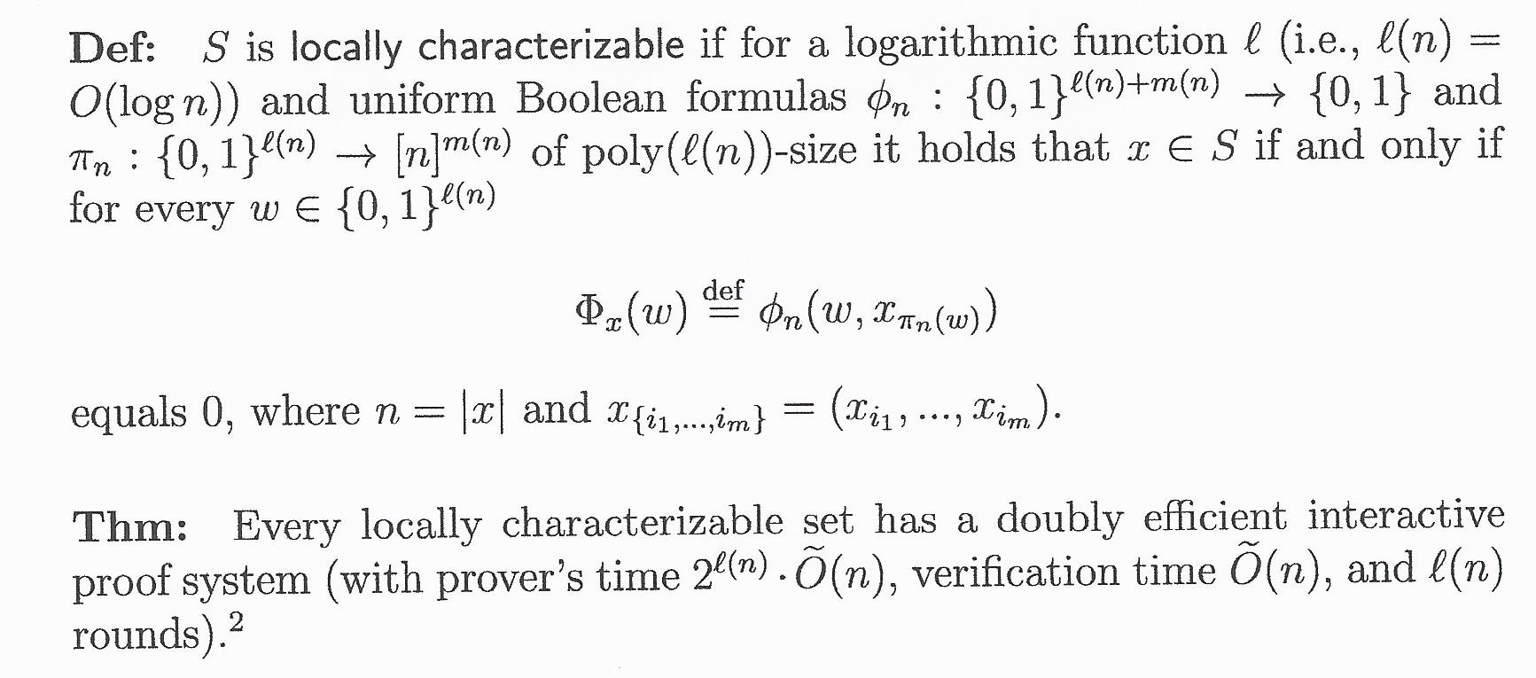
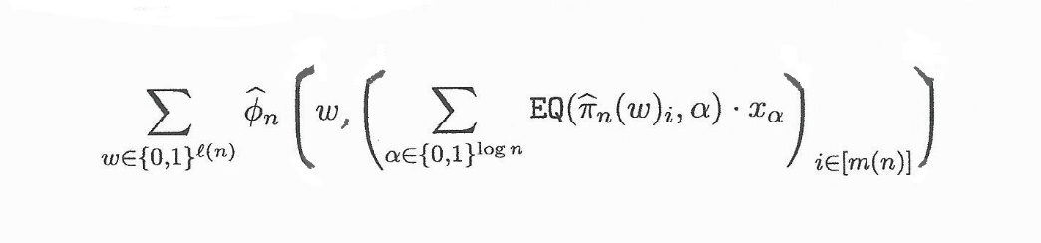
Simple doubly-Efficient IPs for Local. Char. Sets [GR17]
In case of no-t-Clique,
φ_{n}(i₁,…,i_{t}) = ∏_{j,k} x_{i_j,i_k}
View π_{n}(w)_{i} ∈ [n] as a (log n)-long binary sequence. Consider the (log n) corresp. low-deg polys over F.
Proof Idea: For a finite field F, consider low degree ``extensions’’ of the Boolean formulas.
EQ is the “equality” polynomial of the penultimate slide.
All polys have small Arithmetic formulas.
Apply the Sum Check to the sum over w.
Notes:
Having small formulas implies having low degree and being easy to evaluate. Now, apply the Sum-Check protocol.
Note that the verifier needs to evalue \phi_n at one point, which is dominated by the computation of the internal sum of $n$ terms.

Slide 15
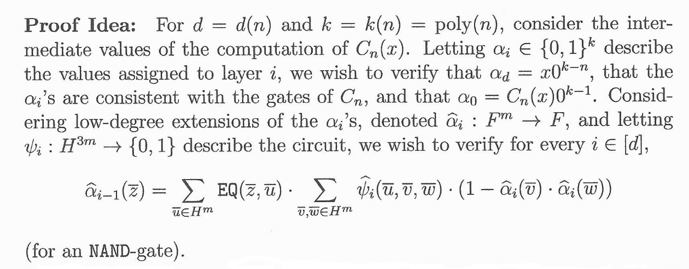
Doubly-Efficient IPs for log-space uniform NC [GKR]
THM: Every set in log-space uniform NC has a doubly efficient interactive proof system. For depth d(n), we get d(n)⋅poly(log n) rounds.
Can easily verify the first and last conditions.
Verify at random point by using the Sum-Check Protocol. Problems: After the Sum-Check we need to
evaluate Ψ_{i} in almost linear time.
evaluate α_{i} on two points.
∧
k = |H|^{m} with |H|=log n
∧
Notes:
Now, apply the Sum-Check protocol: The verification of the value of alpha_{i-1} at $r_{i-1}$ is reduced to verifying the value of alpha_i at some new random point.

Slide 16
Doubly-Efficient (constant-round) IPs for SC [RRR]
THM: Every set in SC has a doubly efficient interactive proof system with constant number of rounds. Ditto for TimeSpace(poly,n^{0.5}).
One of the proof ideas: Batch verification; that is, verifying t claims at cost of o(t) verifications. Used to reduce the verification of the existence of a L-long path to the existence of t paths, each of length=L/t.
A sanity check: Possible if you don’t care of prover time (via IP=PSPACE).
Warm-up: Batch verification for UP (i.e., NP with unique witnesses).
 | Single instance | t=t(n) instances
Prover time | p(n) | t(n) ⋅ p(n)
Verification time | v(n) | t(n)^{1/O(1)} ⋅ v(n) + t(n)
Communication | c(n) | t(n)^{1/O(1)} ⋅ c(n) + t(n)
Notes:
Re the warm-up: It is relatively easy only when compared to the needed batching of IPs…

Slide 17
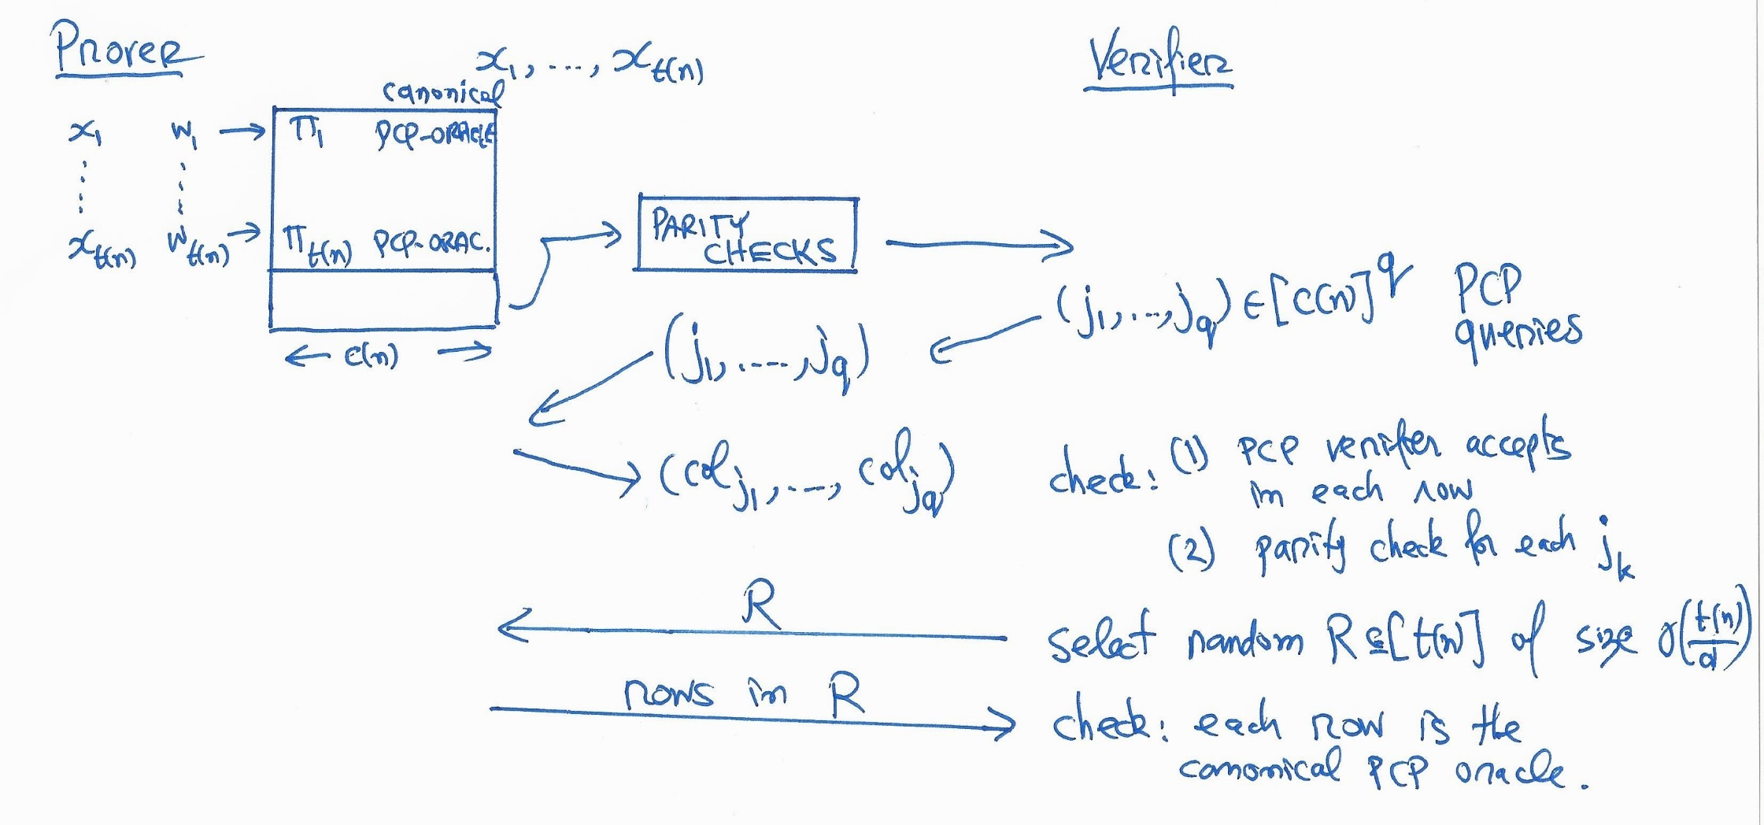
Batch verification for UP [RRR]
For d = t(n)^{1/2} and d’ = d log n, consider the parity check F:{0,1}^{t(n)} →{0,1}^{d’} such that for each v, each Hamming ball of radius d contains at most one pre-image of v under F.
*) input-oblivious queries, recognizable canonical proofs.
Notes:
N.B.: The decision is input-dependent, the queries are not. The canonical proof contains the unique witness.

Slide 18
Wider Perspective: the source of proofs
Proofs do not fall out of thin air.
Setting 1: The prover’s on-line work (de-IP, reviewed here).
Setting 2: Provided by the (high-level) application/user + PPT. E.g., NP-witness provided to a prover in a zero-knowledge system.
Setting 3: Constructed in PPT with oracle access to deciding.
⇒ Different notions of relatively efficient provers. They deserve further study.
“A Taxonomy of Proof Systems” (1995).
Notes:
Sec 2.1.3 “How efficient should the prover be?” In Complexity Theory Retrospective II

Slide 19
END
Slides available at http://www.wisdom.weizmann.ac.il/~oded/T/k-lecture.pptx
Accompanied notes available at http://www.wisdom.weizmann.ac.il/~oded/T/k-lecture.pdf
Related papers available at
http://www.wisdom.weizmann.ac.il/~oded/de-ip.html
Notes:
links

Slide 20
External and Internal Goods in Scientific research
There are two kinds of good possibly to be gained by excelling in the research activity. On the one hand, there are those goods externally and contingently attached to this activity by the accidents of social circumstance; such goods as prestige, status and money. There are always alternative ways for achieving such goods, and their achievement is never to be had only by engaging in research. On the other hand, there are the goods internal to the research activity which cannot be had in any way but by performing research. We call them internal for two reasons: first, because we can only specify them in terms of the research activity itself and by means of examples from this activity (otherwise the meagerness of our vocabulary for speaking of such goods forces us into such devices as talking of 'a certain highly particular kind of'); and, secondly, because they can only be identified and recognized by the experience of participating in the activity in question. Those who lack the relevant experience are incompetent thereby as judges of internal goods.
We are now in a position to notice an important difference between internal and external goods. It is characteristic of what is called external goods that when achieved they are always some individual's property
and possession. Moreover characteristically they are such that the more someone has of them, the less there is for other people. This is sometimes necessarily the case, as with power and fame, and sometimes the case by reason of contingent circumstance as with money. External goods are therefore characteristically objects of competition in which there must be losers as well as winners. Internal goods are indeed the outcome of competition to excel, but it is characteristic of them that their achievement is a good for the whole community who participate in the activity.

