Slide 1
Testing Graphs in Vertex-Distribution-Free Models
Oded Goldreich
Weizmann Institute of Science
Offer: 100USD for an alternative name that is adopted by me. And I’ll be happy to pay.
(Expires: July 14th, 2019.)
Notes:
Indeed, a bad term, but can you suggest a better one?

Slide 2
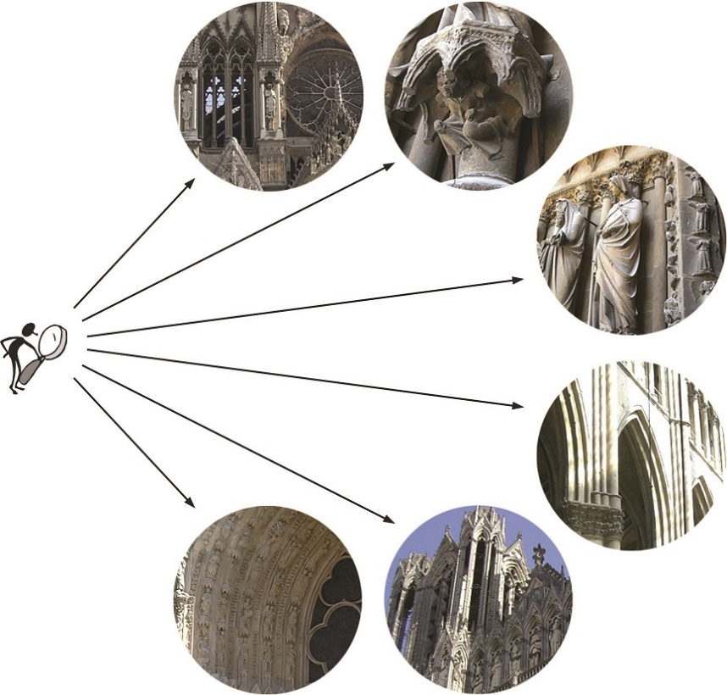
Property Testing = Sublinear Time Approximate Decision
Sublinear time ⇒ Direct access to the input (oracle)
Approximate Decision = Distinguish objects in the set from objects “far” from the set. ⇒ Distance between objects (typically, relative Hamming distance) + A proximity parameter
Tester = sublinear-time approximate-decider. Often focus on its query complexity.

Slide 3
The standard models of Testing Graph Properties
The vertex set is [n], and n is given as input to the tester.
The tester is given oracle access to the graph.
Distance between graphs = (fractional) Hamming distance between corresponding oracles.
The adjacency predicate (dense graph) model
graph G=([n],E) ⇔ oracle f:[n]×[n]→{0,1}
Dist(G,G’) = |{(u,v)∈[n]×[n]:f(u,v)≠f’(u,v)}|/n²
The incidence function (bounded-deg graph) model
graph G=([n],E) ⇔ oracle g:[n]×[d]→[n]∪{0}
Dist(G,G’) = |{(v,i)∈[n]×[d]:g(v,i)≠g’(v,i)}|/dn
The vertex set is fully specified by n, and this allows for uniformly sampling it.
d = the degree bound

Slide 4
“Make it more realistic”: Step 1 = arbitrary vertex set [G18]
The vertex set is an arbitrary set V, and the tester is given |V| as well as a device that samples V uniformly.
The tester is (also) given oracle access to the graph (as before).
Distance between graphs (as before) = (fractional) Hamming distance between corresponding oracles.
The adjacency predicate (dense graph) model
graph G=(V,E) ⇔ oracle f:V×V→{0,1}
Dist(G,G’) = |{(u,v)∈V×V:f(u,v)≠f’(u,v)}|/|V|²
The incidence function (bounded-deg graph) model
graph G=(V,E) ⇔ oracle g:V×[d]→V∪{0}
Dist(G,G’) = |{(v,i)∈V×[d]:g(v,i)≠g’(v,i)}|/d|V|
All (standard model) testers* can be transformed to this model, since they only use their knowledge of V in order to determine |V| and to uniformly sample V.
*) That is, all I can think of…. And if you allow some overhead then actually all.
Notes:
All I did was replace n by |V|. If you replace n by V, then you don’t need the asterisk (*).

Slide 5
“Make it more realistic”: Step 2 = arbitrary distribution on the vertex set
The vertex set is an arbitrary set V, and for an arbitrary distribution D, the tester is given a device that samples V according to D. (Definitional choice: The tester is not given |V|.)
The tester is (also) given oracle access to the graph (as before).
Distance between graphs = D-induced weighted distance between corresponding oracles.
The adjacency predicate (dense graph) model
graph G=(V,E) ⇔ oracle f:V×V→{0,1}
Dist(G,G’) = Prob_{u,v∼D}[f(u,v)≠f’(u,v)]
The incidence function (bounded-deg graph) model
graph G=(V,E) ⇔ oracle g:V×[d]→V∪{0}
Dist(G,G’) = Prob_{v∼D,i∈[d]}[g(v,i)≠g’(v,i)]
The graph exists explicitly in reality (e.g., physical, biological, digital)
The graph is defined by an (adjacency or incidence) oracle that exists in reality.
Notes:
The definitional choice seems more consistent with the envisioned setting.

Slide 6
Our results (1): The role of one-sided error.
Focus on “strong testability” = query complexity that depends only on the proximity parameter (obliviously of the graph and distribution).
One-sided error tester: Always accepts graphs that have the property (i.e., no error here), and rejects w.h.p. graphs that are far from it.
In both (dense and bounded-degree graph) VDF models, strong testability implies strong testability with one-sided error probability.
In the dense model: query complexity is quadrupled. In the BD model: query complexity is exponented.
Corollary: Only properties that are strongly testable with one-sided error in the standard model, can be strongly tested in the VDF model.
In both cases, the necessary condition is not sufficient.
Notes:
More about the insufficiency (e.g., Connectivity) – in the next talk.

Slide 7
Our results (2): Some positive results.
Focus on “strong testability” = query complexity that depends only on the proximity parameter (obliviously of the graph and distribution).
In the dense graph model: Strong testability for two classes. 1. General Graph Partition Prop’s that sat. the necessary condition. 2. Subgraph-freeness properties. Via direct adaptation of the standards model testers of [GGR, AFKS].
In the bounded-degree graph model: Strong testability for a few properties (e.g., subgraph-freeness, degree-regularity, being Eulerian, containing no tree with k leaves).
Notes:
In BDG model can test CONN if also given either |V| or uniformly distributed samples in V.

Slide 8
“Show something technical” (actually, why?)
THM: In both (dense and bounded-degree graph) VDF models, strong testability implies strong testability with one-sided error probability.
“strong testability” = query complexity that depends only on the proximity parameter (obliviously of the graph and distribution).
One-sided error tester: Always accepts graphs that have the property (i.e., no error here), and rejects w.h.p. graphs that are far from it.
PF (for dense model): Let T be a general tester of query complexity q for property Π. Then:
Take a sample of O(q²) vertices, denoted S, from the distribution D.
For each choice of 2q vertices from the sample, and random-tape for T, invoke T with that tape, and answer its queries using these vertices.
Decide according to the majority verdict.
Wlog, T queries the subgraph induced by 2q random vertices.
N.B.: Our tester tosses no coins. Its “randomness” is due to the choice of S.
If G is in Π, then, for each S, tester T should accept whp on Unif(S). ⇒ No error on G∈Π.
If G is far, then T should reject on D. A random 2q-subset of S behaves as a 2q-sample of D.
Notes:
The “randomness” of our test = its probability space. Total query complexity ${|S|\choose2} = O(q^4)$

Slide 9
Proving the Theorem in the bounded-degree graph model
THM: In both (dense and bounded-degree graph) VDF models, strong testability implies strong testability with one-sided error probability.
“strong testability” = query complexity that depends only on the proximity parameter (obliviously of the graph and distribution).
One-sided error tester: Always accepts graphs that have the property (i.e., no error here), and rejects w.h.p. graphs that are far from it.
PF (for BDG model): Let T be a general tester of query complexity q for property Π. Then:
Take a sample of O(q²) vertices, denoted S, from the distribution D.
For each choice of q vertices from the sample, and random-tape for T, invoke T with that tape, and answer its queries using these vertices.
Decide according to the majority verdict.
Query complexity: |S|⋅ exp(q) = exp(q).
Wlog, T sample at most q vertices, and explore vertices at distance at most q from them.
N.B.: Our tester tosses no coins. Its “randomness” is due to the choice of S.
(In the dense graph model it was |S|².)
Notes:
Almost the same, except for what is marked.

Slide 10
Obtaining VDF testers for the dense graph model (general graph partition prop. and subgraph freeness)
Tester: Invoke the standard tester T on the input graph G, while presenting possible repeated samples of a vertex as distinct vertices. (Vertices represented copies of the same vertex are not incident to one another.)
Analysis: Mental experiment in which T is invoked on imaginary G’ that is obtained from G by a weighted blow-up, where a vertex v of weight D(v) is replaced by a cloud of size D(v)⋅N. No problems with k-Colorability and triangle-freeness, but…
For general graph partition properties:
If a vertex of G should appear in a clique (of the k-partition), then its copies should be connected by edges.
Try all possibilities for “heavy” vertices.
For general subgraph freeness:
A forbidden copy of the subgraph in G may not contain copies of the same vertex.
Use a generalization of subgraph freeness to edge colored graphs.
Notes:
Standard testers by GGR and AFKS.

Slide 11

END
Paper available from my homepage
http://www.wisdom.weizmann.ac.il/~oded/
(see http://www.wisdom.weizmann.ac.il/~oded/p_vdf.html)
Slides available at
http://www.wisdom.weizmann.ac.il/~oded/T/vdf.pptx
Recall my offer: 100USD for an alternative name that is adopted by me. (Expires: July 14th, 2019.)

