Slide 1
Neural Architecture Search
Dror Moran
Maayan Tamari

Slide 2
Lecture Outline
Motivation
NAS Categories
NAS with Reinforcement Learning
NAS with Gradient Decent
…….
Summery

Slide 3
Motivation
  Neural networks are:
  powerful and flexible models
  work well for many difficult learning tasks
  neural networks design is:
  Exhausting
  time-consuming process
  vast amount of possible configurations - requires expert knowledge to design
Notes:
Neural networks are powerful and flexible models that work well for many difficult learning tasks
Despite their success, neural networks are still hard to design
exhausting, time-consuming process
the vast amount of possible configurations requires expert knowledge to restrict the search
Therefore, a natural goal is to design optimization algorithms that automate this neural architecture search.

Slide 4
Neural Architecture Search Categories
Search
Space
Search Strategy
Performance Estimation
Notes:
We categories methods for NAS according to three dimensions: search space, search strategy, and performance estimation strategy

Slide 5
  The Search Space
    Defines which architectures can be represented
    Operations:
    Pooling
    Convolution
    Hyper-parameters:
    Number of filters
    Kernel size
    Strides
    Activation functions:
    Relu
    Tanh
    Number of Layers
    Skip Connections
Notes:
Examples of the search space

Slide 6
  The Search Strategy
    Details how to explore the search space
    Random Search
    Evolutionary Methods
    Bayesian Optimization
    Reinforcement Learning
    Gradient-Based Methods
Notes:
Random search- the most basic approach.
While these adaptive approaches differ in how they determine which architectures to evaluate, they all attempt to bias the search toward architectures that are more likely to perform well.

Slide 7
  Performance Estimation
    Methods to reduce the search computational burden
    Training each architecture from scratch
    Lower fidelities
    Learning curve extrapolation
    Weights transferring
    One-Shot architecture search
Notes:
training from scratch – basic but time and resources consuming.
Lower fidelities- we will not go into this topic, but in one sentence – shorter training time, training on subset of the data, training on lower resolution images or training with less filters per layer. Problem – introduce bias between estimation and final performance. Typically underestimate.
Learning curve extrapolation – we will not go into this topic, but in one sentence – terminating those predicted to perform poorly to speed up the search process
Weights transferring – the basic concept is that if we have an architecture (the parent), we introduce “mutations” like adding a layer or adding a skip connections. Each new network with a mutation is a child. Besides for the mutation, all the other weights of the child are the same as the parent so they can be transferred instead of training from scratch
One- shot – the basic concept is to treat all architectures as different subgraph of a supergraph, and share weights between architectures that have edges of the supergraph in common.

Slide 8
  Neural Architecture Search Using Evolutionary Algorithms

Slide 10
  Neural Architecture Search Using Reinforcement Learning

Slide 11
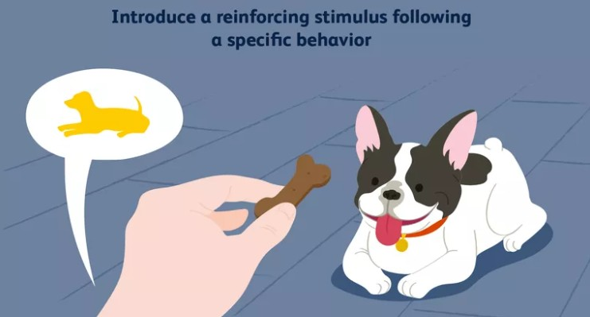
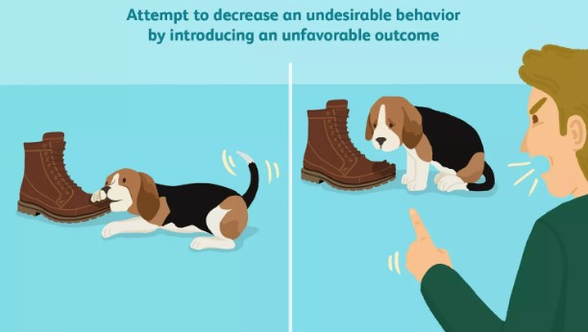
  Reinforcement learning
Notes:
The Reinforcement Learning flavor of the learning problem is strikingly similar to how humans and animals effectively behave — experience the world, accumulate knowledge and use the learnings to handle novel situations.
A large amount of theory behind RL lies under the assumption of The Reward Hypothesis which in summary states that all goals and purposes of an agent can be explained by a single scalar called the reward.

Slide 12
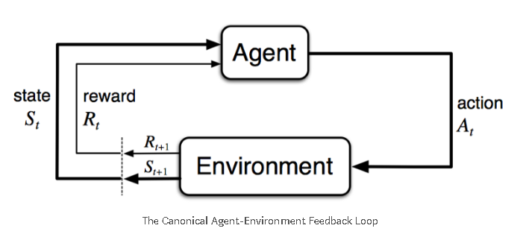
  Reinforcement learning
Notes:
The system description consists of an agent which interacts with the environment via its actions at discrete time steps and receives a reward. This transitions the agent into a new state.
The aim is to maximize a long-term objective.

Slide 13
  Neural Architecture Search with Reinforcement Learning
The structure and connectivity of a neural network can be typically specified by a variable-length string
It is possible to use a recurrent network – a controller-
to generate such string
    Neural Architecture Search with Reinforcement Learning [B. Zoph , Q. V. Le, 2017]

Slide 14
  Neural Architecture Search with Reinforcement Learning
Search
Space
Filter height [1, 3, 5, 7]
Filter width [1, 3, 5, 7]
Num. of filters [24, 36, 48, 64]
Strides [1, 2, 3]
Skip connections
Performance Estimation
Training from Scratch
Search
Space
Search Strategy
Performance Estimation
Search
Strategy
Reinforcement Learning
    Neural Architecture Search with Reinforcement Learning [B. Zoph , Q. V. Le, 2017]
Notes:
As we said before we can divide NAS algorithms according to 3 categories- search space, search strategy and performance estimation.
In this paper, the search space will be composed of decisions regarding filter height, width, number of filters, strides and skip connection, and the total amount of layers in the architecture, which results in

Slide 15
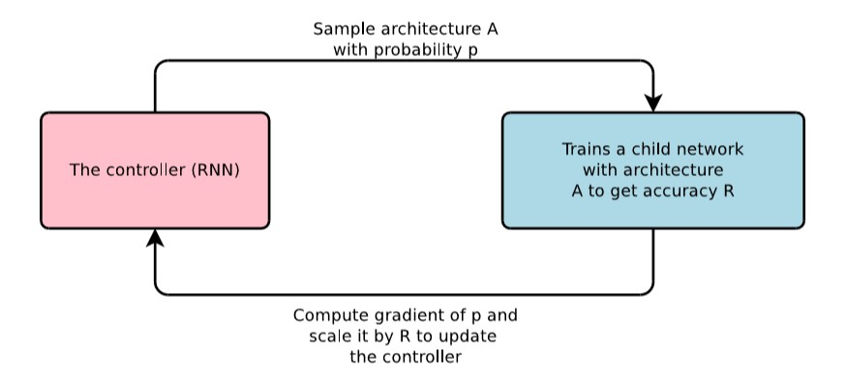
  Neural Architecture Search with Reinforcement Learning
    Neural Architecture Search with Reinforcement Learning [B. Zoph , Q. V. Le, 2017]
Notes:
In our case the system is a bit different from the general system description we just saw
The controller is an RNN that produces architecture strings
In a way we can say that besides the reward, the hole system is inside the controller.
The controller samples an architecture – a child
The child is trained for 50 epochs
The reward will be the maximum validation accuracy of the last 5 epochs cubed
Validation -5000 examples randomly sampled from the training set. Training – 45000 examples.
The controller RNN is a two layer LSTM with 35 hidden units on each layer

Slide 16
  Using RNN as the Controller
Number of Filters
Filter
Height
Filter
Width
Stride
Height
Stride
Width
Number of Filters
Filter
Height
Layer N-1
Layer N
Layer N+1
    Neural Architecture Search with Reinforcement Learning [B. Zoph , Q. V. Le, 2017]

Slide 17
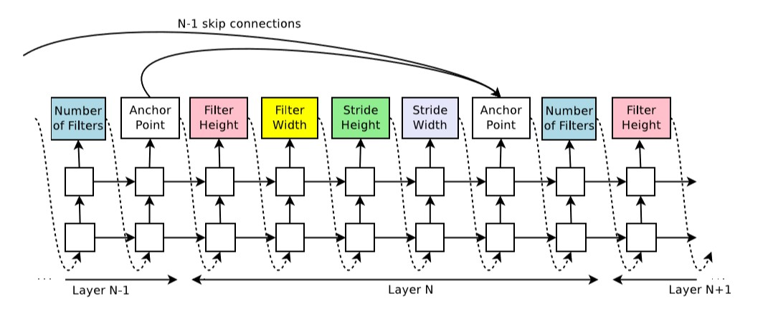
  Using RNN as the Controller
    Neural Architecture Search with Reinforcement Learning [B. Zoph , Q. V. Le, 2017]
Notes:
To enable prediction of skip connections they add the anchor points.
The anchor point is connected to all previous layers via sigmoid functions
Each sigmoid is a function of the current hidden state and the previous hidden state of the controller
Hj – the hidden state of the controller at anchor point for the j-th layer
V,Wprev,Wcurr – matrices. trainable parameters
They than sample from these sigmoids to decide what previous layers to use

Slide 18
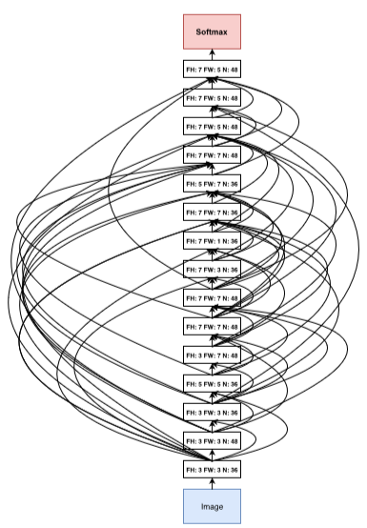
  Results- CNN Architecture for CIFAR-10
    Neural Architecture Search with Reinforcement Learning [B. Zoph , Q. V. Le, 2017]
Notes:
CNN for CIFAR-10
No strides, no pooling
FH- filter height, FW- filter width, N- number of filters
Total of 15 layers
Important to note that for all experiments they start with a network of 6 layers and NAS controllers take it from there
More notes:
The skip connections are not residual connections. If one layer has many inputs they are concatenated in the depth dimention.
There are relatively a lot of rectangular filters

Slide 19
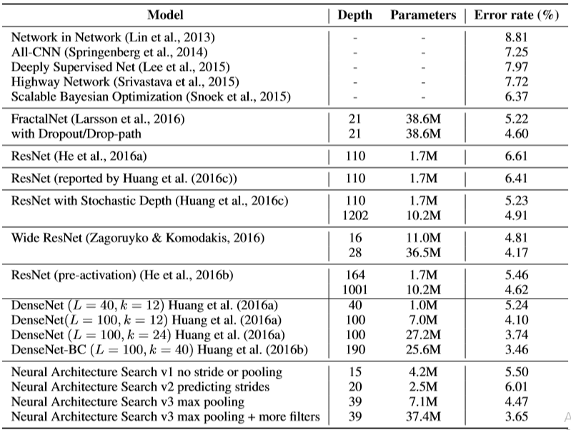
  Results on CIFAR-10
    Neural Architecture Search with Reinforcement Learning [B. Zoph , Q. V. Le, 2017]
Notes:
These are the results of a their best architectures compered to state of the art hand-crafted architectures
The architecture we saw last slide- it has a good balance between accuracy and depth. It is the shallowest and perhaps the most inexpensive among the top in the table.
Their top accuracy results – more filters means that they took the architecture designed by NAS and added 40 filters to each layer
denseNet state of the art result
Before we continue to other works, there are a few important points to notice in this paper-
This method is not fully automated -
Their architecture is not designed from scratch- they start with a 6 layer CNN and the controller takes it from there.
in fact, this is an issue with the field of NAS, because all papers start with some hand-crafted model.
They hand tune some hyper parameters like learning rate and batch normalization parameters etc. same goes for others- there is no fully automated architecture design yet.
This method is very expensive computation wise – they used 800 GPUs for almost a month of training!

Slide 20
B
R
E
A
K
!

Slide 21
  Results on CIFAR-10
800 GPUs, 28 days!
    Neural Architecture Search with Reinforcement Learning [B. Zoph , Q. V. Le, 2017]
Notes:
Inefficient
Definitely will be hard implement on larger dataset ImageNet

Slide 22
Neural Architecture Search
Search
Space
Search Strategy
Performance Estimation
Notes:
Same strategy and performance estimation
Reduce the search space size without a performance loss

Slide 23
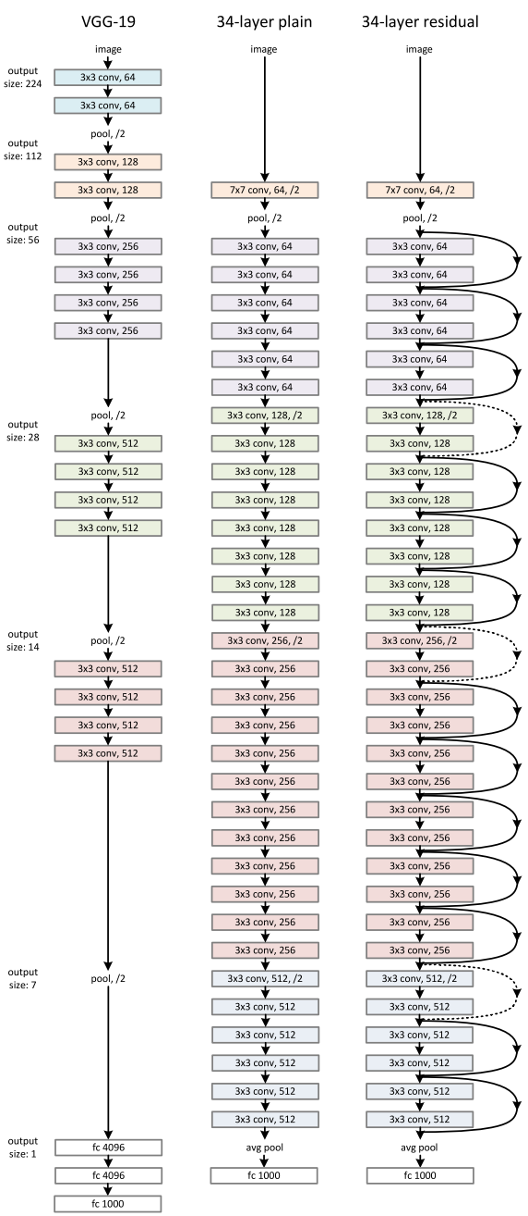
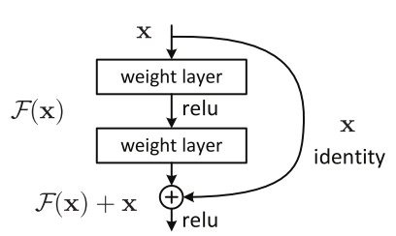
Searching for a Convolutional Cell
Inspired by ResNet
The architecture is built from cells
Search for the best cell
  Reduce the search space size
Stack copies of the cell together to design a convolutional architecture
  Can search for the cell using small dataset (e.g. CIFAR-10)
  Use the cell to learn bigger datasets (e.g. ImageNet)
Learning Transferable Architectures for Scalable Image Recognition [Zoph et al., 2018]
Notes:
Instead of searching in a huge search space of architectures we are searching in a much smaller search space of a cell architectures.
Use the cells to create complex and deeper net

Slide 24
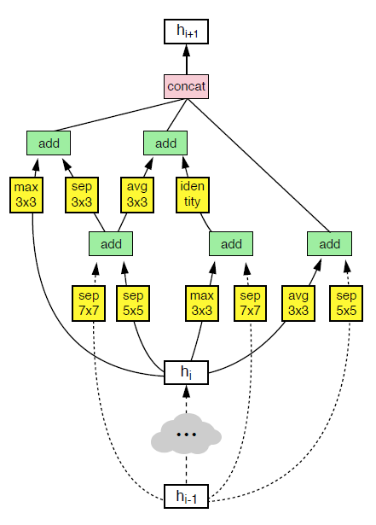
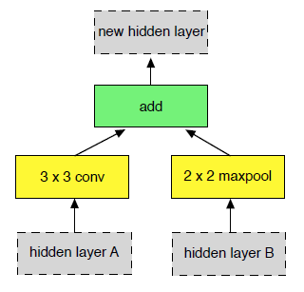
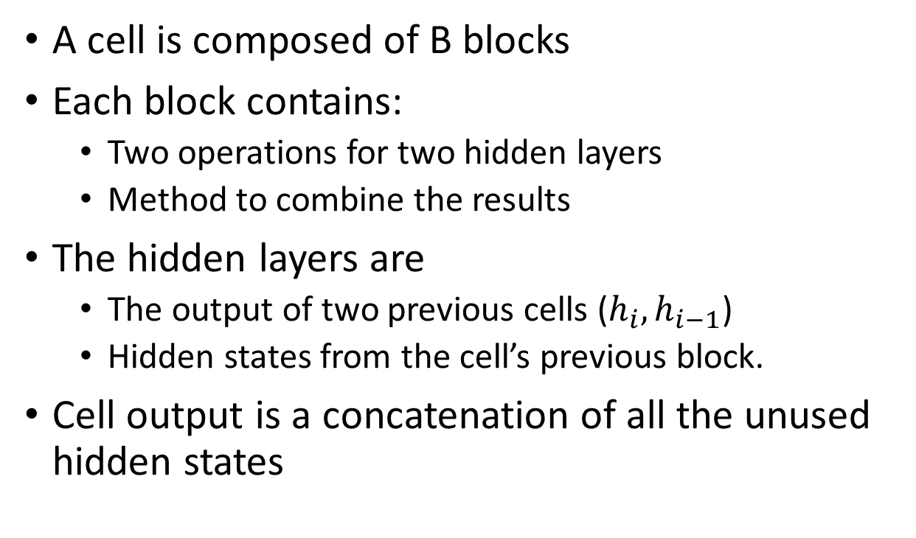
Searching for a Convolutional Cell
A cell is composed of B blocks
Each block contains:
  Two operations for two hidden layers
  Method to combine the results
The hidden layers are
  The output of two previous cells ($h_{i},h_{i−1}$)
  Hidden states from the cell’s previous block.
Cell output is a concatenation of all the unused hidden states
Notes:
For predicting a cell we need to predict B blocks.

Slide 25
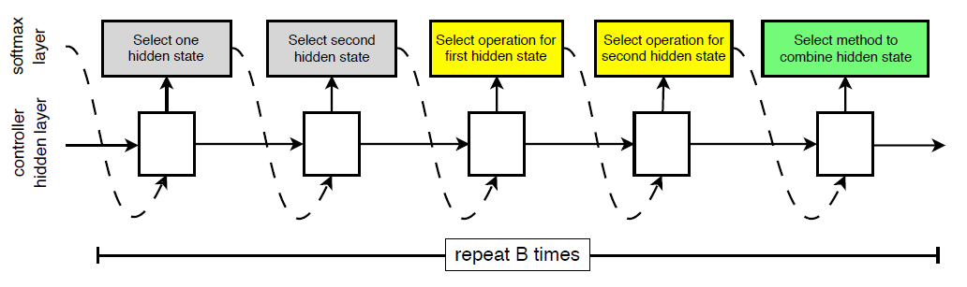
Searching for a Convolutional Cell
The controller samples B blocks
Training is done using reinforcement and network evaluation as suggested by NAS.
Notes:
Same reinforcement learning rule and training from scratch
Train on CIFAR -10
When the search is over, the top 250 architectures are then chosen to train until convergence on CIFAR-10 to determine the very best architecture.

Slide 26
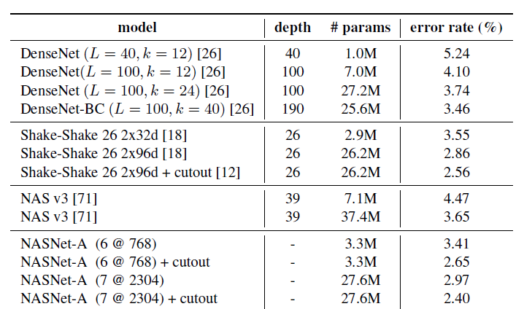
NASNet
Softmax
Performance on CIFAR-10
Cell
N x
Cell
Cell
Image
Notes:
Called NASNet
Built a conv network
Train it (Id don’t think they use the previous weight)
Every cell have it own parameters
20 layers for CIFAR
Better the NAS and trained faster

Slide 27
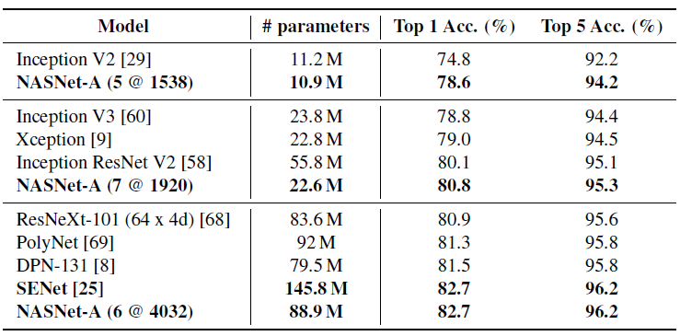
NASNet
Softmax
Performance on CIFAR-10
Cell
N x
Cell
500 GPUs, 4 days!
Cell
Image
Notes:
Called NASNet
Built a conv network
Train it (Id don’t think they use the previous weight)
Every cell have it own parameters
20 layers for CIFAR
Better the NAS and trained faster

Slide 28
Neural Architecture Search
Search
Space
Search Strategy
Performance Estimation
Notes:
Don’t want to train the network from scratch at each iteration

Slide 29
Efficient NAS via Parameter Sharing (ENAS)
Block i in cell A
Block i in cell B
new hidden layer
new hidden layer
add
add
Shared Parameters
3 x 3 maxpool
3 x 3 conv
3 x 3 conv
identity
hidden layer A
hidden layer B
hidden layer B
hidden layer A
Each operation at each block has a set of parameters!
Efficient Neural Architecture Search via Parameter Sharing [Pham et al., 2018)]

Slide 30
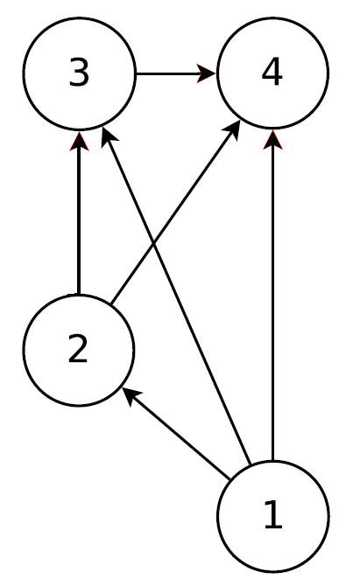


The search space as a Directed Acyclic Graph
Operations of Block 1
Operations of Block 2
Node 1 and node 2 are treated as the outputs of the two previous cells
The remaining nodes represents the local operations
  Where each operation, at each node, has a set of parameters!
Total of #Block + 2 nodes
The edges represents the flow of information
$$h_{i}$$
$$h_{i−1}$$
Notes:
The nodes represents the local operations
Where each operation, at each node, has a set of parameters!
The edges represents the flow of information
Node 1 and node 2 are treated as the outputs of the two previous cells
Total of B+2 nodes

Slide 31
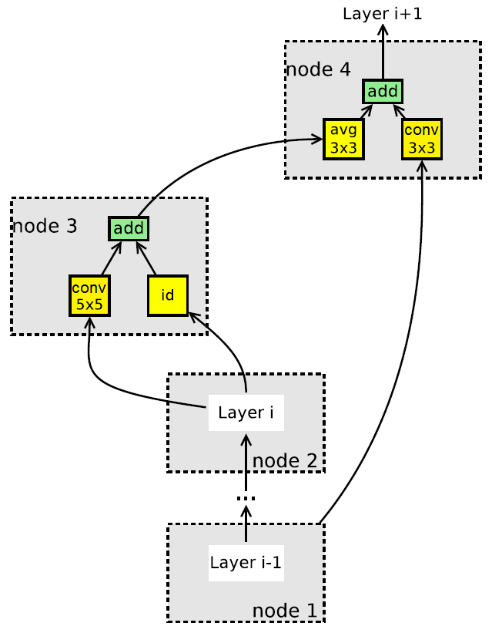
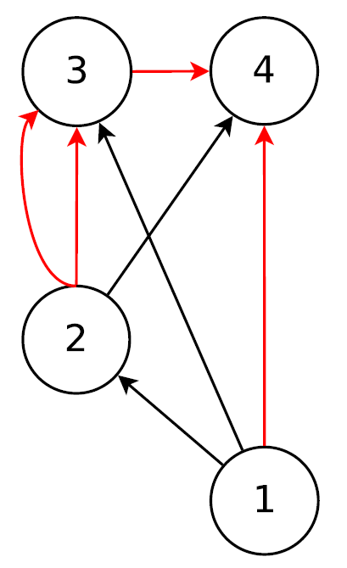






The search space as a Directed Acyclic Graph
Operations of Block 1
Operations of Block 2
The cell architecture is defined by a subgraph!
$$h_{i}$$
$$h_{i−1}$$
Notes:
Block consist of 2 entries and two operation (They just use element-wise addition)

Slide 32

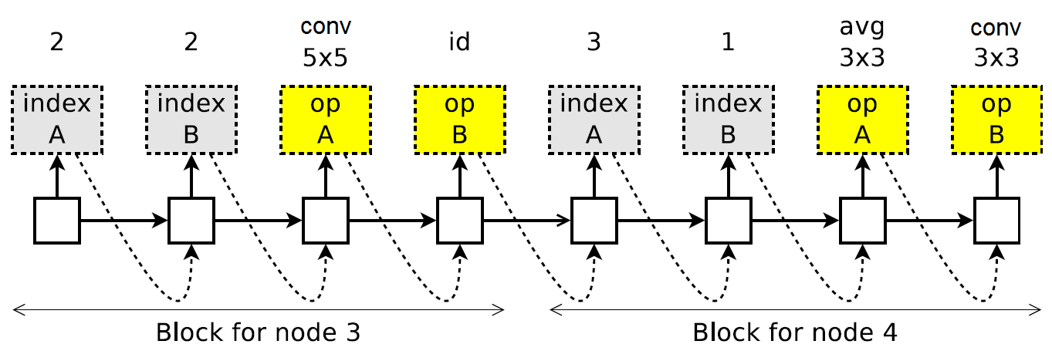

The search space as a Directed Acyclic Graph
Operations of Block 1
Operations of Block 2
The ENAS controller
$$h_{i}$$
$$h_{i−1}$$

Slide 33
Efficient NAS via Parameter Sharing (ENAS)
Training the shared parameters of the child models (ω):
Training the controller parameters (θ):
  Using reinforcement as shown before
  Can evaluate an architecture using the shared parameters!
Notes:
Repeat:
Train t

Slide 34
Result

