Slide 1
SELF-SUPERVISED AUDIO-VISUAL CO-SEGMENTATION
Weizmann Institute of Science
Department of CS and Applied Math.
By: Ilan Aizelman, Natan Bibelnik

Slide 2
Outline
Part 1
Look, Listen and Learn by Relja Arandjelovic´ and Andrew Zisserman
Objects that Sound by Relja Arandjelovic´ and Andrew Zisserman
Part 2
Learning to Lip Read from watching videos by Joon Son Chung and Andrew Zisserman
Dip Reading sentences in the wild by Joon Son Chung

Slide 3
Before we begin
There are many papers that..
Were published almost in the same time,
and are very similar

Slide 4
The Sound of Pixels (Sept 2018)

Slide 5
Audio-Visual Scene Analysis with Self-Supervised Multisensory Features (OCT 2018)

Slide 6
Look, Listen and Learn
by Relja Arandjelovic´ and Andrew Zisserman

Slide 7
Motivation: they use self-supervised learning
Unsupervised learning
The datasets do not need to be manually labelled.
Training data is automatically labelled.
Goal: finding correlation between inputs
Notes:
Self-supervision (or self-supervised learning) is a learning technique where the training data is autonomously (or "automatically") labelled.
It is still supervised learning, but the datasets do not need to be manually labelled by human, but they can e.g. be labelled by finding and exploiting the relations (or correlations) between different input signals (input coming e.g. from frame and audio signal).

Slide 8
Main focus: Visual and Audio events
Visual and audio events tend to occur together:
Baby crying..
Notes:
Visual and audio events tend to occur together:
a wine glass shattering and the accompanying crash;
the roar of a motorcycle as it accelerates.
These visual and audio stimuli are concurrent because they share a common cause.
Our goal: Understanding the relationship between visual events and their associated sounds is a fundamental way that we make sense of the world around us

Slide 10
What do we learn?
What can be learnt by unlabelled videos?
By constructing an Audio-Visual Correspondence (AVC) learning task that enables visual and audio networks to be jointly trained from scratch, we’ll see that…
Notes:
We explore that observation by asking:
What can be learnt by looking at and listening to a large number of unlabelled videos?
By constructing an audio-visual correspondence (AVC) learning task that enables visual and audio networks to be jointly trained from scratch, we’ll see that…

Slide 11
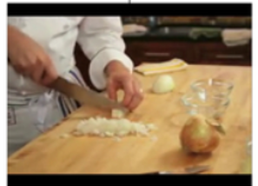
Given
Given Audio input, what’s the related Visual output?
Also Called: Cross/Intra-mode retrival
Neural Network will learn useful semantic concepts
Predict
Notes:
Given Visual input, what’s the related Audio output?

Slide 12
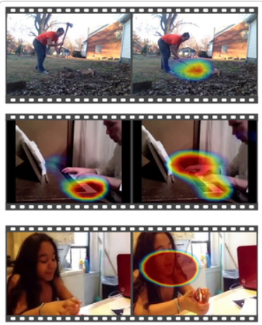
2. Localization!
“Which sound fits well with this image?”

Slide 13
Our main focus in this paper
3. Correlation
“Does the (Visual, Audio) pair correlated?”
Yes: Positive
No: Negative

Slide 14
High-level Overview
The Network should learn to determine whether a pair of (video frame, short audio clip) correspond to each other or not.

Slide 15
The NN learns to detect various semantic concepts in both the visual and the audio domain
Notes:
The AVC task is a simple binary classification task: given an example video frame and a short audio clip – decide whether they correspond to each other or not.
The corresponding (positive) pairs are the ones that are taken at the same time from the same video, while mismatched (negative) pairs are extracted from different videos.
The only way for a system to solve this task is if it learns to detect various semantic concepts in both the visual and the audio domain

Slide 16
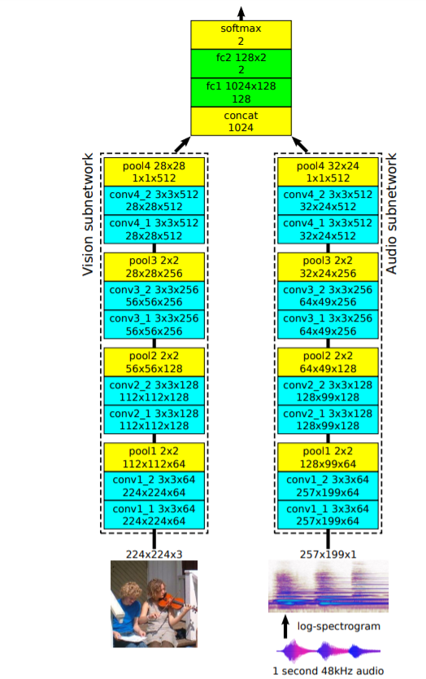
Network Architecture
• Inputs:
Frame
One second audio clip
• Output:
Predict if frame corresponds to audio clip
Notes:
Network consists of two vgg-like networks, whose outputs are concatenated, then passed through 2 fully connected layers.

Slide 17
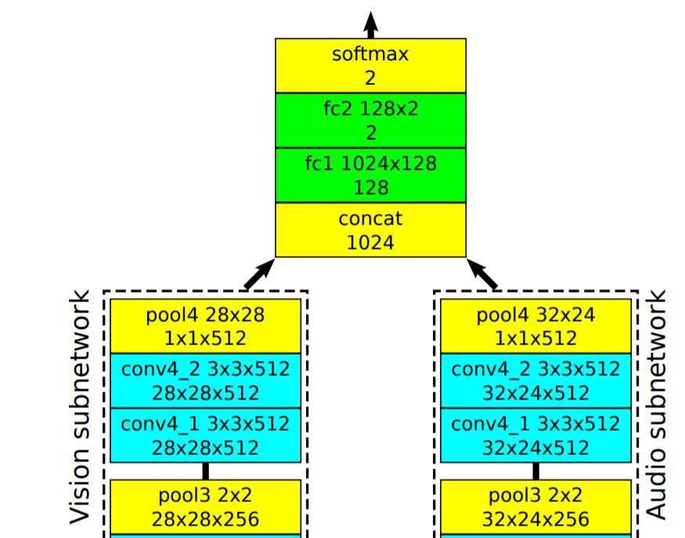
Fusion network
Outputs are concatenated,
then passed through 2 fully connected layers.
Notes:
Fusion network: The two 512-D visual and audio features are concatenated into a 1024-D vector which is passed through the fusion network to produce a 2-way classification output, namely, whether the vision and audio correspond or not. It consists of two fully connected layers, with ReLU in between them, and the intermediate feature size of 128-D

Slide 18
Implementation details
Training
Kinetics dataset – (human action classification)
approx 20k videos with labels. Labels are used only for baselines.
Flickr Dataset (sentence-based image description)
The first 10 seconds of each of 500k videos from Flickr.
Notes:
contains YouTube videos manually annotated for human actions using Mechanical Turk, and cropped to 10 seconds around the action.
Although this dataset is fairly clean by construction, it still contains considerable noise
Kinetics dataset - approx 20k videos with labels. Labels are used only for baselines.
Flickr Dataset The first 10 seconds of each of 500k videos from Flickr.
Sampling –
Corresponding pair: pick a random 1 second sound clip from a random video, then select a random frame overlapping that 1 second.
Non-Corresponding pair: pick two random videos, and take a random frame from one and a random audio clip from the other.
Train on 16 GPUs for two days .

Slide 19
Sampling
Video 1
Corresponding pair: pick a random 1 second sound clip from a random video, then select a random frame overlapping that 1 second.
Video 1
Non-Corresponding pair(Negtive): pick two random videos, and take a random frame from one and a random audio clip from the other.
Train on 16 G P U s for two days .
Video 2

Slide 20
Evaluation results of: AVC Task
We evaluate the results on 3 baselines:
Notes:
Test set accuracy on the AVC task for the L 3 -Net, and the two supervised baselines on the labelled Kinetics-Sounds dataset. The number of positives and negatives is the same, so chance gets 50%. All methods are trained on the training set of the respective datasets

Slide 21
Supervised direct baseline (supervised learning)
Same networks (Visual and Audio) – supervised train
Modified FC layers - output to 34 action classes.
Finally, correspondence score is computed as the similarity of class score distributions of the two networks.
Notes:
\
computes the audio-video correspondence score as the similarity of class score distributions of the two networks, computed as the scalar product between the 34-D network softmax outputs, and decides that audio and video are in correspondence if the score is larger than a threshold.

Slide 22
Pre-training baseline
Extract Visual and Audio trained features
Concatenate both features into original $L^{3}$ Network
Freeze weights and train only FC layers on AVC task

Slide 23
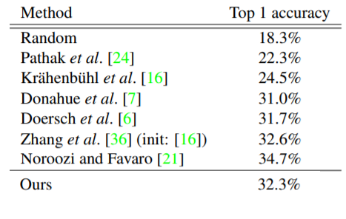
Visual features evaluation independently
Trained on Flickr-SoundNet, evaluated on ImageNet.
The methods below use self-supervised learning.
Also, other self-supervised methods trained on imagenet.
Random Alexnet
+ trained classifier
Colorization
Jigsaw
Audio-Visual
Correspondence
Notes:
We follow the experimental setup of Zhang et al. [36] where features are extracted from 256 × 256 images and used to perform linear classification on ImageNet. As in [36], we take conv4 2 features after ReLU and perform max-pooling with equal kernel and stride sizes until feature dimensionality is below 10k; in our case this results in 4×4×512 = 8192-D features. A single fully connected layer is added to perform linear classification into the 1000 ImageNet classes. All the weights are frozen to their L 3 -Net-trained values, apart from the final classification layer which is trained with cross-entropy loss on the ImageNet training set.

Slide 24
Audio features evaluation independently
the $L^{3}$-Net audio subnetwork trained also on Flickr-SoundNet is used to extract features from 1 second audio clips.
Effectiveness of these features is evaluated on two standard sound classification benchmarks: ESC-50 (Environmental audio recordings) and DCASE (Acoustic scene classification)

Slide 25
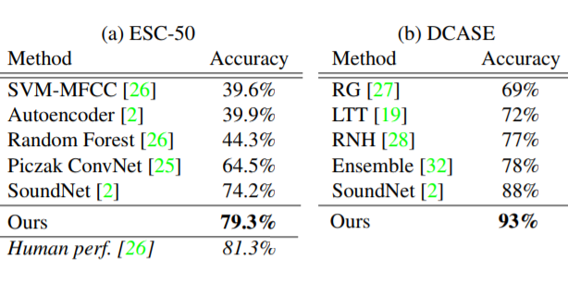
Audio features evaluation independently
Apply audio subnetwork to ESC-50 and DCASE, two sound classification datasets.
Break into 1-second clips, features are obtained by max pooling the last conv layer, pre-processed with z-score normalization, and at test time evaluated with a multi-class SVM on the output.
Compare with other self-supervised classification methods, and with Soundnet
Notes:
s we convincingly beat the previous state-of-the-art, SoundNet [2], by 5.1% and 5% absolute. For ESC-50 we reduce the gap between the previous best result and the human performance by 2% while for DCASE we reduce the error by 4%

Slide 26
Paper 2: Objects that Sound by Relja Arandjelovic´ and Andrew Zisserman
Objectives:
networks that can embed audio and visual inputs into a common space that is suitable for cross-modal and intra-modal retrieval. (new)
a network that can localize the object that sounds in an image, given the audio signal. (new)

Slide 27
But.. How??
Same way as before
We achieve both of these objectives by training from unlabelled video using only audio-visual correspondence (AVC) as the objective function.
But… different Architecture

Slide 28
cross-mode retrieval )Image-to-Sound)

Slide 29
cross-mode retrieval )Sound-to-Image)

Slide 30
Localization

Slide 31
AVE-NET

Slide 32
AVE-NET Architecture
This part is the same as previous architecture
Notes:
To enforce feature alignment, the AVE-Net computes the correspondence score as a function of the Euclidean distance between the normalized visual and audio embeddings. This information bottleneck, the single scalar value that summarizes whether the image and the audio correspond, forces the two embeddings to be aligned.
Furthermore, the use of the Euclidean distance during training is crucial as it makes the features “aware” of the distance metric, therefore making them amenable to retrieval

Slide 33
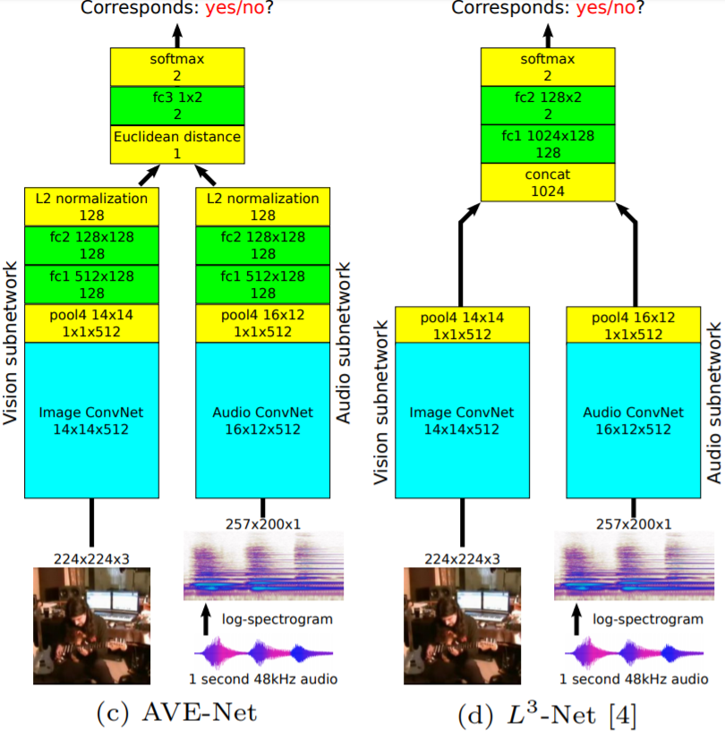
To Enforce Alignment
Directly Optimizes the features for cross-modal retrieval
Notes:
The two subnetworks produce a 128-D L2 normalized embedding for each of the modalities. The Euclidean distance between the two 128-D features is computed, and this single scalar is passed through a tiny FC, which scales and shifts the distance to calibrate it for the subsequent softmax. The bias of the FC essentially learns the threshold on the distance above which the two features are deemed not to correspond. Also,
features are inadequate for cross-modal retrieval (as will be shown in the results of Section 3.1) as they are not aligned in any way – the fusion is performed by concatenating the features and the correspondence score is computed only after the fully connected layers. In contrast, the AVE-Net moves the fully connected layers into the vision and audio subnetworks and directly optimizes the features for cross-modal retrieval.

Slide 34
Evaluation and results
Trained on: AudioSet-Instruments train-val set
Task: AVC
AVE-NET: 81.9%
$L^{3}$-Net: 80.8%
AVE-NET won in the AVC task BUT….
The REAL test of interest here is the retrieval performance.
Notes:
Trained on: AudioSet-Instruments train-val set
On the audio-visual correspondence task, AVE-Net achieves an accuracy of 81.9%, beating slightly the $L^{3}$-Net which gets 80.8%
Note: AVC performance is not the ultimate goal since the task is only used as a proxy for learning good embeddings, so the real test of interest here is the retrieval performance.
e.g. audio-to-image uses the audio embedding as the query vector to search the database of visual embeddings, answering the question “Which image could make this sound?

Slide 35
Evaluation of Cross-modal and intra-modal retrieval
The performance of a retrieval system is assessed using a standard measure – the normalized discounted cumulative gain (nDCG). It measures the quality of the ranked list of the top k retrieved items.
Cross-modal and intra-modal retrieval.
Test set: AudioSet-Instruments
Notes:
The nDCG@30 for all combinations of query-database modalities is shown in Table

Slide 36
Why intra-model works?
Transitivity: An image of a violin is close in feature space to the sound of a violin, which is in turn close to other images of violins.
The AVE-Net outperforms the $L^{3}$-Net because its Euclidean distance is “aware”, i.e. it has been designed and trained with retrieval in mind.
Notes:
intra-modal retrieval works because of transitivity – an image of a violin is close in feature space to the sound of a violin, which is in turn close to other images of violins.
Note: Despite learning essentially the same information on the same task and training data as the $L^{3}$-Net,
The AVE-Net outperforms the $L^{3}$-Net because its Euclidean distance is “aware”, i.e. it has been designed and trained with retrieval in mind.

Slide 37
Cross-modal and intra-modal retrieval
Notes:
Each column shows one query and retrieved results. Purely for visualization purposes, as it is hard to display sound, the frame of the video that is aligned with the sound is shown instead of the actual sound form. The sound icon or lack of it indicates the audio or vision modality, respectively. For example, the last column illustrates query by image into an audio database, thus answering the question “Which sounds are the most plausible for this query image?” Note that many audio retrieval items are indeed correct despite the fact that their corresponding frames are unrelated – e.g. the audio of the blue image with white text does contain drums – this is just an artefact of how noisy real-world YouTube videos are.

Slide 38
Localizing objects that sound
Goal in sound localization is to find regions of the image which explain the sound.
We formulate the problem in the Multiple Instance Learning (MIL) framework.
Namely, local region-level image descriptors are extracted on a spatial grid and a similarity score is computed between the audio embedding and each of the vision descriptors.
Notes:
The network is then trained in the same manner as for the AVC task, i.e. predicting whether the image and the audio correspond. For corresponding pairs, the method encourages one region to respond highly and therefore localize the object, while for mismatched pairs the maximal score should be low thus making the entire score map low, indicating, as desired, there is no object which makes the input sound. In essence, the audio representation forms a filter which “looks” for relevant image patches in a similar manner to an attention mechanism.

Slide 39
Audio-Visual Object Localization (AVOL-Net)
14x14
14x14x128 Grid
128-D vector

Slide 40
produces the localization output in the form of the avc score
for each spatial location
FC to Conv calibration
FC1 & FC2 converted to conv5 conv6
Notes:
In essence, the audio representation forms a filter which “looks” for relevant image patches in a similar manner to an attention mechanism.
Our Audio-Visual Object Localization Network (AVOL-Net) is depicted in Figure 4. Compared to the AVE-Net (Figure 2c), the vision subnetwork does not pool conv4 2 features but keeps operating on the 14 × 14 resolution. To enable this, the two fully connected layers fc1 and fc2 of the vision subnetwork are converted to 1 × 1 convolutions conv5 and conv6. Feature normalization is removed to enable features to have a low response on background regions. Similarities between each of the 14 × 14 128-D visual descriptors and the single 128-D audio descriptor are computed via a scalar product, producing a 14 × 14 similarity score map. Similarly to the AVE-Net, the scores are calibrated using a tiny 1 × 1 convolution (fc3 converted to be “fully convolutional”), followed by a sigmoid which produces the localization output in the form of the imageaudio correspondence score for each spatial location. Max pooling over all spatial Objects that Sound 11 locations is performed to obtain the final correspondence score, which is then used for training on the AVC task using the logistic loss.

Slide 41
Localization of objects – mask overlay over the frame

Slide 42
Hypothesis: the network detects only salient objects
What in the piano-flute image would make a flute sound?”
Notes:
Fig. 6. What would make this sound? Similarly to Figure 5, the AVOL-Net localization output is shown given an input image frame and 1s of audio. However, here the frame and audio are mismatched. Each triplet of images shows the (left) input audio, (middle) input frame, and (right) localization output overlaid over the frame. Purely for visualization purposes, as it is hard to display sound, the frame of the video that is aligned with the sound is shown instead of the actual sound form (left). On the example of the first triplet: (left) flute sound illustrated by an image of a flute, (middle) image of a piano and a flute, (right) the flute from the middle image is highlighted as our network successfully answers the question “What in the piano-flute image would make a flute sound?” In each row the input frame is fixed while the input audio varies, showing that object localization does depend on the sound and therefore our system is not just detecting salient objects in the scene but is achieving the original goal – localizing the object that sounds.

Slide 43
Conclusions
We have seen that the unsupervised audio-visual correspondence task enables, with appropriate network design, two entirely new functionalities to be learnt:
cross-modal retrieval.
and semantic based localization of objects that sound.
The AVE-Net was shown to perform cross-modal retrieval even better than supervised baselines
The AVOL-Net exhibits impressive object localization capabilities.

