Slide 1
Expander graphs and their applications
Lecture 1

Slide 2
Course materials
Course website: http://www.wisdom.weizmann.ac.il/~dinuri/courses/20-expanders/index.htm
Main manuscript: https://www.cs.huji.ac.il/~nati/PAPERS/expander_survey.pdf

Slide 3
Graphs
Fundamental way to describe relations between pairs
Natural: relations between people, proteins, particles
Artificial: Communication network
Combinatorics: this is the most basic object
Algebra: Cayley graphs describe relation of group elements
Geometry: natural “shortest-path” metric
Topology
Probability: Convergence of Markov chains
Which properties of graphs are universally important?

Slide 4
Expansion of graphs
First defined in the 1970’s by Pinsker
Definition can be given in 3 languages
Combinatorially
Probabilistically
Algebraically

Slide 5
Three motivating problems:
Hardness results for linear transformations
Construction of good error correcting codes
Deterministic error amplification for RP (the class of randomized polynomial time algorithms with one-sided error)

Slide 6
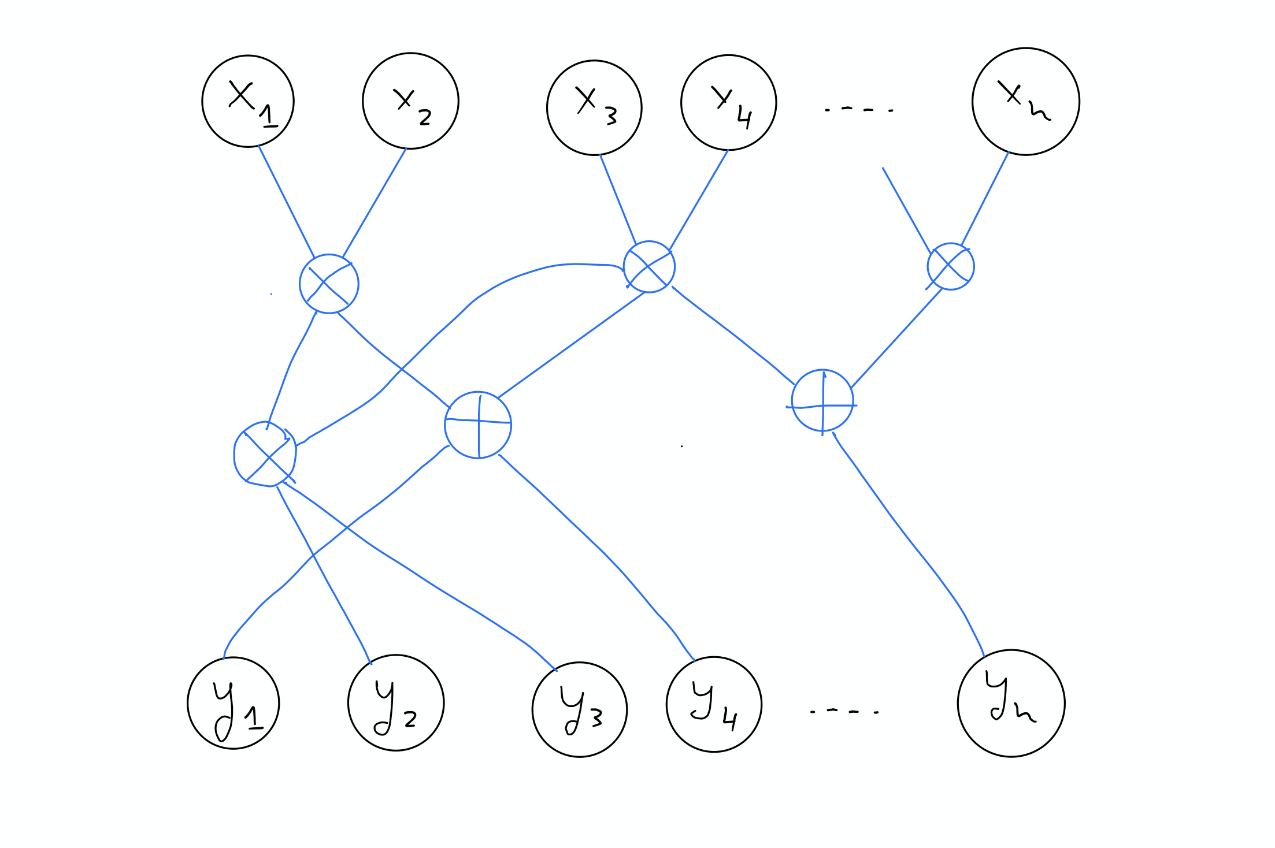
Hardness for linear transformations
Valiant’s problem (1976) – a classical lower bound problem :
Notes:
In complexity the most famous question is the P vs NP question, which is “the” lower bound question. Find a problem in NP that you can show is not in P.
There are many other such questions in restricted models, and this is one of them.

Slide 7
I Hardness for linear transformations
Valiant’s problem (1976) – a classical lower bound problem :
Implementing matrix-vector multiplication takes n² gates
Counting = = > most linear transformations require many gates, $n^{2}/\log{n}$
Lower bound goal: find an explicit transformation with such complexity
Notes:
Example: Fast Fourier Transform (exercise?)

Slide 8
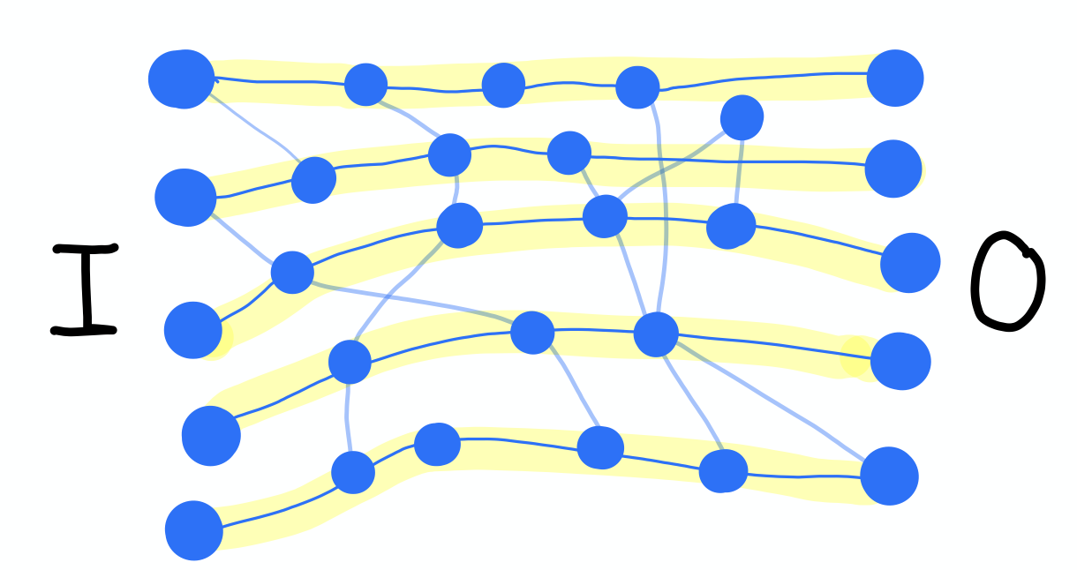
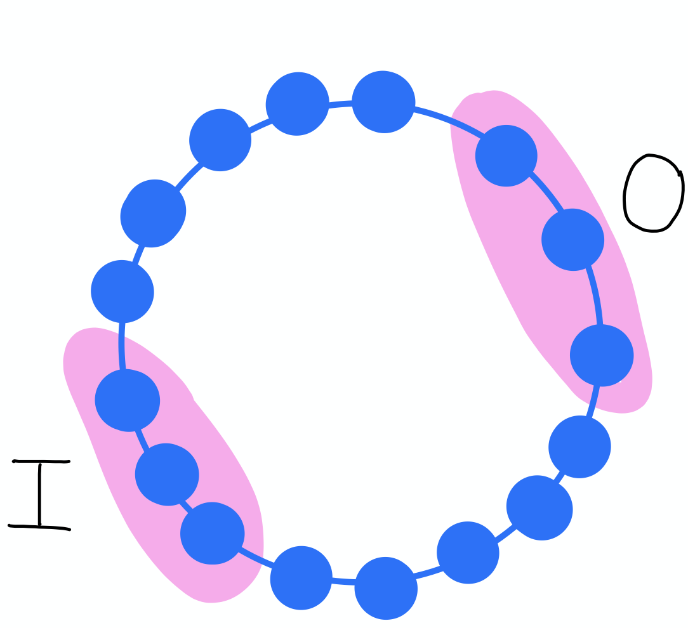
Super concentrators
Notes:
050

Slide 9
Valiant conjectured that a super concentrator must have many edges, super-linear
He later proved that that’s not true! Expanders imply sparse super-concentrators

Slide 10
II Error Correcting Codes
Shannon 1948 “A mathematical theory of communication”
Notes:
E translates messages to encodings = “E is an encoding”
Hope – can recover from some noise

Slide 11
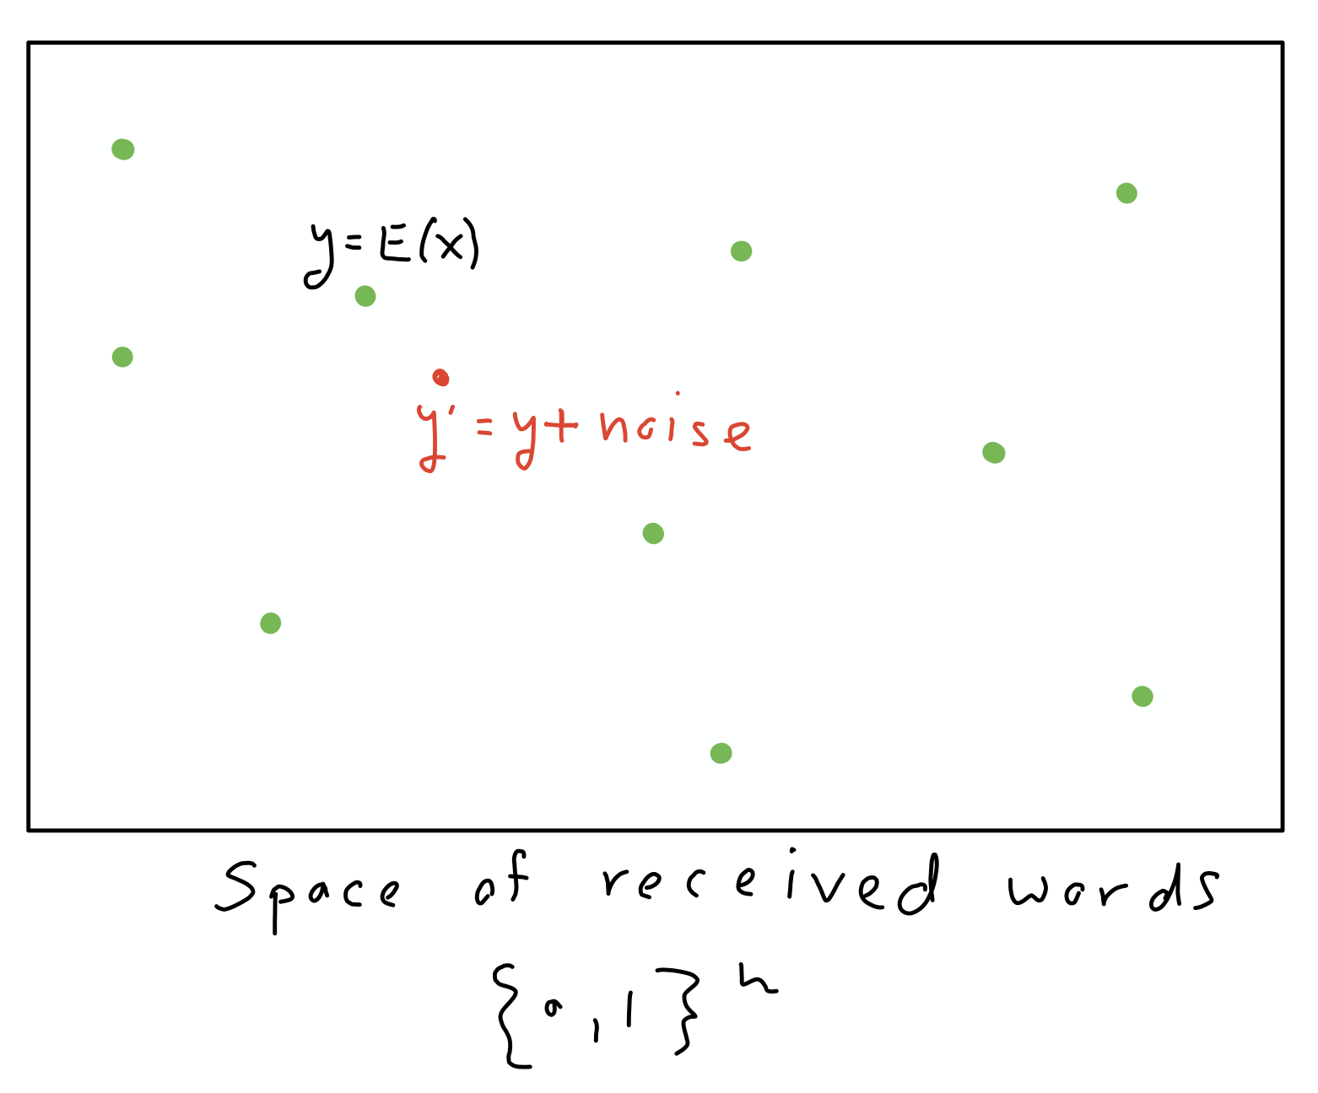
$$E:{\left\{0,1\right\}}^{k}→{\left\{0,1\right\}}^{n}$$
Bob can decode by searching for nearest codeword
If noise is moderate, and green points far apart – can uniquely recover
The relative distance of E is
$$δ= \frac{1}{n}\min_{x≠x′}{dist(E\left(x\right),E(x^{′}))}$$
The rate is $ρ=\frac{k}{n}$
A code family is good if $ρ,δ>0$
Are there good codes with efficient encoding / decoding?
Notes:
Decode by searching for nearest codeword
If few errors occurred, and green points far apart – can uniquely recover

Slide 12
III Error reduction in randomized algorithms
Randomized algorithms are sometimes simpler, and more powerful, than deterministic ones
Example: primality testing: given a number x, is it a prime number?
Rabin-Miller and Solovay Strassen gave randomized algorithms for this problem
A(x,r) is a (one-sided) randomized algorithm if for every input x,
If x is prime, Pr_{r}[A(x,r)=yes] = 1
If x is not prime, Pr_{r}[A(x,r)=yes] < ½
Can the ½ error be decreased?
Notes:
When can a randomized algorithm be stripped of its randomness?

Slide 13
III Error reduction in randomized algorithms
To decrease the error below ½, run the algorithm several times with fresh random strings r₁,r₂,…,r_{t}.
If x is prime, Pr_{r1,r2,…,rt}[A(x,r₁)=A(x,r₂)=…=A(x,r_{t})=yes] = 1
If x is not prime, Pr_{r1,r2,…,rt}[A(x,r₁)=A(x,r₂)=…=A(x,r_{t})=yes] < 1/2^{t}
Can this be done without using more random bits?
Notes:
When can a randomized algorithm be stripped of its randomness?

Slide 14
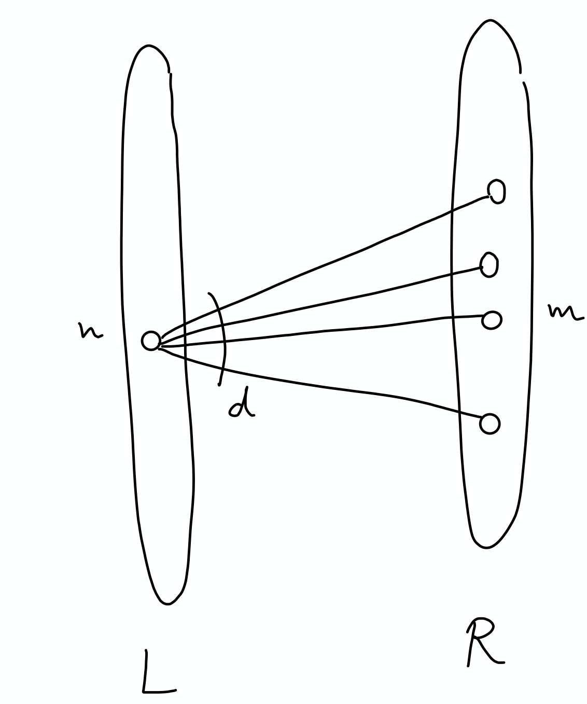
”magical” graphs

Slide 15
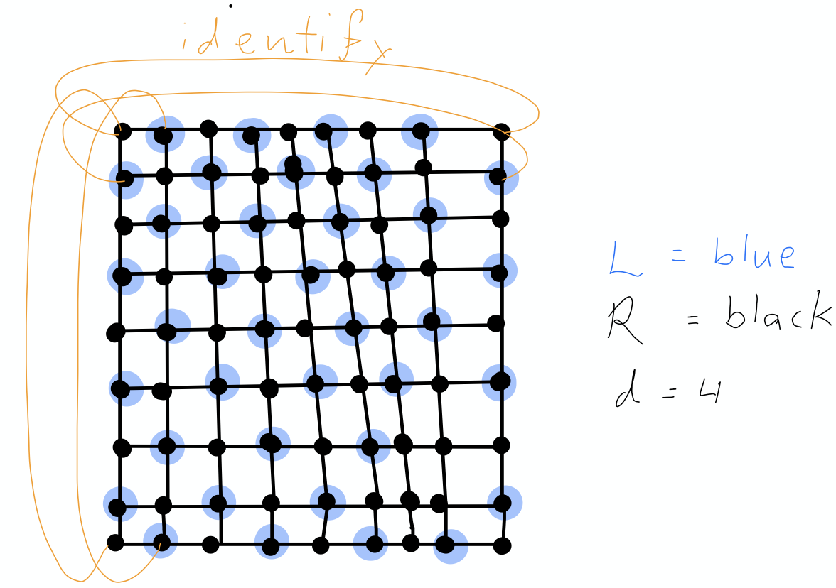
For example, is this a magical graph?
Notes:
Pick a “strip”, each vertex has a “unique” left nbr, and few boundary up/down ones. But not more. Certainly not times d/2.

Slide 17
THE END

Slide 18
Exercise
Exercise 1: show a lower bound on the number of linear transformations, and prove that most such require circuits with almost quadratic number of gates
Exercise 2: show that if A is super regular then it is an adjacency matrix of a graph that is a super concentrator
Exercise 3: show a greedy (non-algorithmic) construction of a code with positive rate and distance: enumerate all messages, and place their encoding in the large space in a greedy manner

