Slide 1
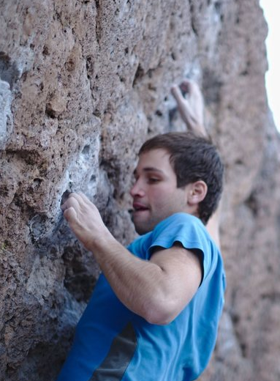
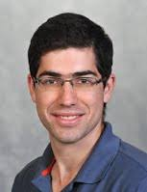

Instance Complexity and Unlabeled Certificates in the Decision Tree Model
Tomer Grossman Ilan Komargodski Moni Naor
Weizmann Institute
NTT→ Huji
Weizmann Institute
IRIF, Paris, Jan 23rd 2020 Algorithms and Discrete Structures Seminar

Slide 2
Unlabeled Certificates: What are they Good for?
Want to check whether a graph satisfies some (graph) property
  Given as an “untrusted hint” an isomorphic copy of the graph.
  The goal is to minimize the number queries to the adjacency matrix
  Are such hints helpful?
  In the worst case?
  Per instance?
  Where do the hints come from?
Want correctness even if the hint is wrong
Tested for efficiency only if the hint is correct
Represent knowledge of the structure of the graph, e.g. social network

Slide 3
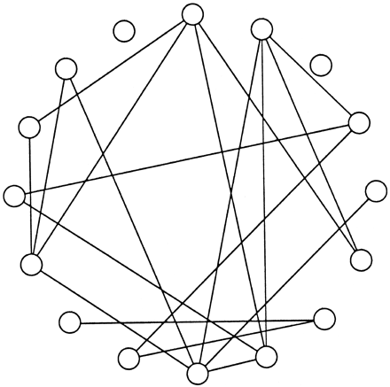
Example: Is there at least one edge?
?
The input graph
The hint

Slide 4
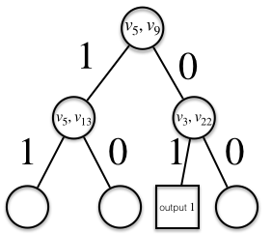
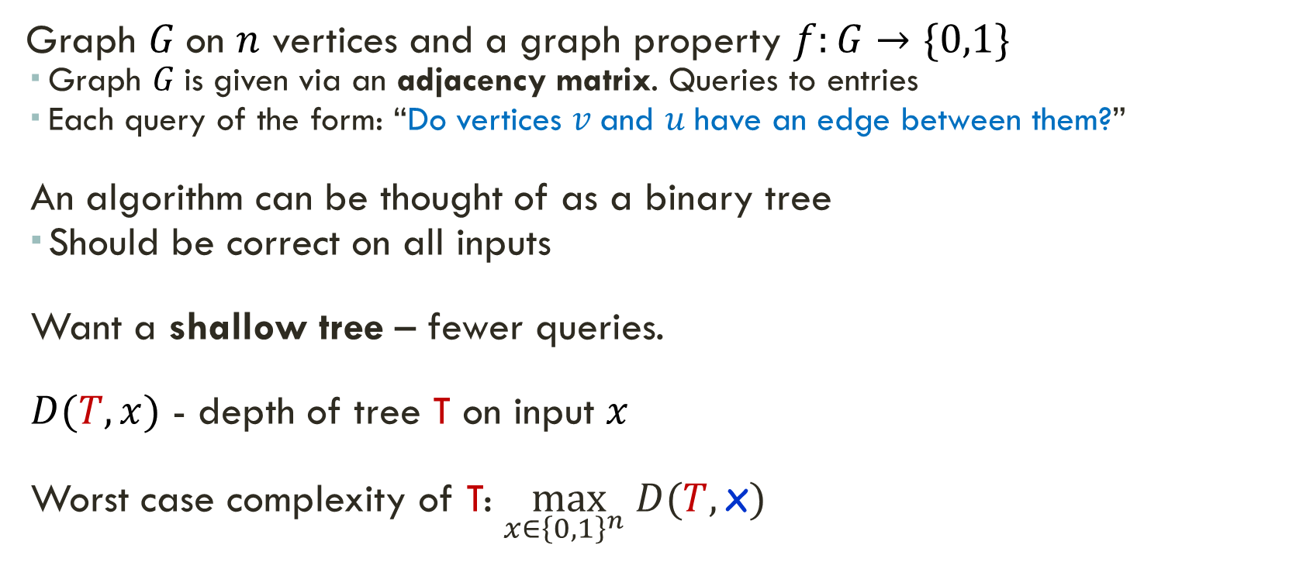
The Decision Tree Model
Labels on the leaves: value of function
Graph $G$on $n$ vertices and a graph property $f:G→\{0,1\}$
  Graph $G$is given via an adjacency matrix. Queries to entries
  Each query of the form: “Do vertices $v \text{and}$ $u$have an edge between them?”
  An algorithm can be thought of as a binary tree
  Should be correct on all inputs
  Want a shallow tree – fewer queries.
  $D(T,x)$ - depth of tree T on input $x$
  Worst case complexity of T: $\max_{x∈{\left\{0,1\right\}}^{n}} D(T,\text{x})$
Tree T

Slide 5

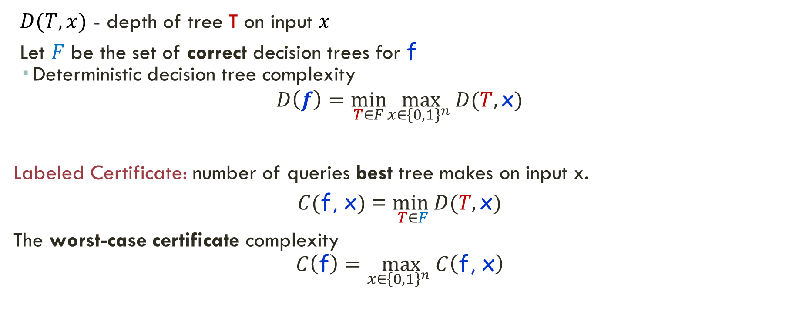
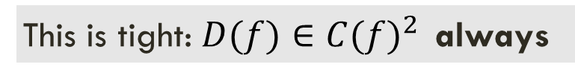
Labeled Certificates
Example: f = “there is an isolated node”
$D\left(f\right)$= $\left({n \atop 2}\right)$
But C$\left(f\right)=$ n-1
$D(T,x)$ - depth of tree T on input $x$
Let $F$ be the set of correct decision trees for f
  Deterministic decision tree complexity
$$D\left(f\right)=\min_{T∈F}\max_{x∈{\left\{0,1\right\}}^{n}} D(T,\text{x})$$
Labeled Certificate: number of queries best tree makes on input x.
$C(\text{f}\text{, }\text{x})$ = $\min_{T∈F}D(T,\text{x})$
The worst-case certificate complexity
$$C\left(\text{f}\right)=\max_{x∈{\left\{0,1\right\}}^{n}} C\left(\text{f}\text{, }\text{x}\right)$$
Among those that are always correct
This is tight: $D(f)∈C(f)^{2 }$ always

Slide 6
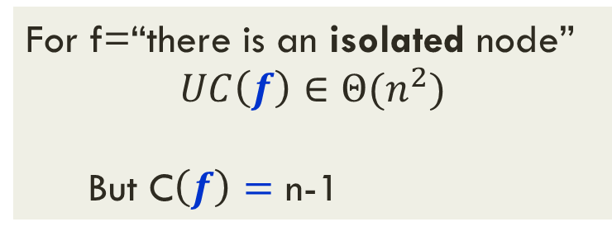
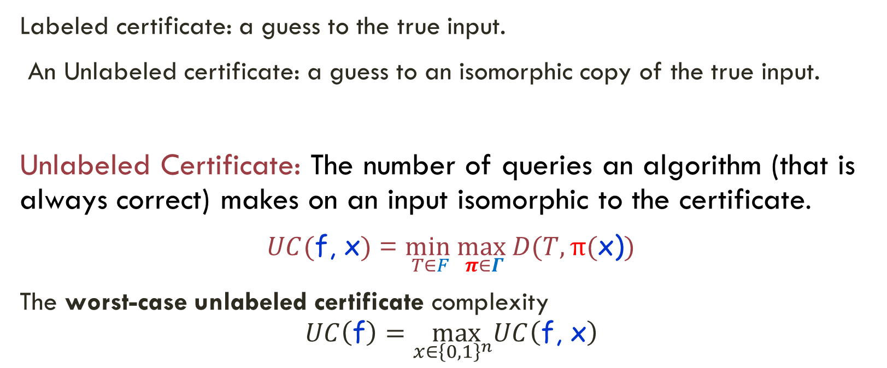
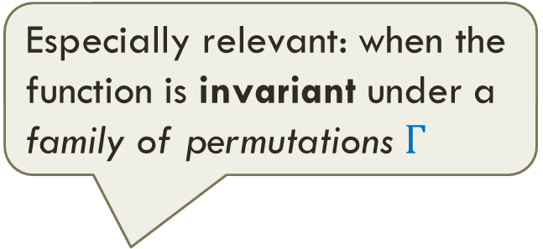

Unlabeled Certificates
Especially relevant: when the function is invariant under a family of permutations $Γ$
Labeled certificate: a guess to the true input.
An Unlabeled certificate: a guess to an isomorphic copy of the true input.
Unlabeled Certificate: The number of queries an algorithm (that is always correct) makes on an input isomorphic to the certificate.
$UC(\text{f}\text{, }\text{x})$ = $\min_{T∈F}\max_{π∈Γ}D(T,π\text{(}\text{x}\text{)})$
The worst-case unlabeled certificate complexity
$$UC\left(\text{f}\right)=\max_{x∈{\left\{0,1\right\}}^{n}}UC\left(\text{f}\text{, }\text{x}\right)$$
For f=“there is an isolated node”
$$UC\left(f\right)∈{Θ(n}^{2})$$
  But C$\left(f\right)=$ n-1
$$D(f)≥UC(f)≥C(f)$$

Slide 7
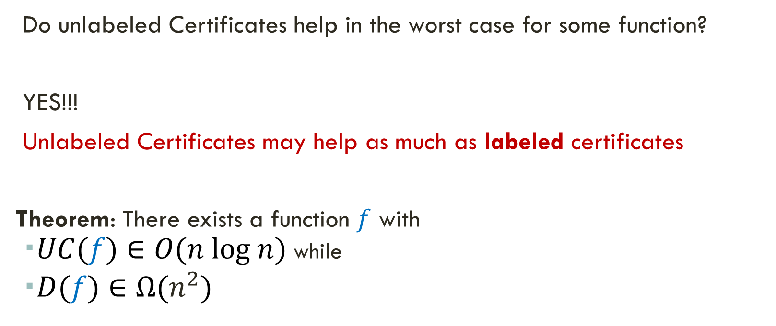
Do Unlabeled Certificates Ever Help in the Worst Case?
Do unlabeled Certificates help in the worst case for some function?
YES!!!
Unlabeled Certificates may help as much as labeled certificates
Theorem: There exists a function $f$ with
  $UC(f)∈O(n log n)$ while
  $D(f)∈Ω(n^{2})$
Do not know any simple function!
Monotone?

Slide 8
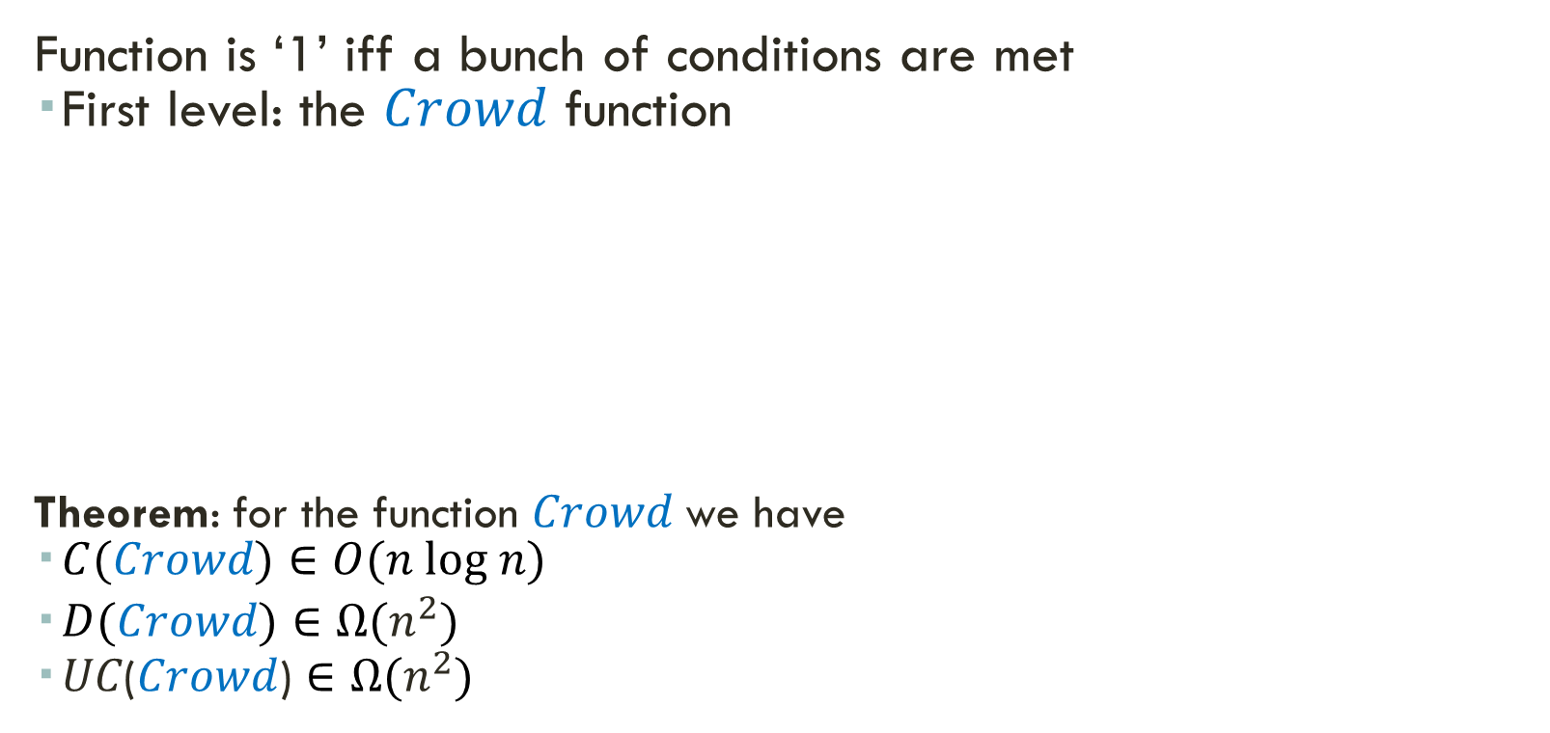
The Construction
Function is ‘1’ iff a bunch of conditions are met
  First level: the $Crowd$ function
Theorem: for the function $Crowd$we have
  $C(Crowd)∈O(n log n)$
  $D(Crowd)∈Ω(n^{2})$
  𝑈𝐶($Crowd$) $∈Ω(n^{2})$
The Crowd: all vertices must have degree at least log n among themselves
Goal: turn the unlabeled certificate into an effectively labeled one for the crowd.

Slide 9
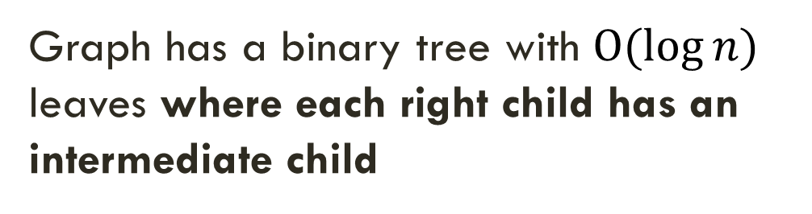
…The Construction
Gives direction.
Breaks symmetry
Graph has a binary tree with $O(log{n)}$ leaves where each right child has an intermediate child
PP
P
log log n
Additional condition: No two vertices in the Crowd have the same neighborhood when restricted to the leaves of the tree
The Crowd: all vertices must have degree at least log n among themselves

Slide 10
…The Construction
Add two additional nodes T₁ and T₂ connected just to P
Add node B connected to all nodes, except T₁ and T₂.
T₁
T₂
B
P
log log n
  Additional condition: No leaf has degree five or less.
  Special nodes: degree 1, 2, 5 and n-3
No two vertices in the Crowd should have same neighborhood in the leaves
The Crowd: all vertices must have degree at least log n among themselves

Slide 11
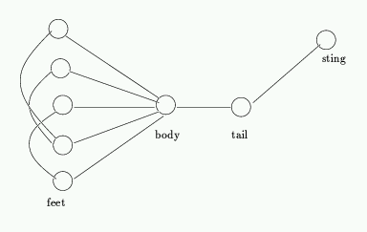
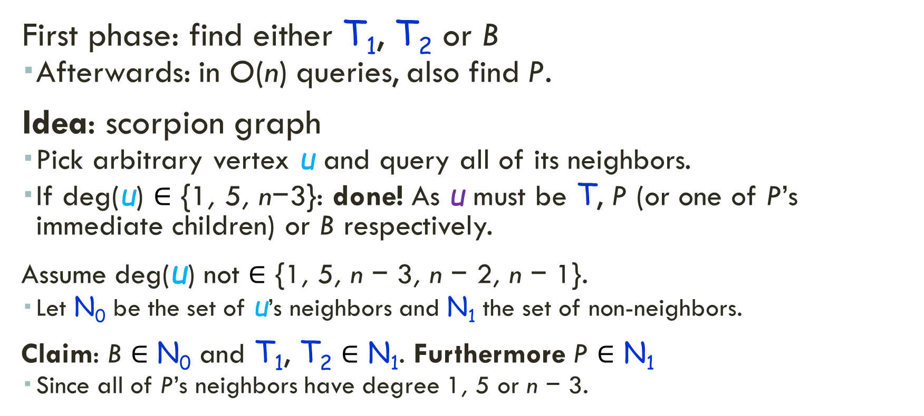
The Algorithm with the Unlabeled Certificate
Best, van Emde Boas
Lenstra
T₁
T₂
B
P
First phase: find either T₁, T₂ or B
  Afterwards: in O(n) queries, also find P.
Idea: scorpion graph
  Pick arbitrary vertex u and query all of its neighbors.
  If deg(u) $∈$ {1, 5, n−3}: done! As u must be T, P (or one of P’s immediate children) or B respectively.
Assume deg(u) not $∈$ {1, 5, n − 3, n − 2, n − 1}.
  Let N₀ be the set of u’s neighbors and N₁ the set of non-neighbors.
Claim: B $∈$ N₀ and T₁, T₂ $∈$ N₁. Furthermore P $∈$ N₁
  Since all of P’s neighbors have degree 1, 5 or n − 3.
N₀
u
N₁

Slide 12
The Algorithm: Finding P
Do not need the certificate!
Candidates for B
Candidates for T₁ or T₂
u
Pick arbitrary vertex u
Assume deg(u)≠{1,5,n-3}
If (v₁, v₂) is an edge: v₂ cannot be T₁ or T₂
If (v₁, v₂) is not an edge: v₁ cannot be B
T₁
T₂
B
T₁
B
P
T₂
P
No two vertices in the Crowd have same neighborhood in the leaves
v₁
?
The Crowd: all vertices must have degree at least log n among themselves
v₂
N₀
N₁

Slide 13
The Construction: Finding the Mapping
After finding P: full tree can be recovered.
Given the leaves: can find the mapping between nodes in
the crowd and the nodes in the graph.
  Can check the min degree.
Total:
  Finding P: O(n) queries
  Finding the tree: O(n log n) queries
  Finding the mapping O(n log n) queries
P
log log n

Slide 14
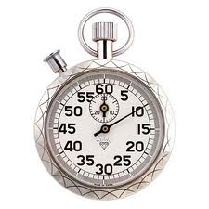

Worst Case Analysis of Algorithms
Worst case analysis of algorithms is the hallmark of theoretical computer science
For a given algorithm A find an input D on which A has the worst performance
  Evaluate the algorithm based on this value
But is it meaningful?
Yes – sometimes!
Prefer algorithms with
small worst case value
Lots of nice properties:
Composition
When the input is adversarially chosen
When we want to have a fixed upper bound on the complexity: hardware, timing attacks

Slide 15
Some Known Properties of Decision Tree Complexity
RC(f) ≤ C(f) ≤ D(f) ≤ n
and RC(f) ≤ R(f) ≤ D(f).
C(f) ≤ s(f) ∙ bs(f)
D(f) ≤ s(f)∙ bs(f)² ≤ bs(f)³
bs(f) ≤ s(f)⁴
D(f) ≤ C(f)²
bs(f) ≤ 3RC(f)
For every monotone Boolean function f:
C(f) = s(f) = bs(f)
Randomized Complexity R(f) : distribution on decision trees
Correct on all inputs with probability at least 2/3
s(f) – Sensitivity bs(f) – Block sensitivity
Extensively studied
  Unconditional lower bounds
  Useful step for lower bounds in other models (“lifting”)
Major findings: polynomial relations between notions
Exact relationships still open

Slide 16
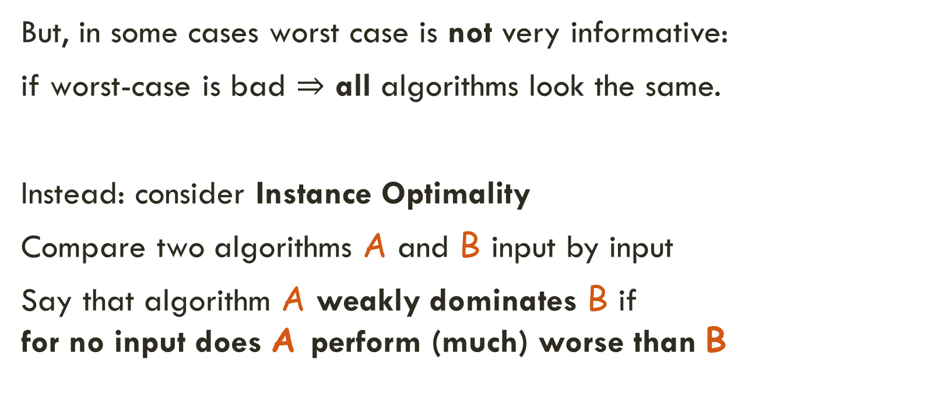
Worst Case vs. Instance by Instance
But, in some cases worst case is not very informative:
if worst-case is bad $⇒$ all algorithms look the same.
Instead: consider Instance Optimality
Compare two algorithms A and B input by input
Say that algorithm A weakly dominates B if
  for no input does A perform (much) worse than B

Slide 17
Instance Optimality of Decision Trees
Let f: {0,1}^{n}  {0,1}
Intuition: want to compare complexity of f on each input to the best possible algorithm per input
  Deterministic
  Randomized
  Unlabeled
Terminology:
  Algorithm or decision tree is instance optimal
  Function is instance optimizable
Characterizations
Unlabeled
certificates
Deterministic vs.
Randomized IO
Are there IO
functions?

Slide 18
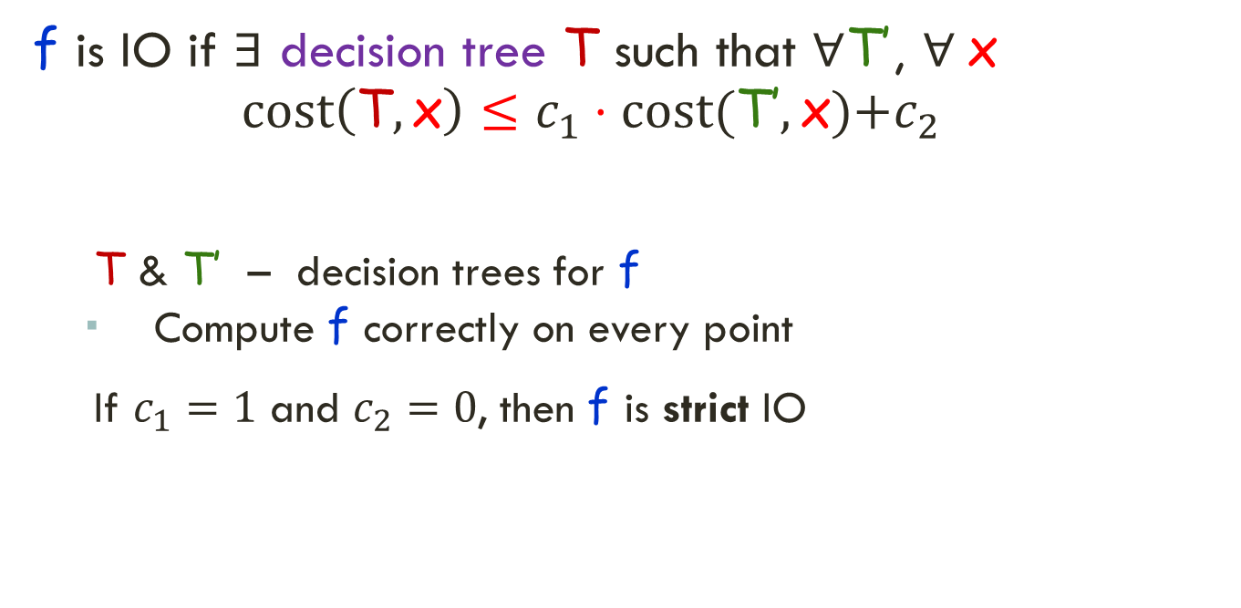
Instance Optimality of Decision Trees
f is IO if $∃$ decision tree T such that $∀$T’, $∀$x
  $$cost\left(\text{T}, \text{x}\right)≤c_{1}⋅cost(\text{T}\text{’},\text{x}\text{)+}c_{2}$$
T & T’ – decision trees for f
  Compute f correctly on every point
If $c_{1}=1$ and $c_{2}=0$, then f is strict IO
Certificate complexity
of f on input x
Characterizations
Unlabeled
certificates
Deterministic vs.
Randomized IO
Are there IO
functions?

Slide 19

Instance Optimality of Decision Trees
Two Instance Optimizable functions:
  Parity f($\text{x}\text{1}$, $\text{x}\text{2}$, …, $\text{x}\text{n}$) = $\sum_{i=1}^{n}{\text{x}\text{i}}$ mod 2
  Address f(i, $\text{x}\text{1}$, $\text{x}\text{2}$, …, $\text{x}\text{n}$) = $\text{x}\text{i}$
All certificates
are of size n
1≤ i ≤ n
log n bits
There is always a certificate of size 1+log n
  And none smaller

Slide 20
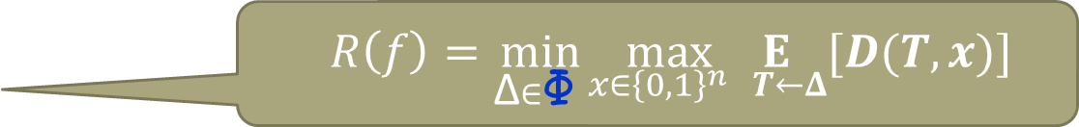
Instance Optimality of Decision Trees
  Instance optimal deterministic and randomized are incomparable!
    There are functions that are one but not the other
    The saga of majority: very sensitive to the model
      Deterministic
      Randomized
      Unlabeled – bits
      Unlabeled – graphs
    Is IO preserved under Composition?
Bounded error
  $$R\left(f\right)=\min_{\text{Δ}∈\text{Φ} }\max_{x∈{\left\{0,1\right\}}^{n}}\underset{ T←Δ}{E}[D(T, x)]$$
Permutation group changes: edges vs. nodes

Slide 21
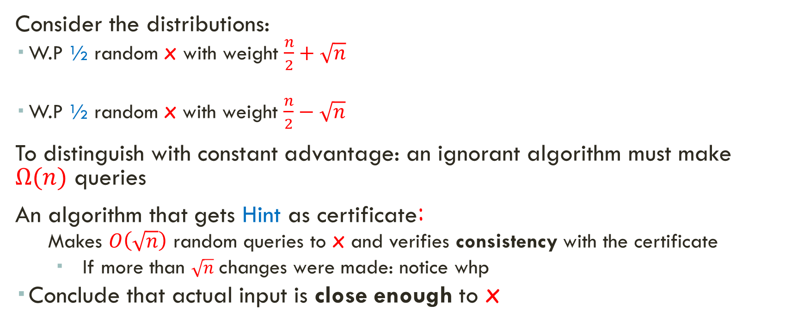
Majority is not Randomized IO vs. Labeled Certificates
x
1
0
1
0
1
0
1
1
0
1
Consider the distributions:
  W.P ½ random x with weight $\frac{n}{2}+\sqrt{n}$
  W.P ½ random x with weight $\frac{n}{2}−\sqrt{n}$
To distinguish with constant advantage: an ignorant algorithm must make $Ω(n)$ queries
An algorithm that gets Hint as certificate:
  Makes $O\left(\sqrt{n}\right)$ random queries to x and verifies consistency with the certificate
    If more than $\sqrt{n}$ changes were made: notice whp
  Conclude that actual input is close enough to x
Hint
1
0
1
0
1
0
1
1
0
0

Slide 22
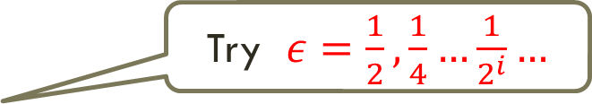
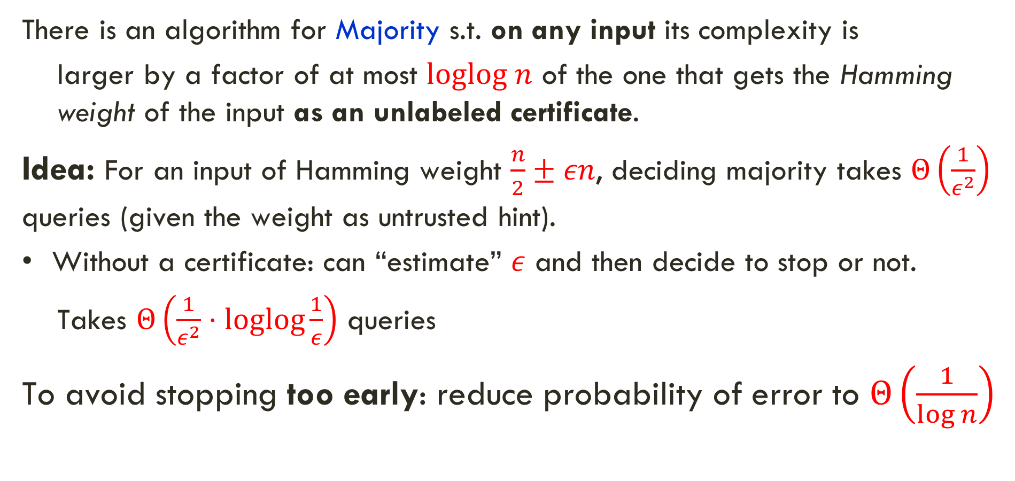
Majority is (almost) Unlabeled IO
There is an algorithm for Majority s.t. on any input its complexity is
  larger by a factor of at most $loglog n$ of the one that gets the Hamming weight of the input as an unlabeled certificate.
Idea: For an input of Hamming weight $\frac{n}{2}±εn$, deciding majority takes $Θ\left(\frac{1}{ε^{2}}\right)$ queries (given the weight as untrusted hint).
Without a certificate: can “estimate” $ε$ and then decide to stop or not.
  Takes $Θ\left(\frac{1}{ε^{2}}⋅loglog\frac{1}{ε}\right)$ queries
To avoid stopping too early: reduce probability of error to $Θ\left(\frac{1}{\log{n}}\right)$
Try $ε=\frac{1}{2},\frac{1}{4}…\frac{1}{2^{i}}…$
Sequential hypothesis testing
[Daskalakis-Kawase17]

Slide 23
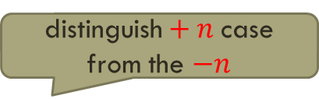
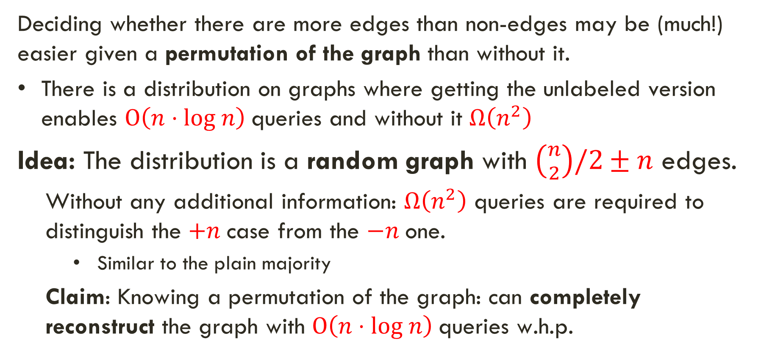
Majority as a Graph Property is not Unlabeled IO
Deciding whether there are more edges than non-edges may be (much!) easier given a permutation of the graph than without it.
There is a distribution on graphs where getting the unlabeled version enables $O\left(n⋅log n\right)$ queries and without it $Ω\left(n^{2}\right)$
Idea: The distribution is a random graph with $\left({n \atop 2}\right)/2±n$ edges.
  Without any additional information: $Ω\left(n^{2}\right)$ queries are required to distinguish the $+n$case from the $−n$one.
    Similar to the plain majority
  Claim: Knowing a permutation of the graph: can completely reconstruct the graph with $O\left(n⋅log n\right)$ queries w.h.p.
$\text{distinguish}+n$case from the $−n$

Slide 24
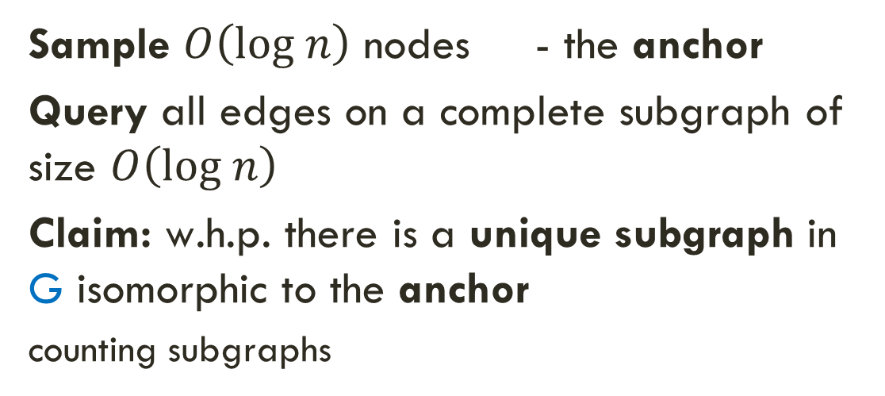
Majority as a Graph Property is not Unlabeled IO
Sample $O\left(log n\right)$ nodes - the anchor
Query all edges on a complete subgraph of size $O\left(log n\right)$
Claim: w.h.p. there is a unique subgraph in G isomorphic to the anchor
counting subgraphs
Graph G

Slide 25
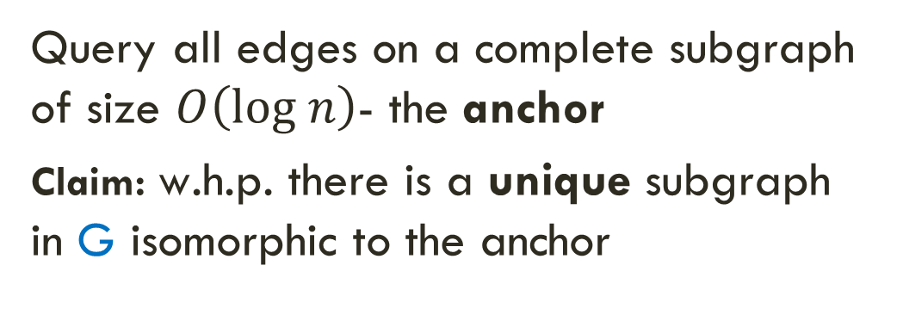
Majority as a Graph Property is not Unlabeled IO
Query all edges on a complete subgraph of size $O\left(log n\right)$- the anchor
Claim: w.h.p. there is a unique subgraph in G isomorphic to the anchor
For each other vertex: query all adjacent edges to the anchor
Claim: w.h.p each vertex is uniquely connected to the anchor (random graph + union bound)
Graph G

Slide 26
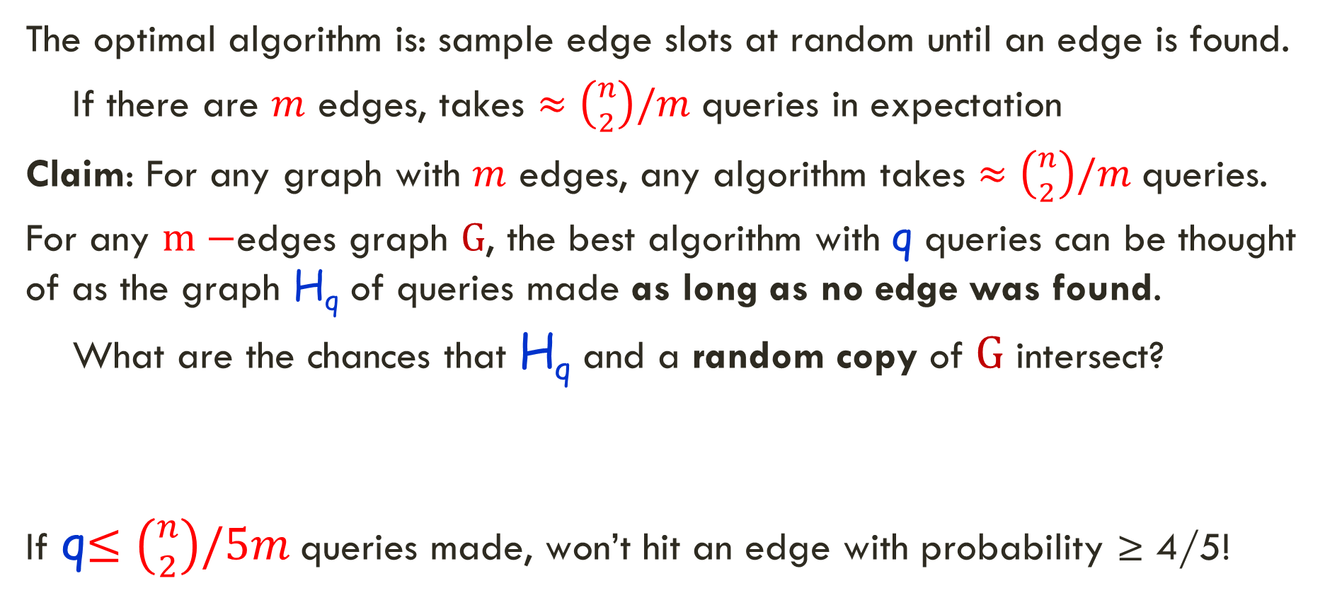
“At least one edge” is Unlabeled IO
Until an edge is found: unlabeled certificate useless
The optimal algorithm is: sample edge slots at random until an edge is found.
  If there are $m$ edges, takes $≈\left({n \atop 2}\right)/m$ queries in expectation
Claim: For any graph with $m$ edges, any algorithm takes $≈\left({n \atop 2}\right)/m$ queries.
For any $m−$edges graph G, the best algorithm with q queries can be thought of as the graph $\text{H}\text{q}$ of queries made as long as no edge was found.
  What are the chances that $\text{H}\text{q}$ and a random copy of G intersect?
If q$≤\left({n \atop 2}\right)/5m$ queries made, won’t hit an edge with probability ≥ 4/5!

Slide 27
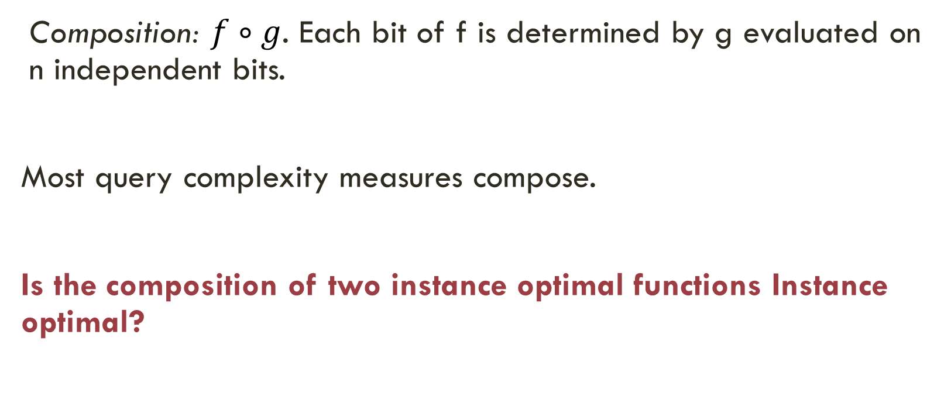
Function Composition
Composition: $f∘g$. Each bit of f is determined by g evaluated on n independent bits.
Most query complexity measures compose.
Is the composition of two instance optimal functions Instance optimal?

Slide 28
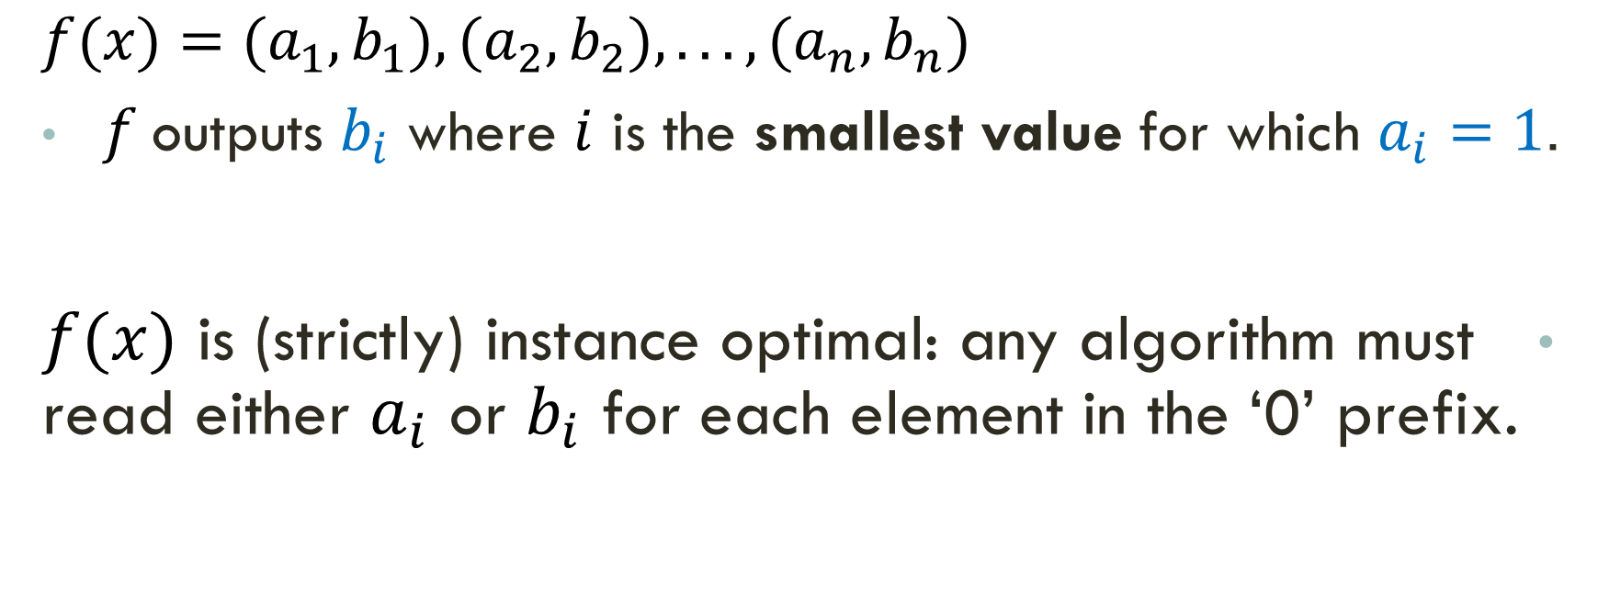
Instance Optimality Does not compose
$$f(x)=(a_{1},b_{1}),(a_{2},b_{2}),...,(a_{n},b_{n})$$
$f$outputs $b_{i}$ where $i$ is the smallest value for which $a_{i}=1$.
$f(x)$ is (strictly) instance optimal: any algorithm must read either $a_{i}$ or $b_{i}$ for each element in the ‘0’ prefix.

Slide 29
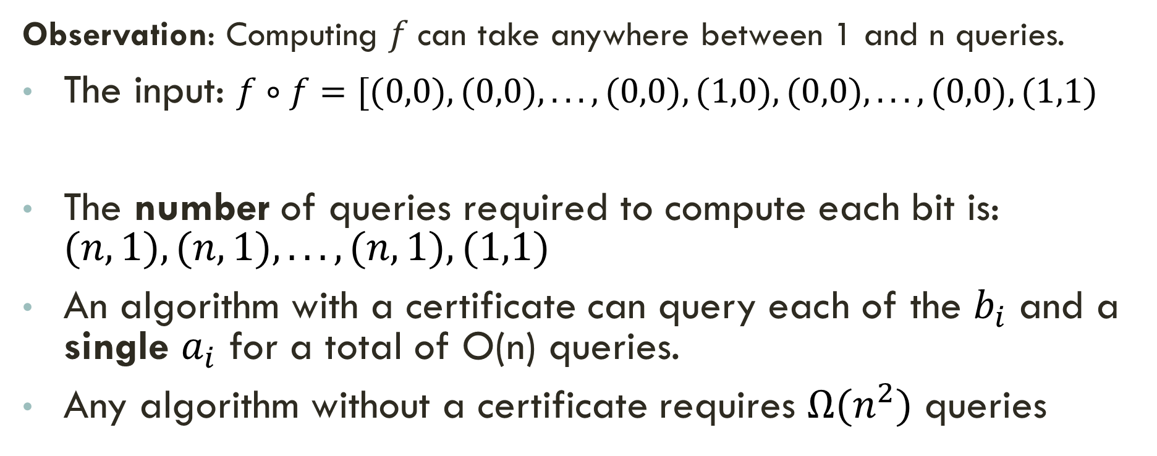
Instance Optimality Does not compose
Observation: Computing $f$can take anywhere between 1 and n queries.
The input: $f∘f=[(0,0),(0,0),...,(0,0),(1,0),(0,0),...,(0,0),(1,1)$
The number of queries required to compute each bit is: $(n,1),(n,1),...,(n,1),(1,1)$
An algorithm with a certificate can query each of the $b_{i}$ and a single $a_{i}$ for a total of O(n) queries.
Any algorithm without a certificate requires $Ω(n^{2})$ queries
f((0,0),(0,0)…(1,0))
f((1,0), …
f((0,0),(0,0)…(1,1))

Slide 30
Further Research:
  Conjecture: Every non-trivial monotone graph property is not R-instance optimizable in the labeled case
What is the complexity of testing whether a given function f is instance optimizable?
Does evasiveness hold in the unlabeled model?
  Can the result of Rivest and Vuillemin be extended to algorithms with an unlabeled certificate?
  Do deterministic decision tree algorithms require querying a constant fraction of the edges for any non-trivial monotone graph property, even given a permutation of the given graph?
Can check whether a given tree is instance optimal for a given function
Thanks!

Slide 31
Instance Optimality
How widely applicable is instance optimality?
  Pick your favorite domain and suggest an instance optimal algorithm
  Is there a general theory of instance algorithms?

Slide 32
Instance Optimality is Widely Applicable
Term from Fagin-Lotem-Naor
Instance Optimal Convex Hull Algorithms
  Afshani, Barbay & Chan, FOCS 2009
Distributed computing:
  Dwork-Moses, Byzantine agreement optimal for every crash sequence, 1986-90
  Elkin’s algorithm for MST, 2003-07
Sleator and Tarjan’s Splay Tree conjecture: Instance Optimality of Binary Search Trees
  Demaine, Harmon, Iacono, Kane & Pătraşcu, SODA 2009
Precise Zero-Knowledge: Simulator works as hard as the verifier per instance
  Micali and Pass, STOC 2006
  Learning distributions (Valiant^2)
Most similar to the unlabeled model:
Shape is known, names unknown

