Slide 1




The Journey from NP to
TFNP Hardness
Pavel Hubáček
Moni Naor
Eylon Yogev
Now at IDC
en route to
Charles U.
Weizmann Institute of Science
SurpriseBonus

Slide 2
I rarely end up where I was intending to go, but often I end up somewhere I needed to be.
Douglas Adams

Slide 3
TFNP – Total Function NP [MP91]
Megiddo and Papadimitriou
NP: easy to verify decision problems
FNP: easy to verify search problems
  Given an instance x, find a valid witness for x
TFNP: a subclass of FNP with guaranteed solution
FNP
coNP
NP
TFNP
P
FP
Notes:
Try to prune the text, be more succinct e.g.,
NP: easy to verify decision problems
FNP: easy to verify search problems
TFNP: search problems in FNP with guaranteed solution

Slide 4





Complexity Zoo
Polynomial Pigeonhole Principle
[Pap94]
$$TFNP$$
Local Optimum
[JPY88]
$$PPP$$
$$PLS$$
$$PPAD$$
Nash Equilibrium
Brouwer Fixed Points
[Pap94,DGP09, CDT09]
Continuous Local Optimum
[DP11]
$$CLS$$
Oracle separations
Notes:
Do you need PPA??
If you cut it the slide would be simpler.
Also, CLS is aligned a bit weird.

Slide 5
Hardness
Collision resistant hash /
one-way permutation
[Pap94]
P ≠ NP ?
$$TFNP$$
$$PPP$$
$$PLS$$
$$PPAD$$
Obfuscation
[BPR15, GPS16]
End-of-line
$$CLS$$
Obfuscation
[HY17]

Slide 6
WHAT IS THE WEAKEST ASSUMPTION UNDER WHICH WE CAN SHOW HARDNESS OF TFNP?

Slide 7
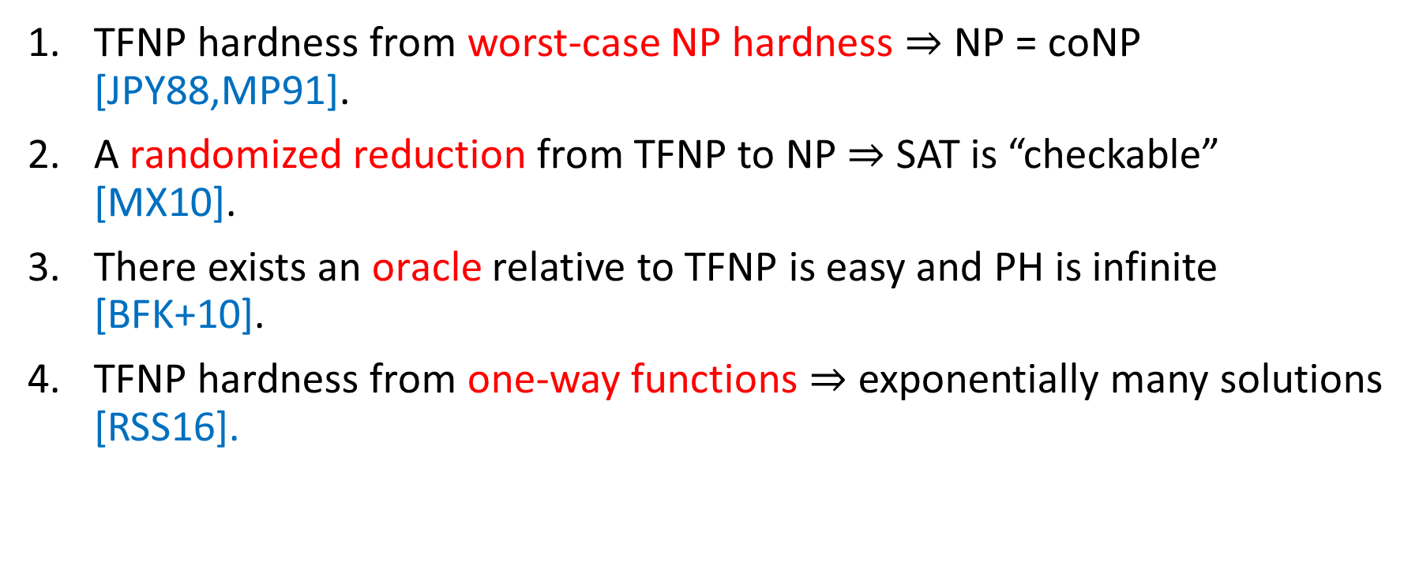
Barriers for Proving TFNP Hardness
TFNP hardness from worst-case NP hardness $⇒$ NP = coNP
[JPY88,MP91].
A randomized reduction from TFNP to NP $⇒$ SAT is “checkable”
[MX10].
There exists an oracle relative to TFNP is easy and PH is infinite
[BFK+10].
TFNP hardness from one-way functions $⇒$ exponentially many solutions [RSS16].
Mahmoody and Xiao
Buhrman, Fortnow, Koucky, Rogers and Vereshchagin
Rosen, Segev, Shahaf
Notes:
Maybe decrease the font size a bit and try to make the each item fit a single line.

Slide 8

The Five Worlds of Impagliazzo
Algorithmica:
P = NP
Heuristica:
P $≠$ NP but
NP is easy-on-average
Heuristica:
P ≠ NP but
NP is easy-on-average
Pessiland:
NP is hard-on-average but $∄$ one-way functions
Pessiland:
NP is hard-on-average but ∄ one-way functions
Minicrypt:
$∃$ one-way functions but $∄$ public-key crypto
Minicrypt:
∃ one-way functions but ∄ public-key crypto
Cryptomania:
$∃$ public-key cryptography
Cryptomania:
∃ public-key cryptography
Obfustopia:
$∃$ indistinguishability obfuscation
Notes:
This is a nice slide

Slide 9
The Five Worlds of Impagliazzo
Algorithmica:
P = NP
Heuristica:
P $≠$ NP but
NP is easy-on-average
Heuristica:
P ≠ NP but
NP is easy-on-average
Pessiland:
NP is hard-on-average but $∄$ one-way functions
Pessiland:
NP is hard-on-average but ∄ one-way functions
Minicrypt:
$∃$ one-way functions but $∄$ public-key crypto
Minicrypt:
∃ one-way functions but ∄ public-key crypto
Cryptomania:
$∃$ public-key cryptography
Cryptomania:
∃ public-key cryptography
Obfustopia:
$∃$ indistinguishability obfuscation

Slide 10
The Five Worlds of Impagliazzo
Algorithmica:
P = NP
Heuristica:
P $≠$ NP but
NP is easy-on-average
Heuristica:
P ≠ NP but
NP is easy-on-average
Pessiland:
NP is hard-on-average but $∄$ one-way functions
Pessiland:
NP is hard-on-average but ∄ one-way functions
Minicrypt:
$∃$ one-way functions but $∄$ public-key crypto
Minicrypt:
∃ one-way functions but ∄ public-key crypto
Cryptomania:
$∃$ public-key cryptography
Cryptomania:
∃ public-key cryptography
Obfustopia:
$∃$ indistinguishability obfuscation

Slide 11
Our Results
TFNP hardness can be based on
any hard-on-average language in NP
For example: planted clique, random SAT, etc.
In particular, any one-way function
Our results show:
hard-on-average TFNP problems exist in Pessiland (and beyond)
Notes:
No need for case: planted clique, random SAT

Slide 12
The Five Worlds of Impagliazzo
Algorithmica:
P = NP
Heuristica:
P $≠$ NP but
NP is easy-on-average
Heuristica:
P ≠ NP but
NP is easy-on-average
Pessiland:
NP is hard-on-average but $∄$ one-way functions
Pessiland:
NP is hard-on-average but ∄ one-way functions
Minicrypt:
$∃$ one-way functions but $∄$ public-key crypto
Minicrypt:
∃ one-way functions but ∄ public-key crypto
Cryptomania:
$∃$ public-key cryptography
Cryptomania:
∃ public-key cryptography
Obfustopia:
$∃$ indistinguishability obfuscation

Slide 13
The Five Worlds of Impagliazzo
Algorithmica:
P = NP
Heuristica:
P $≠$ NP but
NP is easy-on-average
Heuristica:
P ≠ NP but
NP is easy-on-average
Pessiland:
NP is hard-on-average but $∄$ one-way functions
Pessiland:
NP is hard-on-average but ∄ one-way functions
Minicrypt:
$∃$ one-way functions but $∄$ public-key crypto
Minicrypt:
∃ one-way functions but ∄ public-key crypto
Cryptomania:
$∃$ public-key cryptography
Cryptomania:
∃ public-key cryptography
TFNP Hardness
Obfustopia:
$∃$ indistinguishability obfuscation

Slide 14
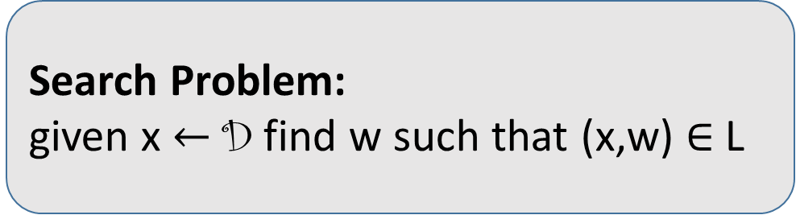
Proof
Let $L∈NP$ be a hard-on-average language with distribution D
{0,1}^{n}
D
L
Not in TFNP
x
Search Problem:
given x $←$ D find w such that (x,w) $∈$ L

Slide 15
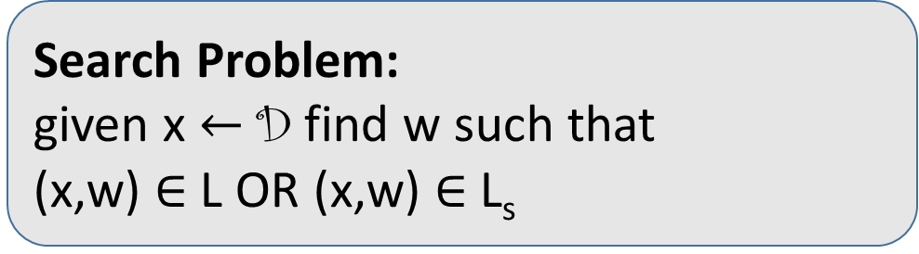
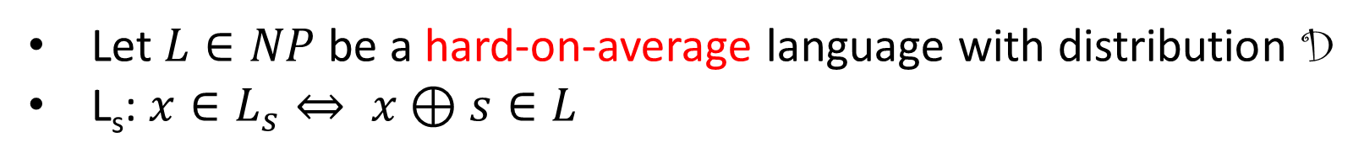
Reverse Randomization
Let $L∈NP$ be a hard-on-average language with distribution D
L_{s}: $x∈L_{s}⇔ x⊕s∈L$
{0,1}^{n}
L_{s}
D
L
x
Search Problem:
given x $←$ D find w such that
(x,w) $∈$ L OR (x,w) $∈$ L_{s}

Slide 16
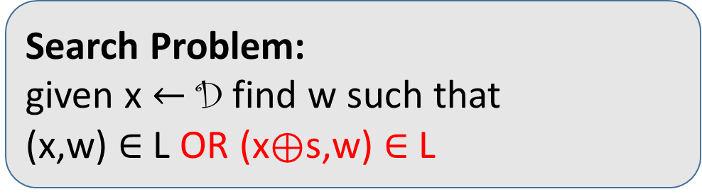

Reverse Randomization
Let $L∈NP$ be a hard-on-average language with distribution D
L_{s}: $x∈L_{s}⇔ x⊕s∈L$
{0,1}^{n}
L_{s}
D
Not hard distribution
L
Distributed according to D
Random shift of D
x
Search Problem:
given x $←$ D find w such that
(x,w) $∈$ L OR (x$⊕$s,w) $∈$ L

Slide 17

Proof
L’: r $∈$ L’ $⇔$ D(r) $∈$ L
{0,1}^{m}
D
{0,1}^{n}
L’
L
r
x

Slide 18
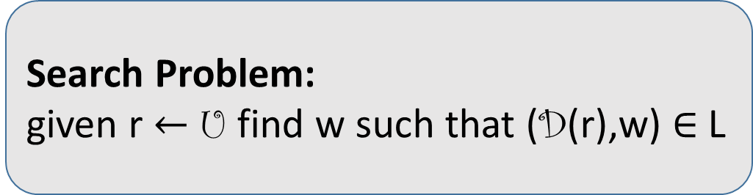
Proof
L’: r $∈$ L’ $⇔$ D(r) $∈$ L
{0,1}^{m}
U
r
Search Problem:
given r $←$ U find w such that (D(r),w) $∈$ L
L’
r
Notes:
The same as for curly D and normal D goes also for curly U and normal U.

Slide 19
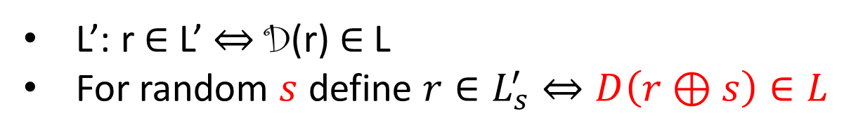

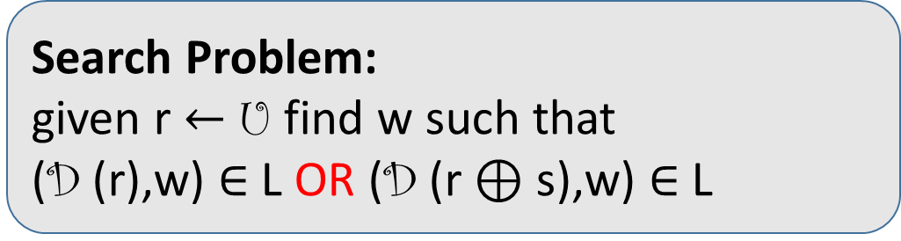
Proof
L’: r $∈$ L’ $⇔$ D(r) $∈$ L
For random $s$ define $r∈L_{s}^{′}⇔D\left(r⊕s\right)∈L$
{0,1}^{m}
U
r
Search Problem:
given r $←$ U find w such that
(D (r),w) $∈$ L OR (D (r $⊕$ s),w) $∈$ L
L’
r
$$L_{s}^{′}$$
Notes:
Typo: L’_i in the bullet point

Slide 20
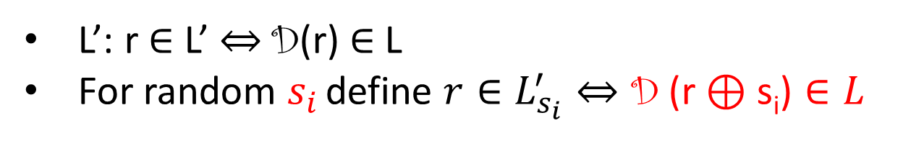

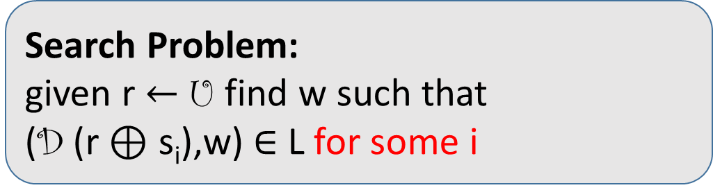
Proof
L’: r $∈$ L’ $⇔$ D(r) $∈$ L
For random $s_{i}$ define $r∈L_{s_{i}}^{′}⇔\text{D}\text{ (}\text{r}⊕\text{s}\text{i}\text{)}∈L$
{0,1}^{m}
U
r
Search Problem:
given r $←$ U find w such that
(D (r $⊕$ s_{i}),w) $∈$ L for some i
L’
r
$$L_{s_{1}}^{′}$$
Notes:
Typos: L’_i in the bullet point and L’_{s_1} in the picture

Slide 21
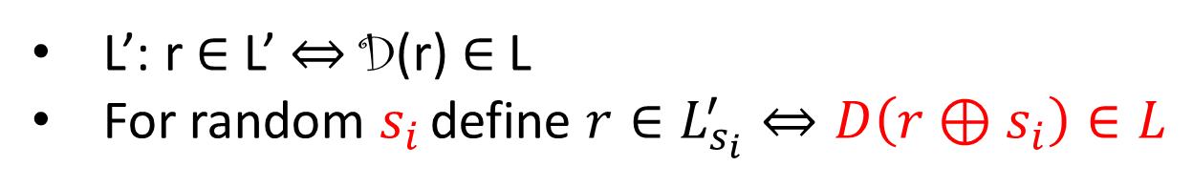
Proof
L’: r $∈$ L’ $⇔$ D(r) $∈$ L
For random $s_{i}$ define $r∈L_{s_{i}}^{′}⇔D\left(r⊕s_{i}\right)∈L$
{0,1}^{m}
U
r
Search Problem:
given r $←$ U find w such that
(D (r $⊕$ s_{i}),w) $∈$ L for some i
L’
r
$$L_{s_{1}}^{′}$$
Hard distribution?

Slide 22
Is this a Hard Distribution?
The instance is the random coins of the distribution
Can we learn anything from the random coins about the solution?
  Think of the planted clique vs. random SAT
We need the distribution to be a “public-coin” distribution
Do such distributions necessarily exist?
Theorem: There exists a reduction from
private-coin to public-coin
Proof goes through universal one-way hash function
Impagliazzo-Levin 90: No better ways to generate hard NP instance…

Slide 23
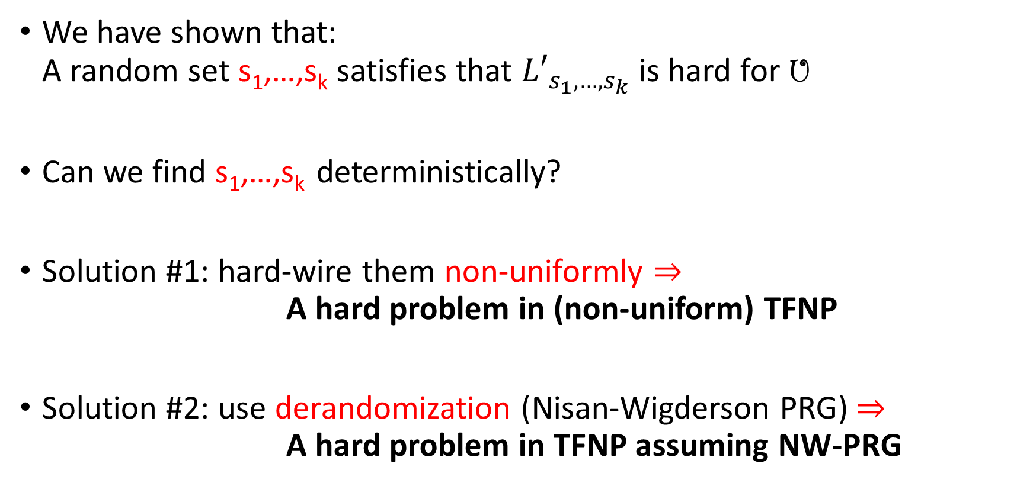
Finding a Good Shift
We have shown that:
A random set s₁,…,s_{k} satisfies that ${L′}_{s_{1},…,s_{k}}$ is hard for U
Can we find s₁,…,s_{k} deterministically?
Solution #1: hard-wire them non-uniformly $⇒$
A hard problem in (non-uniform) TFNP
Solution #2: use derandomization (Nisan-Wigderson PRG) $⇒$
A hard problem in TFNP assuming NW-PRG

Slide 24
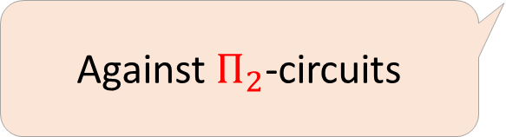
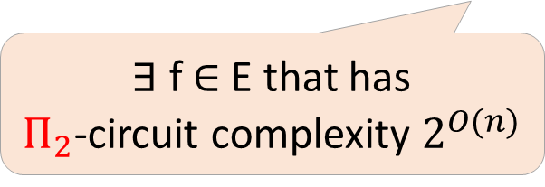
Nisan-Wigderson Pseudorandom Generator
Assume a hard function exists
∃ f $∈$ E that has
$Π_{2}$-circuit complexity $2^{O(n)}$
Exists pseudorandom generator
Against $Π_{2}$-circuits
Combine all shifts to one good shift
We can derandomize

Slide 25
Additional Results
TFNP hardness can be based on
one-way functions + zero knowledge proofs*
Another technique for pushing problems into TFNP
Get a more structural problem
Notes:
No need for case: planted clique, random SAT

Slide 26
Summary
NP is hard-on-average
$$TFNP$$
$$PPP$$
$$PLS$$
$$PPAD$$
$$CLS$$

Slide 27
On the White-Box Complexity of Search Problems:
Ramsey and Graph Property Testing
Ilan Komargodski
Moni Naor
Eylon Yogev
Weizmann Institute of Science

Slide 28
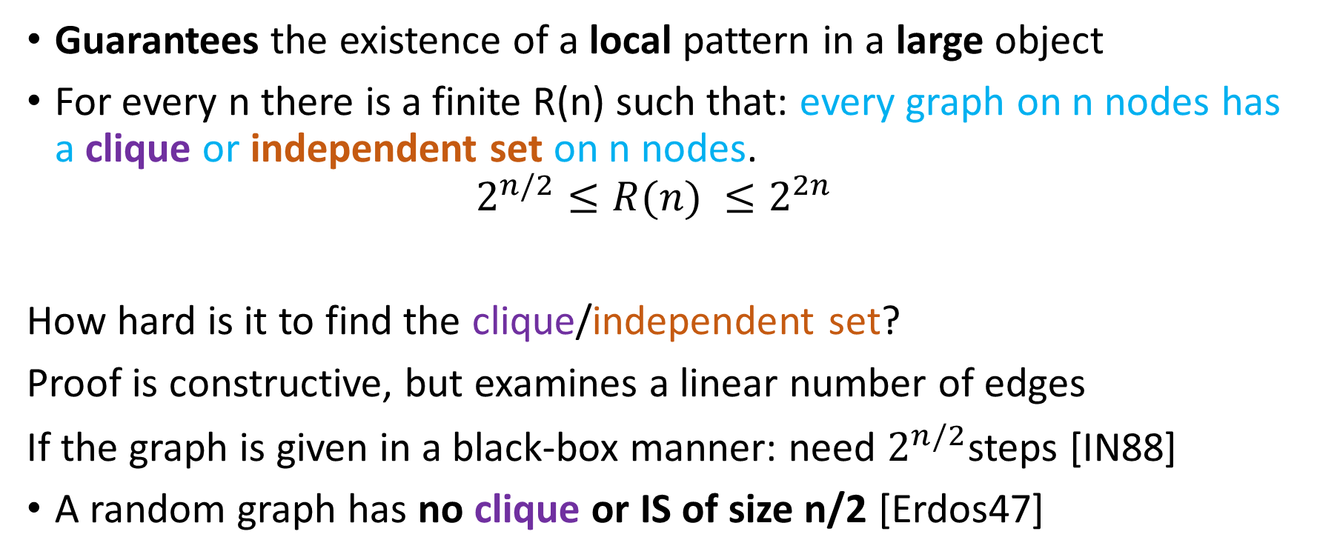
Ramsey Theory
Guarantees the existence of a local pattern in a large object
For every n there is a finite R(n) such that: every graph on n nodes has a clique or independent set on n nodes.
$$2^{n/2}≤R(n) ≤2^{2n}$$
How hard is it to find the clique/independent set?
Proof is constructive, but examines a linear number of edges
If the graph is given in a black-box manner: need $2^{n/2}$steps [IN88]
A random graph has no clique or IS of size n/2 [Erdos47]

Slide 29
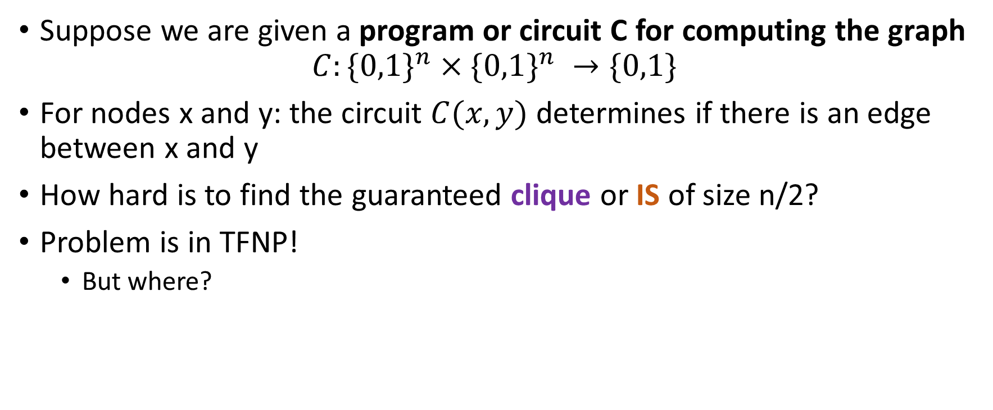
How hard is Ramsey in the white-box model?
Suppose we are given a program or circuit C for computing the graph
$$C:\{{0,1\}}^{n}×\{{0,1\}}^{n} →\{0,1\}$$
For nodes x and y: the circuit $C(x,y)$ determines if there is an edge between x and y
How hard is to find the guaranteed clique or IS of size n/2?
Problem is in TFNP!
  But where?
Buss 2014
Goldberg Papadimitriou 2016

Slide 30

Ramsey in TFNP
$$TFNP$$
$$PPP$$
$$PLS$$
$$Ramsey$$
$$PPAD$$
$$CLS$$
Notes:
Do you need PPA??
If you cut it the slide would be simpler.
Also, CLS is aligned a bit weird.

Slide 31
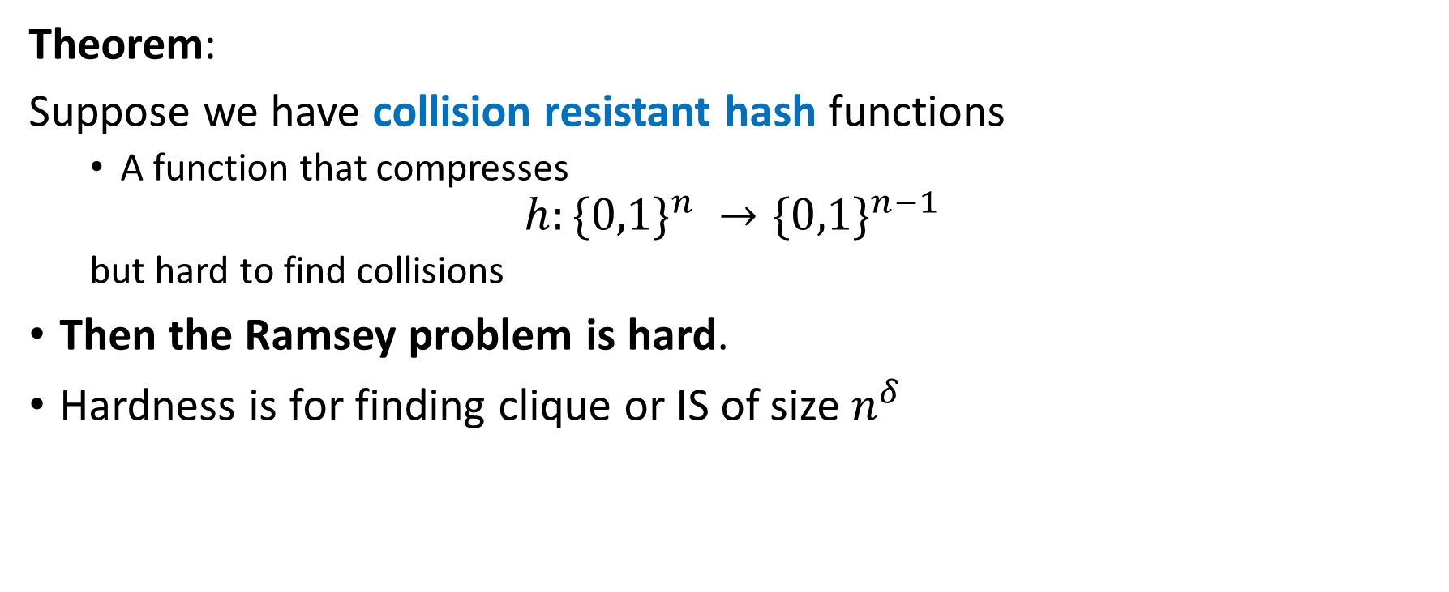
White-box Hardness of Ramsey
Theorem:
Suppose we have collision resistant hash functions
  A function that compresses
$$h:\{{0,1\}}^{n} →\{{0,1\}}^{n−1}$$
  but hard to find collisions
Then the Ramsey problem is hard.
Hardness is for finding clique or IS of size $n^{δ}$
Given circuit of size poly in n
encoding a graph on nodes
Find a clique/IS of size n/2

Slide 32
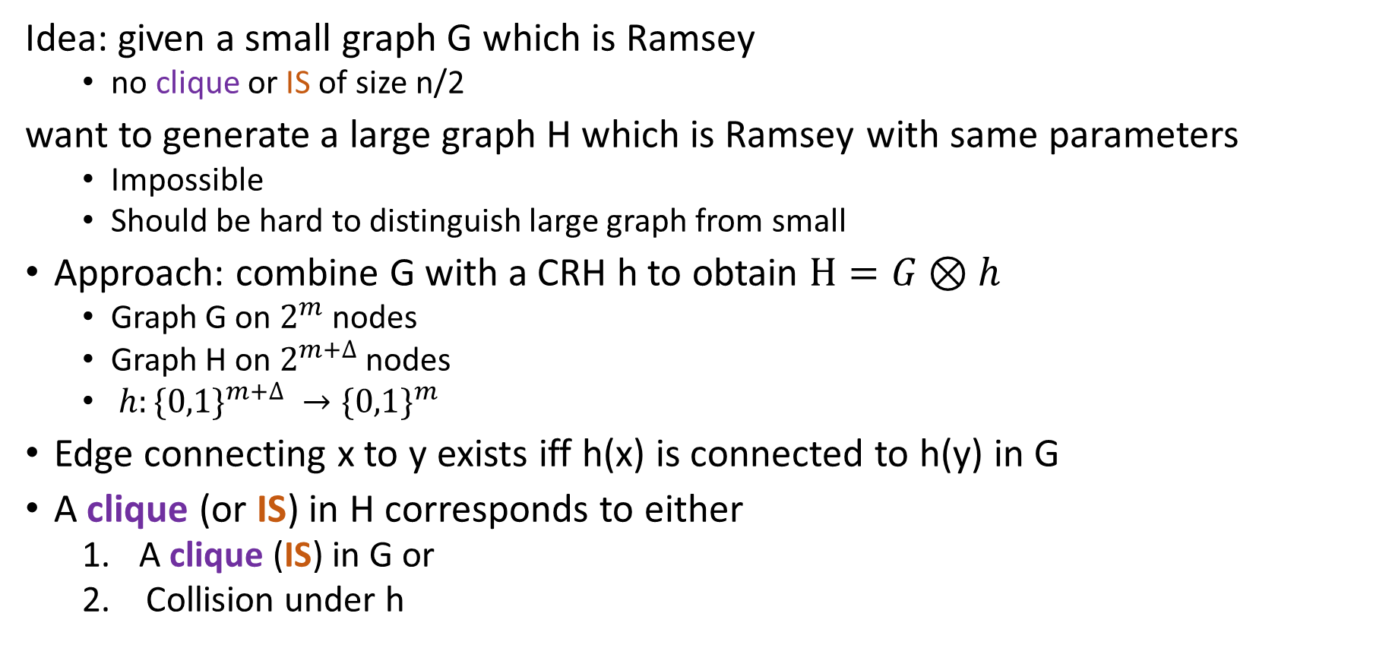
White-box Hardness of Ramsey
Idea: given a small graph G which is Ramsey
  no clique or IS of size n/2
want to generate a large graph H which is Ramsey with same parameters
  Impossible
  Should be hard to distinguish large graph from small
Approach: combine G with a CRH h to obtain $H=G⊗h$
  Graph G on $2^{m}$ nodes
  Graph H on $2^{m+∆}$nodes
  $h:\{{0,1\}}^{m+∆} →\{{0,1\}}^{m}$
Edge connecting x to y exists iff h(x) is connected to h(y) in G
A clique (or IS) in H corresponds to either
  A clique (IS) in G or
  Collision under h
Nodes mapped to h(x)
Nodes mapped to h(y)

Slide 33
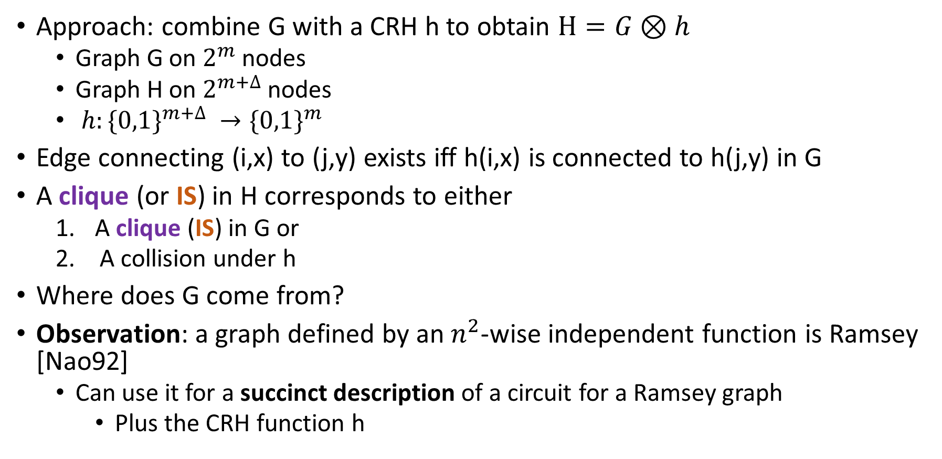
White-box Hardness of Ramsey
Approach: combine G with a CRH h to obtain $H=G⊗h$
  Graph G on $2^{m}$ nodes
  Graph H on $2^{m+∆}$nodes
  $h:\{{0,1\}}^{m+∆} →\{{0,1\}}^{m}$
Edge connecting (i,x) to (j,y) exists iff h(i,x) is connected to h(j,y) in G
A clique (or IS) in H corresponds to either
  A clique (IS) in G or
  A collision under h
Where does G come from?
Observation: a graph defined by an $n^{2}$-wise independent function is Ramsey [Nao92]
  Can use it for a succinct description of a circuit for a Ramsey graph
    Plus the CRH function h
Remarkable progress on explicit constructions
Coh16a, CZ16, BDT16, Coh16b, Li16
Not good enough for us!

Slide 34
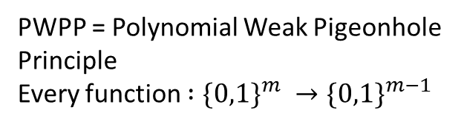


Ramsey in TFNP
PWPP = Polynomial Weak Pigeonhole Principle
Every function $:\{{0,1\}}^{m} →\{{0,1\}}^{m−1}$
$$TFNP$$
$$PPP$$
$$PLS$$
$$Ramsey$$
$$PWPP$$
$$PPAD$$
$$CLS$$
Notes:
Do you need PPA??
If you cut it the slide would be simpler.
Also, CLS is aligned a bit weird.

Slide 35
White-box from Black-box lower bounds
Impossible to translate all query lower bounds for TFNP to white-box lower bounds
  Proof a la CGH04
Property Testing: lots of black-box lower bounds
Theorem: there is a graph property that is hard to test for a white-box graph
  Based on Lossy Functions
We don’t need no obfuscation!
being an extractor

Slide 36
Research Directions
Ramsey style:
  Schur: in every finite coloring of the integers there is a monochromatic
  (X, Y, X+Y)
Lower bounds without obfuscation
  PPAD
  PLS
  Hardness of PPP from one-way functions
Meaning of result for constructing a one-way function from an NP-hard problem
Better constructions of Ramsey Graphs yield deterministic reductions.

