Slide 1
Planar Graphs: Random Walks and Bipartiteness Testing
Artur Czumaj
DIMAP (Centre for Discrete Maths and it Applications)
Department of Computer Science
University of Warwick
Joint work with Morteza Monemizadeh, Krzysio Onak, Christian Sohler
TexPoint fonts used in EMF.
Read the TexPoint manual before you delete this box.: AAAAAAAAAAAAA

Slide 2
Main result:
Testing bipartiteness in planar graphs
(without any bound on the maximum degree!)
can be done in constant time.
Representative problem
First constant-time nontrivial tester for graphs with arbitrary degree
Cool technique: analysis of random walks

Slide 3
Motivation:
Main goal of graph property testing
Establish complexity of testing graph properties
For various graph properties
For various graph representation models

Slide 4
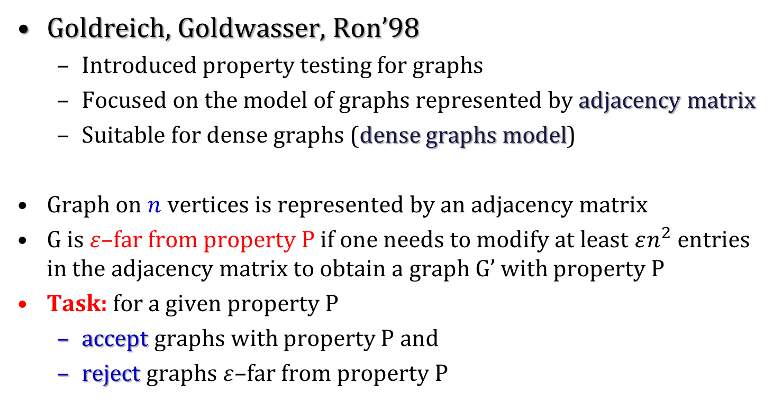
The beginning – dense graphs model
Goldreich, Goldwasser, Ron’98
Introduced property testing for graphs
Focused on the model of graphs represented by adjacency matrix
Suitable for dense graphs (dense graphs model)
Graph on $n$ vertices is represented by an adjacency matrix
G is $ε$–far from property P if one needs to modify at least $εn^{2}$ entries in the adjacency matrix to obtain a graph G’ with property P
Task: for a given property P
accept graphs with property P and
reject graphs $ε$–far from property P

Slide 5
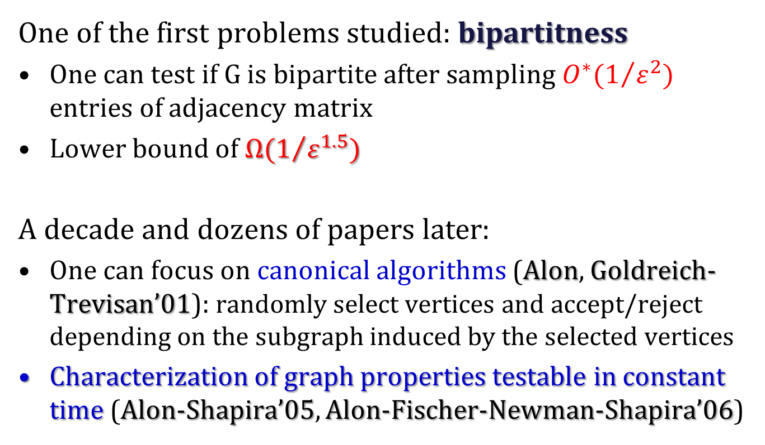
The beginning – dense graphs model
One of the first problems studied: bipartitness
One can test if G is bipartite after sampling $O^{∗}(1/{ε^{2}})$ entries of adjacency matrix
Lower bound of $Ω(1/{ε^{1.5}})$
A decade and dozens of papers later:
One can focus on canonical algorithms (Alon, Goldreich-Trevisan’01): randomly select vertices and accept/reject depending on the subgraph induced by the selected vertices
Characterization of graph properties testable in constant time (Alon-Shapira’05, Alon-Fischer-Newman-Shapira’06)

Slide 6
Next step: adjacency lists representation
Introduced by Goldreich and Ron
Main focus on graphs of bounded-degree
More and more is known …

Slide 7
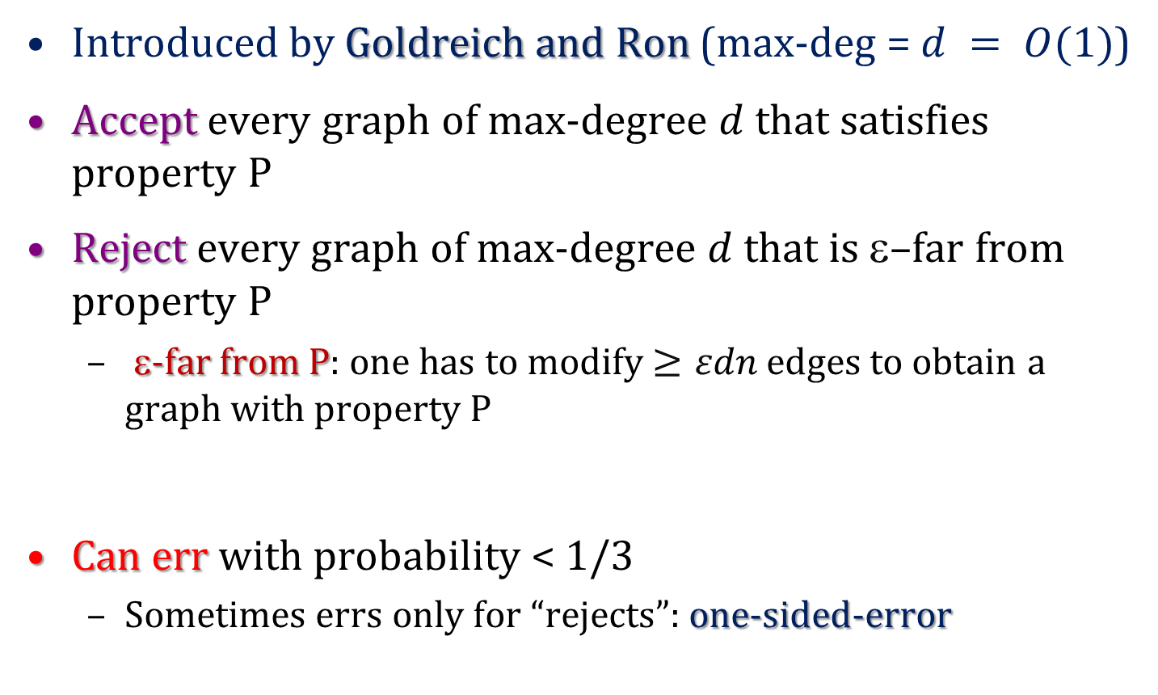
Bounded-degree adjacency list model
Introduced by Goldreich and Ron (max-deg = $d = O(1)$)
Accept every graph of max-degree $d$ that satisfies property P
Reject every graph of max-degree $d$ that is $$–far from property P
ε-far from P: one has to modify $≥εdn$edges to obtain a graph with property P
Can err with probability < 1/3
Sometimes errs only for “rejects”: one-sided-error

Slide 8
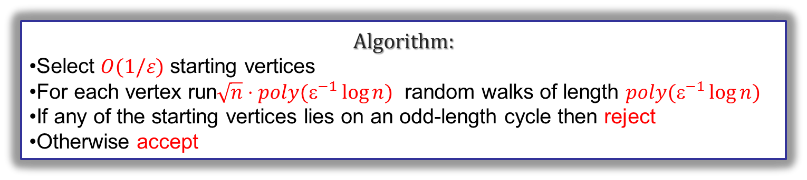
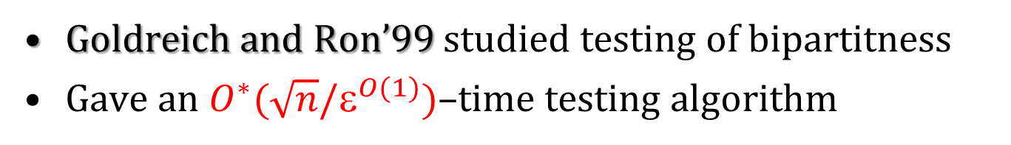
Bounded-degree adjacency list model
Goldreich and Ron’99 studied testing of bipartitness
Gave an $O^{∗}(\sqrt{n}/ε^{O(1)})$–time testing algorithm
Algorithm:
Select $O(1/ε)$ starting vertices
For each vertex run$\sqrt{n}⋅poly(ε^{−1}\log{n) }$ random walks of length $poly(ε^{−1}\log{n)}$
If any of the starting vertices lies on an odd-length cycle then reject
Otherwise accept

Slide 9
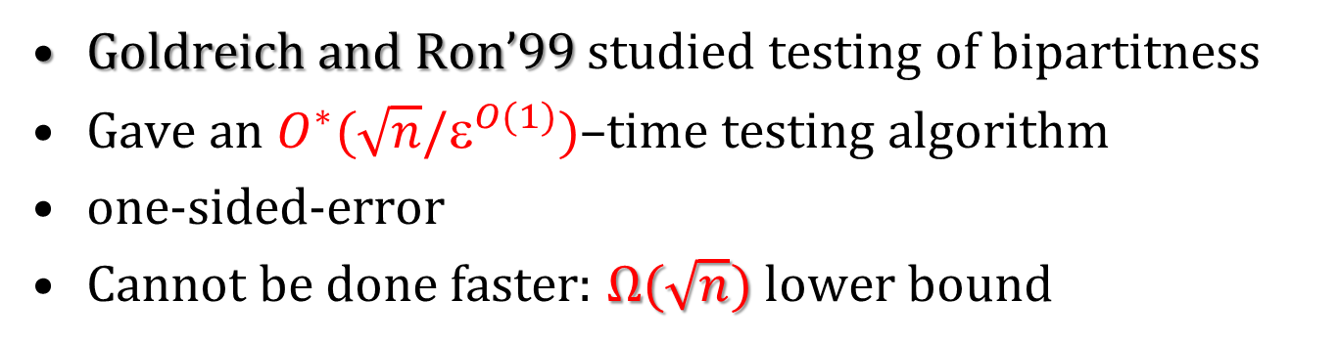
Bounded-degree adjacency list model
Goldreich and Ron’99 studied testing of bipartitness
Gave an $O^{∗}(\sqrt{n}/ε^{O(1)})$–time testing algorithm
one-sided-error
Cannot be done faster: $Ω(\sqrt{n})$ lower bound

Slide 10
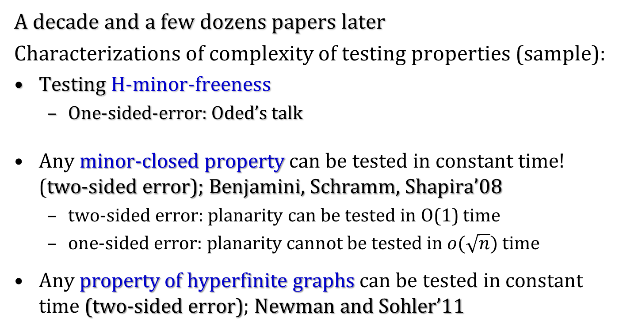
Bounded-degree adjacency list model
A decade and a few dozens papers later
Characterizations of complexity of testing properties (sample):
Testing H-minor-freeness
One-sided-error: Oded’s talk
Any minor-closed property can be tested in constant time! (two-sided error); Benjamini, Schramm, Shapira’08
two-sided error: planarity can be tested in O(1) time
one-sided error: planarity cannot be tested in $o(\sqrt{n})$ time
Any property of hyperfinite graphs can be tested in constant time (two-sided error); Newman and Sohler’11

Slide 11
Bounded-degree adjacency list model
Testing in special classes of graphs
Czumaj, Shapira, Sohler’09:
Testing bipartitness in planar graphs of bounded-degree can be done in O(1) time (two-sided-error)
A few papers later
Newman and Sohler’11:
Testing any property in hyperfinite graphs of bounded-degree can be done in O(1) time (two-sided-error)

Slide 12
Focus of this work …
Testing bipartiteness
Graphs with arbitrary degrees represented by adjacency lists
Previous techniques don’t work for arbitrary-degree graphs

Slide 13
Adjacency Lists
Graph G is ε-far from satisfying property P
If one needs to modify more than ε-fraction of entries in adjacency lists to obtain a graph satisfying P
Model of graphs without any bound for max-degree
Access to G via oracle:
Return a random
neighbor of v
Access to G via oracle:
Return the ith neighbor of v
Return the degree of v

Slide 14
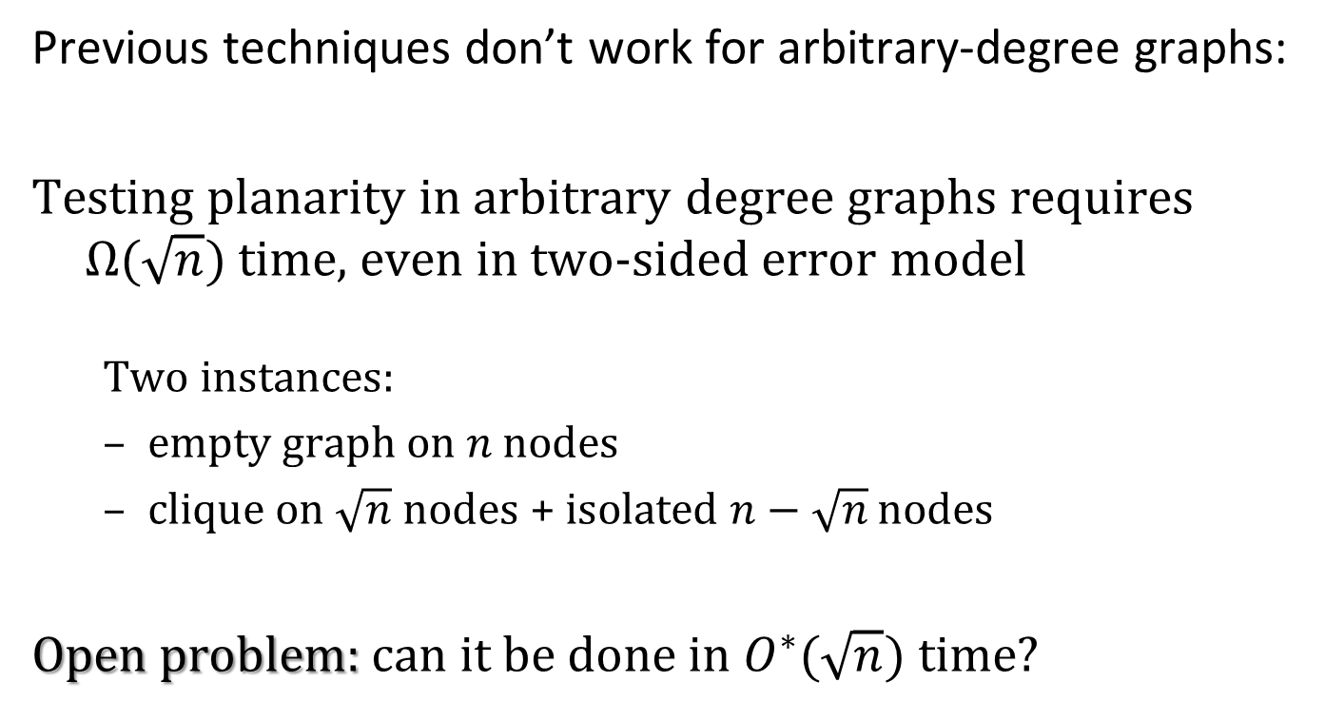
Arbitrary-degree graphs
Previous techniques don’t work for arbitrary-degree graphs:
Testing planarity in arbitrary degree graphs requires $Ω(\sqrt{n})$ time, even in two-sided error model
Two instances:
empty graph on $n$ nodes
clique on $\sqrt{n}$ nodes + isolated $n−\sqrt{n}$ nodes
Open problem: can it be done in $O^{∗}(\sqrt{n})$ time?

Slide 15
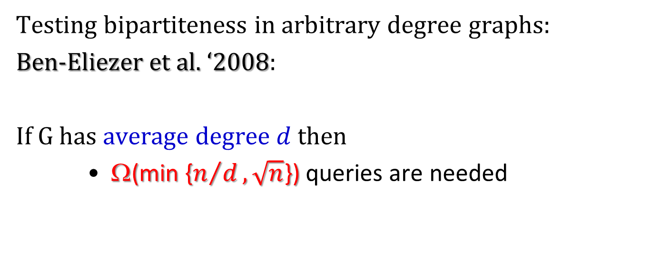
Testing bipartiteness in arbitrary-degree graphs
Testing bipartiteness in arbitrary degree graphs:
Ben-Eliezer et al. ‘2008:
If G has average degree $d$ then
Ω(min {$n/d, \sqrt{n}$}) queries are needed

Slide 16
Testing in arbitrary planar graphs
Czumaj, Monemizadeh, Onak, Sohler
Testing bipartiteness in simple planar graphs of arbitrary degrees can be done in constant time

Slide 17
Testing in arbitrary planar graphs
Czumaj, Monemizadeh, Onak, Sohler
Testing bipartiteness in simple planar graphs of arbitrary degrees can be done in constant time
Why isn’t it trivial by reduction to bounded-degree graphs?

Slide 18
Reductions to bounded-degree graphs
Testing cycle-freeness (local reduction):
Original graph has no cycle iff new graph has no cycle
New graph has degree bounded by 3
➔ If we can access consecutive neighbors of a vertex then testing cycle-freeness in planar graphs can be done in O(1) time

Slide 19
Reductions to bounded-degree graphs
Same reduction doesn’t work for bipartiteness
We can maintain bipartiteness
We cannot maintain distance to bipartiteness!

Slide 20
Reductions to bounded-degree graphs
Same reduction doesn’t work for bipartiteness
We can maintain bipartiteness
We cannot maintain distance to bipartiteness!
ε-far from bipartite
Enough to delete 2 edges to get
a bipartite graph

Slide 21
Reductions to bounded-degree graphs
Reduction used by Kaufman et al. ‘2004:
reduces arbitrary-degree graphs to bounded degree graphs,
doesn’t loose the distance (to bipartiteness) …
but looses planarity!
(substitutes high-degree vertices by expanders)

Slide 22

Testing in arbitrary planar graphs
Main reason why previous approaches fail:
testing neighborhood may cost even $O(n)$ time!

Slide 23
Testing in arbitrary planar graphs
Testing bipartiteness in planar graphs can be done in constant time
Challenge:
how to explore neighborhood of a node quickly?
One-sided error
Run many short random walks
For a planar graph that is ε-far from bipartite, prove that one of the random walks will find an odd-length cycle

Slide 24
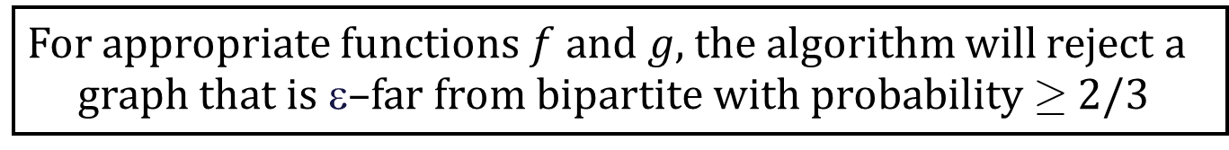
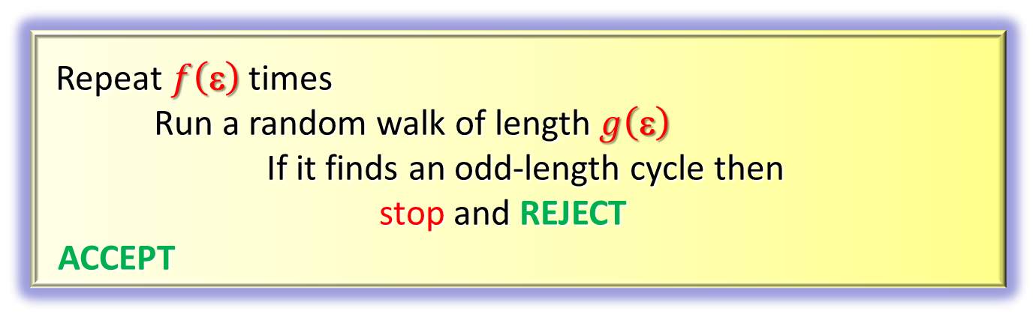
Testing in arbitrary planar graphs
Testing bipartitness in planar graphs can be done in constant time
Repeat $f\left(\text{ε}\right)$ times
Run a random walk of length $g\left(\text{ε}\right)$
If it finds an odd-length cycle then
stop and REJECT
ACCEPT
For appropriate functions $f$ and $g$, the algorithm will reject a graph that is ε–far from bipartite with probability ¸ 2/3

Slide 25
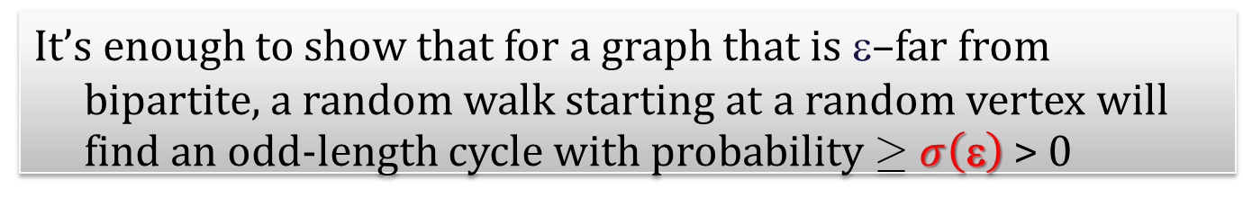
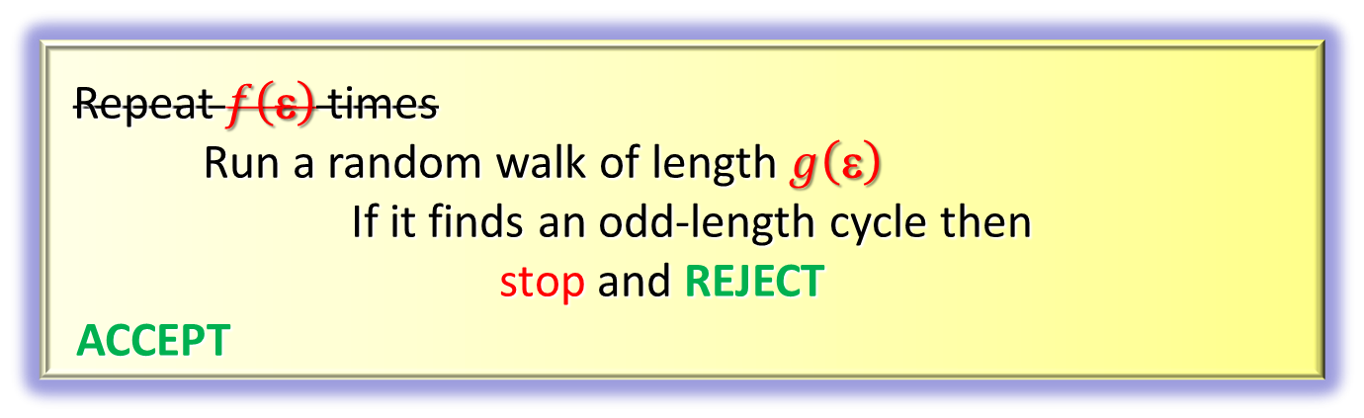
Testing in arbitrary planar graphs
Testing bipartitness in planar graphs can be done in constant time
Repeat $f\left(\text{ε}\right)$ times
Run a random walk of length $g\left(\text{ε}\right)$
If it finds an odd-length cycle then
stop and REJECT
ACCEPT
It’s enough to show that for a graph that is ε–far from bipartite, a random walk starting at a random vertex will find an odd-length cycle with probability ¸ $σ\left(\text{ε}\right)$ > 0

Slide 26
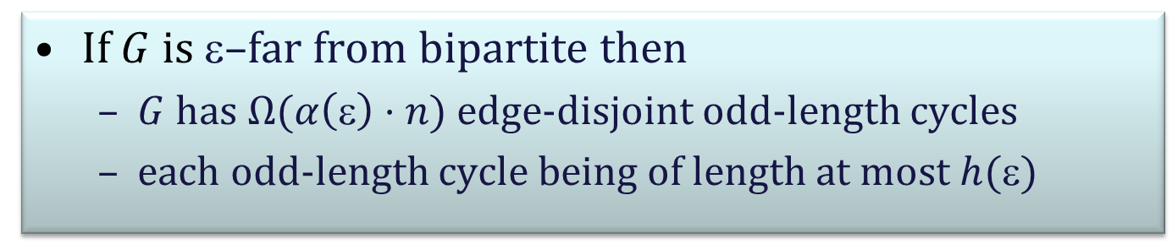
Key properties
If $G$ is $$–far from bipartite then
$G$ has $Ω(α\left(\text{ε}\right)⋅n)$ edge-disjoint odd-length cycles
each odd-length cycle being of length at most $h(\text{ε})$

Slide 27
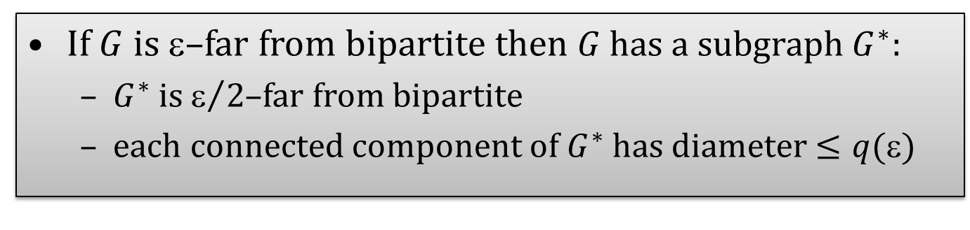
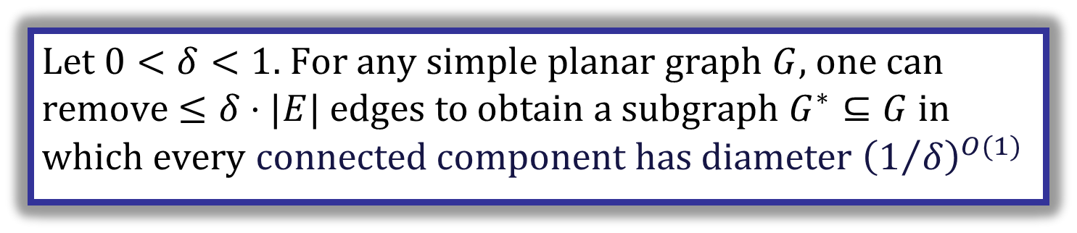
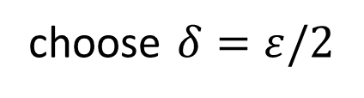
Key properties
Known result, eg Klein, Plotkin, Rao’93
Let $0<δ<1$. For any simple planar graph $G$, one can remove $≤δ⋅|E|$ edges to obtain a subgraph $G^{∗}⊆G$in which every connected component has diameter ${\left(1/δ\right)}^{O(1)}$
choose $δ=ε/2$
If $G$ is $$–far from bipartite then $G$ has a subgraph $G^{∗}$:
$G^{∗}$ is $/2$–far from bipartite
each connected component of $G^{∗}$ has diameter $≤q(\text{ε})$

Slide 28
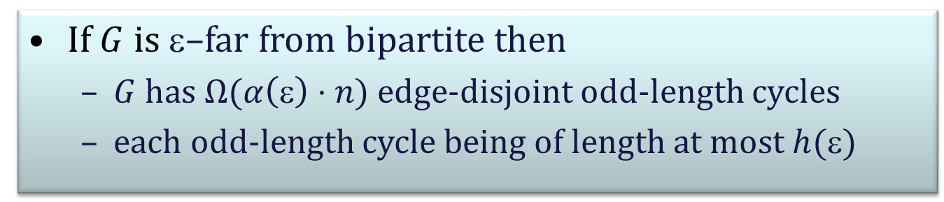
Key properties
If $G$ is $$–far from bipartite then
$G$ has $Ω(α\left(\text{ε}\right)⋅n)$ edge-disjoint odd-length cycles
each odd-length cycle being of length at most $h(\text{ε})$
If $G$ is $$–far from bipartite then $G$ has a subgraph $G^{∗}$:
$G^{∗}$ is $/2$–far from bipartite
each connected component of $G^{∗}$ has diameter $≤q(\text{ε})$

Slide 29
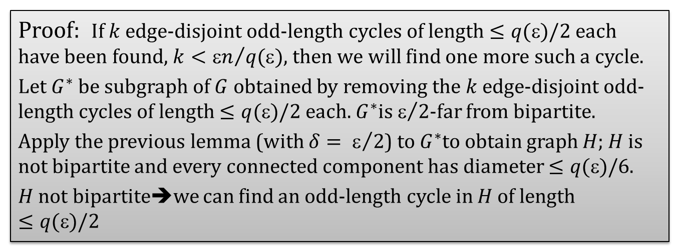
Key properties
If $G$ is $$–far from bipartite then
$G$ has $Ω(α\left(\text{ε}\right)⋅n)$ edge-disjoint odd-length cycles
each odd-length cycle being of length at most $h(\text{ε})$
Proof: If $k$ edge-disjoint odd-length cycles of length $≤q(\text{ε})/2$ each have been found, $k<{\text{ε}n}/{q(\text{ε})}$, then we will find one more such a cycle.
Let $G^{∗}$ be subgraph of $G$ obtained by removing the $k$ edge-disjoint odd-length cycles of length $≤q(\text{ε})/2$ each. $G^{∗}$is $/2$-far from bipartite.
Apply the previous lemma (with ${δ= }/2$) to $G^{∗}$to obtain graph $H$; $H$ is not bipartite and every connected component has diameter $≤q(\text{})/$6.
$H$ not bipartite➔we can find an odd-length cycle in $H$ of length $≤q(\text{ε})/2$

Slide 30
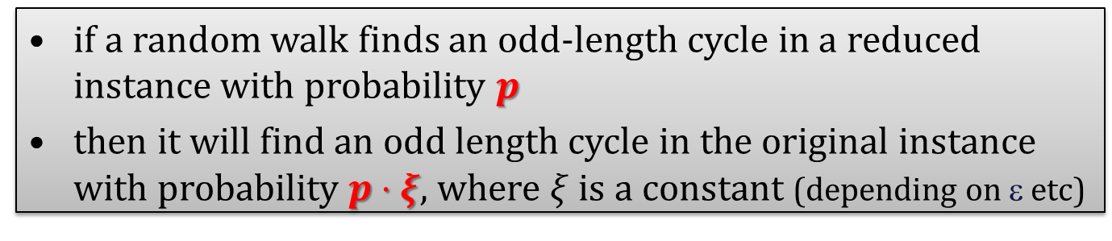
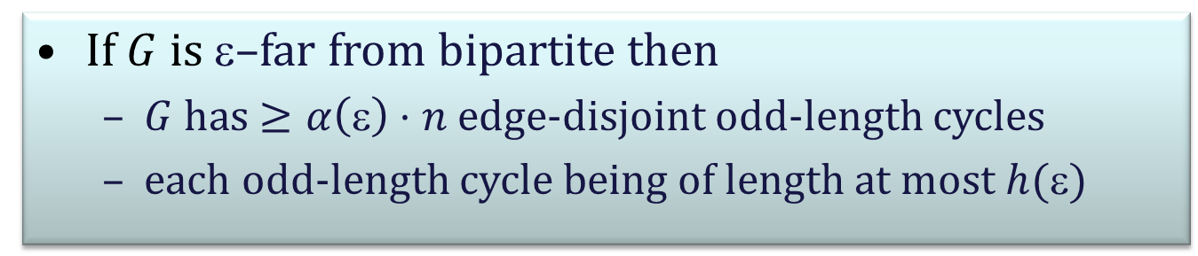
(series of ) reductions
If $G$ is $$–far from bipartite then
$G$ has $≥α\left(\text{ε}\right)⋅n$ edge-disjoint odd-length cycles
each odd-length cycle being of length at most $h(\text{ε})$
How to use this property?
A series of reductions of the form:
if a random walk finds an odd-length cycle in a reduced instance with probability $p$
then it will find an odd length cycle in the original instance with probability $p⋅ξ$, where $ξ$ is a constant (depending on $\text{}$etc)

Slide 31
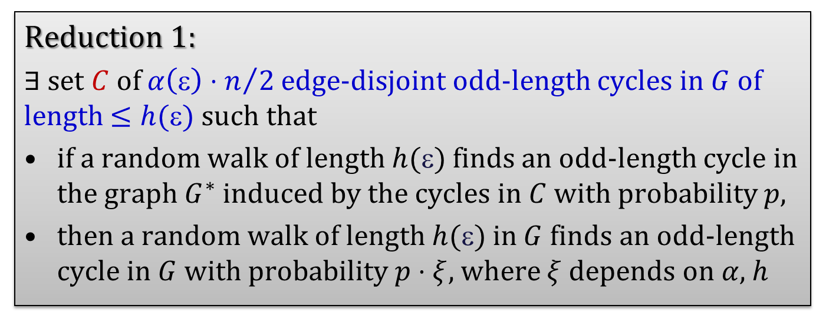
Reduction to a graph induced by short odd-length cycles
If $G$ is $$–far from bipartite then
$G$ has $≥α\left(\text{ε}\right)⋅n$ edge-disjoint odd-length cycles
each odd-length cycle being of length at most $h(\text{ε})$
Reduction 1:
$∃$ set $C$ of $α\left(\text{ε}\right)⋅n/2$ edge-disjoint odd-length cycles in $G$ of length $≤h(\text{ε})$ such that
if a random walk of length $h(\text{ε})$finds an odd-length cycle in the graph $G^{∗}$ induced by the cycles in $C$ with probability $p$,
then a random walk of length $h(\text{ε})$ in $G$ finds an odd-length cycle in $G$ with probability $p⋅ξ$, where $ξ$ depends on $α$, $h$

Slide 32
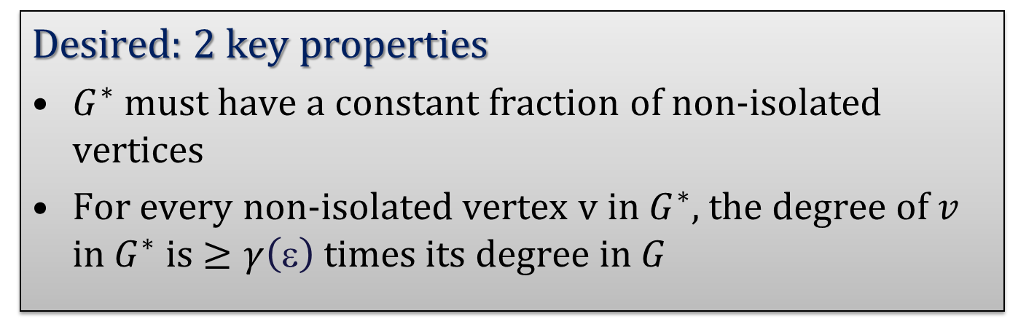
Reduction to a graph induced by short odd-length cycles
Desired: 2 key properties
$G^{∗}$ must have a constant fraction of non-isolated vertices
For every non-isolated vertex v in $G^{∗}$, the degree of $v$ in $G^{∗}$ is $≥γ\left(\text{ε}\right)$ times its degree in $G$

Slide 33
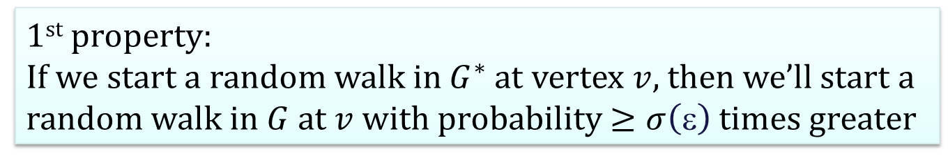
Reduction to a graph induced by short odd-length cycles
Desired: 2 key properties
$G^{∗}$ must have a constant fraction of non-isolated vertices
For every non-isolated vertex v in $G^{∗}$, the degree of $v$ in $G^{∗}$ is $≥γ\left(\text{ε}\right)$ times its degree in $G$
1st property:
If we start a random walk in $G^{∗}$ at vertex $v$, then we’ll start a random walk in $G$ at $v$ with probability $≥σ\left(\text{ε}\right)$ times greater

Slide 34
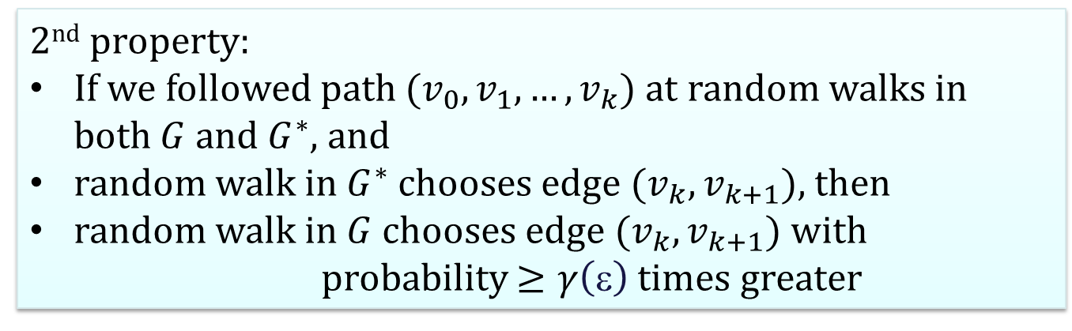
Reduction to a graph induced by short odd-length cycles
Desired: 2 key properties
$G^{∗}$ must have a constant fraction of non-isolated vertices
For every non-isolated vertex v in $G^{∗}$, the degree of $v$ in $G^{∗}$ is $≥γ\left(\text{ε}\right)$ times its degree in $G$
2nd property:
If we followed path $(v_{0},v_{1},…, v_{k})$ at random walks in both $G$ and $G^{∗}$, and
random walk in $G^{∗}$ chooses edge $(v_{k}, v_{k+1})$, then
random walk in $G$ chooses edge $(v_{k}, v_{k+1})$ with
probability $≥γ\left(\text{ε}\right)$ times greater

Slide 35
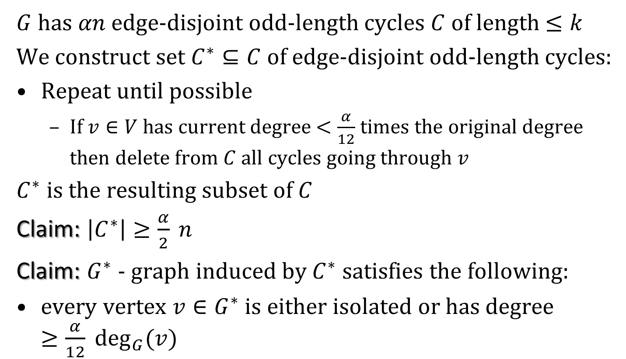
Reduction to a graph induced by short odd-length cycles
$G$ has $αn$ edge-disjoint odd-length cycles $C$ of length $≤k$
We construct set $C^{∗}⊆C$of edge-disjoint odd-length cycles:
Repeat until possible
If $v∈V$ has current degree $<\frac{α}{12}$ times the original degree then delete from $C$ all cycles going through $v$
$C^{∗}$ is the resulting subset of $C$
Claim: $\left|C^{∗}\right|≥\frac{α}{2} n$
Claim: $G^{∗}$ - graph induced by $C^{∗}$satisfies the following:
every vertex $v∈G^{∗}$ is either isolated or has degree $≥\frac{α}{12} \deg_{G}(v)$

Slide 36
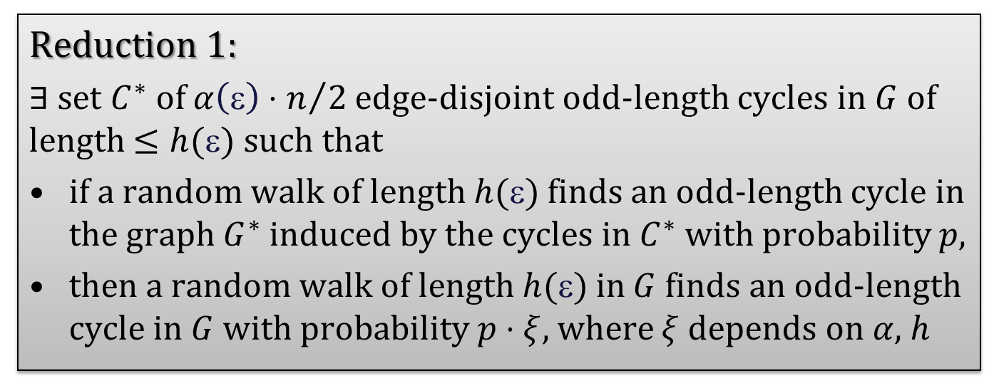
Reduction to a graph induced by short odd-length cycles
If $G$ is $$–far from bipartite then
$G$ has $≥α\left(\text{ε}\right)⋅n$ edge-disjoint odd-length cycles
each odd-length cycle being of length at most $h(\text{ε})$
Reduction 1:
$∃$ set $C^{∗}$ of $α\left(\text{ε}\right)⋅n/2$ edge-disjoint odd-length cycles in $G$ of length $≤h(\text{ε})$ such that
if a random walk of length $h(\text{ε})$finds an odd-length cycle in the graph $G^{∗}$ induced by the cycles in $C^{∗}$ with probability $p$,
then a random walk of length $h(\text{ε})$ in $G$ finds an odd-length cycle in $G$ with probability $p⋅ξ$, where $ξ$ depends on $α,$ $h$

Slide 37

After 1st reduction: collection of edge-disjoint odd-length cycles of small length
We can assume that the input graph is a collection of edge-disjoint odd-length cycles of length at most $q(ε)$ each

Slide 38
Universal counter-example
Even though we reduced the problem to that on a graph induced by edge-disjoint short odd-length cycles, we cannot expect to prove that we’ll find one of the fixed cycles

Slide 39

Problems
We cannot first fix the cycles and then try to find one
We have to consider “replacements” for some parts of the cycles
Approach: if we have two vertices of high degree $v,u$ that are connected by several paths
that have the same parity and
that use only low degree vertices
then we can contract all these paths into parallel edges

Slide 40
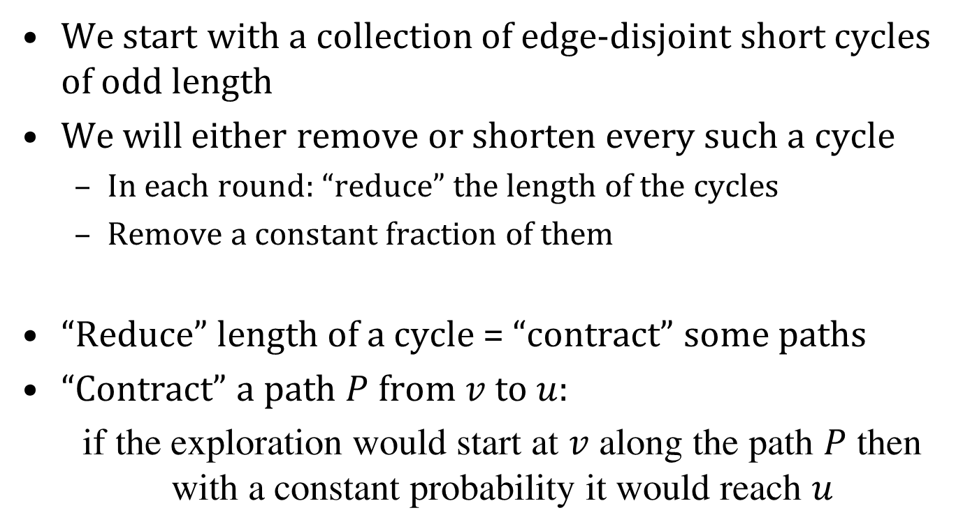
Approach
We start with a collection of edge-disjoint short cycles of odd length
We will either remove or shorten every such a cycle
In each round: “reduce” the length of the cycles
Remove a constant fraction of them
“Reduce” length of a cycle = “contract” some paths
“Contract” a path $P$ from $v$ to $u$:
if the exploration would start at $v$ along the path $P$ then with a constant probability it would reach $u$

Slide 41
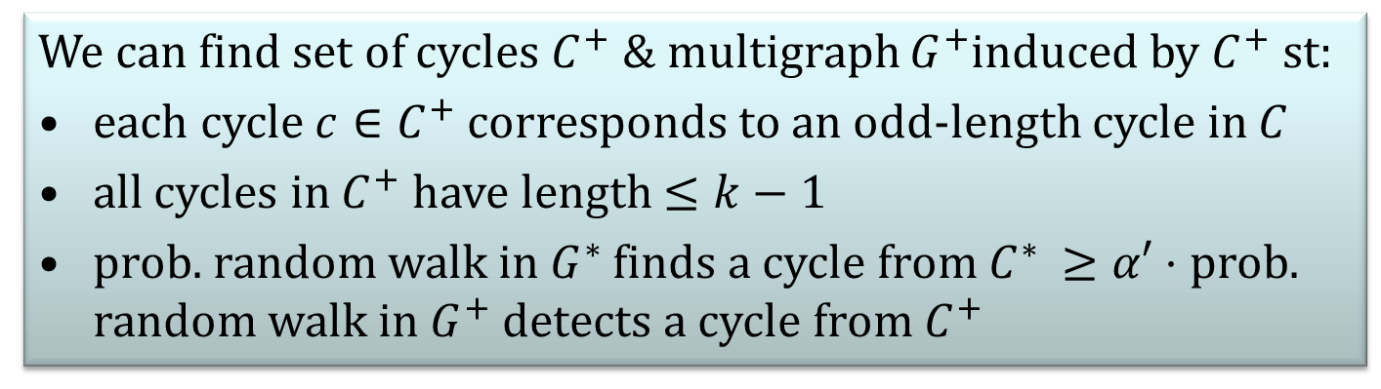
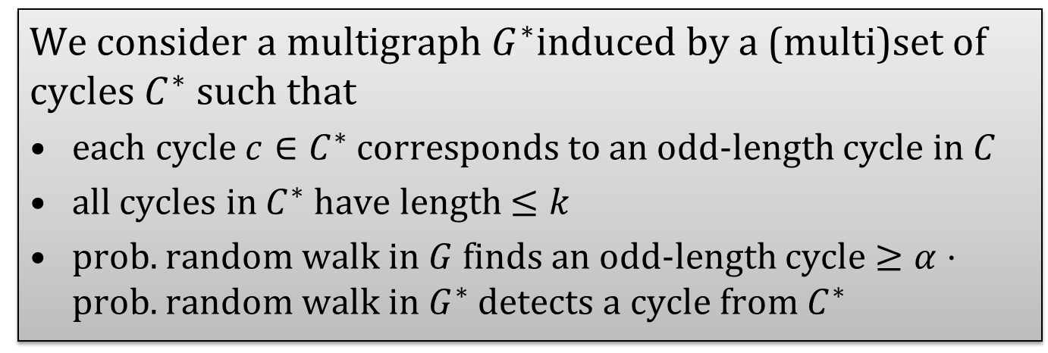
Central idea: contractions of cycles
We consider a multigraph $G^{∗}$induced by a (multi)set of cycles $C^{∗}$ such that
each cycle $c∈C^{∗}$ corresponds to an odd-length cycle in $C$
all cycles in $C^{∗}$ have length $≤k$
prob. random walk in $G$ finds an odd-length cycle $≥α⋅$ prob. random walk in $G^{∗}$ detects a cycle from $C^{∗}$
We can find set of cycles $C^{+}$ & multigraph $G^{+}$induced by $C^{+}$ st:
each cycle $c∈C^{+}$ corresponds to an odd-length cycle in $C$
all cycles in $C^{+}$ have length $≤k−1$
prob. random walk in $G^{∗}$ finds a cycle from $C^{∗}$ $≥α′⋅$ prob. random walk in $G^{+}$ detects a cycle from $C^{+}$

Slide 42
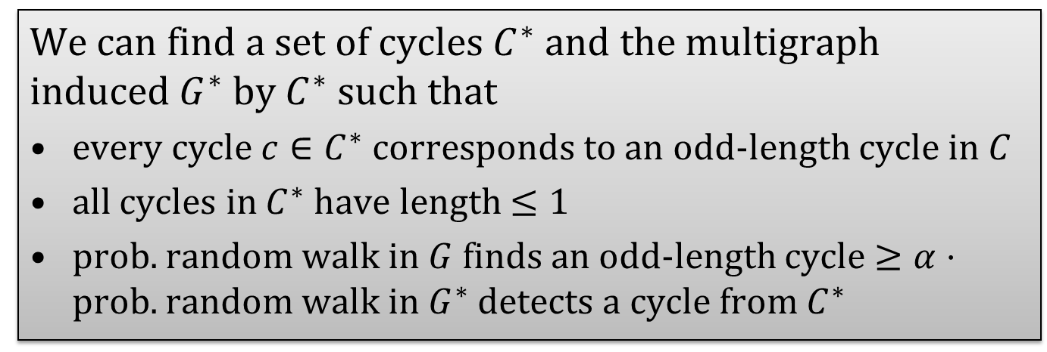
Central idea: contractions of cycles
After repeating it sufficiently many times:
We can find a set of cycles $C^{∗}$ and the multigraph induced $G^{∗}$ by $C^{∗}$ such that
every cycle $c∈C^{∗}$ corresponds to an odd-length cycle in $C$
all cycles in $C^{∗}$ have length $≤1$
prob. random walk in $G$ finds an odd-length cycle $≥α⋅$ prob. random walk in $G^{∗}$ detects a cycle from $C^{∗}$
selfloop!

Slide 43
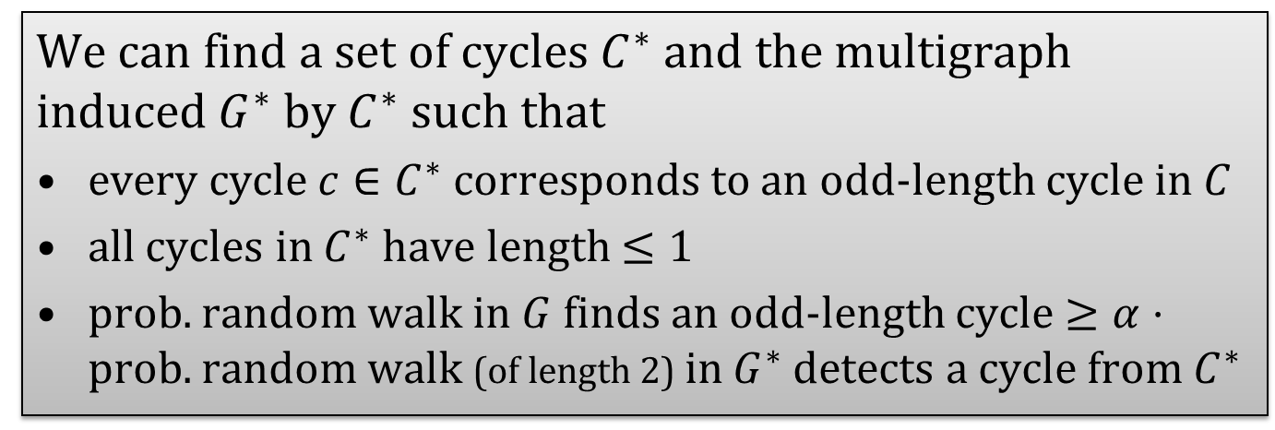

Central idea: contractions of cycles
After repeating it sufficiently many times:
We can find a set of cycles $C^{∗}$ and the multigraph induced $G^{∗}$ by $C^{∗}$ such that
every cycle $c∈C^{∗}$ corresponds to an odd-length cycle in $C$
all cycles in $C^{∗}$ have length $≤1$
prob. random walk in $G$ finds an odd-length cycle $≥α⋅$ prob. random walk (of length 2) in $G^{∗}$ detects a cycle from $C^{∗}$
selfloop!
Checking if a random walk in $G^{∗}$ finds a selfloop is easy!
Prob = #non-isolated vertices/#vertices

Slide 44
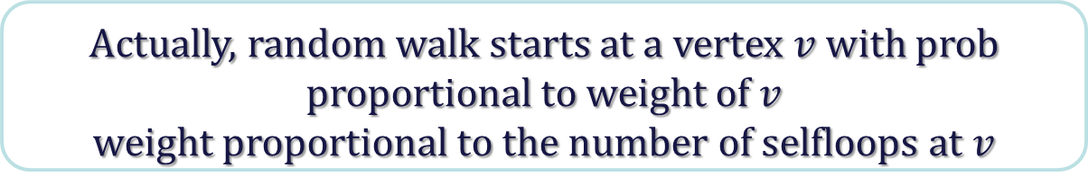
Central idea: contractions of cycles
After repeating it sufficiently many times:
We can find a set of cycles $C^{∗}$ and the multigraph induced $G^{∗}$ by $C^{∗}$ such that
every cycle $c∈C^{∗}$ corresponds to an odd-length cycle in $C$
all cycles in $C^{∗}$ have length $≤1$
prob. random walk in $G$ finds an odd-length cycle $≥α⋅$ prob. random walk (of length 2) in $G^{∗}$ detects a cycle from $C^{∗}$
selfloop!
Actually, random walk starts at a vertex $v$ with prob proportional to weight of $v$
weight proportional to the number of selfloops at $v$

Slide 45
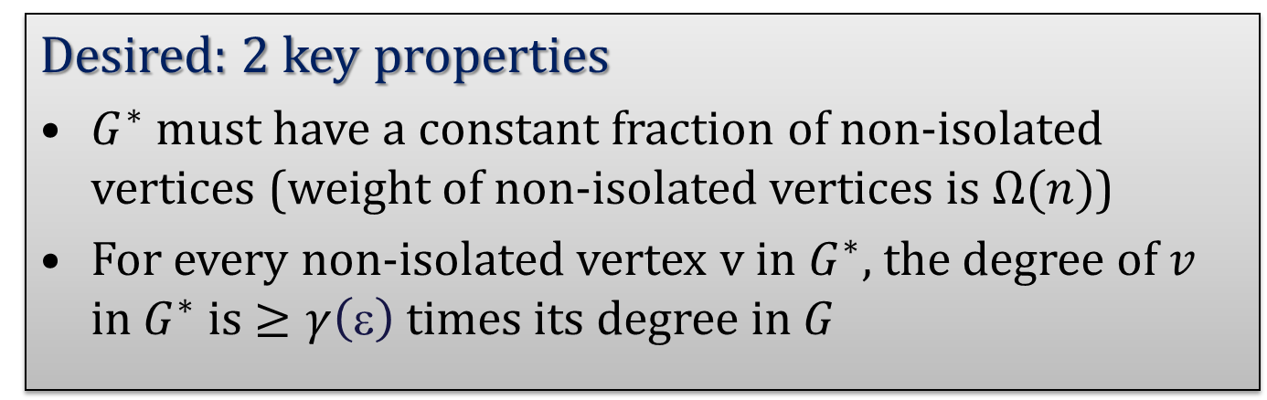
Always keep in mind
Desired: 2 key properties
$G^{∗}$ must have a constant fraction of non-isolated vertices (weight of non-isolated vertices is $Ω(n)$)
For every non-isolated vertex v in $G^{∗}$, the degree of $v$ in $G^{∗}$ is $≥γ\left(\text{ε}\right)$ times its degree in $G$
if a random walk finds an odd-length cycle in a reduced instance with probability $p$
then it will find an odd length cycle in the original instance with probability $p⋅ξ$, where $ξ$ is a constant (depending on $\text{}$etc)

Slide 46
Difficulties (all can be overcome)
Dealing with parallel edges with different parities
Parallel edges encode parity of path they correspond to
Make sure that the number of odd edges connecting two vertices is similar to the number of even edges connecting the same vertices (or one of the sets is empty)
We’re making some vertices isolated
We use weights to compensate this:
Initially all vertices have weights 1
If a vertex is removed by contraction then it allocates its weight to the neighboring vertices

Slide 47
Contractions
and $x, y$add half of weight of $v$ to their own weight

Slide 48
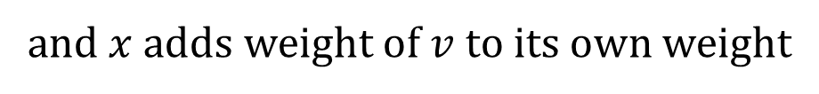
Other type of contractions
and $x$adds weight of $v$ to its own weight

Slide 49
Difficulties (can be overcome)
Proving that we can remove a constant fraction of cycles such that every one has a low-degree vertex is contractible is non-trivial
Since we have multigraphs, we cannot expect to find a constant fraction of vertices to be of constant degree
We do, if degree = # distinct neighbors

Slide 50
Extensions
Broader class of graphs than planar
Graphs defined by arbitrary fixed forbidden minors
Extension beyond bipartiteness: work in progress

