Slide 1
Zero-One Frequency Laws
Vladimir(Vova) Braverman
UCLA
Joint work with Rafail Ostrovsky

Slide 2
Plan:
General method for computing over frequencies with polylog space (Zero-one frequency law)
Recursive sketching for vectors

Slide 3
Frequencies
Stream
0
1
2
3
0
1
0
0
1
0
1
2
0
0
0
Frequency Vector

Slide 4
Frequency-Based Functions
The Data
0
3
0
1
0
1
2
0
0
0
Frequency Vector
G: N —> R
0
G(3)
0
G(1)
G(0)
G(1)
G(2)
G(0)
G(0)
G(0)
Modified Vector
G-Sum(V) = ∑ G(m_{i})
The objective function

Slide 5
The (Basic) Streaming Model
Formal Definition
D is a a stream p₁,…, p_{m} where p_{j} є [n]
Frequency m_{i} = |{j: p_{j} = i}|
Frequency-based function G-Sum(D) =∑_{i} G(m_{i})
F_{k} frequency moment G(m_{i}) = m_{i}^{k}
What is needed
Limitations
Output a multiplicative approximation X such that:
P(|X- ∑_{i} G(m_{i}) | > ε ∑_{i} G(m_{i}) ) < 2/3
A single pass over D
Small (polylog) memory :
(1/ε log(nm))^{O(1)}

Slide 6
Alon, Matias, Szegedy (STOC 1996, JCSS 1999, Gödel Award 2005)
Frequency moments G(x) = x^{k} , in particular:
Polylog-space algorithms for G(x) = x⁰ and G(x) = x²
Lower bounds for k>2
Algorithms for k>2 (large but sublinear memory)

Slide 7
The open question of Alon, Matias, Szegedy (1996)
What is the space complexity of estimating other functions G(x)?

Slide 8
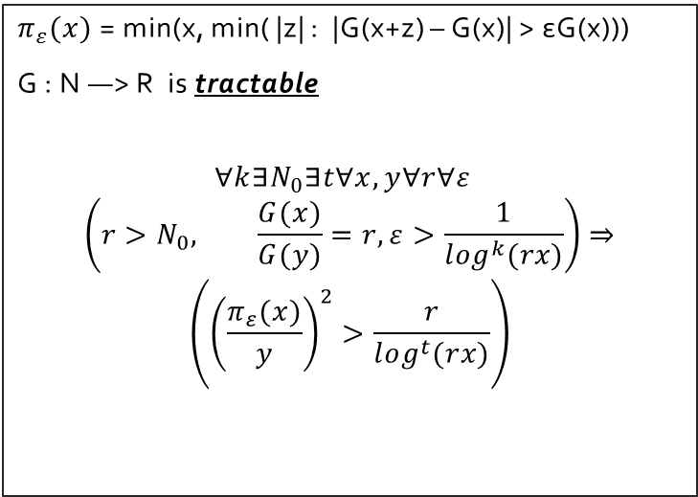
Our Result G(0)=0, G is non-decreasing
Function G : R—> R is in
STREAM-POLYLOG class
If there exists an algorithm A such that for any data stream D and for any ε, A makes a single pass over D, uses
(1/ε log(nm))^{O(1)}
memory bits and outputs X s.t.
P(|X - ∑_{i} G(m_{i}) | > ε ∑_{i} G(m_{i})) < 2/3.
$π_{ε}(x)$ = min(x, min( |z| : |G(x+z) – G(x)| > εG(x)))
G : N —> R is tractable
$$∀k∃N_{0}∃t∀x,y∀r∀ε$$
$$\left(r>N_{0}, \frac{G(x)}{G(y)}=r,ε>\frac{1}{\log^{k}(rx)}\right)⇒$$
$$\left({\left(\frac{π_{ε}(x)}{y}\right)}^{2}>\frac{r}{\log^{t}(rx)}\right)$$
The Main Result
G is in STREAM-POLYLOG if and only if G is tractable

Slide 9
Related Work (A subset)
Alon, Gibbons, Matias, Szegedy PODS 99
Alon, Matias, Szegedy STOC 96
Andoni, Krauthgamer, Onak 2010 (arxiv)
Bar-Yossef, Jayram, Kumar, Sivakumar JCSS 2004
Bar-Yossef, Jayram, Kumar, Sivakumar, Trevisan
RANDOM 2002
Beame, Jayram, Rudra STOC 2007
Bhuvanagiri, Ganguly, Kesh, Saha SODA 2006
Bhuvanagiri, Ganguly ESA 2006
Chakrabarti, Do Ba, Muthukrishnan SODA 2007
Chakrabarti, Cormode, McGregor STOC 08, SODA 07
Chakrabarti, Khot, Sun 2003
Chakrabarti, Regev STOC 2011
Charikar, Chen, Farach-Colton Th.Comp.Sc. 2004
Coppersmith, Kumar SODA 2004
Cormode, Datar, Indyk, Muthukrishnan VLDB 2002
Comrode, Muthukrishnan J.Alg. 2005
Feigenbaum, Kannan, Strauss, Viswanathan FOCS 99
Flajolet, Martin JCSS 85
Ganguly 2004, 2011
Ganguly, Cormode RANDOM 2007
Guha, Indyk, McGregor COLT 2007
Guha, McGregor, Venkatasubramanian SODA 06
Harvey, Nelson, Onak FOCS 08
Indyk FOCS 2000
Indyk, Woodruff FOCS 03, STOC 2005
Jayram, McGregor, Muthukrishnan, Vee PODS 07
Kane, Nelson, Woodruff PODS 2010, SODA 2010
Kane, Nelson, Porat, Woodruff STOC 2011
Li SODA 2009, KDD 07
McGregor, Indyk SODA 2009
Monemizadeh, Woodruff SODA 2010
Muthukrishnan 2005
Nelson, Woodruff PODS 2011
Saks, Sun STOC 2002
Woodruff SODA 2004

Slide 10
Lower Bounds
Reduction to MultiParty SET-DISJOINTESS problem
The reduction requires monotonicity
Relatively straightforward (see the paper)

Slide 11
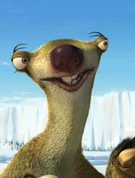

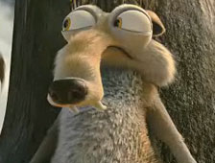
Lower Bounds (informal)
Assume first that
x = k * y
Pick N~ G(x)/G(y)
1
0
0
0
0
1
0
1
0
The Stream
….
…
…
…
i
1
0
0
i
i
….
i
j
j
….
j
y copies
y copies

Slide 12
Reduction (very informal)
If the sets intersect then, by monotonicity, the value of G-Sum is at least NG(y) + G(x) ~ 2G(x)
If do not intersect then the value is at most (N+k)G(y) ~ G(x)
Any constant approximation algorithm for G-Sum MUST recognize the difference
And thus requires N/(k^2) space ([Chakrabarti, Khot, Sun]) which is larger then any polylog
Thus G is not tractable

Slide 13
Upper Bound: Basic Ideas
We follow the fundamental idea of
Indyk and Woodruff
First we solve a specific case of G-heavy elements
Then we show that the general case can be solved by recursive sketching

Slide 14
G
IF H=1 RETURN F
ELSE RETURN 0
Mimic F
1
0
Certifier H

Slide 15
G-heavy elements
Frequency Vector of size n
G(1)
G(10^10)
G(1)
G(1)
G(1)
G(1)

Slide 16

Certifier
G
IF H=1 RETURN F
ELSE RETURN 0
If G is “good” then every
G-heavy element is
also F2-heavy
Mimic F
1
0
Certifier H
Frequencies
G(x)=x^3/2
G(x)=x^2
1
1
10000
1
1
1
100
1
1
1
1000
1
G1
G2
G3

Slide 17
Lemma 0 (very informal)

Slide 18
Proof for L_p (0<p<2)

Slide 19
Proof (sketch)

Slide 20
Mimic Function
G
IF H=1 RETURN F
ELSE RETURN 0
Mimic F
1
0
1
1
1
1
1
n
Certifier H

Slide 21
Recursive Sketches

Slide 22
Lemma 1
Let V є R^{n} be a vector with non-negative entries. Let H є {0,1}^{n} be a random vector with pairwise-independent uniform entries. Let S be s.t.:
Define
Then

Slide 23
Hadamard product Had(U,V) of two vectors U and V is a vector with entries v_{i}u_{i}
v₁
u₁
v₁u₁
v₂
u₂
v₂u₂
Had(U,V)
…
v_{n}
u_{n}
v_{n}u_{n}

Slide 24
Lemma 2
Denote for i=1,2,..,t
are i.i.d. vectors
Then

Slide 25
Lemma 3
Denote
Then for

Slide 26
The general algorithm (informal)
Maintain H₁,..,H_{t}
We can obtain V_{i} by dropping all stream elements that are not “sampled”
For t=O(log(n)), the number of non-zero elements in V_{t} is constant, with constant probability
Thus, given an oracle for “heavy” elements, the sum can be approximated using only log(n) number of calls to “heavy” elements oracle

Slide 27
The Algorithm for large Frequency moments (informal)
The general algorithm works for any “separable” vector, in particular for frequency moments vector
Also, such oracles for “heavy” elements exist for frequency moments
E.g., CountSketch by Charikar, Chen, Farach-Colton, 2004.
The final algorithm requires n^{1-2/k} log(n)log(m)log(log…(log(nm))) memory bits
Independently Andoni, Krauthgamer, Onak improved the bound to
n^{1-2/k} log(n)log(m) (Precision Sampling: Alex’s talk yesterday)

Slide 28
Notes
We need to overcome additional technical issues
Heavy elements: from precise values to approximations

Slide 29
Open problems
Characterize non-monotonic functions
(we made some progress)
Extend the results to sublinear algorithms (o(n) space)
Other models: deletions, sliding windows etc.,
Optimal algorithm for large frequency moments

Slide 30
Thank you!

