Slide 1
Parallel Algorithms for
Geometric Graph Problems
Alex Andoni
(Microsoft Research)
Joint with: Aleksandar Nikolov (Rutgers),
Krzysztof Onak (IBM),
Grigory Yaroslavtsev (ICERM/Brown)

Slide 2
DATA

Slide 3

DATA

Slide 4
Parallel Computing
Systems:
  MapReduce [Dean-Ghewamat 2004]
  Hadoop [White 2012]
  Dryad [Isard etal 2007]
A theory of (modern) parallel computing ?
  Model
  Algorithmic techniques

Slide 5

Computational Model
$M$ machines
$S$ space per machine
$M⋅S$ ≈ O(input size)
  minimal replication
Input: $n$ elements
Output: $O(input size)=O(n)$
  doesn’t fit on a machine: $S≪n$
Round: shuffle all (expensive!)
  [Goodrich-Sitchinava-Zhang’11, Beame-Koutris-Suciu’13]
Notes:
Machines churning data

Slide 6
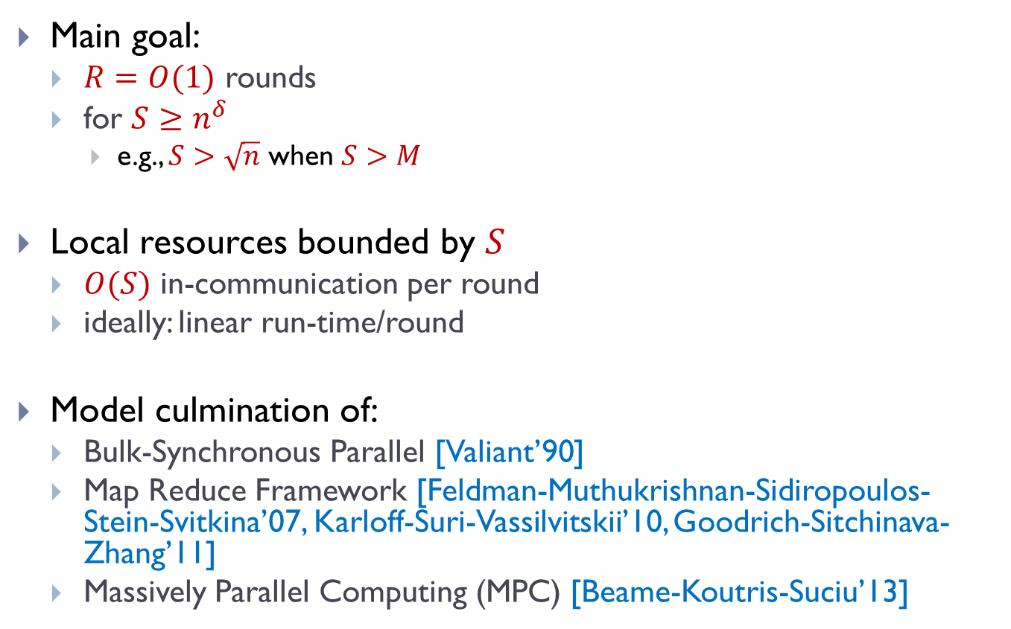
Model Constraints
Main goal:
  $R=O(1)$ rounds
  for $S≥n^{δ}$
    e.g., $S>\sqrt{n}$ when $S>M$
Local resources bounded by $S$
  $O(S)$ in-communication per round
  ideally: linear run-time/round
Model culmination of:
  Bulk-Synchronous Parallel [Valiant’90]
  Map Reduce Framework [Feldman-Muthukrishnan-Sidiropoulos-Stein-Svitkina’07, Karloff-Suri-Vassilvitskii’10, Goodrich-Sitchinava-Zhang’11]
  Massively Parallel Computing (MPC) [Beame-Koutris-Suciu’13]

Slide 7
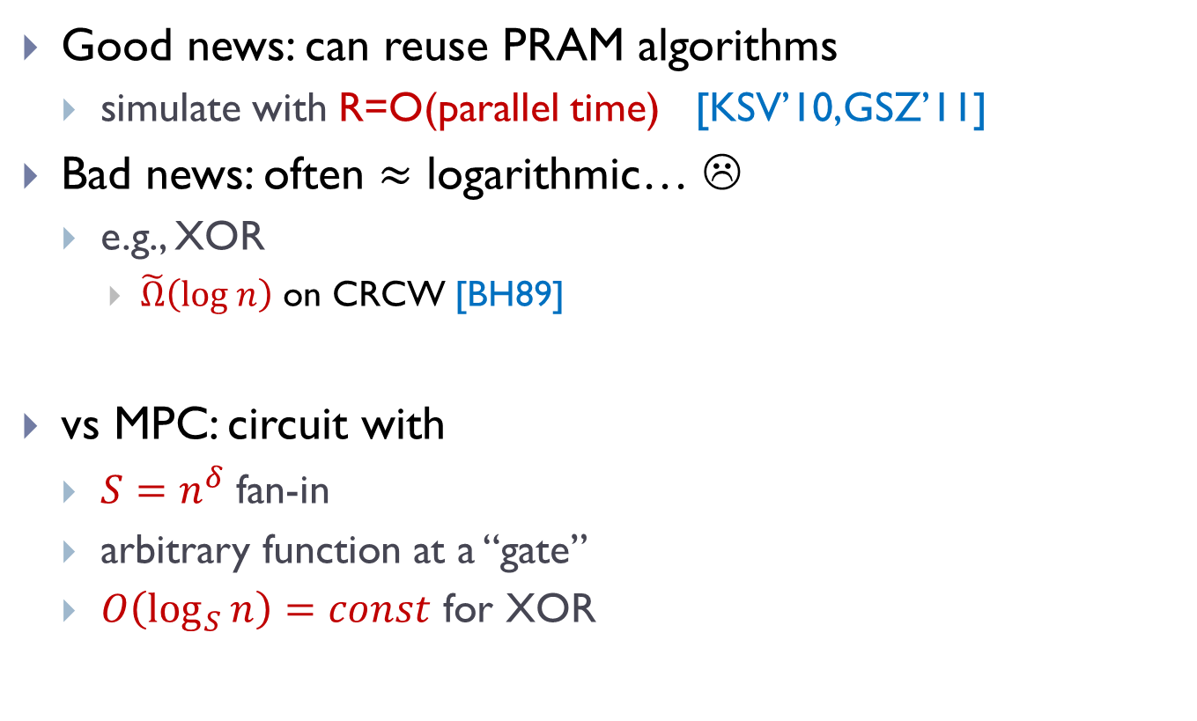
What about PRAMs ?
Good news: can reuse PRAM algorithms
  simulate with R=O(parallel time) [KSV’10,GSZ’11]
Bad news: often $≈$ logarithmic… ☹
  e.g., XOR
    $\tilde{Ω}\left(log n\right)$ on CRCW [BH89]
vs MPC: circuit with
  $S=n^{δ}$ fan-in
  arbitrary function at a “gate”
  $O\left(\log_{S}{n}\right)=const$ for XOR

Slide 8

Between Log and const…
  Graph s-t connectivity?
    $O\left(log n\right)$ on PRAM
  Big open question: $≪\log{n}$ rounds ?
  Seems hard [BKS13]
VS

Slide 9
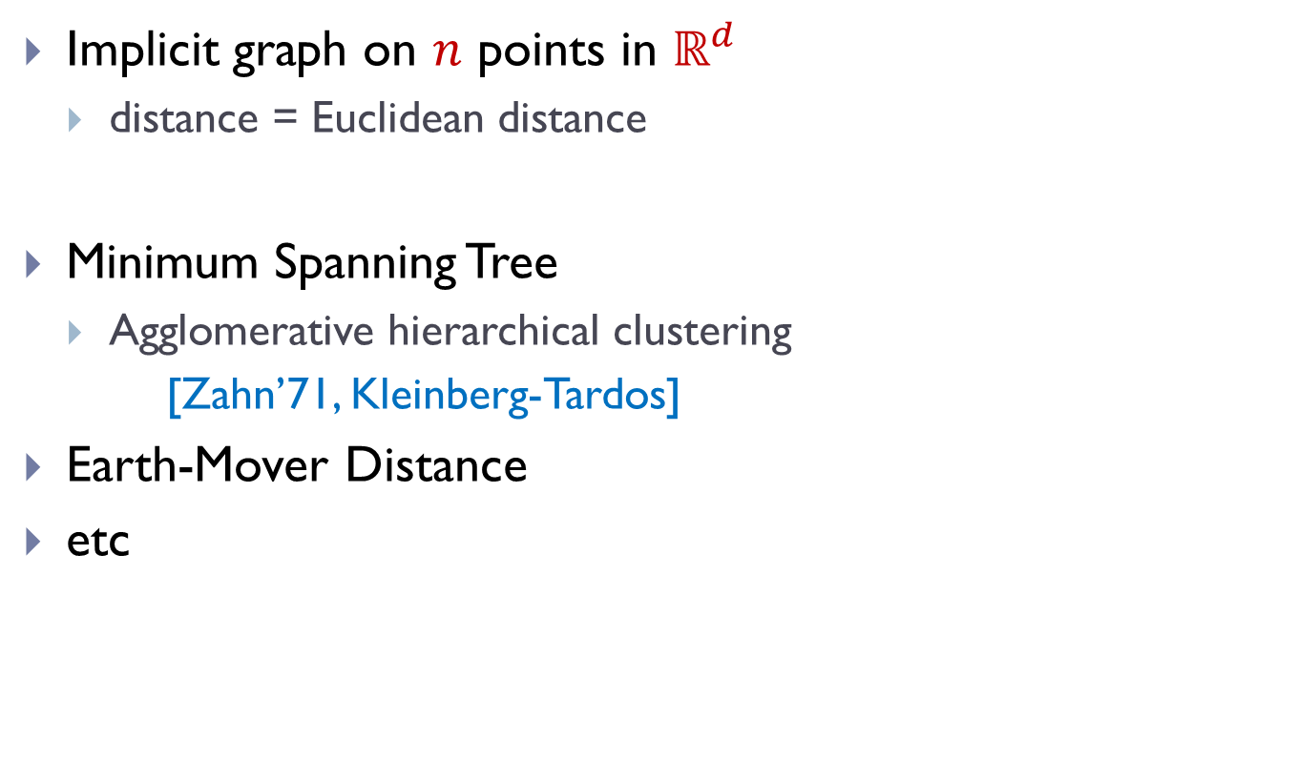
Our problems: Geometric Graphs
Implicit graph on $n$ points in $ℝ^{d}$
  distance = Euclidean distance
Minimum Spanning Tree
  Agglomerative hierarchical clustering
  [Zahn’71, Kleinberg-Tardos]
Earth-Mover Distance
etc
Notes:
pictures of problems!

Slide 10
Our problems: Geometric Graphs
Implicit graph on $n$ points in $ℝ^{d}$
  distance = Euclidean distance
Minimum Spanning Tree
  Agglomerative hierarchical clustering
  [Zahn’71, Kleinberg-Tardos]
Earth-Mover Distance
etc
Notes:
pictures of problems!

Slide 11
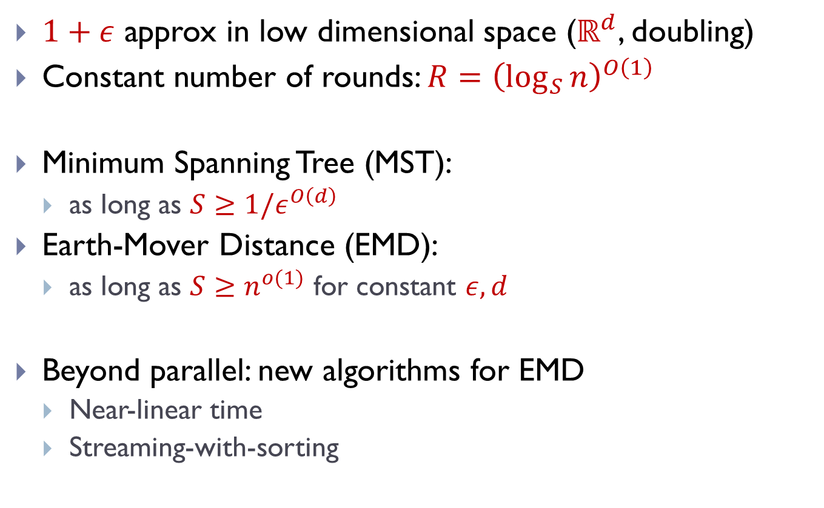
Results: MST & EMD algorithms
$1+ε$ approx in low dimensional space ($ℝ^{d}$, doubling)
Constant number of rounds: $R={\left(\log_{S}{n}\right)}^{O\left(1\right)}$
Minimum Spanning Tree (MST):
  as long as $S≥{1/ε}^{O\left(d\right)}$
Earth-Mover Distance (EMD):
  as long as $S≥n^{o(1)}$ for constant $ε, d$
Beyond parallel: new algorithms for EMD
  Near-linear time
  Streaming-with-sorting

Slide 12
Framework: Solve-And-Sketch
Partition the space hierarchically in a “nice way”
In each part
  Compute a pseudo-solution for the local view
  Sketch the pseudo-solution using small space
  Send the sketch to be used in the next level/round

Slide 13
MST algorithm: attempt 1
Partition the space hierarchically in a “nice way”
In each part
  Compute a pseudo-solution for the local view
  Sketch the pseudo-solution using small space
  Send the sketch to be used in the next level/round
quad trees!
local MST
send any point as a representative

Slide 14
Difficulties
Quad tree can cut MST edges
  forcing irrevocable decisions
Choose a wrong representative

Slide 15

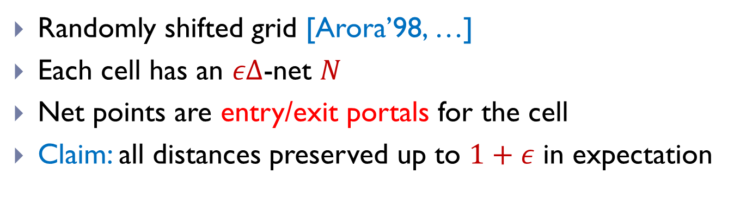
New Partition: Grid Distance
Randomly shifted grid [Arora’98, …]
Each cell has an $εΔ$-net $N$
Net points are entry/exit portals for the cell
Claim: all distances preserved up to $1+ε$ in expectation
$$Δ$$

Slide 16

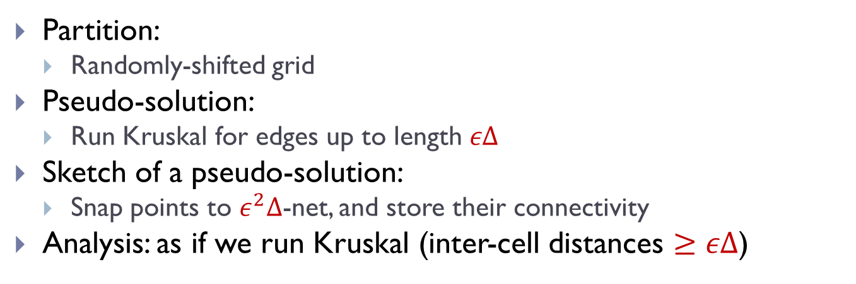
MST Algorithm
Partition:
  Randomly-shifted grid
Pseudo-solution:
  Run Kruskal for edges up to length $εΔ$
Sketch of a pseudo-solution:
  Snap points to $ε^{2}Δ$-net, and store their connectivity
Analysis: as if we run Kruskal (inter-cell distances $≥εΔ$)
$$Δ$$

Slide 17
VS streaming
Fact: linear streaming => parallel
But: computes cost
  e.g., for MST [Indyk’04, Frahling-Indyk-Sohler’05]
Here: actual tree

Slide 18
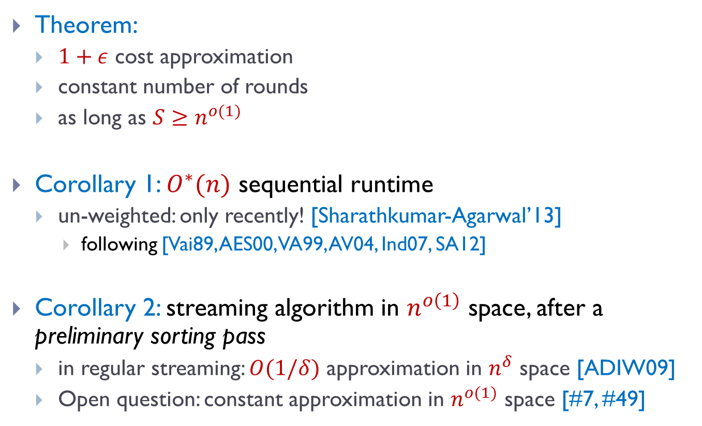
Earth-Mover Distance
Theorem:
  $1+ε$ cost approximation
  constant number of rounds
  as long as $S≥n^{o(1)}$
Corollary 1: $O^{∗}(n)$ sequential runtime
  un-weighted: only recently! [Sharathkumar-Agarwal’13]
    following [Vai89, AES00, VA99, AV04, Ind07, SA12]
Corollary 2: streaming algorithm in $n^{o\left(1\right)}$ space, after a preliminary sorting pass
  in regular streaming: $O(1/δ)$ approximation in $n^{δ}$ space [ADIW09]
  Open question: constant approximation in $n^{o(1)}$ space [#7, #49]

Slide 19
Solve-And-Sketch Framework for EMD
Partition the space hierarchically in a “nice way”
In each part
  Compute a pseudo-solution for the local view
  Sketch the pseudo-solution using small space
  Send the sketch to be used in the next level/round
cannot precompute
any “partial solution”
fat quad-tree (as before)
& use grid distance
after committing to a wrong alternation,
cannot get <2 approximation!

Slide 20
Solve-And-Sketch Framework* for EMD
Partition the space hierarchically in a “nice way”
In each part
  Compute a pseudo-solution for the local view
  Sketch the pseudo-solution using small space
  Send the sketch to be used in the next level/round
all solutions

Slide 21
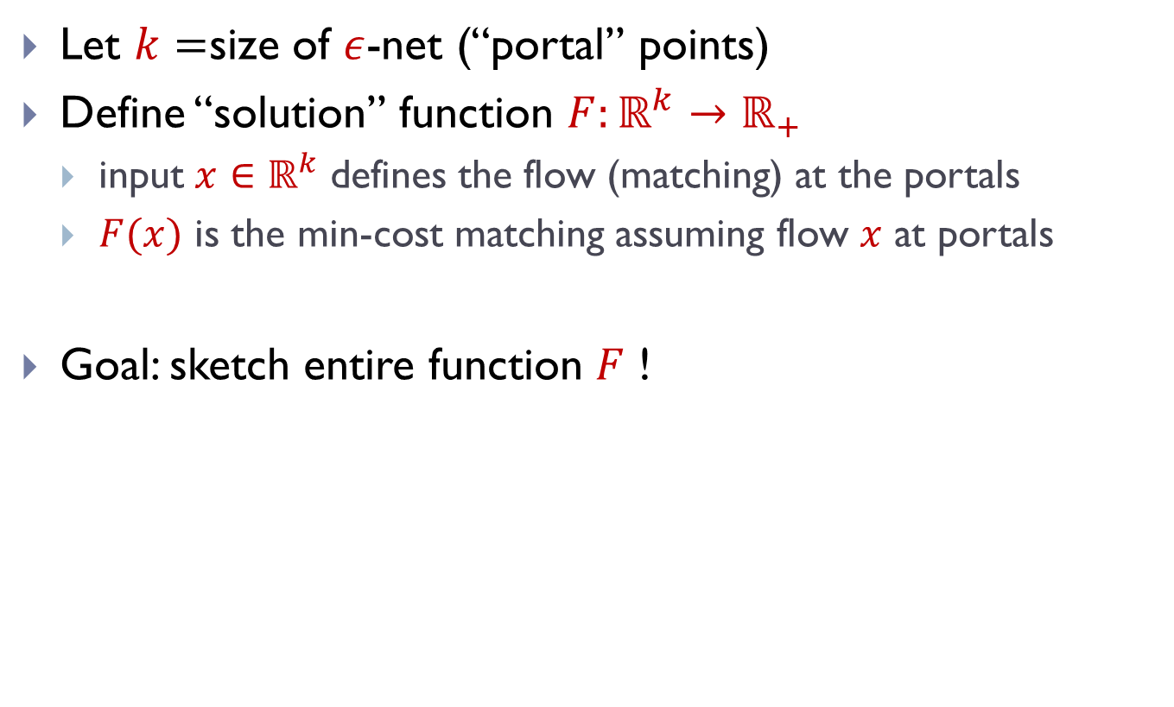
Sketching ALL local solutions
Let $k=$size of $ε$-net (“portal” points)
Define “solution” function $F:ℝ^{k}→ℝ_{+}$
  input $x∈ℝ^{k}$ defines the flow (matching) at the portals
  $F(x)$ is the min-cost matching assuming flow $x$ at portals
Goal: sketch entire function $F$ !

Slide 22
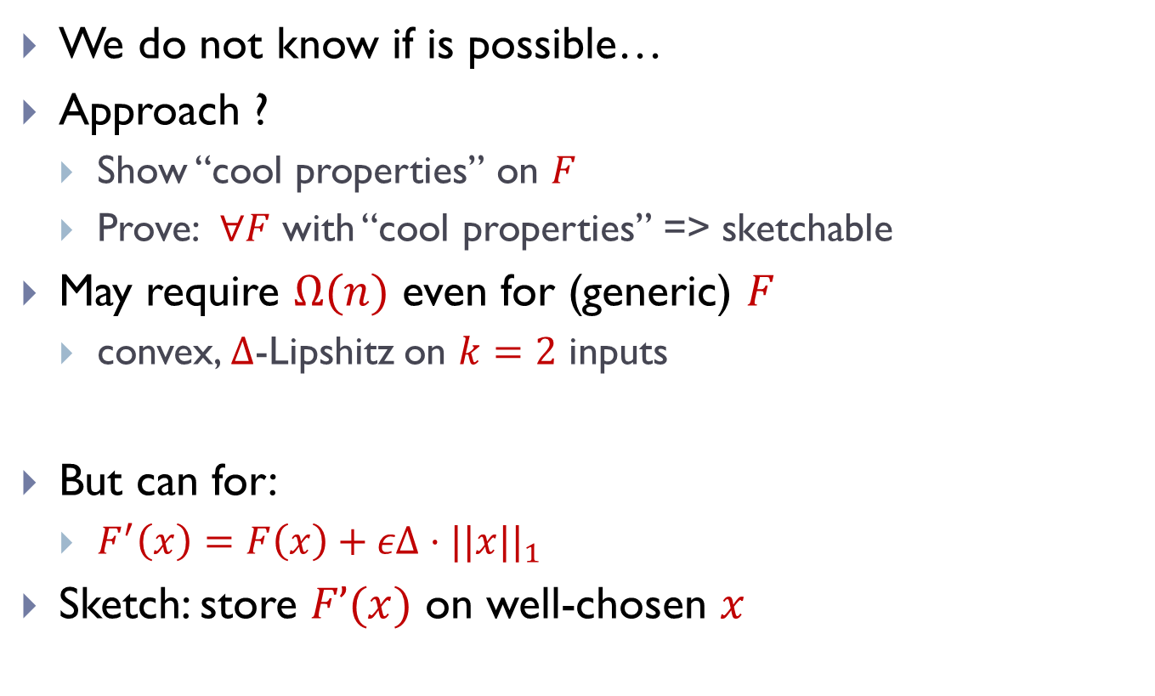

Sketching solution function $F$
We do not know if is possible…
Approach ?
  Show “cool properties” on $F$
  Prove: $∀F$ with “cool properties” => sketchable
May require $Ω(n)$ even for (generic) $F$
  convex, $Δ$-Lipshitz on $k=2$ inputs
But can for:
  $F^{′}\left(x\right)=F\left(x\right)+εΔ⋅||x||_{1}$
Sketch: store $F’(x)$ on well-chosen $x$

Slide 23
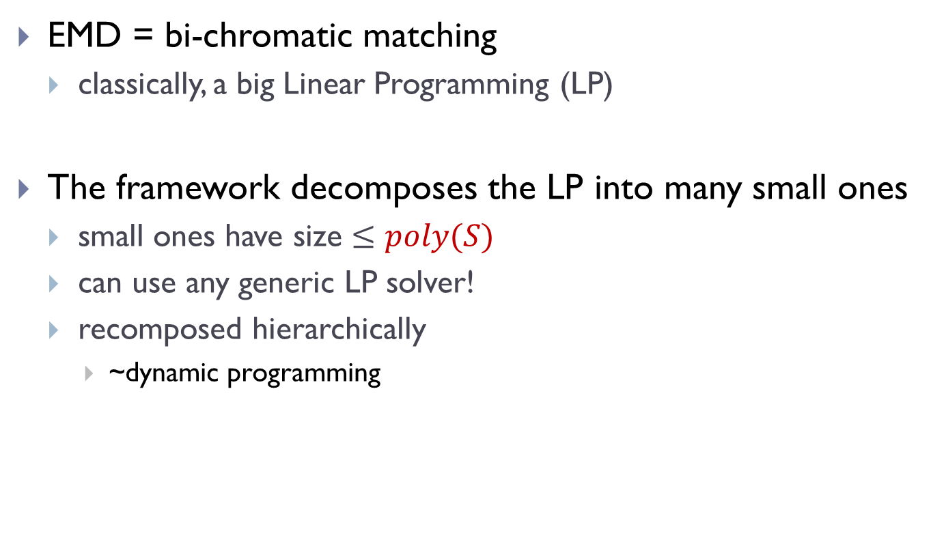
A perspective on EMD
EMD = bi-chromatic matching
  classically, a big Linear Programming (LP)
The framework decomposes the LP into many small ones
  small ones have size $≤poly(S)$
  can use any generic LP solver!
  recomposed hierarchically
    ~dynamic programming

Slide 24
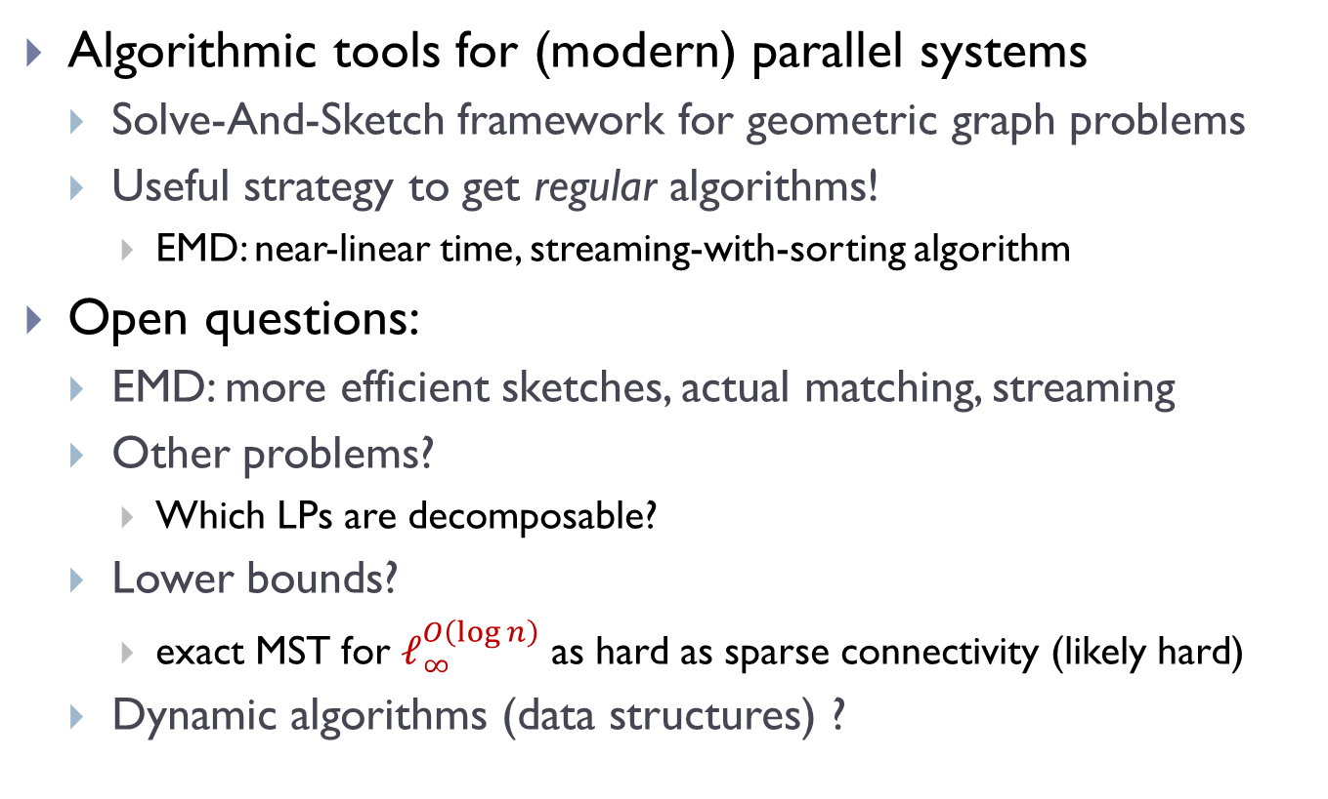
Finale
Algorithmic tools for (modern) parallel systems
  Solve-And-Sketch framework for geometric graph problems
  Useful strategy to get regular algorithms!
    EMD: near-linear time, streaming-with-sorting algorithm
Open questions:
  EMD: more efficient sketches, actual matching, streaming
  Other problems?
    Which LPs are decomposable?
  Lower bounds?
    exact MST for $ℓ_{∞}^{O\left(\log{n}\right)}$ as hard as sparse connectivity (likely hard)
  Dynamic algorithms (data structures) ?

