Slide 1
The Sketching Complexity of Graph Cuts
Robert Krauthgamer, Weizmann Institute of Science
Bertinoro workshop, May 2014
Joint work with Alexandr Andoni and David Woodruff
TexPoint fonts used in EMF.
Read the TexPoint manual before you delete this box.: AAA

Slide 2
Compressing Graphs
Vast literature on “compression” (succinct representation) of graphs
We focus on preserving specific features – distances, cuts, etc.
Edge sparsification:
Cut and spectral sparsifiers [Benczur-Karger, …, Batson-Spielman-Srivastava, …]
Spanners and distance oracles [Peleg-Schaffer, …, Thorup-Zwick,…]
exactly/approximately
graphical representation
data structure (w/fast query)
Lossy
Compression

Slide 3
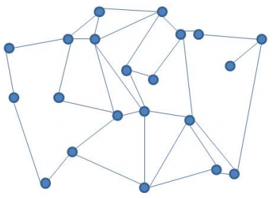




Sketching Cuts
Network G with edge weights $w:E\left(G\right)→R_{+}$. (“huge” network)
Care about cuts: $w\left(S,\overline{S}\right)$ = weight of edges between $S$ and $\overline{S}=V∖S$.
G:
preprocess
query
$$→$$
$$→$$
$w\left(S,\overline{S}\right)$
S
‾S
data structure
Goal: Small data structure that can answer “cut queries” (quickly)

Slide 4

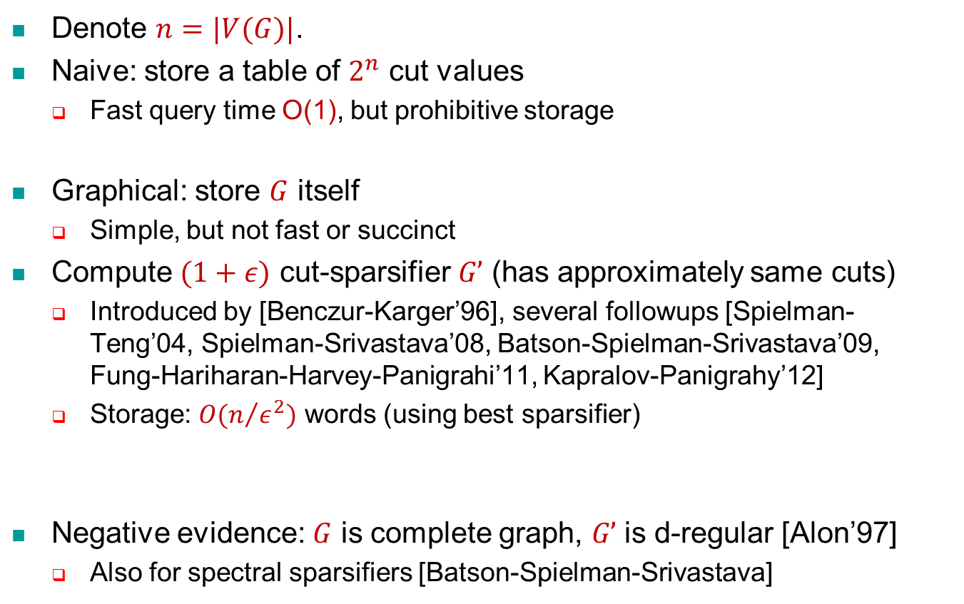
Known Solutions
Denote $n=|V(G)|$.
Naive: store a table of $2^{n}$ cut values
Fast query time O(1), but prohibitive storage
Graphical: store $G$ itself
Simple, but not fast or succinct
Compute $(1+ε)$ cut-sparsifier $G’$ (has approximately same cuts)
Introduced by [Benczur-Karger’96], several followups [Spielman-Teng’04, Spielman-Srivastava’08, Batson-Spielman-Srivastava’09, Fung-Hariharan-Harvey-Panigrahi’11, Kapralov-Panigrahy’12]
Storage: $O(n/{ε^{2}})$ words (using best sparsifier)
Negative evidence: $G$ is complete graph, $G’$ is d-regular [Alon’97]
Also for spectral sparsifiers [Batson-Spielman-Srivastava]
Q: Improve dependence on $ε$?

Slide 5
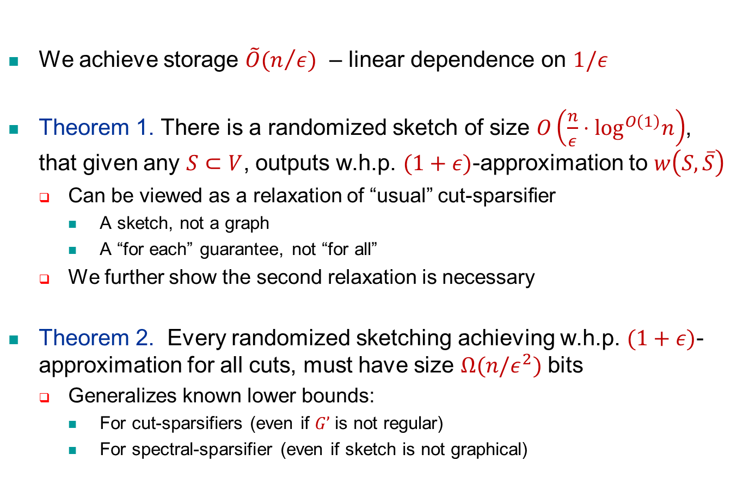
Our Results
We achieve storage $\tilde{O}(n/ε)$ – linear dependence on $1/ε$
Theorem 1. There is a randomized sketch of size $O\left(\frac{n}{ε}⋅\log^{O\left(1\right)}n\right)$, that given any $S⊂V$, outputs w.h.p. $(1+ε)$-approximation to $w\left(S,\overline{S}\right)$
Can be viewed as a relaxation of “usual” cut-sparsifier
A sketch, not a graph
A “for each” guarantee, not “for all”
We further show the second relaxation is necessary
Theorem 2. Every randomized sketching achieving w.h.p. $(1+ε)$-approximation for all cuts, must have size $Ω(n/ε^{2})$ bits
Generalizes known lower bounds:
For cut-sparsifiers (even if $G’$ is not regular)
For spectral-sparsifier (even if sketch is not graphical)

Slide 6
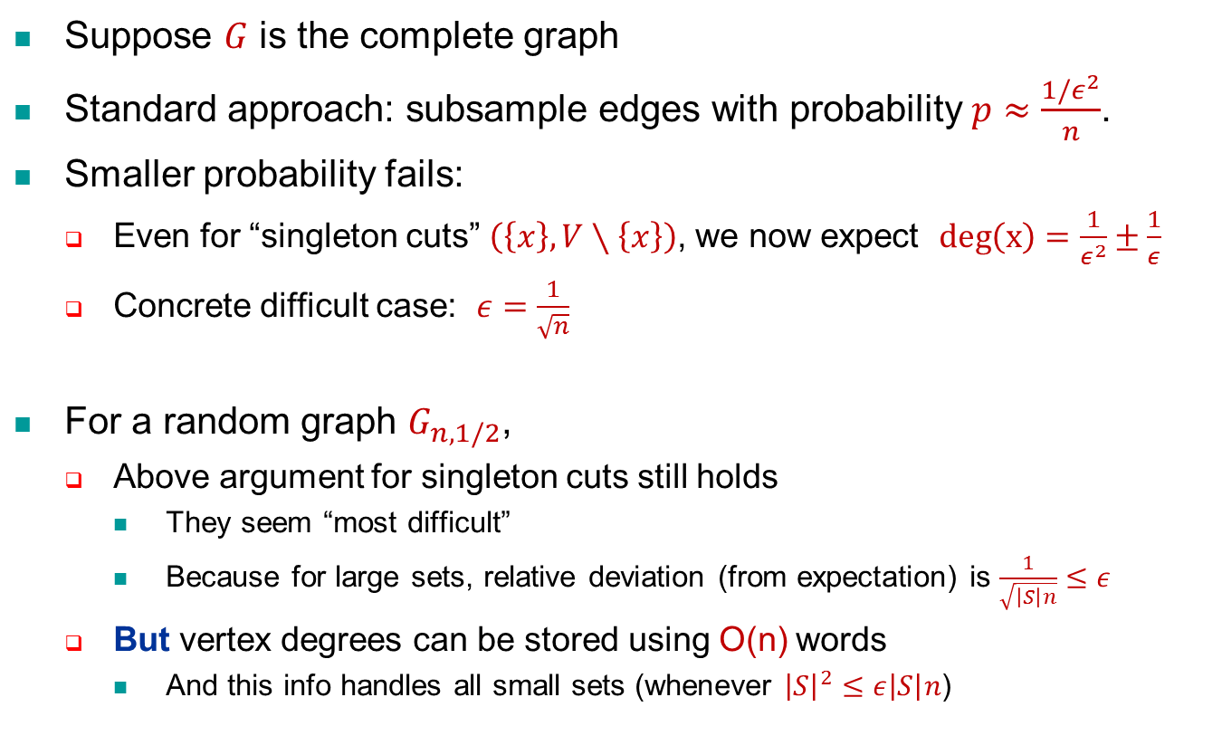
UB: First Attempt – Edge Sampling
Suppose $G$ is the complete graph
Standard approach: subsample edges with probability $p≈\frac{1/ε^{2}}{n}$.
Smaller probability fails:
Even for “singleton cuts” $\left(\left\{x\right\},V∖\left\{x\right\}\right)$, we now expect $deg\left(x\right)=\frac{1}{ε^{2}}±\frac{1}{ε}$
Concrete difficult case: $ε=\frac{1}{\sqrt{n}}$
For a random graph $G_{n,1/2}$,
Above argument for singleton cuts still holds
They seem “most difficult”
Because for large sets, relative deviation (from expectation) is $\frac{1}{\sqrt{\left|S\right|n}}≤ε$
But vertex degrees can be stored using O(n) words
And this info handles all small sets (whenever ${\left|S\right|}^{2}≤ε\left|S\right|n$)

Slide 7
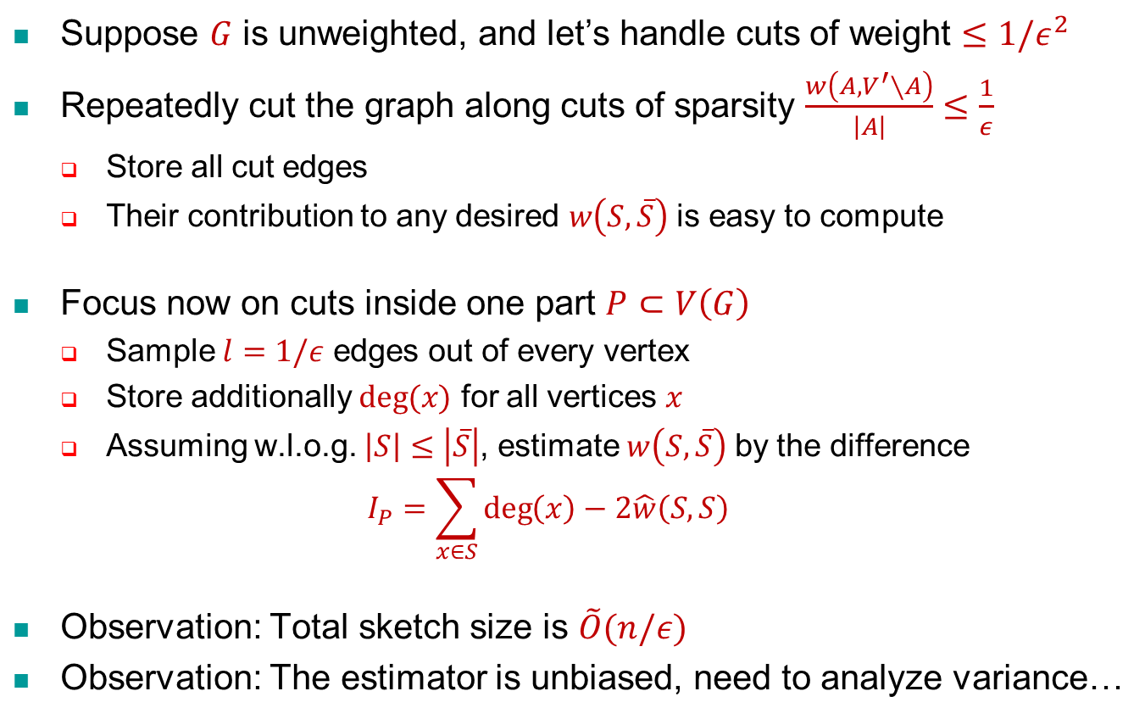
UB: Core Idea
Suppose $G$ is unweighted, and let’s handle cuts of weight $≤1/ε^{2}$
Repeatedly cut the graph along cuts of sparsity $\frac{w\left(A,V^{′}∖A\right)}{\left|A\right|}≤\frac{1}{ε}$
Store all cut edges
Their contribution to any desired $w\left(S,\overline{S}\right)$ is easy to compute
Focus now on cuts inside one part $P⊂V\left(G\right)$
Sample $l=1/ε$ edges out of every vertex
Store additionally $deg⁡(x)$ for all vertices $x$
Assuming w.l.o.g. $\left|S\right|≤\left|\overline{S}\right|$, estimate $w\left(S,\overline{S}\right)$ by the difference
$$I_{P}=\sum_{x∈S}{\deg\left(x\right)}−2\hat{w}\left(S,S\right)$$
Observation: Total sketch size is $\tilde{O}(n/ε)$
Observation: The estimator is unbiased, need to analyze variance…

Slide 8
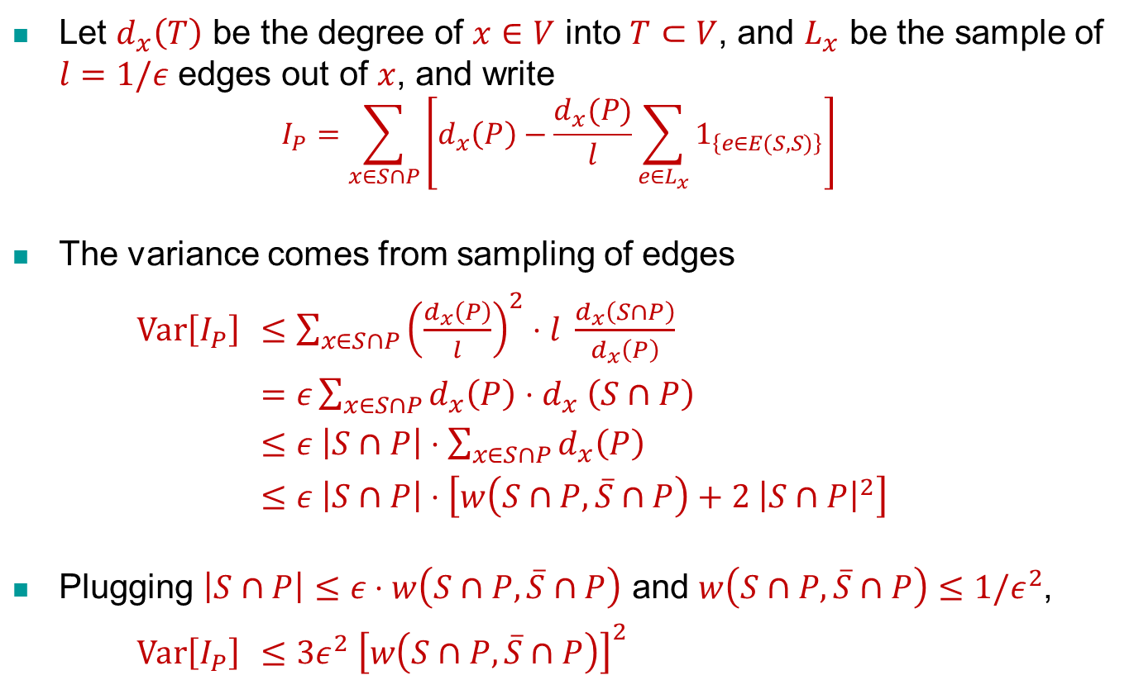
Variance Analysis
Let $d_{x}\left(T\right)$ be the degree of $x∈V$ into $T⊂V$, and $L_{x}$ be the sample of $l=1/ε$ edges out of $x$, and write
$$I_{P}=\sum_{x∈S∩P}{\left[d_{x}\left(P\right)−\frac{d_{x}(P)}{l}\sum_{e∈L_{x}}{1_{\left\{e∈E(S,S)\right\}}}\right]}$$
The variance comes from sampling of edges
$\text{Var}\left[I_{P}\right]$ $≤\sum_{x∈S∩P}{{\left(\frac{d_{x}\left(P\right)}{l}\right)}^{2}⋅l \frac{d_{x}\left(S∩P\right)}{d_{x}\left(P\right)}}$
$=ε\sum_{x∈S∩P}{d_{x}\left(P\right){⋅d}_{x}\left(S∩P\right)}$
$≤ε \left|S∩P\right|⋅\sum_{x∈S∩P}{d_{x}\left(P\right)}$
$≤ε \left|S∩P\right|⋅\left[w\left(S∩P,\overline{S}∩P\right)+2 {\left|S∩P\right|}^{2}\right]$
Plugging $\left|S∩P\right|≤ε⋅w\left(S∩P,\overline{S}∩P\right)$ and $w\left(S∩P,\overline{S}∩P\right)≤1/ε^{2}$,
$\text{Var}\left[I_{P}\right]$ $≤3ε^{2} {\left[w\left(S∩P,\overline{S}∩P\right)\right]}^{2}$

Slide 9
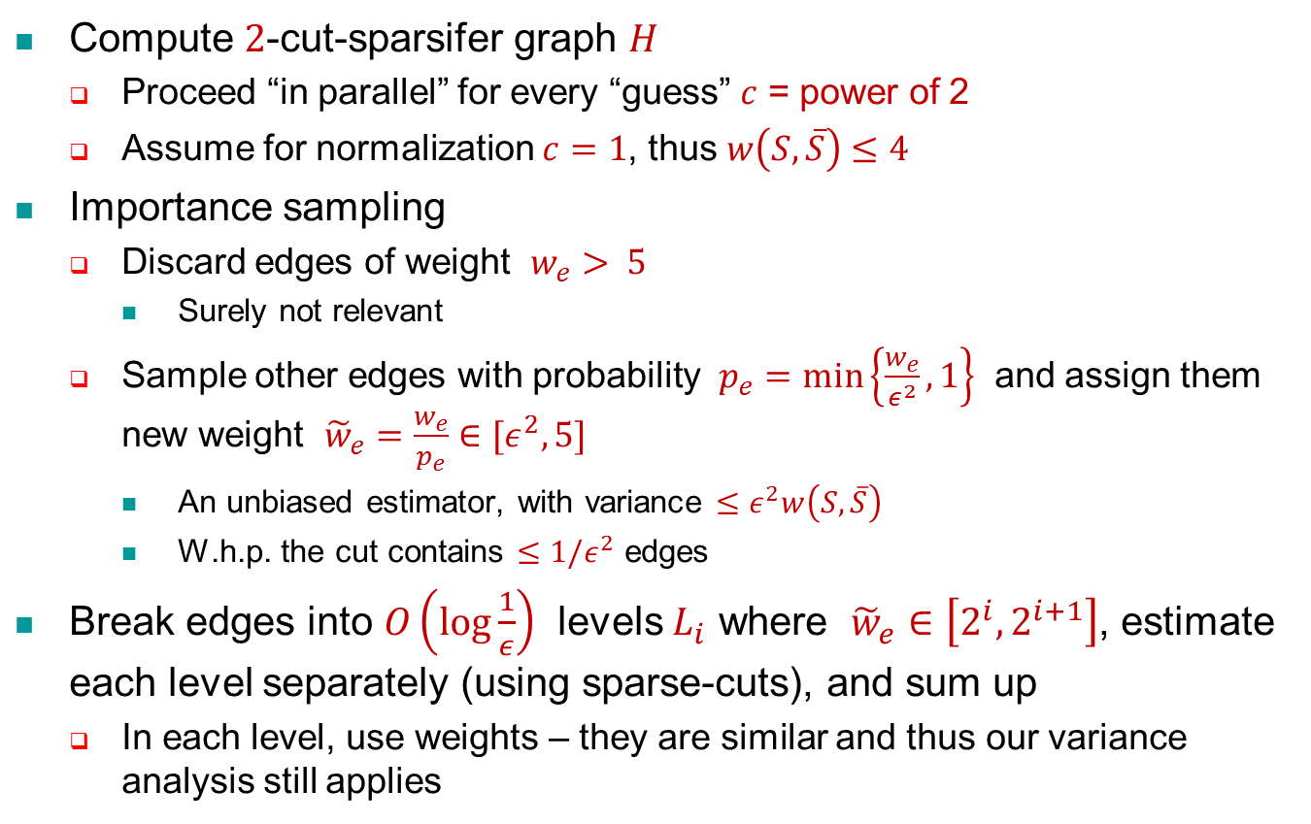
General Case (Polynomial Weights)
Compute $2$-cut-sparsifer graph $H$
Proceed “in parallel” for every “guess” $c$ = power of 2
Assume for normalization $c=1$, thus $w\left(S,\overline{S}\right)≤4$
Importance sampling
Discard edges of weight $w_{e}> 5$
Surely not relevant
Sample other edges with probability $p_{e}=\min\left\{\frac{w_{e}}{ε^{2}},1\right\}$ and assign them new weight ${\tilde{w}}_{e}=\frac{w_{e}}{p_{e}}∈[ε^{2},5]$
An unbiased estimator, with variance $≤ε^{2}w\left(S,\overline{S}\right)$
W.h.p. the cut contains $≤1/ε^{2}$ edges
Break edges into $O\left(\log{\frac{1}{ε}}\right)$ levels $L_{i}$ where ${\tilde{w}}_{e}∈\left[2^{i},2^{i+1}\right]$, estimate each level separately (using sparse-cuts), and sum up
In each level, use weights – they are similar and thus our variance analysis still applies

Slide 10
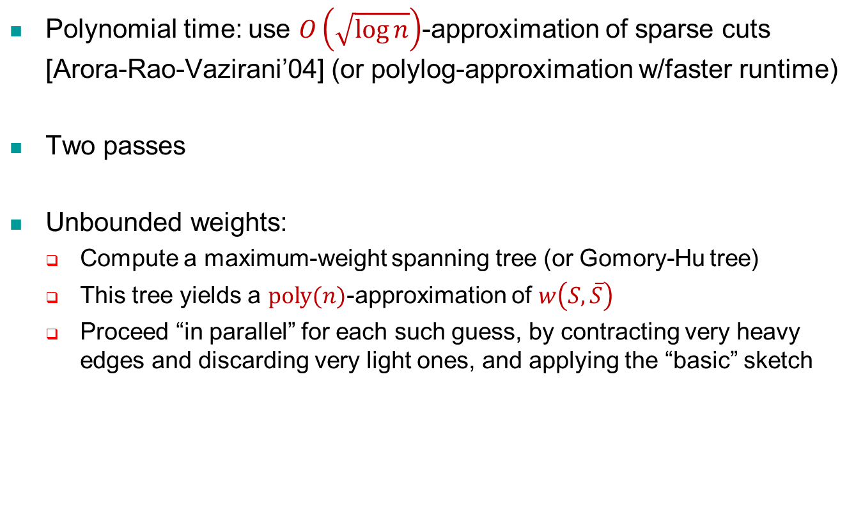
Further Extensions
Polynomial time: use $O\left(\sqrt{\log{n}}\right)$-approximation of sparse cuts [Arora-Rao-Vazirani’04] (or polylog-approximation w/faster runtime)
Two passes
Unbounded weights:
Compute a maximum-weight spanning tree (or Gomory-Hu tree)
This tree yields a $\text{poly}(n)$-approximation of $w\left(S,\overline{S}\right)$
Proceed “in parallel” for each such guess, by contracting very heavy edges and discarding very light ones, and applying the “basic” sketch

Slide 11
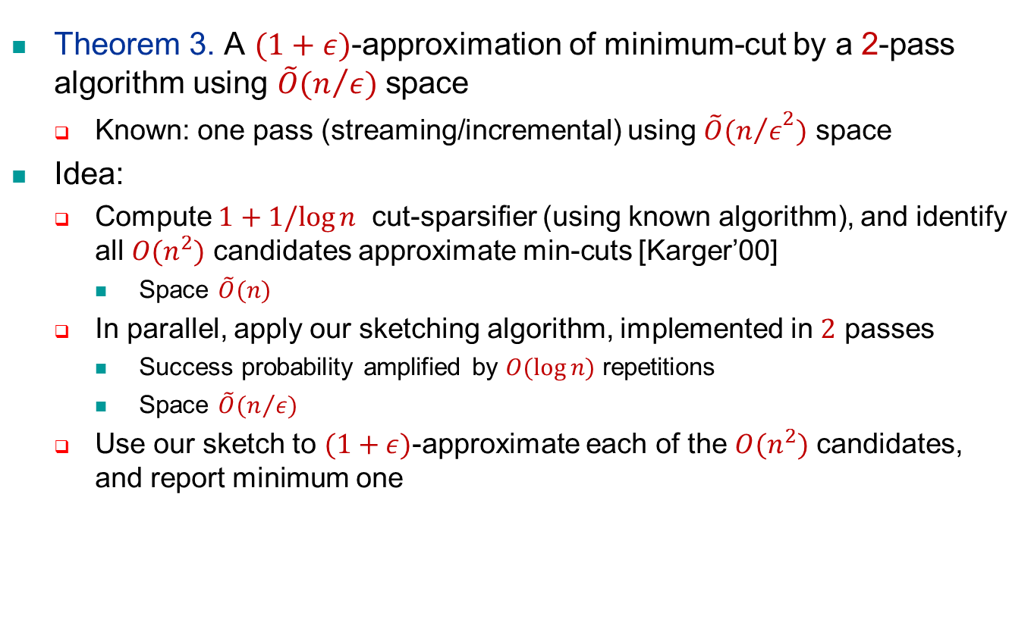
Example Application
Theorem 3. A $(1+ε)$-approximation of minimum-cut by a 2-pass algorithm using $\tilde{O}(n/ε)$ space
Known: one pass (streaming/incremental) using $\tilde{O}({n/ε}^{2})$ space
Idea:
Compute $1+1/log⁡n$ cut-sparsifier (using known algorithm), and identify all $O(n^{2})$ candidates approximate min-cuts [Karger’00]
Space $\tilde{O}(n)$
In parallel, apply our sketching algorithm, implemented in $2$ passes
Success probability amplified by $O(log⁡n)$ repetitions
Space $\tilde{O}(n/ε)$
Use our sketch to $(1+ε)$-approximate each of the $O(n^{2})$ candidates, and report minimum one

Slide 12

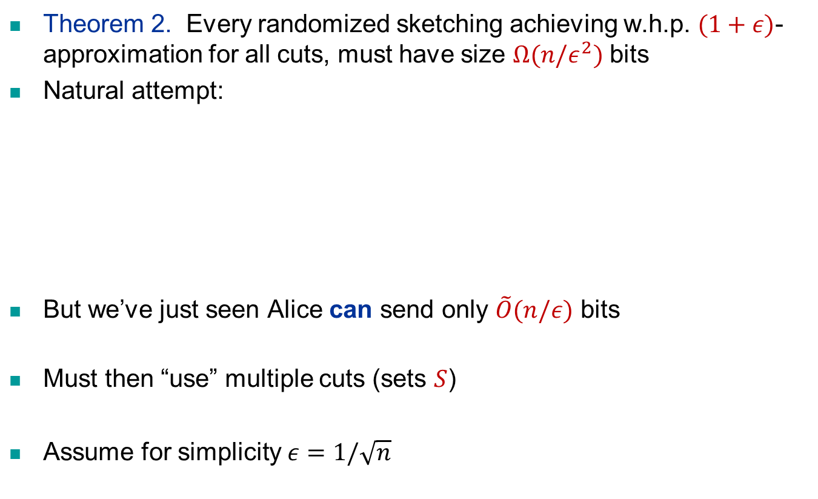

LB: First Attempt – One-way Comm.
Theorem 2. Every randomized sketching achieving w.h.p. $(1+ε)$-approximation for all cuts, must have size $Ω(n/ε^{2})$ bits
Natural attempt:
But we’ve just seen Alice can send only $\tilde{O}(n/ε)$ bits
Must then “use” multiple cuts (sets $S$)
Assume for simplicity $ε=1/\sqrt{n}$
Alice
$$G$$
Bob
$$S⊂V(G)$$

Slide 13
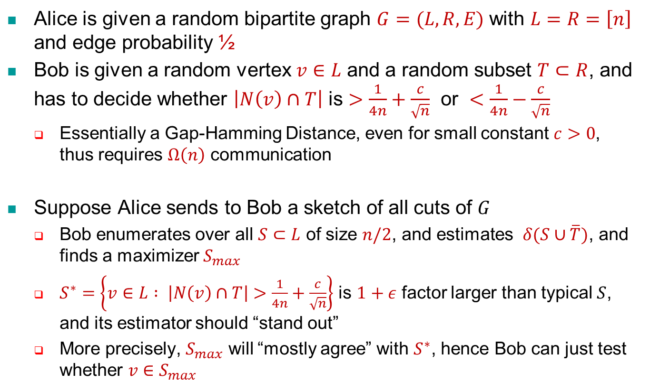
LB: Outline
Alice is given a random bipartite graph $G=(L,R,E)$ with $L=R=\left[n\right]$ and edge probability ½
Bob is given a random vertex $v∈L$ and a random subset $T⊂R$, and has to decide whether $\left|N\left(v\right)∩T\right|$ is $>\frac{1}{4n}+\frac{c}{\sqrt{n}}$ or $<\frac{1}{4n}−\frac{c}{\sqrt{n}}$
Essentially a Gap-Hamming Distance, even for small constant $c>0$, thus requires $Ω\left(n\right)$ communication
Suppose Alice sends to Bob a sketch of all cuts of $G$
Bob enumerates over all $S⊂L$ of size $n/2$, and estimates $δ(S∪\overline{T})$, and finds a maximizer $S_{max}$
$S^{∗}=\left\{v∈L : \left|N\left(v\right)∩T\right|>\frac{1}{4n}+\frac{c}{\sqrt{n}}\right\}$ is $1+ε$ factor larger than typical $S$, and its estimator should “stand out”
More precisely, $S_{max}$ will “mostly agree” with $S^{∗}$, hence Bob can just test whether $v∈S_{max}$

Slide 14
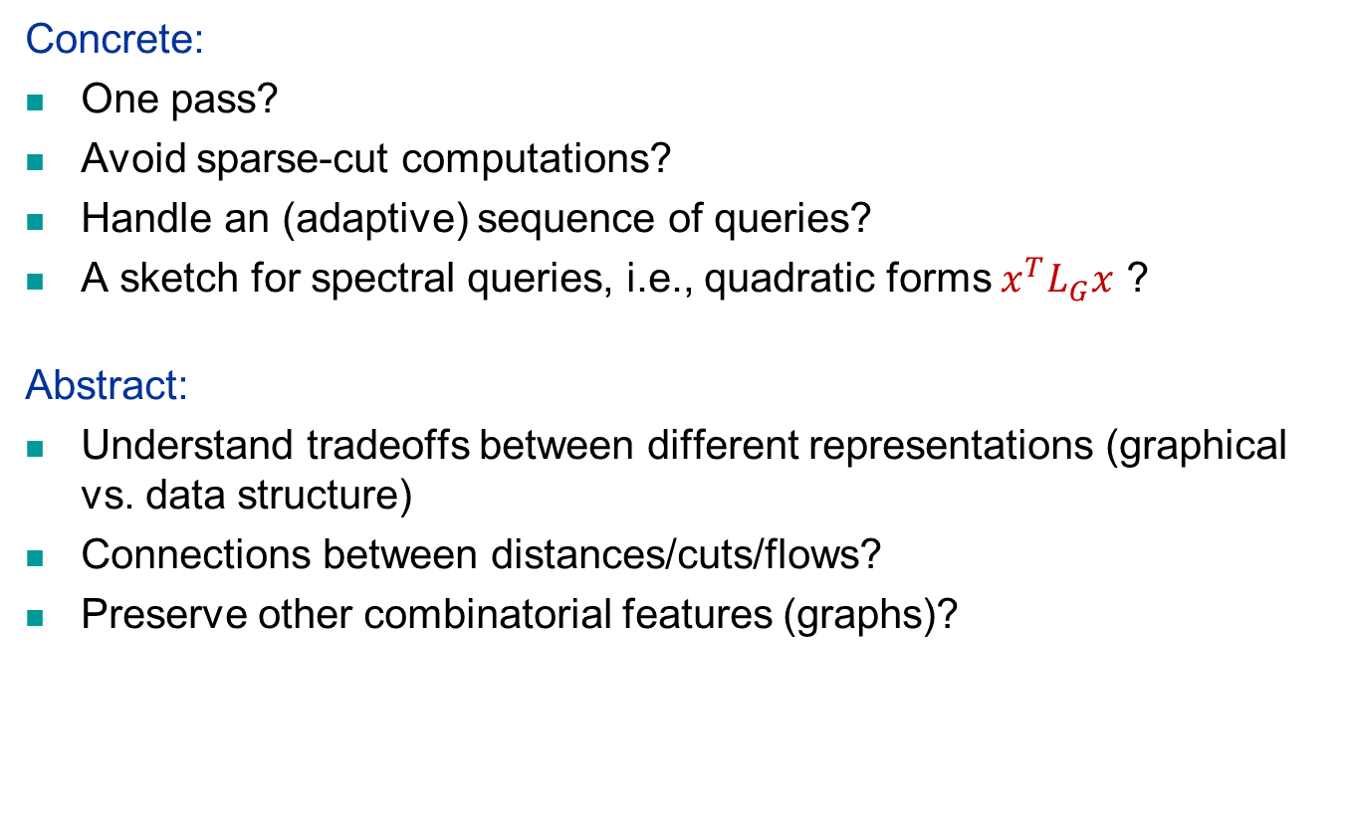
Concluding Remarks
Concrete:
One pass?
Avoid sparse-cut computations?
Handle an (adaptive) sequence of queries?
A sketch for spectral queries, i.e., quadratic forms $x^{T}L_{G}x$ ?
Abstract:
Understand tradeoffs between different representations (graphical vs. data structure)
Connections between distances/cuts/flows?
Preserve other combinatorial features (graphs)?
Thank You!

