Slide 1

Group Testing and New Algorithmic Applications
Ely Porat
Bar-Ilan University

Slide 2

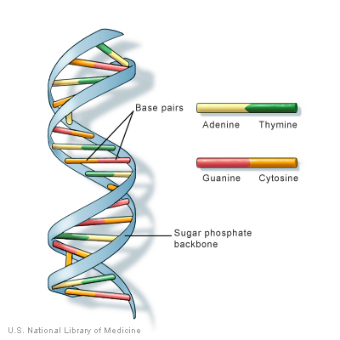
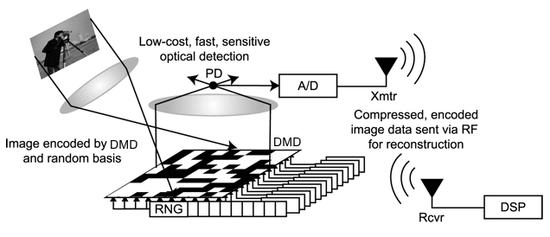
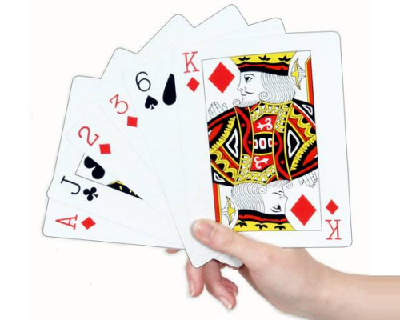

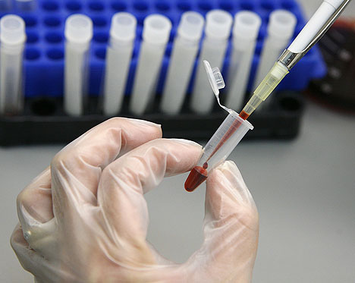

Compressive sensing
Theory of Big data
Pattern matching
Coding theory
Group testing
Game theory
Distributed

Slide 3


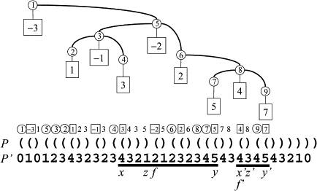

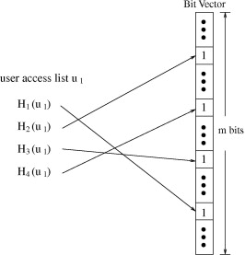

Theory of Big data
Succinct data structures
Streaming
algorithm
Sketching & LSH
Bloom filters
Big Databases

Slide 4
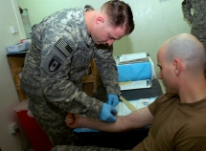

Group Testing Overview
Test soldier for a disease
WWII example: syphillis

Slide 5


Group Testing Overview
Can pool blood samples and check if at least one soldier has the disease
Test an army for a disease
WWII example: syphillis
What if only one soldier has the disease?

Slide 6


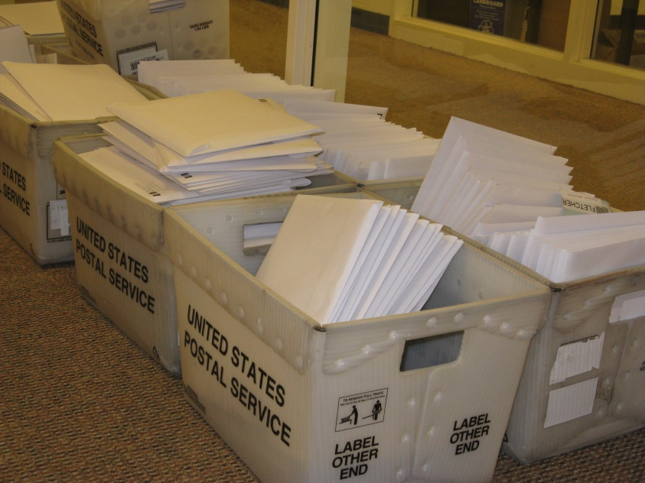
Another motivation

Slide 7



More Motivations
Syphilis, HIV [Dor43]
Mapping genomes [BLC91, BBK+95, TJP00]
Quality control in product testing [SG59]
Searching files in storage systems [KS64]
Sequential screening of experimental variables [Li62]
Efficient contention resolution algorithms for multiple access communication [KS64, Wol85]
Data compression [HL00]
Software testing [BG02, CDFP97]
DNA sequencing [PL94]
Molecular biology [DH00, FKKM97, ND00, BBKT96]
Notes:
לחזור על הדוגמאות.
דורפמן
סובל וגרול
קאוטס וסינגלטון
דו האונג

Slide 8




Adaptive group testing
Number of sick
d ≤ 2

Slide 9
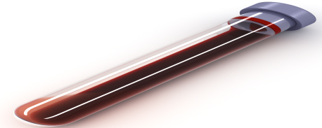
Adaptive general case
n
2d
At most d positive => There remain n/2
Run in recursion
O(dlog(n/d))
Number of sick≤d

Slide 10




Non adaptive group testing
All the tests set in advance.
t
n

Slide 11
Non adaptive group testing
0
(and,or) matrix vector multiplication
0
0
1
0
1
1
0
0
0
1
1
0
1
0
1
1
0
0
1
0
1
0
1
0
1
0
1
1
1
0
1
0
1
0
1
0
1
1
0
0
1
0
0
0
=
0
1
0
1
1
0
1
0
1
0
1
0
0
1
0
1
1
0
1
1
0
0
1
0
0
1
0
0
0
1
0
1
0
0
1
0
1
0
1
0
1
1
1
0
t
0
n

Slide 12
Non adaptive group testing
To be designed
unknown
Observed
1
2
3
…………
n
1
0
0
………….
1
1
x₁
r₁
0
0
1
………….
0
2
x₂
r₂
0
0
0
………….
1
3
x₃
r₃
.
.
.
.
.
.
.
.
.
.
.
.
.
.
.
1
1
1
………….
0
t
r_{t}
Upper bound: t=O(d²logn) [PR08]
Lower bound: t=Ω(d²log_{d}n) [DR82]
x_{n}

Slide 13
Non adaptive group testing

Slide 14
Non adaptive group testing

Slide 15
Non adaptive group testing
Each one has at least 2 good tests
This means that we can deal with
One false positive error
Dealing with any r errors, can be done
with scheme of size O(rdlog_{d}n+d²logn)[NPR11]

Slide 16
2-Stage group testing

Slide 17
2-Stage group testing
We misclassified 2 soldiers.
Using O(dlog n/d) measurement. We will misclassified O(d) soldiers,
which we can easily one by one in a second stage
Property of unbalanced expander.

Slide 18

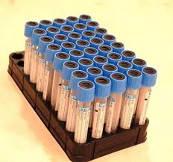
Adaptive vs Non adaptive
If one test take a day performing.
Adaptive testing might take a month
Time
2 stage group testing – take 2 days
Store less
to be check
later

Slide 19
Adaptive vs Non adaptive
If one test take a day performing.
Adaptive testing might take a month
Time
2 stage group testing – take 2 days
Store less
to be check
later

Slide 20
Group testing for Pattern Matching
Text:
n
Pattern:
m

Slide 21


Group testing for Pattern Matching
Supported by
Part of 20M€ consortium project which is supported by MOI (cyber security)

Slide 22

Motivation…
Stock market

Slide 23
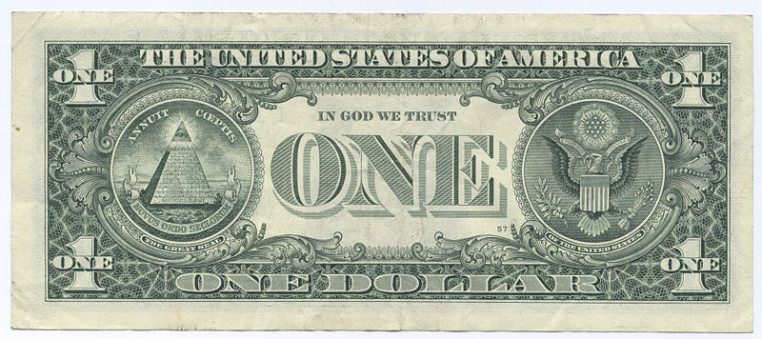

Motivation..
Espionage
The rest we monitor

Slide 24

Motivation…
Viruses and malware
Software solutions:
Snort: 73.5Mb
ClamAV: 1.48Gb
Using TCAMs:
Snort: 680Kb
ClamAV: 25Mb
Our solution (software):
Snort: 51Kb
ClamAV: 216Kb

Slide 25
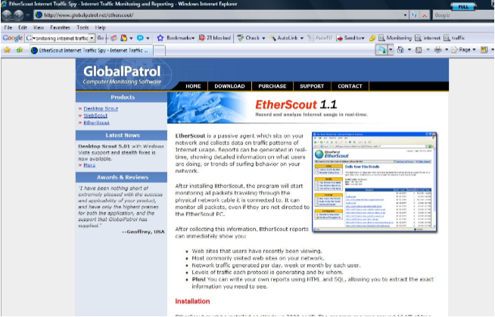


Motivation…
Monitoring internet traffic

Slide 26
Group testing for Pattern Matching
Pattern matching with wildcards
O(nlogm) [CH02]
Up to k mismatches [CEPR07,CEPR09].
Sketching hamming distance [PL07,AGGP13].
Pattern matching in the streaming model [PP09]
Text:
n
Pattern:
m

Slide 27
Group testing for Pattern Matching
Up to k mismatch using group testing
Text:
Pattern:
Group testing scheme
Performing the tests is easy.
However how can we analyze the results?

Slide 28
Fast Decoding
The naïve decoding take O(nt) time.

Slide 29
Fast Decoding
We perform 3 GT schemes.
The original.
First projection.
Second projection.

Slide 30
Fast Decoding
We first decode the projections.
Then we check the d² options naively
If we use the scheme of 2 stage GT,
We will have 4d² candidate to check
In [NPR11] we mange to have scheme
With optimal number of measurements
and decode time O(d²log²n).
(Using recursion and 2-stage GT)

Slide 31

Faster Decoding
According to LW theorem the number of candidate in the join is d^{1.5}
In [NPRR12] we show how to do join in optimal time.
Best paper award
This give a scheme with optimal number of measurements,
which can be decode in time O(d^{1+Ԑ}poly(logn))

Slide 32
Compressive Sensing
2
2
0
1
0
1
t
n

Slide 33
Compressive Sensing
0
0
0
1
0
1
1
0
0
0
1
1
0
1
0
2
1
0
0
1
0
1
0
1
0
1
0
1
1
2
0
1
0
1
0
1
0
1
1
0
0
1
0
0
0
=
0
1
0
1
1
0
1
0
1
0
1
0
0
1
0
1
1
0
1
1
0
0
1
0
0
1
0
0
0
1
0
1
0
0
1
0
1
0
1
0
1
1
1
0
t
0
n

Slide 34
Compressive Sensing
Syphilis tests detect antibodies to the bacterium that causes syphilis
Someone who was sick in the past might have negligible amount of antibodies.
Different people have different amounts of antibodies.
Therefore testing is usually done by thresholding.

Slide 35
Compressive Sensing
0.1
0.2
0
1
0
1
1
0
0
0
1
1
0
1
0.1
13.7
1
0
0
1
0
1
0
1
0
1
0
1
5.8
13.9
0.1
1
0
1
0
1
0
1
1
0
0
1
0
0.7
0.3
=
0
1
0
1
1
0
1
0
1
0
1
0
0.1
6.4
0
1
1
0
1
1
0
0
1
0
0
1
0.2
1.0
0.1
1
0
1
0
0
1
0
1
0
1
0
1
8.2
7.3
0.1
t
0.2
n

Slide 36
Compressive Sensing Problem definition
Find a matrix Ф and an algorithm A s.t.:
In [PS12] we gave the first optimal number of measurement sublinear decoding time.
For p=q=1
In [GLPS09, GNPRS13] we gave a randomized solution (foreach) for p=q=2 with sublinear
decoding.

Slide 37

How Compressive Sensing help Massive Recommender Systems
Consider designing recommender system for web pages
Time a user examines a page is an implicit rating
Millions of users
Each user examines thousands of pages throughout the year
Hard to store and process the information

Slide 38

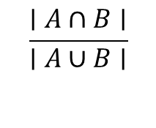


Fingerprint Based Approach
F1
a1
C1
F2
a2
C2
Similarity (ai,aj)
...
Fn
an
Cn

Slide 39
Sampling Approach
a,c,d,f,h,l,m,n,p,r,s,t
c,l,t
a1
C1
a,b,c,f,h,l,m,n,o,p,r,s
f,m,s
a2
C2
Regular sampling doesn’t work

Slide 40
Minwise hashing approach
a,c,d,f,h,l,m,n,p,r,s,t
h
a1
h(x) 5,3, 7,9,2,8
a,b,c,f,h,l,m,n,o,p,r,s
h
a2
h(x) 5,4, 3,7,2,8
[BHP09,BPR09,BP10,FPS11,FPS12,T13]

Slide 41

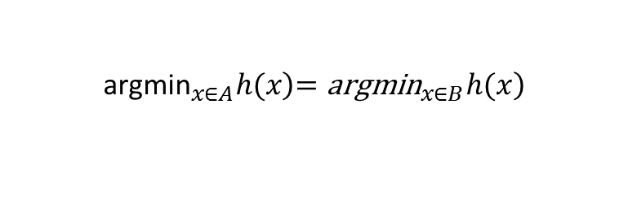
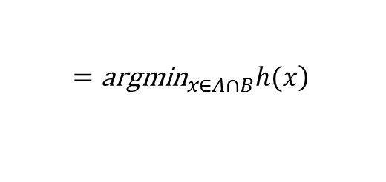
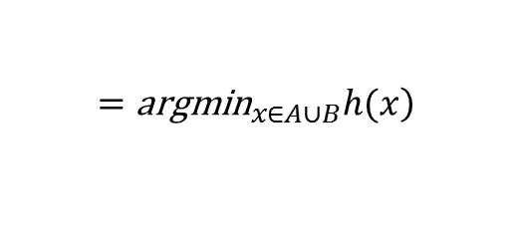
Min wise hash function
A
B

Slide 42

Min wise hash function
A
B

Slide 43


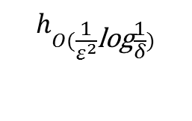
Similarity
Min wise independent
A
B
We get ±є approximation with probability 1-δ

Slide 44


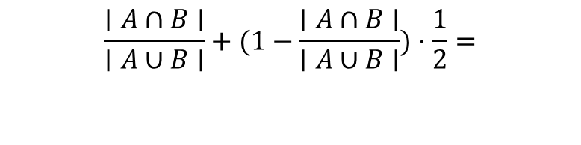
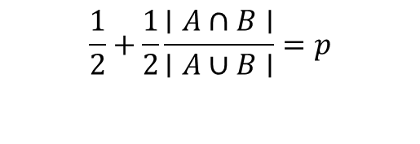
Reducing sketching space [BP10]
Instead of
Additional pairwise independent hash
It was discover independently by Ping Li and Christian Konig

Slide 45
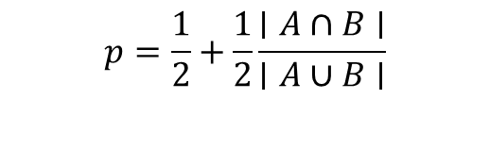


Reducing sketching space [BP10]
Our algorithm estimates

Slide 46
Reducing sketching space even farther [BP10]
We usually interesting in the case that sets are very similar.
Assume J>1-t => p>1-0.5t
A
B
A-B
0
1
1
0
1
0
0
1
0
1
0
1
0
0
1
0
1
1
0
1
0
0
1
0
0
0
-1
0
0
0
2
0
-2
CS

Slide 47
Reducing sketching space even farther [BP10]
We usually interesting in the case that sets are very similar.
Assume J>1-t => p>1-0.5t
A
B
A xor B
0
1
1
0
1
0
0
1
0
1
0
1
0
0
1
0
1
1
0
1
0
0
1
0
0
0
1
0
0
0
1
0
1
CS
This give an improvement of

Slide 48
Removing the min wise independent requirement [BP11]
[KNW10] gave bits sketch for distinct count (F₀)
Their sketch is not linear
However given S(A) and S(B) one can calculate S(A+B) (that will give the size of the union)

Slide 49
Removing the min wise independent requirement [BP11]
Using F₂ instead of F₀ we managed to reduce the sketch size to
Using more randomness we mange to remove factor

Slide 50


File sharing
The naïve way
Supported by

Slide 51



File sharing
Torrent/Emule/Kazaa

Slide 52
File sharing
Source:
Clients:
Coupon collector O(nlogn)
In practice it could be 7Gb instead 1Gb

Slide 53
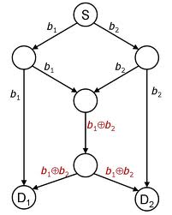

Network coding

Slide 54

Network coding
Source:
1
2
i
n
Client 1: 3X₇+2X₁₇, 5X₂+X₅+4X₁₀, ....
Client 2: 2X₁+3X₃+X₁₇, ....
Client 3:
Client 4:
In a big field, n linear combinations will suffice
We require 1Gb upload for 1Gb file

Slide 55


Poison
Torrent/Emule/Kaza

Slide 56

Signatures against poison
1
2
i
n
MD5
S_{i}
.torrent file
S₁S₂...S_{n}
We might receive poisoned packet
But we won't forward it

Slide 57
Signatures in network coding
1
2
i
n
MD5
S_{i}
.torrent file
S₁,S₂,...S_{n},S(X1+X2),S(X1+X3),.......
There are exponential number of options

Slide 58

Zhao - Homomorphic signature
1 | 2 |  | n
1 | 0 | ... | 0
0 | 1 | ... | 0
. | . | . | .
0 | 0 | ... | 1
1
2
n
M=
We can find a vector u s.t. Mu=0
A correct packet v will be orthogonal to u
<v,u>=0

Slide 59
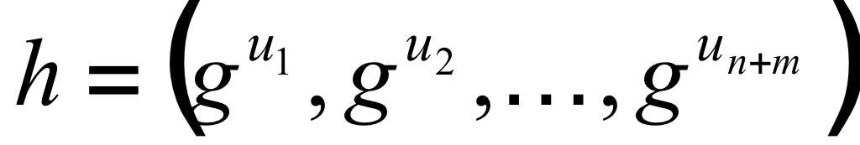
Zhao - Homomorphic signature
We can find a vector u s.t. Mu=0
A correct packet v will be orthogonal to u
<v,u>=0
But if Eve know u then she can find v
which is orthogonal to u.
Solution:
Instead of sending u to everyone send vector

Slide 60
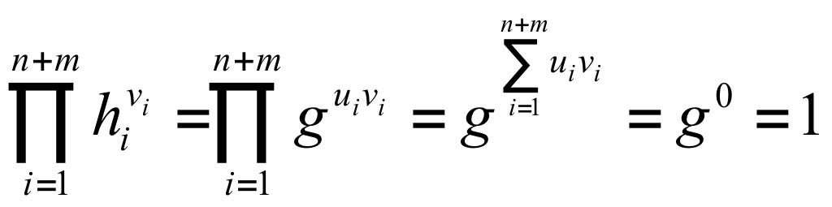
Zhao - Homomorphic signature
Given v which is a linear combination of the files packets
It require n+m power operations.
In practice it take more time then
downloading

Slide 61
Selective verification [PW12]
Packet_{i}
S'_{i}
S''_{i}
If we have both signatures we can choose
randomly which to check

Slide 62

Problem
Eve can combine signatures

Slide 63
Solution
Use a linear error correcting code.
1 | 0 | ... | 0
0 | 1 | ... | 0
. | . | . | .
0 | 0 | ... | 1
1
2
n
We perform Zhao signature on each block

Slide 64
Analysis
1 | 0 | ... | 0
0 | 1 | ... | 0
. | . | . | .
0 | 0 | ... | 1
1
2
n
q^n – True combinations
=defective (for our GT)

Slide 65
Analysis
1 2
r
n+m
dn
Pr[one block pass the test]<q^{n}/q^{dn}=q^{-(d-1)n}
Pr[r/2 out of r pass the test]< 2^{r}q^{-(d-1)r/2}

Slide 66
Analysis
1 2
r
n+m
dn
Pr[one block pass the test]<q^{n}/q^{dn}=q^{-(d-1)n}
Pr[r/2 out of r pass the test]< 2^{r}q^{-(d-1)r/2}
Using union bound:
the probability that a bad packet exist is bounded by q^{(n+m)+r/log q-(d-1)nr}
In practice we improve Zhao signature by a factor of 60.

Slide 67
Conclusion
Group testing/Compressive sensing is very effective tool.
We improved both construction and achieved sublinear decoding time.
Surprising important applications.

