Slide 1
On Sketching Quadratic Forms
Robert Krauthgamer, Weizmann Institute of Science
Joint with: Alex Andoni, Jiecao Chen, Bo Qin, David Woodruff and Qin Zhang
Sublinear Day at MIT, 2015-04-10
TexPoint fonts used in EMF.
Read the TexPoint manual before you delete this box.: AAA

Slide 2
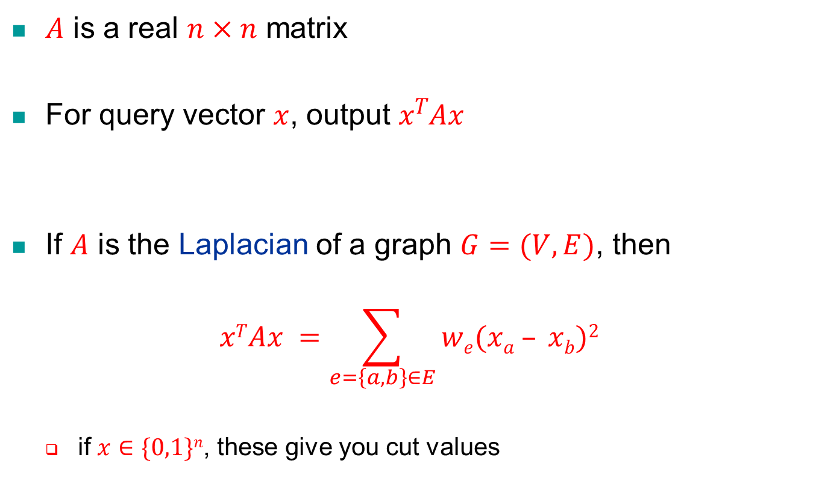
Quadratic Forms
$A$ is a real $n×n$ matrix
For query vector $x$, output $xTAx$
If $A$ is the Laplacian of a graph $G=(V,E)$, then
$$xTAx =\sum_{e=\left\{a,b\right\}∈E}{we(xa – xb)2}$$
if $x∈\{0,1\}n$, these give you cut values

Slide 3
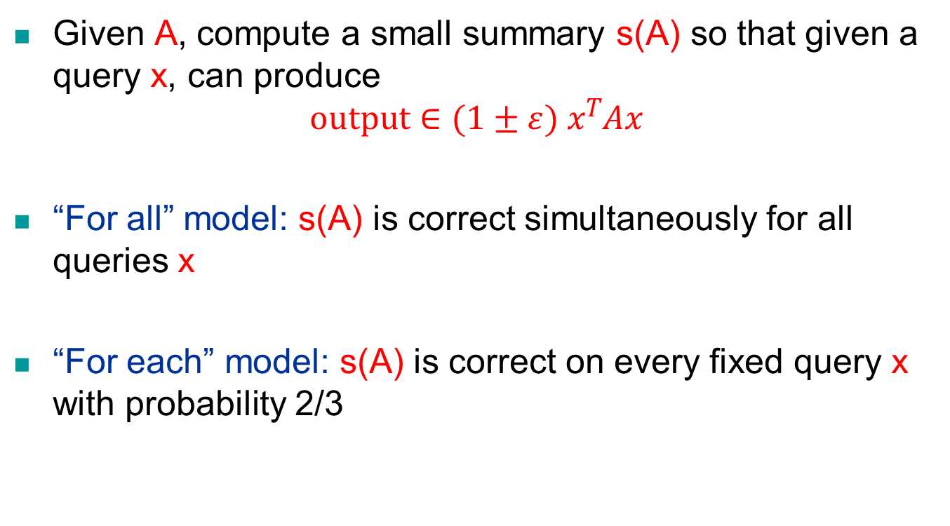
Sketching a Quadratic Form
Given A, compute a small summary s(A) so that given a query x, can produce
$$\text{o}\text{utput}∈(1±ε) xTAx$$
“For all” model: s(A) is correct simultaneously for all queries x
“For each” model: s(A) is correct on every fixed query x with probability 2/3

Slide 4

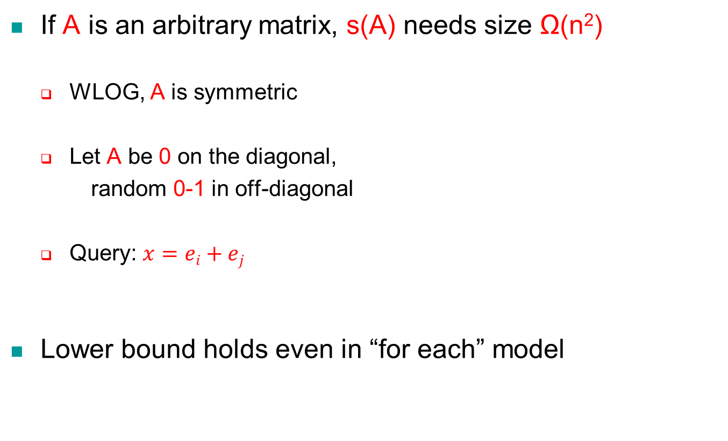
Goal: Sketch s(A) of Small Size
If A is an arbitrary matrix, s(A) needs size Ω(n²)
WLOG, A is symmetric
Let A be 0 on the diagonal,
random 0-1 in off-diagonal
Query: $x=ei+ej$
Lower bound holds even in “for each” model
$$A=\left[\begin{matrix}0 & ⋯ & 0/1 \\ ⋮ & ⋱ & ⋮ \\ 0/1 & ⋯ & 0\end{matrix}\right]$$

Slide 5
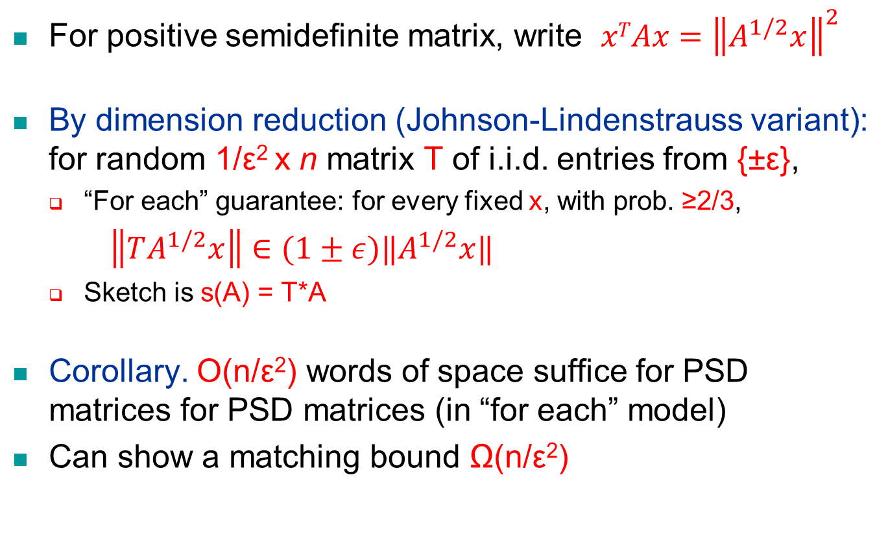
What about PSD Matrices?
For positive semidefinite matrix, write $xTAx={\left\|A^{1/2}x\right\|}^{2}$
By dimension reduction (Johnson-Lindenstrauss variant): for random 1/ε² x n matrix T of i.i.d. entries from {±ε},
“For each” guarantee: for every fixed x, with prob. ≥2/3,
$\left\|TA^{1/2}x\right\|∈(1±ε)‖A^{1/2}x‖$
Sketch is s(A) = T*A
Corollary. O(n/ε²) words of space suffice for PSD matrices for PSD matrices (in “for each” model)
Can show a matching bound Ω(n/ε²)

Slide 6
“For all” Guarantee for PSD Matrices
Even if A is PSD, s(A) must be of size Ω(n²) in “for all” model
Proof idea:
Consider a net of exp(n²) projection matrices onto n/2-dimensional subspaces
For all P,Q in the net, ||P-Q||₂ > 1/4
There is x with ||Px||₂ > 1/16 but ||Qx||₂ = 0
Thus, can recover A from this “encoding”

Slide 7
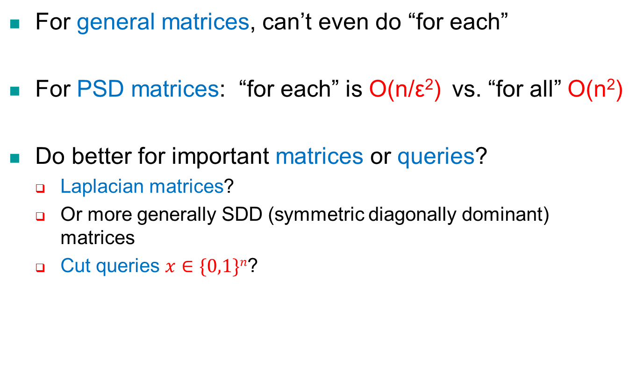
Interim Summary
For general matrices, can’t even do “for each”
For PSD matrices: “for each” is O(n/ε²) vs. “for all” O(n²)
Do better for important matrices or queries?
Laplacian matrices?
Or more generally SDD (symmetric diagonally dominant) matrices
Cut queries $x∈\{0,1\}n$?

Slide 8
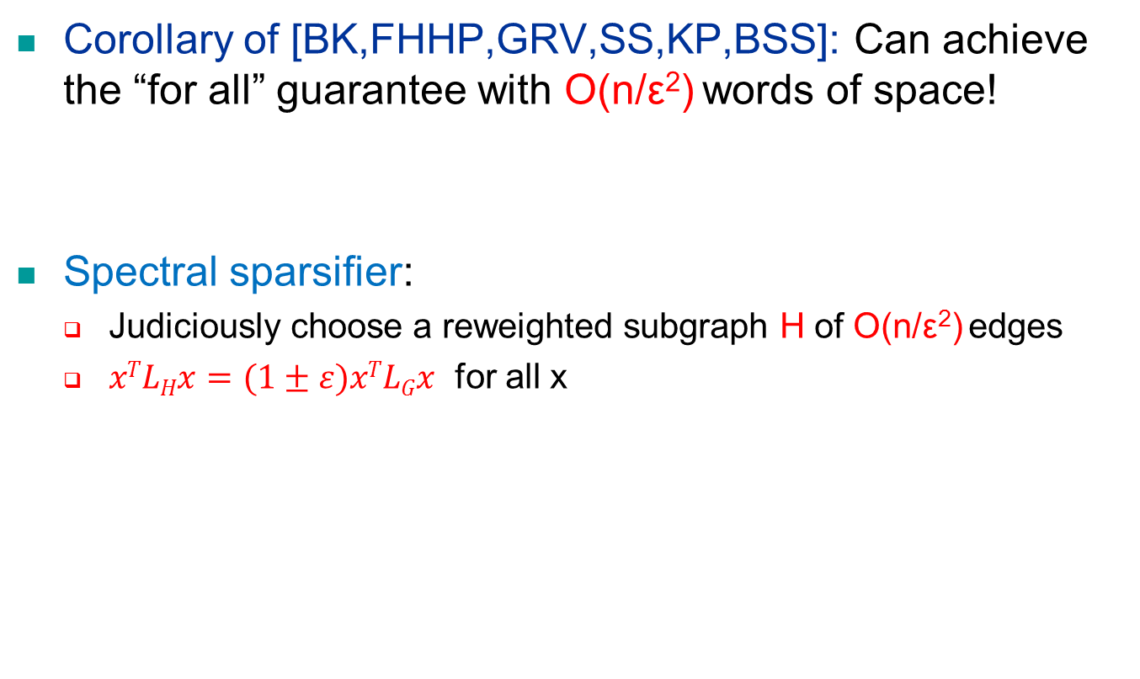
Sketching Laplacians
Corollary of [BK,FHHP,GRV,SS,KP,BSS]: Can achieve the “for all” guarantee with O(n/ε²) words of space!
Spectral sparsifier:
Judiciously choose a reweighted subgraph H of O(n/ε²) edges
$xTLHx=(1±ε)xTLGx$ for all x

Slide 9
Many Intriguing Questions…
Can one do better than [BSS]?
[BSS]: Cannot do better!
Namely, O(n/ε²) edges is optimal size
Assumptions: for general queries x, and using a subgraph H
Unknown:
What about for cut queries?
What about the “for each” model?
What about an arbitrary data structure?

Slide 10
Main Results I [upper bounds]
In “for each” model, can break the O(n/ε²) upper bound of [BSS]!
For cut queries, can achieve Õ(n/ε) space
For arbitrary queries, can achieve Õ(n/ε^{1.6}) space
Provably separate the “for each” and “for all” models for Laplacians
Algorithms extend to SDD matrices

Slide 11
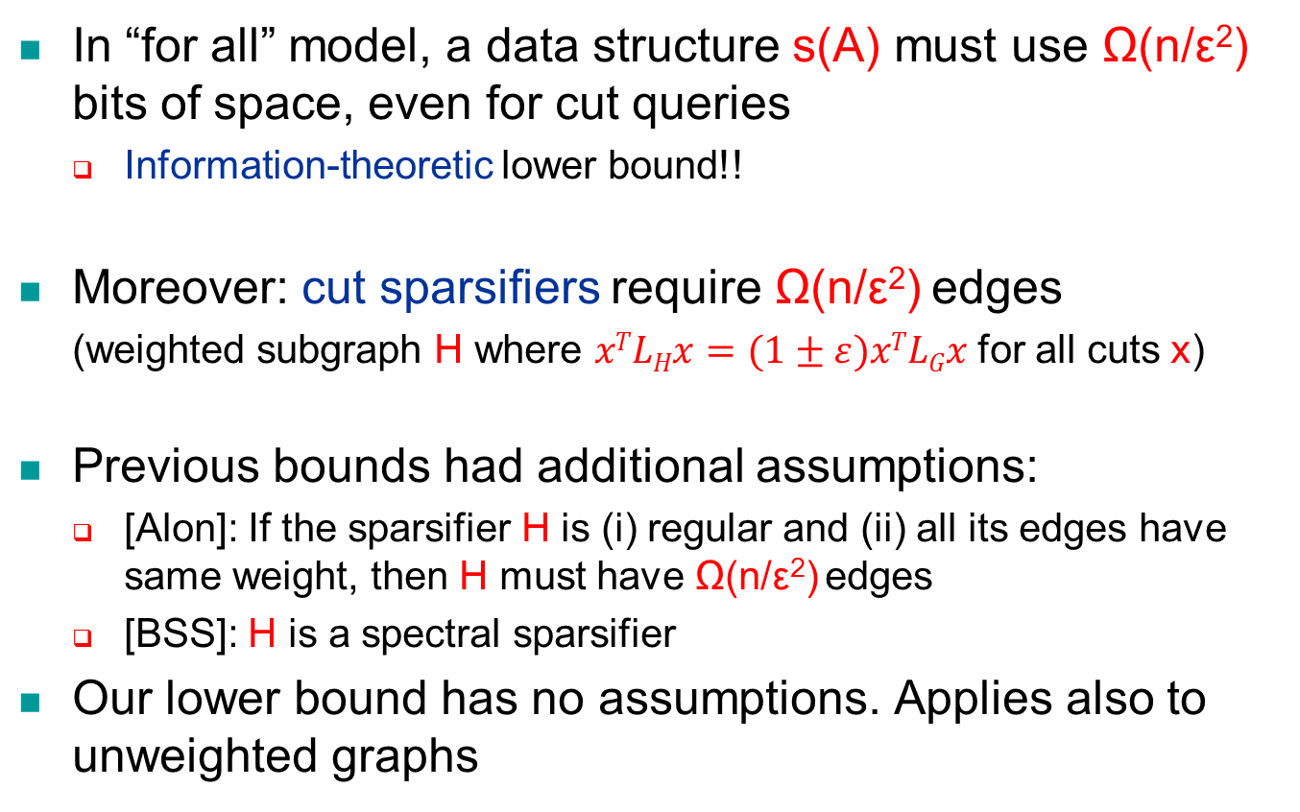
Main Results II [lower bounds]
In “for all” model, a data structure s(A) must use Ω(n/ε²) bits of space, even for cut queries
Information-theoretic lower bound!!
Moreover: cut sparsifiers require Ω(n/ε²) edges
(weighted subgraph H where $xTLHx=(1±ε)xTLGx$ for all cuts x)
Previous bounds had additional assumptions:
[Alon]: If the sparsifier H is (i) regular and (ii) all its edges have same weight, then H must have Ω(n/ε²) edges
[BSS]: H is a spectral sparsifier
Our lower bound has no assumptions. Applies also to unweighted graphs

Slide 12
Rest of Talk – Sketching Cuts
Upper bound in “for each” model
Lower bound in “for all” model

Slide 13
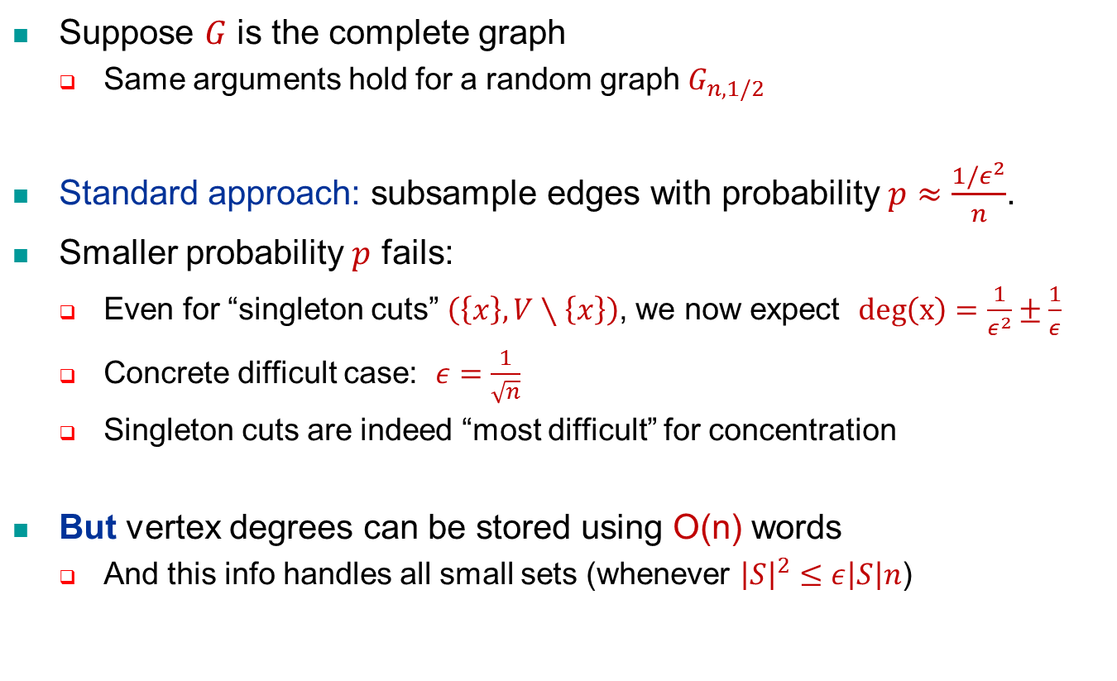
UB: First Attempt – Edge Sampling
Suppose $G$ is the complete graph
Same arguments hold for a random graph $G_{n,1/2}$
Standard approach: subsample edges with probability $p≈\frac{1/ε^{2}}{n}$.
Smaller probability $p$ fails:
Even for “singleton cuts” $\left(\left\{x\right\},V∖\left\{x\right\}\right)$, we now expect $deg\left(x\right)=\frac{1}{ε^{2}}±\frac{1}{ε}$
Concrete difficult case: $ε=\frac{1}{\sqrt{n}}$
Singleton cuts are indeed “most difficult” for concentration
But vertex degrees can be stored using O(n) words
And this info handles all small sets (whenever ${\left|S\right|}^{2}≤ε\left|S\right|n$)

Slide 14
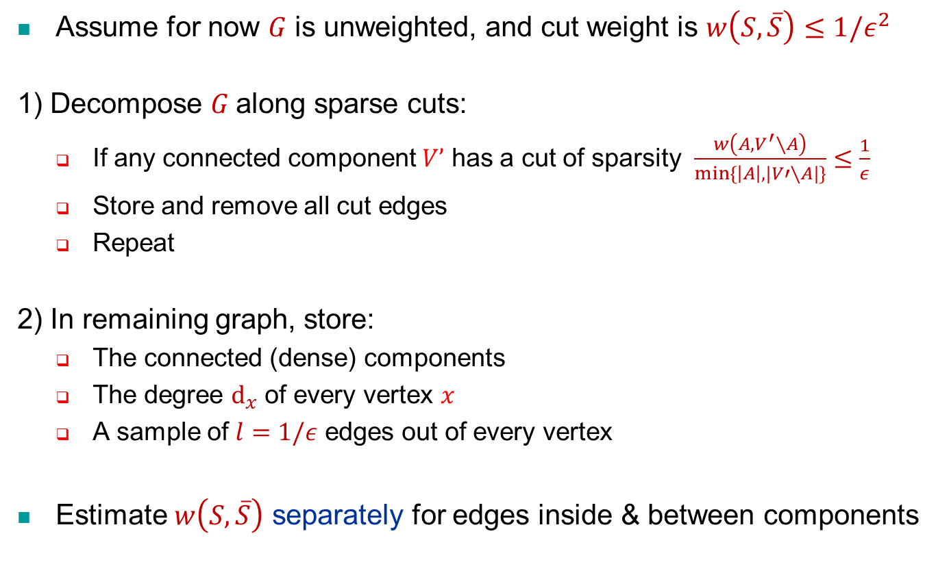
Core Idea
Assume for now $G$ is unweighted, and cut weight is $w\left(S,\overline{S}\right)≤1/ε^{2}$
1) Decompose $G$along sparse cuts:
If any connected component $V’$ has a cut of sparsity $\frac{w\left(A,V^{′}∖A\right)}{min⁡\{\left|A\right|,|V′∖A|\}}≤\frac{1}{ε}$
Store and remove all cut edges
Repeat
2) In remaining graph, store:
The connected (dense) components
The degree $d_{x}$ of every vertex $x$
A sample of $l=1/ε$ edges out of every vertex
Estimate $w\left(S,\overline{S}\right)$ separately for edges inside & between components

Slide 15

Illustration
$$S_{C}:=S∩C$$
S
C
dense components
The graph is decomposed into dense components
Edges between components are stored explicitly
Edges inside each component are sampled
Notes:
\sum_{x\in S_C} d_x - {\color[rgb]{0.900000,0.000000,0.000000}\sum_{(x,y)\in S_C\times S_C}\frac{d_x}{s}\cdot \chi\left[(x,y) \hbox{ sampled edge}\right]}

Slide 16
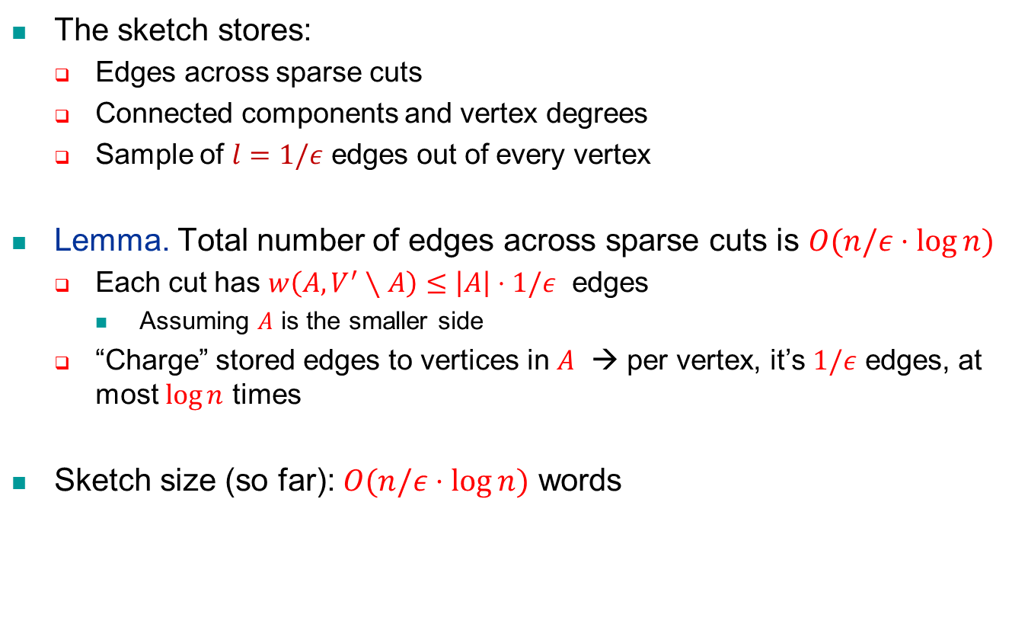
Sketch Size
The sketch stores:
Edges across sparse cuts
Connected components and vertex degrees
Sample of $l=1/ε$ edges out of every vertex
Lemma. Total number of edges across sparse cuts is $O(n/ε⋅\log{n})$
Each cut has $w\left(A,V^{′}∖A\right)≤\left|A\right|⋅1/ε$ edges
Assuming $A$ is the smaller side
“Charge” stored edges to vertices in $A$ → per vertex, it’s $1/ε$ edges, at most $\log{n}$ times
Sketch size (so far): $O(n/ε⋅\log{n})$ words

Slide 17
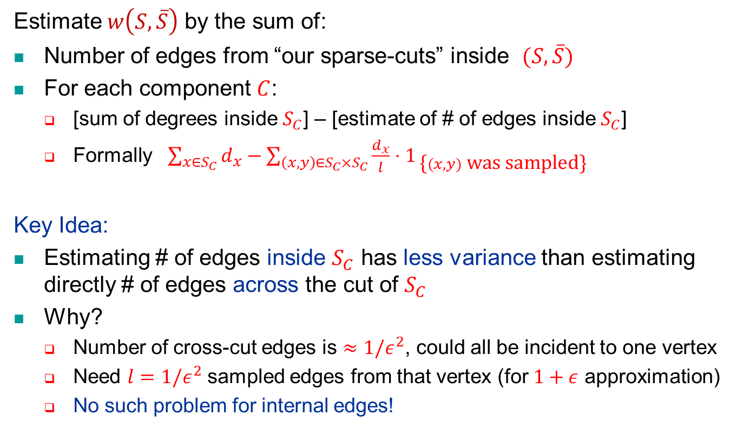
Estimation Procedure
exact
Estimate $w\left(S,\overline{S}\right)$ by the sum of:
Number of edges from “our sparse-cuts” inside $(S,\overline{S})$
For each component $C$:
[sum of degrees inside $S_{C}$] – [estimate of # of edges inside $S_{C}$]
Formally $\sum_{x∈S_{C}}{d_{x}}−\sum_{\left(x,y\right)∈S_{C}×S_{C}}{\frac{d_{x}}{l}⋅1_{ \text{\{}(x,y) \text{was} \text{sampled}\text{\}}} }$
Key Idea:
Estimating # of edges inside $S_{C}$ has less variance than estimating directly # of edges across the cut of $S_{C}$
Why?
Number of cross-cut edges is $≈1/ε^{2}$, could all be incident to one vertex
Need $l=1/ε^{2}$ sampled edges from that vertex (for $1+ε$ approximation)
No such problem for internal edges!

Slide 18
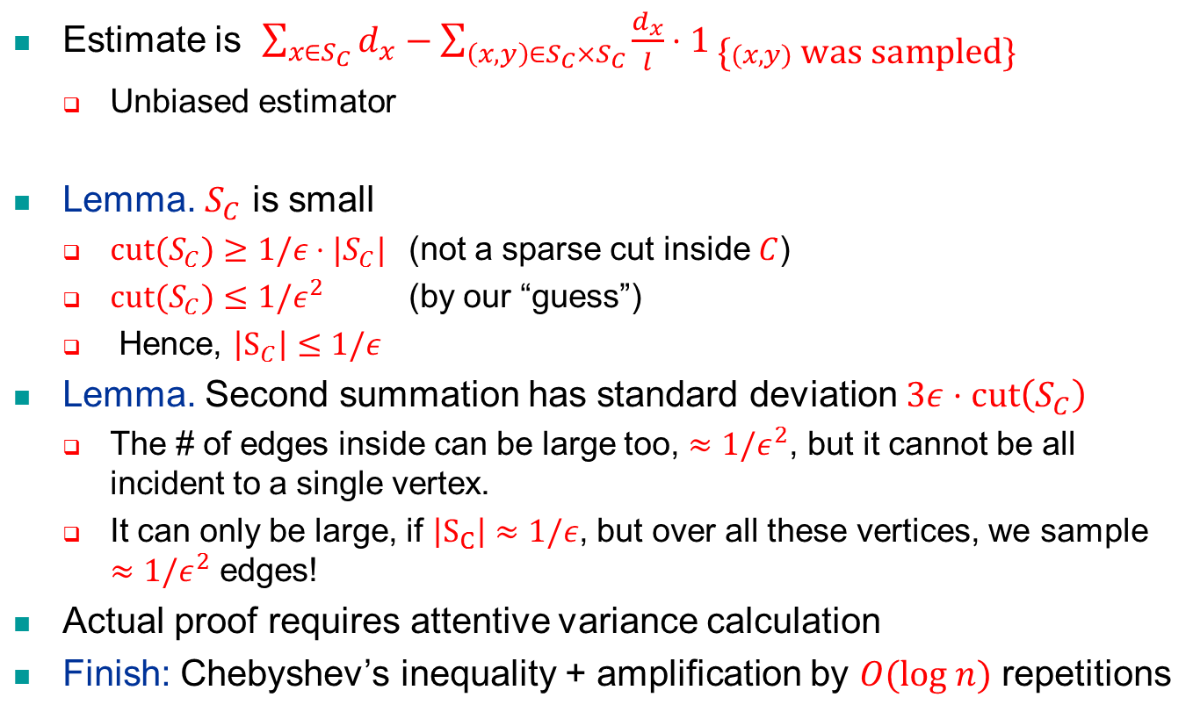
Analysis of Inside Edges
Estimate is $\sum_{x∈S_{C}}{d_{x}}−\sum_{\left(x,y\right)∈S_{C}×S_{C}}{\frac{d_{x}}{l}⋅1_{ \text{\{}(x,y) \text{was} \text{sampled}\text{\}}} }$
Unbiased estimator
Lemma. $S_{C}$ is small
$\text{cut}(S_{C})≥1/ε⋅|S_{C}|$ (not a sparse cut inside $C$)
$\text{cut}(S_{C})≤1/ε^{2}$ (by our “guess”)
Hence, $\left|S_{C}\right|≤1/ε$
Lemma. Second summation has standard deviation $3ε⋅\text{cut}\left(S_{C}\right)$
The # of edges inside can be large too, $≈1/ε^{2}$, but it cannot be all incident to a single vertex.
It can only be large, if $\left|S_{C}\right|≈1/ε$, but over all these vertices, we sample $≈1/ε^{2}$ edges!
Actual proof requires attentive variance calculation
Finish: Chebyshev’s inequality + amplification by $O(log n)$ repetitions

Slide 19

Actual Scheme (Polynomial Weights)
sketch size O(n)
sketch size increases by log n factor
Compute $2$-cut-sparsifier graph $H$
Proceed “in parallel” for every guess $c$ = power of 2
Assume for normalization $c=1$, thus $w\left(S,\overline{S}\right)∈[1,4]$
Importance sampling
Discard edges of weight $w_{e}> 5$
Surely not relevant
Sample other edges with probability $p_{e}=\min\left\{\frac{w_{e}}{ε^{2}},1\right\}$ and assign them new weight ${\tilde{w}}_{e}=\frac{w_{e}}{p_{e}}∈[ε^{2},5]$
An unbiased estimator, with variance $≤ε^{2}w\left(S,\overline{S}\right)$
W.h.p. the cut contains $≤1/ε^{2}$ edges
Break edges into $O\left(\log{\frac{1}{ε}}\right)$ levels $L_{i}$ where ${\tilde{w}}_{e}∈\left[2^{i},2^{i+1}\right]$,
Estimate each level separately (using sparse-cuts etc.), and sum up
Inside each level, do use weights – our variance analysis still applies!

Slide 20
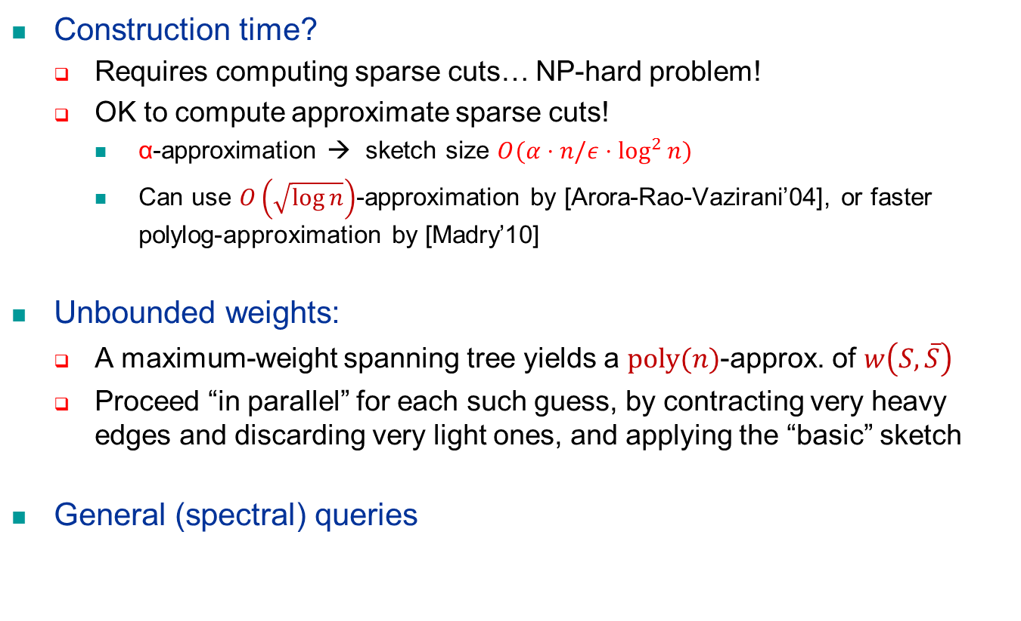
Further Extensions
Construction time?
Requires computing sparse cuts… NP-hard problem!
OK to compute approximate sparse cuts!
α-approximation → sketch size $O(α⋅n/ε⋅\log^{2}{n})$
Can use $O\left(\sqrt{\log{n}}\right)$-approximation by [Arora-Rao-Vazirani’04], or faster polylog-approximation by [Madry’10]
Unbounded weights:
A maximum-weight spanning tree yields a $\text{poly}(n)$-approx. of $w\left(S,\overline{S}\right)$
Proceed “in parallel” for each such guess, by contracting very heavy edges and discarding very light ones, and applying the “basic” sketch
General (spectral) queries

Slide 21

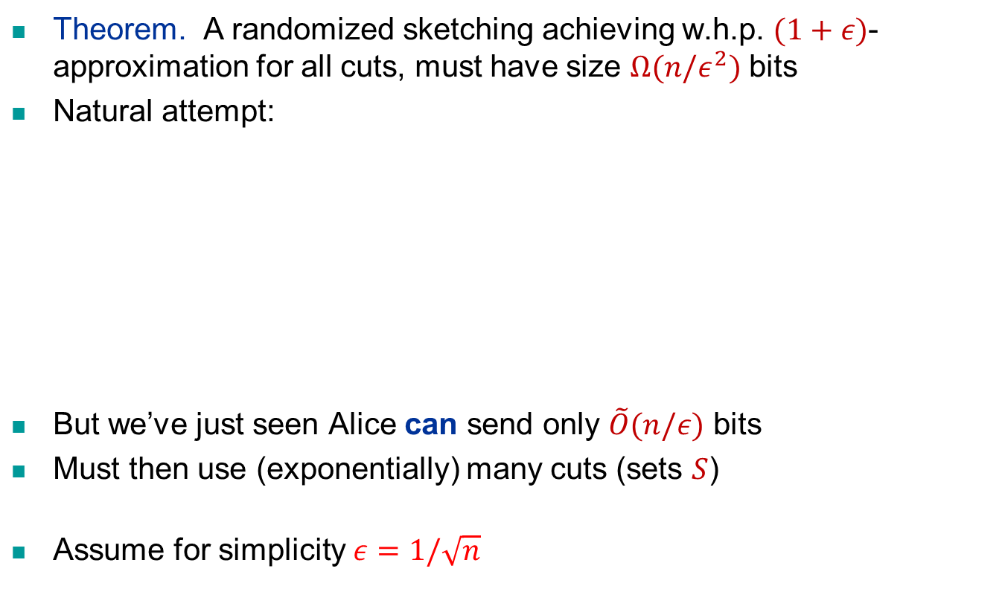


LB First Attempt: One-way Comm.
Theorem. A randomized sketching achieving w.h.p. $(1+ε)$-approximation for all cuts, must have size $Ω(n/ε^{2})$ bits
Natural attempt:
But we’ve just seen Alice can send only $\tilde{O}(n/ε)$ bits
Must then use (exponentially) many cuts (sets $S$)
Assume for simplicity $ε=1/\sqrt{n}$
Alice
$$G$$
Bob
$$S⊂V(G)$$
$$\text{sketch}(G)$$

Slide 22
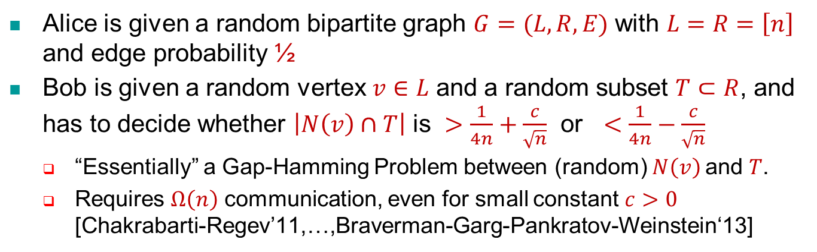




LB Outline: a Hard Comm. Problem
Alice is given a random bipartite graph $G=(L,R,E)$ with $L=R=\left[n\right]$ and edge probability ½
Bob is given a random vertex $v∈L$ and a random subset $T⊂R$, and has to decide whether $\left|N\left(v\right)∩T\right|$ is $>\frac{1}{4n}+\frac{c}{\sqrt{n}}$ or $<\frac{1}{4n}−\frac{c}{\sqrt{n}}$
“Essentially” a Gap-Hamming Problem between (random) $N\left(v\right)$and $T$.
Requires $Ω\left(n\right)$ communication, even for small constant $c>0$ [Chakrabarti-Regev’11,…,Braverman-Garg-Pankratov-Weinstein‘13]
$$T$$
$$v$$
$$L$$
$$R$$

Slide 23



LB Outline: a Reduction
Suppose Alice sends to Bob a sketch of $G$ (good for all cuts)
Bob estimates $δ(S∪\overline{T})$ for all $S⊂L$ of size $n/2$, to find maximizer $S_{max}$
$S^{∗}=\left\{v∈L : \left|N\left(v\right)∩T\right|>\frac{1}{4n}+\frac{c}{\sqrt{n}}\right\}$ has its $δ(S∪\overline{T})$ slightly larger than a typical $S$ (by factor $1+ε_{c}$), and its estimator should “stand out”
More precisely, $S_{max}$ will have “large agreement” with $S^{∗}$
Bob just tests whether $v∈S_{max}≈S^{∗}$
$$S^{∗}$$
$$T$$
$$v$$
$$S_{max}$$
$$L$$
$$R$$

Slide 24

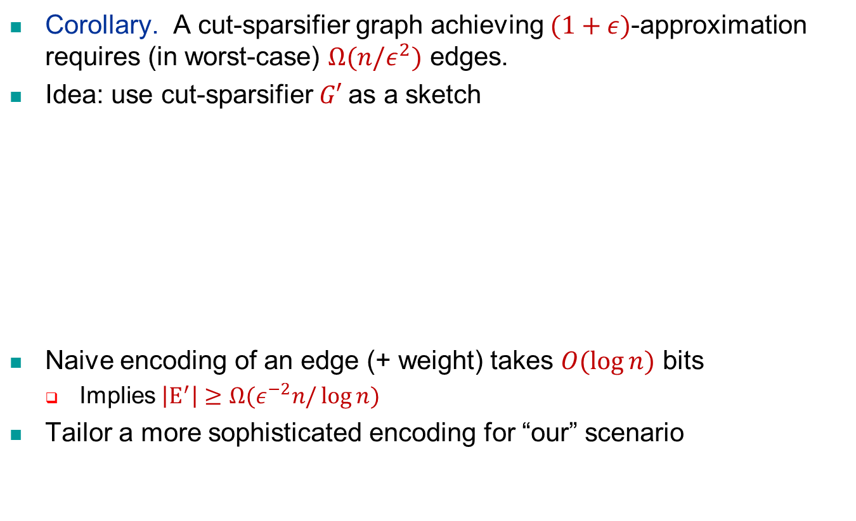


LB for Cut-Sparsifiers
Corollary. A cut-sparsifier graph achieving $(1+ε)$-approximation requires (in worst-case) $Ω(n/ε^{2})$ edges.
Idea: use cut-sparsifier $G′$as a sketch
Naive encoding of an edge (+ weight) takes $O(\log{n})$ bits
Implies $\left|E^{′}\right|≥Ω(ε^{−2}n/\log{n})$
Tailor a more sophisticated encoding for “our” scenario
Alice
$$G$$
Bob
$$S⊂V(G)$$
$$\text{sketch}\text{=}G′$$

Slide 25
Future Questions
Concrete:
Graphical sketch? One pass?
Avoid sparse-cut computations?
Handle adaptive queries?
High-level directions:
Tradeoffs between representations (graphical vs. data structure)
Connections between distances/cuts/flows?
Sketching of other combinatorial features (graphs)?
Thank You!

Slide 27
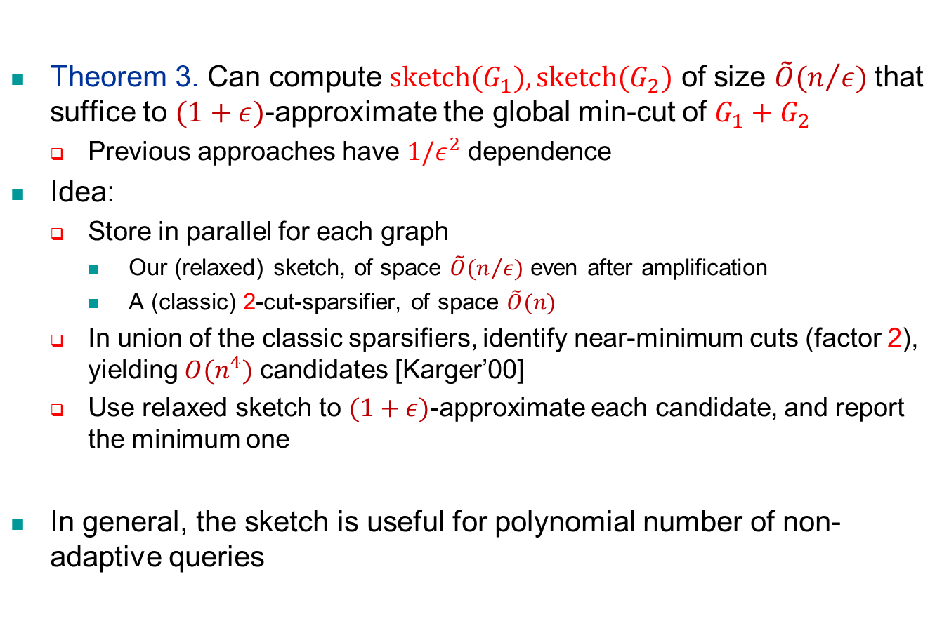
Example Application
Theorem 3. Can compute $\text{sketch}(G_{1}), \text{sketch}(G_{2})$ of size $\tilde{O}(n/ε)$ that suffice to $(1+ε)$-approximate the global min-cut of $G_{1}+G_{2}$
Previous approaches have $1/ε^{2}$ dependence
Idea:
Store in parallel for each graph
Our (relaxed) sketch, of space $\tilde{O}(n/ε)$ even after amplification
A (classic) 2-cut-sparsifier, of space $\tilde{O}(n)$
In union of the classic sparsifiers, identify near-minimum cuts (factor 2), yielding $O(n^{4})$ candidates [Karger’00]
Use relaxed sketch to $(1+ε)$-approximate each candidate, and report the minimum one
In general, the sketch is useful for polynomial number of non-adaptive queries

