Slide 1
Vertex Sparsification of Cuts, Flows, and Distances
Robert Krauthgamer, Weizmann Institute of Science
WorKer 2015, Nordfjordeid
TexPoint fonts used in EMF.
Read the TexPoint manual before you delete this box.: AAA

Slide 2
Graph Sparsification
Vast literature on “compression” (succinct representation) of graphs
  We focus on preserving specific features – distances, cuts, etc.
Edge sparsification:
  Cut and spectral sparsifiers [Benczur-Karger, …, Batson-Spielman-Srivastava]
  Spanners and distance oracles [Peleg-Schaffer, …, Thorup-Zwick,…]
Vertex sparsification (keep only the “terminal” vertices)
  Cut/multicommodity-flow sparsifier [Moitra,…,Chuzhoy]
  Distances [Gupta, Coppersmith-Elkin]
exactly/approximately
Graphical representation
Fast query time
or mostly

Slide 3
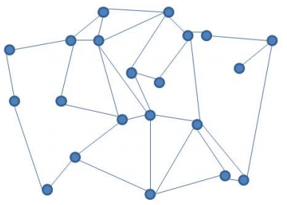
Terminal Cuts
Network G with edge capacities c:E(G)→R₊. (“huge” network)
k terminals K½V(G) (“important” vertices)
We care about terminal cuts:
  mincut_{G}(S) = minimum-capacity cut separating S½K and‾S=KnS.
  (Equivalent to the maximum flow between S and‾S.)
G:

Slide 4
Mimicking Networks
A mimicking network of (G,c) is a network (G’,c’) with same terminals and 8SµK, mincut_{G}(S) = mincut_{G’}(S).
Theorem [Hagerup-Katajainen-Nishimura-Ragde’95]. Every k-terminal network has a mimicking network of ·2^{2k} vertices.
  Pro: independent of n=|V(G)|
  Con: more wasteful than listing the 2^{k} cut values
  (Originally proved for directed networks)
Intuition: There are ·2^{k} relevant cuts (choices for S), which jointly partition the vertices to ·2^{2k} “buckets”; merge each bucket …
G:
2
exact
G’:
3
A
5
9
A
3
B
1
C
B
1
8
C
4

Slide 5
Natural Questions
Narrow the doubly-exponential gap?
Better bounds for specific graph families?
Represent these cut values more succinctly?
  Anything better than a list of 2^{k} values?
  Remark: function mincut_{G}(.) is submodular

Slide 6
Our Results [K.-Rika’13]
Graph Family | Lower Bound | Upper Bound
General graphs | 2^{Ω(k)} Here & indep. by [KR] | 2^{2k} [HKNR]
Star graph | k+1 [CSWZ]
Planar graphs | |E(G’)|≥Ω(k²) Here | O(k² 2^{2k}) Here
Bounded treewidth |  | O(k) [CSWZ]
[Chaudhuri-Subrahmanyam-Wagner-Zaroliagis’98]
[Hagerup-Katajainen-Nishimura-Ragde’95]
[Khan-Raghavendra’14]
Theorem [No succinct representation]: Any storage of the terminal-cut values requires 2^{Ω(k)} machine words. (word = log n bits)

Slide 7








Upper Bound for Planar Graphs
Theorem 1. Every planar k-terminal network G admits a mimicking network of size ·O(k² 2^{2k}); furthermore, this G’ is a minor of G.
  Algorithm: merge vertices whenever possible, similarly to [HKNR]
    Precisely, remove cuts then contract every CC (yields a planar graph)
  Let E_{S}µE be the cutset realizing mincut_{G}(S) [wlog it’s unique]
Lemma 1a. Removing E_{S} breaks G into ·k CCs
  That is, for all S½K, |CC(GnE_{S})| · k.
Idea: a CC containing no terminals can be merged with another CC.
V:
$$t_{2}$$
$$t_{1}$$
$$t_{4}$$
$$?$$
. . .
$$t_{3}$$
$$t_{5}$$
$$t_{k}$$
$$S=\{t_{2},t_{3},t_{5}\}$$

Slide 8








Two Cutsets Together
Lemma 1b. For all S,T½K,
|CC(Gn(E_{S}[E_{T}))| · |CC(GnE_{S})| + |CC(GnE_{T})| + k · 3k.
  (even without planarity)
Idea: Every CC must either contain a terminal or be (exactly) a CC of GnE_{S} or of GnE_{T}. Otherwise, we can “improve” one of the cuts.
$$t_{1}$$
$$t_{4}$$
$$?$$
$$t_{3}$$
$$S=\{t_{3}\}$$
$$t_{2}$$
$$t_{5}$$
$$T=\{t_{2},t_{4}\}$$

Slide 9
Leveraging Planarity
Let E_{S}* be the dual edges to E_{S}.
  It is a union of cycles (called circuit), at most k of them by Lemma 1a.
Lemma 1c. The union _{S}(E_{S}*) partitions the plane into ·O(k² 2^{2k}) “connected regions”.
Idea: By Euler’s formula, it suffices to sum up all vertex degrees >2. These are “attributed” to some intersection E_{S}* & E_{T}*. Every pair S,T “contributes” ·O(k²) by Lemma 1b and Euler’s formula.

Slide 10
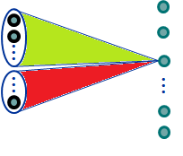












Lower Bound for General Graphs
Theorem 2. For every k>5 there is a k-terminal network, whose mimicking networks must have size ¸2^{Ω(k)}.
  Proved independently by [Khan-Raghavendra’14]
Proof Sketch: consider a bipartite graph
Lemma 2a. Each mincut_{G}(S) is obtained uniquely (u_{S} vs. the rest)
  Thus, each green edge belongs to only one cut.
Intuition for next step: Graphs G’ with few edges have insufficient “degrees of freedom” to create these 2^{Ω(k)} cuts. Use linear algebra…
$$K$$
$$V∖K=$$
$$\left({K \atop 2k/3}\right)$$
$$\left|S\right|=2k/3$$
$$S$$
$$⋮$$
$$c\left(e\right)=1$$
$$u_{S}$$
$$⋮$$
$$⋮$$
$$2+ε$$
$$\overline{S}$$

Slide 11



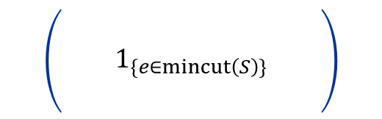



Lower Bounds – Techniques
Lemma 2b. The cutset-edge incidence matrix A_{G} has rank(A_{G})¸ 2^{Ω(k)}.
Lemma 2c. WHP, after perturbing capacities to cˆ (add noise2[0,²]), every mimicking network (G',c') satisfies |E(G')| ¸ rank(A_{G}).
Difficulty: Infinitely-many possible c’, cannot take union bound…
Workaround:
  Fix G’ (without capacities c’) and a matrix A_{G’}.
  Pr[ 9c’ such that (G’,c’) mimicks (G, cˆ) ] = 0.
  Union bound over finitely many G’ and A_{G’}.
$$e∈E$$
$$\left(\begin{matrix} & & \\ & 1_{\{e∈mincut\left(S\right)\}} & \\ & & \end{matrix}\right)$$
$$⋅\left(\begin{aligned}⋮ \\ c(e) \\ ⋮\end{aligned}\right)$$
$$\left(\begin{aligned}⋮ \\ \text{mincut}(S) \\ ⋮\end{aligned}\right)$$
$$S⊂K$$
$$=$$
$$A_{G}$$

Slide 12
Succinct Representation
Theorem 3. Every (randomized) data structure that stores the terminal-cut values of a network requires 2^{Ω(k)} memory words.
  Thus, naively listing all 2^{k} cut values achieves optimal storage.
Proof Sketch:
Use the same bipartite graph.
“Plant” r arbitrary bits by perturbing r edge capacities.
Since rank(A_{G})¸r, the bits can be recovered from the mincut values.
Hence, data structure must have Ω(r) bits.

Slide 13
Further Questions About Cuts
Close the (still) exponential gap?
  Perhaps show the directed case is significantly different?
Extend the planar upper bound
  To excluded-minor graphs?
  To vertex-cuts or directed networks?
Extend to multi-commodity flows?
  A stronger requirement than cuts
Smaller network size by allowing approximation of cuts?
  We already know size is some function s(k), independent of n
  Our lower bound is not “robust”

Slide 14
Approximate Vertex-Sparsifiers
Definition: Quality = approximation-factor guarantee for all cuts
Extreme case: retain only terminals, i.e. s(k)=k [Moitra’09]
    Quality O(log k/loglog k) is possible [Charikar-Leighton-Li-Moitra’10, Makarychev-Makarychev’10, Englert-Gupta-K.-Raecke-TalgamCohen-Talwar’10]
    And Ω((log k)^{1/2}/loglog k) is required [Makarychev-Makarychev’10]
Goal: constant-factor quality using network size << 2^{2k} ?
  Maybe even (1+²)-quality using size s’(k,²)
Theorem [Chuzhoy’12]. O(1)-quality using network size C^{O(log log C)} where C is total capacity of edges incident to terminals
  Note: C might grow with n=|V|

Slide 15
Our Results [Andoni-Gupta-K.’14]
Theorem 4. Bipartite* networks admit (1+²)-quality sparsifiers of size poly(k/²)
  Bipartite* = the non-terminals form an independent set
  Bypasses 2^{Ω(k)} bound we saw for exact sparsifiers (even in bipartite)
Theorem 5. Networks of treewidth w admit O(log w/loglog w)-quality (flow) sparsifiers of size O(w⋅poly(k))
Theorem 6. Series-parallel networks admit exact (quality 1) (flow) sparsifiers of size O(k)

Slide 16
Main Idea: Structure Sampling
Edge sampling useful for edge-sparsifiers [BK’96,SS’11]
But does not work here, need to sample entire sub-structures

Slide 17
Sampling in Bipartite Graphs
Sample non-terminal vertices, together with incident edges
  reweight edges accordingly

Slide 18
Sampling in Bipartite Graphs
Sample non-terminal vertices, together with incident edges
  reweight edges accordingly
Uniform sampling does not work

Slide 19
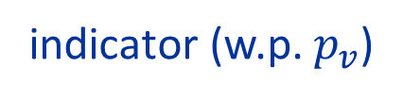
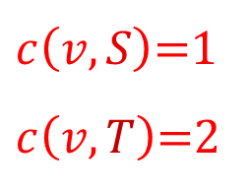




Non-uniform Sampling
Non-terminal $v$ has sampling probability $p_{v}$
If $v$ sampled, reweight edges by factor $1/p_{v}$
Expectation is right:
  Consider a partition $K=S∪T$
  $\text{mincut}(S,T) = \sum_{v}{\min{\{c\left(v,S\right), c(v,T)\}}}$
  $\text{mincut}\text{′}(S,T) = \sum_{v}{\frac{I_{v}}{p_{v}}⋅\min{\{c\left(v,S\right), c(v,T)\}}}$
indicator (w.p. $p_{v}$)
$$S$$
$$v$$
$c\left(v,S\right)$=1
$c\left(v,T\right)$=2
$$T$$

Slide 20

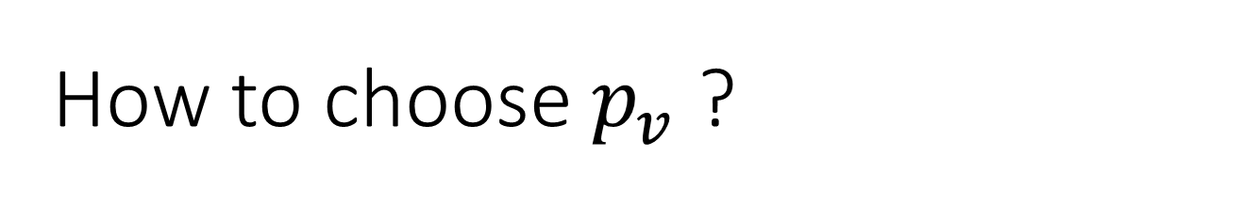
How to choose $p_{v}$ ?
Want
1) $\text{mincut}\text{′}(S,T) = \sum_{v}{\frac{I_{v}}{p_{v}}⋅\min{\{c\left(v,S\right), c(v,T)\}}}$ concentrates
2) $\sum_{v}{p_{v}}$ small i.e. $\text{poly}\left(\frac{k}{ε}\right)$
Issue: contribution can come from just a few terms

Slide 21
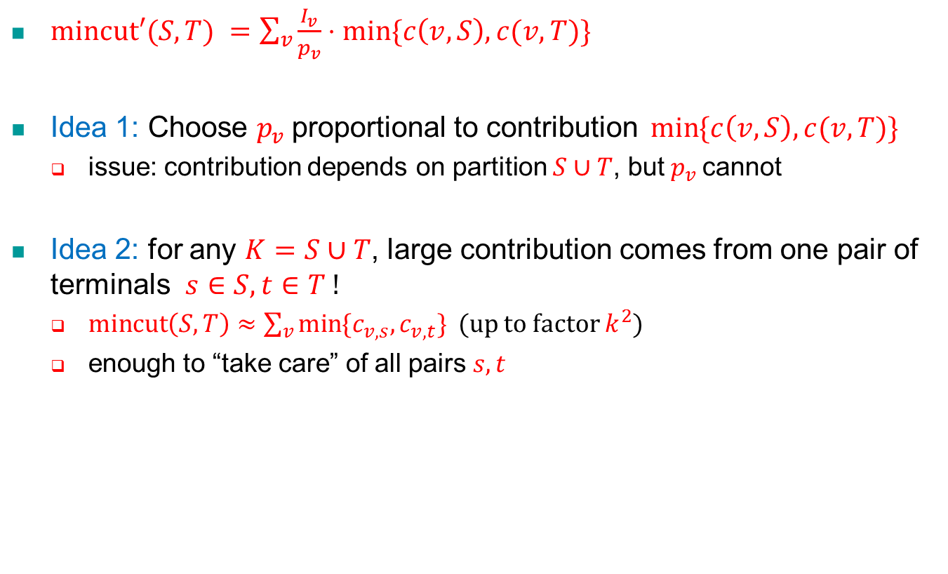
Importance sampling
$\text{mincut}\text{′}(S,T) =\sum_{v}{\frac{I_{v}}{p_{v}}⋅\min{\{c\left(v,S\right), c(v,T)\}}}$
Idea 1: Choose $p_{v}$ proportional to contribution $\min{\{c\left(v,S\right), c(v,T)\}}$
  issue: contribution depends on partition $S∪T$, but $p_{v}$ cannot
Idea 2: for any $K=S∪T$, large contribution comes from one pair of terminals $s∈S,t∈T$ !
  $\text{mincut}\left(S,T\right)≈\sum_{v}{\min{\{c_{v,s}, c_{v,t}\}}}$ (up to factor $k^{2}$)
  enough to “take care” of all pairs $s,t$

Slide 22
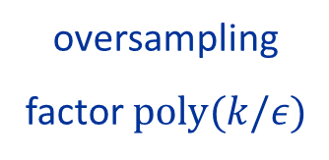
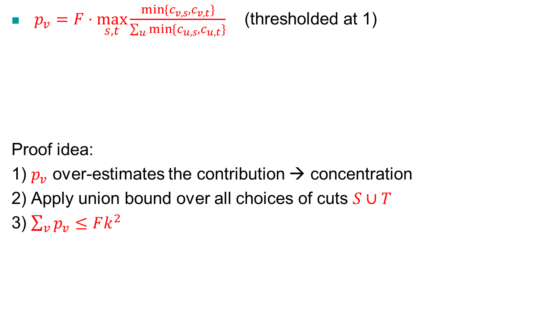
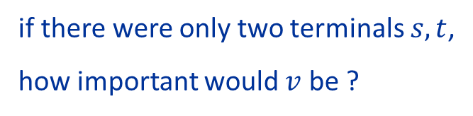
Actual Sampling
$p_{v}=F⋅\max_{s,t}{\frac{\min{\{c_{v,s},c_{v,t}\}}}{\sum_{u}{\min{\{c_{u,s},c_{u,t}\}}}}}$ (thresholded at 1)
Proof idea:
1) $p_{v}$ over-estimates the contribution → concentration
2) Apply union bound over all choices of cuts $S∪T$
3) $\sum_{v}{p_{v}}≤Fk^{2}$
oversampling
factor $\text{poly}(k/ε)$
if there were only two terminals $s,t$,
how important would $v$ be ?

Slide 23
Open Questions
Extend to general networks?
  Want to beat size 2^{2k} (exact sparsification)
  Need to sample other structures (flow paths??)
What about flow-sparsifiers?
  In bipartite networks: ✓ (our technique extends)
  In general networks: no bound s’(k,²) is known
  A positive indication: can build there is a data structure of size (1/²)^{k2} (“big table” with all values)

Slide 24
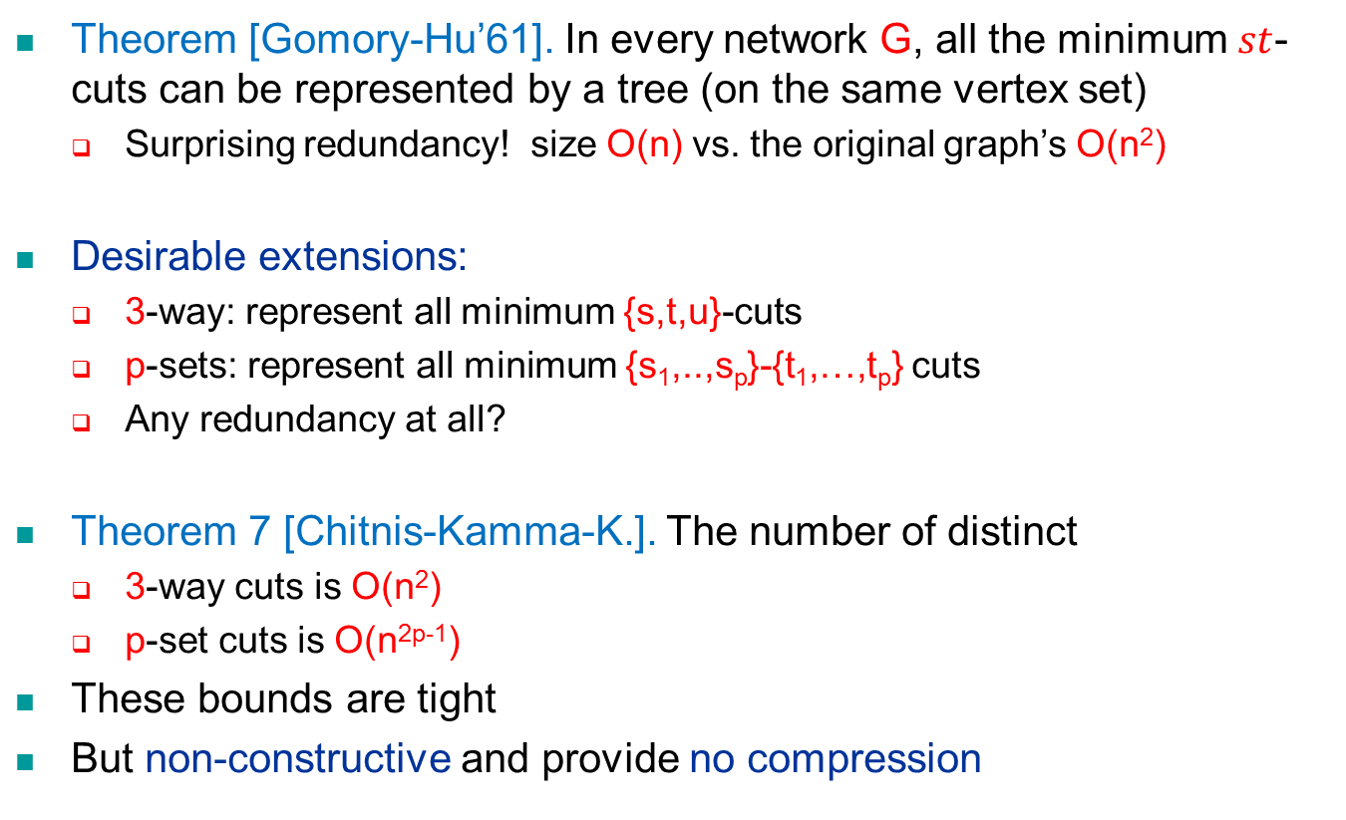
Generalizing Gomory-Hu Trees?
Theorem [Gomory-Hu’61]. In every network G, all the minimum $st$-cuts can be represented by a tree (on the same vertex set)
  Surprising redundancy! size O(n) vs. the original graph’s O(n²)
Desirable extensions:
  3-way: represent all minimum {s,t,u}-cuts
  p-sets: represent all minimum {s₁,..,s_{p}}-{t₁,…,t_{p}} cuts
  Any redundancy at all?
Theorem 7 [Chitnis-Kamma-K.]. The number of distinct
  3-way cuts is O(n²)
  p-set cuts is O(n^{2p-1})
These bounds are tight
But non-constructive and provide no compression

Slide 25
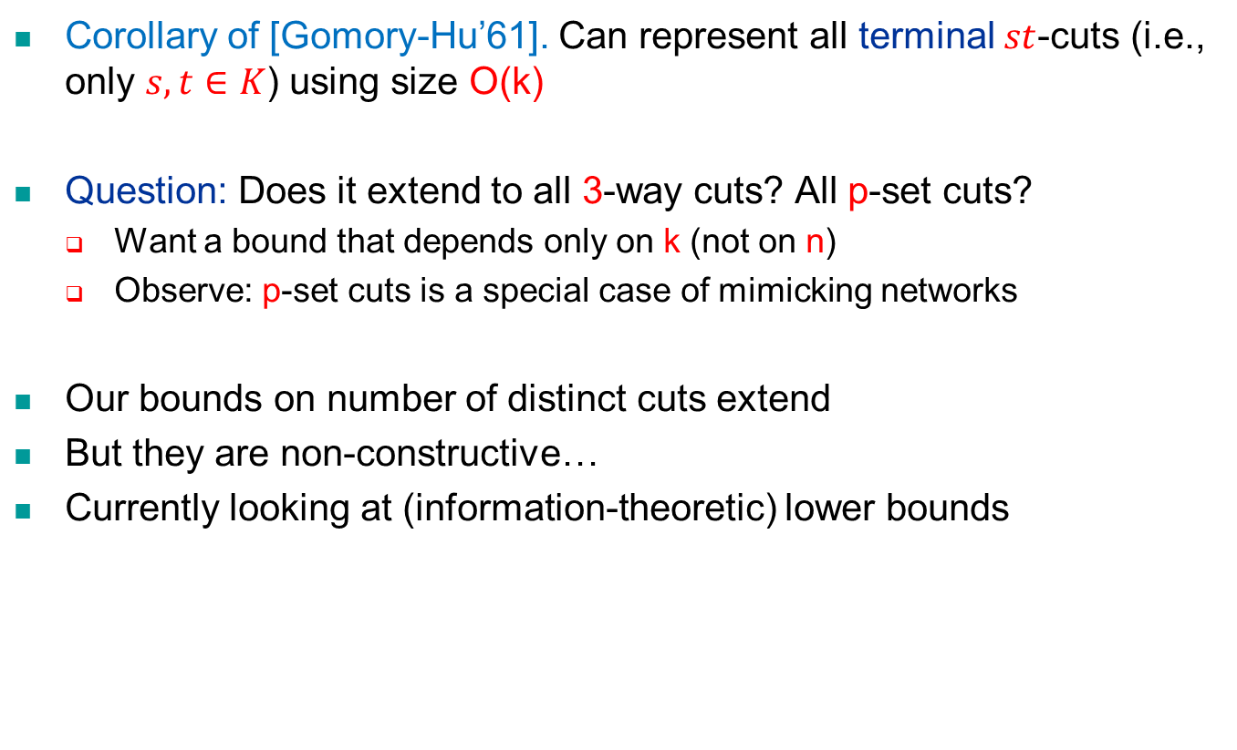
Gomory-Hu Tree for Terminals
Corollary of [Gomory-Hu’61]. Can represent all terminal $st$-cuts (i.e., only $s,t∈K$) using size O(k)
Question: Does it extend to all 3-way cuts? All p-set cuts?
  Want a bound that depends only on k (not on n)
  Observe: p-set cuts is a special case of mimicking networks
Our bounds on number of distinct cuts extend
But they are non-constructive…
Currently looking at (information-theoretic) lower bounds

Slide 26
Terminal Distances
Graph G with edge lengths l:E(G)→R₊. (“huge” network)
k terminals K½V(G) (“important” vertices)
We care about terminal distances:
  d_{G}(s,t) = shortest-path distance according to l between s,t2K.
G:

Slide 27





Distance-Preserving Minor
A distance-preserving minor of (G,l) is a minor G’ with edge-lengths l’ that contains the same k terminals and
8s,t2K, d_{G}(s,t) = d_{G’}(s,t).
Why require a minor? To avoid a trivial solution…
exact
G:
2
G’:
3
A
5
9
A
12
B
9
C
B
1
8
C
4
$$?$$
$$1$$
$$1$$
$$?$$
$$1$$

Slide 28
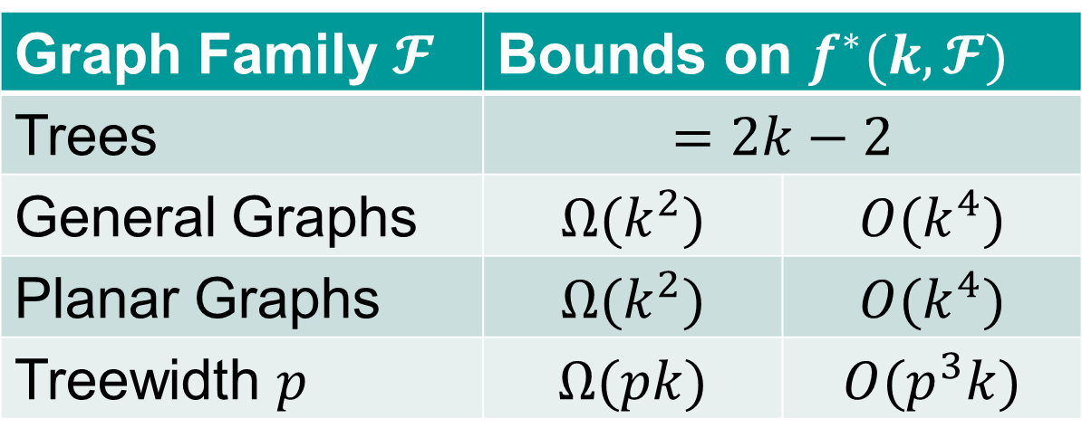
Our Results [K.-Nguyen-Zondiner’14]
We ask: What is the smallest f*(k) such that every k-terminal graph G admits a distance-preserving minor G’ with |V(G’)|≤f*(k) ?
Bounds on $f^{∗}(k, 𝓕)$ |  | Graph Family $𝓕$
$$=2k−2$$ |  | Trees
$$O(k^{4})$$ | $$Ω(k^{2})$$ | General Graphs
$$O(k^{4})$$ | $$Ω(k^{2})$$ | Planar Graphs
$$O(p^{3}k)$$ | $$Ω(pk)$$ | Treewidth $p$

Slide 29
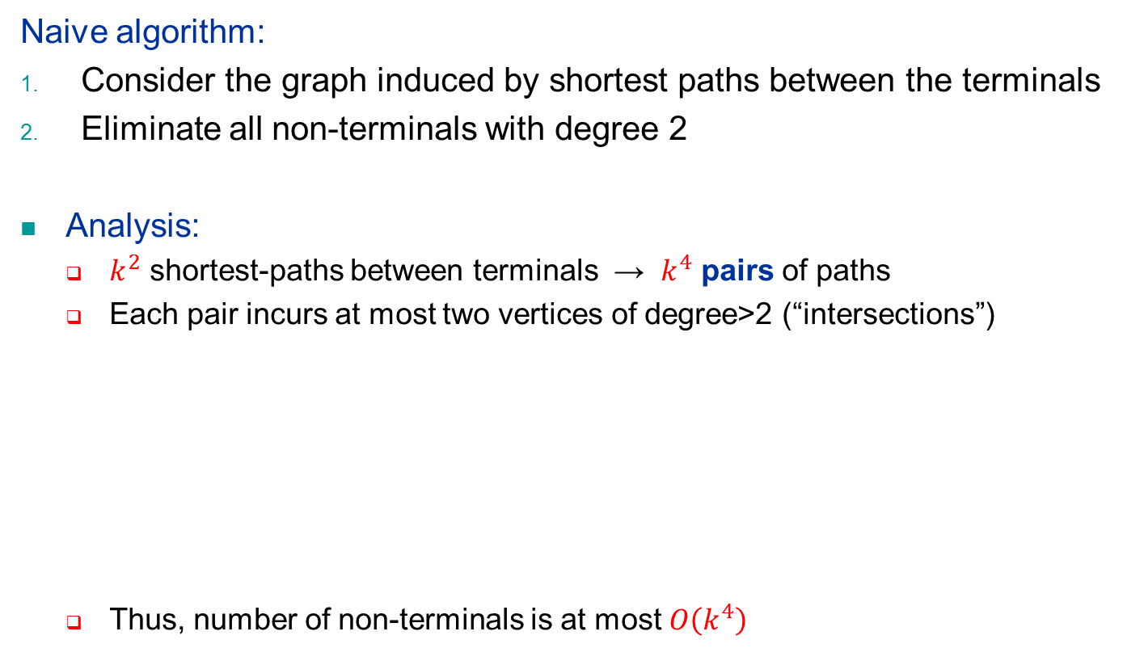
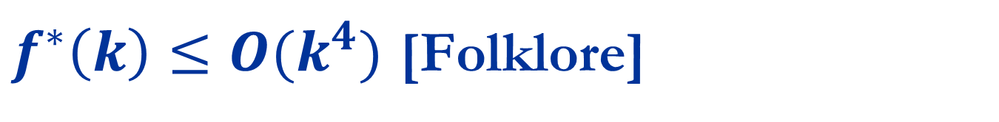


$f^{∗}\left(k\right)≤O(k^{4})$ [Folklore]
Naive algorithm:
Consider the graph induced by shortest paths between the terminals
Eliminate all non-terminals with degree 2
Analysis:
  $k^{2}$ shortest-paths between terminals → $k^{4}$ pairs of paths
  Each pair incurs at most two vertices of degree>2 (“intersections”)
  Thus, number of non-terminals is at most $O\left(k^{4}\right)$
$$v_{1}$$
$$v_{2}$$

Slide 30
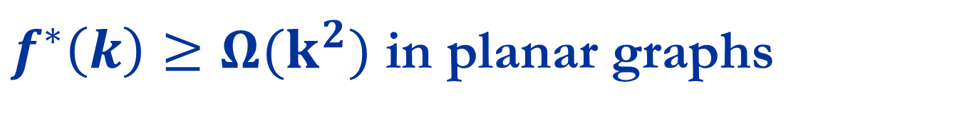
$f^{∗}\left(k\right)≥Ω(k^{2})$ in planar graphs
Outline of our original proof:
  G is a 2-D grid (with specific edge-lengths and terminals)
  Main lemma: Any G’ must have a planar separator of size Ω(k)
  Using the planar separator theorem, |V(G’)| ¸ Ω(k²)
More elementary proof:
  G is just a (k/4)£(k/4) grid
  Terminals: the boundary vertices
  In G’, “horizontal” shortest-paths (from left to
  right terminals) do not intersect
  Same for “vertical” shortest-paths
  Every horizontal path must intersect every vertical path
  These Θ(k²) intersection points must be distinct
Proof extends to (1+ε)-approximation, proving |V(G’)| ¸ Ω(1/ε²).

Slide 31
Our Results [Kamma-K.-Nguyen’14]
Theorem 8. Every k-terminal graph G with edge-lengths l admits a polylog(k) distance-approximating minor of size k.
  I.e., a minor G’ containing only the terminals with new edge-lengths l’ whose terminal-distances approximate G within factor polylog(k).
Previously:
  Approximation factor k is easy
  Probabilistic approximation factor O(log k) (i.e., by a convex combination of minors) [Englert-Gupta-K.-Raecke-TalgamCohen-Talwar’10]

Slide 32
Further Questions
About distances:
Close the gap (for exact version) between Ω(k²) and O(k⁴)
  For general and for planar graphs
What about 1+ε approximation?
Other extreme: Best approximation using a minor of size k?
  Prove a lower bound of Ω(loglog k)?
High-level plan:
Maintain other combinatorial properties
Discover redundancies (exploit them by data structures?)
Matching lower bounds (information-theoretic?)
Thank You!

