Slide 1

Randomized Algorithms
Lecturer: Moni Naor
Lecture 11

Slide 2
Recap and Today
Recap
Algorithmic Local Lemma
Today
Cuckoo Hashing

Slide 3
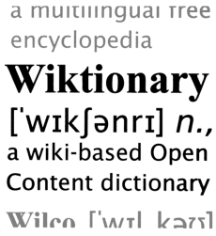


The Setting
Dynamic dictionary:
Lookups, insertions and deletions
Dynamic vs. static
Performance:
Lookup time
Update time
Memory utilization
Related problems:
Approximate set membership (Bloom Filter)
Retrieval

Slide 4
Major Problem in Hashing Based Schemes: Collisions
Hash Tables
Hash Function h Table T
Direct access to memory
Element x should ``reside” in T[h(x)]
Collision: two different elements with the same value under h
Unless |T| ≥ |U|
...
U
T

Slide 5

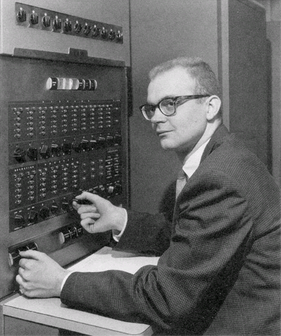
Dealing with Collisions
Lots of methods
Common one: Linear Probing
Proposed by Amdahl
Analyzed by Donald Knuth 1963
“Birth” of analysis of algorithms
Probabilistic analysis

Slide 6
Linear Probing
To insert x: try location h(x) in table T
If occupied, try h(x)+1
and if occupied, try h(x)+2
Until we find a vacant place
Looking for x:
Similar to insert: search until finding x or a vacant place.
••••••• •••••• ••••••••••• ••••••• •

Slide 7
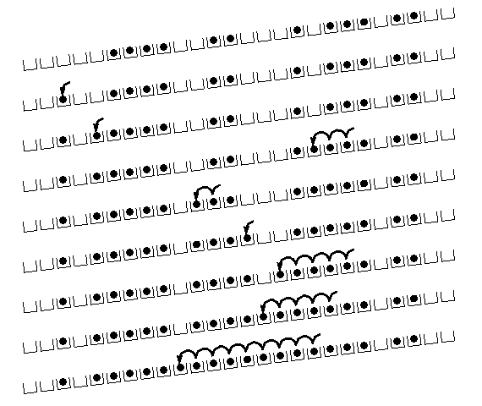
Linear Probing: situation after a while

Slide 8
Cuckoo Hashing: Basics
Introduced by Pagh and Rodler (2001)
Extremely simple:
2 tables: T₁ and T₂
Each of size r = (1+ε)n
2 hash functions: h₁ and h₂
Lookup:
Check in T₁ and T₂
d
t
h₂(x)
c
y
x
h₁(x)
x
b
a
Where is x?
...
...
z
T₁
T₂

Slide 9
Cuckoo Hashing: Insertion Algorithm
To insert element x, call Insert(x, 1)
Insert(x, i):
1. Put x into location h_{i}(x) in T_{i}
2. If T_{i}[h_{i}(x)] was empty: return
3. If T_{i}[h_{i}(x)] contained element y: do Insert(y, 3–i)
Example:
To insert x:
Put in first location and displace residing element if needed
Put displaced element in its other location
Until finding a free spot
d
t
c
y
h₂(y) = h₂(a)
x
b
h₁(e) = h₁(a)
a
e
...
...
h₁(y)
z
T₁
T₂

Slide 10
Cuckoo Hashing: Insertion
What happens if we are not successful?
Unsuccessful stems from two reasons
Not enough space
The path goes into loops
Too long chains
Can detect both by a time limit.

Slide 11
Cuckoo Hashing: Deletion
Extremely simple:
2 tables: T₁ and T₂
Each of size r = (1+ε)n
2 hash functions: h₁ and h₂
As in Lookup:
Check in T₁ and T₂
Remove wherever found
d
t
h₂(x)
c
y
x
h₁(x)
x
b
a
Where is x?
...
...
z
T₁
T₂

Slide 12
The Cuckoo Graph
Set S ⊂ U containing n elements
h₁,h₂ : U {0,...,r-1}
Insertion algorithm achieves this
Bipartite graph with |L|=|R|=r
Edge (h₁(x), h₂(x)) for every x∈S
Claims:
S is successfully stored
Every connected component in the cuckoo graph has at most one cycle
Expected insertion time: O(1)
occupied
vacant

Slide 13
Why?
A dense component: simply not enough places to put the elements
No dense component:
Tree: put elements towards the leaves
Can pick any node as the root
The root remains vacant
Cycle: two possibilities
Cycle plus trees: make the nodes on cycles the roots of the trees

Slide 14

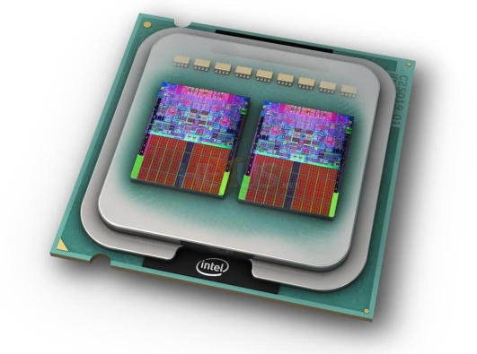
Cuckoo Hashing: Properties
Many attractive properties:
Lookup and deletion in 2 accesses in the worst case
May be done in parallel
Insertion takes amortized constant time
Reasonable memory utilization
No dynamic memory allocation
Lots of Generalizations
Lots of applications to related problems
Growing evidence of practicality on current architectures

Slide 15
Animation of Insertions
T₁
T₂
h₁( ) = 8
h₁( ) = 6
h₁( ) = 2
h₁( ) = 10
h₁( ) = 4
h₁( ) = 8
h₁( ) = 4
h₁( ) = 4
h₁( ) = 10
h₁( ) = 6
0
1
2
3
4
5
6
7
8
9
10
11
0
1
2
3
4
5
6
7
8
9
10
11
h₁( ) = 2
Input
h₂( ) = 6
h₂( ) = 1
h₂( ) = 8
h₂( ) = 10
h₂( ) = 4
h₂( ) = 4
h₁( ) = 6
h₂( ) = 8
Queue
With queue for de-amortization
Notes:
n = 10, epsilon = 0.2, so r = 12
log_2 10 = 3.3, so |Q| = 4, 0.7 for stash
L = 3 for simplicity (can explain 2.5 orally)

Slide 16
More than One Cycle
With probability Θ(1/n) Cuckoo Hashing fails
Recall: connected component with more than one cycle
Standard solution: rehashing
Meaning: insertion worst case may be O(n)
[KMW08] suggested stash
Saves rehashing
Actually reduces insertion worst case to O(log n)
Constant-sized stash is sufficient whp
Kirsch, Mitzenmacher,
Wieder
Prob of more
than k: 1/n^{k+1}

Slide 17
The Stash
Because of stash, need also Cycle Detection Mechanism:
Can accommodate log n elements
Supporting O(1) lookups and resets
Detecting second cycle as it happens
...
Queue
Cuckoo
graph
Notes:
Another explanation (Omer): there is BIG failure (rehash) amd SMALL (more than constant # of moves).
For both use Queue.

Slide 18
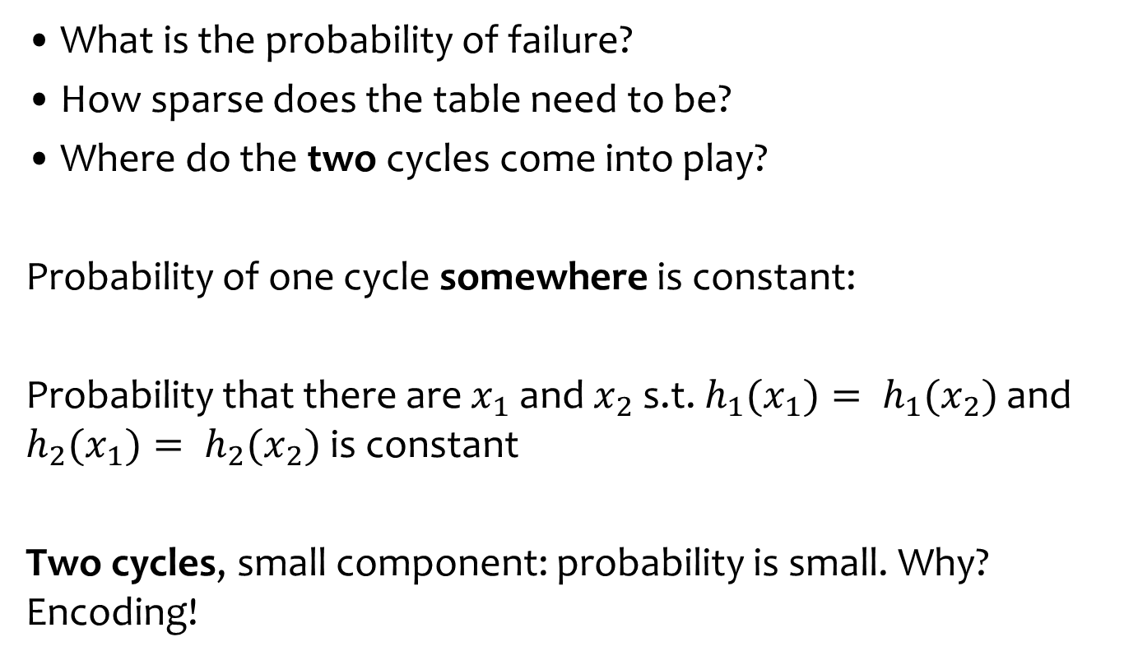
Analysis: why Does it work?
What is the probability of failure?
How sparse does the table need to be?
Where do the two cycles come into play?
Probability of one cycle somewhere is constant:
Probability that there are $x_{1}$ and $x_{2}$ s.t. $h_{1}(x_{1})= h_{1}(x_{2})$and $h_{2}(x_{1})= h_{2}(x_{2})$is constant
Two cycles, small component: probability is small. Why? Encoding!

Slide 19
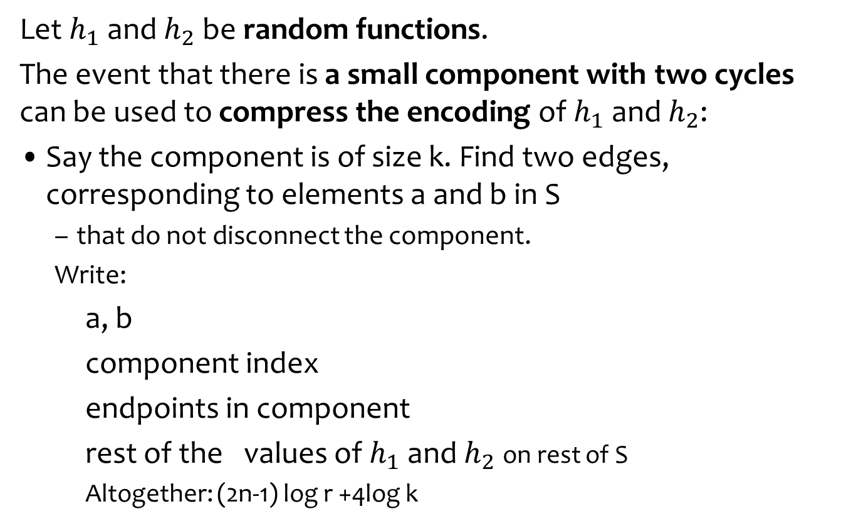
Two cycles, small component
2n log r bits on S
...
Let $h_{1}$ and $h_{2}$ be random functions.
The event that there is a small component with two cycles can be used to compress the encoding of $h_{1}$ and $h_{2}$:
Say the component is of size k. Find two edges, corresponding to elements a and b in S
that do not disconnect the component.
Write:
a, b
component index
endpoints in component
rest of the values of $h_{1}$ and $h_{2}$on rest of S
Altogether: (2n-1) log r +4log k
Saving is almost log r.
Happens with probability ≈ 1/n
2 log n bits
log n bits
Where we use
the small component
4 log k bits
2(n-2) log r bits

Slide 20
Analysis: long walk
What is the probability when inserting x that we need a chain of length k?

Slide 21
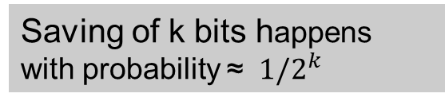
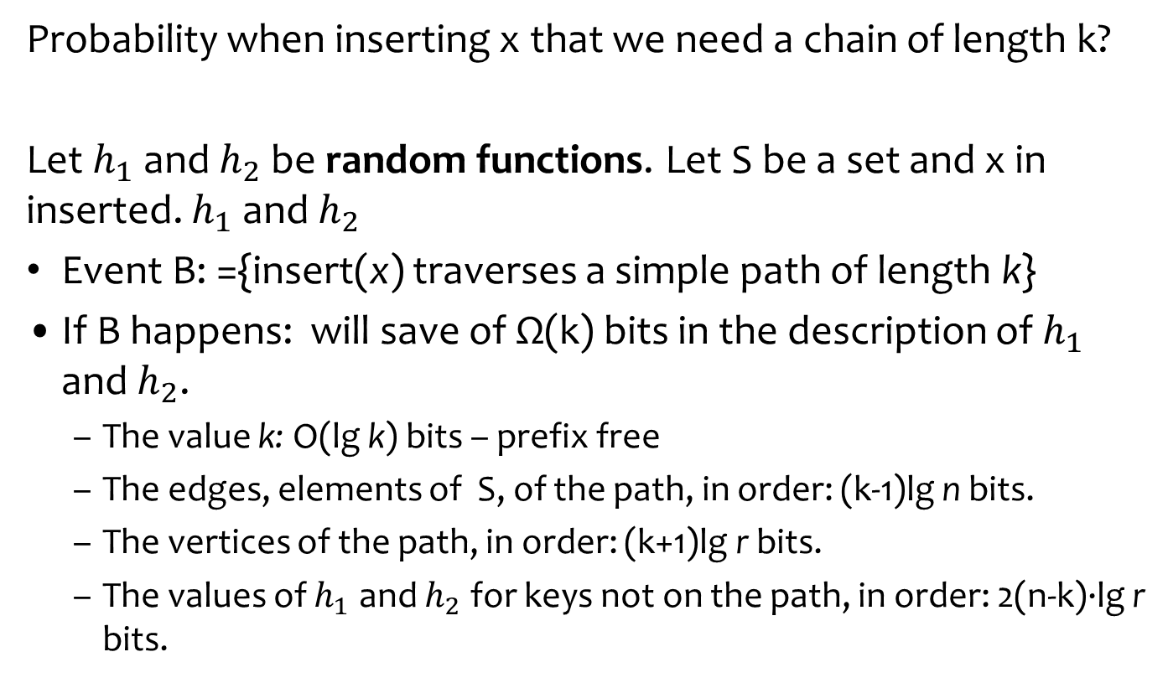
Analysis: long walk when inserting x
Probability when inserting x that we need a chain of length k?
Let $h_{1}$ and $h_{2}$ be random functions. Let S be a set and x in inserted. $h_{1}$ and $h_{2}$
Event B: ={insert(x) traverses a simple path of length k}
If B happens: will save of Ω(k) bits in the description of $h_{1}$ and $h_{2}$.
The value k: O(lg k) bits – prefix free
The edges, elements of S, of the path, in order: (k-1)lg n bits.
The vertices of the path, in order: (k+1)lg r bits.
The values of $h_{1}$ and $h_{2}$ for keys not on the path, in order: 2(n-k)·lg r bits.
2n log r bits on S
Saving of k bits happens with probability ≈ ${ 1/2}^{k}$

