Slide 1
Randomized Algorithms
Lecturer: Moni Naor
Lecture 13

Slide 2
Recap and Today
Recap
Random Graphs
Cuckoo Hashing
Today
Balls and Bins
Two Choice paradigm

Slide 3
Detecting 2 Cycles in Cuckoo Hashing
How do you know that you are in a cycle?

Slide 4
Karp Rabin Hash Function for Streaming
Fingerprinting files:
Given an n-bit message m₀,...,m_{n-1}: view it as
f(x) = $\sum_{i=0}^{n}{m_{i}x^{i}}$
polynomial of degree n-1 over GF[2]
Choose p(x) a random irreducible polynomial of degree k over GF[2]
The hash value is the remainder r(x) of f(x)/p(x): k bits
Very easy to compute in a sliding manner
Can compute the hash of next window by removing the msb shifting by multiplying by 2 and adding the lsb
A similar family:
treat strings as integers
and the function is defined
by a small prime p
Defines the family

Slide 5
Analysis of Fingerprinting
For any x and x s.t. $1≤ x < x’≤ 2^{n}$,
what is the probability of that $x = x’ mod p$ for a random prime $p$
$p$ is k bits long
$p$ should divide x-x’
How many such primes? At most n/log⁡ n
How many primes of length k?
By prime number theorem: roughly $\frac{2^{k}}{k\ln{2}}$
So if $k > 2\log{n},$roughly $1/n$
$$p_{1}⋅ p_{2}⋯ p_{ℓ}<ℓ!$$

Slide 6
Overview
The Birthday Paradox
Balls & Bins
Poisson Distribution & Approximation
Application: Sharp Threshold for Coupon Collector
Some slides from Elad Tzalic

Slide 7
The Birthday Paradox
Find least $m$, where if $m$ balls thrown into $n$ bins, then with probability at least $\frac{1}{2}$: two ball fall into the same bin?
In the birthday example $n=365$, $m=23$

Slide 8
The Birthday Paradox – lower bound
Bound the prob. of no collisions:
$E_{i}$ - the $i^{th}$ person’s birthday does not match all persons before.

Slide 9
The Birthday Paradox – Upper Bound
Consider $2\sqrt{n}$ balls thrown in 2 batches of $\sqrt{n}$each.
If no collision occurred in the first $\sqrt{n} balls,$ then $\frac{1}{\sqrt{n}}$of the bins have a ball.
If $2\sqrt{n}$balls had no collision, the second batch fell only in the $1−\frac{1}{\sqrt{n}}$fraction of the empty bins. This has probability:

Slide 10
Balls & Bins
Recall: $m$ balls are thrown into $n$ bins independently and uniformly.
Application:
Assignment rule of jobs to processors.
Hashing.

Slide 11
Balls & Bins - Questions of Interest
What is the maximum load over the bins?
Distribution of #bins with more than 1 ball.
Distribution of bins with exactly $r$ balls?
r=0?

Slide 12
Balls & Bins – Max Load
Max load bound:
We show ($w.h.p$) : $Θ\left(\frac{\log\left(n\right)}{\log\left(\log\left(n\right)\right)}\right)$ when $m=n$.

Slide 13
Balls & Bins – Max Load
$$\operatorname{Pr}\left[X_{i}=r\right]= \left({n \atop r}\right)p^{r}{(1−p)}^{n−r}$$
Calim: max load is ($w.h.p$) : $Θ\left(\frac{\log\left(n\right)}{\log\left(\log\left(n\right)\right)}\right)$
Let $X_{i}$be the number of balls in the $i^{th}$bin. $X_{i}\sim Bin(n,\frac{1}{n})$
For a given $M:$ bound $\operatorname{Pr}\left[X_{i}≥M\right]by$ $\left({n \atop M}\right) {\left(\frac{1}{n}\right)}^{M}$
Set $M=3\frac{\log\left(n\right)}{\log\left(\log\left(n\right)\right)}$and take a union bound over all bins.
Simple, since we could look at every bin separately

Slide 14
Poisson Approximation - Intuition
Bin distribution: $X_{i}\sim Bin\left(m, \frac{1}{n}\right)$.
Thus we get $\operatorname{Pr}\left[X_{i}=r\right]= \left({m \atop r}\right){\left(\frac{1}{n}\right)}^{r}{\left(1−\frac{1}{n}\right)}^{m−r}$
$=\frac{1}{r!} \frac{\left(m\left(m−1\right)…\left(m−r+1\right)\right)}{n^{r}} {\left(1−\frac{1}{n}\right)}^{m−r}$ $≈\frac{1}{r!} {\left(\frac{m}{n}\right)}^{r}$ ${ e}^{−\frac{m}{n}}$
This suggests the distribution:
$k≥0 Pr\left[X=k\right]=e^{−λ}⋅\frac{λ^{k}}{k!}$.
When approximating $Bin\left(m,\frac{1}{n}\right)$ we have $λ=\frac{m}{n}$

Slide 15
Poisson Distribution - Properties
A Poisson $r.v.$ $X\sim P(λ)$ satisfies:
Motivation: approximate $Bin\left(m,\frac{1}{n}\right)$ by $P\left(\frac{m}{n}\right)$
$E\left[X\right]=λ$
$Var\left[X\right]=λ$
$M_{x}\left(t\right)=e^{λ\left(e^{t}−1\right)}$
$X\sim P(λ_{1})$, $Y\sim P(λ_{2})$
$X$ ,$Y$ are independent $⇒$ $$X+Y \sim P(λ_{1}+λ_{2})$$
$$Pr⁡[X=k]=e^{−λ}⋅\frac{λ^{k}}{k!}$$

Slide 16
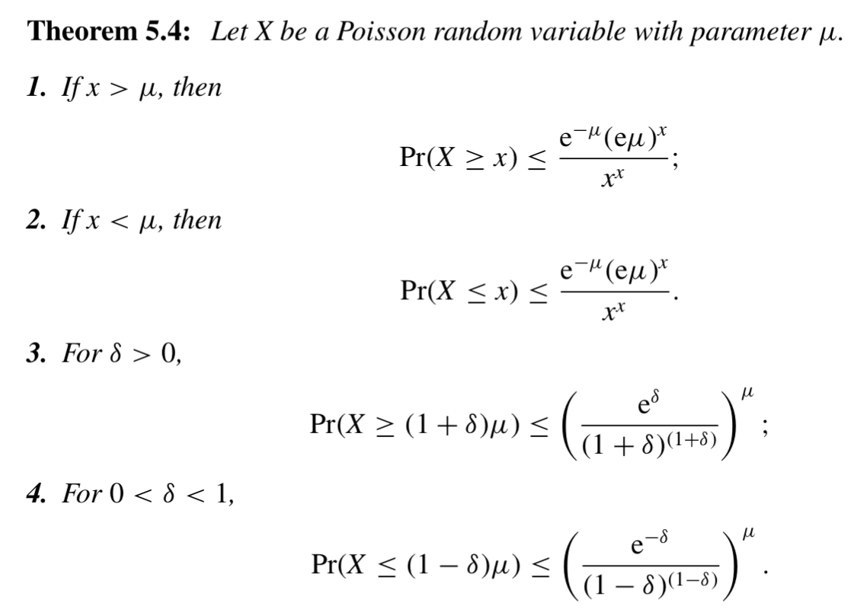
Concentration Bounds for Poisson Distribution

Slide 17
Poisson Approximation
Poisson distribution approximates Binomial distribution.
Theorem: Let $X_{n}$ be binomial r.v. with parameters $n$ and $p$ where $p$ is a function of n and $λ=$ $\lim_{n→∞}{np}$ is a constant.
Then for any fixed k:
$\lim_{n→∞}{Pr⁡[X_{n}=k]= \frac{e^{−λ}{\begin{aligned}λ \\ \end{aligned}}^{k}}{k!}}$
Consider a variant on the ball & bins model: instead of $m$ balls being distributed to $n$ bins, each bin load is $P\left(\frac{m}{n}\right)$.
These two models yields different distributions, but they are tightly related.

Slide 18
Poisson Approximation
Theorem: For any n,m and k: Let $Y_{1}^{(m)}$, $Y_{2}^{(m)}$, … $Y_{n}^{(m)}$ be independent Poisson r.v. with p=m/n and let $X_{1}^{(k)}, X_{2}^{(k)}$, … $X_{n}^{(k)}$ be r.v. indicating the number of balls in bin i when throwing k balls.
Then the distribution of $Y_{1}^{(m)}$, $Y_{2}^{(m)}$, … $Y_{n}^{(m)}$ conditioned on $\sum_{i}{Y_{i}^{(m)}}=k$ is identical to
$X_{1}^{(k)}, X_{2}^{(k)}$, … $X_{n}^{(k)}$
Theorem: Let $f(x_{1}, x_{2}, … x_{n})$be a non-negative function.
Then E[f($X_{1}^{(k)}, X_{2}^{(k)}$, … $X_{n}^{(k)}$)] $≤ e \sqrt{m}$E[$Y_{1}^{(m)}$, $Y_{2}^{(m)}$, … $Y_{n}^{(m)}$ ]
Corollary: Any event that occurs with probability p in the Poisson case occurs with probability at most $ep\sqrt{m}$ in the binomial case

Slide 19
Poisson Approximation
Theorem: the distribution of $Y_{1}^{(m)}$, $Y_{2}^{(m)}$, … $Y_{n}^{(m)}$ conditioned on $\sum_{i}{Y_{i}^{(m)}}=k$ is identical to $X_{1}^{(k)}, X_{2}^{(k)}$, … $X_{n}^{(k)}$
$$\operatorname{Pr}\left[\left(X_{1}^{(k)},…,X_{n}^{\left(k\right)}\right)=\left(k_{1},,…, k_{n}\right)\right]=\frac{1}{n^{k}}\left({k \atop k_{1},…,k_{n}}\right)$$
$$\operatorname{Pr}\left[\left(Y_{1}^{(m)},…,Y_{n}^{\left(m\right)}\right)=\left(k_{1},,…, k_{n}\right)|∑Y_{i}=k\right]=\frac{Π{Pr⁡[Y}_{i}^{(m)}=k_{i}]}{Pr⁡[∑Y_{i}=k]}$$
$= \frac{Π\frac{1}{k_{i}!}e^{−\frac{m}{n}}{\left(\frac{m}{n}\right)}^{k_{i}}}{\frac{1}{k!}e^{−m}{\left(m\right)}^{k}}=\frac{1}{n^{k}}$ $\left({k \atop k_{1},…,k_{n}}\right)$

Slide 20
Application: Sharp Threshold for coupon collector
Collect $n$ coupons:
Each round get a coupon chosen uniformly at random from [n].
Can view the coupon collector problem as a Balls & Bins problem.
$X,$the number rounds until all coupons collected.
Picking all coupons $⟺$ we have no empty bins.
We know: E[X]= n ln n
Would like to bound: $Pr⁡[x> n ln n +cn]$
Will see: $\lim_{n→∞}{Pr⁡[x> n ln n +cn]\text{=}{1−e}^{−ⅇ^{−c}}}$

Slide 21
Sharp Threshold for coupon collector: Proof Sketch
Easier to analyze the ``Poisson Balls & Bins”.
The total number of balls thrown in the Poisson model is concentrated around $m$ ($w.h.p$)
Show that a small deviation from $m$ has little effect the probability of collecting all coupons.

Slide 22
Sharp Threshold for coupon collector: Notations
$Ɛ:$The event of collecting all coupons.
$m=n⋅ln\left(n\right)+cn$, the wanted number of trials.
$d=\sqrt{2m⋅ln\left(m\right)}$
$Y_{i}$ - #coupons in bin $i$. Distribution is $P\left(\frac{m}{n}\right)$
Will show:
$\lim_{n→∞}{\operatorname{Pr}\left[Ɛ | ∑Y_{i}=m\right] }$= $\lim_{n→∞}{\operatorname{Pr}{[Ɛ]}}=e^{{−e}^{−c}}$

Slide 23
Sharp Threshold for coupon collector
In the Poisson model: each bin is distributed $P\left(\ln\left(n\right)+c\right)$
Each bin is empty with probability: $e^{−\ln\left(n\right)−c}=\frac{e^{−c}}{n}$
Probability that all bins are non-empty:
${\left(1−\frac{e^{−c}}{n}\right)}^{n} \underset{→}{n→∞}e^{{−e}^{−c}}$
Thus $\lim_{n→∞}{\operatorname{Pr}{[Ɛ]}}=e^{{−e}^{−c}}$

Slide 24
Sharp Threshold for coupon collector
Recall $m=n\ln\left(n\right)+cn$.
Will show: the total number of coupons close to $m$ ($w.h.p$)
More specifically:
$X=∑Y_{i}$ , where each $Y_{i}\sim P\left(\ln\left(n\right)+c\right)$.
The ${\left\{Y_{i}\right\}}_{i}$ are independent.
$X\sim P(n⋅ln\left(n\right)+cn)$
Concentration bound for $X$ with deviation $\sqrt{2m ln⁡m}$ completes what we want
Adding Poisson r.v
is a Poisson r.v.

Slide 25
Sharp Threshold for coupon collector
If the total number of balls is $m$ we are done.
Need to show small deviation has no effect in the limit i.e.
$Ɛ$ is monotone in the number of balls:
This yields

Slide 26
Sharp Threshold for coupon collector
We showed:
Want to show: that R.H.S is small.
Interpretation of the difference: probability of:
Throwing $m−d$balls and having some empty bins
Then throwing another $2d$ balls and having all bins non-empty.
This is bounded by $1−{\left(1−\frac{1}{n}\right)}^{d}=o(1)$ as $d=o(n)$

Slide 27
Sharp Threshold for coupon collector
1
Finally by Law of Total Probability:
Thus: $\lim_{n→∞}{\operatorname{Pr}\left[Ε | ∑Y_{i}=m\right] }$= $\lim_{n→∞}{\operatorname{Pr}{[Ε]}}$
0

Slide 28
The Power of Two Choices or Multiple Choices
Suppose that instead of throwing the balls into the bins at once, we do it one by one
No change
Now suppose: we select for each ball two bins, and place it in the lighter bin
How to break ties?
How loaded is the heaviest bin?
With high probability: ln ln n + O(1)
With d functions: ln ln n/ln d + O(1)

Slide 29
Upper Bound
Theorem: if n balls are sequentially placed into n bins in the following using the two (d) choice approach.
ties broken randomly.
After all the balls are placed: the maximum load is at most ln ln n/ ln d + O(1) with probability 1 − o(1/n).
Proof: Let $v_{i}(t)$be the number of bins with at least $i$ balls after t balls were inserted.
$v_{i}(t)$is non-decreasing in $t$ so it is enough to bound $v_{i}(n)$
Want to choose a sequence $β_{i}$ s.t.: Pr[$v_{i+1}$≤ $β_{i+1}$| $v_{i}$≤ $β_{i}$]>$1−1/n^{2}$
If few bins ($β_{i}$) of load ≥ i, it is likely that there are even fewer bins ($β_{i+1}$) of load ≥ i+ 1

Slide 30
Upper Bound Idea
Want to choose one that
goes down very quickly
$β_{1}, β_{2}$… $β_{j}$a sequence s.t.: Pr[$v_{i+1}$≤ $β_{i+1}$| $v_{i}$≤ $β_{i}$]>$1−1/n^{2}$
Key point: for a ball to fall into a bin where it is at least the i+1 ball (i.e. increase $v_{i+1}$)
It must be the case that all d choices were to bins with at least i balls
Happens with probability at most ${β_{i}}^{d}/n^{d}$

Slide 31
Upper Bound
Induction on i
Total number of balls is n, hence for every j >0 there could be at most n/j bins with j balls or more
Base case for induction Pr[$v_{i}$≤n/j]= 1 (say j=4)
Let h(t) be the height of ball t: one plus the number of balls in the bin in which it was placed, at the time of placement.
$Pr⁡[h(t)≥i+ 1| v_{i}$(t-1) ≤ $β_{i}$]≤${β_{i}}^{d}/n^{d}$
Let $u_{i}(t)$ be the number of balls of height at least i.
We have for all $i,t$: $u_{i}(t)$ $≥$ $v_{i}$(t)

Slide 32
Upper Bound
Let $Y_{t}=1$iff $h(t)≥i+ 1$ and $v_{i}$(t-1)≤ $β_{i}$
We know that $Pr⁡[Y_{t}=1| v_{i}$(t-1) ≤ $β_{i}$]≤${β_{i}}^{d}/n^{d}$
Pr[$u_{i}(n)$ > k| $v_{i}$(n) ≤ $β_{i}$] = $Pr⁡[∑Y_{t}> k| v_{i}$(n) ≤ $β_{i}$]
≤ $\frac{Pr⁡[∑Y_{t}>k]}{\text{Pr}\text{[}v_{i}\text{(}\text{n}\text{) }\text{≤ }β_{i}\text{]}}$
$E⁡[∑Y_{t}$] $≤ {β_{i}}^{d}/n^{d}$
Set ${{β_{i+1}=2β}_{i}}^{d}/n^{d−1}$
Lemma: $β_{i}$≤$\frac{n}{2^{d^{i−4}}}$
Done in log log n/log d steps

Slide 33
Lower Bound
Suppose that n balls are sequentially placed into n bins in the following using the two choice approach.
ties broken randomly.
After all the balls are placed: the maximum load is at least ln ln n/ ln d - O(1) with probability 1 − o(1/n)

Slide 34
The Left[d] Process
Breaking ties by going left consistently actually improve a little the bounds:
After n balls are placed sequentially into n bins using the Left[d] scheme with d >1, it holds that
$$Pr⁡[L(n) ≥\frac{\log{log }n}{dlnφ_{d}}+O(1)]≤o(1/n)$$
Where $φ_{d}$ is some constant that depends only on d and is always in (1.6,2)

Slide 35
Heavy Loaded Case
The case m >> n is captures typical load balancing challenges in large systems
Multiple items are placed per host.
Example: large distributed block storage system, balls represent blocks and bins represent hosts
How larger does the largest bin have to be, compared to average?
“Theorem”: the gap (Gap(m)) between the maximum and the average load stays roughly log log n.
For any m, after m balls are placed with Greedy[d]
Pr[Gap(m)≥ $\frac{\log{log }n}{\ln{d}} +γ$]≤$1/n^{−c}$
$γ$Is a function of c

