Slide 1

Randomized Algorithms
Introductory Lecture
Lecturers:
Robert (Robi) Krauthghamer
Moni Naor
First Assignment:
learn to spell Robi’s name

Slide 2
Administrivia
Meetings: Mondays 14:15-17:00
It is expected that all students attend all lectures and actively participate in classes
Read material before class
Present in class – hw solutions etc.
Interact during lectures
Test
Lectures are recorded (please remind the speaker to start)

Slide 3
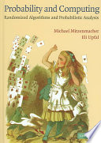
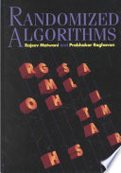
Course:
Sources:
Mitzenmacher and Upfal
Probability and Computing
Motwani and Raghavan
Randomized Algorithms
A few lectures from Ryan O'Donnell's course ``A Theorist's Toolkit"

Slide 4
Today
Why?
Min Cut
2-SAT
Randomized Complexity Classes
Next time

Slide 5
Why Randomized Algorithms?
May solve problems faster than deterministic ones
May be essential in some settings:
Sublinear time complexity realm
Distributed algorithms, e.g. for breaking symmetry
Cryptography and privacy
Yield construction of desirable objects that we do not know how to build explicitly.
Beyond worst case analysis: analyze algorithms when assuming some distribution on the input,
or some mixture of worst case and then a perturbation of the input (smoothed analysis).
Example: PCP Theorem
Example: Differential Privacy

Slide 6
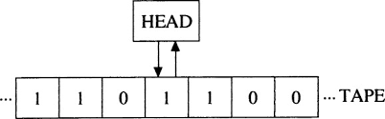
Why Randomized Algorithms?
Prob is over
its choice
Our emphasis would be worst case
We assume the algorithm or computing device receives in addition to the input also a random `tape’
like the other tapes of the Turing Machine, but this one with truly random symbols.
A nice feature that some randomized algorithms have is that they are simple.
Will demonstrate this in two algorithms.
Or other models
Decision tree
Communication complexity
Random tape

Slide 7
Global Minimum Cut?
Find a partition (A, B) of V s. t. the number of edges crossing from A to B is of minimum cardinality.
G = (V, E)
d
A
B
b
f
Size of mincut is 3
Several such cuts
a
h
g
c

Slide 8
Global Minimum Cut
Global min cut: Given a connected, undirected graph G = (V, E) find a cut (A, B) of minimum cardinality.
Applications: Partition items in a database, cluster documents, network reliability, network design, TSP solvers.
Network flow approach: run (n-1) s-t min cut (flow)
Which is harder: Global min-cut or min s-t cut?

Slide 9
Basic operation: edge contraction
Contract an edge e = (u, v).
replace u and v by single new super-node w
preserve edges, update endpoints of u and v to w
keep parallel edges, but delete self-loops
e =(b,c)
d
Mincut does not decrease as a result of contraction
Might increase if you hit the mincut
b
f
a
h
g
c

Slide 10
Contraction algorithm [Karger 1995]
Pick an edge e = (u, v) uniformly at random.
Contract the edge e.
replace u and v by single new super-node w
preserve edges, update endpoints of u and v to w
keep parallel edges, but delete self-loops
Repeat until only two nodes v₁ and v₂ left.
Return the cut (A,B)
A = all nodes that were contracted to form v₁
B = all nodes that were contracted to form v₂

Slide 11
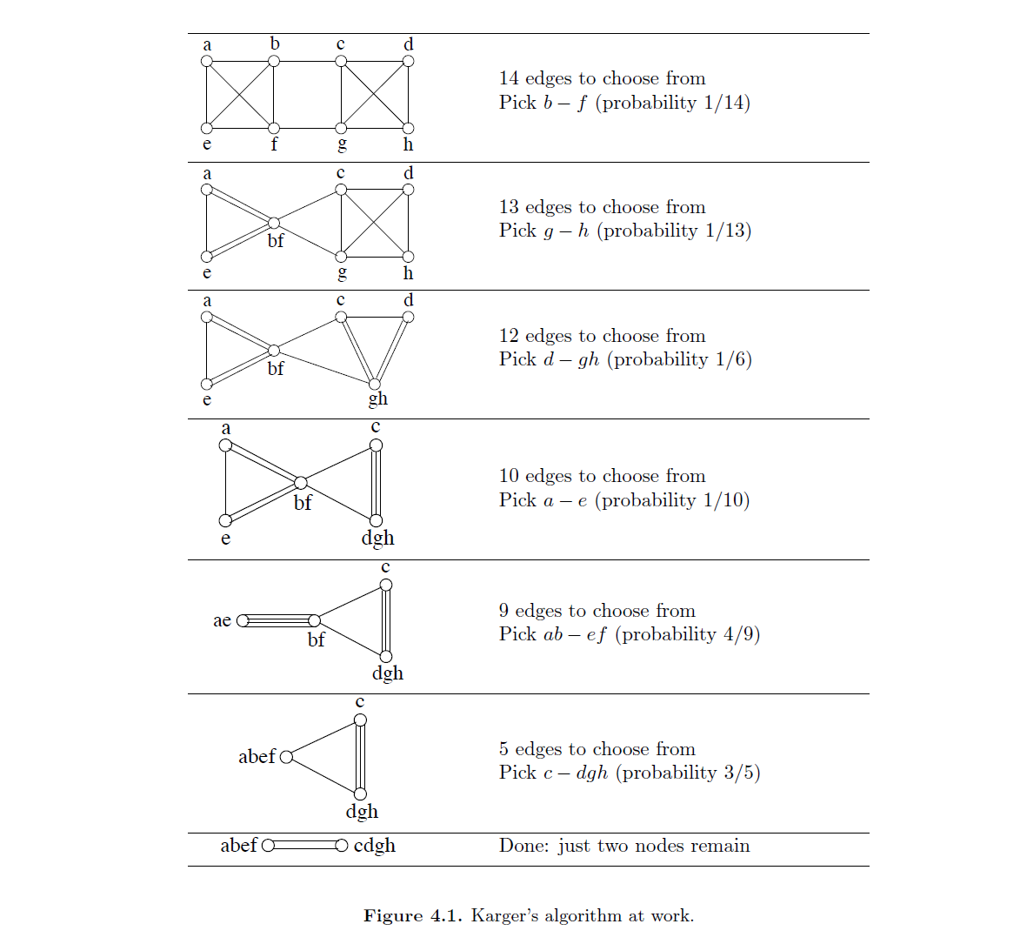
From Arora’s notes

Slide 12
Analysis of Contraction Algorithm
Which one?
Claim: Contraction Algorithm returns a min cut with probability at least 1/n².
Proof: Consider a specific global min-cut (A*, B*) of G. Let F* be the edges in the cut and k = |F*|
In the first step, an edge in F* is contracted with probability k / |E|.
Every node has degree ≥ k,
Otherwise (A*, B*) would not be a min-cut
⇒|E| ≥½kn.
Hence: an edge in F* is contracted with prob. ≤ 2/n.

Slide 13
…Analysis of Contraction Algorithm
After j iterations: there are n’ = n-j (super)nodes
Suppose no edge in F* has been contracted:
The mincut in G’=(V’,E’) is still of size k
Therefore |E’| ≥ ½k∙n’
Thus the algorithm contracts an edge in F* with probability ≤2/n’
Let E_{j} be the event: “an edge in F* has not been contracted in iteration j”
E₁ ∩ E₂ ∩ … ∩ E_{n-2}
The good case

Slide 14
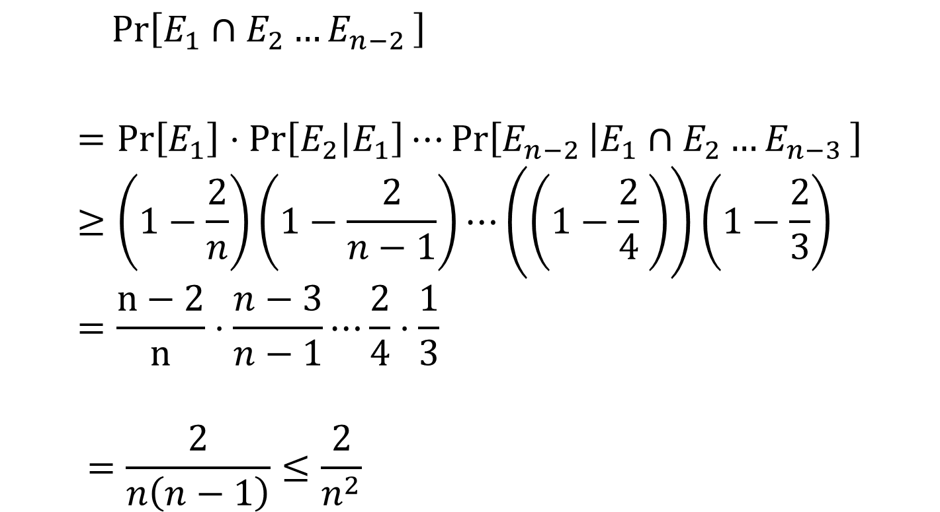
≥
n(n-1)
n²

Slide 15
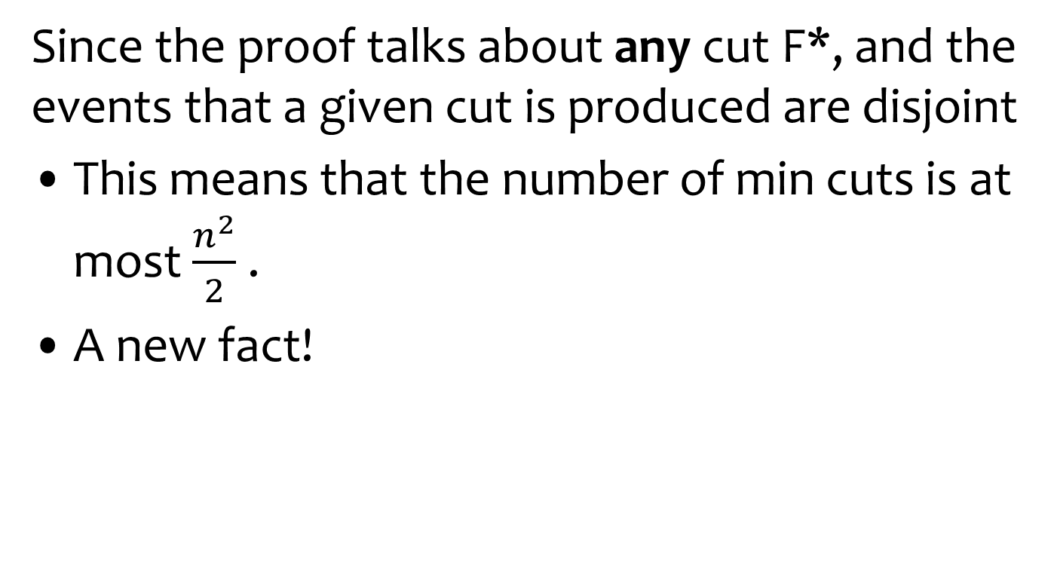
How many cuts?
Each assignment to the random tape yields one cut.
The assignments leading to cuts F₁ and F₂ are disjoints

Slide 16
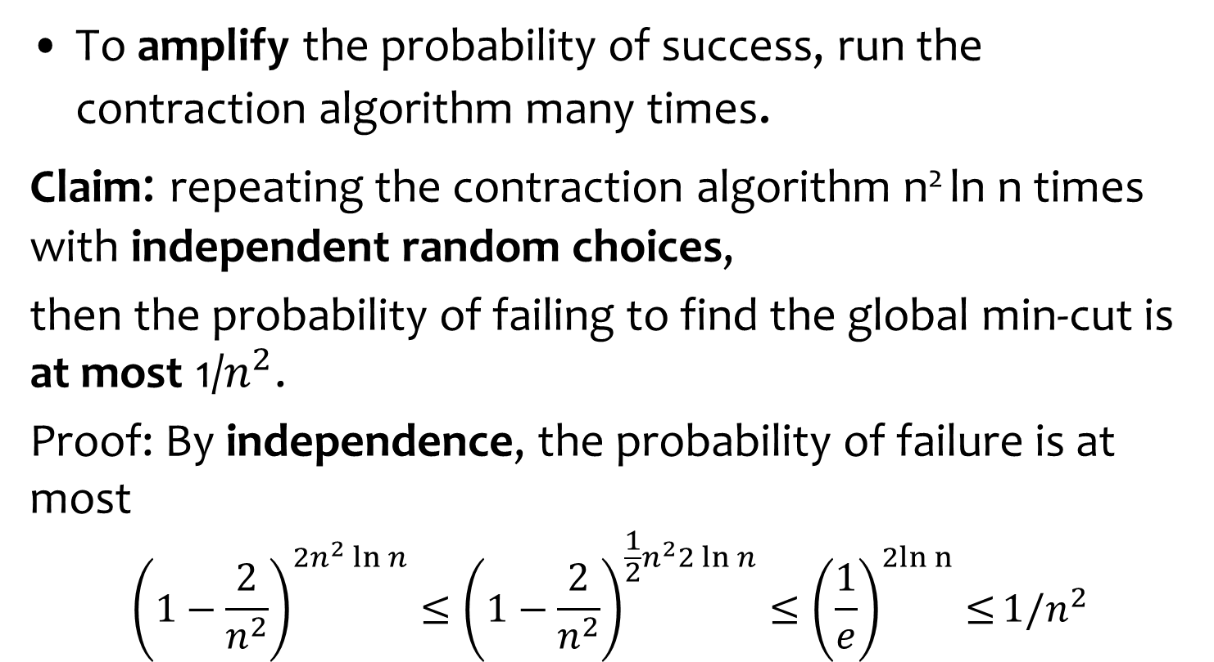
Amplification
Taking the smallest
cut from all iterations
Upper on the prob

Slide 17
Running Time and Improvements
Overall running time: perform Θ(n² ln n ) iterations, each one taking Ω(m) time. Total: Θ(m n² ln n )
Improvement: [Karger-Stein 1996] O(n² ln³ n).
Early iterations less likely to hit min cut than later ones: probability of contracting an edge in min cut hits 50% when n/√2 nodes remain.
Run contraction algorithm until n/√2 nodes remain.
Run contraction algorithm twice on resulting graph, and return best of two cuts.
Best known. [Karger 2000] O(m ln³ n).

Slide 18
Equivalent form of the algorithm
Choose a random permutation on the edges
Scan the edges according to the permutation
When an edge arrives, if its two end points have not be contracted to the same super node, contract
Output the last two supernodes
Question: prove that the two algorithms are equivalent

Slide 19
Homework
Question: What happens if instead of picking a random edge you pick at random a pair of vertices and contract?
Is the resulting algorithm a good min-cut algorithm?
Question: The algorithm also showed a bound on the number of min-cuts.
In contrast show that for s-t cuts there can be exponentially many min-cuts.
since for every min-cut the probability of
outputting this specific cut was >1/n²
where there are two input nodes s and t
that should be separated

Slide 20
Question
Suppose you choose an edge by
Picking a random node u
Pick a random neighbor v of u
The result is edge (u,v)
Show that this is not the same as picking a random edge (u,v) among all edges.
Analyze the Karger cut algorithm with this way of picking an edge.

Slide 21
Watch Lecture on Entropy
Entropy || @ CMU || Lecture 24a and 24b of CS Theory Toolkit
https://www.youtube.com/watch?v=b6x4AmjdvvY

