Slide 1

Randomized Algorithms
Lecturer: Moni Naor
Lecture 5

Slide 2
Recap and Today
Recap
Streaming
Multiset equality
Today
Streaming
Proof by encoding

Slide 3
Homework Recap
Vague: Question: Why choose majority and not some other function for amplification?
Question: why does Freivald’s matrix multiplication checking work?

Slide 4
Multi-set equality
We have two multi-sets A and B
  given in an arbitrary order. Once an element is given it cannot be accessed again
    (unless it is explicitly stored) and our
  goal a low memory algorithm for equality.
Idea: choose a function h and compute h(A) and h(B) gradually.
h chosen from a family of hash functions H
  All the randomness comes from choice of h
Cannot hope to have
a deterministic algorithm

Slide 5
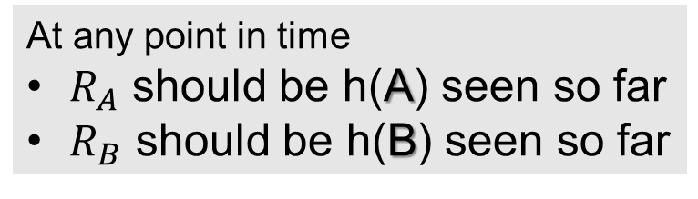
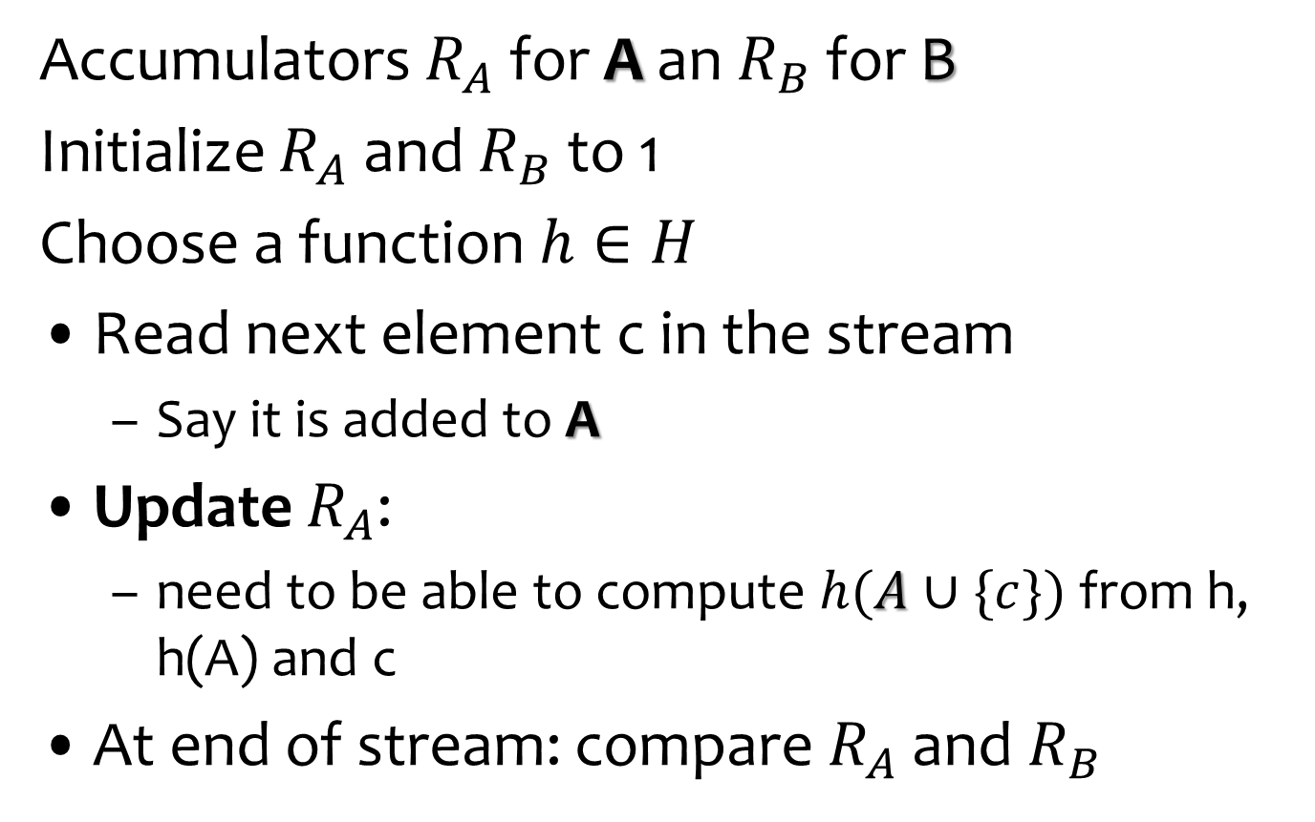
Algorithm
From the range of h
Accumulators $R_{A}$ for A an $R_{B}$ for B
Initialize $R_{A}$ and $R_{B}$ to 1
Choose a function $h∈H$
Read next element c in the stream
  Say it is added to A
Update $R_{A}$:
  need to be able to compute $h(A∪\{c\})$from h, h(A) and c
At end of stream: compare $R_{A}$ and $R_{B}$
At any point in time
$R_{A}$ should be h(A) seen so far
$R_{B}$ should be h(B) seen so far
Uniformly at random

Slide 6
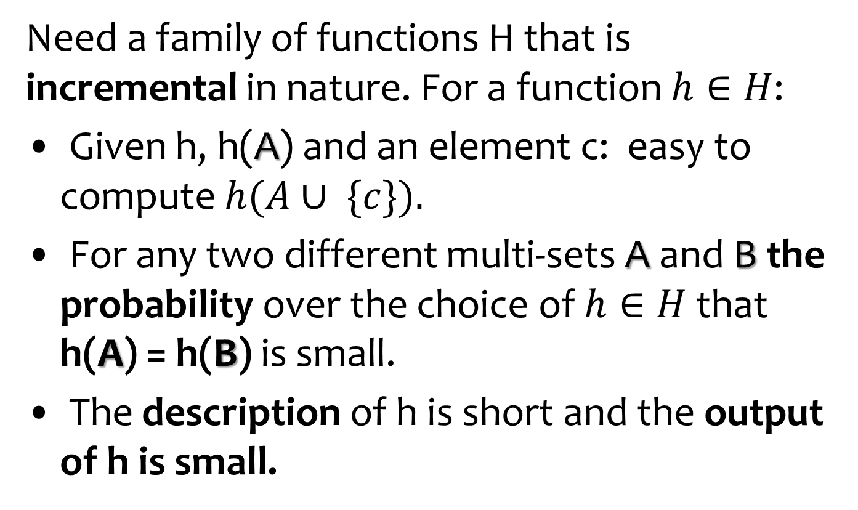
Multi-set equality
Need a family of functions H that is incremental in nature. For a function $h∈H$:
Given h, h(A) and an element c: easy to compute $h(A∪ \{c\}).$
For any two different multi-sets A and B the probability over the choice of $h∈H$that h(A) = h(B) is small.
The description of h is short and the output of h is small.

Slide 7
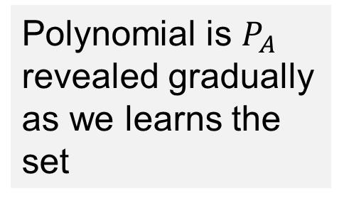
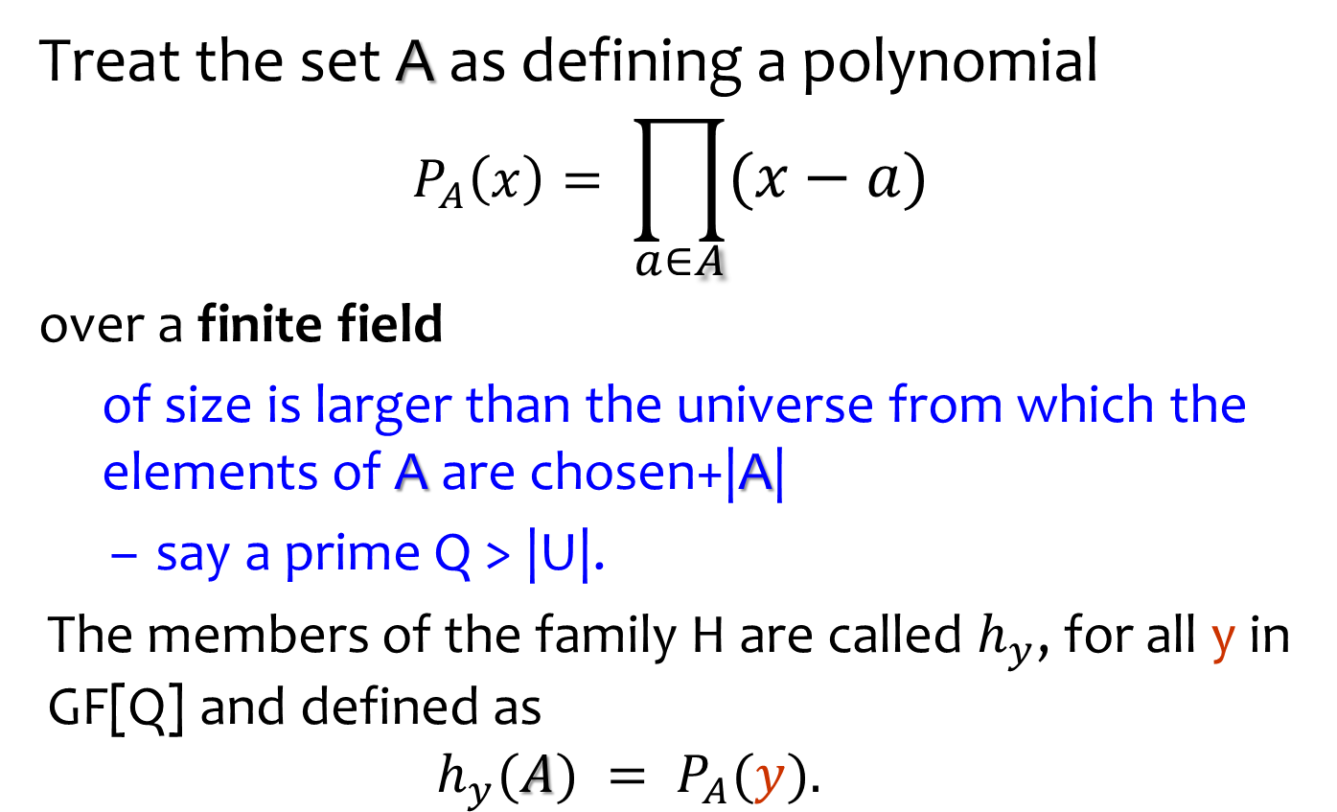
Functions for Multi-set equality
Treat the set A as defining a polynomial
$$P_{A}\left(x\right)= \prod_{a∈A}{(x−a)}$$
over a finite field
  of size is larger than the universe from which the elements of A are chosen+|A|
  say a prime Q > |U|.
The members of the family H are called $h_{y}$, for all y in GF[Q] and defined as
  $$h_{y}(A) = P_{A}(y).$$
Polynomial is $P_{A}$ revealed gradually as we learns the set

Slide 8
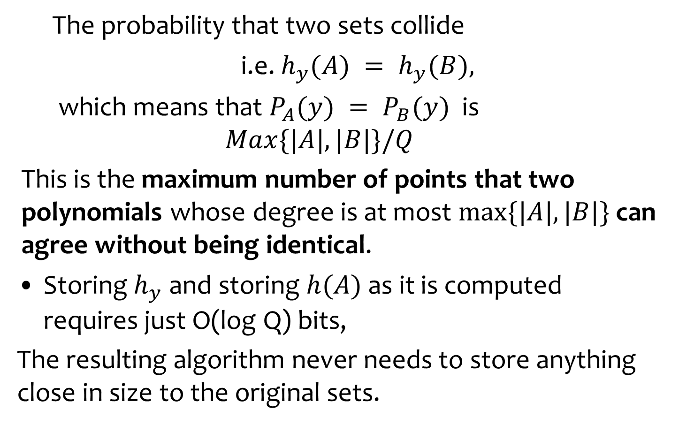
Analysis
  The probability that two sets collide
  i.e. $h_{y}(A) = h_{y}(B),$
  which means that $P_{A}(y) = P_{B}(y)$is
  $$Max\{|A|, |B|\}/Q$$
This is the maximum number of points that two polynomials whose degree is at most $max⁡\{|A|, |B|\}$can agree without being identical.
Storing $h_{y}$ and storing $h(A)$ as it is computed requires just O(log Q) bits,
The resulting algorithm never needs to store anything close in size to the original sets.

Slide 9

Model
Secure zone
CPU needs to make sure what it read is what it wrote
Accesses addresses q₁, q₂…
q_{i}
CPU
Main memory
Small private memory
M[q_{i}]

Slide 10
Open Question
What happens when the size n of the set is unknown in advance

Slide 11
Question
What if instead of multi-set equality we want to test set equality?
  No matter how many times an elements appears we count it once
Theorem: set equality of sets of size n requires Ω(n) bits of memory

Slide 12
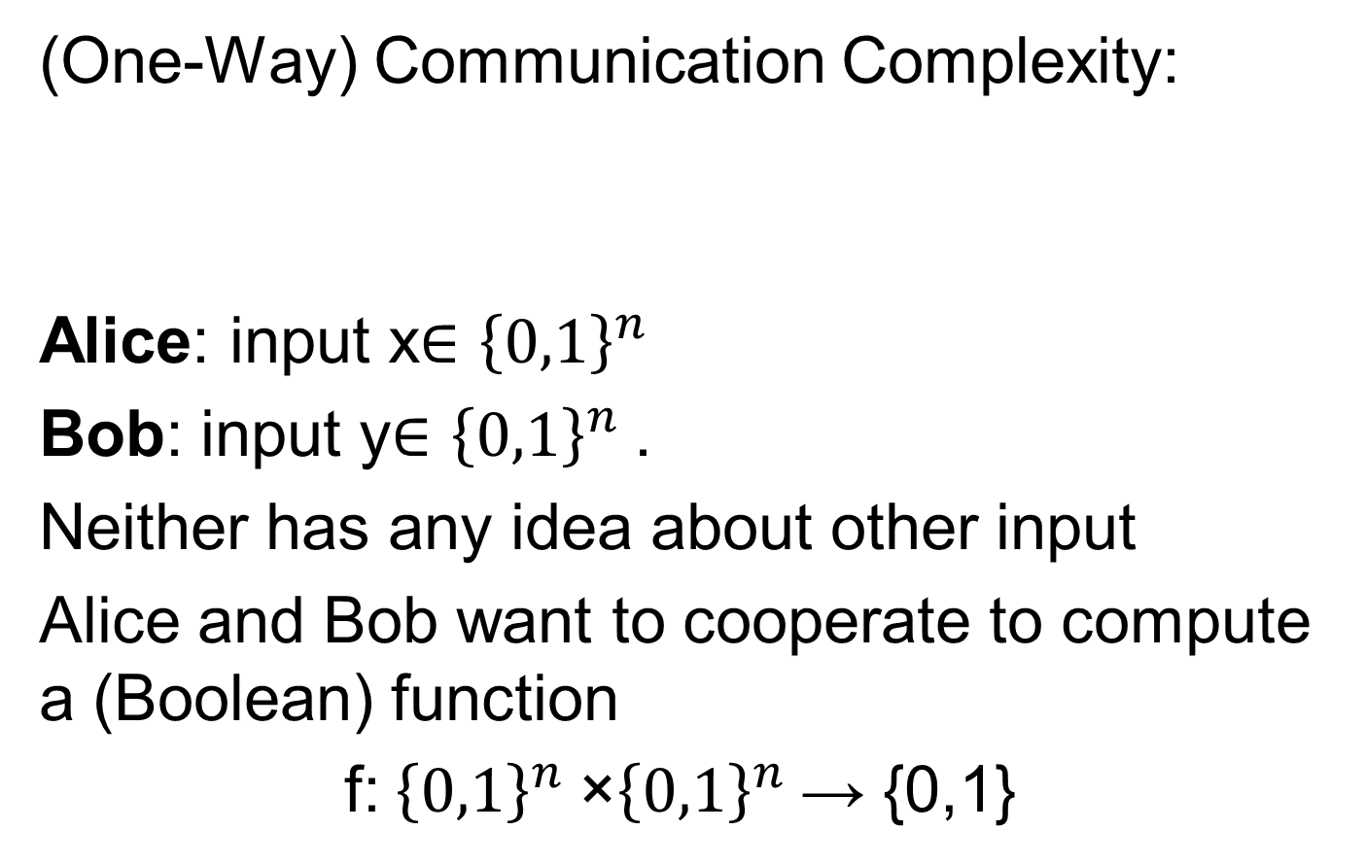
Set disjointness or Set Intersection
(One-Way) Communication Complexity:
Alice: input x∈ ${\left\{0,1\right\}}^{n}$
Bob: input y∈ ${\left\{0,1\right\}}^{n}$.
Neither has any idea about other input
Alice and Bob want to cooperate to compute a (Boolean) function
f: ${\left\{0,1\right\}}^{n}$×${\left\{0,1\right\}}^{n}$→ {0,1}
A
B

Slide 13
Connection to Streaming Algorithms
Small-space streaming algorithms imply low-communication 1-way protocols:
Alice and Bob treat their inputs as streams.
Alice sends to Bob the state when her input is over
Bob continues with the simulation
state
A
B

Slide 14
Disjointness
Alice and Bob: each gets n-bit vectors x and y.
  Characteristic vectors of two subsets of the universe {1,2,...,n}
  Boolean function DISJ of the corresponding subset
Claim: Every deterministic one-way communication protocol that computes DISJ requires n bits of communication in the worst case.

Slide 15
Disjointness
Alice and Bob: each gets n-bit vectors x and y.
  Characteristic vectors of two subsets of the universe {1,2,...,n}
  Boolean function DISJ is ‘1’ iff the corresponding subsets are disjoint.
Theorem: Every randomized protocol that for every input (x,y) correctly decides the function DISJ with probability at least 2/3, uses Ω(n) communication in the worst case

Slide 16
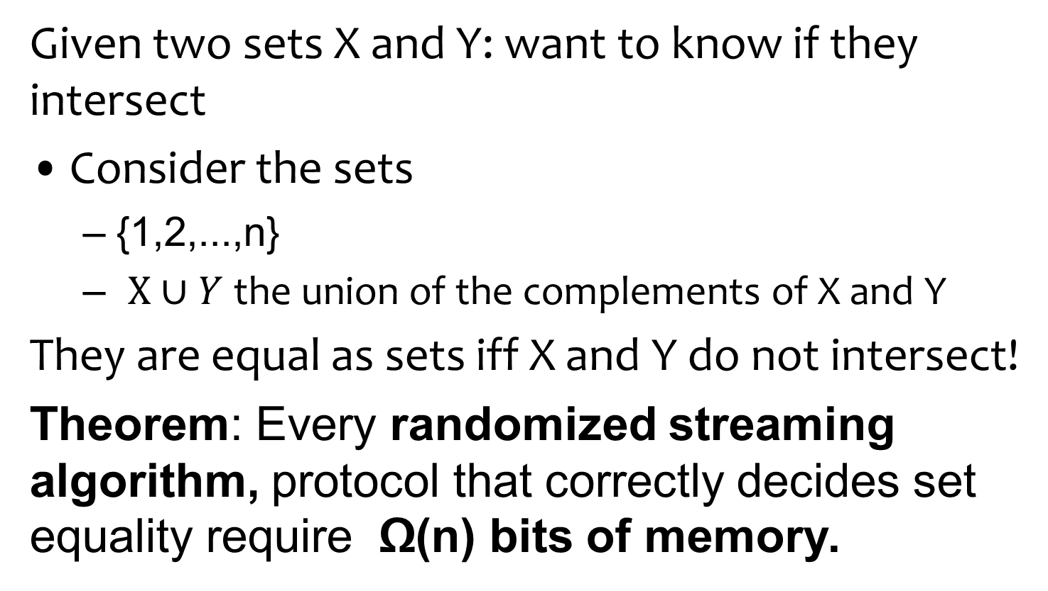
Lower bound for set equality through set equality
Given two sets X and Y: want to know if they intersect
Consider the sets
  {1,2,...,n}
  $X∪Y$ the union of the complements of X and Y
They are equal as sets iff X and Y do not intersect!
Theorem: Every randomized streaming algorithm, protocol that correctly decides set equality require Ω(n) bits of memory.

Slide 17
Streaming
Suppose you want to compute a function on a stream of data but do not have enough memory to store it
Which functions are computable?
What accuracy
Randomness essential
A
B

Slide 18
Example of a streaming problem: majority
An array/stream of length n, elements from domain of size u
Promise: there is a majority element, i.e. occurs strictly more than n/2 times.
A simple one-pass algorithm, maintaining only the current candidate majority element and a counter for it - Boyer Moore.

Slide 19
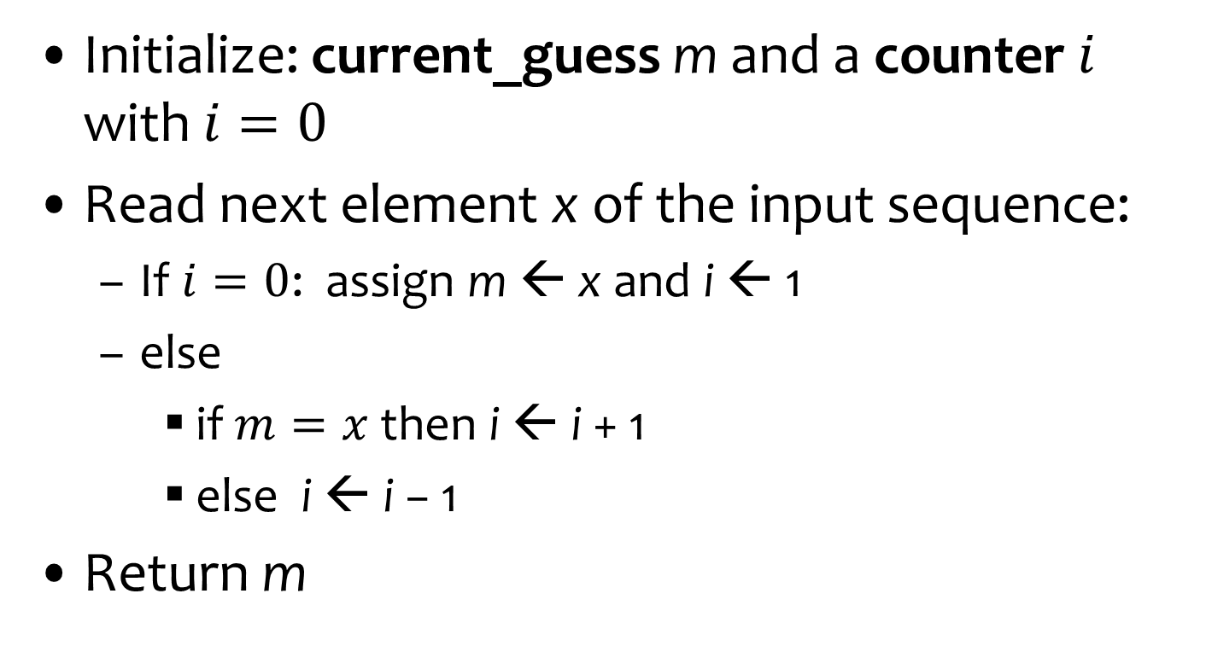
Boyer Moore Majority Algorithm
Initialize: current_guess m and a counter $i$ with $i=0$
Read next element x of the input sequence:
  If $i=0$: assign m ← x and i ← 1
  else
    if $m=x$then i ← i + 1
    else i ← i − 1
Return m
O(log n+ log u) bits
One of the few deterministic algorithms in the area
If a majority element exist, it is always returned

Slide 20
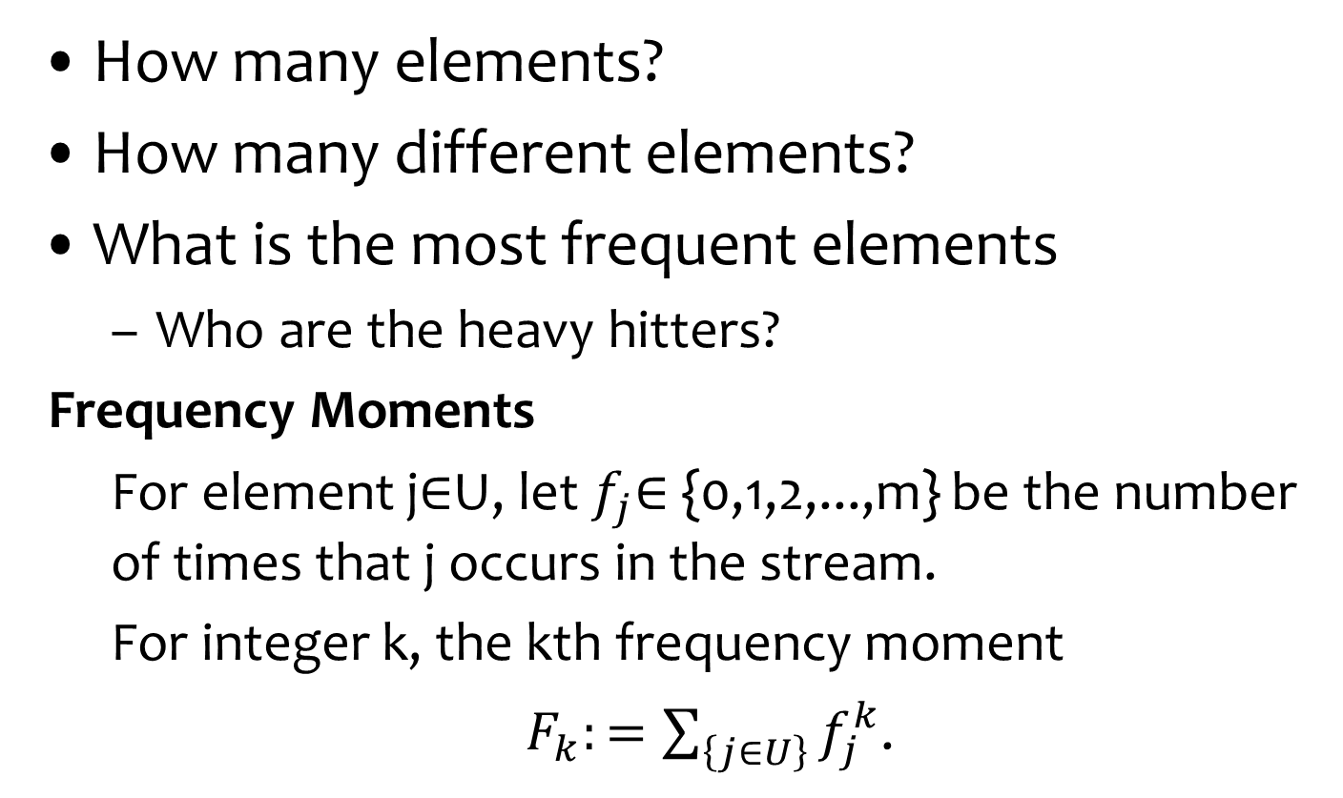
Computing on streams
How many elements?
How many different elements?
What is the most frequent elements
  Who are the heavy hitters?
Frequency Moments
  For element j∈U, let $f_{j}$∈ {0,1,2,...,m} be the number of times that j occurs in the stream.
  For integer k, the kth frequency moment
  $F_{k}:=\sum_{\left\{j∈U\right\}}{f_{j}^{k}}$.

Slide 21
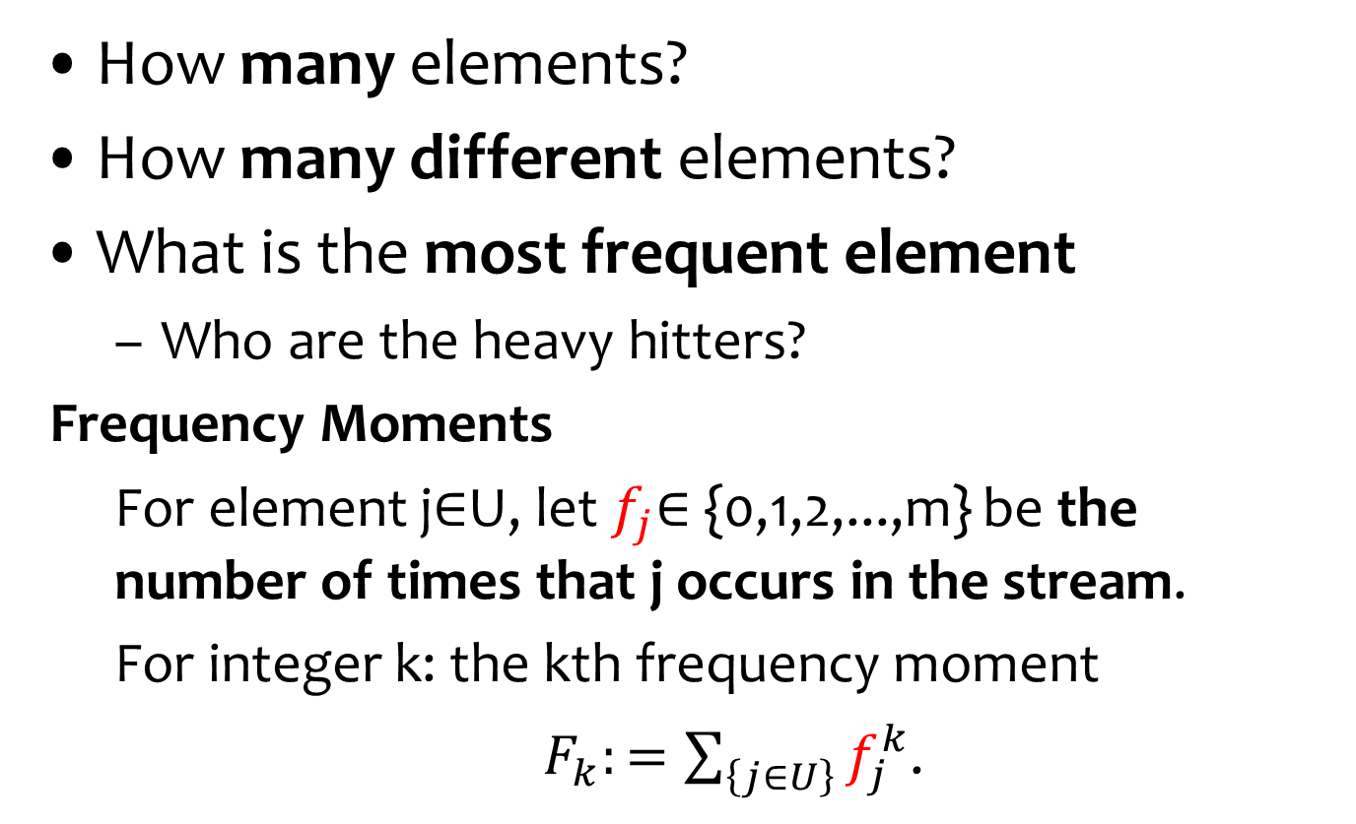
Computing on streams
How many elements?
How many different elements?
What is the most frequent element
  Who are the heavy hitters?
Frequency Moments
  For element j∈U, let $f_{j}$∈ {0,1,2,...,m} be the number of times that j occurs in the stream.
  For integer k: the kth frequency moment
  $F_{k}:=\sum_{\left\{j∈U\right\}}{f_{j}^{k}}$.

Slide 22
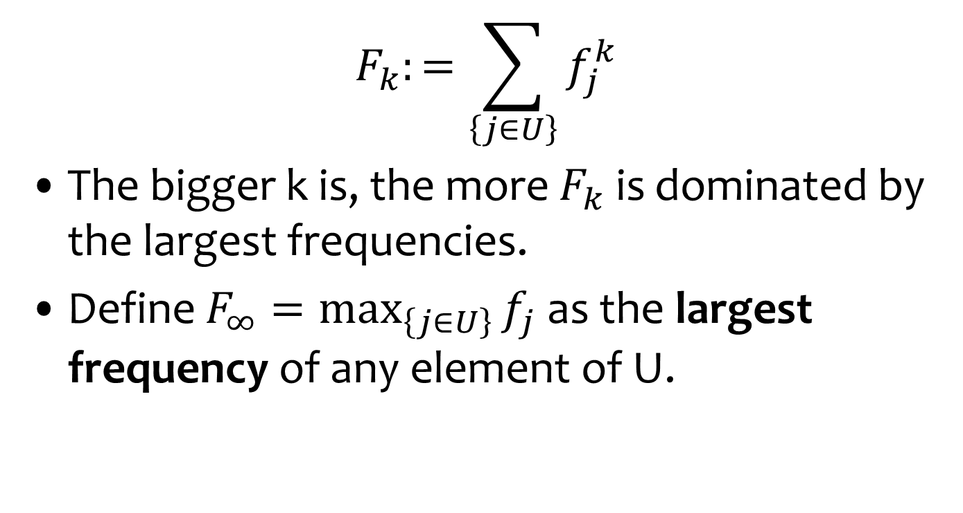
Frequency Moments
$$F_{k}:=\sum_{\left\{j∈U\right\}}{f_{j}^{k}}$$
The bigger k is, the more $F_{k}$ is dominated by the largest frequencies.
Define $F_{∞}=\max_{\left\{j∈U\right\}}{f_{j}}$ as the largest frequency of any element of U.

Slide 23
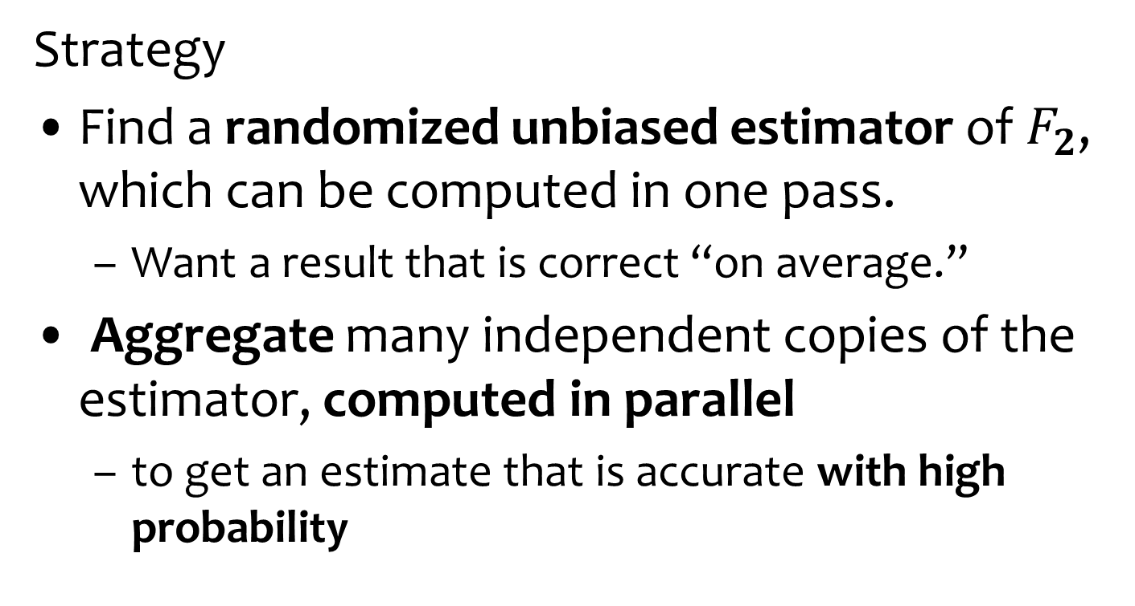

Estimating $F_{2}$
Strategy
Find a randomized unbiased estimator of $F_{2}$, which can be computed in one pass.
  Want a result that is correct “on average.”
Aggregate many independent copies of the estimator, computed in parallel
  to get an estimate that is accurate with high probability
How to aggregate?

Slide 24
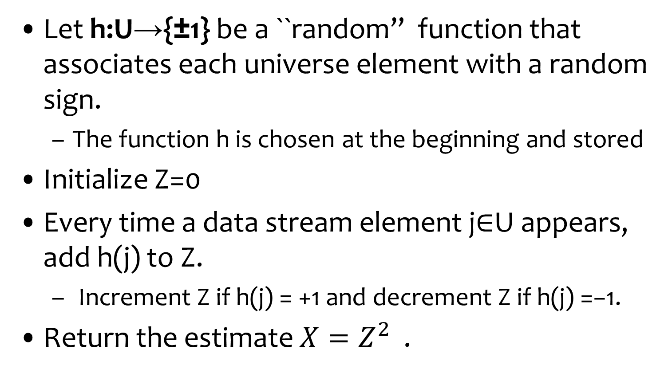

Estimating $F_{2}$
Should be independent of the stream.
We will see that 4-wise ind. Is enough
Let h:U→{±1} be a ``random” function that associates each universe element with a random sign.
  The function h is chosen at the beginning and stored
Initialize Z=0
Every time a data stream element j∈U appears, add h(j) to Z.
  Increment Z if h(j) = +1 and decrement Z if h(j) =−1.
Return the estimate $X=Z^{2}$ .

Slide 25
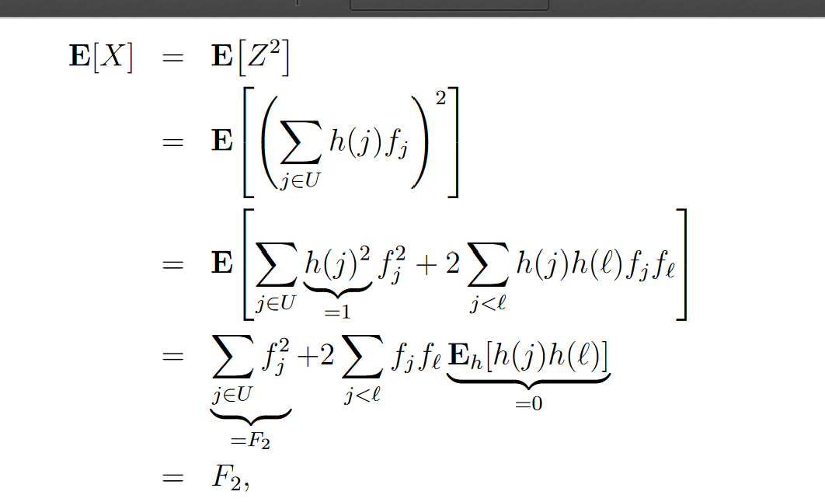

Good Estimator
Claim: For every data stream
$E_{h}$[X] =$F_{2}$
Linearity of
expectations
Ind. of the values of h
Pairwise is enough!

Slide 26
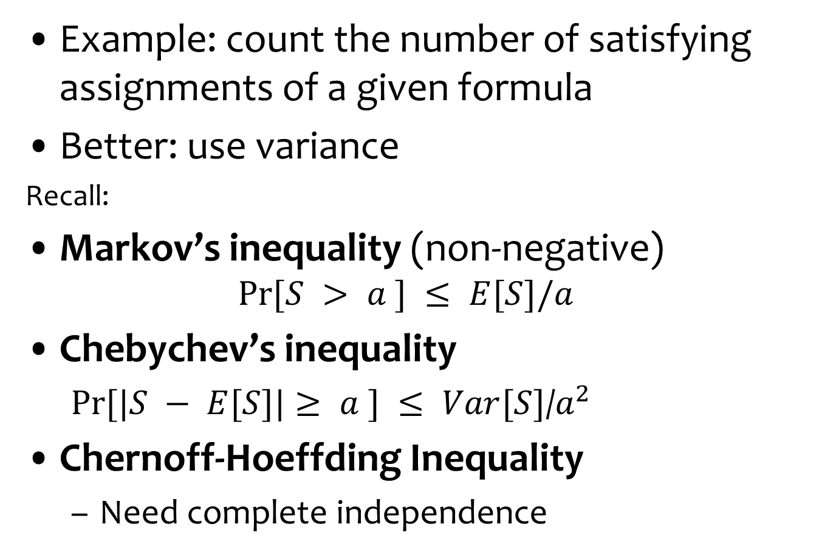
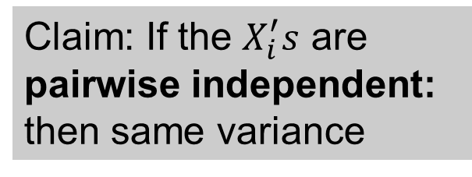
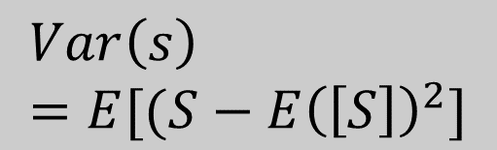
Are Great Expectations Good Enough?
Example: count the number of satisfying assignments of a given formula
Better: use variance
Recall:
Markov’s inequality (non-negative)
  $$Pr⁡[S > a ] ≤ E[S]/a$$
Chebychev’s inequality
  $Pr⁡[|S − E[S]|≥ a ] ≤ Var[S]$/$a^{2}$
Chernoff-Hoeffding Inequality
  Need complete independence
$$Var\left(s\right)=E[(S−E{\left(\left[S\right]\right)}^{2}]$$
Claim: If the $X_{i}^{′}s$ are pairwise independent: then same variance

Slide 27
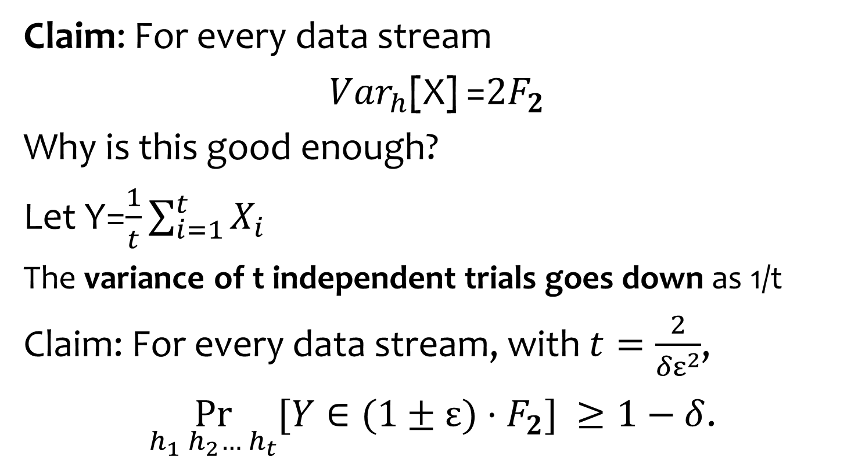
Good Variance
Claim: For every data stream
${Var}_{h}$[X] =${2F}_{2}$
Why is this good enough?
Let Y=$\frac{1}{t}\sum_{i=1}^{t}{X_{i}}$
The variance of t independent trials goes down as 1/t
Claim: For every data stream, with $t=\frac{2}{{δε}^{2}}$,
$\underset{h_{1} h_{2}… h_{t}}{Pr}{[Y∈(1±ε)·F_{2}]} ≥1−δ$.
4-wise independence
sufficient

Slide 28
k-wise independence
Approach: use k-wise independence for smallest k possible
Definition: A family H of hash functions is k-wise
independent if for any distinct x₁,...,x_{k}∈U and for
any y₁,...,y_{k}∈[0,...,m-1]:
Pr [h(x₁)=y₁ ^ h(x₂)=y₂ ^ ... ^ h(x_{k})=y_{k}] = 1/m^{k}
_{h∈H}

Slide 29
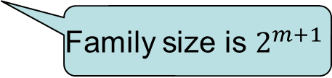
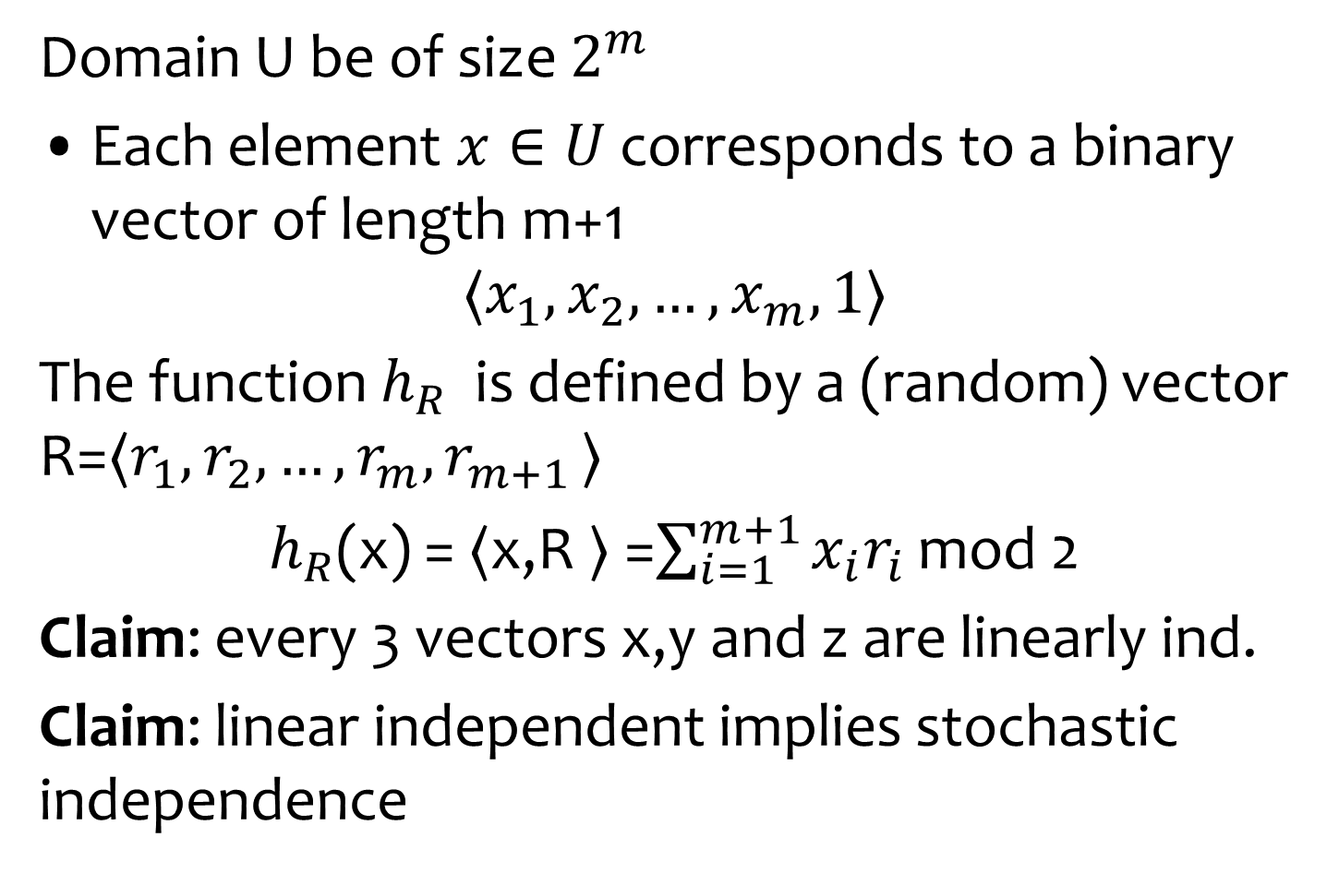
Constructing 3-wise independence
Domain U be of size $2^{m}$
Each element $x∈U$ corresponds to a binary vector of length m+1
$$〈x_{1},x_{2}, …, x_{m},1〉$$
The function $h_{R}$ is defined by a (random) vector R=$〈r_{1},r_{2}, …, r_{m}{,r}_{m+1}〉$
$h_{R}$(x) = $〈$x,R $〉$ =$\sum_{i=1}^{m+1}{x_{i}r_{i}}$ mod 2
Claim: every 3 vectors x,y and z are linearly ind.
Claim: linear independent implies stochastic independence
Family size is $2^{m+1}$

