Slide 1
Deep Neural Networks:
A Hands on Challenge
Course goals
Meeting times and structure
Slack: https://dnn-challenge.slack.com
Data handling
Infrastructure
  Python, Pandas, Tensorflow, Compute cluster
TAs:
  Hadar Gorodissky: gorohadar@gmail.com
  Niv Haim: nivhaa@gmail.com

Slide 2
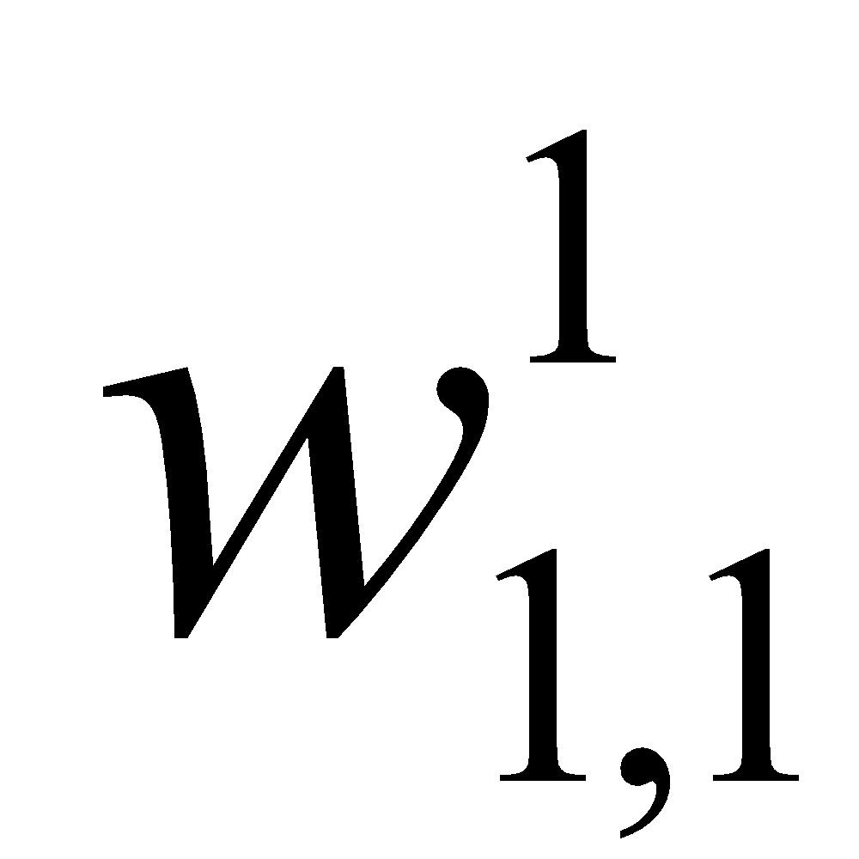
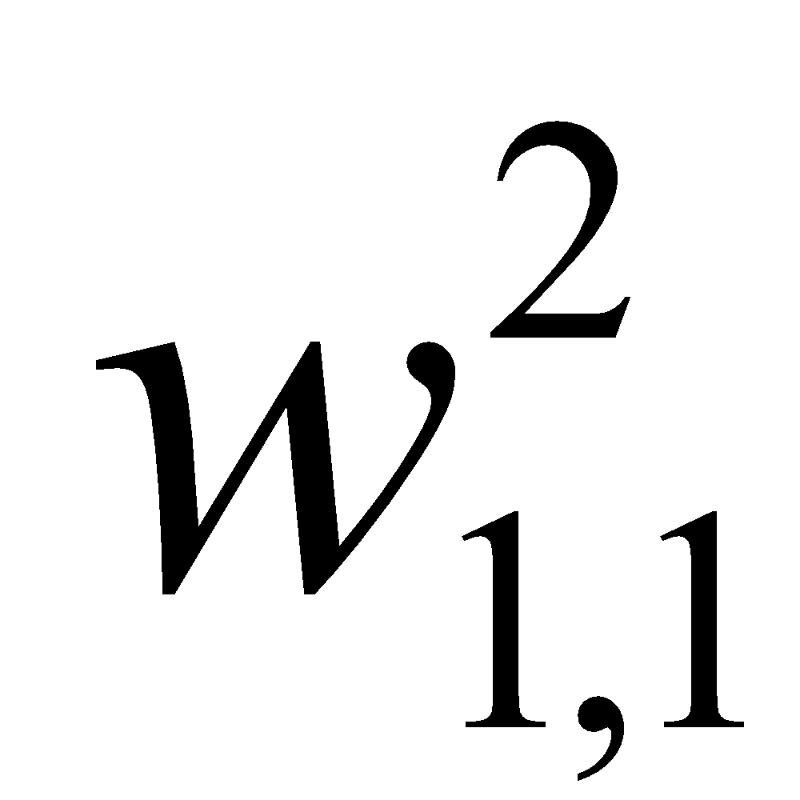
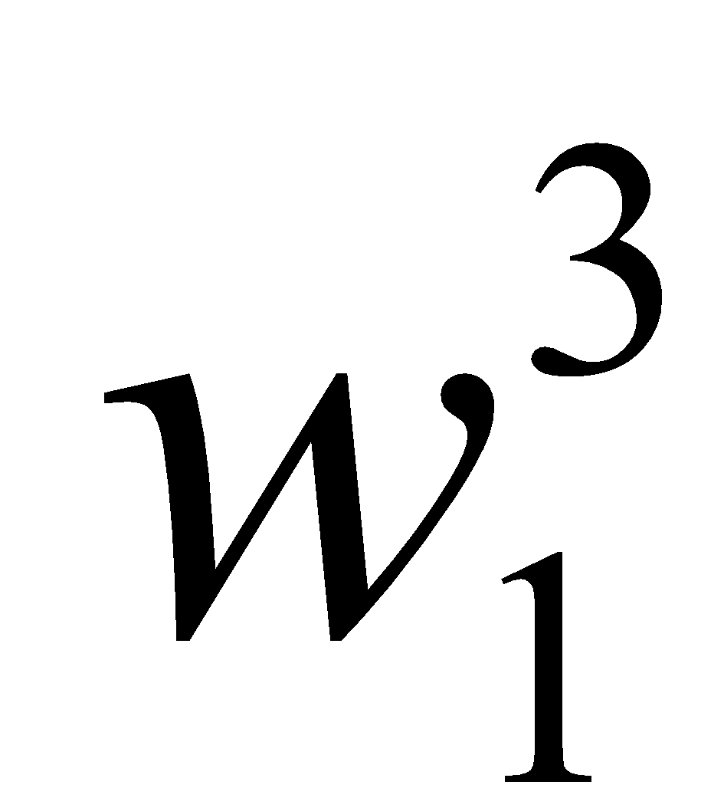

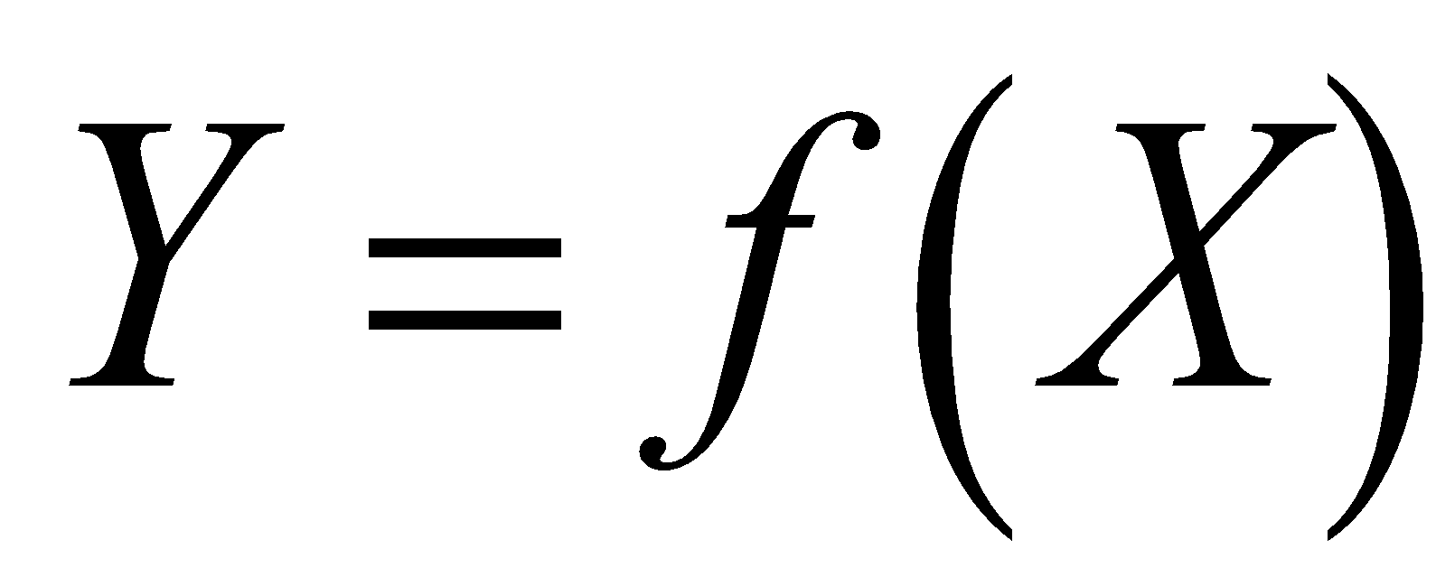
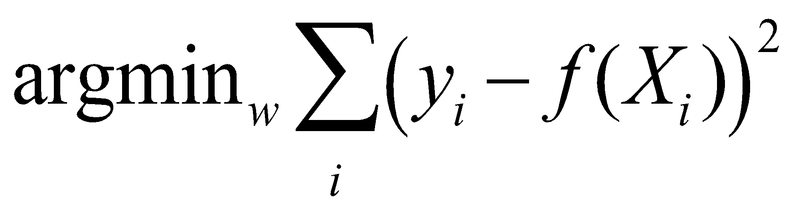
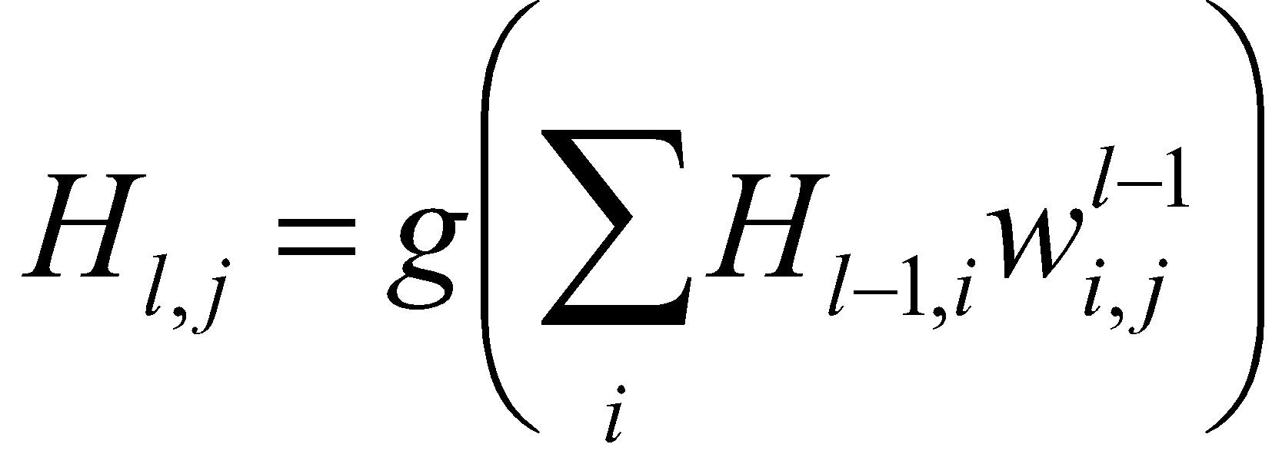
Neural networks
X₁
H_{1,1}
H_{2,1}
X₂
X₃
H_{1,2}
H_{2,2}
Y
X₄
H_{1,3}
H_{2,3}
X₅
Network computation:
Objective function (L2):
Node computation
(g: activation function):

Slide 3
Course topics
Data statistics
Data preprocessing & feature generation
Neural network optimization
  Hyper parameters (activation functions, dropout, learning rate, etc.)
  Optimization methods
  Data augmentation
  Network architecture
  Batch normalization
  Layer normalization
  Stochastic deep networks
  Regularization
  Deep & wide networks
  Auto encoders
  Ensembles

Slide 4
The challenge
Predict future change in glucose levels using
  Personal features
  Previous glucose data
  Events (meals, sleep, exercise)

Slide 5
DataFrames
  ConnectionToUser.df
GlucoseValues.df
Personal parameters
  BloodTests.df
  BacterialSpecies.df
  Measurements.df
Events
  TestFoods.df
  Exercises.df
  Meals.df
  Sleep.df

Slide 6
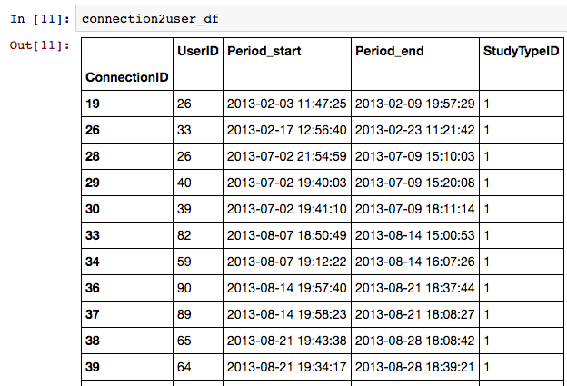
ConnectionToUser

Slide 7
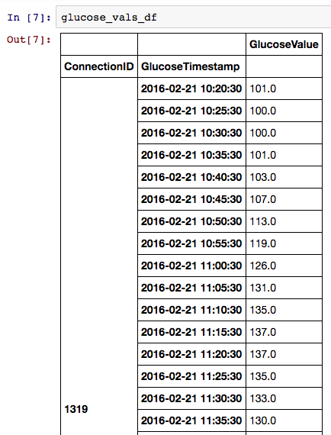
Glucose Values

Slide 8
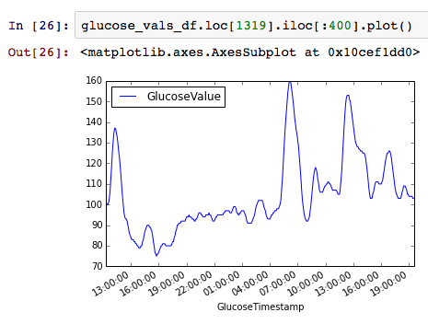
Glucose Values

Slide 9
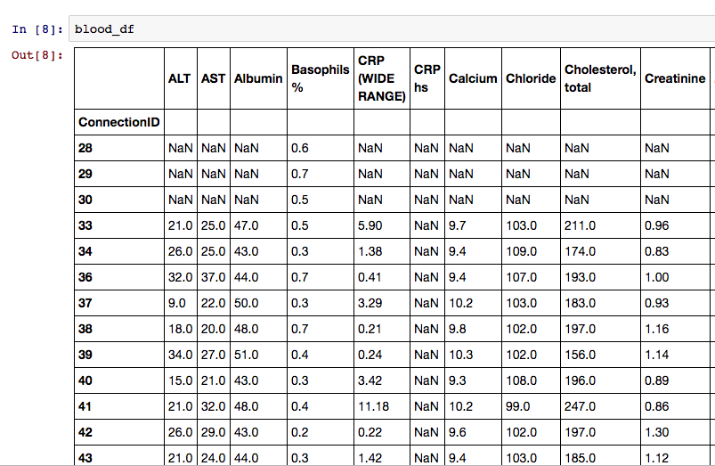
Blood Tests

Slide 10
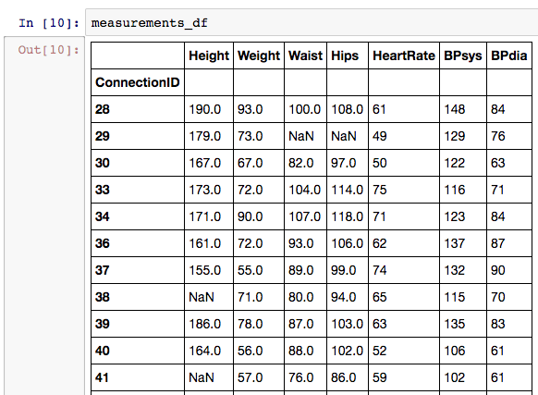
Measurements

Slide 11
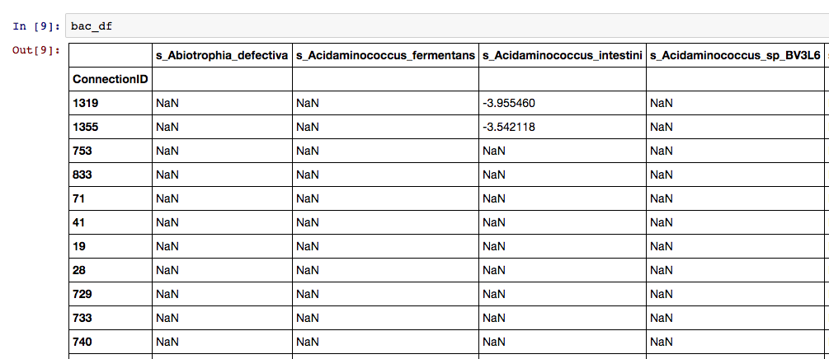
Bacterial Species

Slide 12
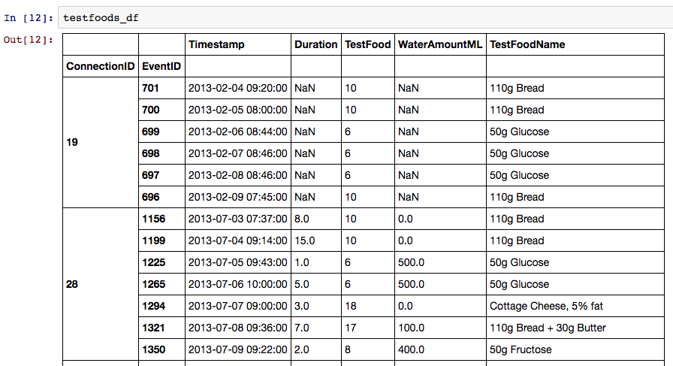
TestFoods

Slide 13
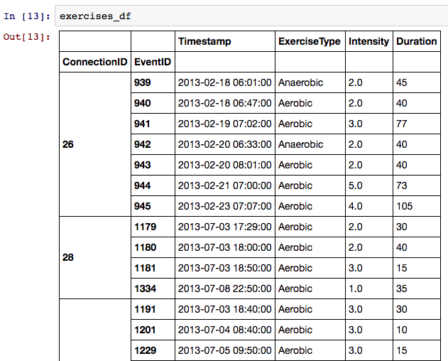
Exercises

Slide 14
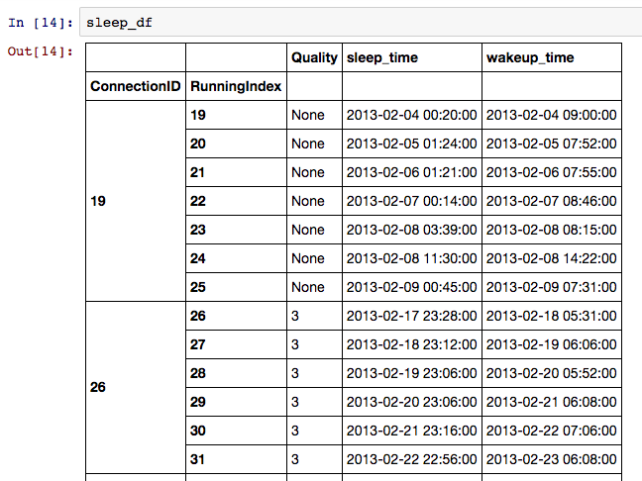
Sleep

Slide 15
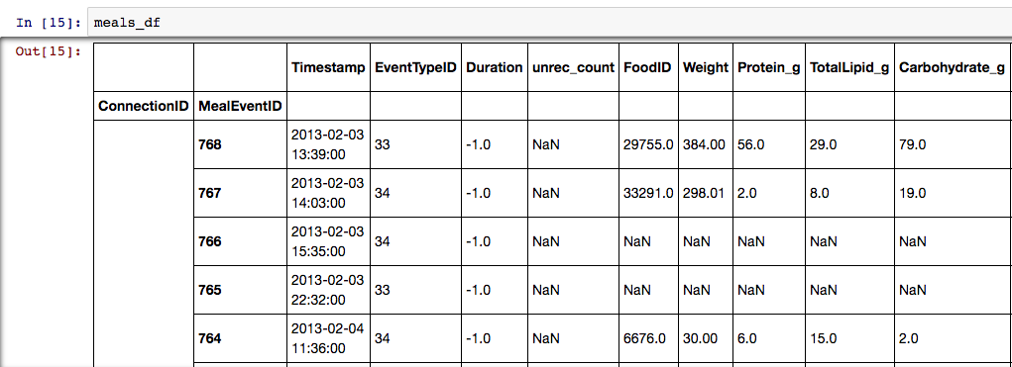
Meals

Slide 16
Features
Personal parameters
  Dimensionality reduction (auto encoding, PCA)
Lags
  Avg / Min / Max / Sum over features

Slide 17
Technical Review
Python (Anaconda, PyCharm)
Jupyter
Pandas
Tensorflow

Slide 18
Python
We’ll work with Python 3
Download&Install Anaconda
  “leading open data science platform powered by Python” (c)
  Includes all major scientific packages, jupyter, ipython, pandas, etc.
  (download page)
IDE: I recommend PyCharm

Slide 19
Jupyter Pandas walkthrough
“The Jupyter Notebook is a web application that allows you to create and share documents that contain live code, equations, visualizations and explanatory text.” (c)
“pandas library - providing high-performance, easy-to-use data structures and data analysis tools for the Python” (c)
Short Walkthrough
Gazillions of tutorials online: 1, 2, 3

Slide 20
Jupyter from your folder
Start Jupyter from your folder:
  Make a shortcut file in your folder (or copy jupyter-notebook shortcut from start menu)
  Change Target to: jupyter notebook
  Change Start-in to current folder
(ref here)

Slide 21
Tensorflow
Represents computations as graphs
  Nodes = operations
  Sum, multiplication, relu, etc.
Executes graphs - Sessions
  translates the graph definition into executable operations
  Interactive session
Represents data as tensors
Variables
  maintain state across executions of the graph
  e.g. Weights
Feeds
  Placeholder - input

Slide 22
Given Code
Vanilla net
Predictor
test script (test+val 1 and test+val 2)

Slide 23
Weizmann Cluster – General Flow
Connect to a workstation - Putty
get a GUI using VNC
Connect to a cluster machine via the workstation
Do some work ☺
For many more details, please visit: http://math96-lx/

Slide 24
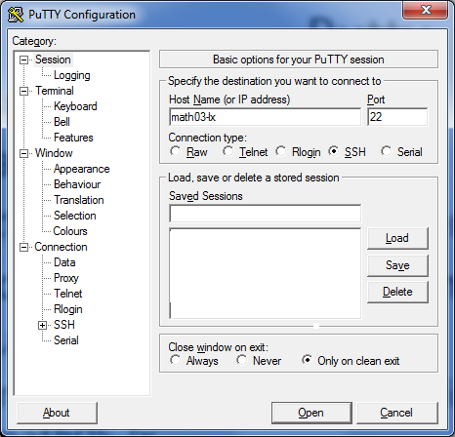

Step 1 – workstation
Lunch Putty - a windows SSH client (standart port : 22)
Host: math05-lx or 13,14,15
In terminal window enter user name and password

Slide 25
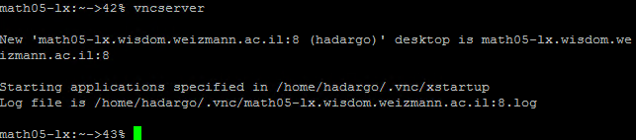
Step 2 : VNC server
Remote connection to a desktop
Install UltraVNC or TurboVNC on windows machine
Start in the terminal vncserver
  >vncserver
  >vncserver –geometry <1280>x<1024>
Get a port number

Slide 26
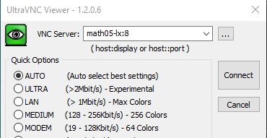
Step 2 : VNC server
Run VNC from windows machine
Plug in : math03-lx:number
Closing a VNC viewer will not end your session!
>vncserver –kill :N (terminal)

Slide 27
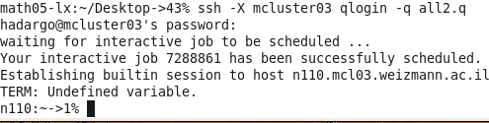
Step 3 – connect to cluster
Open a terminal
The machines on the cluster are split into different queues
request a cluster machine from one of the queues
>ssh -X mcluster03
>qlogin -q all2.q

Slide 28
Step 4 – Do some work
Set environment
      setenv LD_LIBRARY_PATH
      /usr/local/cuda/lib64:/usr/local/lib:/usr/local/lib64:/usr/local/cudnn-v5/lib64
      setenv PYTHONPATH “/usr/wisdom/python3_ext:/usr/wisdom/python3"
      setenv PATH /usr/wisdom/python3/bin:$PATH
      setenv CUDA_HOME /usr/local/cuda/lib64
      setenv DISPLAY math<NUMBER>-lx:<PORT>
      unsetenv http_proxy
** We changes the bold line at March 6, 2017 – make sure to use this line instead of the old one. .

Slide 29
Step 4 – Do some work
Start Jupyter
>/usr/bin/firefox &
>jupyter notebook
make sure firefox is installed (if not - ask Amir Gonen)
useful - copy commands from pc - vncconfig

Slide 30
Slack
Use it
Help each other

Slide 31
Home work
Tutorials : tensorflow, pandas,..
Connect to cluster : open jupyter, import tensorflow, run the vanilla net
Convince yourselves that the data is correct - play with it

