Slide 1
Dnn Challenge
Final Class
10/09/2017

Slide 2
Data Sets
1000 connection Ids
Days 1-7
800 connection Ids
Days 1-7
100 connection Ids
Days 1-7
100 connection Ids
Days 1-7
Test 1
Val 1
800 connection Ids
Days 1-6
400 connection Ids
day 7
400 connection Ids
day 7
Train
Test 2
Val 2

Slide 3
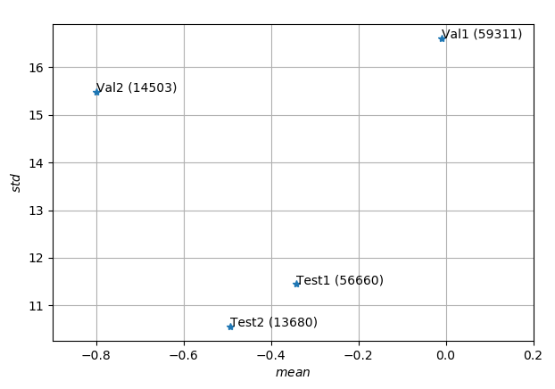
Data Sets
** Testsets were cleaned to include quantiles 2.5%-97.5% (according to glucose levels)

Slide 4
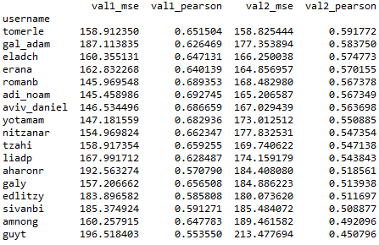
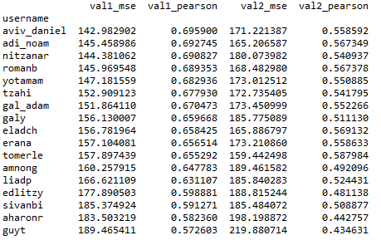
Validation Scores

Slide 5
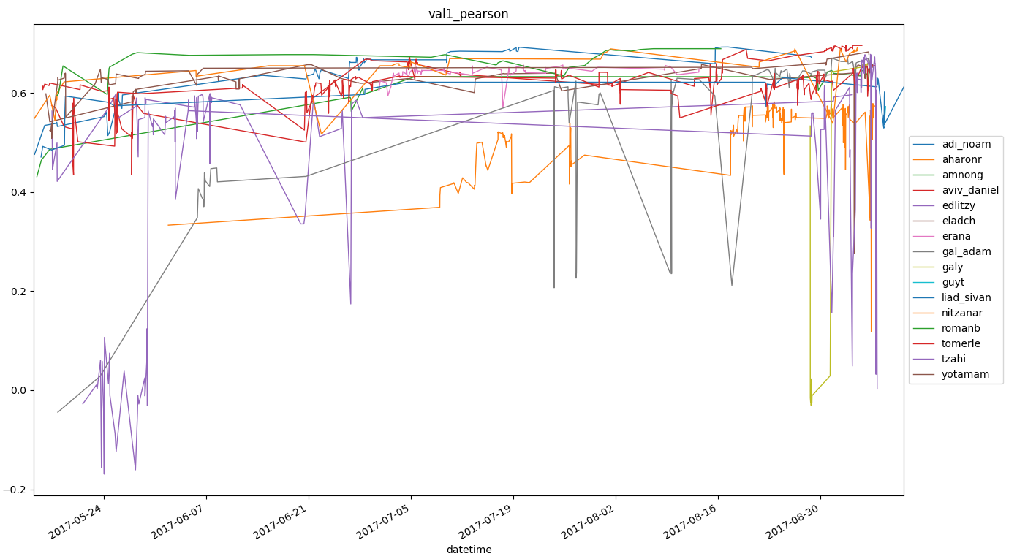
Evolution of Scores

Slide 6
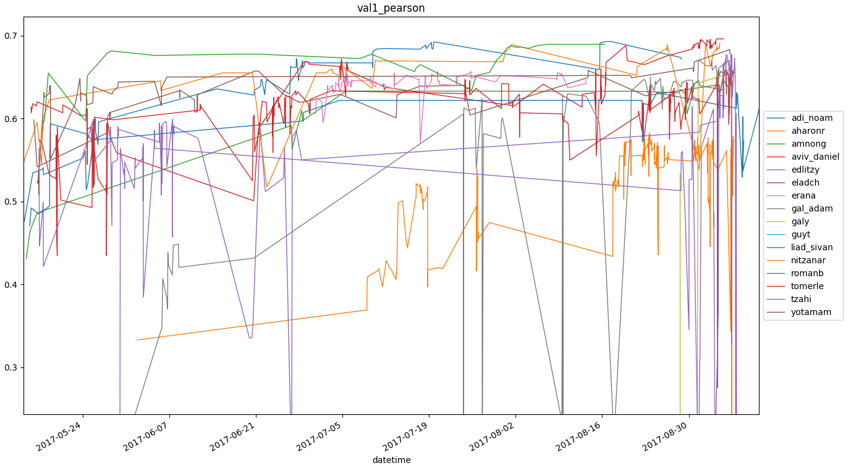

Slide 7
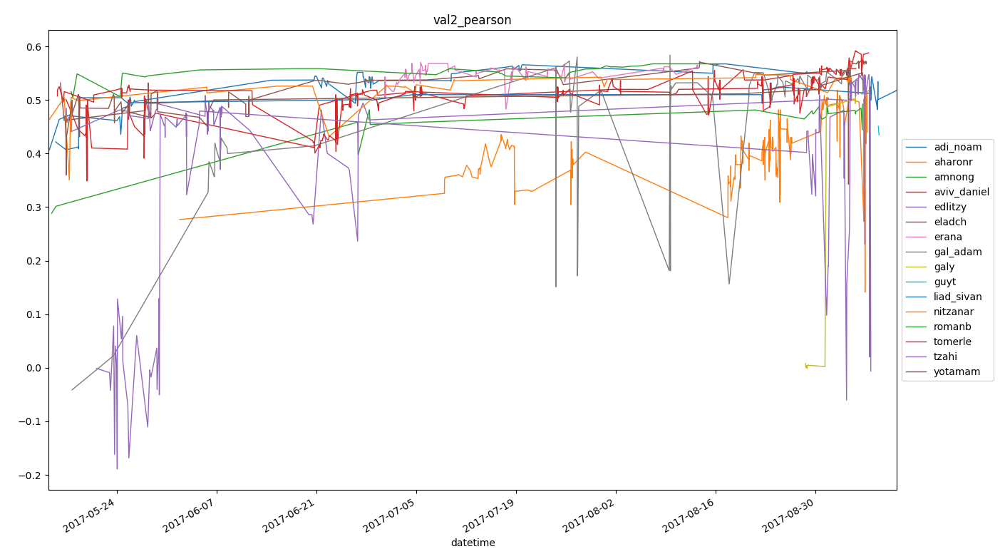
Evolution of Scores

Slide 8
Test Scores
Set 1
Set 2

Slide 9
Test Scores

Slide 10
