Slide 1
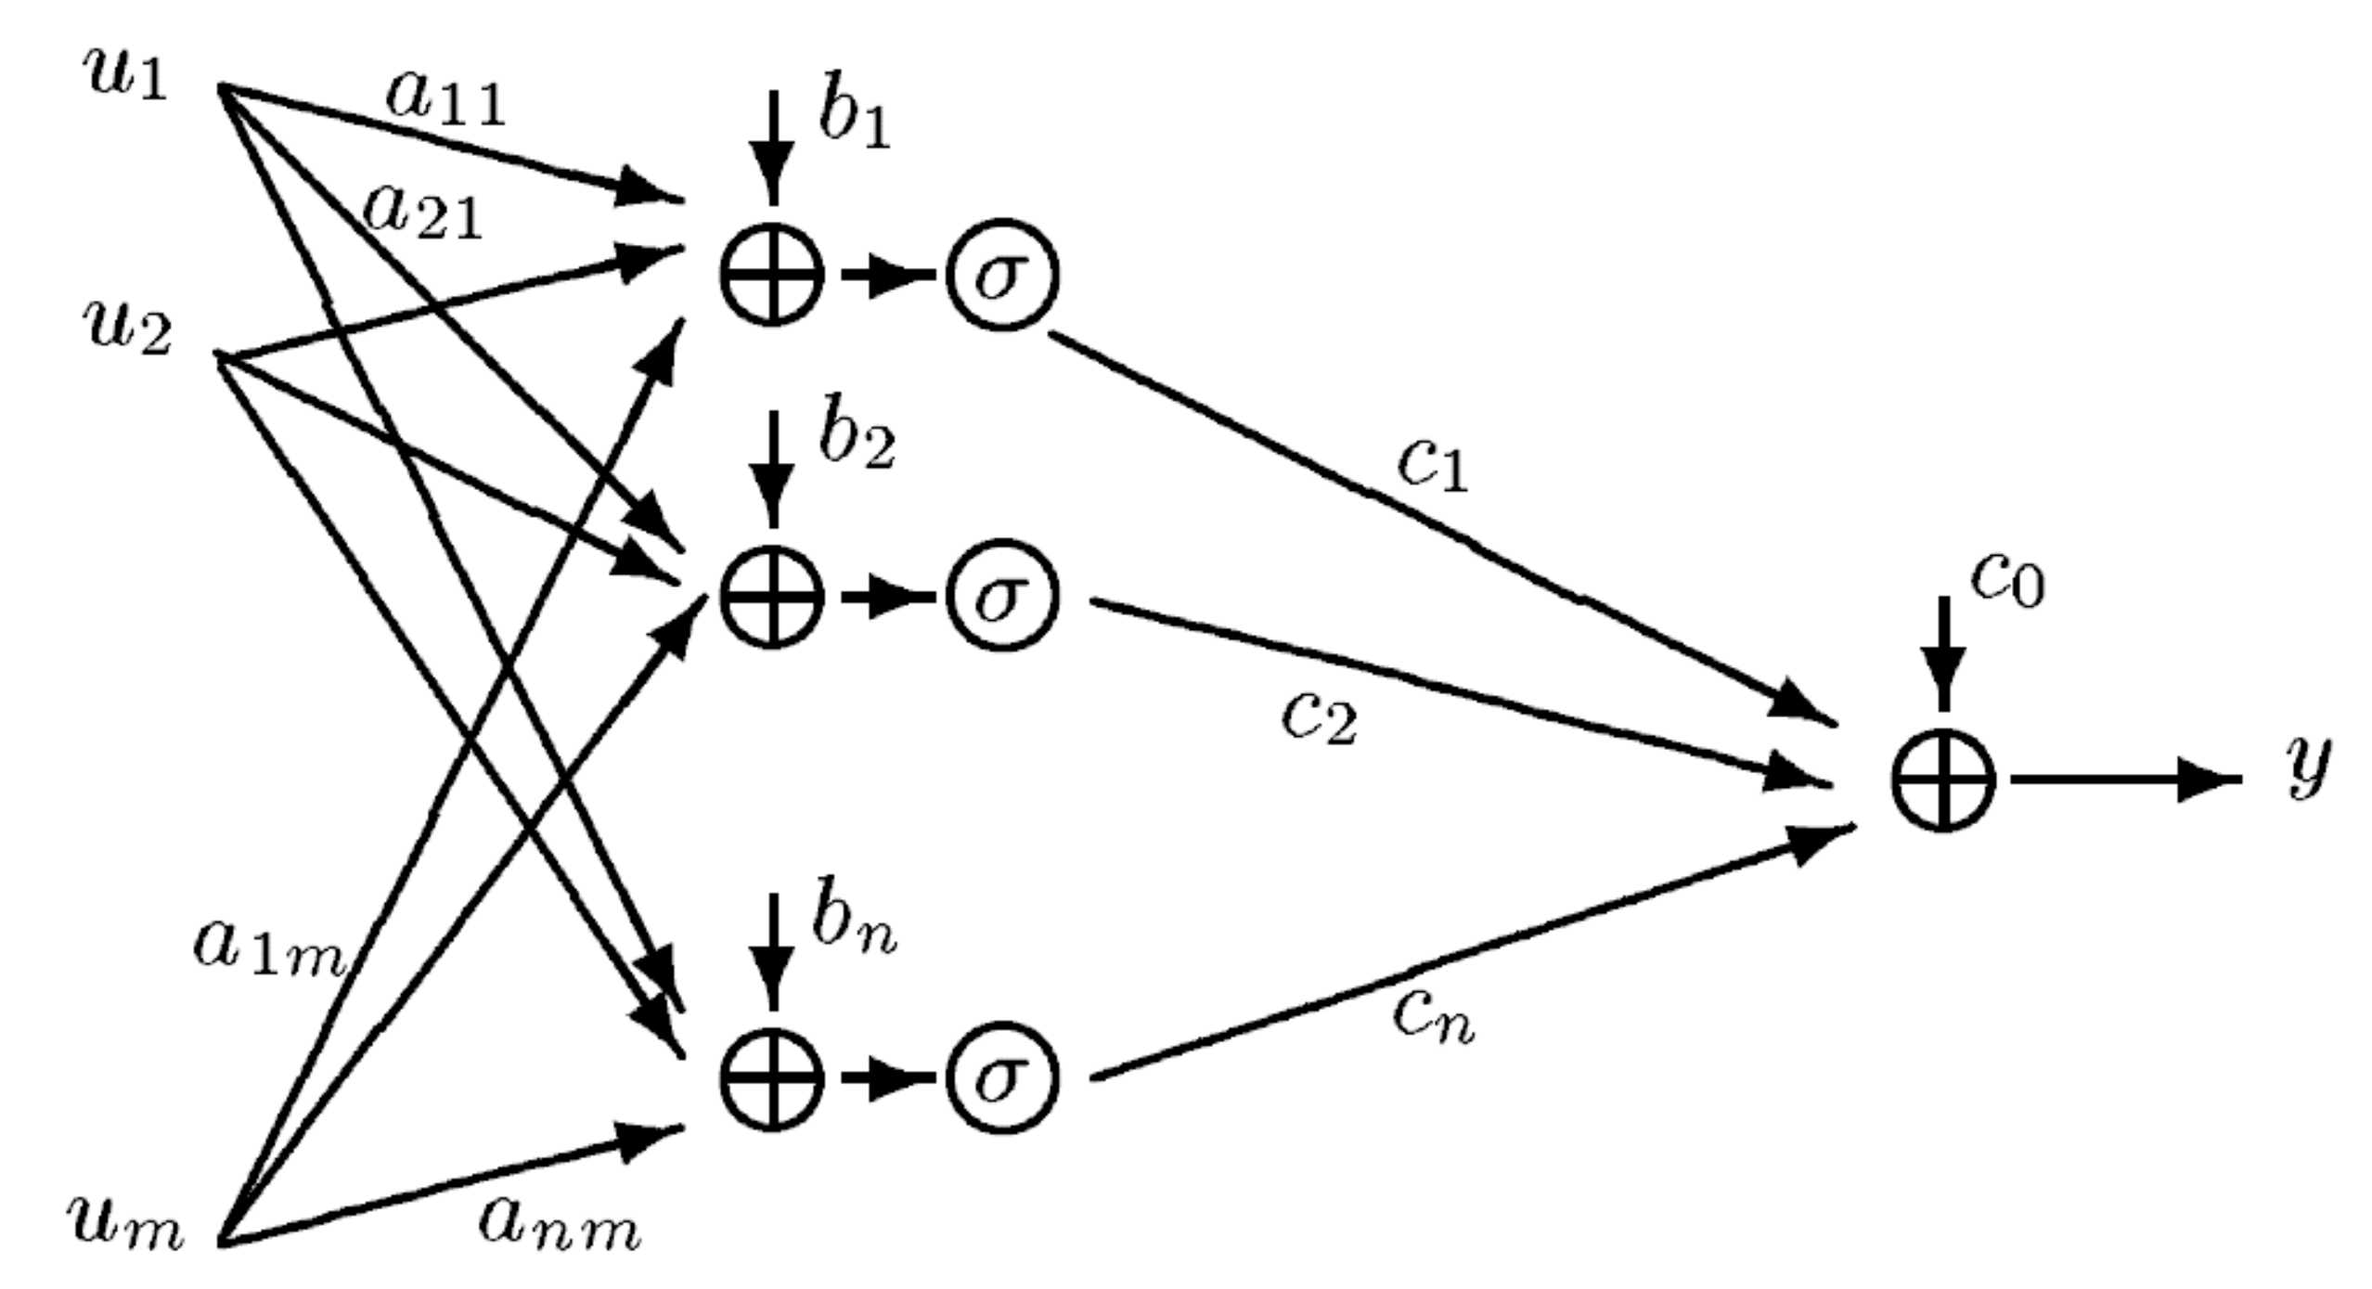
VC Dimension of Neural Nets
Liran Szlak & Shira Kritchman

Slide 2
Outline
VC dimension
VC dimension & Sample Complexity
VC dimension & Generalization
VC dimension in neural nets
Fat-shattering – for real valued neural nets
Experiments

Slide 3
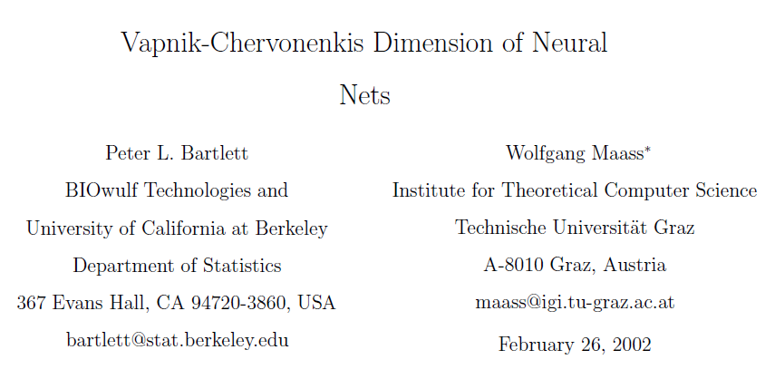
Part I: VC Dimension Theory

Slide 4
Motivation
Last week:
Any continuous function can be approximated by a neural net with 1 hidden layer!*
* Under some restrictions on $σ$

Slide 5
Motivation
What property makes a learning model good?
Can we learn from a finite sample?
How many examples do we need to be good?
How to choose a good model?

Slide 6
Hypothesis Class
An hypothesis class H is a set of models
b
$$sign(w^{T}x+b)$$
$$sign(x−b)$$
$$sign(x^{2}−b)$$

Slide 7
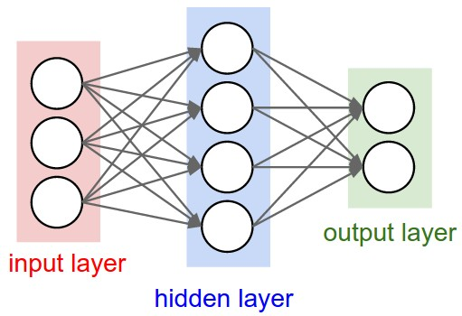
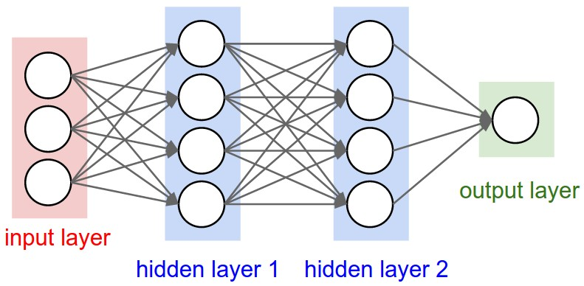
Neural Nets Hypothesis Class

Slide 8
VC Dimension – Shattering
An Hypothesis class H shatters a set of points $x_{1},x_{2},…,x_{m}∈U$ iff for every $y_{1},y_{2},…,y_{m}∈{\left\{−1,1\right\}}^{m}$, there exists $h∈H$ s.t. $∀i:h\left(x_{i}\right)=y_{i}$
$$H=\{sign\left(w^{T}x+b\right):w∈ℝ^{2}, b∈ℝ\}$$

Slide 9
VC Dimension – Shattering
An Hypothesis class H shatters a set of points $x_{1},x_{2},…,x_{m}∈U$ iff for every $y_{1},y_{2},…,y_{m}∈{\left\{−1,1\right\}}^{m}$, there exists $h∈H$ s.t. $∀i:h\left(x_{i}\right)=y_{i}$
$$H=\{sign\left(w^{T}x+b\right):w∈ℝ^{2}, b∈ℝ\}$$

Slide 10
VC Dimension – Shattering
An Hypothesis class H shatters a set of points $x_{1},x_{2},…,x_{m}∈U$ iff for every $y_{1},y_{2},…,y_{m}∈{\left\{−1,1\right\}}^{m}$, there exists $h∈H$ s.t. $∀i:h\left(x_{i}\right)=y_{i}$
$$H=\{sign\left(w^{T}x+b\right):w∈ℝ^{2}, b∈ℝ\}$$

Slide 11
VC Dimension – Shattering
An Hypothesis class H shatters a set of points $x_{1},x_{2},…,x_{m}∈U$ iff for every $y_{1},y_{2},…,y_{m}∈{\left\{−1,1\right\}}^{m}$, there exists $h∈H$ s.t. $∀i:h\left(x_{i}\right)=y_{i}$
$$H=\{sign\left(w^{T}x+b\right):w∈ℝ^{2}, b∈ℝ\}$$

Slide 12
VC Dimension – Shattering
An Hypothesis class H shatters a set of points $x_{1},x_{2},…,x_{m}∈U$ iff for every $y_{1},y_{2},…,y_{m}∈{\left\{−1,1\right\}}^{m}$, there exists $h∈H$ s.t. $∀i:h\left(x_{i}\right)=y_{i}$
$$H=\{sign\left(w^{T}x+b\right):w∈ℝ^{2}, b∈ℝ\}$$

Slide 13
VC Dimension – Shattering
An Hypothesis class H shatters a set of points $x_{1},x_{2},…,x_{m}∈U$ iff for every $y_{1},y_{2},…,y_{m}∈{\left\{−1,1\right\}}^{m}$, there exists $h∈H$ s.t. $∀i:h\left(x_{i}\right)=y_{i}$
$$H=\{sign\left(w^{T}x+b\right):w∈ℝ^{2}, b∈ℝ\}$$

Slide 14
VC Dimension – Shattering
An Hypothesis class H shatters a set of points $x_{1},x_{2},…,x_{m}∈U$ iff for every $y_{1},y_{2},…,y_{m}∈{\left\{−1,1\right\}}^{m}$, there exists $h∈H$ s.t. $∀i:h\left(x_{i}\right)=y_{i}$
$$H=\{sign\left(w^{T}x+b\right):w∈ℝ^{2}, b∈ℝ\}$$

Slide 15
VC Dimension – Shattering
An Hypothesis class H shatters a set of points $x_{1},x_{2},…,x_{m}∈U$ iff for every $y_{1},y_{2},…,y_{m}∈{\left\{−1,1\right\}}^{m}$, there exists $h∈H$ s.t. $∀i:h\left(x_{i}\right)=y_{i}$
$$H=\{sign\left(w^{T}x+b\right):w∈ℝ^{2}, b∈ℝ\}$$

Slide 16
VC Dimension – Definition
The VC-Dimension of an hypothesis class H is the maximum number of points that can be shattered by H
$$VC\left(H\right)=sup⁡\{\left|S\right|:S is shattered by H\}$$
There exists a set S of size VC(H) that is shattered by H
No set of size > VC(H) can be shattered by H
Vapnik & Chervonenkis, 1971

Slide 17
VC Dimension – Open Intervals
Infinite open intervals or the empty set
$H=\{1_{x∈I}:I=\left(a,∞\right) or I=\left(−∞,a\right) or I=∅\}$
$$∅$$
$$VC\left(H\right)≥2$$

Slide 18
VC Dimension – Open Intervals
Infinite open intervals or the empty set
$H=\{1_{x∈I}:I=\left(a,∞\right) or I=\left(−∞,a\right) or I=∅\}$
$$⇒VC\left(H\right)=2$$

Slide 19
VC Dimension – Convex Sets
All convex sets in $ℝ^{2}$
$$H=\{1_{x∈C} :C is a convex set in ℝ^{2}\}$$

Slide 20
VC Dimension – Convex Sets
All convex sets in $ℝ^{2}$
$$H=\{1_{x∈C} :C is a convex set in ℝ^{2}\}$$

Slide 21
VC Dimension – Convex Sets
All convex sets in $ℝ^{2}$
$$H=\{1_{x∈C} :C is a convex set in ℝ^{2}\}$$
$$⇒VC\left(H\right)=∞$$

Slide 22
VC Dimension – Linear Halfspaces in $ℝ^{2}$
We saw we can shatter 3 points before

Slide 23
VC Dimension – Linear Halfspaces in $ℝ^{2}$
We saw we can shatter 3 points before
No set of 4 points can be shattered

Slide 24
VC Dimension – Linear Halfspaces in $ℝ^{2}$
We saw we can shatter 3 points before
No set of 4 points can be shattered
$$⇒VC\left(H\right)=3$$

Slide 25
VC Dimension – Linear Halfspaces in $ℝ^{n}$
$H=\{sign\left(w^{T}x \right) :w∈ℝ^{n}\}$
Claim: $\text{VC}\text{(}\text{H}\text{) }\text{= }\text{n}$
Proof:
$VC\left(H\right)≥n$
$VC\left(H\right)≤n$

Slide 26
VC Dimension – Linear Halfspaces in $ℝ^{n}$
$H=\{sign\left(w^{T}x \right) :w∈ℝ^{n}\}$
$VC\left(H\right)≥n$
Take the following set of n points in $ℝ^{n}$:
x₁ = (1,0,0,…,0)
x₂ = (0,1,0,…,0)
:
x_{n} = (0,0,0,…,1)
Let y₁, y₂,… y_{n} , be any one of the 2^{n} combinations of class labels

Slide 27
VC Dimension – Linear Halfspaces in $ℝ^{n}$
$H=\{sign\left(w^{T}x \right) :w∈ℝ^{n}\}$
$VC\left(H\right)≥n$
Set $w_{i}=y_{i}$ for all i !
$$\left(y_{1},y_{2},…,y_{n}\right)\left({0 \atop \begin{aligned}\begin{aligned}0 \\ ⋮\end{aligned} \\ 1 \\ ⋮ \\ 0\end{aligned}}\right)$$
i
$$= y_{i}$$
w
$$x_{i}$$

Slide 28
VC Dimension – Linear Halfspaces in $ℝ^{n}$
$H=\{sign\left(w^{T}x \right) :w∈ℝ^{n}\}$
$VC\left(H\right)<n+1$
Take any set of n+1 points in $ℝ^{n}$: $x_{1},x_{2},…,x_{n+1}$
More points than dimensions$⟹x_{j}=\sum_{i≠j}{a_{i}x_{i}}$
Set $∀i≠j : y_{i}=sign\left(a_{i}\right), { y}_{j}=−1$
$x_{j}=\sum_{i≠j}{a_{i}x_{i}}$ $⟹{w^{T}x}_{j}=\sum_{i≠j}{a_{i}⋅w^{T}x_{i}}$
For $a_{i}≠0:$ If $y_{i}=sign\left(w^{T}x_{i}\right)=sign(a_{i})$ $⟹$ $a_{i}⋅w^{T}x_{i}>0$
Then: ${w^{T}x}_{j}=\sum_{i≠j}{a_{i}⋅w^{T}x_{i}}>0$ $⟹$ $sign\left(w^{T}x_{j}\right)=+1≠y_{j}$

Slide 29
Reminder!
What property makes a learning model good?
Can we learn from a finite sample?
How many examples do we need to be good?
How to choose a good model?
VC Dimension
Sample Complexity
Generalization

Slide 30
What Is a Good Model?
$\left(x,y\right)\sim D$
Training Set: $S=\left\{\left(x_{1},y_{1}\right),…,\left(x_{m},y_{m}\right)\right\} \sim D$
Training (empirical) Error:
$R_{S}=\frac{1}{m}\sum_{i=1}^{m}{1_{\{h\left(x_{i}\right)≠y_{i}\}}}$
Test Error:
$${R_{D}=𝔼}_{D}[h\left(x\right)≠y]$$
x
h
y
i.i.d

Slide 31
What Is a Good Model?
PAC
Intuition: We want to be close to the right function with high probability
Probably
Approximately
Correct
$$ε∈(0,1)$$
$$δ∈\left(0,1\right)$$
$$m(δ,ε)$$
H is PAC-learnable if there exists an algorithm A, s.t. given any $δ,ε$ there exists an integer $m_{0}=m\left(δ,ε\right)$,
$s.t. for any D, given a training set S∼D \left(i.i.d\right) of size$ $m_{0}$, with probability $≥1−δ, h=A\left(H\right)$
has an error$R_{D}(h)≤{R_{D}(h}^{∗})+ϵ$

Slide 32
What Is a Good Model?
H is PAC-learnable if there exists an algorithm A, s.t. given any $δ,ε$ there exists an integer $m_{0}=m\left(δ,ε\right)$,
$s.t. for any D, given a training set S∼D \left(i.i.d\right) of size$ $m_{0}$, with probability $≥1−δ, h=A\left(H\right)$
has an error${ R}_{D}(h)≤{R_{D}(h}^{∗})+ϵ$
H

Slide 33
What Is a Good Model?
H is PAC-learnable if there exists an algorithm A, s.t. given any $δ,ε$ there exists an integer $m_{0}=m\left(δ,ε\right)$,
$s.t. for any D, given a training set S∼D \left(i.i.d\right) of size$ $m_{0}$, with probability $≥1−δ, h=A\left(H\right)$
has an error${ R}_{D}(h)≤{R_{D}(h}^{∗})+ϵ$
Backpropagation
Algorithm A
H

Slide 34
What Is a Good Model?
H is PAC-learnable if there exists an algorithm A, s.t. given any $δ,ε$ there exists an integer $m_{0}=m\left(δ,ε\right)$,
$s.t. for any D, given a training set S∼D \left(i.i.d\right) of size$ $m_{0}$, with probability $≥1−δ, h=A\left(H\right)$
has an error${ R}_{D}(h)≤{R_{D}(h}^{∗})+ϵ$
$$S=\left\{\left(x_{1},y_{1}\right),…,\left(x_{m},y_{m}\right)\right\} \sim D$$
Backpropagation
Algorithm A
H

Slide 35
What Is a Good Model?
H is PAC-learnable if there exists an algorithm A, s.t. given any $δ,ε$ there exists an integer $m_{0}=m\left(δ,ε\right)$,
$s.t. for any D, given a training set S∼D \left(i.i.d\right) of size$ $m_{0}$, with probability $≥1−δ, h=A\left(H\right)$
has an error $R_{D}(h)≤{R_{D}(h}^{∗})+ϵ$
$$S=\left\{\left(x_{1},y_{1}\right),…,\left(x_{m},y_{m}\right)\right\} \sim D$$
$$h^{∗}$$
Backpropagation
Algorithm A
$$h$$
$$h=A\left(H\right)$$
$$h∈H$$
H

Slide 36
What Is a Good Model?
PAC learnable H
Distribution free guarantee
Overly pessimistic…?...
Other measures of “goodness” might be relevant
How does the VC-dimension relate to PAC learnability?
How expressive is H?
Can we approximate any D with H, using a finite training set?

Slide 37
VC Dimension and PAC Learnability
Claim:
If $VC\left(H\right)=∞$ then H is not learnable
Proof:
Choose $δ=0.1, ε=0.1$
Assume towards contradiction H is learnable with a sample size $m$
Find 2m points $\{x_{1},x_{2},…,x_{2m}\}$ which are shattered by H
Choose D = the uniform distribution over $\{x_{1},x_{2},…,x_{2m}\}$
$∀i :$set $y_{i}=±1$ with probability $\frac{1}{2}$
Sample m training points from D. Denote by S.
Expected error on D:
$$R_{D}=𝔼_{D}\left[h\left(x\right)≠y\right]=\frac{1}{2}⋅\sum_{points ∈ S}{0} + \frac{1}{2}⋅ \sum_{points ∉ S}{\frac{1}{2}}= \frac{1}{4}$$

Slide 38
VC Dimension & Learning Guarantees
Theorem: Suppose H is an hypothesis class mapping from a domain X into {-1, 1}, and suppose H has VC-dimension $d<∞$.
Let $S=\{(x_{1},y_{1}),(x_{2},y_{2}),…,(x_{m},y_{m})\}$ be a set of m examples drawn i.i.d from D. Then, with probability at least $1−δ$,
$$R_{D}\left(h\right)≤R_{S}\left(h\right)+\left(\frac{d+d\log\left(\frac{2m}{d}\right)−log⁡\left(\frac{δ}{4}\right)}{m}\right)$$
Vapnik & Chervonenkis, 1971

Slide 39
VC Dimension & Learning Guarantees
$$R_{D}\left(h\right)≤R_{S}\left(h\right)+\left(\frac{d+d\log\left(\frac{2m}{d}\right)−log⁡\left(\frac{δ}{4}\right)}{m}\right)$$
$$ϵ$$
VC confidence
Want $ε$ small $⟹$ need m large enough
$m≥\frac{c⋅\left(d+\log\left(\frac{1}{δ}\right)\right)}{ε^{2}}$

Slide 40
Sauer’s Lemma
$\{x_{1},x_{2},…,x_{m}\}$
$H:X →\{−1,1\}$
H

Slide 41
Sauer’s Lemma
$\{x_{1},x_{2},…,x_{m}\}$
$H:X →\{−1,1\}$
H

Slide 42
Sauer’s Lemma
$\{x_{1},x_{2},…,x_{m}\}$
$H:X →\{−1,1\}$
H

Slide 43
Sauer’s Lemma
$\{x_{1},x_{2},…,x_{m}\}$
$H:X →\{−1,1\}$
$$γ\left(x_{1},x_{2},…,x_{m}\right) ≔card\left\{\left(h\left(x_{1}\right),…h\left(x_{m}\right)\right)∈{\left\{−1,1\right\}}^{m} \right| h∈H \}$$
The number of different labeling strings
that H can achieve on the set
$$φ\left(m,d\right)≔ \sum_{i=0}^{d}{\left({m \atop i}\right)}≤{\left({em \atop d}\right)}^{d}$$
H

Slide 44
Sauer’s Lemma
$H:X →\left\{−1,1\right\}$
$$γ\left(x_{1},x_{2},…,x_{m}\right) ≔card\left\{\left(h\left(x_{1}\right),…h\left(x_{m}\right)\right)∈{\left\{−1,1\right\}}^{m} \right| h∈H \}$$
$$φ\left(m,d\right)≔ \sum_{i=0}^{d}{\left({m \atop i}\right)}≤{\left({em \atop d}\right)}^{d}$$
Sauer’s Lemma:
Suppose that $VC\left(H\right)=d<∞$ . Then, for each $m≥d$ and all sequences $x_{1},x_{2},…,x_{m}$,
$$γ\left(x_{1},x_{2},…,x_{m}\right)≤φ\left(m,d\right)$$
Vapnik & Chervonenkis, 1971
Sauer, 1972
Shelah, 1972

Slide 45
Recap!
$$R_{D}(h)$$
$$R_{s}(h^{∗})$$
VC(H)

Slide 46
Recap!
$$R_{D}(h)$$
$$R_{s}(h^{∗})$$
VC(H)

Slide 47
Recap!
$$R_{D}(h)$$
$$R_{D}(h^{∗})$$
VC(H)

Slide 48
Recap!
$$R_{D}(h)$$
$$R_{D}\left(h\right)≤R_{S}\left(h\right)+\left(\frac{d+d\log\left(\frac{2m}{d}\right)−log⁡\left(\frac{δ}{4}\right)}{m}\right)$$
$$R_{D}(h^{∗})$$
VC(H)

Slide 49
Recap!
What property makes a learning model good?
Can we learn from a finite sample?
How many examples do we need to be good?
How to choose a good model?
If $VC\left(H\right)=∞$ then H is not learnable
$m≥\frac{c⋅\left(d+\log\left(\frac{1}{δ}\right)\right)}{ε^{2}}$
$$R_{D}\left(h\right)≤R_{S}\left(h\right)+\left(\frac{d+d\log\left(\frac{2m}{d}\right)−log⁡\left(\frac{δ}{4}\right)}{m}\right)$$

Slide 50
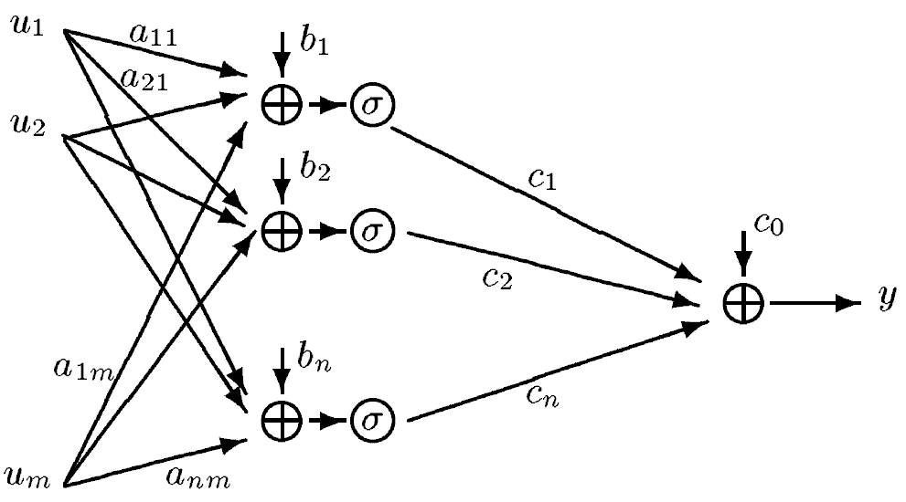
VC Dimension of NN
How to compute?
No simple recipe
No simple bounds
What are the relevant properties?
# weights
# layers
Type of activation function
Linear
Binary
Piecewise polynomial (degree, # pieces)
Sigmoid $1/{1+e^{−x}}$

Slide 51
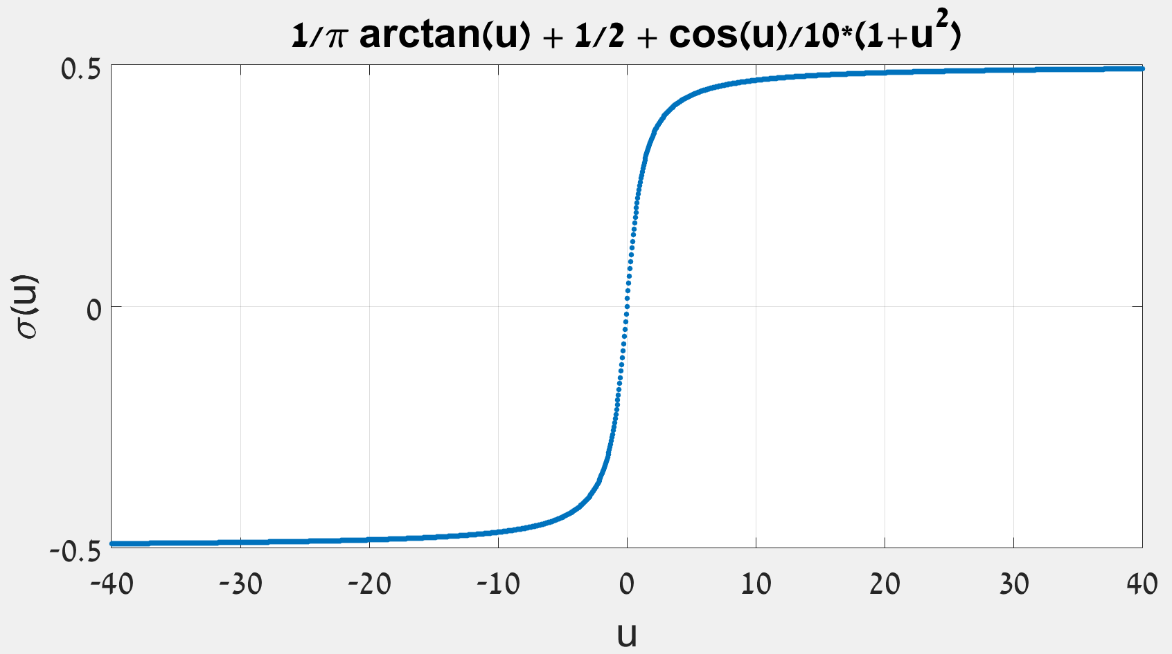
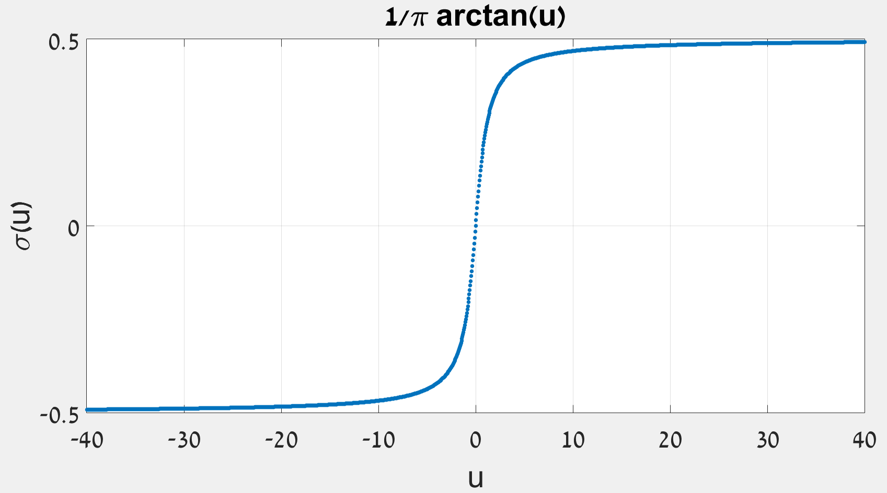
VC-Dimension of NN
Hypothesis Class | VC-dim
linear parameterization with n parameters (i.e. perceptron) | $$n$$
single hidden layer with fixed input weights | $$n+1$$ (tanh, arctan, logistic function + conditions on the fixed weights)
single hidden layer with fixed output weights | $$∞$$ (special sigmoidal, n = 2, m = 1)
multilayer neural net with binary activations and p weights | $$O(p\log{p})$$
multilayer neural net with binary / linear activations and p weights | $$O(p^{2})$$
piecewise polynomial activations, Deg<=D, <=p pieces | $$O(p+p^{2}∗(\log{p+\log{D))}}$$
Sigmoid activation with p parameters | $$O(p^{4})$$
Discrete input in ${\left\{−k,…,k\right\}}^{n}$, two layers, standard sigmoid, $p$ parameters | $$O(p\log\left(pk\right))$$
$$H=\{sign\left(w^{T}x \right) :w∈ℝ^{n}\}$$
H = All n degree polynomials
$$=span\left\{1,x,x^{2},…,x^{n}\right\}$$
$$H=\{sin⁡(αx):α∈ℝ\}$$
$m≥\frac{c⋅\left(d+\log\left(\frac{1}{δ}\right)\right)}{ε^{2}}$

Slide 52
Other Dimensions
Dense subset
Fat shattering
Natarajan dimension
$γ$-$ψ$ dimension
…

Slide 53
Fat Shattering
VC-dimension requires binary output
Fat Shattering dimension is a scale sensitive generalization of the VC dimension for real valued functions
$F$: set of functions $X→ ℝ$
$S=\{x_{1},x_{2},…,x_{m}\}$
$γ:$positive real number
$$b=(1,−1,1)$$
$$x_{1}$$
$$x_{2}$$
$$x_{3}$$

Slide 54
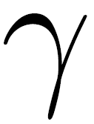
Fat Shattering
VC-dimension requires binary output
Fat Shattering dimension is a scale sensitive generalization of the VC dimension for real valued functions
$F$: set of functions $X→ ℝ$
$S=\{x_{1},x_{2},…,x_{m}\}$
$γ:$positive real number
S is $γ$-shattered by F if $∃r_{1},…,r_{m}, ∀b∈{\left\{−1,1\right\}}^{m}, ∃f_{b}$ s.t.
$$b=(−1,1,1)$$
$$r_{3}$$
$$b=(1,−1,1)$$
$$r_{1}$$
$$r_{2}$$
$$x_{1}$$
$$x_{2}$$
$$x_{3}$$

Slide 55
Fat Shattering
VC-dimension requires binary output
Fat Shattering dimension is a scale sensitive generalization of the VC dimension for real valued functions
$F$: set of functions $X→ ℝ$
$S=\{x_{1},x_{2},…,x_{m}\}$
$γ:$positive real number
S is $γ$-shattered by F if $∃r_{1},…,r_{m}, ∀b∈{\left\{−1,1\right\}}^{m}, ∃f_{b}$ s.t.
$Fat_{γ}\left(F\right)=\max_{n}\left\{\left|S\right|:S is γ−shattered \right\}$
➔ generalization bounds for regression

Slide 56
VC-dimension and PAC Learning Approach to NN – Caveats
VC-bound learning guarantee:
Too strict
Any distribution D
Any function h
Not tight
Only a bound
Computing the VC-dimension
One shattered set is enough
$$R_{D}\left(h\right)≤R_{S}\left(h\right)+\left(\frac{d+d\log\left(\frac{2m}{d}\right)−\log\left(\frac{δ}{4}\right)}{m}\right)$$

Slide 57
Part II: Empirical Tests

Slide 58
Experiments’ Motivation
Empirical phenomenon: huge NN have very good generalization
Small difference between training and test error
Even with $m<\left|W\right|$
Theoretical reasoning:
Properties of the model family (VC-dimension, Rademacher complexity…)
Regularization techniques
Goal: empirically test the theoretical reasoning

Slide 59
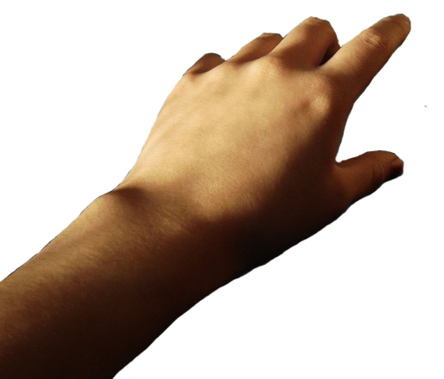
Experiments’ Methodology
H
Hypothesis Class
D
Distribution
f
A
Algorithm
n examples
(x,y)
f

Slide 60
Experiments Toy Example – Regression
?
H
Hypothesis Class
Training
Test

Slide 61
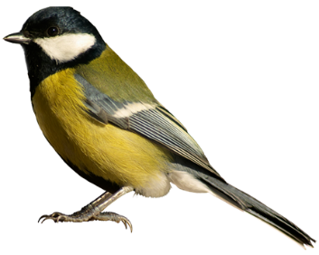
Randomization Tests Methodology
Multi-label classification problems with standard successful architectures
Randomization test: train on random labels
Expected test error:
Expected training error:
bird
tree
random chance, $\frac{k−1}{k}$
$${R_{D}=𝔼}_{D}[h\left(x\right)≠y]$$
approximate on a validation set
$R_{S}=\frac{1}{m}\sum_{i=1}^{m}{1_{\{h\left(x_{i}\right)≠y_{i}\}}}$

Slide 62
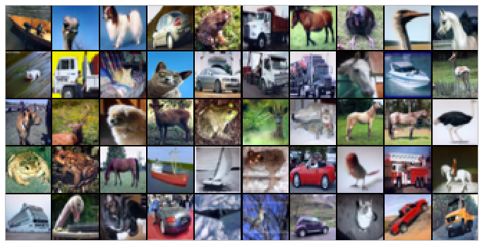
Randomization Tests Methodology
Data
CIFAR10, with 10 categories (Russakovsky et al., 2015)
ImageNet, with 1000 categories (Krizhevsky & Hinton, 2009)

Slide 63
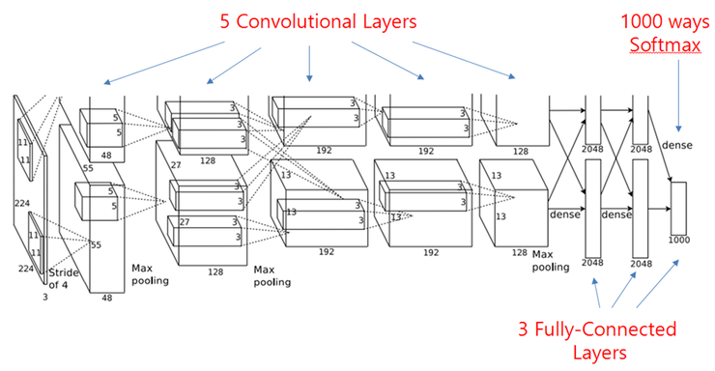
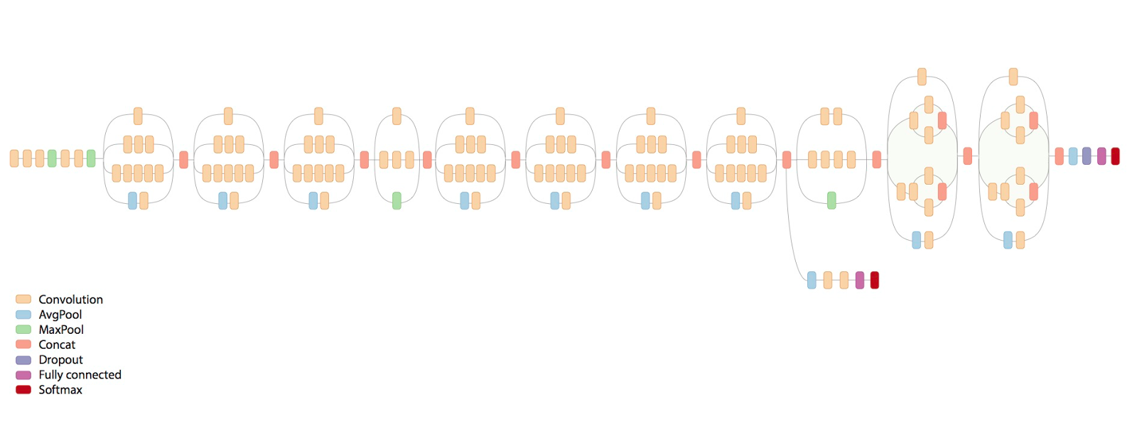
Randomization Tests Methodology
Data
CIFAR10, with 10 categories (Russakovsky et al., 2015)
ImageNet, with 1000 categories (Krizhevsky & Hinton, 2009)
Architectures
MLP (Multi-Layer Perceptron)
AlexNet (Krizhevsky et al., 2012)
Incecption V3 (Szegedy et al., 2016)

Slide 64
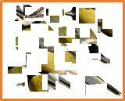
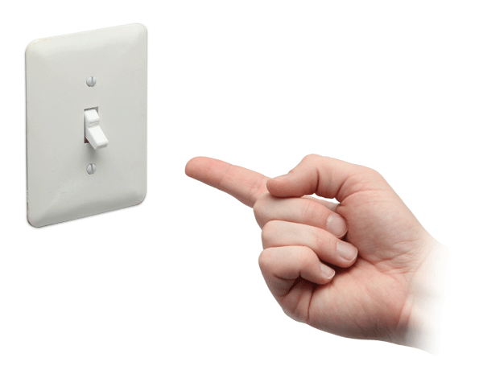
Randomization Tests Methodology
Data
CIFAR10, with 10 categories (Russakovsky et al., 2015)
ImageNet, with 1000 categories (Krizhevsky & Hinton, 2009)
Architectures
MLP (Multi-Layer Perceptron)
AlexNet (Krizhevsky et al., 2012)
Incecption V3 (Szegedy et al., 2016)
Data manipulation
True labels
Random labels
Shuffled pixels
Random pixels
Gaussian
Algorithm manipulation
Dropout
Data augmentation
Weight decay
Early stopping
Batch normalization
bird
tree
Generalization techniques: standard tools to confine our learning and encourage generalization

Slide 65
Randomization Tests Methodology
Multi-label classification problems with standard successful architectures
Randomization test: train on random labels
Expected test error:
CIFAR10 (10 categories): 90%
ImageNet (1000 categories): 99.9%
Expected training error:
random chance, $\frac{k−1}{k}$
$${R_{D}=𝔼}_{D}[h\left(x\right)≠y]$$
approximate on a validation set
$R_{S}=\frac{1}{m}\sum_{i=1}^{m}{1_{\{h\left(x_{i}\right)≠y_{i}\}}}$

Slide 66
Randomization Tests Results (CIFAR10)
Empirical training error:
0
“Deep neural networks easily fit random labels”
“by randomizing labels alone we can force the generalization error of a model to jump up considerably without changing the model, its size, hyperparameters, or the optimizer”
(Inception)

Slide 67
Randomization Tests Implications
Recall VC bound generalization guarantee:
➔ The network’s capacity is high enough to memorize the entire dataset
VC-dim is high
VC-dim doesn’t explain the good generalization!
$$R_{D}\left(h\right)≤R_{S}\left(h\right)+\left(\frac{d+d\log\left(\frac{2m}{d}\right)−\log\left(\frac{δ}{4}\right)}{m}\right)$$
large
0
large
low on real labels

Slide 68
Randomization Tests Results (CIFAR10)
Empirical training error:
0
“Deep neural networks easily fit random labels”
(Inception)

Slide 69
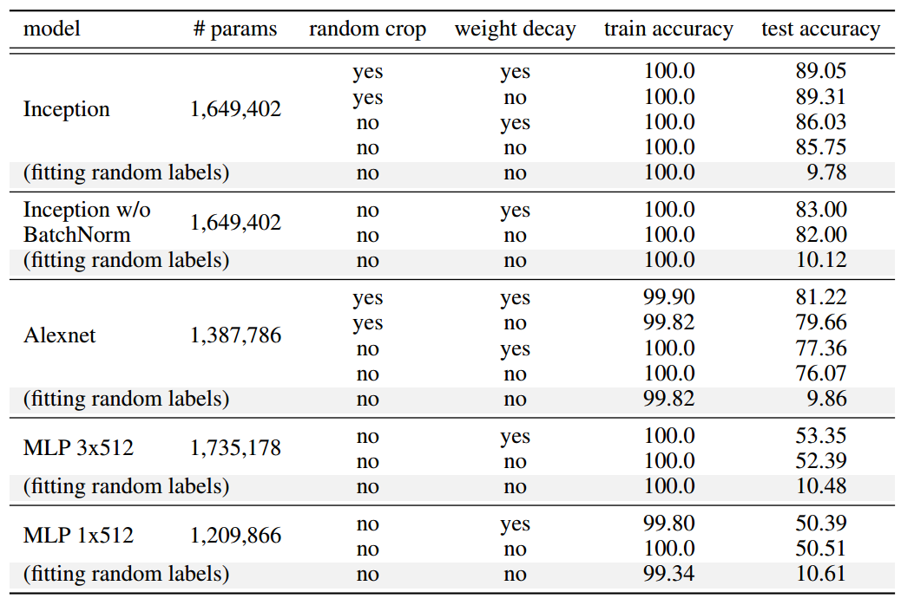
Randomization Tests Results (CIFAR10)
“Explicit regularization may improve generalization performance, but is neither necessary nor by itself sufficient for controlling generalization error”
Huge unexplained gap!

Slide 70
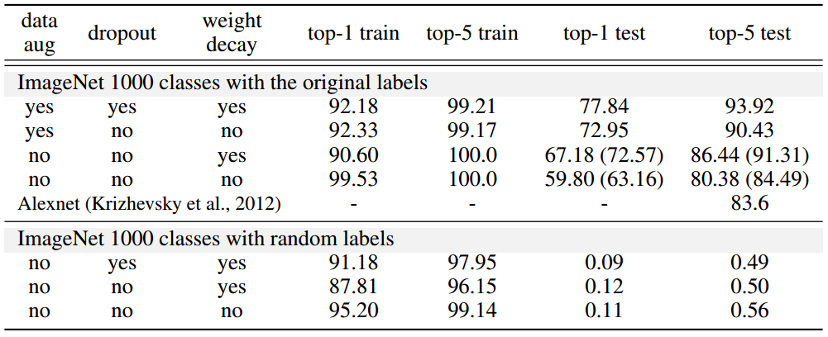
Randomization Tests Results (ImageNet)
“Explicit regularization may improve generalization performance, but is neither necessary nor by itself sufficient for controlling generalization error”

Slide 71
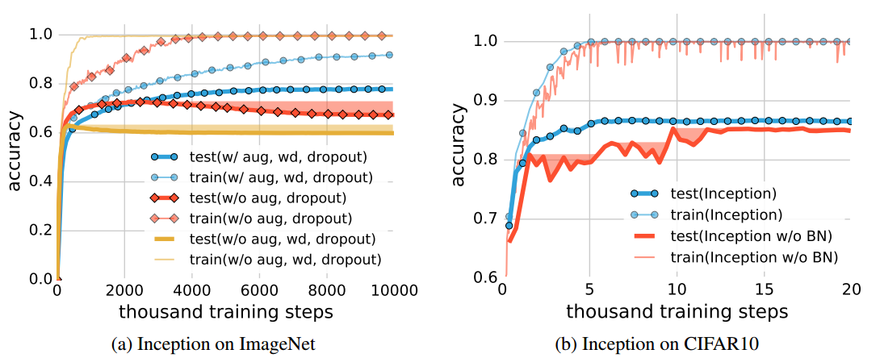
Randomization Tests Results
“Explicit regularization may improve generalization performance, but is neither necessary nor by itself sufficient for controlling generalization error”

Slide 72
Randomization Tests Implications
Recall VC bound generalization guarantee:
➔ The network’s capacity is high enough to memorize the entire dataset
VC-dim is high
VC-dim doesn’t explain the good generalization!
Regularization techniques don’t explain it either!
$$R_{D}\left(h\right)≤R_{S}\left(h\right)+\left(\frac{d+d\log\left(\frac{2m}{d}\right)−\log\left(\frac{δ}{4}\right)}{m}\right)$$
large
0
large
low on real labels
even without regularization techniques

Slide 73
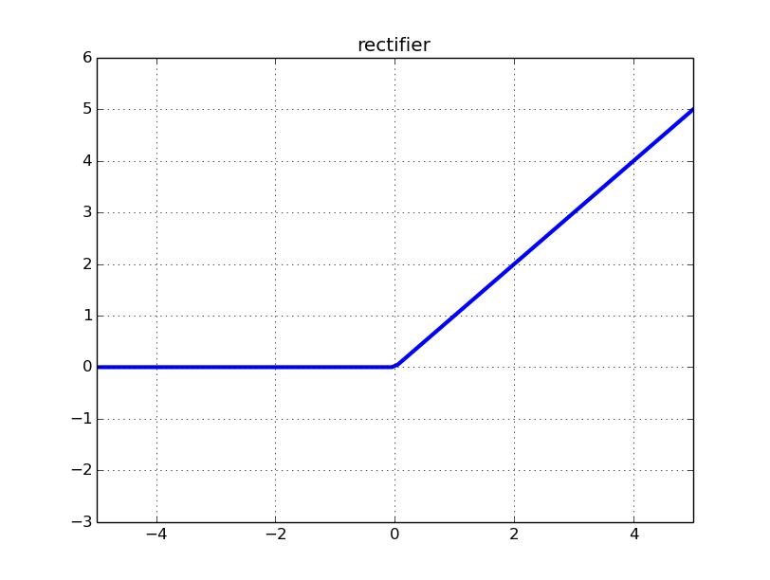
Finite Sample Expressivity
Input
d dimensions (e.g. # of pixels)
n samples
Theorem: there exist a network with 2n+d weights that can represent any function on any sample
Network
Two layers (but wide)
or k layers each with O(n/k) parameters
ReLU activation
P = 2n + d parameters

Slide 74
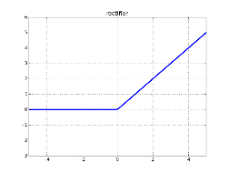
Finite Sample Expressivity – Proof
$${−b}_{1}$$
$$c\left(z\right)=\sum_{j=1}^{n}{w_{j}\max\left\{\left\langle a,z\right\rangle −b_{j},0\right\}}$$
$$a_{1}$$
$$⊕_{ }^{ }$$
$$σ$$
$$w_{1}$$
$$z_{ }^{1}$$
$$a_{d}$$
Can be expressed by a depth 2 NN with ReLU activations
Can memorize any input
$$⋮$$
$$⋮$$
$$⋮$$
$$⊕_{ }^{ }$$
$$z^{d}$$
$$a_{1}$$
$${−b}_{n}$$
$$a_{d}$$
$$⊕_{ }^{ }$$
$$σ$$
$$w_{n}$$
$$2n+d$$

Slide 75
Finite Sample Expressivity – Proof
$b_{1}<x_{1}<b_{2}<x_{2}<b_{3}<x_{3}$
$A_{ij}=\max{\{x_{i}−b_{j},0\}}$
$$A=\left[\begin{matrix}x_{1}−b_{1} & 0 & 0 \\ x_{2}−b_{1} & x_{2}−b_{2} & 0 \\ x_{3}−b_{1} & x_{3}−b_{2} & x_{3}−b_{3}\end{matrix}\right]$$
Fact: the eigenvalues of a lower triangular matrix are equal to its diagonal elements
Values on diagonal are all $>0$
➔ A is full rank

Slide 76
Finite Sample Expressivity – Proof
$S=\left\{z_{1},…,z_{n}\right\}$ $z_{i}∈ℝ^{d}, y∈ℝ^{n}$
need: $c\left(z_{i}\right)=\sum_{j=1}{w_{j}\max\left\{\left\langle a,z_{i}\right\rangle −b_{j},0\right\}=y_{i} ∀i∈\left[n\right]}$
Choose $a$ and $b$ such that with $x_{i}=\left\langle a,z_{i}\right\rangle ,$we have
$$b_{1}<x_{1}<b_{2}<x_{2}<…<b_{n}<x_{n}$$
Denote $A_{ij}=\max\left\{\left\langle a,z_{i}\right\rangle −b_{j},0\right\}$
➔ $A$ is lower triangular with positive elements on the diagonal
➔ $A$ is full rank
$∃w$ s.t. $Aw=y$
Note that $c\left(z_{i}\right)=\sum_{j=1}{w_{j}\max\left\{\left\langle a,z_{i}\right\rangle −b_{j},0\right\}}=\sum_{j=1}{w_{j}A_{ij}={\left(Aw\right)}_{i}=y_{i} }$
➔ ${\left(c\left(z_{1}\right),…,c\left(z_{n}\right)\right)}^{T}=y$

Slide 77
Finite Sample Expressivity
Input
d dimensions (e.g. # of pixels)
n samples
Theorem: there exist a network with 2n+d weights that can represent any function on any sample
Network
Two layers (but wide)
or k layers each with O(n/k) parameters
ReLU activation
P = 2n + d parameters

Slide 78
Experiments’ Methodology
H
Hypothesis Class
?
D
Distribution
f
A
Algorithm
n examples
(x,y)
f

Slide 79
SGD as an Implicit Regularizer
Consider Empirical Risk Minimization on a Linear Model
When $d>n$ we can fit any labeling, by solving $Xw=y$
We have infinite number of solutions!
Do all global minima generalize equally well?

Slide 80
SGD as an Implicit Regularizer
Consider Empirical Risk Minimization on a Linear Model
SGD step:
➔
Minimal - norm solution of $Xw=y$!

Slide 81
Summary
Theory
Shattering and VC-dim
PAC learning
VC-dim implications on generalization and sample complexity
Sauer’s Lemma
Bounds for VC-dim of NN
Fat shattering dimension
Experiments
Randomization tests: 0% training error
Explicit regularizers: can generalize without
Finite sample expressivity
SGD as implicit regularizer
Still don’t know the reason for good generalization!

Slide 82
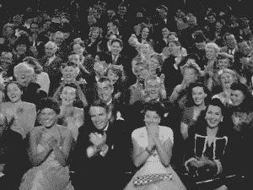
THE END

