Slide 1
Geometry 1: Projection and Epipolar Lines
Introduction to Computer Vision
Ronen Basri
Weizmann Institute of Science

Slide 2
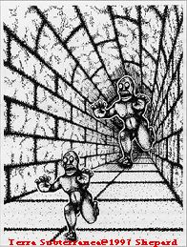
Perspectivity

Slide 3
Material covered
Pinhole camera model, perspective projection
Two view geometry, general case:
Epipolar geometry, the essential matrix
Camera calibration, the fundamental matrix
Two view geometry, degenerate cases
Homography (planes, camera rotation)
A taste of projective geometry
Stereo vision: 3D reconstruction from two views
Multi-view geometry, reconstruction through factorization

Slide 4
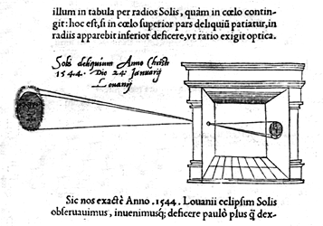
Camera obscura (“dark room”)
"Reinerus Gemma-Frisius, observed an eclipse of the sun at Louvain on January 24, 1544, and later he used this illustration of the event in his book De Radio Astronomica et Geometrica, 1545. It is thought to be the first published illustration of a camera obscura..."
(Hammond, John H., The Camera Obscura, A Chronicle)

Slide 5
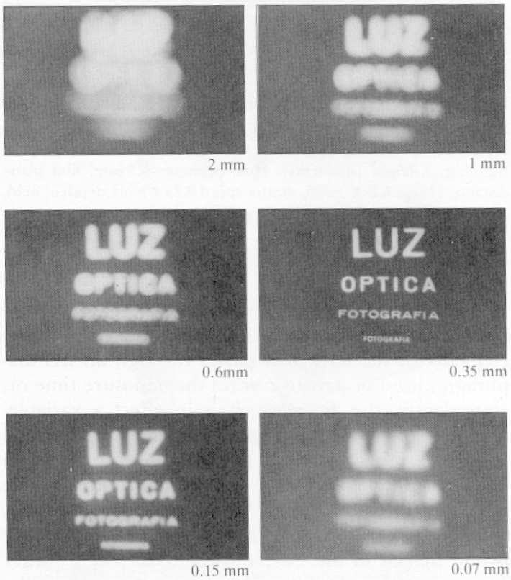
Why not use a pinhole camera?
Pinhole cameras are dark
Pinhole too big – blurry image
Pinhole too small – diffraction

Slide 6
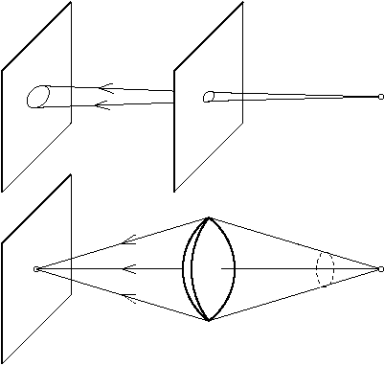
Lenses

Slide 7
Lenses
Lenses collect light from a large hole and direct it to a single point
Overcome the darkness of pinhole cameras
But there is a price
Focus
Radial distortions
Chromatic abberations
…
Pinhole is useful as a geometric model
Perspective: “perspicere” – to see through

Slide 8
Pinhole camera model

Slide 9
Perspective projection
$$P=\left(X,Y,Z\right)$$
$$p=\left(x,y\right)$$
$$O$$

Slide 10
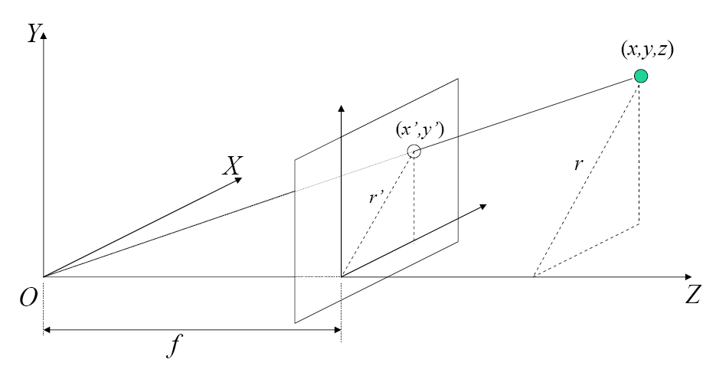
Perspective projection
O – Focal center
π – Image plane
Z – Optical axis
f – Focal length

Slide 11
Perspective projection
$$y$$
$$x$$
$$f$$
$$Y$$
$$X$$
$$Z$$
$$\frac{x}{X}=\frac{y}{Y}=\frac{f}{Z}$$

Slide 12
Perspective projection
Perspective rule
$$x=\frac{fX}{Z} y=\frac{fY}{Z}$$
In homogeneous coordinates
$$\left(\begin{matrix}x \\ y \\ f\end{matrix}\right)=\frac{f}{Z}\left(\begin{matrix}X \\ Y \\ Z\end{matrix}\right)$$

Slide 13
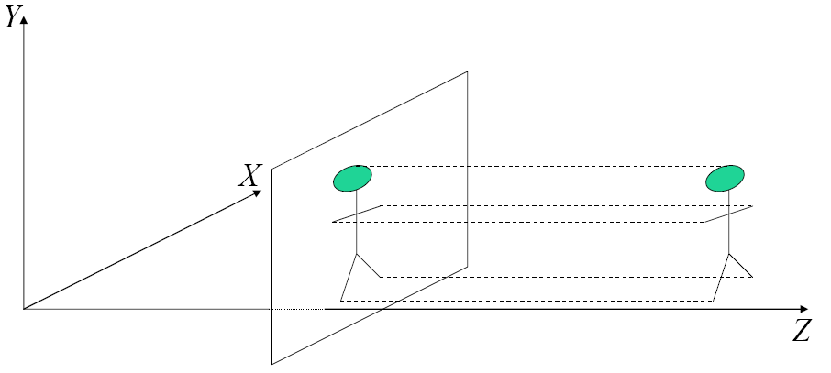
Orthographic projection
When objects are far from the camera
Projection rays are nearly parallel
Camera center at infinity
$$x=X$$
$$y=Y$$

Slide 14
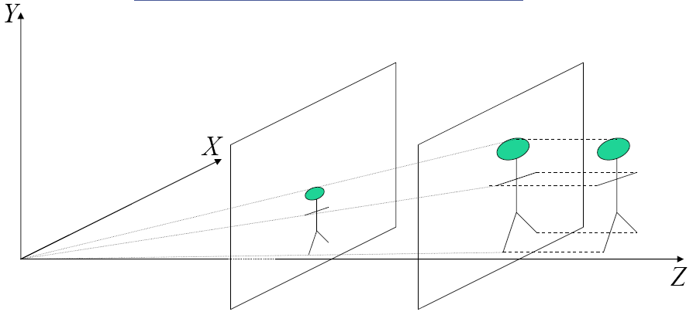
Scaled orthographic
How would a tilted rectangle look like under perspective projection? And under scaled orthography?
$$\begin{matrix}\begin{matrix}x=sX \\ y=sY\end{matrix} & s=\frac{f}{Z_{0}}\end{matrix}$$

Slide 15
Which projection model should I use?
Perspective model is needed
In scenes that contain many depth differences
For accurate 3D reconstruction (stereo, structure from motion)
Scaled orthographic can be used
When objects are small relative to their distance from the camera
Often sufficient for recognition applications

Slide 16
Camera matrix
A $3×4$ matrix that captures camera location, $t$, orientation, $R$, and (linear) calibration parameters, $K$
$$p∝K\left[R | t\right]P$$
$$\left(\begin{matrix}x \\ y \\ f\end{matrix}\right) ∝ \left(\begin{matrix}fm_{x} & γ & x_{0} \\ 0 & fm_{y} & y_{0} \\ 0 & 0 & 1\end{matrix}\right)\left(\begin{matrix}\begin{matrix}r_{11} & r_{12} & r_{13} \\ r_{21} & r_{22} & r_{23} \\ r_{31} & r_{32} & r_{33}\end{matrix} & \begin{matrix}t_{x} \\ t_{y} \\ t_{z}\end{matrix}\end{matrix}\right)\left(\begin{matrix}\begin{matrix}X \\ Y\end{matrix} \\ \begin{matrix}Z \\ 1\end{matrix}\end{matrix}\right)$$
Internal external calibration calibration
‘$∝$’ means “up to (non-zero) scale factor.” Scale is different for every point
In “camera coordinate system” $R=I$ and $t=0$

Slide 17
Calibration matrix
A $3×3$ upper diagonal matrix, $K$, that captures (linear) internal calibration parameters
$$K= \left(\begin{matrix}fm_{x} & γ & x_{0} \\ 0 & fm_{y} & y_{0} \\ 0 & 0 & 1\end{matrix}\right)$$
Parameters:
$f$ - focal length
${(m}_{x},m_{y})$ - pixel size
$γ$ - skew
${(x}_{0},y_{0})$ - image center
Radial distortions are treated separately
Both linear and radial calibration parameters are available in Exif tags

Slide 18
X

Slide 19
Two view geometry
epipolar line

Slide 20
Epipolar plane
Definition:
Epipolar plane: a plane that contains the baseline
$$P$$
epipolar plane
epipolar line
epipolar line
$$O$$
Baseline
$$O’$$

Slide 21
Epipoles
Each epipolar plane produces a pair of epipolar lines
There is a 1-D system of epipolar planes
All epipolar planes contain the baseline, therefore all epipolar lines contain its intersection with the respective image planes
These intersection points are called epipoles
An epipole is the projection of the right focal center onto the left image (and vice versa)
epipolar lines
epipolar lines
$$O$$
$$O’$$
Baseline

Slide 22
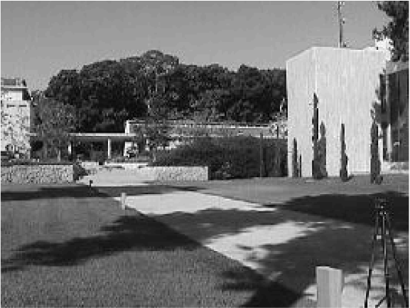
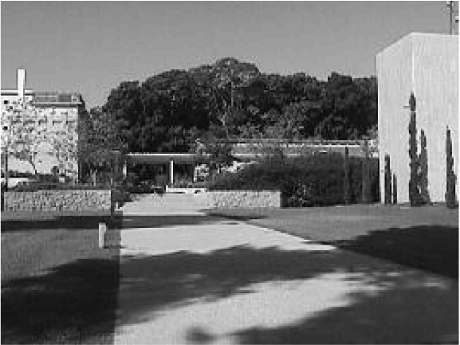
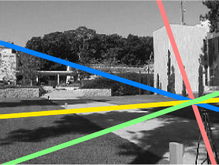
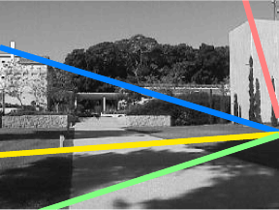

Slide 23
Epipolar constraints: derivation
We derive the constraints by requiring $p,q,O,O′$ to lie in the same plane
$$P$$
$$p$$
epipolar plane
$$q$$
$$O$$
Baseline
$$O’$$

Slide 24
Cross product, triple product
Cross product
$$u×v=\left(\begin{matrix}u_{2}v_{3}−u_{3}v_{2} \\ u_{3}v_{1}−u_{1}v_{3} \\ u_{1}v_{2}−u_{2}v_{1}\end{matrix}\right)$$
$u×v$ is orthogonal to $u$ and $v$
$|u×v|$ is the area of the parallelogram defined by $u$ and $v$
Cross product is a linear operator expressed by a skew-symmetric matrix (verify)
$u×v={[u]}_{×}v$, with ${[u]}_{×}=\left(\begin{matrix}0 & −u_{3} & u_{2} \\ u_{3} & 0 & −u_{1} \\ −u_{2} & u_{1} & 0\end{matrix}\right)$
Triple product: $u^{T}(v×w)$
$u,v,w$ are coplanar iff $u^{T}\left(v×w\right)=0$

Slide 25
Epipolar constraints: the Essential matrix
Assume $K=diag\left(f,f,1\right)$ and $f$ is known
$p=\frac{f}{Z}P$, $q=\frac{f}{Z}Q$, $Q=RP+t$
$t×Q=t×RP$ ($t×t=0)$
$$0=Q^{T}\left(t×Q\right)=Q^{T}\left(t×RP\right)=Q^{T}{\left[t\right]}_{×}RP$$
$$0=Q^{T}{\left[t\right]}_{×}RP=q^{T}{\left[t\right]}_{×}Rp$$
$$q^{T}Ep=0$$
$E={\left[t\right]}_{×}R$ is called the Essential matrix

Slide 26
The Essential matrix
Given $q$, $E$ defines a line (verify)
Equation defines a necessary condition for correspondences. Is this condition sufficient?
$E$ is rank 2, its (right and left) null spaces contain the epipoles
Equation is homogeneous, we can scale the scene and move cameras apart and see the same images
$$q^{T}Ep=0$$

Slide 27
The Essential matrix
Recovery of camera position and orientation given $E$
Translation (up to scale) is given by the epipole (2 dofs)
Rotation can be fully determined (3 dofs)
4 solutions (two rotations, sign ambiguity for translation). The correct one is found by forcing all points to have positive depths in the coordinate systems of both images
Recovery of $E$ (up to scale) using point matches:
Linear solution requires (at least) 8 matches
Non-linear solution requires 5 matches
$$q^{T}Ep=0$$

