Slide 1
Geometry 4:
Multiview Stereo
Introduction to Computer Vision
Ronen Basri
Weizmann Institute of Science

Slide 2
Material covered
Pinhole camera model, perspective projection
Two view geometry, general case:
  Epipolar geometry, the essential matrix
  Camera calibration, the fundamental matrix
Two view geometry, degenerate cases
  Homography (planes, camera rotation)
  A taste of projective geometry
Stereo vision: 3D reconstruction from two views
Multi-view geometry, reconstruction through factorization

Slide 3
Structure from motion
Input:
  a set of point tracks
Output:
  3D location of each point (shape)
  camera parameters (motion)
Assumptions:
  Rigid motion
  Orthographic projection (no scale)
Method: SVD factorization (Tomasi & Kanade)

Slide 4
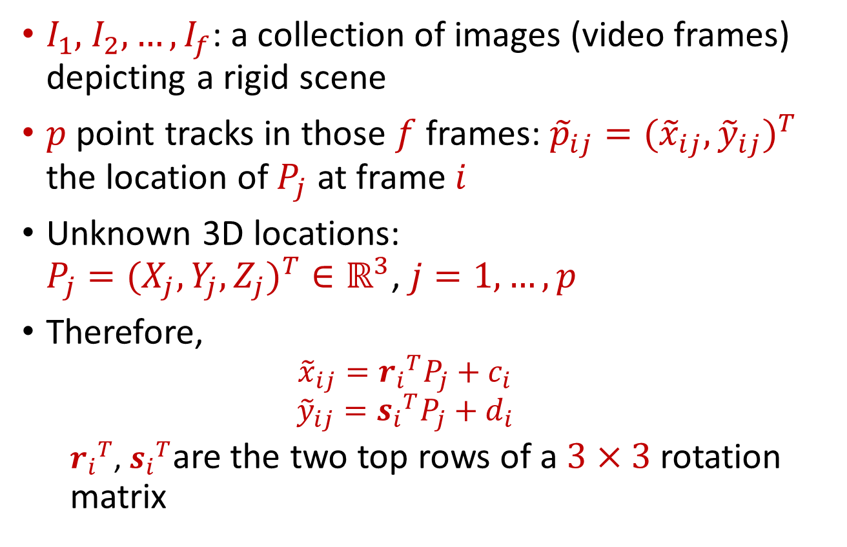
Setup
$I_{1},$ $I_{2},…,I_{f}$: a collection of images (video frames) depicting a rigid scene
$p$ point tracks in those $f$ frames: ${{\tilde{p}}_{ij}=({\tilde{x}}_{ij},{\tilde{y}}_{ij})}^{T}$ the location of $P_{j}$ at frame $i$
Unknown 3D locations:
${P_{j}=(X_{j},Y_{j},Z_{j})}^{T}∈ℝ^{3}$, $j=1,…,p$
Therefore,
  $${\tilde{x}}_{ij}={r_{i}}^{T}P_{j}+c_{i}$$
  $${\tilde{y}}_{ij}={s_{i}}^{T}P_{j}+d_{i}$$
  ${r_{i}}^{T}$, ${s_{i}}^{T}$are the two top rows of a $3×3$ rotation matrix

Slide 5
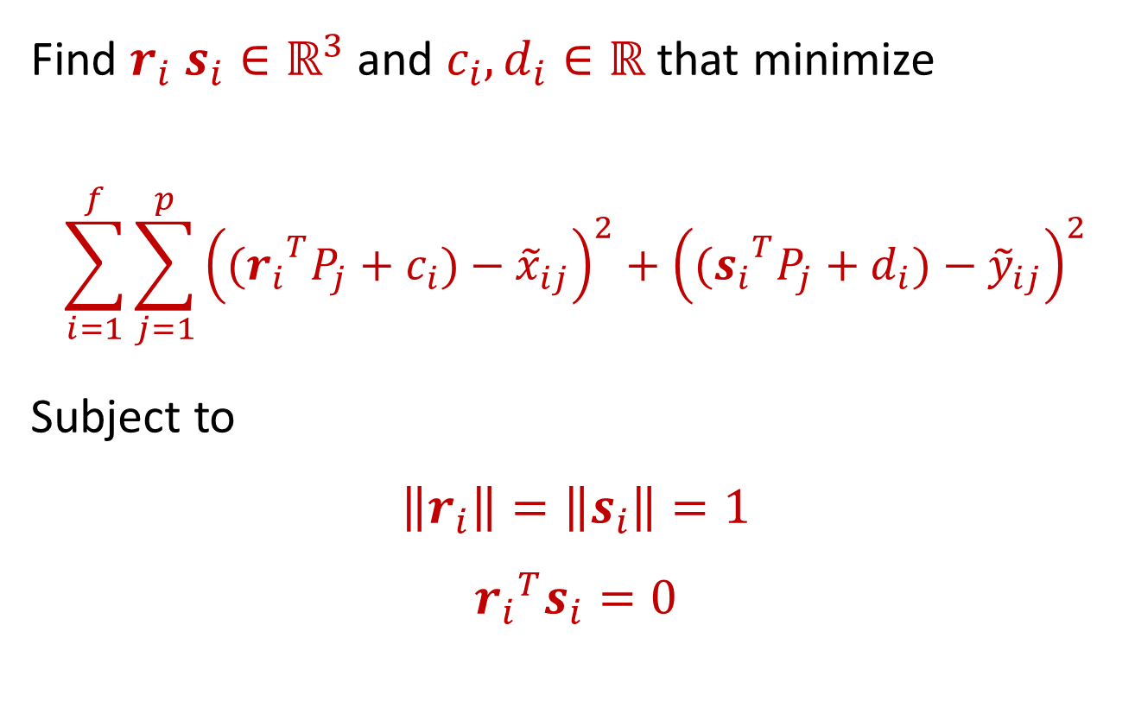
Objective
Find $r_{i}$ $s_{i}∈ℝ^{3}$ and $c_{i},d_{i}∈ℝ$ that minimize
$$\sum_{i=1}^{f}{\sum_{j=1}^{p}{{\left({(r_{i}}^{T}P_{j}+c_{i})−{\tilde{x}}_{ij}\right)}^{2}+{\left({(s_{i}}^{T}P_{j}+d_{i})−{\tilde{y}}_{ij}\right)}^{2}}}$$
Subject to
$$\left\|r_{i}\right\|=\left\|s_{i}\right\|=1$$
$${r_{i}}^{T}s_{i}=0$$

Slide 6
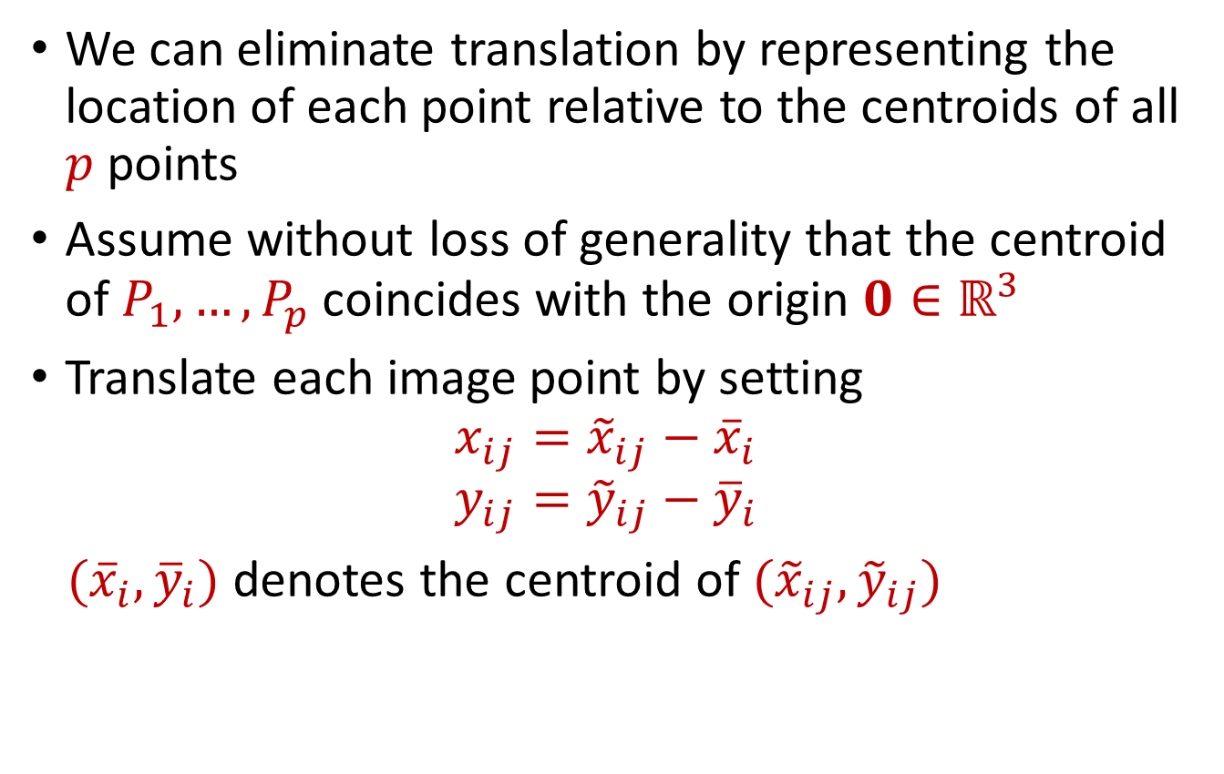
Eliminate translation
We can eliminate translation by representing the location of each point relative to the centroids of all $p$ points
Assume without loss of generality that the centroid of $P_{1},…,P_{p}$ coincides with the origin $0∈ℝ^{3}$
Translate each image point by setting
$$x_{ij}={\tilde{x}}_{ij}−{\overline{x}}_{i}$$
$$y_{ij}={\tilde{y}}_{ij}−{\overline{y}}_{i}$$
$({\overline{x}}_{i},{\overline{y}}_{i})$ denotes the centroid of ${(\tilde{x}}_{ij},{\tilde{y}}_{ij})$

Slide 7

Objective (no translation)
Find $r_{i}$ $s_{i}∈ℝ^{3}$ that minimize
$$\sum_{i=1}^{f}{\sum_{j=1}^{p}{{\left({r_{i}}^{T}P_{j}−x_{ij}\right)}^{2}+{\left({s_{i}}^{T}P_{j}−y_{ij}\right)}^{2}}}$$
Subject to
$$\left\|r_{i}\right\|=\left\|s_{i}\right\|=1$$
$${r_{i}}^{T}s_{i}=0$$

Slide 8

Measurement matrix
$$M={\left(\begin{matrix}\begin{matrix}x_{11} & x_{12} & . \\ … & & \\ x_{f1} & x_{f2} & .\end{matrix} & \begin{matrix}. & . & x_{1p} \\ & & … \\ . & . & x_{fp}\end{matrix} \\ \begin{matrix}y_{11} & y_{12} & . \\ .. & & \\ y_{f1} & y_{f2} & .\end{matrix} & \begin{matrix}. & . & y_{1p} \\ & & … \\ . & . & y_{fp}\end{matrix}\end{matrix}\right)}_{2f×p}$$

Slide 9

Transformation and shape matrices
$${T=\left(\begin{matrix}\begin{matrix}{r_{1}}^{T} \\ … \\ {r_{f}}^{T}\end{matrix} \\ \begin{matrix}{s_{1}}^{T} \\ … \\ {s_{f}}^{T}\end{matrix}\end{matrix}\right)=\left(\begin{matrix}\begin{matrix}r_{11} & r_{12} & r_{13} \\ … & & … \\ r_{f1} & r_{f2} & r_{f3}\end{matrix} \\ \begin{matrix}s_{11} & s_{12} & s_{13} \\ … & & … \\ s_{f1} & s_{f2} & s_{f3}\end{matrix}\end{matrix}\right)}_{2f×3}$$
$$S={\left(\begin{matrix}\begin{matrix}X_{1} & X_{2} & \\ Y_{1} & Y_{2} & . \\ Z_{1} & Z_{2} & \end{matrix} & \begin{matrix} & & X_{p} \\ . & . & Y_{p} \\ & & Z_{p}\end{matrix}\end{matrix}\right)}_{3×p}$$

Slide 10

Objective: matrix notation
Find $T$ and $S$ that minimize
$${\left\|M−TS\right\|}_{F}$$
Subject to
$$\left\|r_{i}\right\|=\left\|s_{i}\right\|=1$$
$${r_{i}}^{T}s_{i}=0$$
$M$ is $2f×p$, $T$ is $2f×3$, $S$ is $3×p$

Slide 11
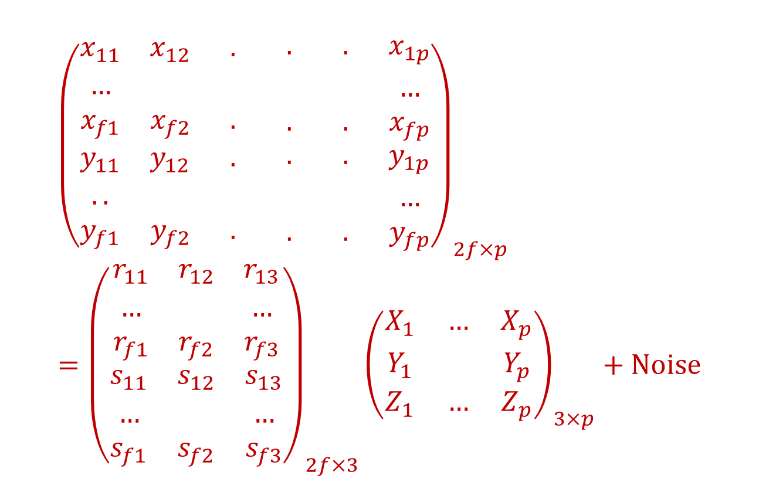
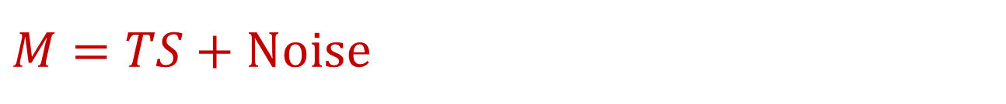
$$M=TS+Noise$$
$${\left(\begin{matrix}\begin{matrix}x_{11} & x_{12} & . \\ … & & \\ x_{f1} & x_{f2} & .\end{matrix} & \begin{matrix}. & . & x_{1p} \\ & & … \\ . & . & x_{fp}\end{matrix} \\ \begin{matrix}y_{11} & y_{12} & . \\ .. & & \\ y_{f1} & y_{f2} & .\end{matrix} & \begin{matrix}. & . & y_{1p} \\ & & … \\ . & . & y_{fp}\end{matrix}\end{matrix}\right)}_{2f×p}={\left(\begin{matrix}\begin{matrix}r_{11} & r_{12} & r_{13} \\ … & & … \\ r_{f1} & r_{f2} & r_{f3}\end{matrix} \\ \begin{matrix}s_{11} & s_{12} & s_{13} \\ … & & … \\ s_{f1} & s_{f2} & s_{f3}\end{matrix}\end{matrix}\right)}_{2f×3}{\left(\begin{matrix}X_{1} & … & X_{p} \\ Y_{1} & & Y_{p} \\ Z_{1} & … & Z_{p}\end{matrix}\right)}_{3×p}+Noise$$

Slide 12
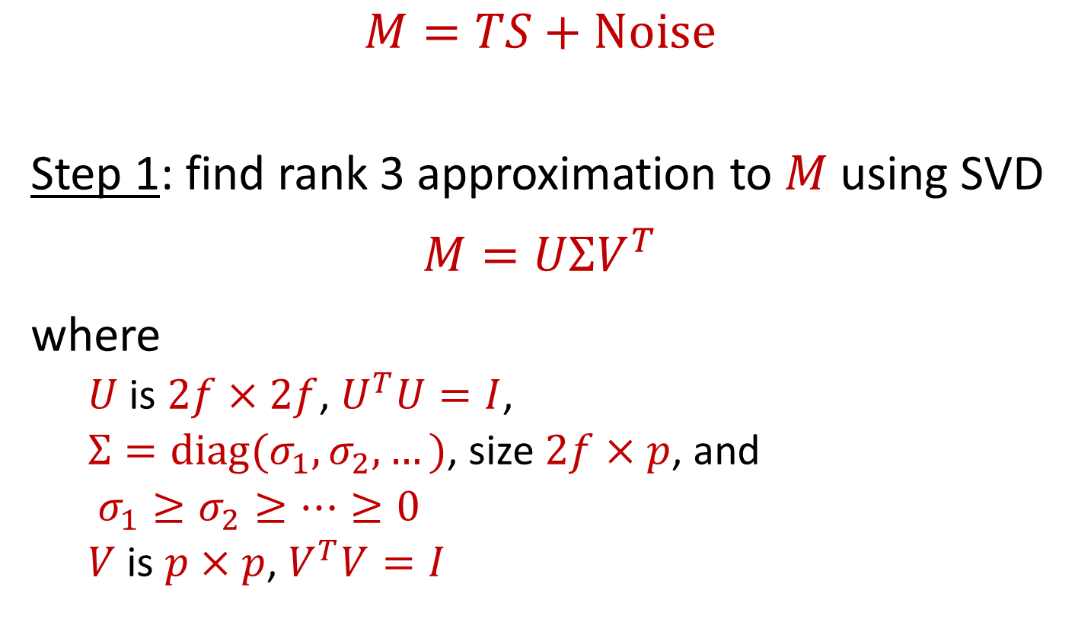
TK-Factorization
$$M=TS+Noise$$
Step 1: find rank 3 approximation to $M$ using SVD
$$M=UΣV^{T}$$
where
  $U$ is $2f×2f$, $U^{T}U=I$,
  $Σ=diag(σ_{1},σ_{2},…)$, size $2f×p$, and
  $σ_{1}≥σ_{2}≥…≥0$
  $V$ is $p×p$, $V^{T}V=I$

Slide 13
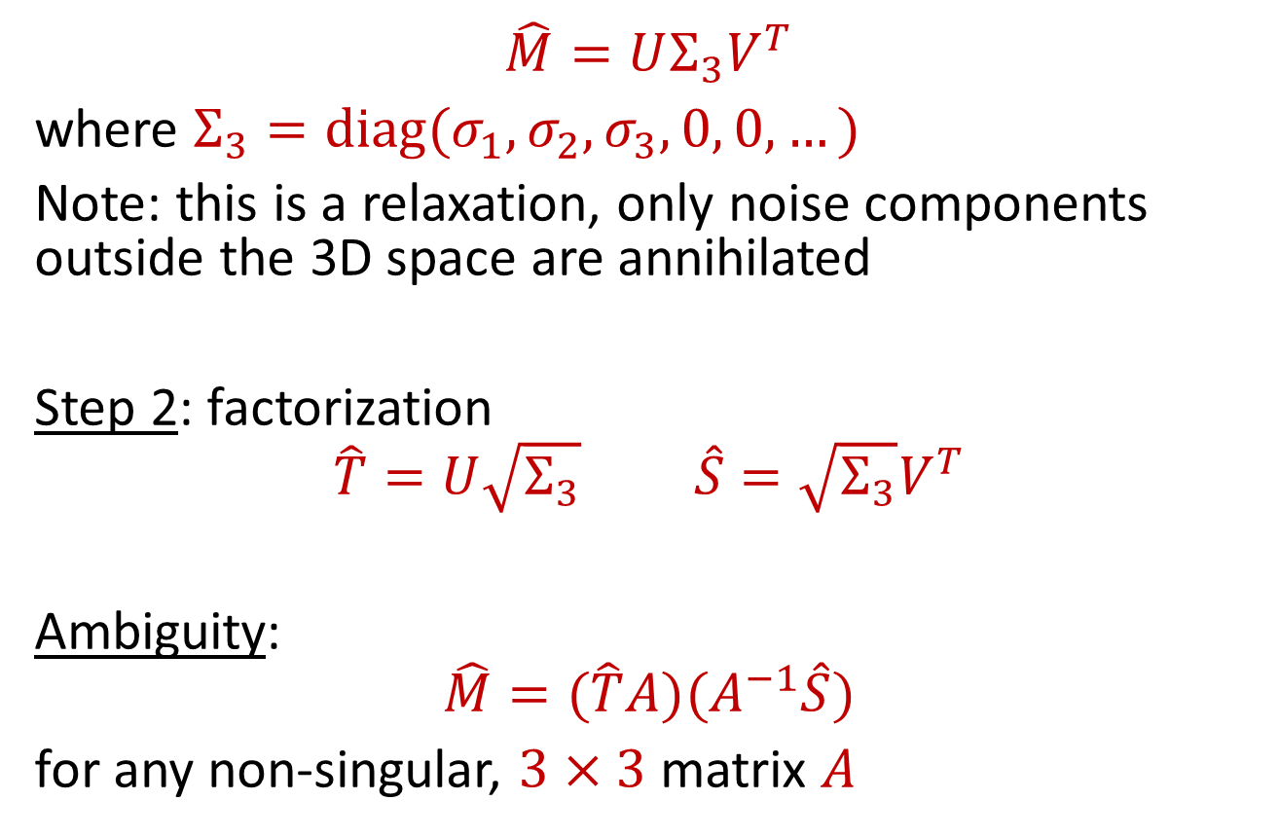
TK-Factorization
$$\hat{M}=UΣ_{3}V^{T}$$
where $Σ_{3}=diag(σ_{1},σ_{2},σ_{3},0, 0,…)$
Note: this is a relaxation, only noise components outside the 3D space are annihilated
Step 2: factorization
$$\hat{T}=U\sqrt{Σ_{3}} \hat{S}=\sqrt{Σ_{3}}V^{T}$$
Ambiguity:
$$\hat{M}=(\hat{T}A)(A^{−1}\hat{S})$$
for any non-singular, $3×3$ matrix $A$

Slide 14
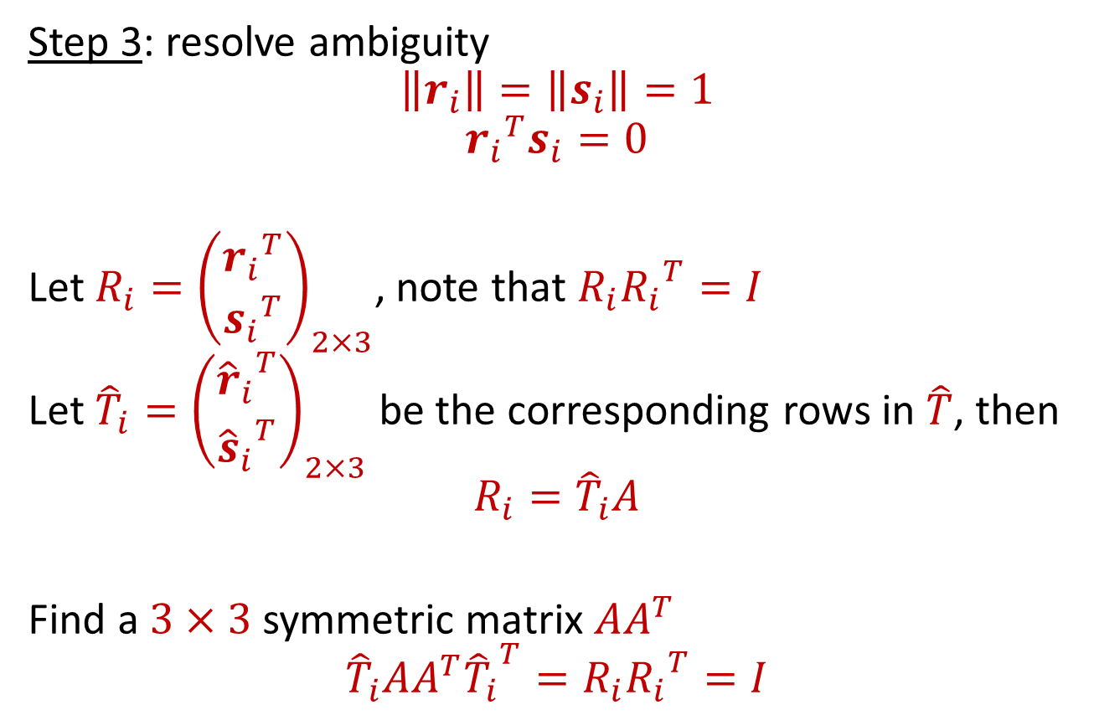
TK-Factorization
Step 3: resolve ambiguity
$$\left\|r_{i}\right\|=\left\|s_{i}\right\|=1$$
$${r_{i}}^{T}s_{i}=0$$
Let $R_{i}={\left(\begin{matrix}{r_{i}}^{T} \\ {s_{i}}^{T}\end{matrix}\right)}_{2×3}$, note that $R_{i}{R_{i}}^{T}=I$
Let ${\hat{T}}_{i}={\left(\begin{matrix}{{\hat{r}}_{i}}^{T} \\ {{\hat{s}}_{i}}^{T}\end{matrix}\right)}_{2×3}$ be the corresponding rows in $\hat{T}$, then
$$R_{i}={\hat{T}}_{i}A$$
Find a $3×3$symmetric matrix $AA^{T}$
$${\hat{T}}_{i}AA^{T}{{\hat{T}}_{i}}^{T}=R_{i}{R_{i}}^{T}=I$$

Slide 15
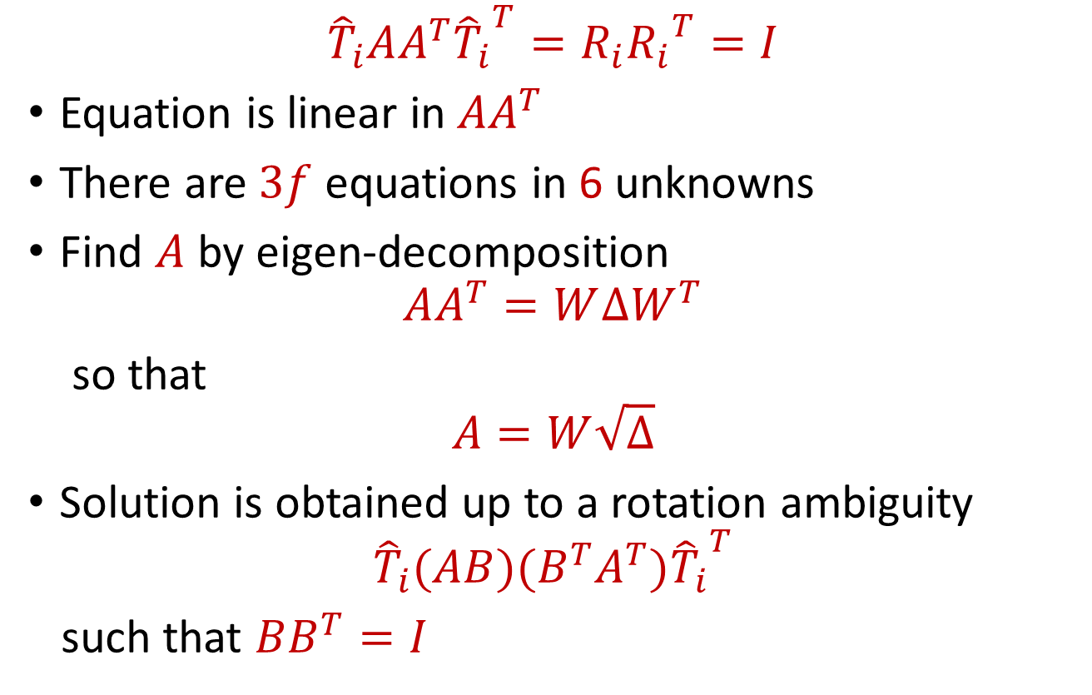
TK-Factorization
$${\hat{T}}_{i}AA^{T}{{\hat{T}}_{i}}^{T}=R_{i}{R_{i}}^{T}=I$$
Equation is linear in $AA^{T}$
There are $3f$ equations in 6 unknowns
Find $A$ by eigen-decomposition
$$AA^{T}=W∆W^{T}$$
so that
$$A=W\sqrt{∆}$$
Solution is obtained up to a rotation ambiguity
$${\hat{T}}_{i}(AB)(B^{T}A^{T}){{\hat{T}}_{i}}^{T}$$
such that $BB^{T}=I$

Slide 16
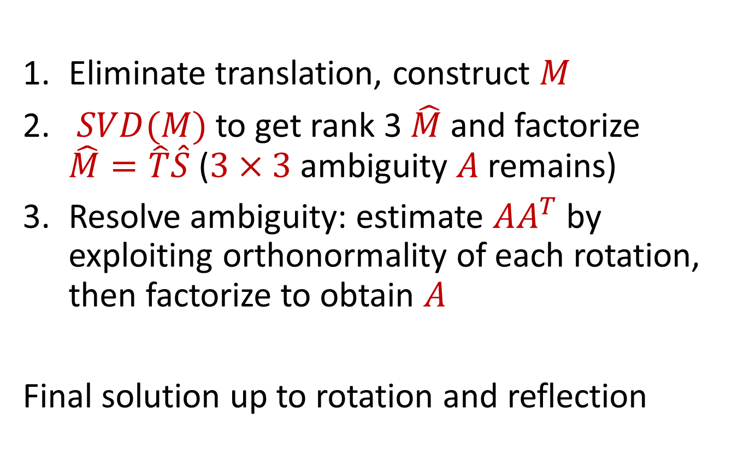
TK-Factorization: Summary
Eliminate translation, construct $M$
$SVD(M)$ to get rank 3 $\hat{M}$ and factorize $\hat{M}=\hat{T}\hat{S}$ ($3×3$ambiguity $A$remains)
Resolve ambiguity: estimate $AA^{T}$ by exploiting orthonormality of each rotation, then factorize to obtain $A$
Final solution up to rotation and reflection

Slide 17
TK-Factorization: pros and cons
Advantages:
  Breaks a difficult, non-linear optimization into simple optimization steps
  Works well with errors
Disadvantage:
  Orthographic projection
  Requires complete tracks

Slide 18
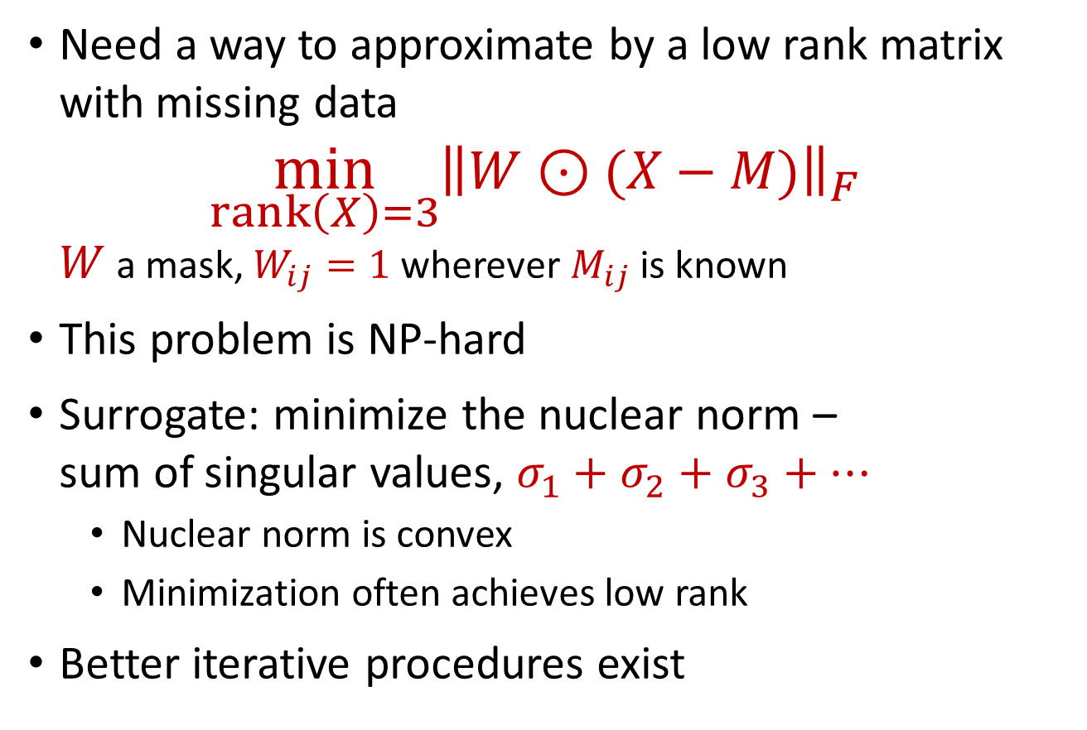
Factorization with incomplete tracks
Need a way to approximate by a low rank matrix with missing data
$\min_{rank\left(X\right)=3}{{\left\|W⊙(X−M)\right\|}_{F}}$
$W$ a mask, $W_{ij}=1$ wherever $M_{ij}$ is known
This problem is NP-hard
Surrogate: minimize the nuclear norm –
sum of singular values, $σ_{1}+σ_{2}+σ_{3}+…$
  Nuclear norm is convex
  Minimization often achieves low rank
Better iterative procedures exist

Slide 19
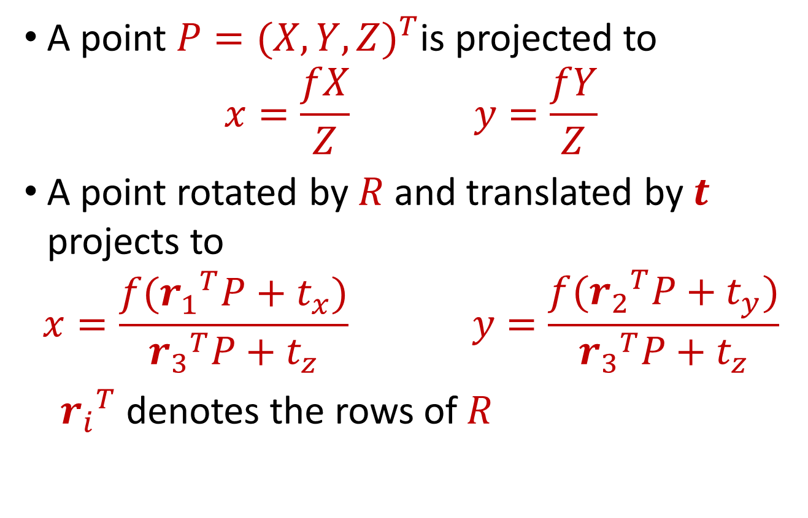
Perspective multiview stereo
A point $P={(X,Y,Z)}^{T}$is projected to
$$x=\frac{fX}{Z} y=\frac{fY}{Z}$$
A point rotated by $R$ and translated by $t$ projects to
$$x=\frac{f({r_{1}}^{T}P+t_{x})}{{r_{3}}^{T}P+t_{z}} y=\frac{f({r_{2}}^{T}P+t_{y})}{{r_{3}}^{T}P+t_{z}}$$
${r_{i}}^{T}$ denotes the rows of $R$

Slide 20
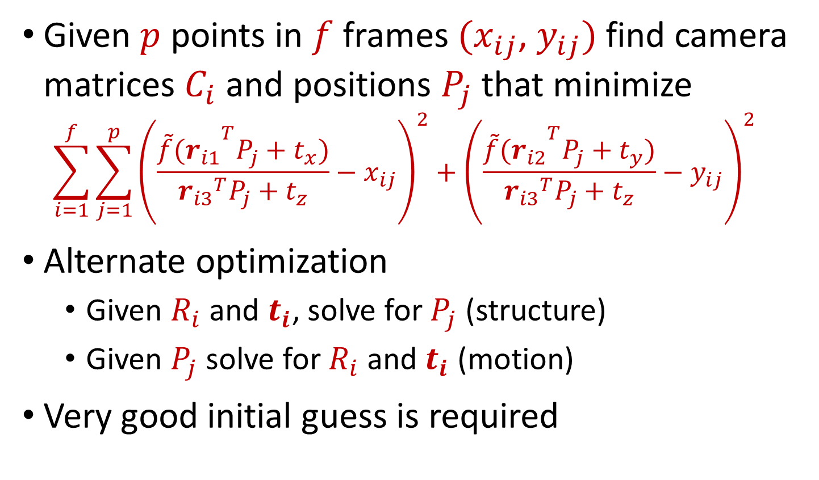
Bundle adjustment
Given $p$ points in $f$ frames ${(x}_{ij}$, $y_{ij})$ find camera matrices $C_{i}$ and positions $P_{j}$ that minimize
$$\sum_{i=1}^{f}{\sum_{j=1}^{p}{{\left(\frac{{\tilde{f}(r_{i1}}^{T}P_{j}+t_{x})}{{r_{i3}}^{T}P_{j}+t_{z}}−x_{ij}\right)}^{2}+{\left(\frac{{{\tilde{f}(r}_{i2}}^{T}P_{j}+t_{y})}{{r_{i3}}^{T}P_{j}+t_{z}}−y_{ij}\right)}^{2}}}$$
Alternate optimization
  Given $R_{i}$ and $t_{i}$, solve for $P_{j}$ (structure)
  Given $P_{j}$ solve for $R_{i}$ and $t_{i}$ (motion)
Very good initial guess is required

Slide 21
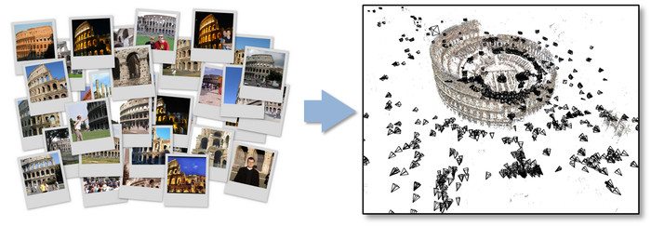
Bundler (Photo Tourism)
(Snavely et al.)

Slide 22
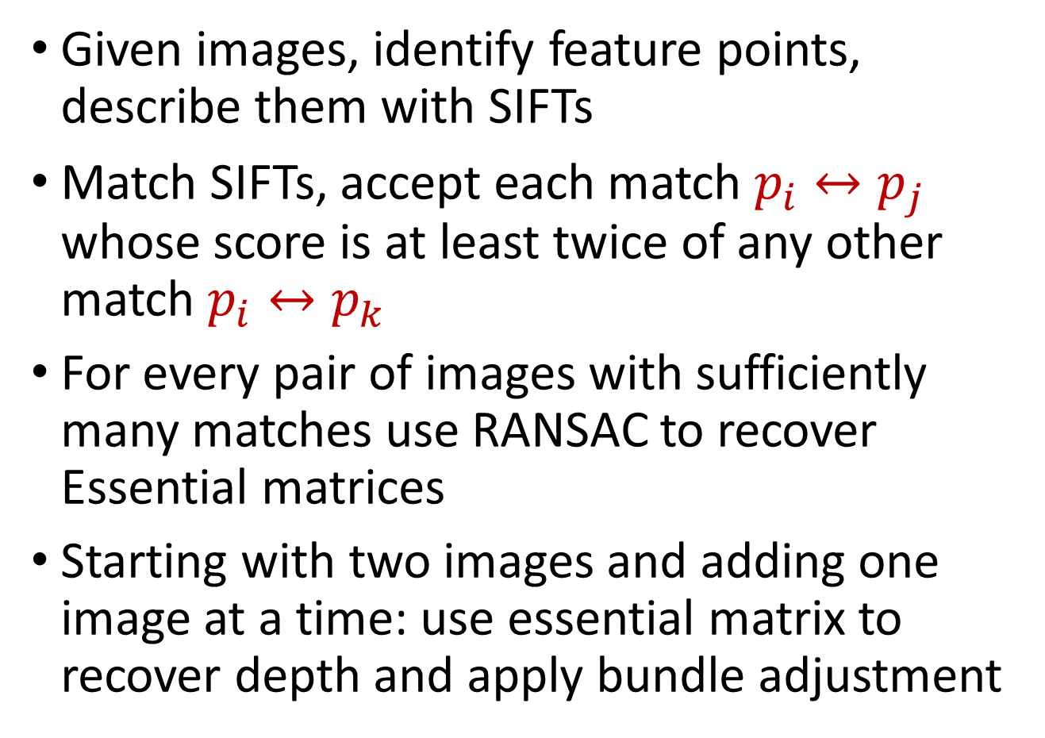
Bundler (Photo Tourism)
Given images, identify feature points, describe them with SIFTs
Match SIFTs, accept each match $p_{i}↔p_{j}$ whose score is at least twice of any other match $p_{i}↔p_{k}$
For every pair of images with sufficiently many matches use RANSAC to recover Essential matrices
Starting with two images and adding one image at a time: use essential matrix to recover depth and apply bundle adjustment

Slide 23
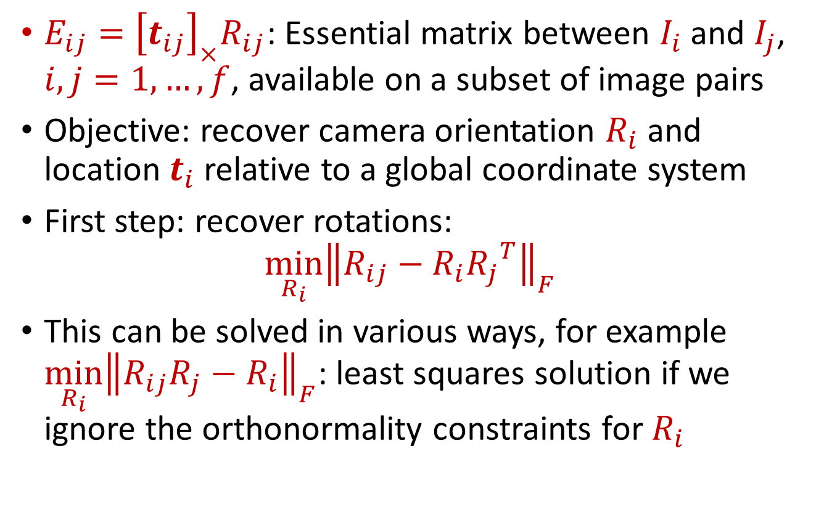
Simultaneous solutions
$E_{ij}={{\left[t_{ij}\right]}_{×}R}_{ij}$: Essential matrix between $I_{i}$ and $I_{j}$, $i,j=1,…,f$, available on a subset of image pairs
Objective: recover camera orientation $R_{i}$ and location $t_{i}$ relative to a global coordinate system
First step: recover rotations:
$$\min_{R_{i}}{{\left\|R_{ij}−R_{i}{R_{j}}^{T}\right\|}_{F}}$$
This can be solved in various ways, for example $\min_{R_{i}}{{\left\|R_{ij}R_{j}−R_{i}\right\|}_{F}}$: least squares solution if we ignore the orthonormality constraints for $R_{i}$

Slide 24
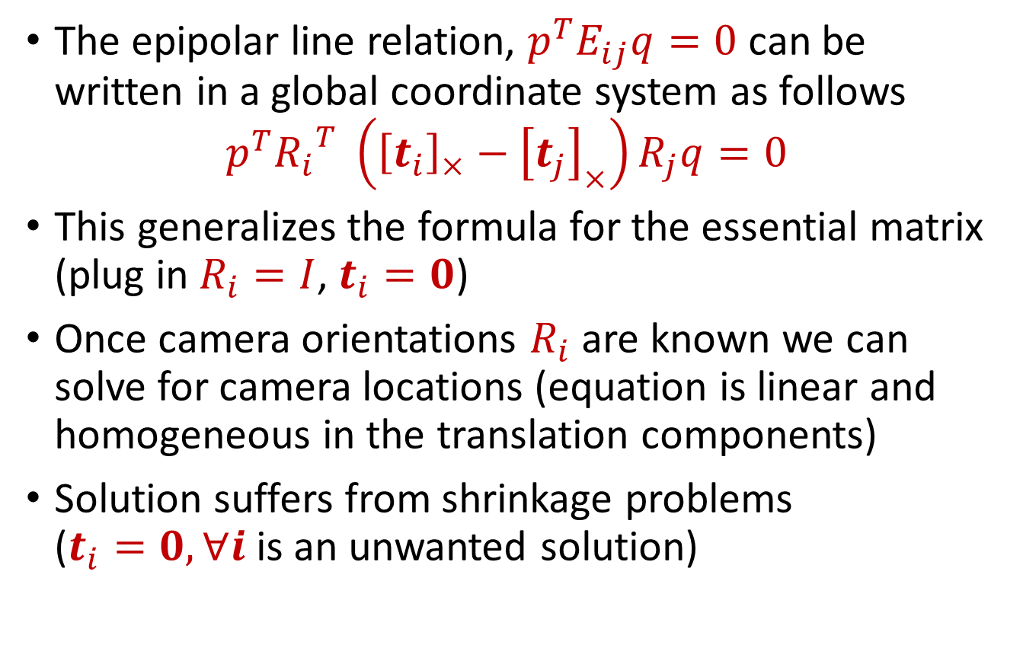
Epipolar relation in global coordinates
The epipolar line relation, $p^{T}E_{ij}q=0$ can be written in a global coordinate system as follows
$$p^{T}{R_{i}}^{T} \left({\left[t_{i}\right]}_{×}−{\left[t_{j}\right]}_{×}\right)R_{j}q=0$$
This generalizes the formula for the essential matrix (plug in $R_{i}=I$, $t_{i}=0$)
Once camera orientations $R_{i}$ are known we can solve for camera locations (equation is linear and homogeneous in the translation components)
Solution suffers from shrinkage problems
($t_{i}=0, ∀i$ is an unwanted solution)

Slide 25
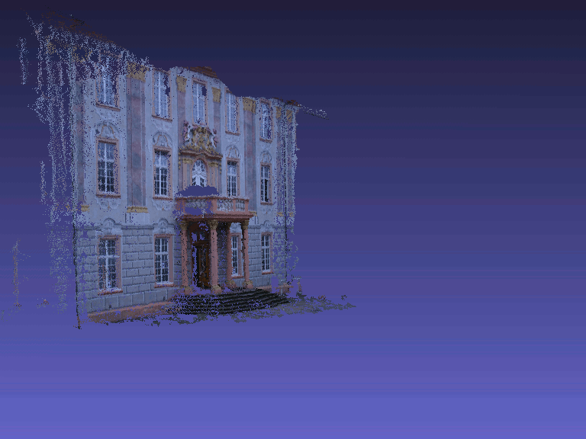
Multiview reconsruction

