Slide 1
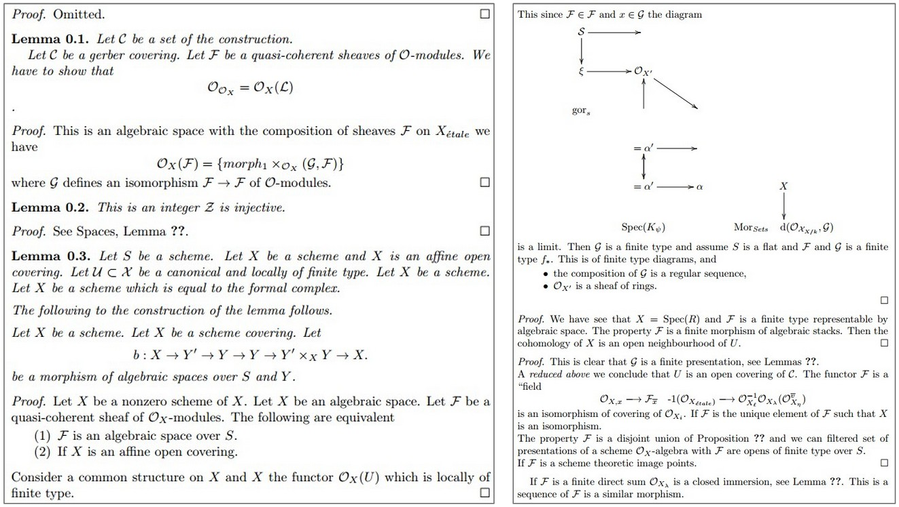
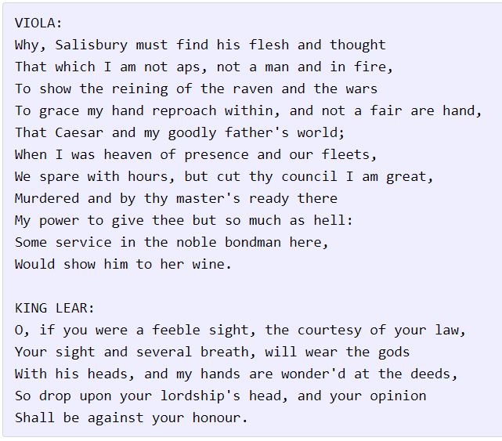
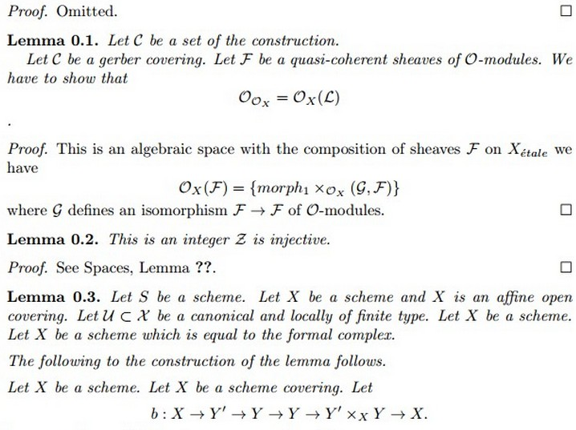
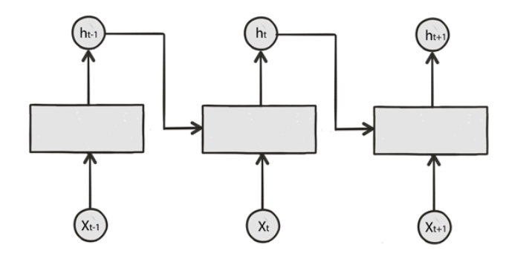
Zc
_{ab}
Advanced RNNs
(Sequence modeling)
Roman Beily Math & CS, MSc student @ Michal Irani
Guy Gaziv Math & CS, PhD candidate @ Michal Irani
27.5.18

Slide 2
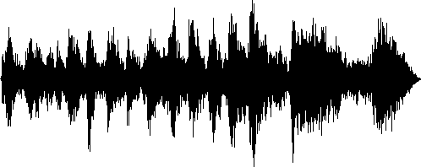


RNNs model sequence to sequence mappings of arbitrary lengths
Andrew Ng, RNN course
Task | Input | Output
Speech recognition |  | “This is an advanced course in deep learning.”
Sentiment classification | “There is nothing to like in this movie.”
Machine translation |  | “I love you”
Video activity recognition | Sequence of frames | “Running”
Name entity recognition | Yesterday, Harry Potter met Hermoine Granger | Yesterday, Harry Potter met Hermoine Granger
Notes:
Why not via RNNs?

Slide 3
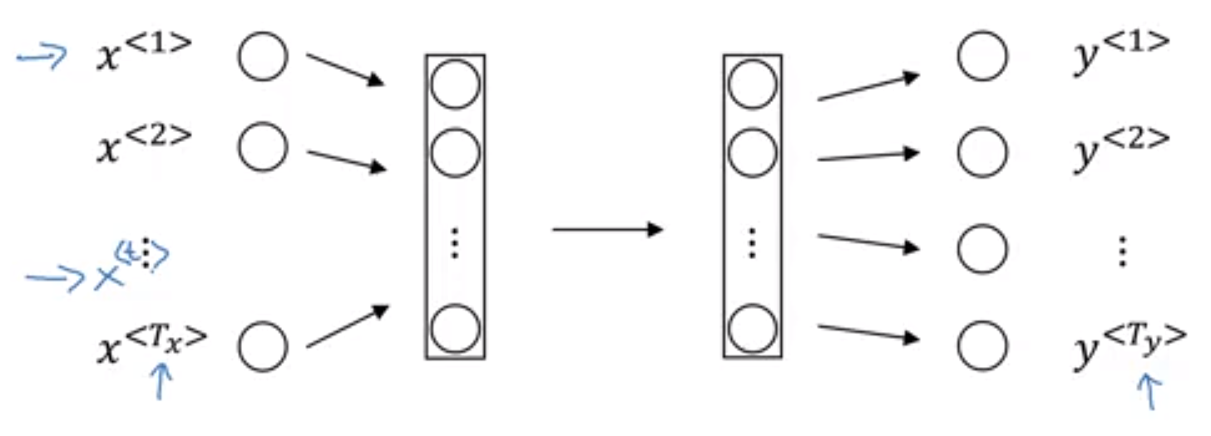
Feed forward models are not a natural fit to represent sequences
Problems:
Inputs, outputs can be different lengths in different examples.
Doesn’t share features learned across different positions in sequence.
Momentary inputs typically of order 10k.
Andrew Ng, RNN course
Notes:
e.g. Entity name recognition.
Different sizes of sequences.
Generalize quickly to other parts of the sequence, like done with images.
Inputs are typically 10000 size – large temporal support will give rise to huge number of params.

Slide 4


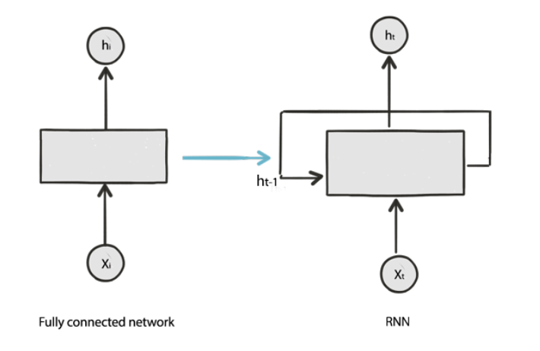
RNNs modulate their response to current input based on their previous state
https://jhui.github.io/2017/03/15/RNN-LSTM-GRU/
Notes:
Unlike feed-forward architectures. State machines.

Slide 5


The basic RNN transition function is an affine transformation of current input and previous state
Basic RNN unit (affine/tanh)
Chung & Bengio et al., 2015
Notes:
Commonly RNN models are unraveled in time for clarity.

Slide 6

RNNs can model probability distribution over sequences
Chung & Bengio et al., 2015
Notes:
we can train an RNN to model this distribution by
letting it predict the probability of the next symbol xt+1
given hidden states ht which is a function of all the previous
symbols x 1-(t-1) and current symbol xt

Slide 7
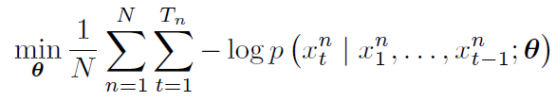
RNNs can model probability distribution over sequences
Negative Log-Likelihood
(NLL)
Objective:
All sequences
All elements in sequence
Probability of getting element given previous elements in sequence
Chung & Bengio et al., 2015
Notes:
we can train an RNN to model this distribution by
letting it predict the probability of the next symbol xt+1
given hidden states ht which is a function of all the previous
symbols x 1-(t-1) and current symbol xt

Slide 8
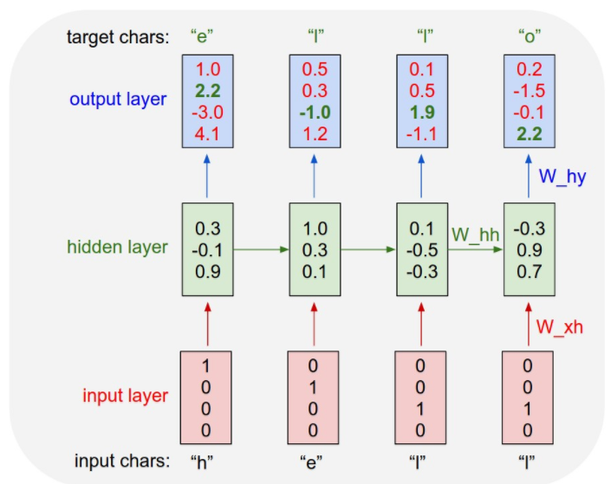
Example: single layer RNN for character-level language modeling
Vocabulary:
{“h”,”e”,”l”,”o”}
Training sequence:
“hello”
Notes:
This training sequence is in fact a source of 4 separate training examples: 1. The probability of “e” should be likely given the context of “h”, 2. “l” should be likely in the context of “he”, 3. “l” should also be likely given the context of “hel”, and finally 4. “o” should be likely given the context of “hell”.

Slide 9
RNNs are difficult in capturing long-term dependencies
The student, who worked really hard on this presentation, was hungry.
The students, who already ate all the delicious humus, were full.
Notes:
Vanishing gradient problem.
Credit assignment problem.
Backprop in time

Slide 10
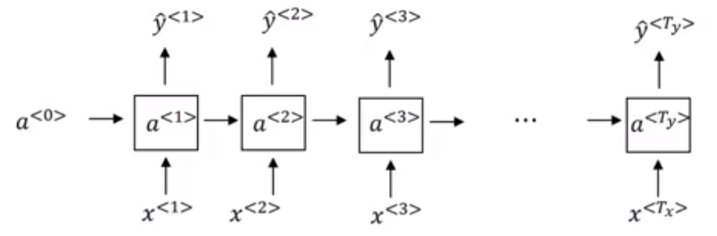
RNNs are difficult in capturing long-term dependencies
Andrew Ng, RNN course
The student, who worked really hard on this presentation, was hungry.
The students, who already ate all the delicious humus, were full.
RNN
Notes:
Vanishing gradient problem.
Credit assignment problem.
Backprop in time

Slide 11

RNNs are difficult in capturing long-term dependencies
Andrew Ng, RNN course
The student, who worked really hard on this presentation, was hungry.
The students, who already ate all the delicious humus, were full.
RNN
Notes:
Vanishing gradient problem.
Credit assignment problem.
Backprop in time

Slide 12
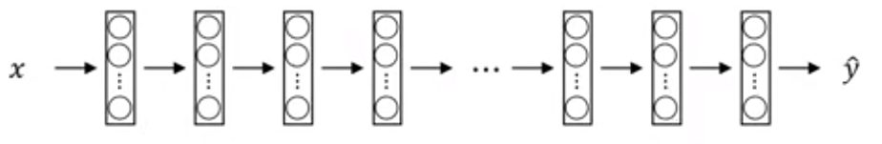
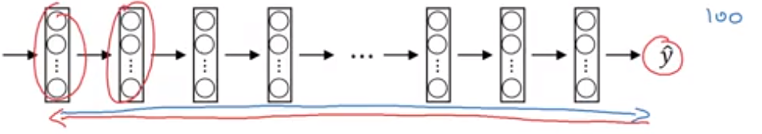
RNNs are difficult in capturing long-term dependencies
Andrew Ng, RNN course
The student, who worked really hard on this presentation, was hungry.
The students, who already ate all the delicious humus, were full.
RNN
DNN
Notes:
Vanishing gradient problem.
Credit assignment problem.
Backprop in time

Slide 13
RNNs are difficult in capturing long-term dependencies
Andrew Ng, RNN course
The student, who worked really hard on this presentation, was hungry.
The students, who already ate all the delicious humus, were full.
RNN
DNN
Notes:
Vanishing gradient problem.
Credit assignment problem.
Backprop in time

Slide 14


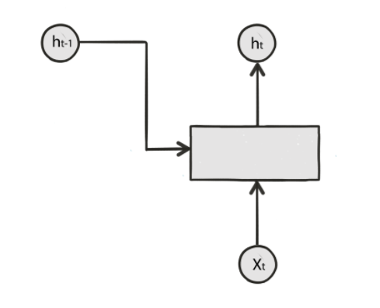




LSTM and GRU incorporate gated memory mechanisms to better capture long-term dependencies
Candidate state
LSTM
RNN block
Notes:
To the rescue.

Slide 15










LSTM and GRU incorporate gated memory mechanisms to better capture long-term dependencies
Candidate state
LSTM
RNN block
Notes:
To the rescue.

Slide 16
LSTM and GRU incorporate gated memory mechanisms to better capture long-term dependencies
Candidate state
LSTM
RNN block
Notes:
To the rescue.

Slide 17




LSTM and GRU incorporate gated memory mechanisms to better capture long-term dependencies
Candidate state
LSTM
Candidate state
GRU
RNN block
Leaky integration
Basic RNN (reminder)
Notes:
To the rescue.

Slide 18
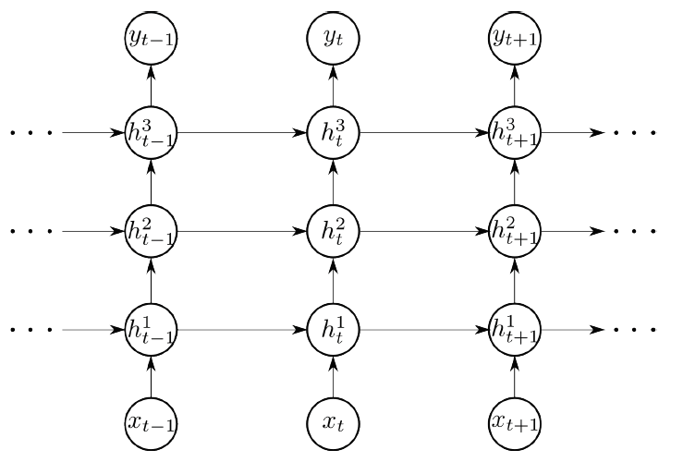
RNN blocks are commonly stacked as deep networks to gain expressive power and temporal hierarchy
Chung & Bengio et al., 2015
Notes:
How does this introduce temporal hierarchy?

Slide 19
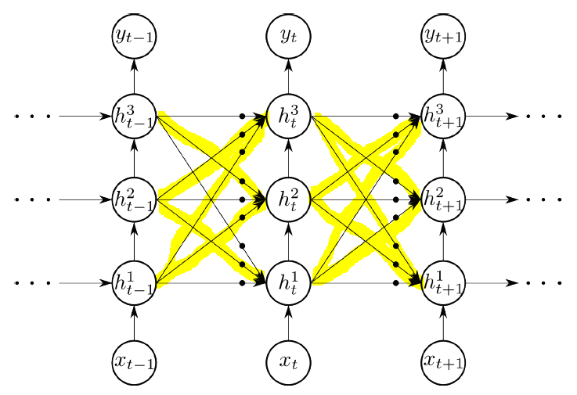
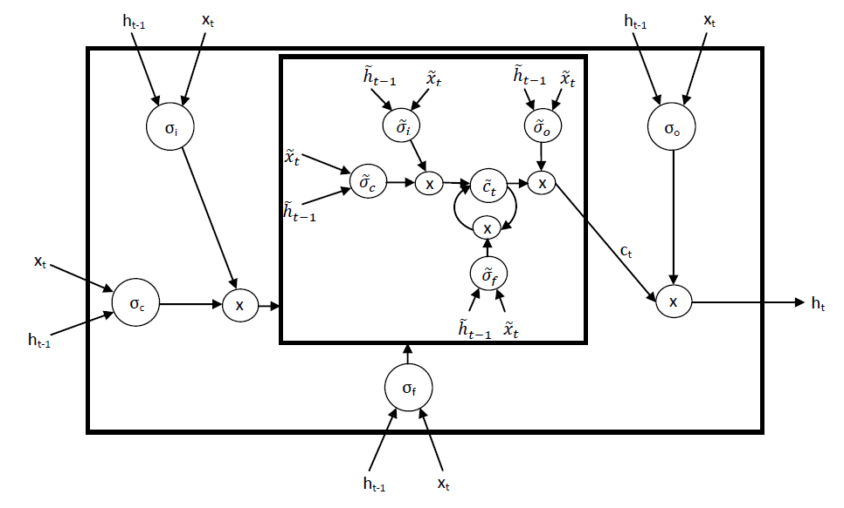
Primary research in RNNs focuses on improving their ability represent dependencies across multiple timescales
Gated Feedback RNNs
Chung & Bengio et al., 2015
(“skip-connections” in stacked RNNs)
Nested LSTMs
Moniz & Krueger, 2018
(Nesting units as alternative to stacking)

Slide 20
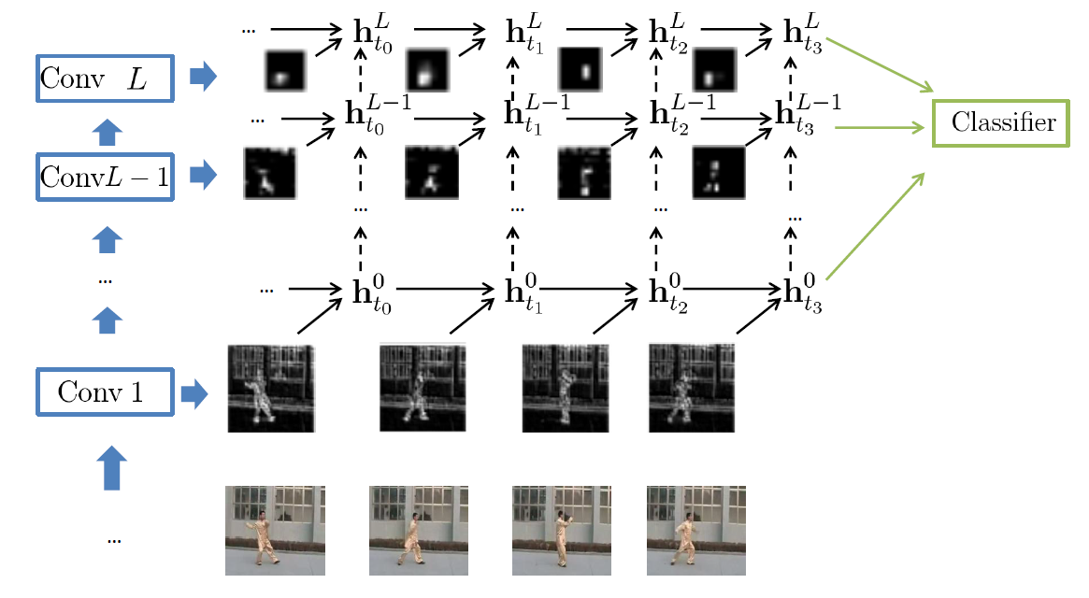
Researchers combine the spatial and temporal representation power of CNN and RNN respectively
Delving Deeper Into Convolutional Networks for Learning Video Representations
Ballas & Courville et al., 2016
(Use RNNs to capture dynamics of semantic “percepts”, i.e. CNN features)

Slide 21
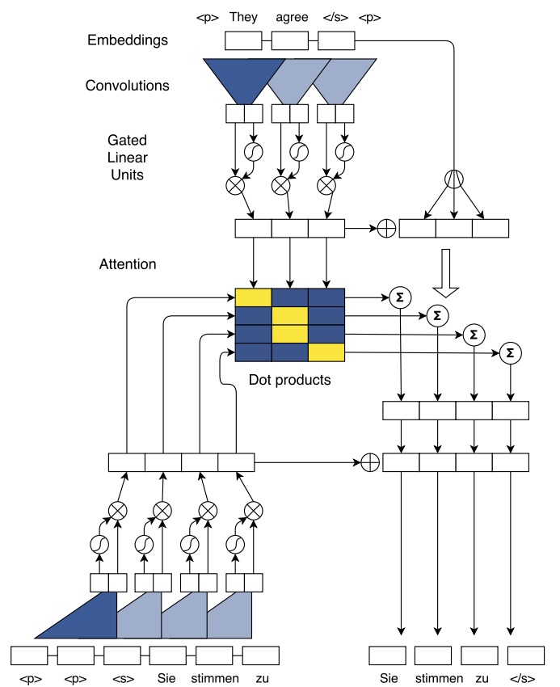
Recent studies show that CNNs can be designed to outperform RNNs in sequence modeling
Convolutional Sequence to Sequence Learning
Gehring & Dauphin et al., 2017
(Modeling sequences efficiently using convolutional operations combined with attention mechanisms)
Notes:
Alternative to recurrent connections.

Slide 22
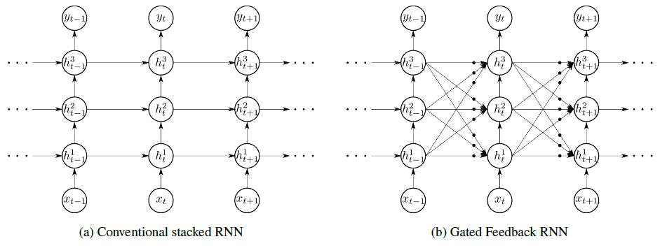
Gated feedback RNN is a stacked RNN with fully connected recurrent transitions
Chung & Bengio et al., 2015
Notes:
a sequence often consists of both slow moving and fast-moving components, of which only the
former corresponds to long-term dependencies.
Ideally, an RNN needs to capture both long-term and short-term dependencies.
Unlike the CW-RNN, however, we do not set an explicit
rate for each module. Instead, we let each module operate
at different timescales by hierarchically stacking them.
The GF-RNN, however, further
allows information from the upper recurrent layer, corresponding
to coarser timescale, flows back into the lower
recurrent layers, corresponding to finer timescales.

Slide 23

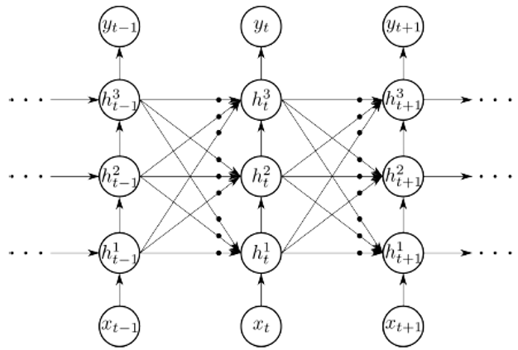

Global reset gates moderate the flow across levels in consecutive steps
Chung & Bengio et al., 2015
Notes:
where ht
􀀀1 is the concatenation of all the hidden states
from the previous timestep t 􀀀 1. The superscript i!j is
an index of associated set of parameters for the transition
from layer i in timestep t􀀀1 to layer j in timestep t.

Slide 24
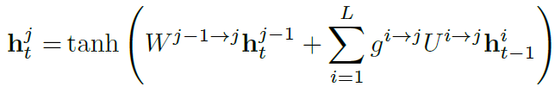
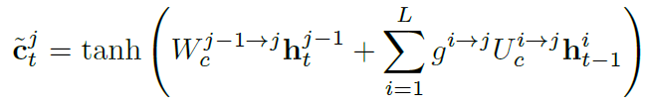
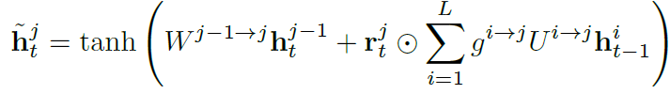
Global reset gates moderate the flow across levels in consecutive steps
Affine/tanh:
LSTM:
GRU:
Chung & Bengio et al., 2015
Notes:
where ht
􀀀1 is the concatenation of all the hidden states
from the previous timestep t 􀀀 1. The superscript i!j is
an index of associated set of parameters for the transition
from layer i in timestep t􀀀1 to layer j in timestep t.

Slide 25
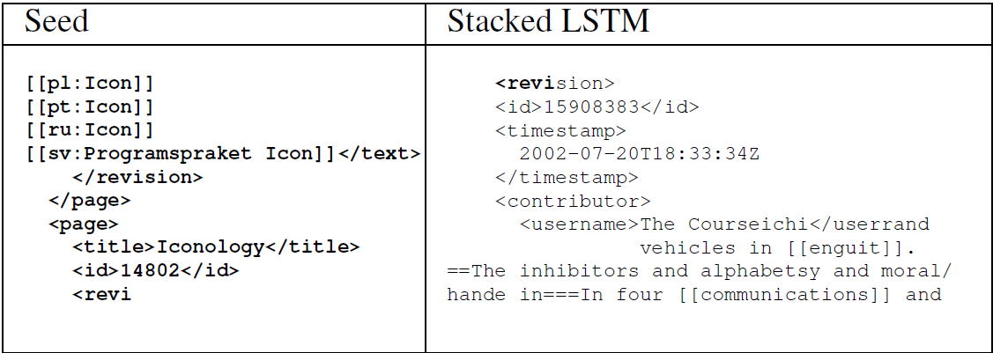

The authors considered two sequence modeling tasks: language modeling and code execution
Char-level Language Modeling (following Mikolov 2012)
Dataset:
Human knowledge compression contest (Hutter, 2012).
100MB of English wiki-like characters.
Task: Given char sequence, predict next char.
Performance measure:
bits per character (BPC).
Chung & Bengio et al., 2015
Notes:
The dataset, which contains 100 MBytes of characters which include Latin alphabets, non-Latin alphabets,
XML markups and special characters.

Slide 26
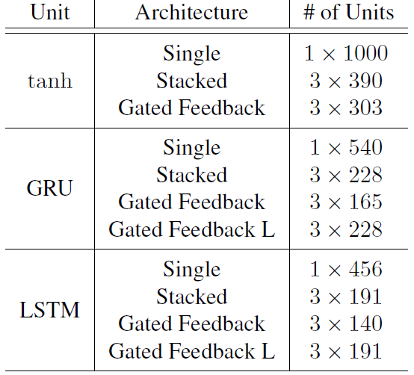
GF-RNN was evaluated against single and stacked architectures
Chung & Bengio et al., 2015
Notes:
Table 1. The sizes of the models used in character-level language
modeling. Gated Feedback L is a GF-RNN with a same number
of hidden units as a Stacked RNN (but more parameters). The
number of units is shown as (number of hidden layers)
(number of hidden units per layer).

Slide 27
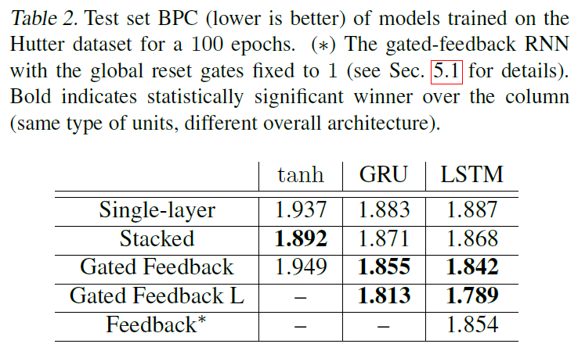
GF-RNN with LSTM/GRU outperforms stacked and shallow RNNs
Chung & Bengio et al., 2015
Notes:
Table 1. The sizes of the models used in character-level language
modeling. Gated Feedback L is a GF-RNN with a same number
of hidden units as a Stacked RNN (but more parameters). The
number of units is shown as (number of hidden layers)
(number of hidden units per layer).
the proposed architecture
failed to improve the performance of a vanilla-
RNN with tanh units.

Slide 28
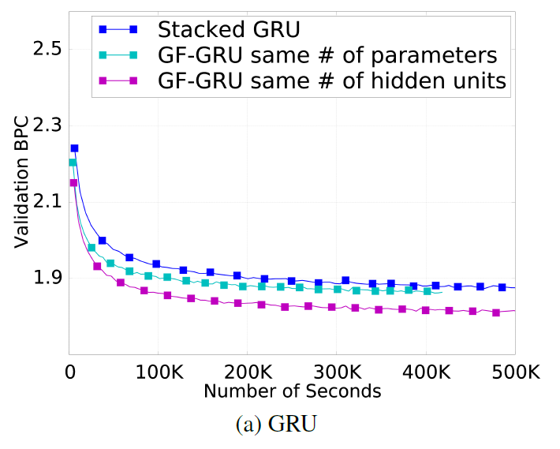
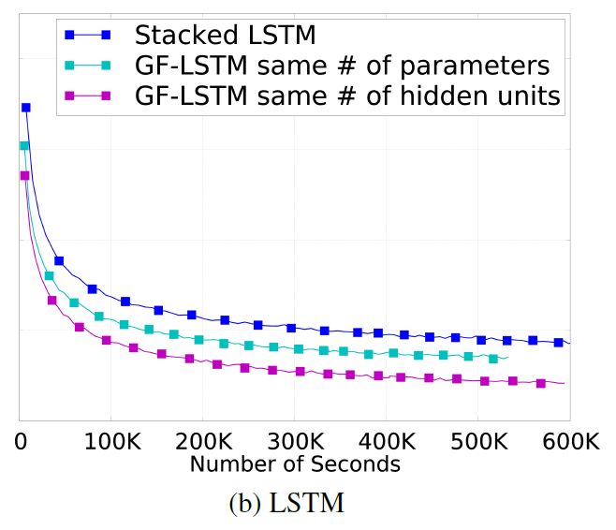
GF-RNN makes faster progress over the training
Chung & Bengio et al., 2015
Notes:
This behavior is observed both when the number
of parameters is constrained and when the number of hidden units is constrained. This suggests that the proposed
GF-RNN significantly facilitates optimization/learning.

Slide 29
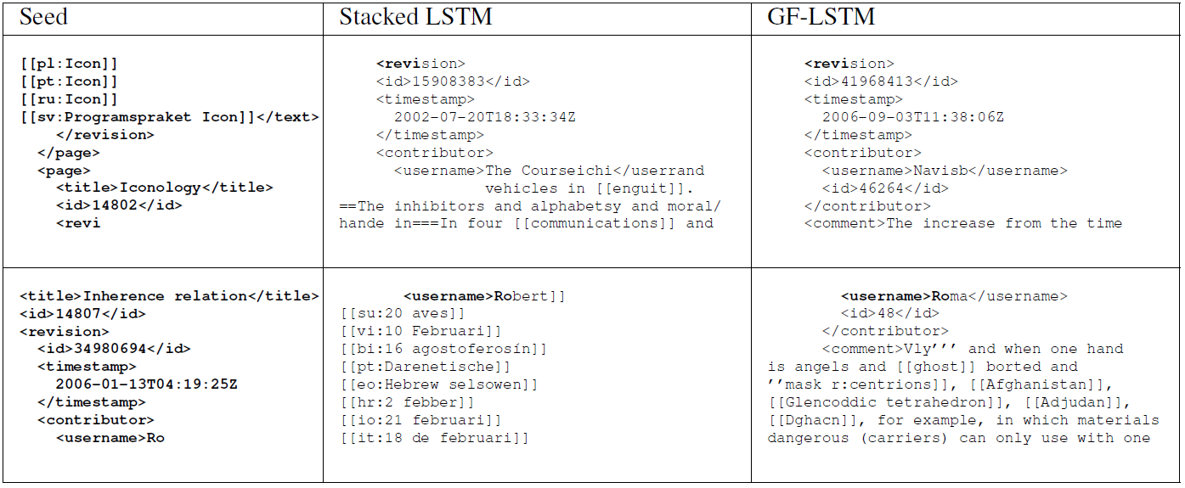
GF-RNN is better in capturing structure of XML tags
Chung & Bengio et al., 2015
Notes:
Table 3. Generated texts with our trained models. Given the seed at the left-most column (bold-faced font), the models predict next
300 characters. Tabs, spaces and new-line characters are also generated by the models.
Given two seed snippets selected randomly from the test
set, we generated the sequence of characters ten times for
each model (stacked LSTM and GF-LSTM). We show one
of those ten generated samples per model and per seed snippet
in Table 3. We observe that the stacked LSTM failed to
close the tags with </username> and </contributor>
in both trials. However, the GF-LSTM succeeded to close both of them, which shows that it learned about the structure
of XML tags. This type of behavior could be seen
throughout all ten random generations.

Slide 30
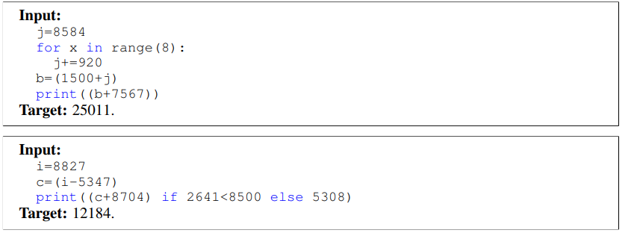
The authors considered two sequence modeling tasks: language modeling and code execution
Python Program Evaluation
(following Zaremba & Sutskever 2014)
Dataset:
320k (code, output) examples, diverse difficulty.
Task: Given python script, generate correct output.
Performance measure:
Probability of correct prediction of next output symbol given preceding symbols.
Zaremba & Sutskever, 2014
Notes:
Python program evaluation: Scripts used in this task include addition, multiplication,
subtraction, for-loop, variable assignment, logical comparison
and if-else statement. Both the input script and the output are sequences of characters,
where the input and output vocabularies respectively
consist of 41 and 13 symbols. The difficulty is determined by
the number of nesting levels in the input sequence and the
length of the target sequence. When training the models, Python scripts
are fed into the encoder RNN, and the hidden state of the
encoder RNN is unfolded for 50 timesteps. Prediction is
performed by the decoder RNN whose initial hidden state
is initialized with the last hidden state of the encoder RNN. We generated 320; 000 examples using the script
provided by Zaremba & Sutskever (2014), with the nesting
randomly sampled from [1, 5] and the target length from [1, 10^10].
.

Slide 31
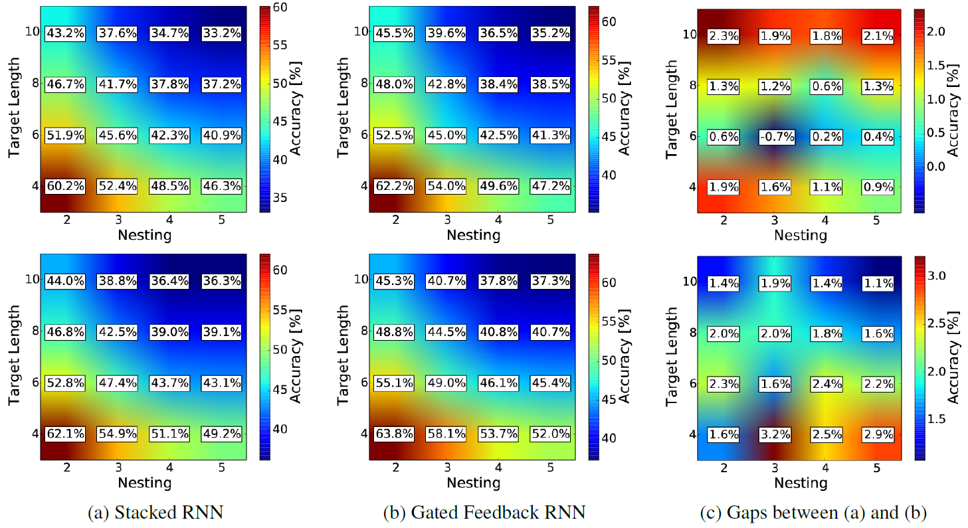
GF-RNN outperforms stacked RNNs in code execution
Chung & Bengio et al., 2015
GRU
LSTM
Notes:
The accuracy tends to decrease by the growth of the length of target sequences or the number of nesting
levels, where the difficulty or complexity of the Python program
increases.
At test time, we evaluated each model on multiple sets of
test examples where each set is generated using a fixed target
length and number of nesting levels. Each test set contains
2000 examples which are ensured not to overlap with
the training set.
From this
we can more easily see that the GF-RNN outperforms the
stacked RNN, especially as the number of nesting levels
grows or the length of target sequences increases.

Slide 32
GF-RNN outperforms stacked RNNs in code execution
Chung & Bengio et al., 2015
GRU
LSTM
Notes:
The accuracy tends to decrease by the growth of the length of target sequences or the number of nesting
levels, where the difficulty or complexity of the Python program
increases.
At test time, we evaluated each model on multiple sets of
test examples where each set is generated using a fixed target
length and number of nesting levels. Each test set contains
2000 examples which are ensured not to overlap with
the training set.
From this
we can more easily see that the GF-RNN outperforms the
stacked RNN, especially as the number of nesting levels
grows or the length of target sequences increases.

Slide 33
GF-RNN outperforms stacked RNNs in code execution
Chung & Bengio et al., 2015
GRU
LSTM
Notes:
The accuracy tends to decrease by the growth of the length of target sequences or the number of nesting
levels, where the difficulty or complexity of the Python program
increases.
At test time, we evaluated each model on multiple sets of
test examples where each set is generated using a fixed target
length and number of nesting levels. Each test set contains
2000 examples which are ensured not to overlap with
the training set.
From this
we can more easily see that the GF-RNN outperforms the
stacked RNN, especially as the number of nesting levels
grows or the length of target sequences increases.

Slide 34
GF-RNN outperforms stacked RNNs in code execution
Chung & Bengio et al., 2015
GRU
LSTM
Notes:
The accuracy tends to decrease by the growth of the length of target sequences or the number of nesting
levels, where the difficulty or complexity of the Python program
increases.
At test time, we evaluated each model on multiple sets of
test examples where each set is generated using a fixed target
length and number of nesting levels. Each test set contains
2000 examples which are ensured not to overlap with
the training set.
From this
we can more easily see that the GF-RNN outperforms the
stacked RNN, especially as the number of nesting levels
grows or the length of target sequences increases.

Slide 35
How to efficiently capture diversity of timescales?
Nested LSTMs
Moniz & Krueger, 2018
Notes:
This key feature allows the model to implement
a more effective temporal hierarchy than a conventional Stacked LSTM.
In contrast, in stacked LSTMs, the upper-level activations (analogous to the inner memories) are
directly accessed to produce an output, and therefore must contain all the short-term information
which is relevant to the current prediction.

Slide 36
Stacked RNNs are commonly used to encode implicit prior of temporal hierarchy
Chung & Bengio et al., 2015
Notes:
This key feature allows the model to implement
a more effective temporal hierarchy than a conventional Stacked LSTM.
In contrast, in stacked LSTMs, the upper-level activations (analogous to the inner memories) are
directly accessed to produce an output, and therefore must contain all the short-term information
which is relevant to the current prediction.

Slide 37
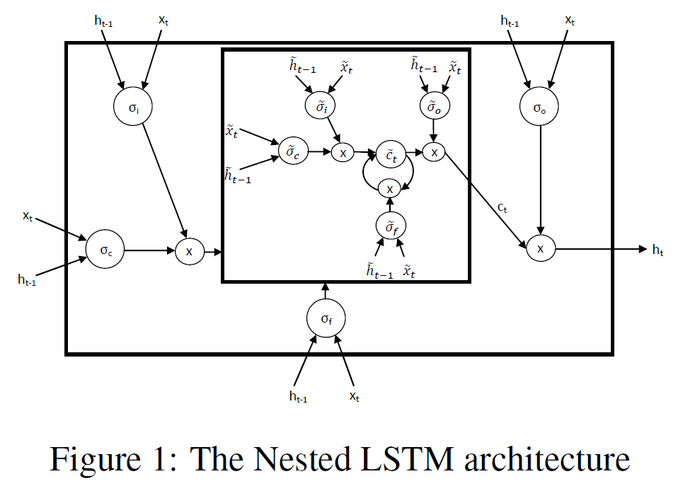
The authors argue that nesting RNN units is a better way to encode prior of temporal hierarchy
(General RNN)
Moniz & Krueger, 2018
Notes:
This key feature allows the model to implement
a more effective temporal hierarchy than a conventional Stacked LSTM.
In contrast, in stacked LSTMs, the upper-level activations (analogous to the inner memories) are
directly accessed to produce an output, and therefore must contain all the short-term information
which is relevant to the current prediction.

Slide 38
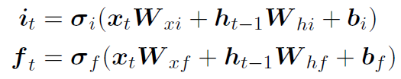


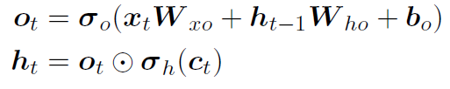
Basic LSTM updates its memory as a double-gated sum of previous memory and a candidate memory
Moniz & Krueger, 2018
Notes:
a sequence often consists of both slow moving and fast-moving components, of which only the
former corresponds to long-term dependencies.
Ideally, an RNN needs to capture both long-term and short-term dependencies.
Unlike the CW-RNN, however, we do not set an explicit
rate for each module. Instead, we let each module operate
at different timescales by hierarchically stacking them.
The GF-RNN, however, further
allows information from the upper recurrent layer, corresponding
to coarser timescale, flows back into the lower
recurrent layers, corresponding to finer timescales.

Slide 39





Nested LSTM update its memory using a learned stateful function
Moniz & Krueger, 2018
Notes:
a sequence often consists of both slow moving and fast-moving components, of which only the
former corresponds to long-term dependencies.
Ideally, an RNN needs to capture both long-term and short-term dependencies.
Unlike the CW-RNN, however, we do not set an explicit
rate for each module. Instead, we let each module operate
at different timescales by hierarchically stacking them.
The GF-RNN, however, further
allows information from the upper recurrent layer, corresponding
to coarser timescale, flows back into the lower
recurrent layers, corresponding to finer timescales.

Slide 40


Particularly, the learned stateful function is yet another LSTM
LSTM
Moniz & Krueger, 2018
Notes:
a sequence often consists of both slow moving and fast-moving components, of which only the
former corresponds to long-term dependencies.
Ideally, an RNN needs to capture both long-term and short-term dependencies.
Unlike the CW-RNN, however, we do not set an explicit
rate for each module. Instead, we let each module operate
at different timescales by hierarchically stacking them.
The GF-RNN, however, further
allows information from the upper recurrent layer, corresponding
to coarser timescale, flows back into the lower
recurrent layers, corresponding to finer timescales.

Slide 41
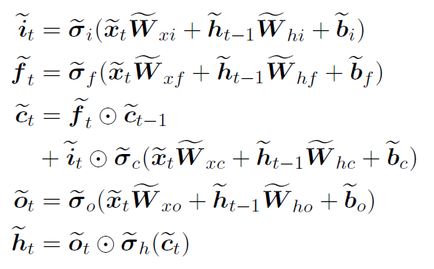
Particularly, the learned stateful function is yet another LSTM
Outer LSTM
Inner LSTM
Moniz & Krueger, 2018
Notes:
a sequence often consists of both slow moving and fast-moving components, of which only the
former corresponds to long-term dependencies.
Ideally, an RNN needs to capture both long-term and short-term dependencies.
Unlike the CW-RNN, however, we do not set an explicit
rate for each module. Instead, we let each module operate
at different timescales by hierarchically stacking them.
The GF-RNN, however, further
allows information from the upper recurrent layer, corresponding
to coarser timescale, flows back into the lower
recurrent layers, corresponding to finer timescales.

Slide 42
Particularly, the learned stateful function is yet another LSTM
Outer LSTM
Moniz & Krueger, 2018
Notes:
a sequence often consists of both slow moving and fast-moving components, of which only the
former corresponds to long-term dependencies.
Ideally, an RNN needs to capture both long-term and short-term dependencies.
Unlike the CW-RNN, however, we do not set an explicit
rate for each module. Instead, we let each module operate
at different timescales by hierarchically stacking them.
The GF-RNN, however, further
allows information from the upper recurrent layer, corresponding
to coarser timescale, flows back into the lower
recurrent layers, corresponding to finer timescales.

Slide 43
The authors considered tasks of text generation
Penn Treebank Corpus (PTB, Marcus et al., 1993).
1M words / 2500 stories from 1989 Wall Street Journal material.
Notes:
the Penn Treebank Corpus
(Marcus et al., 1993) and the larger Text8 dataset (Mahoney, 2011) (both representing standard
character-level language modeling, with Text8 being much larger than the Penn Treebank Corpus),
the Chinese Poem Generation dataset (Zhang and Lapata, 2014) (which requires character-level
language modeling on much smaller sequences with less temporal dependency than is common, but
with a significantly larger number of characters than would typically be found in English), and the
MNIST Glimpses task (Ba et al., 2016) (which is a classification task, but one that contains temporal
5
MONIZ KRUEGER
dependencies).
We also try to match the number of parameters of the different stacked LSTM baselines as closely
as possible with our 2-layer Nested LSTM by adjusting the number of hidden units.
Amongst the many different types of classical Chinese poetry, quatrain and regulated verse are perhaps the best-known ones.
Quatrains have four lines, each five or seven characters long. Characters in turn follow specific phonological patterns, within each line and across lines. For instance, the final characters in the second, fourth and (optionally) first line must rhyme, whereas there are no rhyming constraints for the third line. Moreover, poems must follow a prescribed tonal pattern. In traditional Chinese, every character has one tone, Ping (level tone) or Ze (downward tone). The poem in Table 1 exemplifies one of the most popular tonal patterns (Wang, 2002). Besides adhering to the above formal criteria, poems must exhibit concise and accurate use of language, engage the reader/hearer, stimulate their imagination, and bring out their feelings.
In the MNIST Glimpses task, introduced in Ba et al. (2016), each 28x28 image (with the pixel values
normalized to the range [0, 1]) is split into 4 quadrants. Glimpses of each quadrant (in the form of
alternate rows and columns), followed by the entire quadrant are then fed sequentially into the model
(with 20 elements in the sequence, each element comprising of 49 pixels). The model then predicts
which integer the input represented. The four coarse regions, down-sampled to 7 × 7, along with their the four 7×7 quadrants are presented in a single sequence

Slide 44
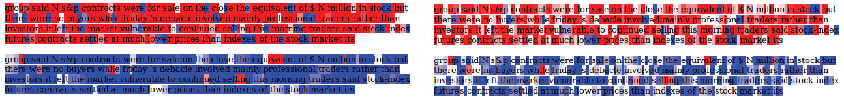
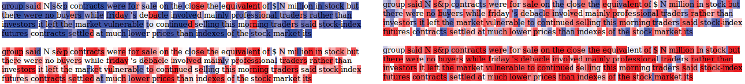
Nested LSTM better represents temporal hierarchy than stacked version
Moniz & Krueger, 2018
Penn Treebank Corpus (PTB, Marcus et al., 1993).
1M words / 2500 stories from 1989 Wall Street Journal material.
Inner cell
Nested
Outer cell
Second layer
Stacked
First layer
Notes:
Red implies a negative cell state value,
and blue a positive one. A darker shade implies a larger magnitude.
In other words, the primary difference between stacked
LSTMs and Nested LSTMs is the idea of selective access to inner memories which the NLSTM
implements. This frees the inner memories to remember and process events on longer time scales,
even when these events are not relevant to the immediate present.
Our visualizations demonstrate that the inner memories of NLSTMs do in fact operate on longer
time-scales than higher-level memories in a stacked LSTM.

Slide 45
Nested LSTM better represents temporal hierarchy than stacked version
Moniz & Krueger, 2018
Penn Treebank Corpus (PTB, Marcus et al., 1993).
1M words / 2500 stories from 1989 Wall Street Journal material.
Inner cell
Nested
Outer cell
Second layer
Stacked
First layer
Notes:
Red implies a negative cell state value,
and blue a positive one. A darker shade implies a larger magnitude.
In other words, the primary difference between stacked
LSTMs and Nested LSTMs is the idea of selective access to inner memories which the NLSTM
implements. This frees the inner memories to remember and process events on longer time scales,
even when these events are not relevant to the immediate present.
Our visualizations demonstrate that the inner memories of NLSTMs do in fact operate on longer
time-scales than higher-level memories in a stacked LSTM.

Slide 46
Nested LSTM better represents temporal hierarchy than stacked version
Moniz & Krueger, 2018
Penn Treebank Corpus (PTB, Marcus et al., 1993).
1M words / 2500 stories from 1989 Wall Street Journal material.
Inner cell
Nested
Outer cell
Second layer
Stacked
First layer
Notes:
Red implies a negative cell state value,
and blue a positive one. A darker shade implies a larger magnitude.
In other words, the primary difference between stacked
LSTMs and Nested LSTMs is the idea of selective access to inner memories which the NLSTM
implements. This frees the inner memories to remember and process events on longer time scales,
even when these events are not relevant to the immediate present.
Our visualizations demonstrate that the inner memories of NLSTMs do in fact operate on longer
time-scales than higher-level memories in a stacked LSTM.

Slide 47
Nested LSTM better represents temporal hierarchy than stacked version
Moniz & Krueger, 2018
Penn Treebank Corpus (PTB, Marcus et al., 1993).
1M words / 2500 stories from 1989 Wall Street Journal material.
Inner cell
Nested
Outer cell
Second layer
Stacked
First layer
Notes:
Red implies a negative cell state value,
and blue a positive one. A darker shade implies a larger magnitude.
In other words, the primary difference between stacked
LSTMs and Nested LSTMs is the idea of selective access to inner memories which the NLSTM
implements. This frees the inner memories to remember and process events on longer time scales,
even when these events are not relevant to the immediate present.
Our visualizations demonstrate that the inner memories of NLSTMs do in fact operate on longer
time-scales than higher-level memories in a stacked LSTM.

Slide 48
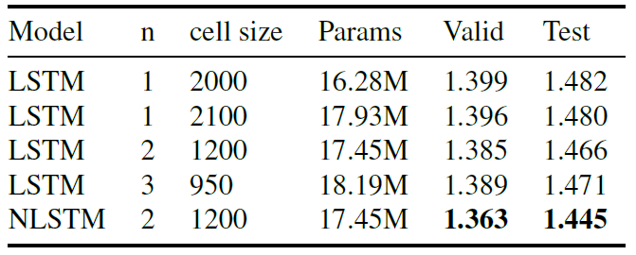
NLSTM outperforms baselines on wiki-like char-level prediction
Moniz & Krueger, 2018
Text8 (Mahoney, 2011): 100MB of English wiki-like text.
Notes:
BPC

Slide 49
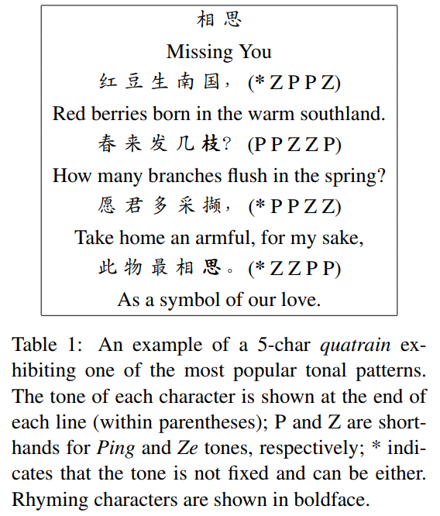
The authors considered the task of Chinese Poem Generation
Chinese Poem Generation (Zhang and Lapata, 2014).
Quatrains with 5-characters.
|vocab| > 5000
Notes:
Amongst the many different types of classical Chinese poetry, quatrain and regulated verse are perhaps the best-known ones.
Quatrains have four lines, each five or seven characters long. Characters in turn follow specific phonological patterns, within each line and across lines. For instance, the final characters in the second, fourth and (optionally) first line must rhyme, whereas there are no rhyming constraints for the third line. Moreover, poems must follow a prescribed tonal pattern. In traditional Chinese, every character has one tone, Ping (level tone) or Ze (downward tone). The poem in Table 1 exemplifies one of the most popular tonal patterns (Wang, 2002). Besides adhering to the above formal criteria, poems must exhibit concise and accurate use of language, engage the reader/hearer, stimulate their imagination, and bring out their feelings.
the Chinese Poem Generation dataset (Zhang and Lapata, 2014) (which requires character-level language modeling on much smaller sequences with less temporal dependency than is common, but with a significantly larger number of characters than would typically be found in English)
We also try to match the number of parameters of the different stacked LSTM baselines as closely
as possible with our 2-layer Nested LSTM by adjusting the number of hidden units.
In the MNIST Glimpses task, introduced in Ba et al. (2016), each 28x28 image (with the pixel values
normalized to the range [0, 1]) is split into 4 quadrants. Glimpses of each quadrant (in the form of
alternate rows and columns), followed by the entire quadrant are then fed sequentially into the model
(with 20 elements in the sequence, each element comprising of 49 pixels). The model then predicts
which integer the input represented. The four coarse regions, down-sampled to 7 × 7, along with their the four 7×7 quadrants are presented in a single sequence

Slide 50

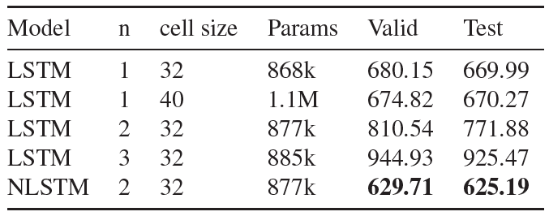
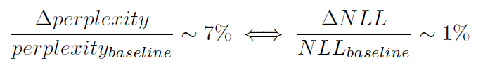
NLSTM slightly outperforms baselines on Chinese Poem Generation
Moniz & Krueger, 2018
Notes:
Note that because of the small cell sizes, the number of parameters in all these models is roughly the same
(around 850k) in spite of the different numbers of layers (except in the case of the single layered
LSTM with a cell size of 40, which has around 1.1M parameters).
Surprisingly, we find that both the single-layered LSTM baselines outperform the corresponding
stacked LSTM baselines, even the one-layered LSTM with slightly fewer parameters. This is possibly
because of the relatively small cell size used in this experiment.

Slide 51
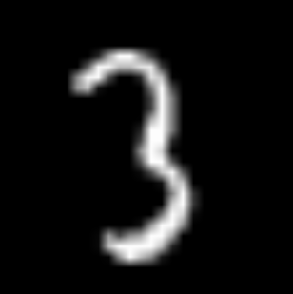
The authors considered the task of MNIST glimpses
MNIST Glimpses task (Ba et al., 2016).
Sequences of 20x49 pixel
Task: Predict which 0-9 integer the input represented.
Notes:
the Penn Treebank Corpus
(Marcus et al., 1993) and the larger Text8 dataset (Mahoney, 2011) (both representing standard
character-level language modeling, with Text8 being much larger than the Penn Treebank Corpus),
the Chinese Poem Generation dataset (Zhang and Lapata, 2014) (which requires character-level
language modeling on much smaller sequences with less temporal dependency than is common, but
with a significantly larger number of characters than would typically be found in English), and the
MNIST Glimpses task (Ba et al., 2016) (which is a classification task, but one that contains temporal
5
MONIZ KRUEGER
dependencies).
We also try to match the number of parameters of the different stacked LSTM baselines as closely
as possible with our 2-layer Nested LSTM by adjusting the number of hidden units.
Amongst the many different types of classical Chinese poetry, quatrain and regulated verse are perhaps the best-known ones.
Quatrains have four lines, each five or seven characters long. Characters in turn follow specific phonological patterns, within each line and across lines. For instance, the final characters in the second, fourth and (optionally) first line must rhyme, whereas there are no rhyming constraints for the third line. Moreover, poems must follow a prescribed tonal pattern. In traditional Chinese, every character has one tone, Ping (level tone) or Ze (downward tone). The poem in Table 1 exemplifies one of the most popular tonal patterns (Wang, 2002). Besides adhering to the above formal criteria, poems must exhibit concise and accurate use of language, engage the reader/hearer, stimulate their imagination, and bring out their feelings.
In the MNIST Glimpses task, introduced in Ba et al. (2016), each 28x28 image (with the pixel values
normalized to the range [0, 1]) is split into 4 quadrants. Glimpses of each quadrant (in the form of
alternate rows and columns), followed by the entire quadrant are then fed sequentially into the model
(with 20 elements in the sequence, each element comprising of 49 pixels). The model then predicts
which integer the input represented. The four coarse regions, down-sampled to 7 × 7, along with their the four 7×7 quadrants are presented in a single sequence

Slide 52
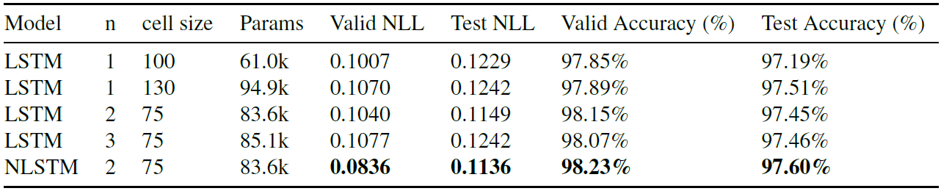
NLSTM slightly outperforms baselines on MNIST glimpses
Moniz & Krueger, 2018
Notes:
The Nested LSTM outperforms the (stacked) LSTM baselines in terms of both NLL and error
percentage, both on the validation and test datasets. In particular, it reduces the validation error by
4.3% when compared to the next best performing model (to 1.77%, down from 1.85% for a 2-layered
stacked LSTM), and the validation NLL by almost 17% (down to 0.0836 from 0.1007 in the case of
a single-layered LSTM).

Slide 53
Summary Part 1
RNNs are commonly used in sequence modeling.
Tolerate sequence length variability.
Model size not directly dependent on the support of desired timescale.
Reviewed tasks:
Char-level language modeling, Program execution.
Difficult to capture long range dependencies and temporal hierarchy.
Vanishing gradients / credit assignment.
Approaches to improve modeling of temporal hierarchy.
Crosstalk across layers between consecutive timesteps. (Gated feedback)
Nesting as opposed to stacking. (NLSTM)
Notes:
GF - More paths for gradients to flow.
NLSTM - Inner memory is free to remember and process events on longer time scales.

