Slide 1
Advanced RNNs
(Sequence modeling)
Part 2

Slide 2
Delving Deeper into Convolutional
Networks for Learning Video
Representations
Nicolas Ballas, Li Yao, Chris Pal, Aaron Courville
Notes:
RNN application for video analysis tasks with new RNN aricetecture

Slide 3
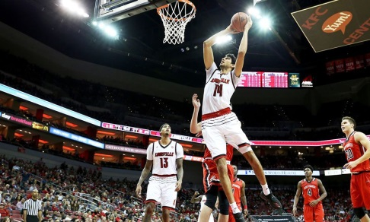
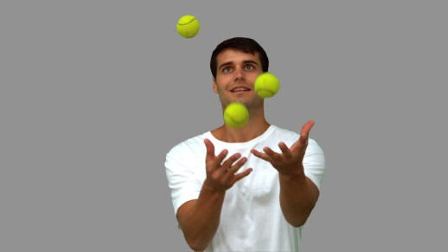
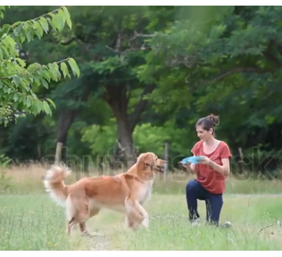
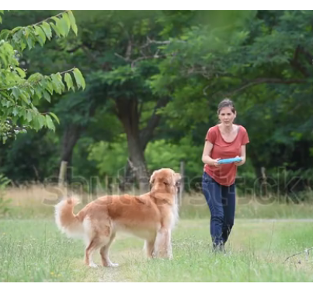
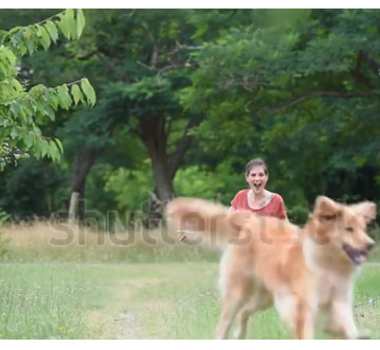
LEARNING VIDEO REPRESENTATIONS – tasks
Video classification
Video Captioning
score a basket
Juggling balls
A woman is playing Frisbee with a dog outdoors
Notes:
Video analysis and understanding represents a major challenge for computer vision and machine learning research.
There is a growing interest in designing general video representations that could help solve tasks in video understanding such as human action recognition, video retrieval or video captionning

Slide 4
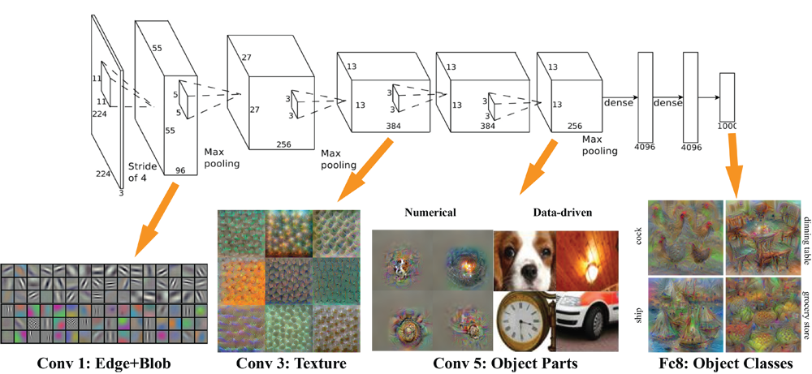
ConvNets are good models for meaningful semantic concepts
Krizhevsky et Al. (2014)
Notes:
Two-dimensional Convolutional Neural Networks (CNN) have exhibited state-of-art performance in still image tasks such as classification or detection
However, such models discard temporal information that has been shown to provide important cues in videos

Slide 5
Combining ConvNets and RNNs for spatio-temporal video representation
ConvNet extracts visual features from frames
High level ConvNet features are passed to LSTM
LSTM captures temporal behavior between frames
Notes:
RNNs are good models for sequences
Good video representation benefits from good temporal model of high-level percepts
Recurrent Convolution Networks (RCN) (Srivastava et al., 2015; Donahue et al., 2014; Ng et al., 2015) that leverage both recurrence and convolution have recently been introduced for learning video representation. Such approaches typically extract “visual percepts” by applying a 2D CNN on the video frames and then feed the CNN activations to an RNN in order to characterize the video temporal variation

Slide 6
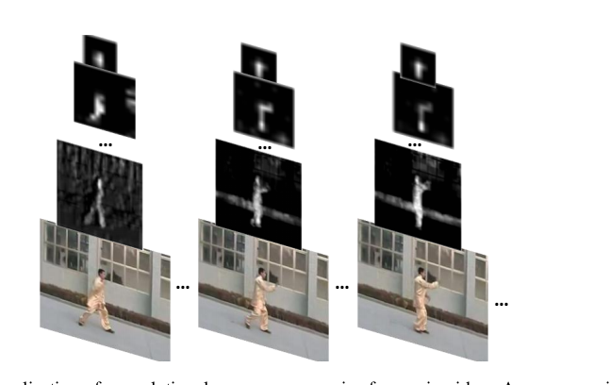
Convolutional maps on video frames in top layer discard fine motion information
CNNs tends to discard local information in their top layers
The motion of video patches tend to be restricted to a local neighborhood
RCN architectures are not well suited for capturing fine motion information
Notes:
While CNNs tends to discard local information in their top layers, frame-to-frame temporal variation is known to be smooth. The motion of video patches tend to be restricted to a local neighborhood
we argue that current RCN architectures are not well suited for capturing fine motion information. Instead, they are more likely focus on global appearance changes such as shot transitions.

Slide 7
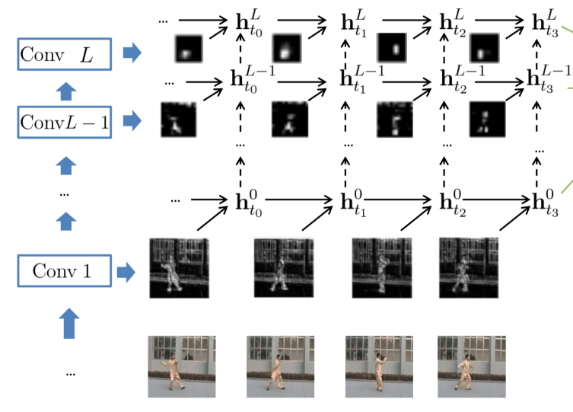
Capture spatial features in different levels of the network
Lower layers preserve a finer spatial resolution
Large number of parameters input-to-hidden transformation due to the convolutional maps size
Notes:
of the input video from which local spatio-temporal patterns are extracted
To address this issue, we introduce a novel RCN architecture that applies an RNN not solely on the 2D CNN top-layer but also on the intermediate convolutional layers.
Convolutional layer activations, or convolutional maps, preserve a finer spatial resolution of the input video from which local spatio-temporal patterns are extracted.

Slide 8
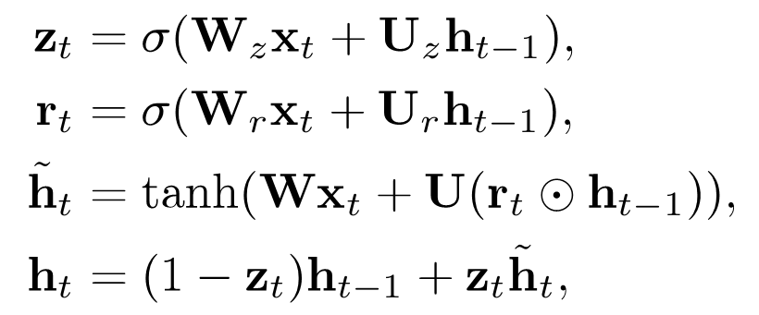
Capture temporal multi-resolution spatial-temporal via Gated Recurrent Unit – large number of parameters
Number of parameters in GRU architecture:
Notes:
however, inevitably results in a drastic number of parameters characterizing the input-to-hidden transformation due to the convolutional maps size

Slide 9
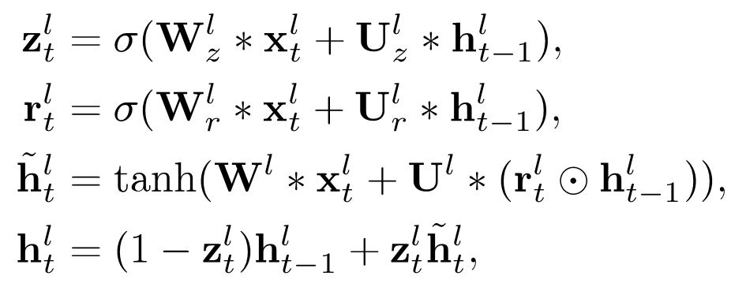
Capture temporal multi-resolution spatial-temporal via GRU-RCN
replace the fully-connected units in GRU with convolution operations
Recurrent units have sparse connectivity and share their parameters across different inputs
Number of parameters in GRU-RCN architecture:
Notes:
however, inevitably results in a drastic number of parameters characterizing the input-to-hidden transformation due to the convolutional maps size

Slide 10
GRU-RCN variation - STACKED GRU-RCN
:

Slide 11
GRU-RCN variation – Bi-directional GRU-RCN
$${\tilde{h}}_{3}^{L}$$
$${\tilde{h}}_{2}^{L}$$
$${\tilde{h}}_{1}^{L}$$
$${\tilde{h}}_{0}^{L}$$

Slide 12
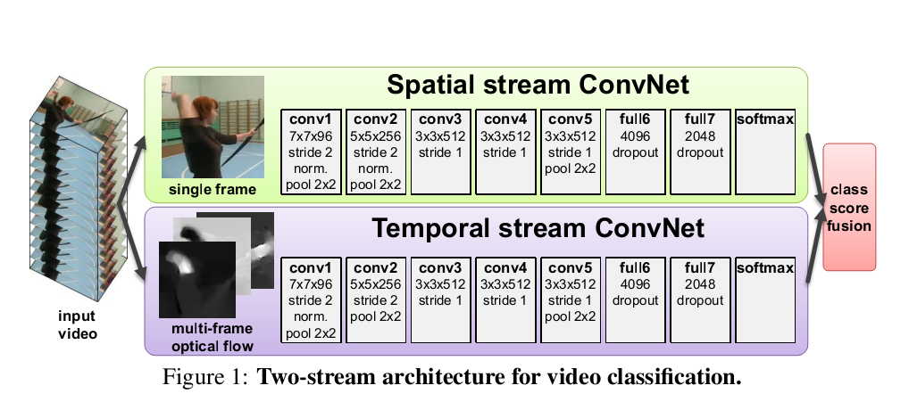
Optical flow utilized for video analysis tasks
Input stacked optical flow displacement fields between several consecutive frames
Explicitly describes the motion between video frames

Slide 13
Approaches for video analysis tasks(CONT)
Frames are passed to 3D ConvNet
Filters extract spatiotemporal features

Slide 14
Approaches for video analysis tasks(CONT)
Optical-flow stream added to network

Slide 15
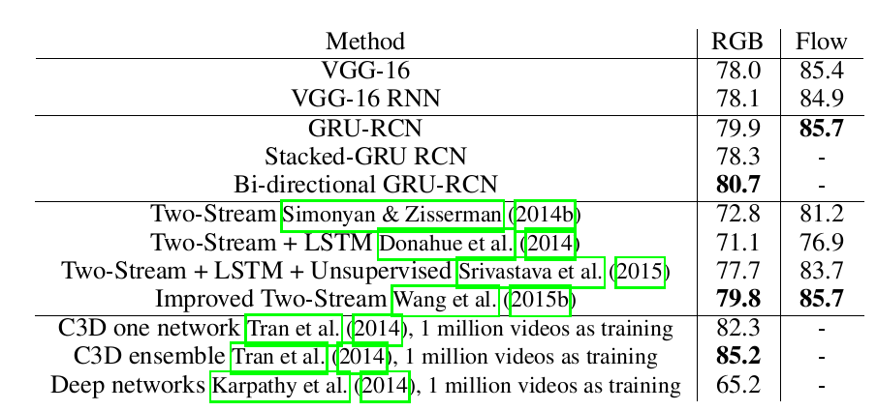
Results – video classification
UCF101 - Dataset has 101 action classes spanning over 13320 YouTube videos clips
Videos composing the dataset are subject to large camera motion, viewpoint change and cluttered backgrounds
RGB(Bi-directional GRU-RCN)+FLOW(GRU-RCN) 90.8

Slide 16
Results – video captioning
YouTube2Text dataset has 1,970 video clips with multiple natural language descriptions for each video clip.
Pre-trained on UCF-101
Notes:
bilingual evaluation understudy
algorithm for evaluating the quality of text which has been machine-translated from one natural language to another
C3D trained on large dataset

Slide 17
Paper summary
Importance of modeling temporal variation from “visual percepts” at different spatial resolutions.
Novel recurrent convolutional network architecture that leverages convolutional maps, captures “percepts” from different spatial resolutions.

Slide 18
RNNs suffer two major problems
Long term and LSTM and derivatives use mainly sequential processing over time.

Slide 19
Two major problems with RNNs
1. long-range dependencies still tricky
RNN and LSTM and derivatives use mainly sequential processing over time.
Long-term information has to sequentially travel through all cells before getting to the present processing cell.
Signal can be easily corrupted by being multiplied many time by small numbers < 0 (vanishing gradients)
Sequential processing in RNN, from: http://colah.github.io/posts/2015-08-Understanding-LSTMs/

Slide 20
Two major problems with RNNs
2. RNNs are not hardware friendly
Sequential operations require more time
RNNs are hard to parallelize because of non-homogeneous nature
Memory bandwidth for RNNs is one of the highest, usually it is not possible to fully utilize hardware.
Notes:
computation that re-uses data, will require less memory bandwidth.
It takes a lot of resources and time to train and run RNNs.

Slide 21
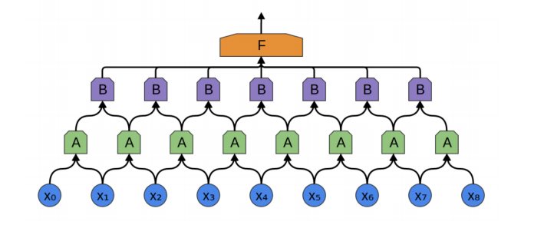
Sequences can also be modeled with ConvNets - revisted
We said:
1) Neural nets don’t deal well with inputs outputs with various lengths in different examples.
<SOLUTION>
Repetitive operation can be applied to any input size.
Incorporating attention will allow adaptive behavior
2) don’t share features learned across different positions of text.
<SOLUTION>
Temporal ConvNets share weights across time
Notes:
We said that 1) convenet don’t deal well with intputs outputs with various lengths in differtent examples. And 2) don’t share features learned across different positions of text.

Slide 22
CNN constitute good alternative architectures for machine translation
Trivial to parallelize
Convolutional networks do not depend on the computations of the previous time step and therefore allow parallelization
Control dependency length
Allows to precisely control the maximum length of dependencies to be modeled
Build in hierarchy
Easier to capture long range dependencies
Capturing relationships of n words is obtained by a less than linear operations(O(n/k) compared to O(n))
Notes:
They demonstrated that it works much faster and outperforms in accuracy. Intuition why it’s a better approach.

Slide 23
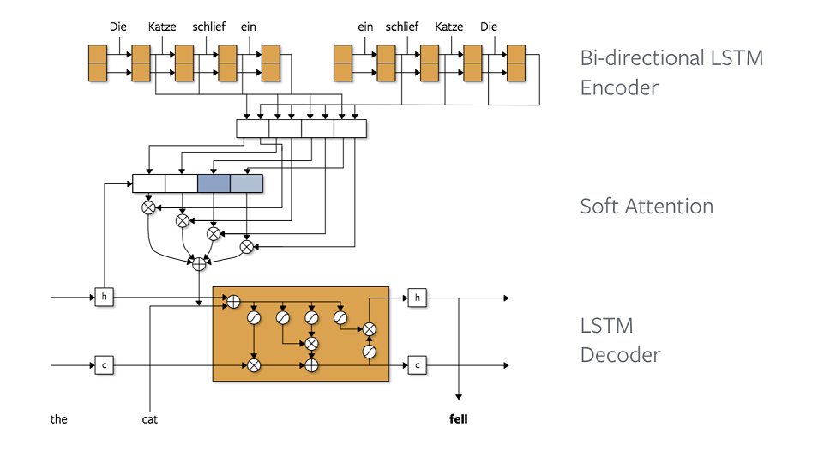
Machine translation was commonly implemented using RNN (LSTM)
Notes:
Explain attention module.

Slide 24
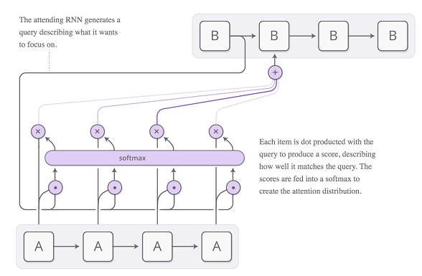
Attention
Incorporate all hidden states of encoder, rather than the last one
Use weighted combination of each encoder hidden state
Bahdahau et al. 2014
Notes:
Each item is dot producted with the query to produce a score, describing how well it matches the query. The scores are fed into a softmax to create the attention distribution.

Slide 25
Attention
Example of attention for machine translation
Bahdahau et al. 2014

Slide 26
RNN based Seq2Seq

Slide 27
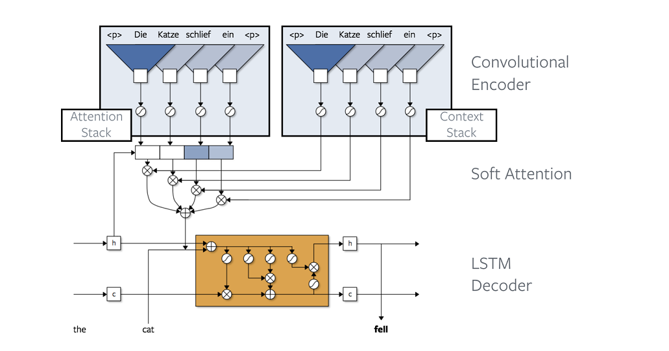
Convolutional Encoder

Slide 28
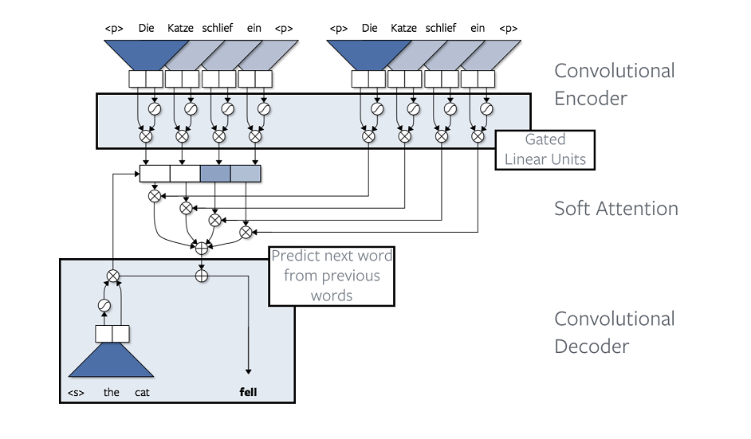
Convolutional Decoder

Slide 29
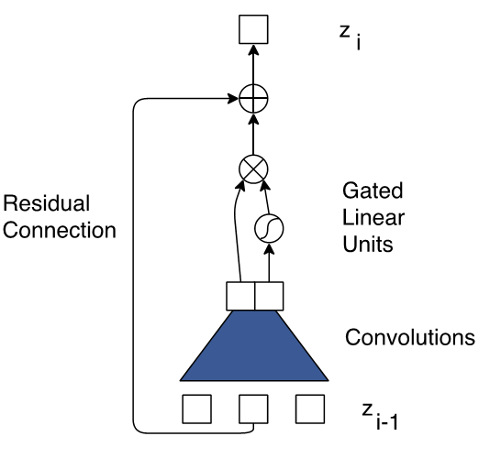
Encoder
Convolutional block structure for encoder:
$z_{0}$=Embeddings
word or sub-word embedding
position embedding: 0,1,2,...
Gated linear units control the information flow in the neural network(Dauphin et al., 2016)
residual connections
Notes:
r gated linear units reduce the vanishing gradient problem for deep architectures by providing a linear path for the gradients while retaining non-linear capabilities

Slide 30
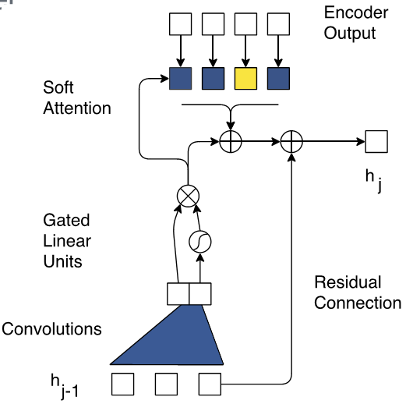
Decoder
Convolutional block structure for decoder:
$h_{0}$ = embeddings (word + pos)
Gated linear units, residual connection
Soft attention pass at every layer

Slide 31
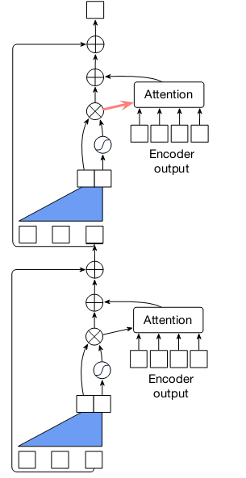
Multi-hop Attention
Each layer has it is own attention mechanism, which allows it to focus on different part of the sentence.
Instead of looking at a sentence once, the network takes several glimpses to produce better translation

Slide 32
Multi-hop Attention

Slide 33
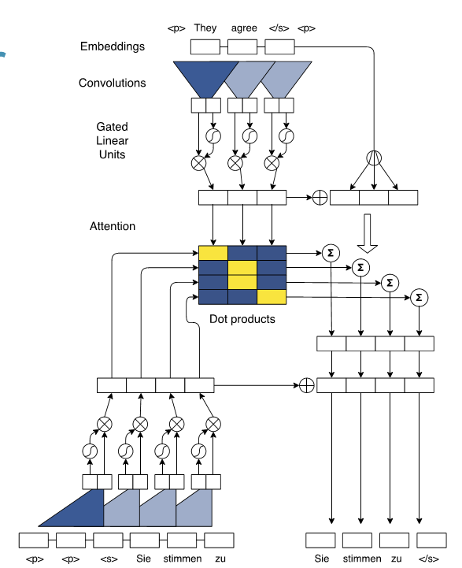
All together
Putting it all together:
Here: single-layer encoder and decoder
High training efficiency due to parallel
computation in decoder

Slide 34
Architecture
15 layers in both encoder and decoder
Convolutional kernel size is 3
Hidden size gradually increases from 512 to 4096
Embedding size is 512

Slide 35
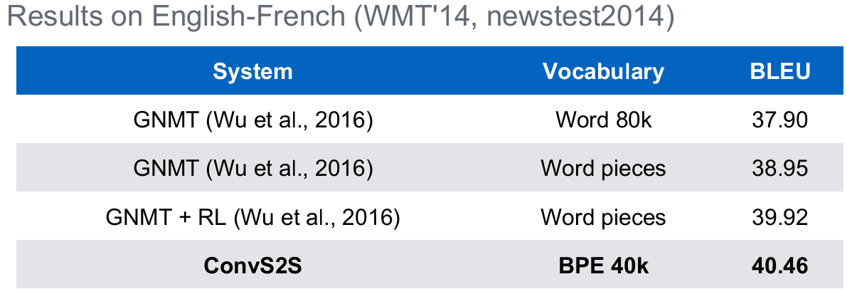
Results –translation accuracy

Slide 36
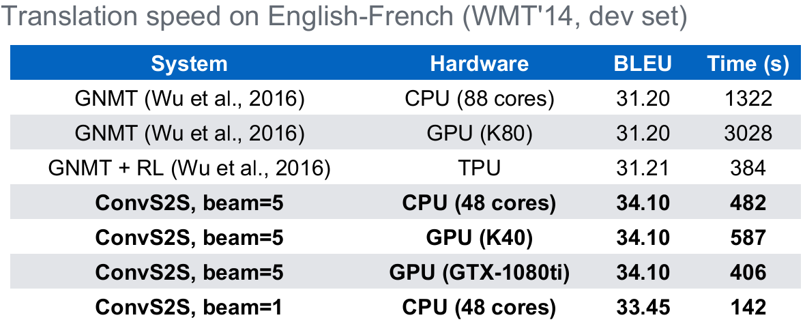
Results – translation performance and inference speed

Slide 37
Results – text summarization
Notes:
Rouge-N Overlap of N-grams
ROUGE-L: Longest Common Subsequence based statistics

Slide 38
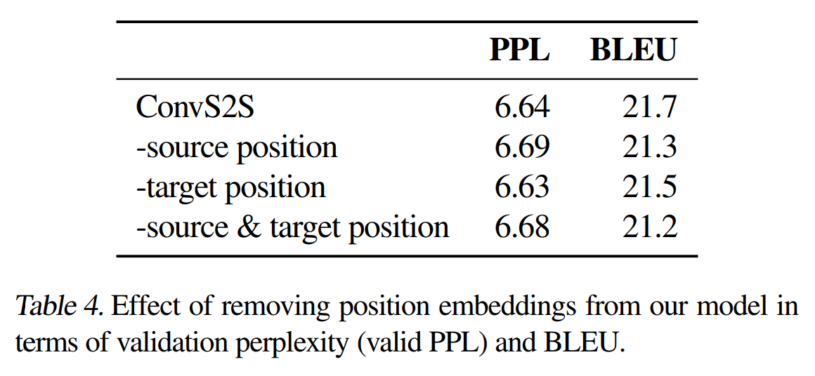
Positional embedding significance

Slide 39
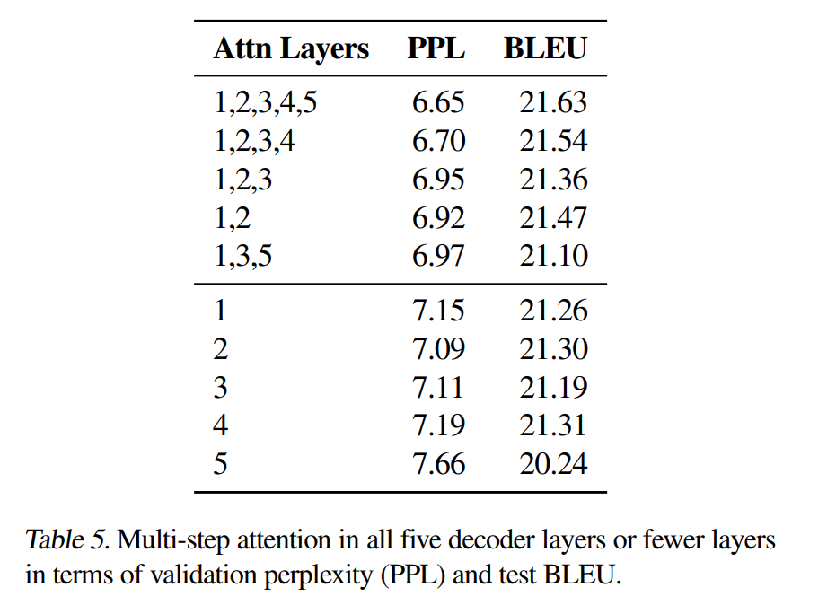
Multi hop attention significance

Slide 40
Summary & Future challenges
Mechanisms for improving long range modeling in RNNs
Designing good spatio-temporal representations (video).
Alternative architecture for sequence modeling.
Notes:
ADD temproal hierchay in Rnns

Slide 41
Thank you for your attention!

