Slide 1
Games, Proofs, Norms, and Algorithms
Boaz Barak – Microsoft Research
Based (mostly) on joint works with Jonathan Kelner and David Steurer

Slide 2
This talk is about
Hilbert’s 17th problem / Positivstellensatz
Proof complexity
Semidefinite programming
The Unique Games Conjecture
Machine Learning
Cryptography.. (in spirit).

Slide 3
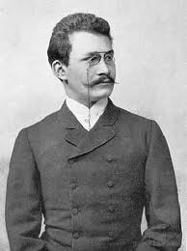
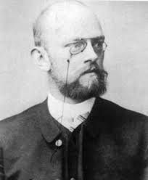
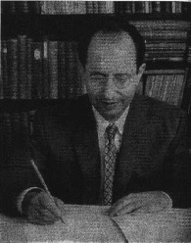
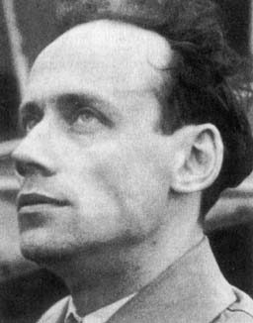
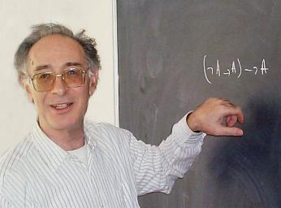
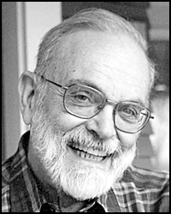
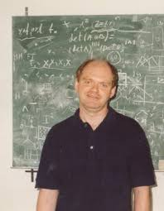
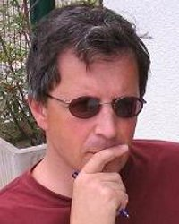
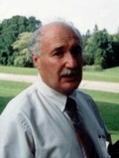
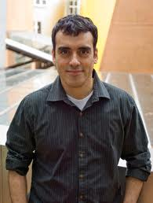
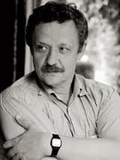
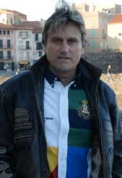
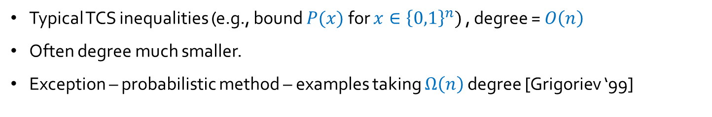

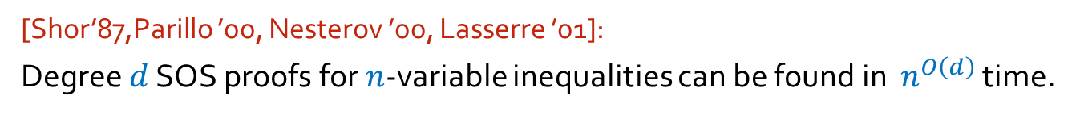

Theorem: $∀x∈ℝ, 10x −x^{2}≤25$
Proof: $10x −x^{2}=25−{\left(x−5\right)}^{2}$
Sum of squares of polynomials
[Minkowski 1885, Hilbert 1888,Motzkin 1967]:
$∃$ (multivariate) polynomial inequality without “square completion” proof
Hilbert’s 17th problem:
Can we always prove $P\left(x_{1}..x_{n}\right)≤C$ by showing $P=C −SOS/(1+SOS^{′})$?
[Artin ’27, Krivine ’64, Stengle ‘73 ]: Yes!
Even more general polynomial equations. Known as “Positivstellensatz”
[Grigoriev-Vorobjov ’99]: Measure complexity of proof = degree of $SOS,SOS′$.
Typical TCS inequalities (e.g., bound $P(x)$ for $x∈{\left\{0,1\right\}}^{n})$ , degree = $O\left(n\right)$
Often degree much smaller.
Exception – probabilistic method – examples taking $Ω\left(n\right)$ degree [Grigoriev ‘99]
SOS / Lasserre
SDP hierarchy
[Shor’87,Parillo ’00, Nesterov ’00, Lasserre ’01]:
Degree $d$ SOS proofs for $n$-variable inequalities can be found in $n^{O\left(d\right)}$ time.

Slide 4
Theorem: $∀x∈ℝ, 10x −x^{2}≤25$
Proof: $10x −x^{2}=25−{\left(x−5\right)}^{2}$
Sum of squares of polynomials
[Minkowski 1885, Hilbert 1888,Motzkin 1967]:
$∃$ (multivariate) polynomial inequality without “square completion” proof
Hilbert’s 17th problem:
Can we always prove $P\left(x_{1}..x_{n}\right)≤C$ by showing $P=C −SOS/(1+SOS^{′})$?
[Artin ’27, Krivine ’64, Stengle ‘73 ]: Yes!
Even more general polynomial equations. Known as “Positivstellensatz”
[Grigoriev-Vorobjov ’99]: Measure complexity of proof = degree of $SOS,SOS′$.
Typical TCS inequalities (e.g., bound $P(x)$ for $x∈{\left\{0,1\right\}}^{n})$ , degree = $O\left(n\right)$
Often degree much smaller.
Exception – probabilistic method – examples taking $Ω\left(n\right)$ degree [Grigoriev ‘99]
SOS / Lasserre
SDP hierarchy
[Shor’87,Parillo ’00, Nesterov ’00, Lasserre ’01]:
Degree $d$ SOS proofs for $n$-variable inequalities can be found in $n^{O\left(d\right)}$ time.

Slide 5

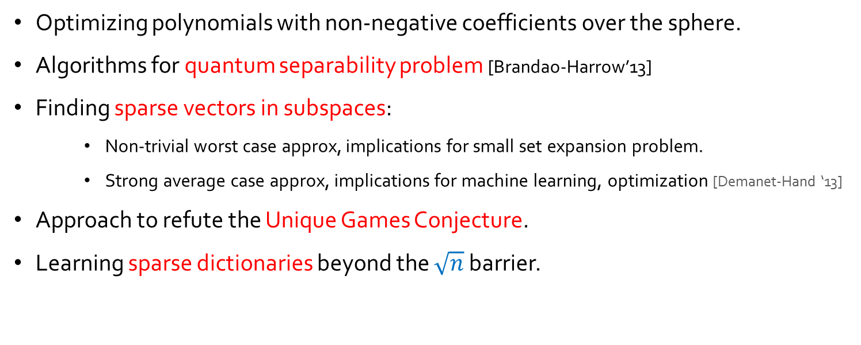
[Shor’87,Parillo ’00, Nesterov ’00, Lasserre ’01]:
Degree $d$ SOS proofs for $n$-variable inequalities can be found in $n^{O\left(d\right)}$ time.
General algorithm for polynomial optimization – maximize $P(x)$ over $x∈{\left\{0,1\right\}}^{n}$.
(more generally: optimize over $x$ s.t. $P_{1}\left(x\right)=..=P_{k}(0)$ for low degree $P_{1}..P_{k}$)
Efficient if $∃$ low degree SOS proof for bound, exponential in the worst case.
This talk: General method to analyze the SOS algorithm. [B-Kelner-Steurer’13]
Applications:
Optimizing polynomials with non-negative coefficients over the sphere.
Algorithms for quantum separability problem [Brandao-Harrow’13]
Finding sparse vectors in subspaces:
  Non-trivial worst case approx, implications for small set expansion problem.
  Strong average case approx, implications for machine learning, optimization [Demanet-Hand ‘13]
Approach to refute the Unique Games Conjecture.
Learning sparse dictionaries beyond the $\sqrt{n}$ barrier.

Slide 6



[Shor’87,Parillo ’00, Nesterov ’00, Lasserre ’01]:
Degree $d$ SOS proofs for $n$-variable inequalities can be found in $n^{O\left(d\right)}$ time.
General algorithm for polynomial optimization – maximize $P(x)$ over $x∈{\left\{0,1\right\}}^{n}$.
Rest of this talk:
(more generally: optimize over $x$ s.t. $P_{1}\left(x\right)=..=P_{k}(0)$ for low degree $P_{1}..P_{k}$)
Previously used for lower bounds.
Here used for upper bounds.
Describe general approach for rounding SOS proofs.
Define “Pseudoexpectations” aka “Fake Marginals”
Pseudoexpectation $↔$ SOS proofs connection.
Using pseudoexpectation for combining $↦$ rounding.
Example: Finding sparse vector in subspaces
(main tool: hypercontractive norms $∥⋅∥_{p→q}$ for $q>p$)
Relation to Unique Games Conjecture
Future directions
Efficient if $∃$ low degree SOS proof for bound, exponential in the worst case.
This talk: General method to analyze the SOS algorithm. [B-Kelner-Steurer’13]
Applications:
Optimizing polynomials with non-negative coefficients over the sphere.
Algorithms for quantum separability problem [Brandao-Harrow’13]
Finding sparse vectors in subspaces:
  Non-trivial worst case approx, implications for small set expansion problem.
  Strong average case approx, implications for machine learning, optimization [Demanet-Hand ‘13]
Approach to refute the Unique Games Conjecture.
Learning sparse dictionaries beyond the $\sqrt{n}$ barrier.

Slide 7




Problem: Given low degree $P,P_{1},..,P_{k}:ℝ^{n}→ℝ$ maximize $P(x)$ s.t. $∀_{i}P_{i}\left(x\right)=0$
Hard: Encapsulates SAT, CLIQUE, MAX-CUT, etc..
Easier problem: Given many good solutions, find single OK one.
(multi) set $S$ of $x^{′}s$ s.t. $P\left(x\right)≥v$, ${∀_{i}P}_{i}\left(x\right)=0$
Non-trivial combiner:
Only depends on low degree marginals of $S$
Combiner
$$\{ 𝔼_{x∼S}{ x}_{i_{1}}⋯x_{i_{k}} \}_{i_{1},..,i_{k}∈\left[n\right]}$$
Single $x^{∗}$ s.t. $P\left(x^{∗}\right)≥v^{′}$, ${∀_{i}P}_{i}\left(x^{∗}\right)=0$
[B-Kelner-Steurer’13]: Transform “simple” non-trivial combiners to algorithm for original problem.
Crypto flavor…
Idea in a nutshell:
Simple combiners will output a solution even when fed “fake marginals”.
Next: Definition of “fake marginals”

Slide 8
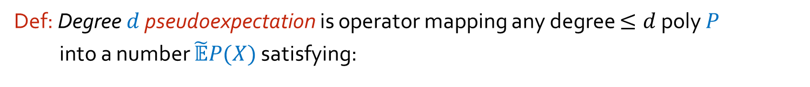
Def: Degree $d$ pseudoexpectation is operator mapping any degree $≤d$ poly $P$
into a number $\tilde{𝔼}P(X)$ satisfying:
Normalization: $\tilde{𝔼}1=1$
Linearity: $\tilde{𝔼}\left[aP\left(X\right)+bQ\left(X\right)\right]=a\tilde{𝔼}P\left(X\right)+b\tilde{𝔼}Q\left(X\right) ∀P,Q$ of deg$≤d$
Positivity: $\tilde{𝔼}P^{2}(X)≥0$ $∀P$ of deg$≤d/2$
Can describe operator as $n^{d/2}×n^{d/2}$matrix $M$ s.t. $M_{i_{1}..i_{d}}=\tilde{𝔼}X_{i_{1}}⋯X_{i_{d}}$
Dual view of SOS/Lasserre
Positivity condition means $M$ is p.s.d : $p^{T}Mp≥0$ for every vector $p∈ℝ^{n^{d/2}}$
$⇒$ can optimize over deg $d$ pseudoexpectations in $n^{O\left(d\right)}$ time.
Fundamental Fact: $∃$ deg $d$ SOS proof for $P>0$ $⇔$
$\tilde{𝔼}P\left(X\right)>0$ for any deg $d$ pseudoexpectation operator
Take home message:
Pseudoexpectation “looks like” real expectation to low degree polynomials.
Can efficiently find pseudoexpectation matching any polynomial constraints.
Proofs about real random vars can often be “lifted” to pseudoexpectation.

Slide 9



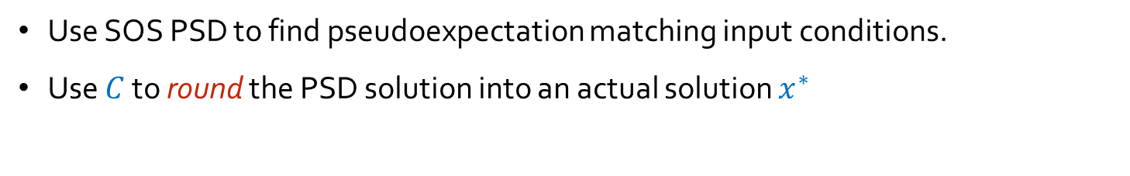
Combining $⇒$ Rounding
Problem: Given low degree $P,P_{1},..,P_{k}:ℝ^{n}→ℝ$ maximize $P(x)$ s.t. $∀_{i}P_{i}\left(x\right)=0$
[B-Kelner-Steurer’13]: Transform “simple” non-trivial combiners to algorithm for original problem.
Non-trivial combiner: Alg $C$ with
Input: $\{ 𝔼 X_{i_{1}}⋯X_{i_{k}}\}_{i_{1}..i_{k}∈[n]}$ , $X$ r.v. over $ℝ^{n}$ s.t. $𝔼{\left(P\left(x\right)−v\right)}^{2}=0, ∀_{i}𝔼P_{i}{\left(X\right)}^{2}=0$
Output: $x^{∗}∈ℝ^{n}$ s.t. $P\left(x^{∗}\right)≥v/2, ∀_{i} P_{i}(x^{∗})=0$
Crucial Observation: If proof that $x^{∗}$ is good solution is in SOS framework, then it holds even if $C$ is fed with a pseudoexpectation.
Corollary: In this case, we can find $x^{∗}$efficiently:
Use SOS PSD to find pseudoexpectation matching input conditions.
Use $C$ to round the PSD solution into an actual solution $x^{∗}$

Slide 10
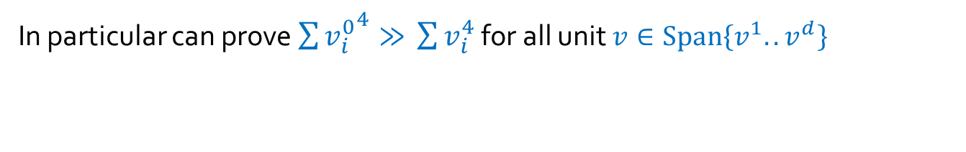



Example: Finding a planted sparse vector
Let unit $v^{0}∈ℝ^{n}$ be sparse ($Supp\left(v^{0}\right)=μn$ ), $v^{1},..,v^{d}∈ℝ^{n}$ random
Goal: Given basis for $V=Span\{v^{0},..,v^{d}\}$ , find $v_{0}$
(motivation: machine learning, optimization , [Demanet-Hand 13]
worst-case variant is algorithmic bottleneck in UG/SSE alg [Arora-B-Steurer’10])
Previous best results: $μ≪1/\sqrt{d}$ [Spielman-Wang-Wright ’12, Demanet-Hand ’13]
We show: $μ≪1$ is sufficient, as long as $d≤\sqrt{n}$
Approach: $v^{0}$looks like this:
Vector $v∈Span\left\{v^{1}..v^{d}\right\}$ looks like this:
In particular can prove $\sum{{v_{i}^{0}}^{4}≫} \sum{v_{i}^{4}}$ for all unit $v∈Span\left\{v^{1}..v^{d}\right\}$

Slide 11
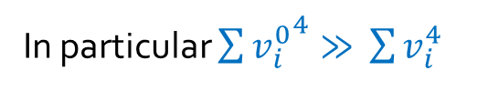
Example: Finding a planted sparse vector
Let unit $v^{0}∈ℝ^{n}$ be sparse ($Supp\left(v^{0}\right)=μn$ ), $v^{1},..,v^{d}∈ℝ^{n}$ random
Goal: Given basis for $V=Span\{v^{0},..,v^{d}\}$ , find $v_{0}$
(motivation: machine learning, optimization , [Demanet-Hand 13]
worst-case variant is algorithmic bottleneck in UG/SSE alg [Arora-B-Steurer’10])
In particular $\sum{{v_{i}^{0}}^{4}≫} \sum{v_{i}^{4}}$
Previous best results: $μ≪1/\sqrt{d}$ [Spielman-Wang-Wright ’12, Demanet-Hand ’13]
We show: $μ≪1$ is sufficient, as long as $d≤\sqrt{n}$
Approach: $v^{0}$looks like this:
Vector $v∈Span\left\{v^{1}..v^{d}\right\}$ looks like this:
In particular can prove $\sum{{v_{i}^{0}}^{4}≫} \sum{v_{i}^{4}}$ for all unit $v∈Span\left\{v^{1}..v^{d}\right\}$

Slide 12
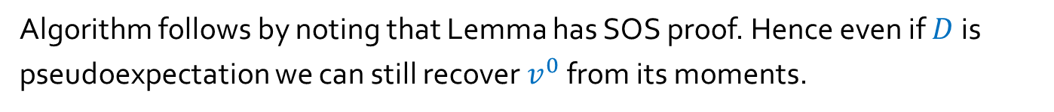

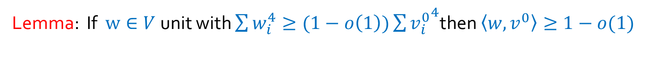

Let unit $v^{0}∈ℝ^{n}$ be sparse ($Supp\left(v^{0}\right)=μn$ ), $v^{1},..,v^{d}∈ℝ^{n}$ random
Goal: Given basis for $V=Span\{v^{0},..,v^{d}\}$ , find $v_{0}$
Approach: $v^{0}$looks like this:
Vector $v∈Span\left\{v^{1}..v^{d}\right\}$ looks like this:
In particular $\sum{{v_{i}^{0}}^{4}≫} \sum{v_{i}^{4}}$
Lemma: If $w∈V$unit with $\sum{w_{i}^{4}}≥(1−o\left(1\right))\sum{{v_{i}^{0}}^{4}}$then $〈w,v^{0}〉≥1−o(1)$
i.e., it looks like this:
Proof: Write $w=ρu^{0}+w′$
$$\left(1−o\left(1\right)\right)∥v^{0}∥_{4}≤∥v∥_{4}≤ρ∥u^{0}∥_{4}+∥v^{′}∥_{4}≤ρ∥v^{0}∥_{4}+o(∥v^{0}∥_{4})$$
Corollary: If $D$ distribution over such $w$then top e-vec of $𝔼_{w∼D}w^{⊗2}$ is
$1−o\left(1\right)$ correlated with $v^{0}$.
Algorithm follows by noting that Lemma has SOS proof. Hence even if $D$is pseudoexpectation we can still recover $v^{0}$ from its moments.

Slide 13
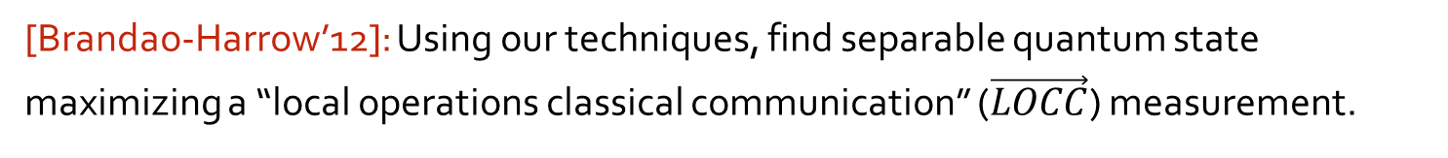
Other Results
Solve sparse vector problem* for arbitrary (worst-case) subspace $V$if $μ≪d^{−1/3}$
Sparse Dictionary Learning (aka “Sparse Coding”, “Blind Source Separation”):
Recover $v^{1}..v^{m}∈ℝ^{n}$ from random $μ$-sparse linear combinations of them.
Important tool for unsupervised learning.
Previous work: only for $μ≪1/\sqrt{n}$
[Spielman-Wang-Wright ‘12, Arora-Ge-Moitra ‘13, Agrawal-Anandkumar-Netrapali’13]
Our result: any $μ≪1$ (can also handle $m>n$ )
[Brandao-Harrow’12]: Using our techniques, find separable quantum state maximizing a “local operations classical communication” ($\vec{LOCC}$) measurement.

Slide 14
A personal overview of the Unique Games Conjecture
Unique Games Conjecture: UG/SSE problem is NP-hard. [Khot’02,Raghavendra-Steurer’08]
reasons to believe
reasons to suspect
“Standard crypto heuristic”:
Tried to solve it and couldn’t.
Random instances are easy via simple algorithm
[Arora-Khot-Kolla-Steurer-Tulsiani-Vishnoi’05]
Very clean picture of complexity landscape:
simple algorithms are optimal
[Khot’02…Raghavendra’08….]
SOS proof system
Simple poly algorithms can’t refute it
[Khot-Vishnoi’04]
Quasipoly algo on KV instance
[Kolla ‘10]
Simple subexp' algorithms can’t refute it
[B-Gopalan-Håstad-Meka-Raghavendra-Steurer’12]
Subexponential algorithm
[Arora-B-Steurer ‘10]
SOS solves all candidate hard instances
[B-Brandao-Harrow-Kelner-Steurer-Zhou ‘12]
SOS useful for sparse vector problem
Candidate algorithm for search problem
[B-Kelner-Steurer ‘13]

Slide 15
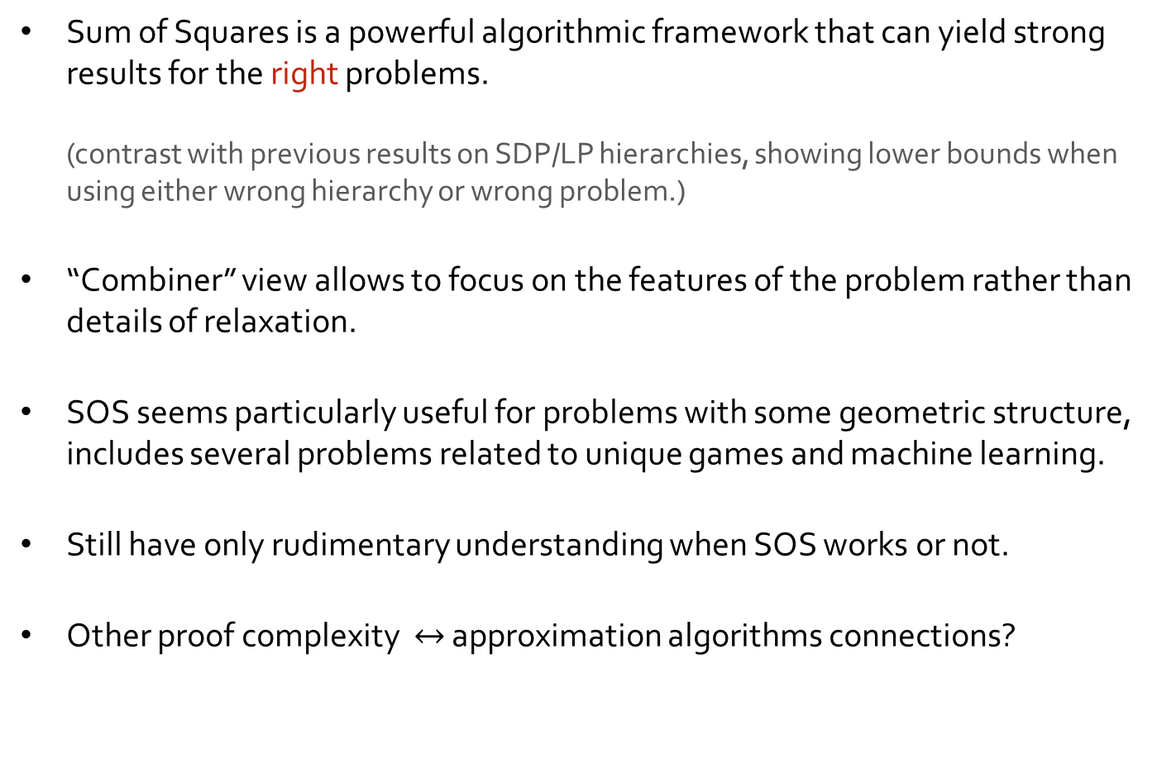
Conclusions
Sum of Squares is a powerful algorithmic framework that can yield strong results for the right problems.
(contrast with previous results on SDP/LP hierarchies, showing lower bounds when using either wrong hierarchy or wrong problem.)
“Combiner” view allows to focus on the features of the problem rather than details of relaxation.
SOS seems particularly useful for problems with some geometric structure, includes several problems related to unique games and machine learning.
Still have only rudimentary understanding when SOS works or not.
Other proof complexity $↔$ approximation algorithms connections?

