Slide 1
Coin Flipping of any Constant Bias
Implies One-Way Functions
Iftach Haitner
Based on joint works with
Itay Berman, Eran Omri and Aris Tentes
TexPoint fonts used in EMF.
Read the TexPoint manual before you delete this box.: AAAA

Slide 2
Cryptography Implies One-Way Functions
Almost all “computational” cryptography is known to imply one-way functions [c.f. Impagliazzo-Luby ‘89]
  One-way functions (OWFs): efficiently computable functions that no efficient algorithm can invert (with more than negligible probability)
These reductions are typically rather straightforward for
non-interactive primitives, or for interactive primitives with single “failure point”, e.g., commitment schemes
Rather complex for some interactive primitives
Full characterization of coin-flipping protocols is not known
Notes:
Apart from things we cannot prove ☺
Specifically, proving hardness is required might be hard, but then proving OWF is needed is typicall easy

Slide 3
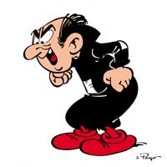



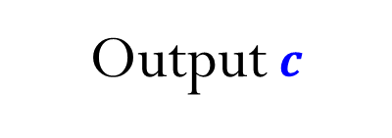





Coin-Flipping Protocols
Parities want to jointly flip a uniform string
I want $c=0$
$$c←\{0,1\}$$
$$c$$
Output $c$
Output $c$

Slide 4



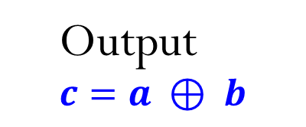

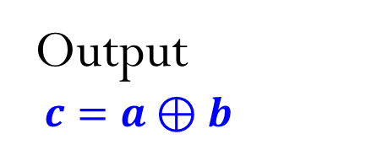



Blum’s Coin-Flipping Protocol
I want $c=0$
$$a←\{0,1\}$$
$$z←commit(a)$$
$$b←\{0,1\}$$
$$b$$
$$a←decommit(z)$$
Output $c=a⊕b$
$$\text{Output} \\ c=a ⊕ b$$
Negligible bias
Commitment obtained using OWF

Slide 5
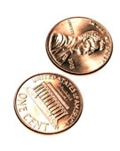
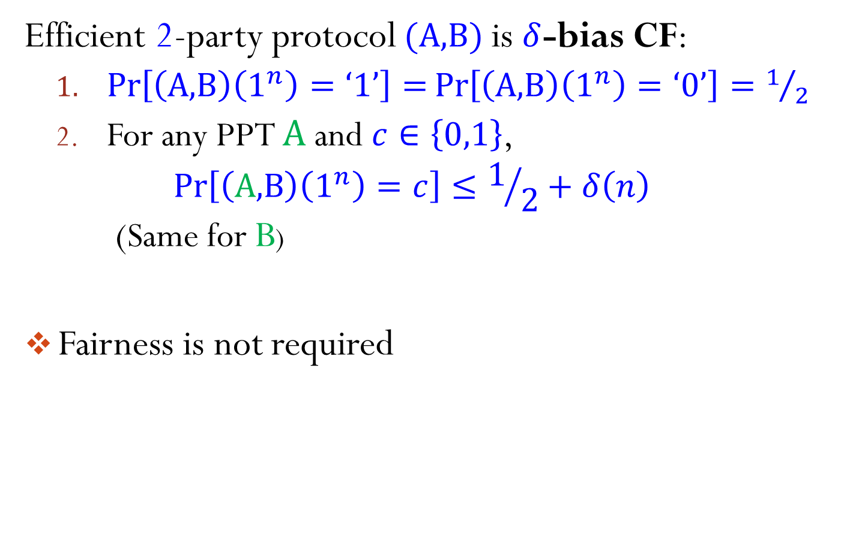
Coin-Flipping Protocols
Efficient 2-party protocol $(\text{A}\text{,}\text{B})$ is $δ$-bias CF:
  $\operatorname{Pr}\left[\left(\text{A}\text{,}\text{B}\right)\left(1^{n}\right)=\text{‘}1\text{’}\right]=\operatorname{Pr}\left[\left(\text{A}\text{,}\text{B}\right)\left(1^{n}\right)=\text{‘}0\text{’}\right]=1/2$
  For any PPT $A$ and $c∈\left\{0,1\right\}$,
  $\operatorname{Pr}\left[\left(\text{A}\text{,}\text{B}\right)\left(1^{n}\right)=c\right]≤1/2+δ\left(n\right)$
  (Same for B)
Fairness is not required

Slide 6
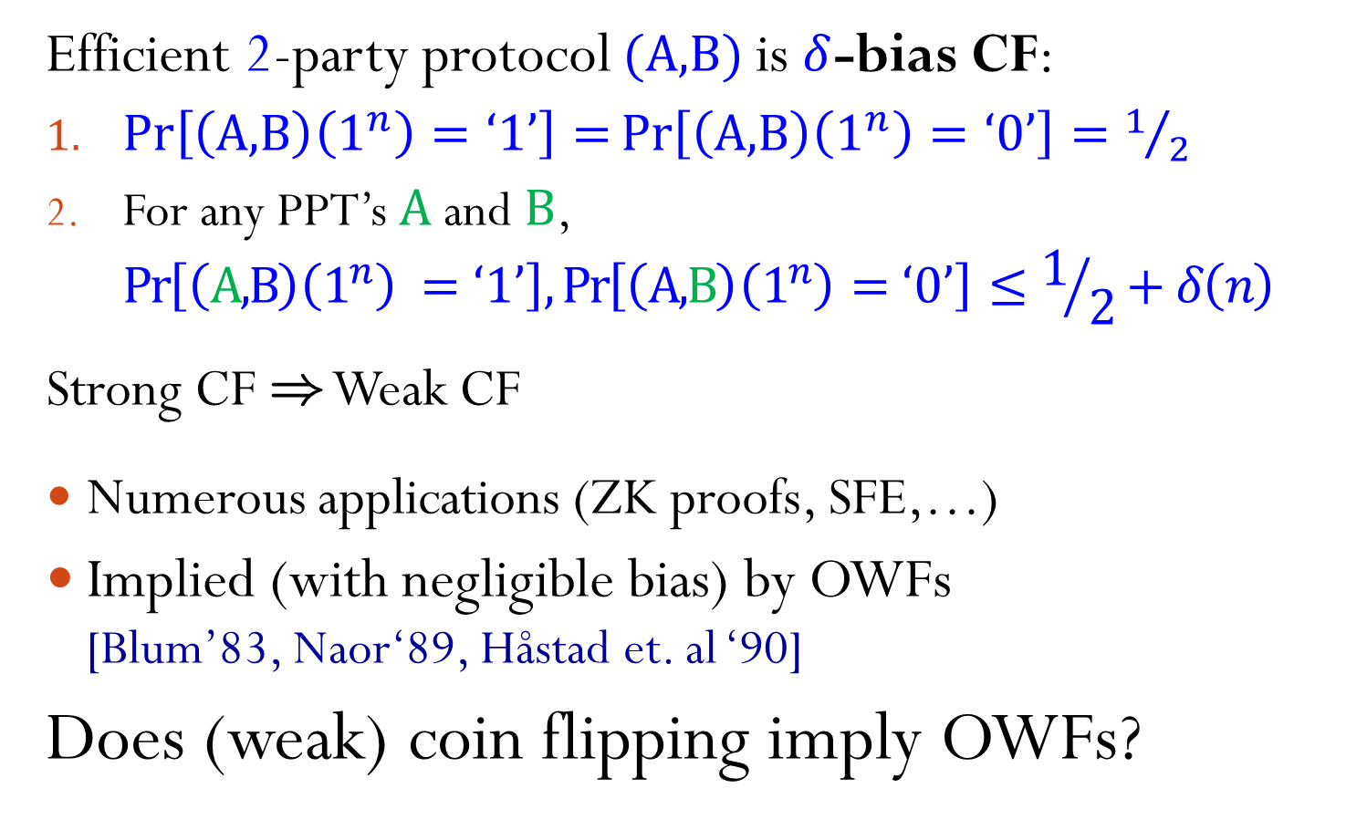
Weak Coin-Flipping Protocols
Efficient 2-party protocol $(\text{A}\text{,}\text{B})$ is $δ$-bias CF:
$\operatorname{Pr}\left[\left(\text{A}\text{,}\text{B}\right)\left(1^{n}\right)=\text{‘}1\text{’}\right]=\operatorname{Pr}\left[\left(\text{A}\text{,}\text{B}\right)\left(1^{n}\right)=\text{‘}0\text{’}\right]=1/2$
For any PPT’s $\text{A}$ and $\text{B}$,
$\operatorname{Pr}\left[\left(\text{A}\text{,}\text{B}\right)\left(1^{n}\right) =\text{‘}1\text{’}\right],\operatorname{Pr}\left[\left(\text{A}\text{,}\text{B}\right)\left(1^{n}\right)=\text{‘}0\text{’}\right]≤1/2+δ\left(n\right)$
Strong CF ) Weak CF
Numerous applications (ZK proofs, SFE,…)
Implied (with negligible bias) by OWFs
[Blum’83, Naor‘89, Håstad et. al ‘90]
Does (weak) coin flipping imply OWFs?

Slide 7
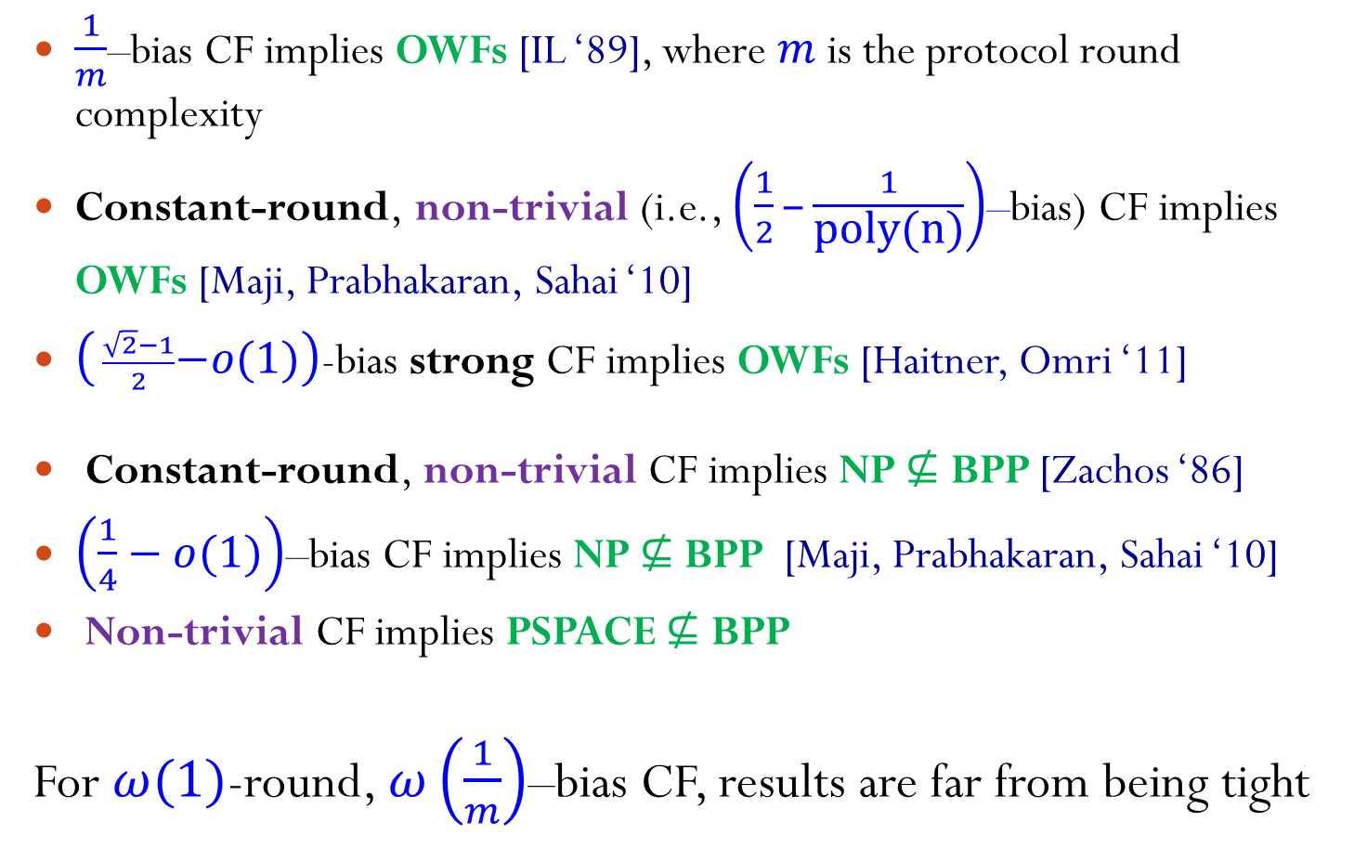
Known Results
$\frac{1}{m}$–bias CF implies OWFs [IL ‘89], where $m$ is the protocol round complexity
Constant-round, non-trivial (i.e., $\left(\frac{1}{2}\text{–}\frac{1}{\text{poly}\text{(}\text{n}\text{)}}\right)$–bias) CF implies OWFs [Maji, Prabhakaran, Sahai ‘10]
$\left( \frac{\sqrt{2}−1}{2}−o(1)\right)$-bias strong CF implies OWFs [Haitner, Omri ‘11]
Constant-round, non-trivial CF implies NP $⊈$ BPP [Zachos ‘86]
$\left(\frac{1}{4}−o(1)\right)$–bias CF implies NP $⊈$ BPP [Maji, Prabhakaran, Sahai ‘10]
Non-trivial CF implies PSPACE $⊈$ BPP
For $ω(1)$-round, $ω\left(\frac{1}{m}\right)$–bias CF, results are far from being tight

Slide 8
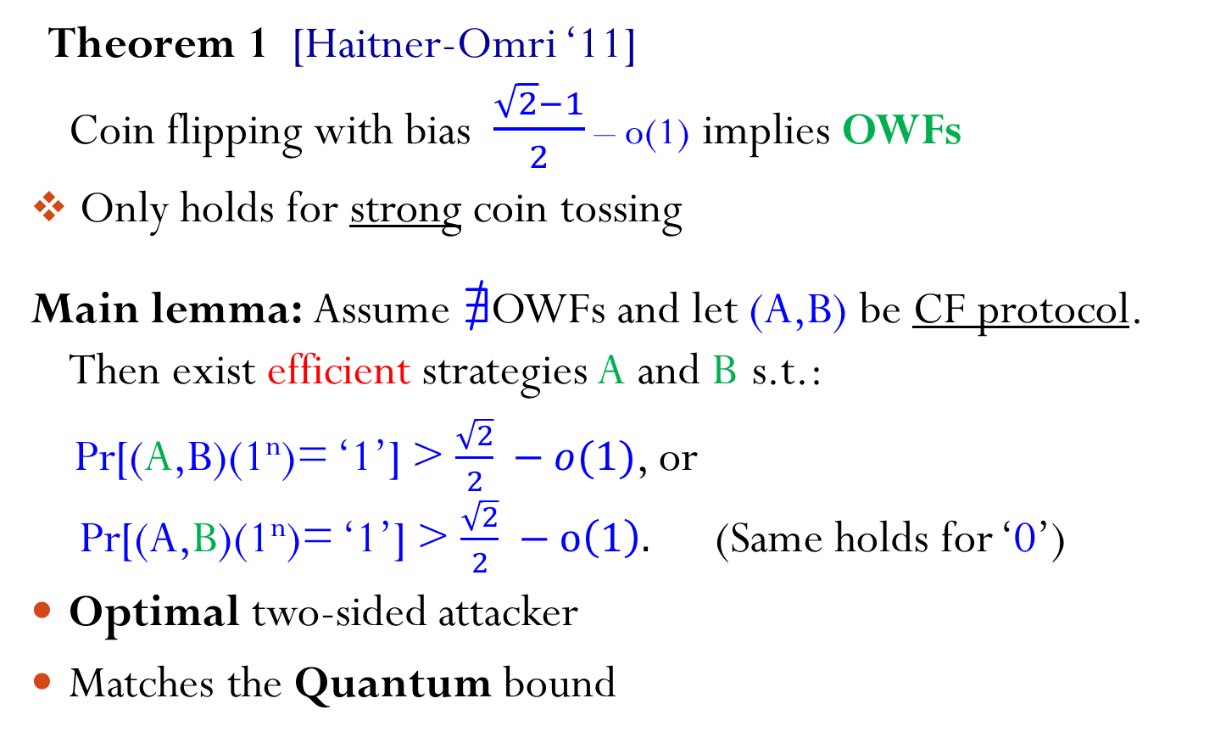
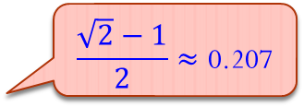
[Haitner-Omri ‘11]
Theorem 1 [Haitner-Omri ‘11]
Coin flipping with bias $\frac{\sqrt{2}−1}{2}\text{–} \text{o}\text{(}\text{1}\text{)}$ implies OWFs
Only holds for strong coin tossing
Main lemma: Assume @OWFs and let (A,B) be CF protocol.
Then exist efficient strategies A and B s.t.:
Pr[(A,B)(1^{n})= ‘1’] > $\frac{\sqrt{2}}{2} −o(1)$, or
Pr[(A,B)(1^{n})= ‘1’] > $\frac{\sqrt{2}}{2} −o\left(1\right).$ (Same holds for ‘0’)
Optimal two-sided attacker
Matches the Quantum bound
$$\frac{\sqrt{2}−1}{2}≈\text{0}\text{.}\text{207}$$

Slide 9
[Berman-Haitner-Tentes ‘13]
Theorem 2 [Berman-Haitner-Tentes ‘13]
Coin flipping of any (non-trivial) constant bias
(e.g., 0.4999) implies OWFs
Also holds for weak coin tossing
Main lemma: Assume @OWFs and let (A,B) be CF protocol.
Then $∀ε>0$ exist efficient strategies A and B s.t.:
Pr[(A,B)(1^{n})= ‘1’] >$1−ε$, or
Pr[(A,B)(1^{n})= ‘0’] >$1−ε.$ (Same holds for opposite directions)
Almost fully characterizes complexity of coin-flipping protocols. Yet to be characterized: CF of bias $\frac{1}{2}−o(1)$
Notes:
Changed the strong to weak.

Slide 10
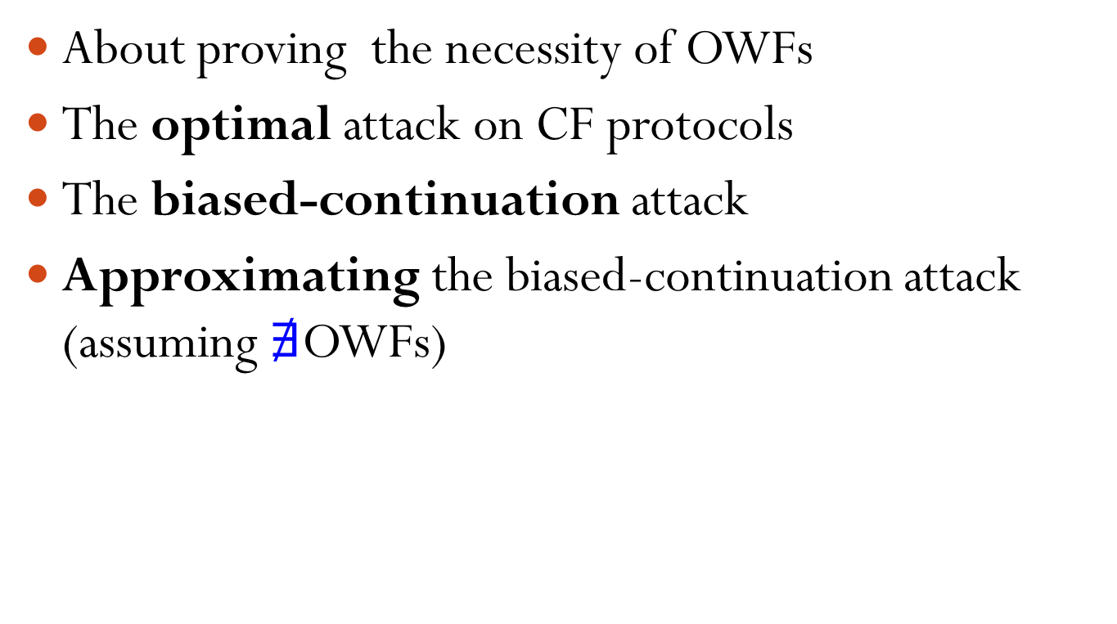
Rest of the Talk
About proving the necessity of OWFs
The optimal attack on CF protocols
The biased-continuation attack
Approximating the biased-continuation attack
(assuming $∄$OWFs)

Slide 11
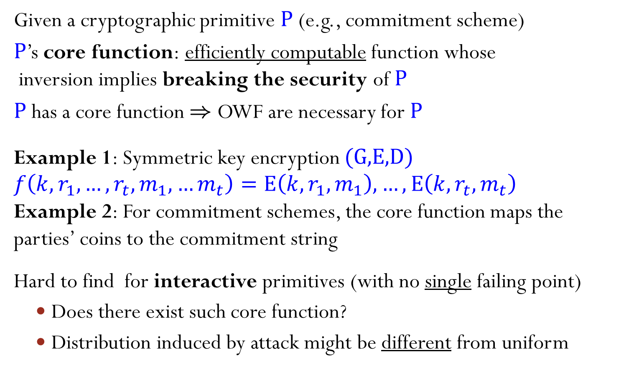
Proving The Necessity of OWFs
Given a cryptographic primitive $\text{P}$ (e.g., commitment scheme)
$\text{P}$’s core function: efficiently computable function whose
inversion implies breaking the security of $\text{P}$
$\text{P}$ has a core function ) OWF are necessary for $\text{P}$
Example 1: Symmetric key encryption $\text{(}\text{G}\text{,}\text{E}\text{,}\text{D}\text{)}$ $f\left(k,r_{1},…,r_{t},m_{1},…m_{t}\right)=\text{E}\left(k,r_{1},m_{1}\right),…,\text{E}\left(k,r_{t},m_{t}\right)$
Example 2: For commitment schemes, the core function maps the parties’ coins to the commitment string
Hard to find for interactive primitives (with no single failing point)
  Does there exist such core function?
  Distribution induced by attack might be different from uniform

Slide 12
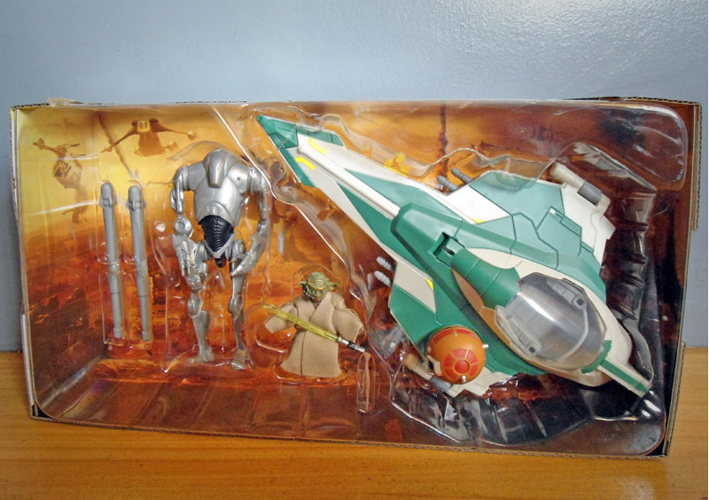
The Optimal Adversaries

Slide 13
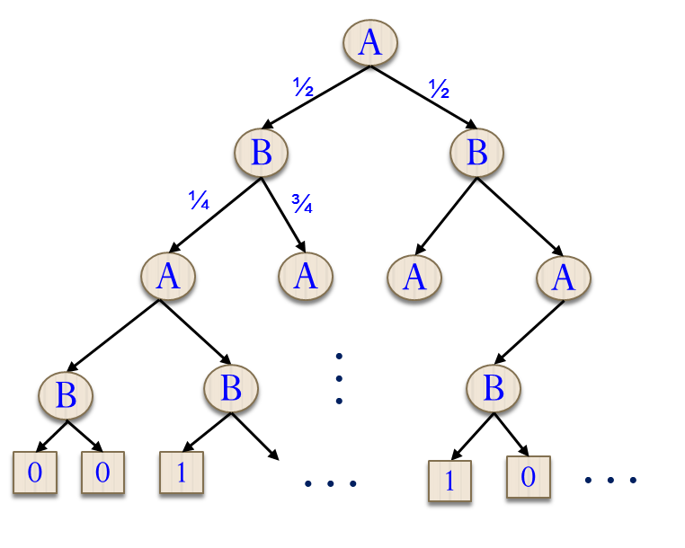
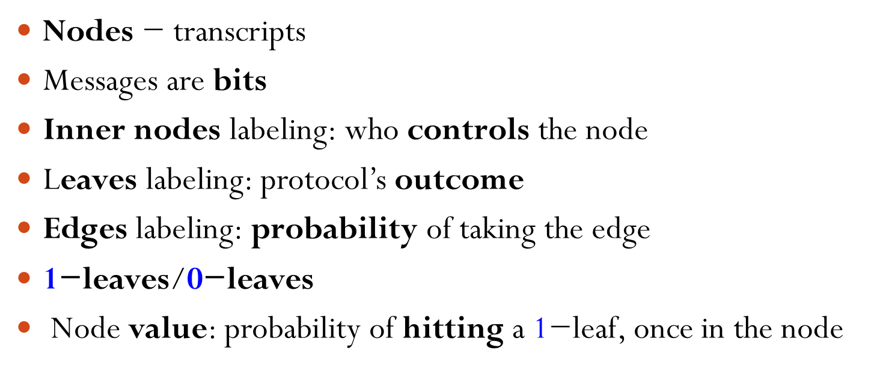
Protocols as Binary Trees
Nodes $\text{−}$ transcripts
Messages are bits
Inner nodes labeling: who controls the node
Leaves labeling: protocol’s outcome
Edges labeling: probability of taking the edge
1$\text{−}$leaves/0$\text{−}$leaves
Node value: probability of hitting a 1$\text{−}$leaf, once in the node

Slide 14
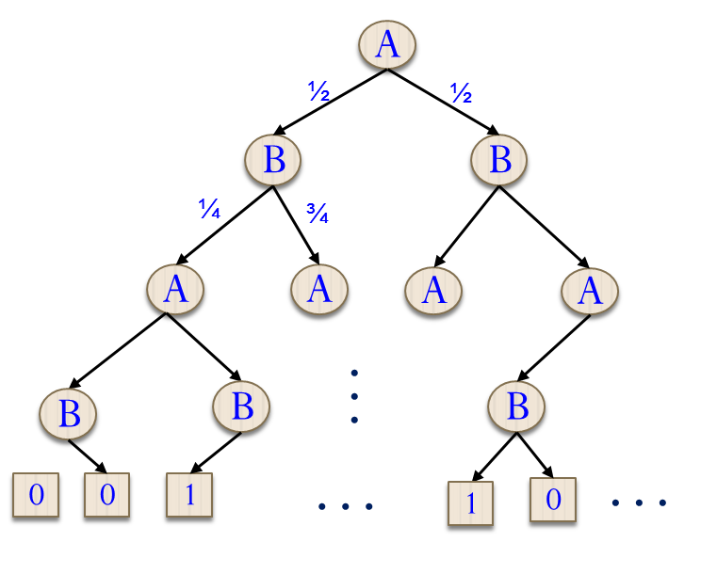

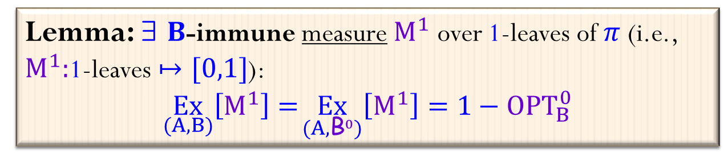
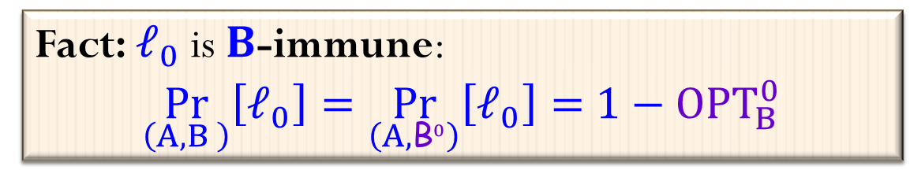

Optimal Attacks on CF Protocols
Optimal adversaries for $π=(\text{A}\text{,}\text{B})$:
${\text{A}}_{}^{1}$ – optimal valid strategy for A attacking towards 1
${\text{B}}_{}^{0}$ – optimal valid strategy for B attacking towards 0
Assume wlg. that $\underset{\text{(}{\text{A}}_{}^{1}\text{,}{\text{B}}_{}^{0}\text{)}}{Pr}[$‘1’$]$ = $1$
)${ \text{OPT}}_{B}^{0} ≝\underset{\text{(}\text{A}\text{,}{\text{B}}_{}^{0}\text{)}}{Pr}\left[\text{‘}\text{0}\text{’}\right]=1−α<1$
Question: what makes ${\text{A}}_{}^{1}$ wins?
A
®
1- ®
$$ℓ_{o}$$
B
1
¯
0
A
Fact: $ℓ_{0}$ is $B$-immune:
$$\underset{\left(A,B \right)}{Pr}\left[ℓ_{0}\right]=\underset{\left(A,{\text{B}}_{}^{0}\right)}{Pr}\left[ℓ_{0}\right]={ 1−\text{OPT}}_{B}^{0}$$
1
Lemma: 9 $B$-immune measure $M_{}^{1}$ over 1-leaves of $π$ (i.e., $M_{}^{1}:$1-leaves $↦[0,1]$):
$$\underset{(A,B)}{Ex}\left[M_{}^{1}\right]=\underset{(A,{\text{B}}_{}^{0})}{Ex}\left[M_{}^{1}\right]=1−{ \text{OPT}}_{B}^{0}$$

Slide 15
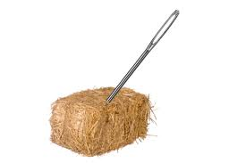

The Biased Continuation Attack
Or, hitting the $\text{B}$–immune measure

Slide 16
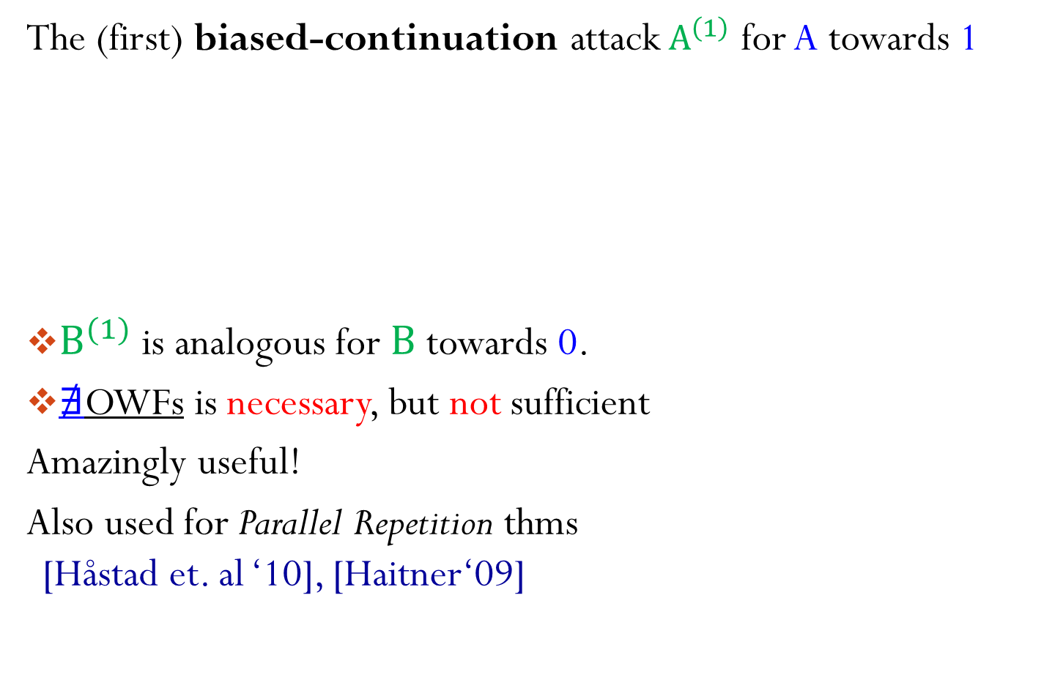
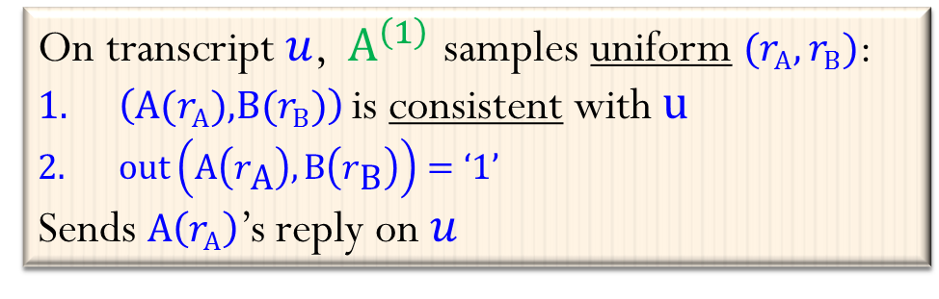
The Biased-Continuation Attack
The (first) biased-continuation attack${ A}^{\left(1\right)}$ for A towards 1
${\text{B}}^{(1)}$ is analogous for $\text{B}$ towards 0.
$∄$OWFs is necessary, but not sufficient
Amazingly useful!
Also used for Parallel Repetition thms
[Håstad et. al ‘10], [Haitner‘09]
On transcript $u$, ${ A}^{\left(1\right)}$ samples uniform $(r_{\text{A}},r_{\text{B}})$:
$\left(\text{A}\text{(}r_{\text{A}}\text{)}\text{,}\text{B}\text{(}r_{\text{B}}\text{)}\right)$ is consistent with $u$
$\text{out}\left(\text{A}\left(r_{\text{A}}\right),\text{B}\left(r_{\text{B}}\right)\right)=\text{‘}\text{1}\text{’}$
Sends $\text{A}\left(r_{\text{A}}\right)$’s reply on $u$
A
½
½
B
B
¼
¾
A
A
A
A
B
B
…
B
…
…
0
0
1
1
0

Slide 17

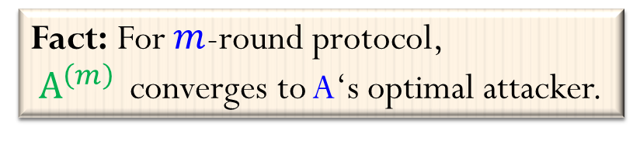

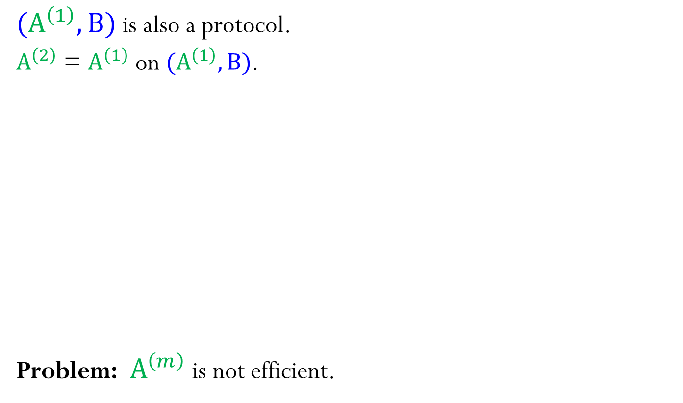

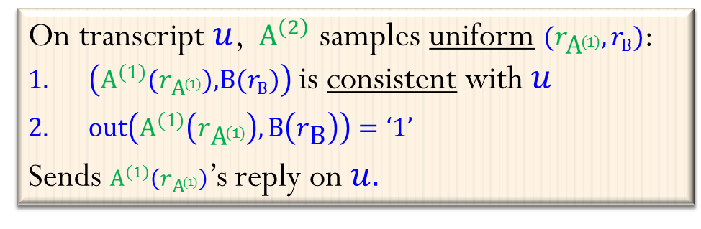

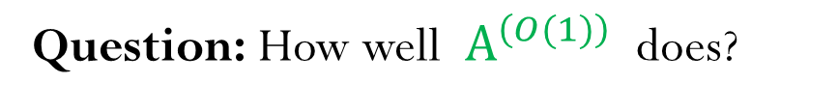

Recursions
$(A^{\left(1\right)},B)$ is also a protocol.
$A^{\left(2\right)}$ = $A^{\left(1\right)}$ on $(A^{\left(1\right)},B)$.
Problem: ${ A}^{\left(m\right)}$ is not efficient.
On transcript $u$, ${ A}^{\left(2\right)}$ samples uniform $(r_{{\text{A}}^{(1)}},r_{\text{B}})$:
$\left({\text{A}}^{(1)}\text{(}r_{{\text{A}}^{(1)}}\text{)}\text{,}\text{B}\text{(}r_{\text{B}}\text{)}\right)$ is consistent with $u$
$\text{out}\left({\text{A}}^{(1)}\left(r_{{\text{A}}^{(1)}}\right),\text{B}\left(r_{\text{B}}\right)\right)=\text{‘}\text{1}\text{’}$
Sends ${\text{A}}^{(1)}\left(r_{{\text{A}}^{(1)}}\right)$’s reply on $u.$
$$A^{\left(1\right)}$$
A
½
¼
¾
½
B
B
¼
¾
Fact: For $m$-round protocol,
${ A}^{\left(m\right) }$ converges to A‘s optimal attacker.
$$A^{\left(1\right)}$$
$$A^{\left(1\right)}$$
$$A^{\left(1\right)}$$
$$A^{\left(1\right)}$$
A
A
A
A
B
B
…
B
…
0
0
1
1
0
Question: How well ${ A}^{\left(O(1)\right) }$ does?

Slide 18


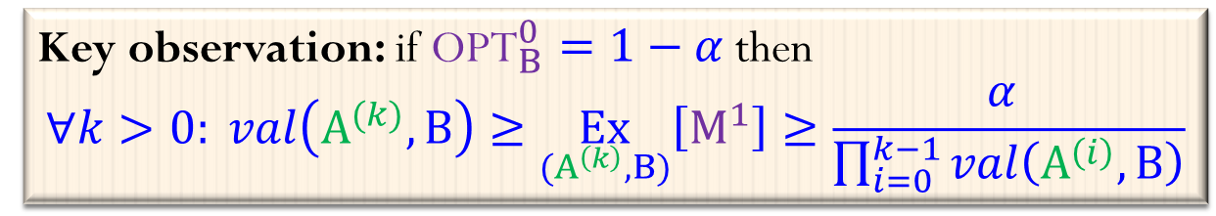
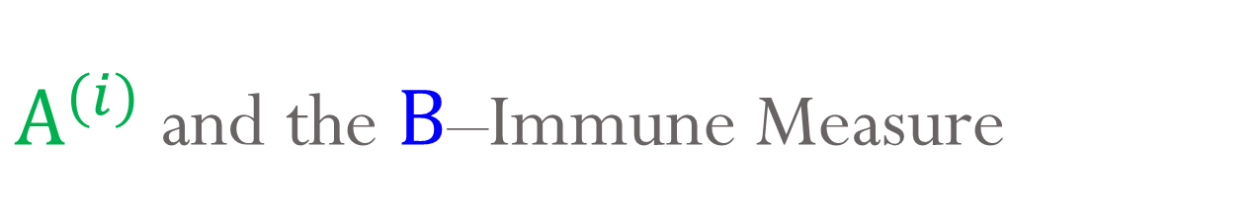
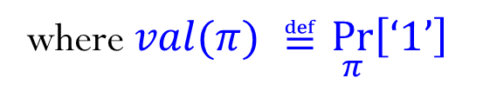
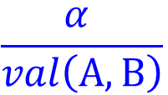

$A^{(i)}$ and the $\text{B}$–Immune Measure
$$val\left(A^{(1)},B\right)≥$$
$\underset{{(A}^{\left(1\right)},B)}{Pr}\left[ℓ_{o}\right]=\text{2}α$
$val\left(A^{(k)},B\right)≥\underset{{(A}^{\left(k\right)},B)}{Pr}\left[ℓ_{o}\right]=\frac{α }{\prod_{i=0}^{k−1}{val\left(A^{\left(i\right)},B\right)}}$
letting $A^{(0)}=A$.
Since $val\left(A,B\right)=\frac{1}{2}$ ) $val\left(A^{(k)},B\right)≥1−ε$
for $k=\log{\frac{1}{α}}/\log{\frac{1}{1−ε}}$
Problem:
$α∈o(1)$ ) (even for constant $ε>0$) $k∈ω\left(1\right)$ ) $A^{(k)}$ is inefficient
$$\frac{α }{val\left(A,B\right)}$$
A
$$ℓ_{o}$$
®
where $val(π) ≝$ $\underset{π}{Pr}\left[\text{‘}\text{1}\text{’}\right]$
1- ®
1
B
¯
0
A
1
…
Key observation: if ${\text{OPT}}_{B}^{0}=1−α$ then
$$∀k>0: val\left(A^{(k)},B\right)≥\underset{{(A}^{\left(k\right)},B)}{Ex}\left[M_{}^{1}\right]≥\frac{α }{\prod_{i=0}^{k−1}{val\left(A^{\left(i\right)},B\right)}}$$

Slide 19
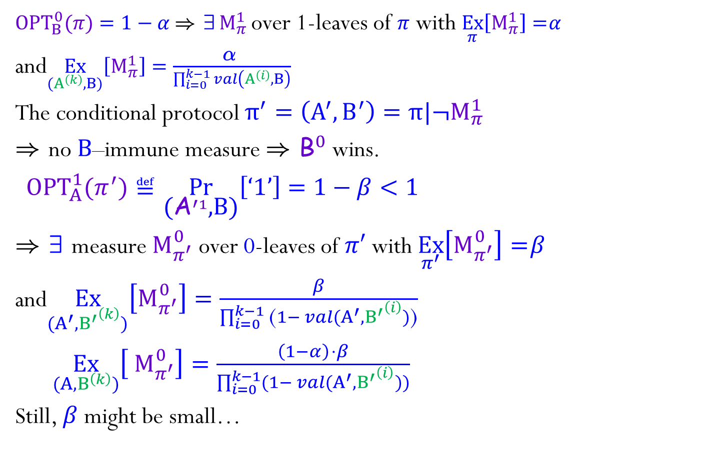
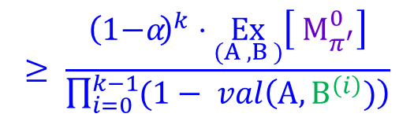
Conditional Protocols
${\text{OPT}}_{B}^{0}(π)=1−α \text{)} \text{9}{ \text{M}}_{π}^{1}$over 1-leaves of $π$ with $\underset{π}{Ex}\left[{\text{M}}_{π}^{1}\right]=α$
and$\underset{{(A}^{\left(k\right)},B)}{Ex}\left[{\text{M}}_{π}^{1}\right]=\frac{\text{®} }{\prod_{i=0}^{k−1}{val\left(A^{\left(i\right)},B\right)}}$
The conditional protocol $π^{′}=\left(A^{′},B^{′}\right)=π|¬{\text{M}}_{π}^{1}$
) no $\text{B}$–immune measure ) ${\text{B}}_{}^{0}$wins.
${ \text{OPT}}_{A}^{1}(π^{′})≝\underset{\text{(}{\text{A}}_{}^{′1}\text{,}\text{B}\text{)}}{Pr}\left[\text{‘}\text{1}\text{’}\right]=1−β<1$
) 9 measure${ \text{M}}_{π^{′}}^{0}$ over 0-leaves of $π′$ with $\underset{π^{′}}{Ex}\left[{\text{M}}_{π^{′}}^{0}\right]=β$
and$\underset{{(A^{′},B^{′}}^{\left(k\right)})}{Ex}\left[{\text{M}}_{π^{′}}^{0}\right]=\frac{β}{\prod_{i=0}^{k−1}{\text{(}1− val{(A^{′},B^{′}}^{\left(i\right)})\text{)}}}$
$\underset{{(A,B}^{\left(k\right)})}{Ex}\left[{ \text{M}}_{π^{′}}^{0}\right]=\frac{{\left(1−α\right)}^{ }⋅β}{\prod_{i=0}^{k−1}{(1− val{(A^{′},B^{′}}^{\left(i\right)}))}}$
Still, $β$ might be small…
A
®
1- ®
1
B
¯
0
A
1
…
$$≥ \frac{{\left(1−α\right)}^{k}⋅\underset{{(A}^{ },B^{ })}{Ex}\left[{ \text{M}}_{π^{′}}^{0}\right]}{\prod_{i=0}^{k−1}{(1− val\left(A,B^{\left(i\right)})\right)}}$$

Slide 20

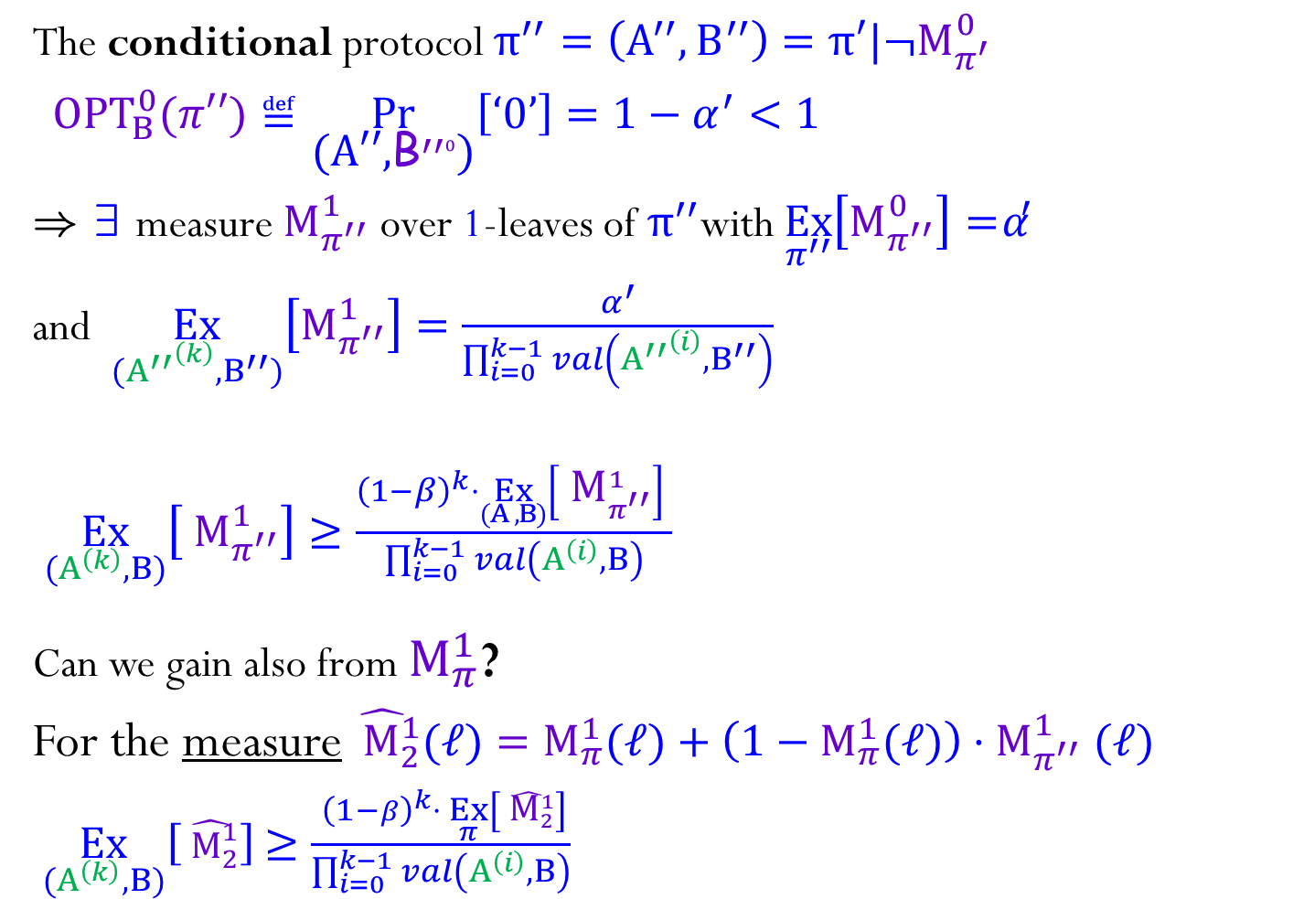


Conditional Protocols cont.
The conditional protocol $π^{′′}=\left(A^{′′},B^{′′}\right)=π′|¬{\text{M}}_{π^{′}}^{0}$
${ \text{OPT}}_{B}^{0}\text{(}π′′)≝\underset{\text{(}\text{A}\text{′′,}{\text{B}}_{}^{′′0}\text{)}}{Pr}\left[\text{‘}\text{0}\text{’}\right]=1−α^{′}<1$
) 9 measure${ \text{M}}_{π^{′′}}^{1}$ over 1-leaves of $π^{′′}$with $\underset{π^{′′}}{Ex}\left[{\text{M}}_{π^{′′}}^{0}\right]=α′$
and $\underset{{(A^{′′}}^{\left(k\right)},B^{′′})}{Ex}\left[{\text{M}}_{π^{′′}}^{1}\right]=\frac{α^{′}}{\prod_{i=0}^{k−1}{val\left({A^{′′}}^{\left(i\right)},B^{′′}\right)}}$
$\underset{{(A}^{\left(k\right)},B)}{Ex}\left[{ \text{M}}_{π^{′′}}^{1}\right]≥\frac{{{\left(1−β\right)}^{k}⋅\underset{{(A}^{ },B)}{Ex}\left[{ \text{M}}_{π^{′′}}^{1}\right]}^{ }}{\prod_{i=0}^{k−1}{val\left(A^{\left(i\right)},B\right)}}$
Can we gain also from ${\text{M}}_{π}^{1}$?
For the measure${\hat{{ \text{M}}_{2}^{1}}(ℓ)={\text{M}}_{π}^{1}(ℓ)+\left(1−{\text{M}}_{π}^{1}(ℓ)\right){⋅\text{M}}_{π^{′′}}^{1}(ℓ)}_{}^{ }$
$\underset{{(A}^{\left(k\right)},B)}{Ex}\left[\hat{{ \text{M}}_{2}^{1}}\right]$ $≥\frac{ {{\left(1−β\right)}^{k}⋅}^{ }\underset{π}{Ex}\left[\hat{{ \text{M}}_{2}^{1}}\right]}{\prod_{i=0}^{k−1}{val\left(A^{\left(i\right)},B\right)}}$
A
®
1- ®
1
B
¯
0
A
$$α^{′}$$
$$\left(1−α\right)⋅\left(1−β\right)⋅α′$$
1
…
$$α+\left(1−α\right)⋅\left(1−β\right)⋅α′$$

Slide 21
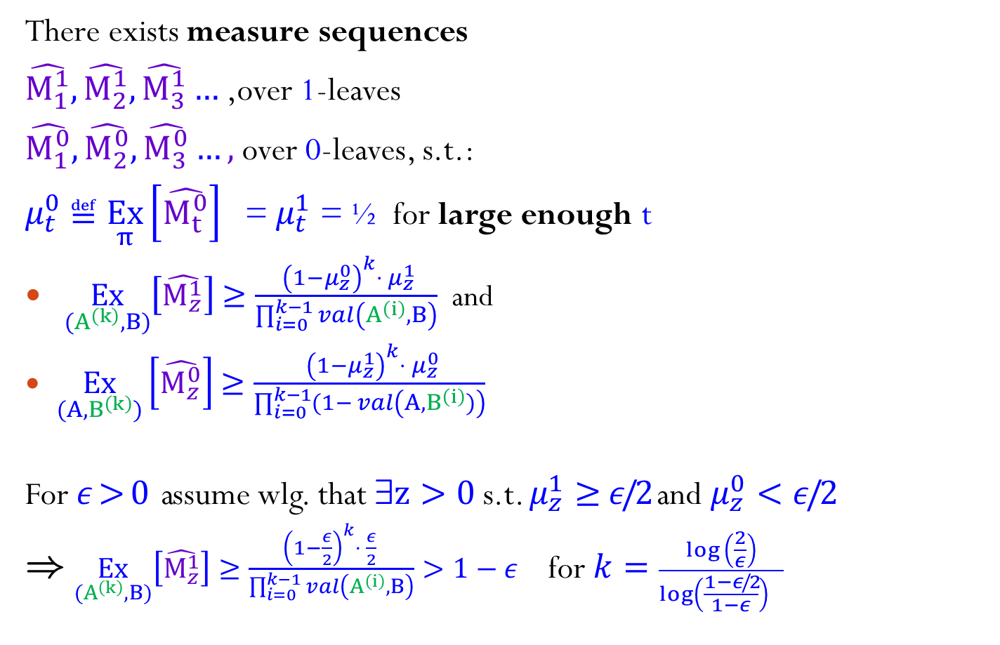
Sequence of Conditional Protocols
There exists measure sequences
$\hat{{\text{M}}_{1}^{1}},\hat{{\text{M}}_{2}^{1}},\hat{{\text{M}}_{3}^{1}}…$,over 1-leaves
$\hat{{\text{M}}_{1}^{0}},\hat{{\text{M}}_{2}^{0}},\hat{{\text{M}}_{3}^{0}}…,$over 0-leaves, s.t.:
$μ_{t}^{0}$ $≝$ $\underset{π}{Ex}\left[\hat{{\text{M}}_{t}^{0}}\right]$ = $μ_{t}^{1}$ = ½ for large enough t
$\underset{{(A}^{\left(k\right)},B)}{Ex}\left[\hat{{\text{M}}_{z}^{1}}\right]$ $≥\frac{ {{\left(1−μ_{z}^{0}\right)}^{k}⋅}^{ }μ_{z}^{1}}{\prod_{i=0}^{k−1}{val\left(A^{\left(i\right)},B\right)}}$ and
$\underset{(A,B^{\left(k\right)})}{Ex}\left[\hat{{\text{M}}_{z}^{0}}\right]$ $≥\frac{ {{\left(1−μ_{z}^{1}\right)}^{k}⋅}^{ }μ_{z}^{0}}{\prod_{i=0}^{k−1}{(1− val\left(A,B^{\left(i\right)})\right)}}$
For $ε>0$ assume wlg. that 9$z>0$s.t. $μ_{z}^{1}≥$ $ε/2$ and $μ_{z}^{0}<ε/2$
) $\underset{{(A}^{\left(k\right)},B)}{Ex}\left[\hat{{\text{M}}_{z}^{1}}\right]≥\frac{{{\left(1−\frac{ε}{2}\right)}^{k}⋅ \frac{ε}{2}}^{ }}{\prod_{i=0}^{k−1}{val\left(A^{\left(i\right)},B\right)}}>1−ε$ for $k=\frac{\log\left(\frac{2}{ε}\right)}{log\left(\frac{1−ε/2}{1−ε}\right){ }}$

Slide 22
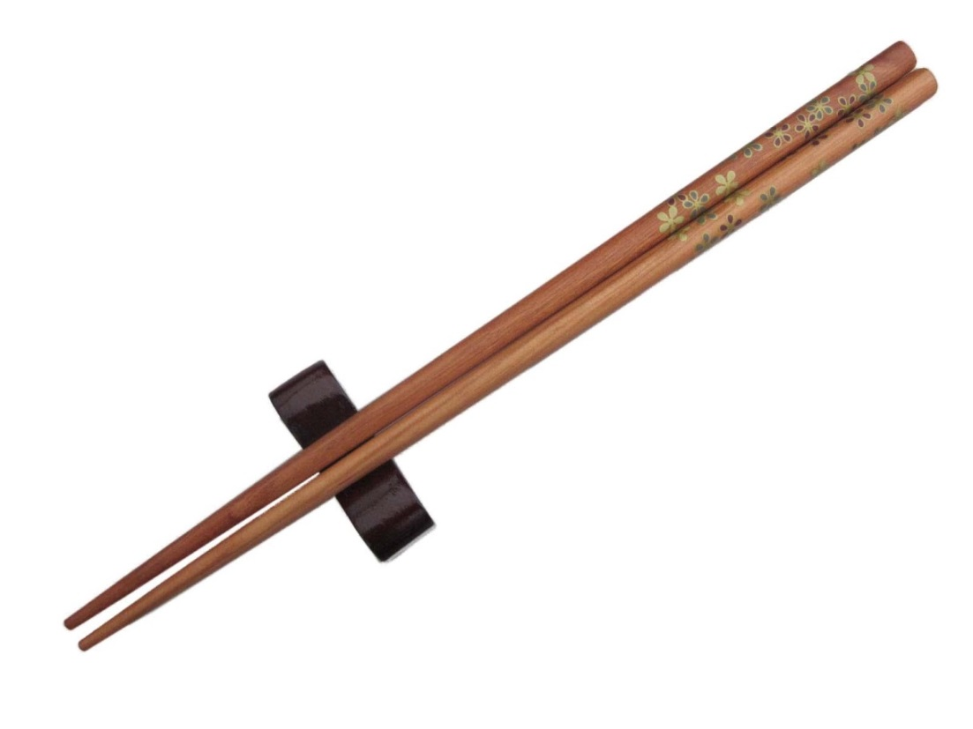
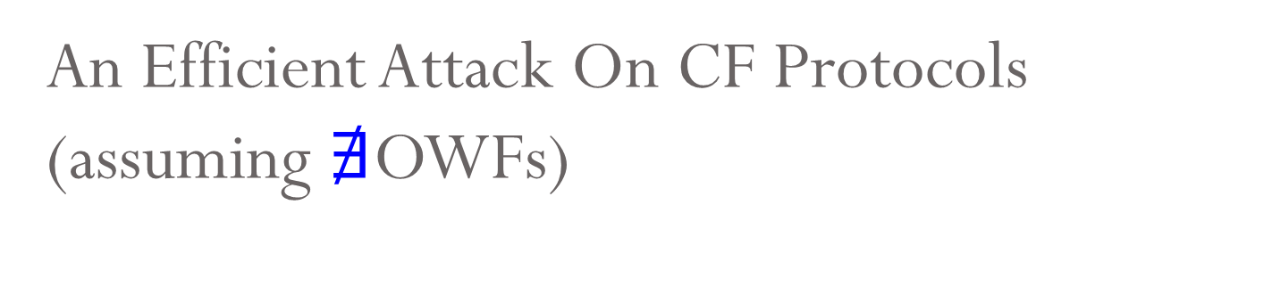
An Efficient Attack On CF Protocols
(assuming $∄$OWFs)

Slide 23
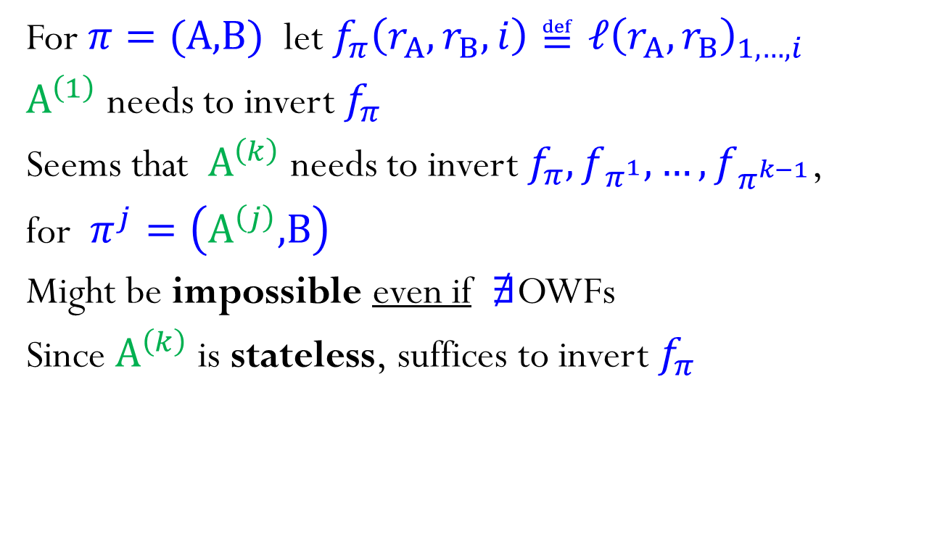
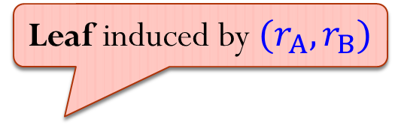
Transcript Function
Leaf induced by $(r_{A},r_{B})$
For $π=(\text{A}\text{,}\text{B})$let $f_{π}\left(r_{A},r_{B},i\right)≝ℓ{\left(r_{A},r_{B}\right)}_{1,…,i}$
$A^{\left(1\right)}$ needs to invert $f_{π}$
Seems that $A^{\left(k\right)}$ needs to invert $f_{π},f_{π^{1}},…,f_{π^{k−1}}$,
for $π^{j}=\left(A^{\left(j\right)}\text{,}\text{B}\right)$
Might be impossible even if $∄$OWFs
Since $A^{\left(k\right)}$ is stateless, suffices to invert $f_{π}$

Slide 24


Hard to Invert Transcripts
${LowVal}_{δ}^{A}=\{v :v in A^{′}s control \& val\left(v\right)<δ\}$
${{\text{Un}Bal}_{γ}^{A}}_{ }^{}=\{v :v in A^{′}s control \&\underset{{(A}^{\left(k\right)},B)}{Pr}\left[v\right]>γ⋅\underset{(A,B)}{Pr}\left[v\right]\}$
@OWF does not suffice for attacking these nodes
…
A
$$2^{−n}$$
A
0
½
1
0

Slide 25
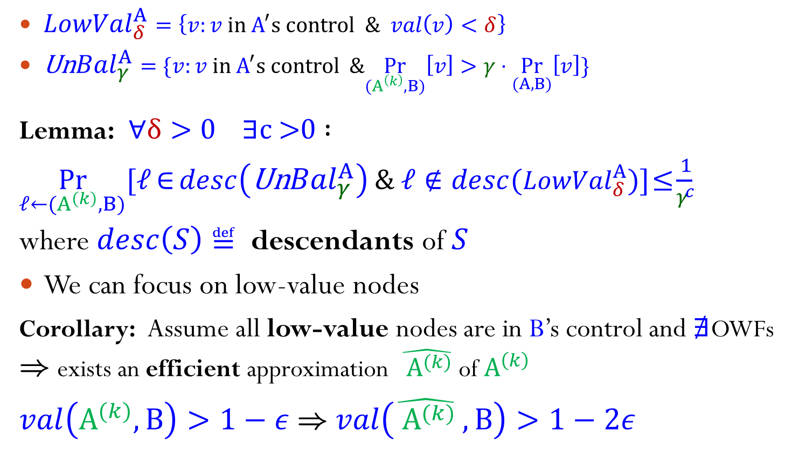

Large is Balanced
…
A
${LowVal}_{δ}^{A}=\left\{v:v in A^{′}s control \& val\left(v\right)<δ\right\}$
${\text{Un}Bal}_{γ}^{A}=\{v:v in A^{′}s control \&\underset{{(A}^{\left(k\right)},B)}{Pr}\left[v\right]>γ⋅\underset{(A,B)}{Pr}\left[v\right]\}$
Lemma: $∀δ>0 ∃$c >0 $:$
$\underset{{ℓ←(A}^{\left(k\right)},B)}{Pr}[ℓ∈{desc\left({\text{Un}Bal}_{γ}^{A}\right)}_{}^{ }\& ℓ∉desc({LowVal}_{δ}^{A})]≤\frac{1}{γ^{c}}$
where $desc\left(S\right)$ $≝$ descendants of $S$
We can focus on low-value nodes
Corollary: Assume all low-value nodes are in B’s control and $∄$OWFs
) exists an efficient approximation ${\hat{{ A}_{ }^{(k)}}}_{}^{ }$of $A^{\left(k\right)}$
$val\left(A^{(k)},B\right)>1−ε \text{)}$ $val\left({\hat{{ A}_{ }^{(k)}}}_{}^{ },B\right)>1−2ε$
$$2^{−n}$$
A
0
½
1
0

Slide 26
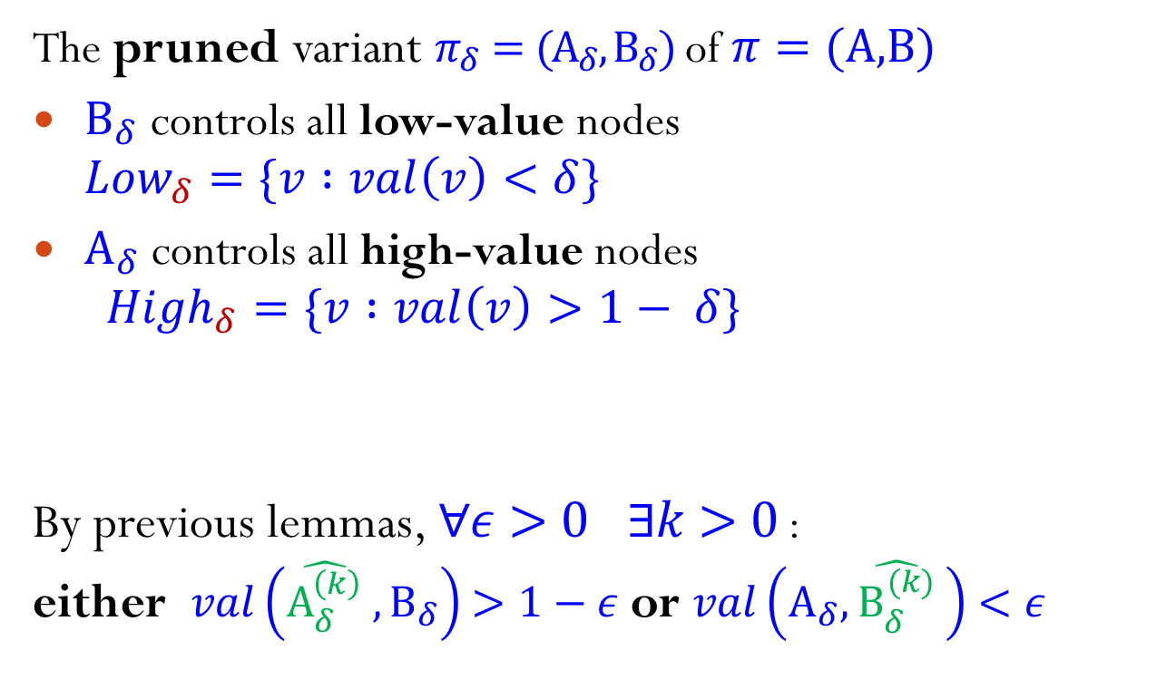
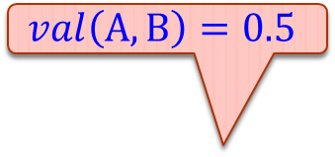
Pruned Protocols
$$val\left(A,B\right)=0.5$$
The pruned variant $π_{δ}=(A_{δ},B_{δ})$ of $π=(\text{A}\text{,}\text{B})$
$B_{δ}$ controls all low-value nodes
${Low}_{δ}=\{v :val\left(v\right)<δ\}$
$A_{δ}$ controls all high-value nodes
${High}_{δ}=\{v :val\left(v\right)>1− δ\}$
By previous lemmas, $∀ε>0 ∃k>0$ :
either $val\left({\hat{A_{δ}^{\left(k\right)}}}_{}^{ },B_{δ}\right)$ $>1−ε$ or $val\left(A_{δ},{\hat{B_{δ}^{(k)}}}_{}^{ }\right)$ $<ε$
A
.5
A
B
B
.999
.2
A
A
B
A
A
.3
.001
…
A
A
B
B
1
0
B
…
0
0
1
1
0

Slide 27

The Pruning Attacker
The pruning attacker, acts as if it is in the pruned protocol
Let $π=(\text{A}\text{,}\text{B})$.
The pruning attacker $\tilde{A_{}^{\left(k\right),δ}}$ for $\text{A}$, acts as ${\hat{A_{δ}^{(k)}}}_{}^{ }$
until reaching a pruned node, and then start acting honestly (like $\text{A}$)
Assume wlg. that $val\left({\hat{A_{δ}^{(k)}}}_{}^{ },B\right)$ $>$ $1−ε$ then
$val\left(\tilde{A_{}^{\left(k\right),δ}},B\right)$ $>$ $1−ε −δ$
A
.5
B
A
B
A
.999
.2
A
A
B
B
A
A
.3
.001
A
A
A
A
B
B
1
0
B
0
0
1
1
0

Slide 28


Summary
Coin flipping of any constant-bias implies OWFs
Challenge $\text{−}$ show the same for bias $\frac{1}{2}−o(1)$
Further implications for the connection between zero-sum games and existence of OWFs

