Slide 1
Limits on the Power of
Cryptographic Cheap Talk
Pavel Hubáček*
Jesper Buus Nielsen
Alon Rosen
*Produced all the good slides

Slide 2

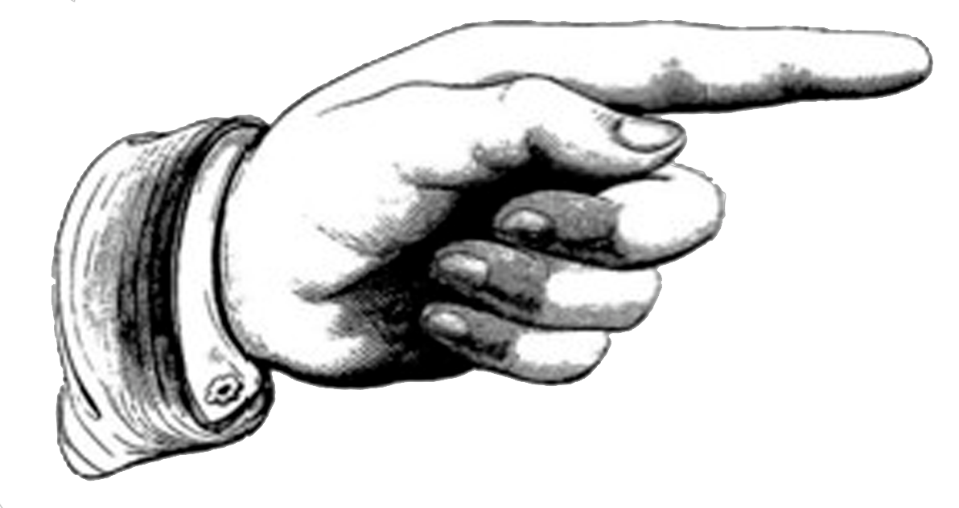
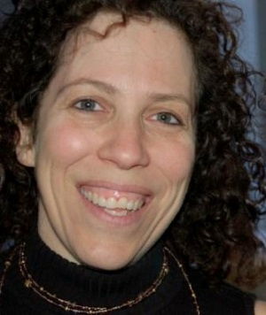
NE, Nash 1950
 | 6, 6 | 2, 7
 | 7, 2 | 0, 0
14/3
14/3
1/10
Notes:
The story starts in 1950 with Nash’s notion of NE
I’ll look at matrix games where a row player picks a row and a column play picks a column and they get the utilities in the intersection, here 7 for Rabin and 2 for Canetti
They might use a randomized strategy, Canetti could e.g. play left with probability 2/3.

Slide 3
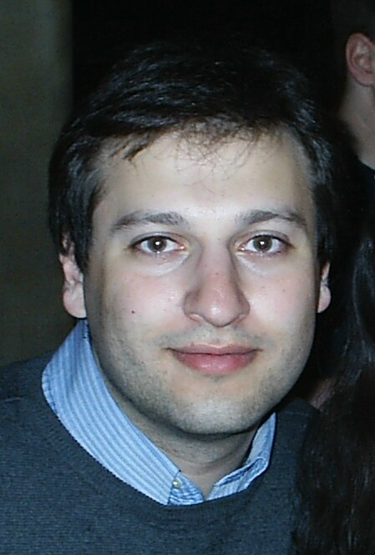
CE, Aumann 1974
Correlated equilibria can pick up more utility!
Play right!
 | 6, 6 | 2, 7
 | 7, 2 | 0, 0
4
5>14/3
7
Play top!
2/10
Notes:
24 years later Aumann pointed out that if the players could correlate their actions they can do better than any NE. But they need a correlation device. The correlation device can sometimes give bad advice, like playing top for Rabin, which only gives utility 4, but such bad advice can be essential for overall stability.

Slide 4

Dodis-Halevi-Rabin 2000
For any CE, a computational NE achieving the same utility!
$$⋮$$
Cheap Talk
Bad advice, I abort!
Top!
 | 6, 6 | 2, 7
 | 7, 2 | 0, 0
Right!
MiniMax
3/10
Notes:
26 years later it was proposed to implement the correlation device using two-party computation. If a party deviates, it will be punished using the minimax strategy by the other player.

Slide 5
Gradwohl-Livne-Rosen 2010
MiniMax might be an empty threat
First explicit model of empty threat-free (ETF) strategy for a cryptographic cheap-talk game
Gives an ETF strategy for large sub-class of CE
4/10
Notes:
Playing minimax is typically an empty threat. So 10 years later GLR proposed an explicit notion of ETF and implemented a large class of CE in an ETF way.

Slide 6
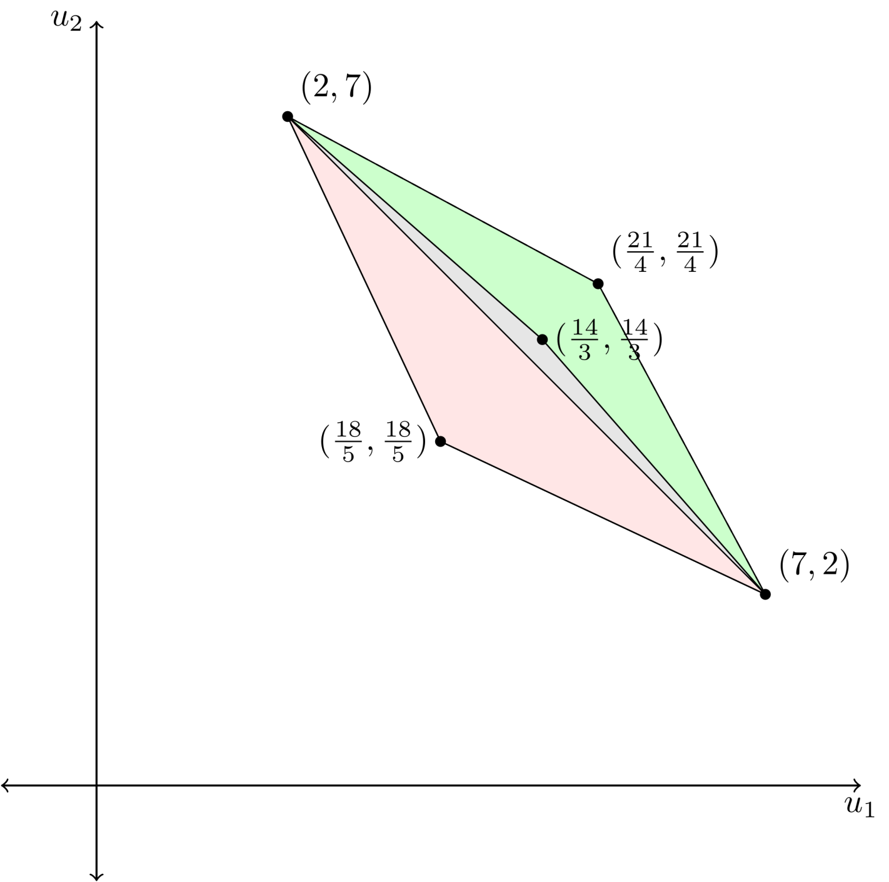
The grey region is
the convex hull of
the utility profiles
of the NE
This is what GLR10
achieves
Can crypto help
us pick up the
green utility?
 | 6, 6 | 2, 7
 | 7, 2 | 0, 0
5/10
Notes:
The CE they can implement all have utilities in the convex hull of utilities of NE. The game we look at as example has three NE: (left, bottom), (top,right) and the one from the first slide. The utility profiles are (7,2), (2,7) and (14,14)/3. So GLR can implement the grey region. The green region was an open problem. We give a full characterization of the region which can be implement in an ETF way.

Slide 7
Def. 1: NES⊂CE
A CE is called NE-Safe (NES) iff the residual utility given any advise is at least the utility in the
worst NE for the same player
 | 6, 6 | 2, 7
 | 7, 2 | 0, 0
4
7
6/10

Slide 8
Def. 2: ETF⊂CE
A CE S for a matrix game M is called ETF if there exist an ETF strategy for the corresponding cryptographic cheap-talk game for M which has the same utility profile as S
“The utility which we can pick up using cryptographic cheap-talk”
7/10

Slide 9
Hubáček-N-Rosen 2013
We identify and define NES
  The NE safe correlated equilibrium
We prove:
  ETF ⊂ NES
  CE ⊄ NES
  If OT exists then ETF = NES
  If ETF = NES then OT exists
8/10

Slide 10
ETF
A strategy is ETF if it is a computational NE and neither player has an empty threat
Empty threat of Rabin in strategy S=(S_{R},S_{C}) :
A non-negligible event E observable by Canetti and a deviation D for Canetti such that:
if Canetti switch to D when observing E,
then in all ETF continuations, following
the switch, Canetti gets non-negligibly
more utility than if he had stuck to S
9/10
Notes:
To see why this is a meaningful definition, note that that since S is a NE, if Canetti deviates and Rabin sticks to her strategy, then Canetti does not get more. So since he gets more in all ETF continuations, S itself is not an ETF continuation after E occurred. This is a backwards recursive definition. The ETF strategies in the last round if the protocol, i.e. in the matrix game, is just the NE.

Slide 11
  ETF ⊂ NES
Assume a strategy is not NES for Rabin
Event E: Rabin receives an advice with residual utility lower than her worst NE
Deviation D: Rabin sends her advice + entire view of the protocol to Canetti and then plays according to her worst NE
Analysis: After Rabin reveals her view to Canetti, they essentially only have common randomness, so if the continuation is stable, it is a (convex combination of) NE
10/10

Slide 12
  CE ⊄ NES
 | 9, 9 | -25, -25 | -25, -25 | -25, -25
 | -25, -25 | 9, 10 | 10, 9 | -100, -100
 | -25, -25 | -100, -100 | 9, 10 | 4, 9
 | -25, -25 | 10, 3 | -100, -100 | 3, 4
11/10
Notes:
There is a unique NE (left, top). Any CE doing better needs weight on the second row from the bottom and some of the weight need to be on the rightmost cell. Hence the expected utility of Rabin given this advice will be less than 9. Hence this CE is not NES. Hence it cannot be implemented in an ETF way using cryptographic cheap-talk :-(

