Slide 1
It’s Not The Assumption, It’s The Reduction
GMfest13c Assumptions Panel Presentation
Ran Canetti

Slide 2
Let’s assume P=NP
But proof is non-constructive…
… and we still have no idea how to factor…
Is cryptography as we know it dead?
NO!
Do we need to resort to heuristics?
NO!
The “security by reduction” paradigm still works!

Slide 3
Let’s assume P=NP
But proof is non-constructive…
… and we still have no idea how to factor…
Is cryptography as we know it dead?
NO!
Do we need to resort to heuristics?
NO!
The “security by reduction” paradigm still works!

Slide 4
Let’s assume P=NP
But proof is non-constructive…
… and we still have no idea how to factor…
Is cryptography as we know it dead?
NO!
Do we need to resort to heuristics?
NO!
The “security by reduction” paradigm still works!

Slide 5
Let’s assume P=NP
But proof is non-constructive…
… and we still have no idea how to factor…
Is cryptography as we know it dead?
Do we need to resort to heuristics?
NO!
The “security by reduction” paradigm still works!

Slide 6
Let’s assume P=NP
But proof is non-constructive…
… and we still have no idea how to factor…
Is cryptography as we know it dead?
Do we need to resort to heuristics?
NO!
The “security by reduction” paradigm still works!

Slide 7
Let’s assume P=NP
But proof is non-constructive…
… and we still have no idea how to factor…
Is cryptography as we know it dead?
Do we need to resort to heuristics?
NO!
The “security by reduction” paradigm still works!

Slide 8
Need to change mindset
Can no longer assume
“There is no PT algorithm for factoring”.
But it doesn’t matter:
The universal quantifier is a nice mathematical
abstraction, but doesn’t really capture what we want…
A “good” reduction to factoring is still as valid as before!

Slide 9

The case of Collision Resistant Functions
[Rogaway 07]
A single compressing function f:{0,1}*$→${0,1}* cannot be CR in the standard sense:
$∀$n $∃$polysize A_{n} that finds n-bit collisions.
“Textbook” Solutions:
  Move to asymptotic security and require A to be uniform: Way Too Weak
  Move to a family of functions f_k : Unnatural, Unrealistic
“Real” solution:
Forget the assumption, reduce to Human ignorance…

Slide 10
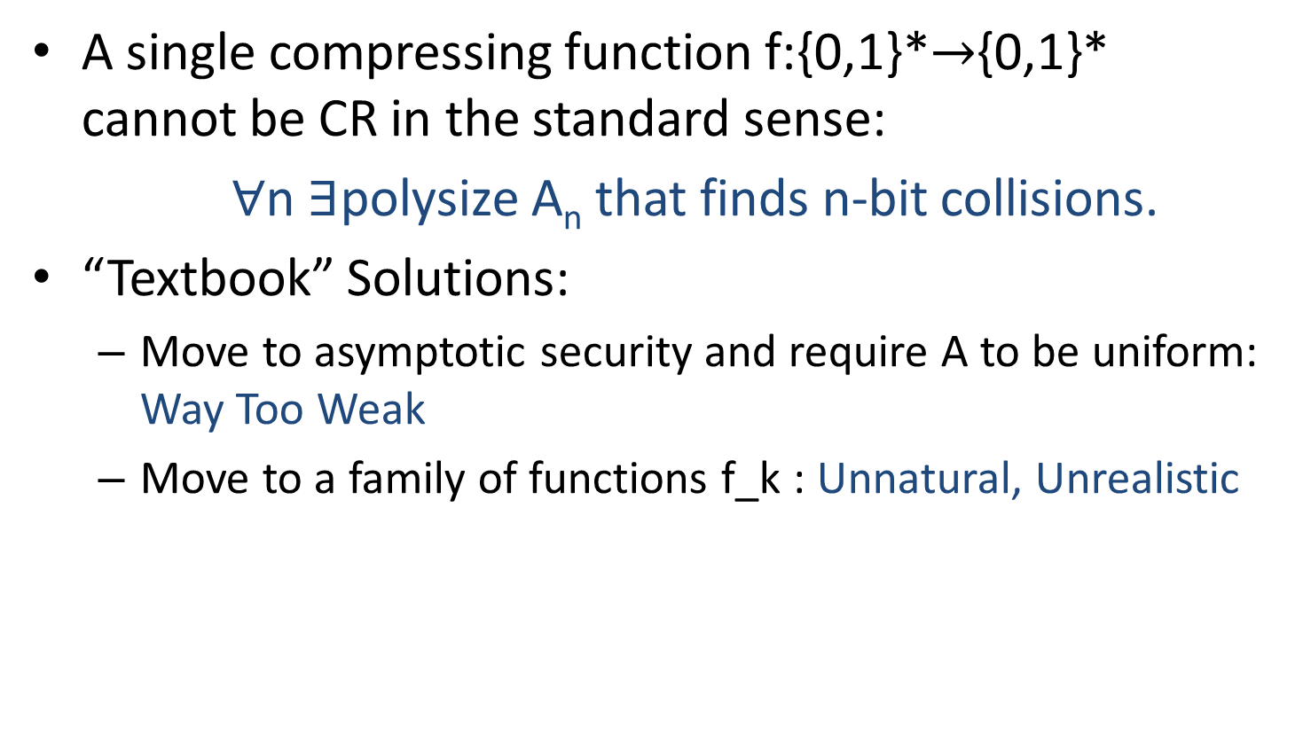
The case of Collision Resistant Functions
[Rogaway 07]
A single compressing function f:{0,1}*$→${0,1}* cannot be CR in the standard sense:
$∀$n $∃$polysize A_{n} that finds n-bit collisions.
“Textbook” Solutions:
  Move to asymptotic security and require A to be uniform: Way Too Weak
  Move to a family of functions f_k : Unnatural, Unrealistic
“Real” solution:
Forget the assumption, reduce to Human ignorance…

Slide 11
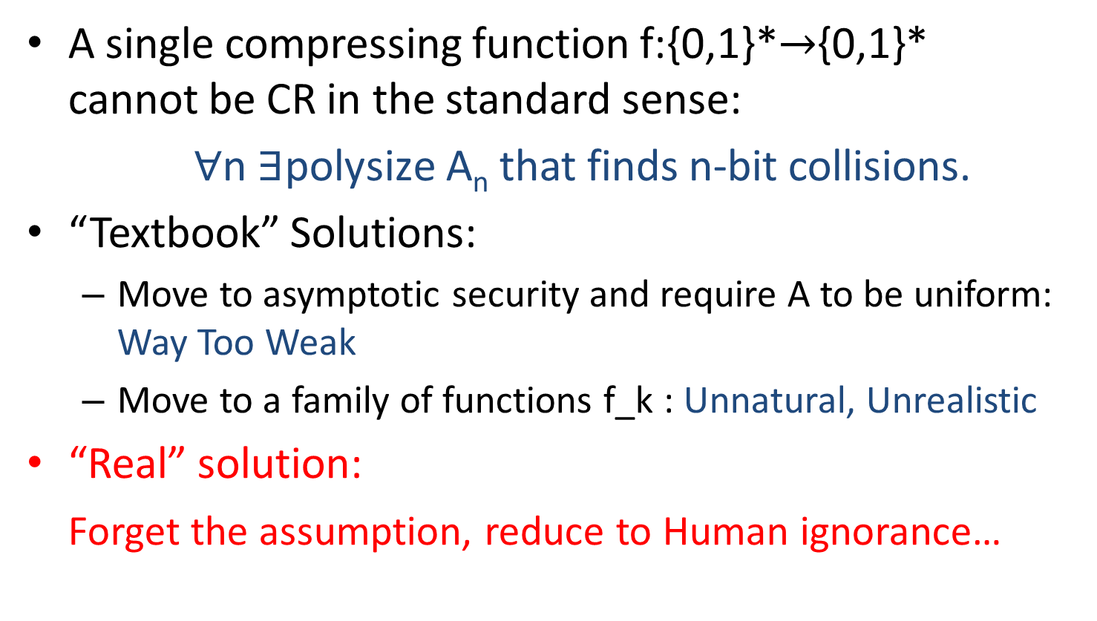
The case of Collision Resistant Functions
[Rogaway 07]
A single compressing function f:{0,1}*$→${0,1}* cannot be CR in the standard sense:
$∀$n $∃\text{polysize}$ A_{n} that finds n-bit collisions.
“Textbook” Solutions:
  Move to asymptotic security and require A to be uniform: Way Too Weak
  Move to a family of functions f_k : Unnatural, Unrealistic
“Real” solution:
Forget the assumption, reduce to Human ignorance…

Slide 12
So, sometimes the gist is in the reduction, not the assumption…

Slide 13
Classification of reductions
By assumption and complexity: time, space, #queries,…
By access to the underlying adversary:
  One pass Black Box
  “Quantum” (uncontrollable randomness)
  Resettable Black Box
  General (“Non BB”)
By advice:
  No advice: completely algorithmic (this is what we want!)
  Advice depending on security parameter + primitive
  (eg: Collision in a hash function, Hellman table for a block cipher)
  Advice depending on adversary program (“non-uniform”)
  (eg: Simulator in point obfuscation)
  Advice depending on (public) randomness
  (eg: extractable functions /knowledge of exponent, ULE, DI-IO,…)
  Viewed this way, KOE & friends are not “assumptions”; they are “holes” in a reduction that we fill via external advice.

Slide 14
Classification of reductions
By assumption and complexity: time, space, #queries,…
By access to the underlying adversary:
  One pass Black Box
  “Quantum” (uncontrollable randomness)
  Resettable Black Box
  General (“Non BB”)
By advice:
  No advice: completely algorithmic (this is what we want!)
  Advice depending on security parameter + primitive
  (eg: Collision in a hash function, Hellman table for a block cipher)
  Advice depending on adversary program (“non-uniform”)
  (eg: Simulator in point obfuscation)
  Advice depending on (public) randomness
  (eg: extractable functions /knowledge of exponent, ULE, DI-IO,…)
  Viewed this way, KOE & friends are not “assumptions”; they are “holes” in a reduction that we fill via external advice.

Slide 15
Classification of reductions
By assumption and complexity: time, space, #queries,…
By access to the underlying adversary:
  One pass Black Box
  “Quantum” (uncontrollable randomness)
  Resettable Black Box
  General (“Non BB”)
By advice:
  No advice: completely algorithmic (this is what we want!)
  Advice depending on security parameter + primitive
  (eg: Collision in a hash function, Hellman table for a block cipher)
  Advice depending on adversary program (“non-uniform”)
  (eg: Simulator in point obfuscation)
  Advice depending on (public) randomness
  (eg: extractable functions /knowledge of exponent, ULE, DI-IO,…)
  Viewed this way, KOE & friends are not “assumptions”; they are “holes” in a reduction that we fill via external advice.

Slide 16
Classification of reductions
By assumption and complexity: time, space, #queries,…
By access to the underlying adversary:
  One pass Black Box
  “Quantum” (uncontrollable randomness)
  Resettable Black Box
  General (“Non BB”)
By advice:
  No advice: completely algorithmic (this is what we want!)
  Advice depending on security parameter + primitive
  (eg: Collision in a hash function, Hellman table for a block cipher)
  Advice depending on adversary program (“non-uniform”)
  (eg: Simulator in point obfuscation)
  Advice depending on (public) randomness
  (eg: extractable functions /knowledge of exponent, ULE, DI-IO,…)
  Viewed this way, KOE & friends are not “assumptions”; they are “holes” in a reduction that we fill via external advice.

Slide 17
Classification of reductions
By assumption and complexity: time, space, #queries,…
By access to the underlying adversary:
  One pass Black Box
  “Quantum” (uncontrollable randomness)
  Resettable Black Box
  General (“Non BB”)
By advice:
  No advice: completely algorithmic (this is what we want!)
  Advice depending on security parameter + primitive
  (eg: Collision in a hash function)
  Advice depending on adversary program (“non-uniform”)
  (eg: inverse of adv’s challenge, Points queried in point obfuscation)
  J
  J
  j

Slide 18
Classification of reductions
By assumption and complexity: time, space, #queries,…
By access to the underlying adversary:
  One pass Black Box
  “Quantum” (uncontrollable randomness)
  Resettable Black Box
  General (“Non BB”)
By advice:
  No advice: completely algorithmic (this is what we want!)
  Advice depending on security parameter + primitive
  (eg: Collision in a hash function)
  … + adversary program (“non-uniform”)
  (eg: inverse of adv’s challenge, Points queried in point obfuscation)
  Advice depending on (public) randomness
  (eg: extractable functions /knowledge of exponent, ULE, DI-IO,…)
  Viewed this way, KOE & friends are not “assumptions”; they are “holes” in a reduction that we fill via external advice.

Slide 19
Classification of reductions
By assumption and complexity: time, space, #queries,…
By access to the underlying adversary:
  One pass Black Box
  “Quantum” (uncontrollable randomness)
  Resettable Black Box
  General (“Non BB”)
By advice:
  No advice: completely algorithmic (this is what we want!)
  Advice depending on security parameter + primitive
  (eg: Collision in a hash function)
  … + adversary program (“non-uniform”)
  (eg: inverse of adv’s challenge, Points queried in point obfuscation)
  … + public randomness/ secrets
  (eg: extractable functions,knowledge of exponent/ UCE, DI-IO,…)
  Viewed this way, KOE & friends are not “assumptions”; they are “holes” in a reduction that we fill via external advice.

Slide 20
Classification of reductions
By assumption and complexity: time, space, #queries,…
By access to the underlying adversary:
  One pass Black Box
  “Quantum” (uncontrollable randomness)
  Resettable Black Box
  General (“Non BB”)
By advice:
  No advice: completely algorithmic (this is what we want!)
  Advice depending on security parameter + primitive
  (eg: Collision in a hash function)
  … + adversary program (“non-uniform”)
  (eg: inverse of adv’s challenge, Points queried in point obfuscation)
  … + public randomness/ secrets
  (eg: extractable functions,knowledge of exponent/ UCE, DI-IO,…)
  Viewed this way, KOE & friends are not “assumptions”; they are “holes” in a reduction that we fill via external advice.

Slide 21
The new mindset*
(This slide is a later addition… was indeed missing in the presentation)
The goal when analyzing security of a scheme is to come up with a reduction to another problem.
The result statement is now unconditional:
“We show how to transform an adversary that breaks X into an adversary that breaks Y.”
  If the transformation is not completely specified then need to be explicit about it
This has multiple corollaries:
  In of itself: A reduction to “Human Ignorance”
  Non-u security of Y implies non-u security of X
  Uniform security of Y implies uniform security of X
  …advice.
((In fact, the mindset is pretty old… was around in the 80’s )

Slide 22
The new mindset*
(This slide is a later addition… was indeed missing in the presentation)
The goal when analyzing security of a scheme is to come up with a reduction to another problem.
The result statement is now unconditional:
“We show how to transform an adversary that breaks X into an adversary that breaks Y.”
  If the transformation is not completely specified then need to be explicit about it
This has multiple corollaries:
  In of itself: A reduction to “Human Ignorance”
  Non-u security of Y implies non-u security of X
  Uniform security of Y implies uniform security of X
  …advice.
((In fact, the mindset is pretty old… was around in the 80’s )

Slide 23
The new mindset*
(This slide is a later addition… was indeed missing in the presentation)
The goal when analyzing security of a scheme is to come up with a reduction to another problem.
The result statement is now unconditional:
“We show how to transform an adversary that breaks X into an adversary that breaks Y.”
  If the transformation is not completely specified then need to be explicit about it
This has multiple corollaries:
  In of itself: A reduction to “Human Ignorance”
  Non-u security of Y implies non-u security of X
  Uniform security of Y implies uniform security of X
  …advice.
((In fact, the mindset is pretty old… was around in the 80’s )

Slide 24
The new mindset*
(This slide is a later addition… was indeed missing in the presentation)
The goal when analyzing security of a scheme is to come up with a reduction to another problem.
The result statement is now unconditional:
“We show how to transform an adversary that breaks X into an adversary that breaks Y.”
  If the transformation is not completely specified then need to be explicit about it
This has multiple corollaries:
  In of itself: A reduction to “Human Ignorance”
  Non-u security of Y implies non-u security of X
  Uniform security of Y implies uniform security of X
  …advice.
(
(In fact, the mindset is pretty old… was around in the 80’s )

