Slide 1
Non-Adaptive vs Adaptive Queries in the Dense Graph Testing Model
Oded Goldreich and Avi Wigderson

Slide 2
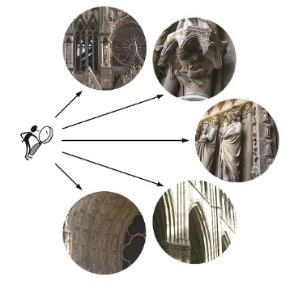
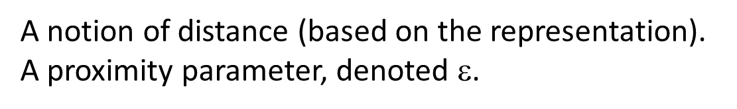
Property Testing: Super-fast Approximate Decisions
[BLR, RS, GGR]
Object to be tested (for membership in a set, having a property)
Super-fast alg. = run in time sublinear in the (tested) object’s size.
Oracle access to parts of (the representation of) the object.
Approximate decision = accept (whp) if object is in the set,
reject (whp) if the object is far from the set.
A notion of distance (based on the representation).
A proximity parameter, denoted $$.
Think of 1/ε as small/tiny
in comparison to the size of the (huge) tested object.
Notes:
Object may be a function, a string, a graph, etc.
The photo shows testing a building for the property of being a Gothic Cathedral.

Slide 3
PT in the Dense Graph Model (aka Adjacency Predicate Model)
[GGR]
Objects = (unlabeled) graphs
Alternatively, graph properties def’ed as closed under isomorphism.
The representation: Adjacency predicate (or matrix).
Query (u,v) answered 1 iff {u,v} is an edge in the (tested) graph.
Distance: fraction of entries on which the adjacency matrices differ.
(E.g., far = at constant distance, close = o(1) distance.)
Sparse graphs are close to the empty graph. (Hence we focus on dense ones.)
All graphs are close to being Hamiltonian.
Cliques are far from being triangle-free.
Cliques are far from being bipartite.
Notes:
Each property satisfied by an empty graph is trivial to test for sparse ones.
Testing HAM is trivial, since each graph is close to HAM.

Slide 4
PT in the Dense Graph Model, the actual definition
[GGR]
Objects = (unlabeled) graphs
Alternatively, graph properties def’ed as closed under isomorphism.
The representation: Adjacency predicate (or matrix).
Query (u,v) answered 1 iff {u,v} is an edge in the (tested) graph.
Distance: fraction of entries on which the adjacency matrices differ.
(E.g., far = at constant distance, close = o(1) distance.)
A tester for (graph) property Π is a probabilistic oracle machine
that satisfies the following two conditions:
When given proximity parameter ε and oracle access to a graph in Π, the machine accepts with probability at least 2/3.
(In the one-sided error version: Accepts w.p. 1.)
When given proximity parameter ε and oracle access to a graph that
is ε-far from Π, the machine rejects with probability at least 2/3.
Notes:
The alternative is actually more popular, and we’ll use it.

Slide 5
Some known results (for perspective)
[GGR] [A]
denotes the proximity parameter
n denotes the number of vertices in the tested graph.
THM: bipartitness is testable in Õ(1/ε²)-time.
Ditto for 3-colorability.
Indeed, the complexities are independent of n; they are size-oblivious.
THM: triangle-freeness is testable in T(ε)-time,
but T(ε) is greater than any poly(1/ε).
(Known upper bound is a tower of O(log(1/ε)) exponents.)
Notes:
The 1st thm is due to Noga Alo, the 2nd to GGR.

Slide 6
Canonical testers and non-adaptivity
[AFKS, GT] vs [GR11]
THM: If Π is testable in Q(n,ε) queries, then it can be tested by inspecting the subgraph induced by O(Q(n,ε)) random vertices. Hence, Π has a tester that uses O(Q(n,ε)²) non-adaptive queries.
A non-adaptive oracle machine is one that determines all its queries based on its explicit input (and randomness), independently of the answers to prior queries.
THM: There exists Π that is testable in Õ(1/ε) queries,
but cannot be tested by o(1/ε^{1.5}) non-adaptive queries.
Notes:
The 1st thm is due to GT and AFKS, the 2nd to GR.
Hence, state of knowledge is between power 2 and power 1.5.

Slide 7
Main Result: A quadratic gap
THM: There exists Π that is testable in Õ(n^{0.5}/ε) queries,
but cannot be tested by o(n) non-adaptive queries.
THM: For every c∈[1,2] and nice function f,
there exists Π that is testable in Õ(f(n,ε)/ε²) queries,
but cannot be tested by o(f(n,ε)^{c}) non-adaptive queries.
Both (upper and lower) bounds are quite tight for Π.
Can replace the constant c by variable c(n,ε).
Notes:
Quite tight = upto 1/eps factors. The 1st THM is a special case of f(n,eps)=n^{1/2}.
Nice maens monotonicity as well as at most sqrt(n).

Slide 8
Tools: Robustly self-ordered graphs and locally self-ordering a graph.
G=(V,E) is asymmetric (self-ordered) if for every G’=(V’,E’) that is isomorphic to G, there exists a unique bijection π such that G’=π(G).
I.e., we can “order” the vertices of G’ according to G.
Def (quantitative): G=(V,E) is γ-robustly self-ordered if for every bijection π:V→V the symmetric difference between G and π(G) is at least γ⋅|{v∈V:π(v)≠v}|.
(Robustly self-ordered = Ω(|V|)-robustly self-ordered.)
Def: G=(V,E) is q-locally self-ordered if there exists a q-query oracle machine M that satisfies M^{π(G)}(v)=π⁻¹(v) for every bijection π:V→V and every v∈V.
(Locally self-ordered = poly(log(|V|))-query self-ordered.)

Slide 9
The main construction
For k-by-k matrices A and B, consider the graph G_{A,B} (under relabeling)
The challenge of testing: Distinguish the case of A=B from the case of independent A and B.
1
i
k
k+i
2k
A random 2k-vertex graph
A_{i,j}
B_{i,j}
A random 7k-vertex graph
2k+1
2k+j
3k
8k+1
8k+j
9k
Both random graphs are robustly self-ordered and locally self-ordered.
Notes:
Stress – under relabeling, which means that the tester does not know the location of queried vertices in the picture.
Intuitively, NA tester must hit two matched pairs of vertices, AD tester may match individual vertices and query on pairs.

Slide 10
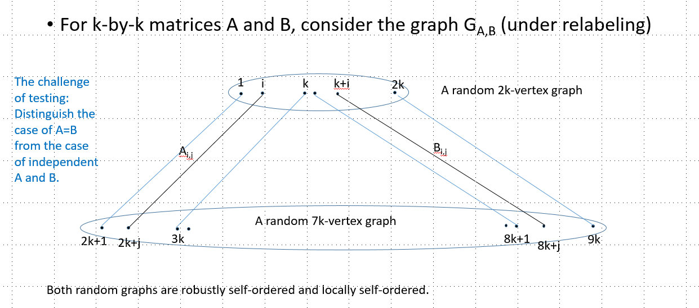
The non-adaptive lower bound
Find i,j such that A_{i,j} ≠ B_{i,j}
Recall that the graph is relabeled by π; that is, we need to query
the vertex pairs (u,v) and (u’,v’) such that π⁻¹(u)=π⁻¹(u’)-k
and π⁻¹(v)-2k=π⁻¹(v’)-8k
(i.e., u=π(i), v= π(2k+j), u’= π(k+i),
and v’= π(8k+j)).
Non-adaptivity means that we need to make all edge queries ahead of time.
The probability for the said event, when making q queries, is smaller than q² ⋅ (1/k²).
The following two distributions are indistinguishable by o(k) non-adaptive queries:
A random isomorphic copy of G_{A,A} for a random A.
A random isomorphic copy of G_{A,B} for random A and B.
But are they far apart? Yes! Due to the robust self-ordering of each of the sides.
Notes:
Last line to be detailed in next slide.

Slide 11
The non-adaptive lower bound (detail)
The following two distributions are indistinguishable by o(k) non-adaptive queries:
A random isomorphic copy
of G_{A,A} for a random A.
A random isomorphic copy
of G_{A,B} for random A and B.
But are they far apart? Yes!
Due to the robust self-ordering of each of the sides.
Consider the distance of a generic G_{A,B} from the support of distribution (1), which is the property we test.
Each vertex that moves between the parts contributes Ω(k), due to the difference in degrees.
Each vertex that moves within a part contributes Ω(k), due to the robust self-ordering.
Each relevant pair of pairs of vertices (related to fixedpoint vertices) contributes one unit,
if the corresponding pair of entries in the matrices A and B differ.
Notes:
Read the last item backward: If the entries differ, and if the corresponding vertex pairs are not moved, then we get a unit contribution.

Slide 12
The adaptive upper bound
Find i,j such that A_{i,j} ≠ B_{i,j}
Recall that the graph is relabeled by π; that is, we need to query
the vertex pairs (u,v) and (u’,v’) such that π⁻¹(u)=π⁻¹(u’)-k
and π⁻¹(v)-2k=π⁻¹(v’)-8k
(i.e., u=π(i), v= π(2k+j), u’= π(k+i),
and v’= π(8k+j)).
Using adaptive queries, we find u and u’ such that π⁻¹(u)=π⁻¹(u’)-k
(and likewise v and v’ such that π⁻¹(v)-2k=π⁻¹(v’)-8k)
by selecting O(k^{1/2}) random vertices, and locating them
using the locally self-ordering procedures (which takes O(log k) queries).

Slide 13
Smaller complexity gaps (between non-adaptive and adaptive)
For any t∈[1,k],
use matrices in which each column is repeated t times.
The non-adaptive lower bound is Ω((k²/t)^{1/2}), but the adaptive upper bound remains Õ(k^{1/2}/ε²).
Lower levels (of non-adaptive and adaptive complex.)
For any t’∈[1,k] and t∈[t’,k] , use matrices in which each row is repeated t’ times and each column is repeated t times.
Caveat: The overhead in adaptive queries is still O(log k).

Slide 14
Lower levels complexity, revised
THM: For every c∈[1,2] and nice function f,
there exists Π that is testable in Õ(f(n)/ε²) queries,
but cannot be tested by o(f(n)^{c}) non-adaptive queries.
Both (upper and lower) bounds are quite tight for Π.
(Inspired by [GKNR])
For n’=f(n) and t=n/n’, we consider the set of n-vertex graphs that are obtained by
a t-factor blow-up of the set of n’-vertex graphs as defined in the prior proof (i.e., for f(n)=n^{1/2}).
The lower bounds rely on the fact that
(balanced) graph blow-ups preserve distances. [GKNR, P]
The upper bounds rely on specific features of the set of n’-vertex graphs and their testers. Specifically, the local self-ordering procedure for the n-vertex (blow-up) graph works in complexity related to n’ (since it uses LSO of the n’-vertex graph), and testing balanced blow-up reduces to testing distributions for uniformity. Furthermore, the testers for n’-vertex graphs are “robust” under small (but not negligible) changes in the distribution of sampled vertices.
Notes:
Recall: In prior construction we had an overhead factor of O(log k) on adaptive queries.
[P] = Pikhurko. An analytic approach to stability. Discrete Mathematics, Vol. 310 (21), 2010.
Small but not negligible = of the order O(eps), but not o(1/F(n’)).

Slide 15
Complexities that depend on the proximity parameter
THM: For every c∈[1,2] and nice function f,
there exists Π that is testable in Õ(f(n,ε)/ε²) queries,
but cannot be tested by o(f(n,ε)^{c}) non-adaptive queries.
Both (upper and lower) bounds are quite tight for Π.
Proved by using the previous results and following the strategy of [G19].
For fixed ε, let n’= Θ(ε)⋅n and consider the set of n-vertex graphs that consist of n’-vertex graphs as defined in the prior proof and an isolated (n-n’)-vertex clique.
Take the union over all ε’s that are powers of ½.
The lower bounds refer to the relevant value of ε and rely on the fact that
the graphs that correspond to different values (of ε) are far apart.
The upper bounds rely on testers that first determine the size of the isolated cliques, and then emulate the original testers.
Notes:
Recall: In prior result/slide we had f depend only on n (but not on ε).

Slide 16
Versions for one-sided error
THM: For every c∈[1,2] and nice function f,
there exists Π that is testable with one-sided error
in O(f(n)⋅poly(log n)/ε) queries,
but cannot be tested by o(f(n)^{c}) non-adaptive queries.
Both (upper and lower) bounds are quite tight for Π.
N.B.: Here the slackness is polylogarithmic in n (rather than in f(n))
and the lower bound does not depend of ε (since f does not depend on it).
The proof is more complex than the prior ones, and includes designing one-sided error local self-ordering procedures (which err on very few vertices of the relevant graphs), and revising the testers so that they avoid rejection based on statistical evidence.

Slide 17
Conclusion
We have shown that, up to some slackness, the relation between
the complexities of non-adaptive and adaptive testing
(in the dense graph model) can take any form
between linear and quadratic.
Removing the slackness: E.g., some ε factors (which are acute in the case of very low complexities), more in the case of one-sided error.
Natural examples: E.g., the case of testing Bipartitness.
In contrast to what is often said, this model is NOT well-understood;
e.g., the gap between the known bounds for testing triangle-freeness
(i.e., super-polynomial vs tower-of-exponents) is striking.
Other models of testing graph properties…

