Slide 1
Probabilistic Proof Systems
Oded Goldreich
Weizmann Institute of Science
Notes:
For IMU meeting (at BGU) on July 6th, 2021.

Slide 2
Initial comments
We shall consider proofs for mundane and totally formal theorems;
e.g., a specific propositional formula is satisfiable, a specific system of quadratic equations (over a finite field) has a solution, a specific graph (or map) can be properly colored using three colors, etc.
These theorems arise in various applications (e.g., Cryptography).
Proof systems are defined in terms of their verification procedures.
We seek efficient verification procedures.
Efficient procedures efficient algorithms.
Efficient algorithms = polynomial-time algorithms.
I will not mention the applications of these proof systems
(to Cryptography and study of approximation), unless you ask…
Notes:
The association of efficiency with poly-time is inessential and made for simplicity of discussion and study, which would be hairy in general terms.

Slide 3
Traditional proof systems (i.e., NP-proof systems)
Efficient verification = verification procedure that runs in time that is polynomial in the length of the theorem being claimed.
Completeness: If the claim is valid, then there exists a proof that is accepted by the verification procedure (i.e., “verifier”).
Soundness: If the claim is invalid, then no alleged proof will be accepted by the verifier, who will always reject the claim.
The “prover” is implicit in the formulation (and inessential to it):
The prover is the person providing alleged proofs.
We implicitly consider a unidirectional communication from the prover to the verifier; the message sent is the alleged proof.
*) NP-proof systems correspond to the complexity class NP, conjectured to extend beyond P.
Notes:
Taking this association strictly, which fit the traditional view of proofs, we consider deterministic poly-time algs. (Later, we’ll consider randomized ones.)
*) Hence, P=NP means that there is no point in proofs, since verification offers no significant speed-up over deciding by oneself.

Slide 4
NP-proof systems: Examples
The claim is that a given propositional formula is satisfiable.
The alleged proof is a satisfying assignment.
Verification amounts to substation and calculation (or evaluation).
The claim is that a given system of quadratic equations over a finite field (say GF(2) or GF(3)) has a solution.
The alleged proof is a solution.
Verification amounts to substation and calculation (or evaluation).
The claim is that a given graph (map) is 3-colorable.
The alleged proof is a (legal) 3-coloring of the graph.
Verification amounts to checking that the endpoints of each edges are assigned different colors in {1, 2, 3}.
Notes:
These sets of claims are NP sets.

Slide 5
Interactive proof systems
[Goldwasser, Micali, and Rackoff]
New ingredients: Randomness and Interaction.
The verifier tosses coins and interacts with the prover.
A “proof” is no longer a static object, it is a process.
The “proof” carries an error probability, which is explicitly bounded.
Efficient verification = a probabilistic and interactive procedure (verifier) that runs in time that is polynomial in the length of the claim.
Completeness: If the claim is valid, then there exists a prover strategy that leads the verifier to accept with probability 1 (alternative: ≥ 2/3).
Soundness: If the claim is invalid, then no (“cheating prover”) strategy can lead the verifier to accept with probability greater than ½ (alt: 1/3).
The verifier and the prover are explicit in the formulation.
The error probability can be reduced by repetitions.
Notes:
Indeed, a revolutionary departure from the tradition – randomness and interaction!

Slide 6
Interactive proof systems: Comments + Example
If the verifier is deterministic, then IP-systems collapses to NP-systems.
“No point to interact with a predictable person who is computationally weaker.”
Interactive proofs are akin to daily processes such as cross-examination in court, asking questions regarding a proof described in a lecture, and mental experiments that take place in traditional proofs (i.e., “For an arbitrary X, do F(x)”).
THM [Goldwasser&Sipser]: Wlog, suffices to ask totally random questions.
One day on Olympus, bright-eyed Athena claimed that nectar poured from new silver-coated jars tasted less sweet than nectar poured from older gold-decorated jars. Mighty Zeus, who was forced to introduce the new jars by the practically minded Hera, was annoyed at the claim.
He ordered that Athena be served one hundred glasses of nectar, each poured at random either from an old jar or from a new one, and that she tell the source of the drink in each glass. To everybody’s surprise, wise Athena correctly identified the source of each serving, to which the father of the gods responded, “My child, you are either right or
extremely lucky.” Since all the gods knew that being lucky was not one of the attributes of Pallas-Athena, they all concluded that the impeccable goddess was right in her claim.
THM [G., Micali, Wigderson]: Graph Non-Isomorphism has an interactive proof system.
Notes:
A story not told by Ovid. The same story is demonstrated by the Green-Red video. It underlies the THM re GNI.

Slide 7
The power of interactive proof systems
THM [Lund, Fortnow, Karloff, and Nisan]: coNP is in IP.
Every set in coNP (i.e., the set of wrong claims for an NP-proof system) has an interactive proof system. E.g., one can prove (interactively) that
A given propositional formula is NOT satisfiable.
A given system of quadratic equations over a finite field (say GF(2) or GF(3)) has NO solution.
A given graph (map) is NOT 3-colorable.
“If the existence of something in some situation can be proved,
then also its non-existence in this situation can be proved (interactively).”
THM [Shamir]: PSPACE = IP. (Corollary: coIP = IP.)
IP = all sets having interactive proof systems.
PSPACE = all sets that can be decided in polynomial amount of space.
Notes:
Re the LFKN THM, it actually extends to counting the number of sat-assignments, solutions, and 3-colorings in these objects.

Slide 8
Zero-knowledge proof systems
[Goldwasser, Micali, and Rackoff]
Typically, proofs yields much beyond their validity.
In contrast, ZK proofs yield nothing beyond.
“Whatever can be efficiently computed after interacting with the prover, can be efficiently computed assuming the claim is correct.”
Formally, for an interactive proof (P,V) and any (valid) claim x,
we consider two distributions:
The output generated by V
(or even by any feasible “knowledge-seeking adversary”)
on input x after interacting with the prover strategy P.
The output of some efficient procedure (“simulator”) on input x.
We require that these distributions are identical / statistically-close / computationally-indistinguishable.
Notes:
Three corresponding types of ZK:
Perfect, Statistical (or almost-perfect), and Computational (general).
The existence of a simulator means that, assuming the claim is vaild, we did not gain anything by interacting with the prover. The gain is only being convinced of the validity.

Slide 9
Zero-knowledge proof systems: Comments + Example
Not possible with NP-proof systems: If an NP-proof systems is zero-knowledge, then the verifier does not need the prover (i.e., can decide by itself).
THM [G., Micali, and Wigderson]:
There exists a (perfect) zero-knowledge proof system for Graph Isomorphism.
The prover sends the verifier a random isomorphic copy of the 1st input graph, and the verifier selects at random i∈{1,2}, sends i to the prover, who is required to respond with the isomorphism between the i^{th} input graph and the graph sent in step 1.
Soundness: If the input graphs are not isomorphic, the prover fails w.p. (at least) ½.
Zero-knowledge: The simulator selects j∈{1,2} at random, places a random isomorphic copy of the j^{th} input graph, and produces output if i=j. (Recall: i is chosen by the verifier.)

Slide 10
The power of zero-knowledge proof systems
THM [G., Micali, and Wigderson]: Assuming one-way functions, every NP-proof system can be transformed to a zero-knowledge proof system.
E.g., one can prove in zero-knowledge that
A given propositional formula is satisfiable.
A given system of quadratic equations over a finite field (say GF(2) or GF(3)) has a solution.
A given graph (map) is 3-colorable.
“If the existence of something in some situation can be proved,
then also it can be proved in zero-knowledge.”
THM [Ben-Or et al]: Under same assumption, every interactive proof system can be transformed to a zero-knowledge proof system.
Notes:
These ZK proofs do not yield any information about the sat-assignment, solution, 3-coloring.

Slide 11
Probabilistically checkable proof (PCP) systems
[Feige, Goldwasser, Lovasz, Safra, and Szegedy] & [Arora and Safra]
Back to NP-proofs, but in redundant form,
which are probed at few random locations.
The (randomized) verifier has direct access to bits of the alleged proof.
Super-fast verification = a probabilistic machine (verifier) that tosses logarithmically many coins and makes a constant number of probes
(to an alleged proof of polynomial length).
Completeness: If the claim is valid, then there exists a proof that
makes the verifier accept with probability 1.
Soundness: If the claim is invalid, then the verifier rejects
with probability at least ½, no matter which (false) proof is presented.
The error probability can be reduced by repetitions.
Notes:
Stress: The proof is in redundant form! O.w., you would not expect probing to suffice.
The fact that the proof length is polynomial is implied by the number of coin tosses.
Stress the contrast to traditional verification that requires reading the entire alleged proof.

Slide 12
The power of PCP systems
THM [FGLSS, AS, ALMSS]: Every NP-proof system can be transformed to a PCP system. (Furthermore, an NP-proof for any valid claim can be efficiently transformed into a suitable proof for the PCP System.)
This yields amplifying reductions for many natural sets, including
Satisfiable propositional 3CNF formula,
where 3CNF = Conjunctive Normal Form with 3 literals is each clause.
3-colorable graphs (maps).
Def: f is an amplifying reduction for 3SAT if it satisfies:
Completeness: If ϕ is satisfiable, then f(ϕ) is satisfiable.
Soundness: If ϕ is not satisfiable, then each truth-assignment to f(ϕ)
satisfies at most 99% of the clauses. (Can be improved to 7/8+o(1).)
This means that approximating the fraction of clauses in a formula that can be simultaneously satisfied is as hard as determining whether the formula is satisfiable.
Notes:
ALMSS = Arora, Lund, Motwani, Sudan, and Szegedy.

Slide 13
The proof(s) of the PCP Theorem
Both proofs use the notion of “proof composition”
“NP in rPCP[r_{out} ,q_{out} ]” + “P in PCPP[r_{in} ,q_{in} ]”
= “NP in rPCP[r_{out}+r_{in}(q_{out}),q_{in}(q_{out})]
1st proof [Arora, Lund, Motwani, Sudan, and Szegedy]:
“NP in rPCPP[log,polylog]”
“NP in rPCPP[poly,O(1)]”
2nd proof [Dinur]: For some constant c>1, and every ρ<1/c
PCP_{ρ}[r,c] in PCP_{4ρ}[r+O(1),O(1)] “Gap (i.e., detect.-prob.) Amplification”
PCP_{4ρ}[r’,O(1)] in PCP_{2ρ}[r’+O(1),c]. (Uses composition with a PCPP[poly,c] system)
*) PCP[r,q] = PCP system with randomness complexity r (proof length exp(r)) and query complexity q.
PCP_{ρ} indicates a system with false-detection probability ρ, where q=1/n is trivial and we seek ρ=1/2.
Notes:
PCPP = PCP of Proximity; rPCP = robust PCP (relevant only for super-constant query complexity).

Slide 14
Interactive proof systems, revisited:
Doubly-Efficient interactive proofs systems
[Goldwasser, Kalai, and Rothblum]
Efficient prover, very efficient verifier.
E.g., the prover runs in polynomial-time
but the verifier runs in almost-linear-time.
So the prover is more powerful, and the verifier can still gain
(e.g., it may be more efficient than a decision procedure).
The power of doubly-efficient IP systems:
Cannot exist for claims that cannot be verified both in polynomial-time
and in almost-linear-space.
THM [Reingold, Guy and Ron Rothblum]: Do exist for claims that can be decided by a polynomial-time procedure that uses small (i.e., n^{o(1)}) space.
Notes:
Gaps: (i) intersection of classes vs a simultaneous (time & space) class, (ii) almost-linear vs small.

Slide 15
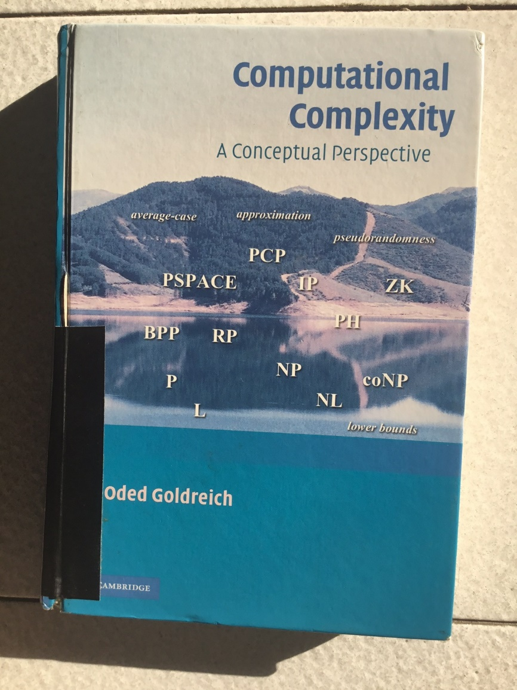
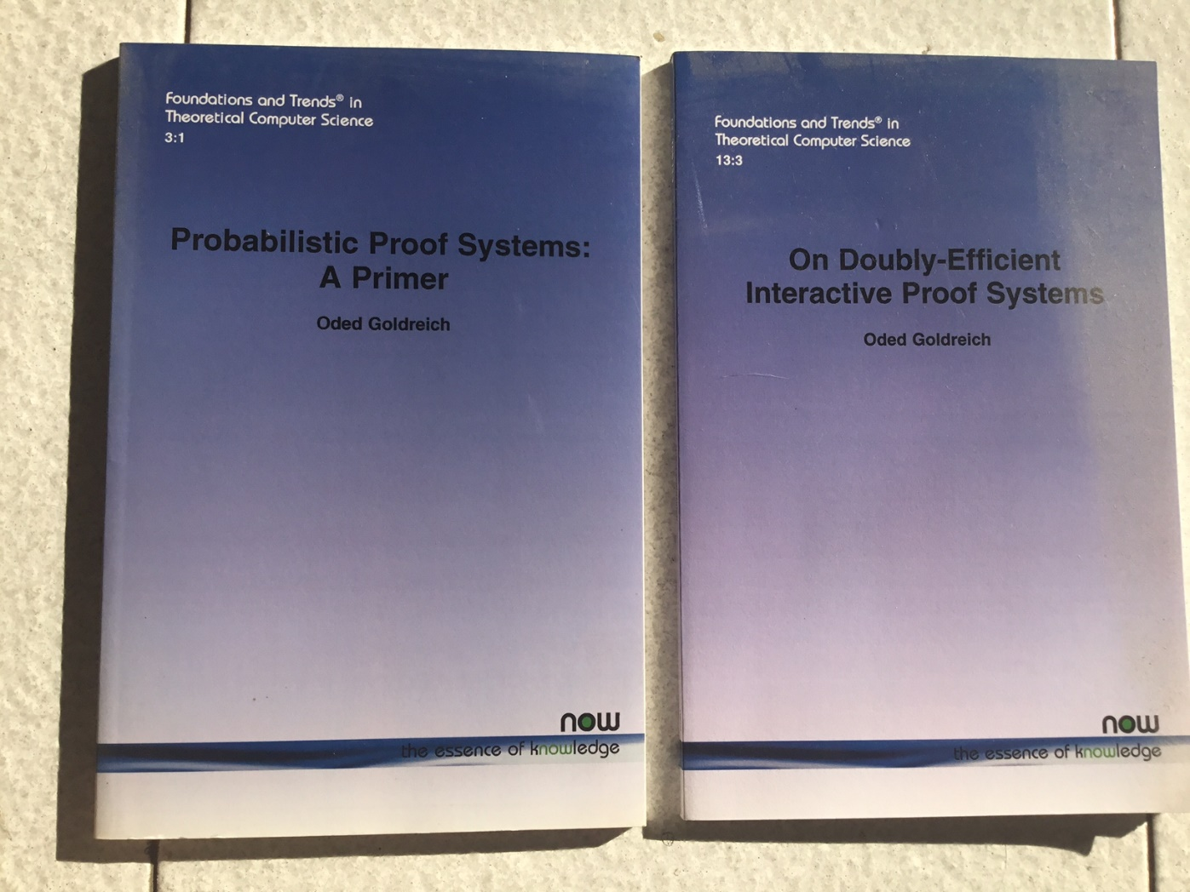
END
See http://www.wisdom.weizmann.ac.il/~oded/pps.html and de-ip.html
and cc-book.html
Notes:
The PPS primer covers the first three topics and a version of it appears as Chapter 9 in the (general) computational complexity book [2008].

