Slide 1
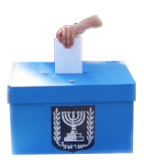
Privacy, Democracy and the Secret Ballot
An Informal Introduction to Cryptographic Voting
?

Slide 2
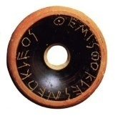



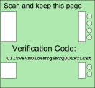
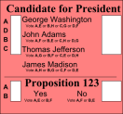
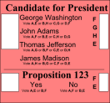
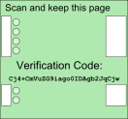
Talk Outline
Background on Voting
Voting with Mix-Nets
Voting and Privacy
A Human-Verifiable Voting Scheme
Splitting trust between multiple authorities

Slide 3
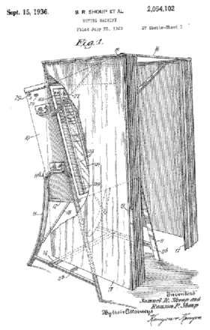
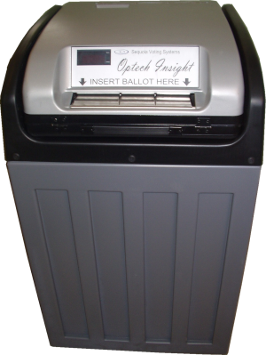
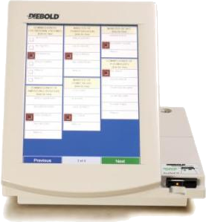
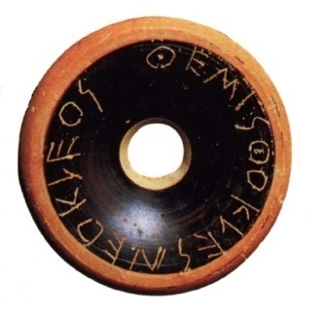
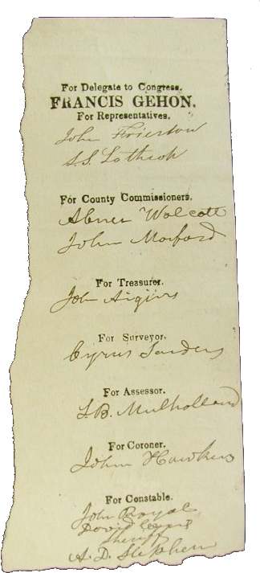


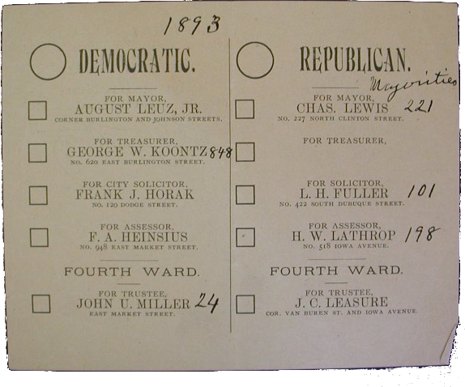
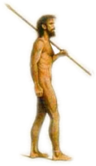
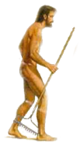


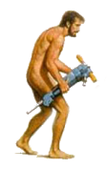
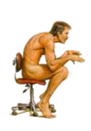

A [Very] Brief History of Voting
Ancient Greece (5th century BCE)
Paper Ballots
  Rome: 2nd century BCE
  (Papyrus)
  USA: 17th century
Secret Ballots (19th century)
  The Australian Ballot
Lever Machines
Optical Scan (20th century)
Direct Recording Electronic
(DRE)

Slide 4
Voting: The Challenge
Requirements based on democratic principles:
  Outcome should reflect the “people’s will”
Fairness
  One person, one vote
Privacy
  Not a principle in itself;
  required for fairness
Cast-as-intended
Counted-as-cast
Additional requirements:
Authorization, Availability

Slide 5
The Case for Cryptographic Voting
Elections don’t just name the winner
must convince the loser they lost!
Elections need to be verifiable
Counting in public:
  Completely verifiable
  But no vote privacy
Using cryptography ,
we can get both!

Slide 6
Voting with Mix-Nets
Idea due to David Chaum (1981)
Multiple “Election Authorities”
  Assume at least one is honest
Each voter creates “Onion Ballot”
Authorities decrypt and shuffle
No Authority knows all permutations
  Authorities can publish “proof of shuffle”
No
No
Yes
Yes
No
Yes
No
No
Yes
No
No
No
No

Slide 7
How Private is Private?
Intuition: No one can tell how you voted
This is not always possible
Best we can hope for:
  As good as the “ideal” vote counter
i₁
i₂
i_{n}
…
v₁
v₂
v_{n}
Tally

Slide 8
Privacy is not Enough!
Voter can sell vote by disclosing randomness
Example: Italian Village Elections
  System allows listing candidates
  in any order
  Bosses gave a different permutation of
  “approved” candidates to each voter
  They could check which permutations
  didn’t appear
Need “Receipt-Freeness”
[Benaloh&Tuinstra 1994]

Slide 9
Flavors of Cryptographic Privacy
Computational
  Depends on a computational assumption
  A powerful enough adversary can “break” the privacy guarantee
  Example: Mix-Nets (public-key encryption)
Unconditional
  Privacy holds even for infinitely powerful adversary
  Example: Statistically-Hiding Commitment
Everlasting
  After protocol ends, privacy is “safe” forever
  Example: Unopened Statistically-Hiding Commitments

Slide 10

Who can you trust to encrypt?
Public-key encryption requires computers
Voting at home
  Coercer can sit next to you
Voting in a polling booth
  Can you trust the polling computer?
Verification should be possible for a human!
Receipt-freeness and privacy are also affected.

Slide 11
A New Breed of Voting Protocols
Chaum introduced first “human-verifiable” protocol in 2004
Two classes of protocols:
  Destroy part of the ballot in the booth [Chaum]
  Hide order of events in the booth [Neff]
Next: a “hidden-order” based protocol
  Receipt-free
  Universally verifiable
  Everlasting Privacy

Slide 12






Alice and Bob for Class President
Cory “the Coercer” wants to rig the election
  He can intimidate all the students
Only Mr. Drew is not afraid of Cory
  Everybody trusts Mr. Drew to keep secrets
  Unfortunately, Mr. Drew also wants to rig the election
  Luckily, he doesn't stoop to blackmail
Sadly, all the students suffer severe RSI
  They can't use their hands at all
  Mr. Drew will have to cast their ballots for them

Slide 13

Commitment with “Equivalence Proof”
We use a 20g weight for Alice...
...and a 10g weight for Bob
Using a scale, we can tell if two votes are identical
  Even if the weights are hidden in a box!
The only actions we allow are:
  Open a box
  Compare two boxes

Slide 14
Additional Requirements
An “untappable channel”
  Students can whisper in Mr. Drew's ear
Commitments are secret
  Mr. Drew can put weights in the boxes privately
Everything else is public
  Entire class can see all of Mr. Drew’s actions
  They can hear anything that isn’t whispered
  The whole show is recorded on video (external auditors)
I’m whispering

Slide 15
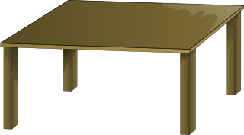

Ernie Casts a Ballot
Ernie whispers his choice to Mr. Drew
I like Alice

Slide 16

Ernie Casts a Ballot
Mr. Drew puts a box on the scale
Mr. Drew needs to prove to Ernie
that the box contains 20g
  If he opens the box, everyone else will see what Ernie voted for!
Mr. Drew uses a “Zero Knowledge Proof”
Ernie

Slide 17

Ernie Casts a Ballot
Ernie Casts a Ballot
Mr. Drew puts k (=3) “proof” boxes on the table
  Each box should contain a 20g weight
  Once the boxes are on the table, Mr. Drew is committed to their contents
Ernie

Slide 18


Ernie Casts a Ballot
Weigh 1
Open 2
Open 3
Ernie “challenges” Mr. Drew; For each box, Ernie flips a coin and either:
  Asks Mr. Drew to put the box on the scale (“prove equivalence”)
    It should weigh the same as the “Ernie” box
  Asks Mr. Drew to open the box
    It should contain a 20g weight
Ernie
Ernie

Slide 19
Ernie Casts a Ballot
Open 1
Weigh 2
Open 3
If the “Ernie” box doesn’t
contain a 20g weight, every
proof box:
  Either doesn’t contain a 20g weight
  Or doesn’t weight the same as the
  Ernie box
Mr. Drew can fool Ernie with
probability at most 2^{-k}
Ernie

Slide 20


Ernie Casts a Ballot
Why is this Zero Knowledge?
When Ernie whispers to Mr. Drew,
he can tell Mr. Drew what his
challenge will be.
Mr. Drew can put 20g weights in the boxes he will open, and 10g weights in the boxes he weighs
I like Alice
Open 1
Weigh 2
Weigh 3

Slide 21



Ernie Casts a Ballot: Full Protocol
Ernie whispers his choice
and a fake challenge to Mr. Drew
Mr. Drew puts a box on the scale
  it should contain a 20g weight
Mr. Drew puts k “Alice” proof boxes
and k “Bob” proof boxes on the table
  Bob boxes contain 10g or 20g weights according to the fake challenge
I like Alice
Open 1
Weigh 2
Weigh 3
Ernie

Slide 22


Ernie Casts a Ballot: Full Protocol
Ernie shouts the “Alice” (real) challenge and the “Bob” (fake) challenge
Drew responds to the challenges
No matter who Ernie voted for,
The protocol looks exactly the same!
Open 1
Open 2
Weigh 3
Open 1
Weigh 2
Weigh 3
Ernie
Ernie

Slide 23

Implementing “Boxes and Scales”
We can use Pedersen commitment
G: a cyclic (abelian) group of prime order p
g,h: generators of G
  No one should know log_{g}h
To commit to m2Z_{p}:
  Choose random r2Z_{p}
  Send x=g^{m}h^{r}
Statistically Hiding:
  For any m, x is uniformly distributed in G
Computationally Binding:
  If we can find m’≠m and r’ such that g^{m’}h^{r’}=x then:
  g^{m-m’}=h^{r-r’}≠1, so we can compute log_{g}h=(r-r’)/(m-m’)
r

Slide 24
Implementing “Boxes and Scales”
To prove equivalence of x=g^{m}h^{r} and y=g^{m}h^{s}
  Prover sends t=r-s
  Verifier checks that yh^{t}=x
r
s
g
h
g
h
t=r-s

Slide 25




A “Real” System
Hello Ernie, Welcome to VoteMaster
Please choose your candidate:
Alice
Bob
1 Receipt for Ernie
2 o63ZJVxC91rN0uRv/DtgXxhl+UY=
3 - Challenges -
4 Alice:
5 Sn0w 619- ziggy p3
6 Bob:
7 l4st phone et spla
8 - Response -
9 9NKWoDpGQMWvUrJ5SKH8Q2CtwAQ=
0 === Certified ===

Slide 26
A “Real” System
Hello Ernie, You are voting for Alice
Please enter a fake challenge for Bob
Alice:
Bob :
l4st phone et spla
Continue
1 Receipt for Ernie
2 o63ZJVxC91rN0uRv/DtgXxhl+UY=
3 - Challenges -
4 Alice:
5 Sn0w 619- ziggy p3
6 Bob:
7 l4st phone et spla
8 - Response -
9 9NKWoDpGQMWvUrJ5SKH8Q2CtwAQ=
0 === Certified ===

Slide 27
A “Real” System
Hello Ernie, You are voting for Alice
Make sure the printer has output two
lines (the second line will be covered)
Now enter the real challenge for Alice
Alice:
Sn0w 619- ziggy p3
Bob :
l4st phone et spla
Continue
1 Receipt for Ernie
2 o63ZJVxC91rN0uRv/DtgXxhl+UY=
3 - Challenges -
4 Alice:
5 Sn0w 619- ziggy p3
6 Bob:
7 l4st phone et spla
8 - Response -
9 9NKWoDpGQMWvUrJ5SKH8Q2CtwAQ=
0 === Certified ===

Slide 28
A “Real” System
Hello Ernie, You are voting for Alice
Please verify that the printed challenges
match those you entered.
Alice:
Sn0w 619- ziggy p3
Bob :
l4st phone et spla
Finalize Vote
1 Receipt for Ernie
2 o63ZJVxC91rN0uRv/DtgXxhl+UY=
3 - Challenges -
4 Alice:
5 Sn0w 619- ziggy p3
6 Bob:
7 l4st phone et spla
8 - Response -
9 9NKWoDpGQMWvUrJ5SKH8Q2CtwAQ=
0 === Certified ===

Slide 29
A “Real” System
Hello Ernie, Thank you for voting
Please take your receipt
1 Receipt for Ernie
2 o63ZJVxC91rN0uRv/DtgXxhl+UY=
3 - Challenges -
4 Alice:
5 Sn0w 619- ziggy p3
6 Bob:
7 l4st phone et spla
8 - Response -
9 9NKWoDpGQMWvUrJ5SKH8Q2CtwAQ=
0 === Certified ===
1
2

Slide 30
Counting the Votes
Mr. Drew announces the final tally
Mr. Drew must prove the tally correct
  Without revealing who voted for what!
Recall: Mr. Drew is committed to
everyone’s votes
Alice: 3
Bob: 1
Ernie
Fay
Guy
Heidi

Slide 31

Counting the Votes
Weigh
Weigh
Open
Mr. Drew puts k rows of
new boxes on the table
  Each row should contain the
  same votes in a random order
A “random beacon” gives k challenges
  Everyone trusts that Mr. Drew
  cannot anticipate the
  challenges
Alice: 3
Bob: 1
Ernie
Fay
Guy
Heidi

Slide 32

Counting the Votes
Weigh
Weigh
Open
For each challenge:
  Mr. Drew proves that the row
  contains a permutation of
  the real votes
Alice: 3
Bob: 1
Ernie
Fay
Guy
Heidi
Fay
Guy
Heidi
Ernie

Slide 33
Counting the Votes
Weigh
Weigh
Open
For each challenge:
  Mr. Drew proves that the row
  contains a permutation of
  the real votes
    Or
  Mr. Drew opens the boxes and
  shows they match the tally
Alice: 3
Bob: 1
Ernie
Fay
Guy
Heidi

Slide 34
Counting the Votes
Weigh
Weigh
Open
If Mr. Drew’s tally is bad
  The new boxes don’t match
  the tally
    Or
  They are not a permutation
  of the committed votes
Drew succeeds with prob.
at most 2^{-k}
Alice: 3
Bob: 1
Ernie
Fay
Guy
Heidi

Slide 35
Counting the Votes
Weigh
Weigh
Open
This prototocol does not
reveal information about
specific votes:
  No box is both opened and
  weighed
  The opened boxes are in
  a random order
Alice: 3
Bob: 1
Ernie
Fay
Guy
Heidi

Slide 36
Interim Summary
Background on Voting
Voting with Mix-Nets
Voting and Privacy
A Human-Verifiable Voting Scheme
  Universally-Verifiable
  Receipt-Free
  Based on commitment with equivalence testing
Next
  Splitting trust between multiple authorities

Slide 37



Protocol Ingredients
Two independent voting authorities
Public bulletin board
  “Append Only”
Private voting booth
Private channel between authorities

Slide 38



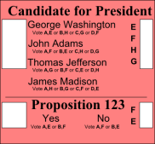
Protocol Overview
#1 Left
Voters receive separate parts of the ballot
from the authorities
They combine the parts to vote
Some of the ballot is destroyed to maintain privacy
  No authority knows all of the destroyed parts
Both authorities cooperate to tally votes
  Public proof of correctness (with everlasting privacy)
    Even if both authorities cooperate cheating will be detected
  Private information exchange to produce the proof
    Still maintains computational privacy
#1 Right

Slide 39
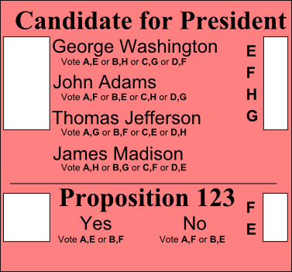

Casting a Ballot
Choose a pair of ballots to audit
#1 Left
#1 Right
#2 Left
#2 Right
#1 Left
#1 Right

Slide 40

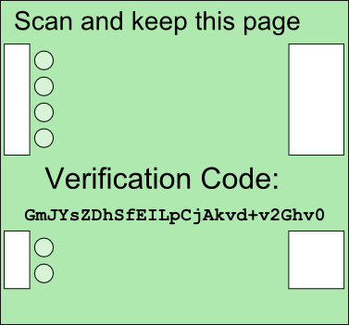

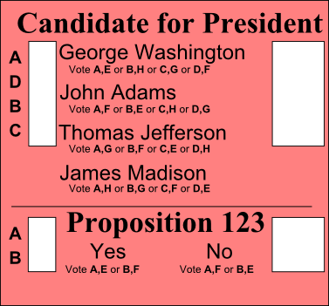
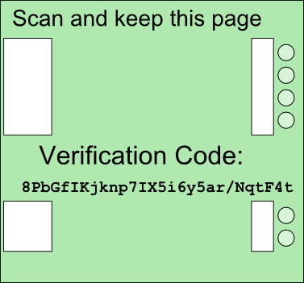
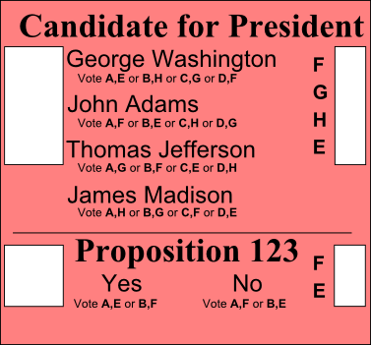


Casting a Ballot
Choose a pair of ballots to audit
Open and scan audit ballot pair
#2 Left
#2 Right
#1 Left
#1 Right

Slide 41



Casting a Ballot
Private Booth
Choose a pair of ballots to audit
Open and scan audit ballot pair
Enter private voting booth
Open voting ballot pair
#2 Left
#2 Right
#2 Left
#2 Right

Slide 42
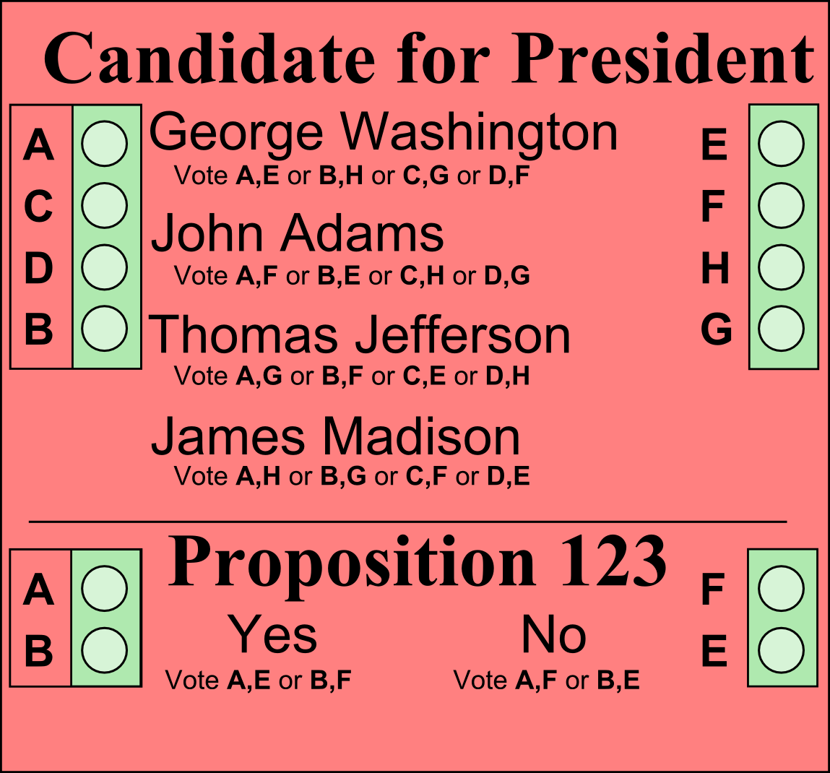

Casting a Ballot
Private Booth
Choose a pair of ballots to audit
Open and scan audit ballot pair
Enter private voting booth
Open voting ballot pair
Stack ballot parts
Mark ballot
A,F
B,E
C,H
D,G

Slide 43
Casting a Ballot
Private Booth
Choose a pair of ballots to audit
Open and scan audit ballot pair
Enter private voting booth
Open voting ballot pair
Stack ballot parts
Mark ballot
Separate pages

Slide 44
Casting a Ballot
Private Booth
Choose a pair of ballots to audit
Open and scan audit ballot pair
Enter private voting booth
Open voting ballot pair
Stack ballot parts
Mark ballot
Separate pages
Destroy top (red) pages
Leave booth. Scan bottom pages
Commitment to letter order
Random letter order: different on each ballot

Slide 45
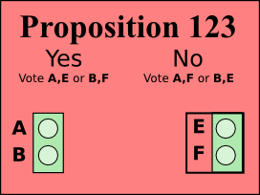



Forced Destruction Requirement
Voters must be forced to destroy top sheets
  Marking a revealed ballot as spoiled is not enough!
Coercer can force voter to spoil certain ballots
  Coerced voters vote “correctly” 50% of the time
Attack works against other cryptographic voting systems too

Slide 46

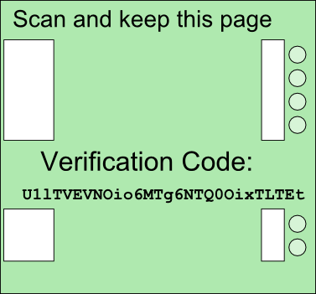
Checking the Receipt
Receipt consists of:
  Filled-out bottom (green) pages of voted ballot
  All pages of empty audit ballot
Verify receipt copy on bulletin board is accurate
Audited
Unvoted Ballots
Audit checks that commitment matches ballot

Slide 47


Counting the Ballots
Bulletin board contains commitments to votes
  Each authority publishes “half” a commitment
  Doesn’t know the other half
We can publicly “add” both halves
  “Homomorphic Commitment”
Now neither authority can open!
We need to shuffle commitments before opening
  Encryption equivalent is mix-net
  Won’t work for everlasting privacy: not enough information

Slide 48
Counting the Ballots
We need an oblivious commitment shuffle
Idea: Use homomorphic commitment and encryption over the same group
  Publicly “add” commitments
  Publicly shuffle commitments
  Privately perform the same operations using encryptions
  Just enough information to open, still have privacy

Slide 49

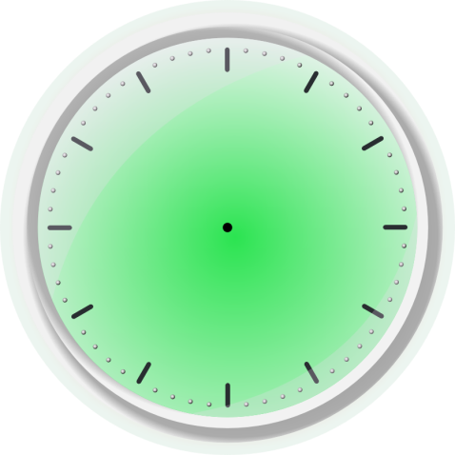

Oblivious Commitment Shuffle
Show a semi-honest version of the protocol
Real protocol works in the malicious model
We’ll use a clock analogy for homomorphic commitment and encryption

Slide 50
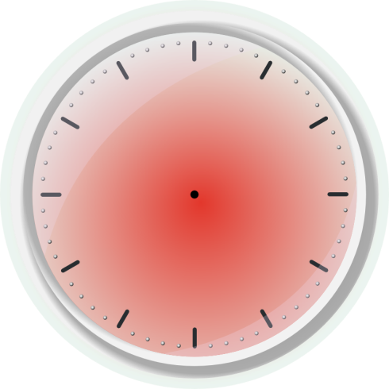
Oblivious Commitment Shuffle
Modular addition with clocks
x+y
←
z

Slide 51


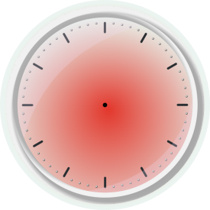


Oblivious Commitment Shuffle
Homomorphic Commitment
  Hour hand is “value”
  Minute hand is opening key (randomness)
  Value and key are added separately
  After homomorphic addition, commitment cannot be opened by either party!

Slide 52
Oblivious Commitment Shuffle

Slide 53
Oblivious Commitment Shuffle

Slide 54
Oblivious Commitment Shuffle

Slide 55
Oblivious Commitment Shuffle

Slide 56
Oblivious Commitment Shuffle

Slide 57
Summary and Open Questions
Background on Voting
Voting with Mix-Nets
Voting and Privacy
A Human-Verifiable Voting Scheme
Splitting trust between multiple authorities
  Protocol distributes trust between two authorities
  Everlasting Privacy
Can we improve the human interface?
  Required if we want more authorities
New voting protocols?

Slide 58

Thank
You!

