Slide 1


Key Derivation without entropy waste
Yevgeniy Dodis
New York University
Based on joint works with B. Barak, H. Krawczyk, O. Pereira, K. Pietrzak, F-X. Standaert, D. Wichs and Y. Yu

Slide 2

Key Derivation
Setting: application P needs m–bit secret key R
Theory: pick uniformly random R ← {0,1}^{m}
Practice: have ”imperfect randomness” X ∈ {0,1}^{n}
  physical sources, biometric data, partial key leakage, extracting from group elements (DH key exchange), …
Need a “bridge”: key derivation function (KDF) h: {0,1}^{n} → {0,1}^{m} s.t. R = h(X) is “good” for P
  … only assuming X has “minimal entropy” k

Slide 3
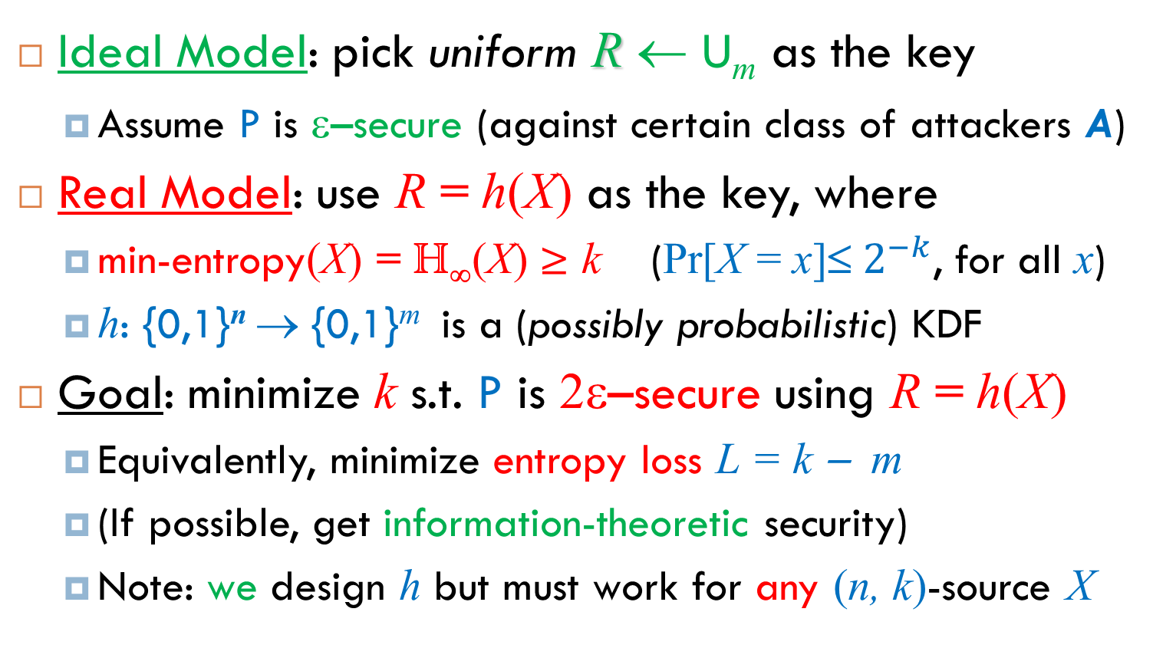
Formalizing the Problem
Ideal Model: pick uniform R ← U_{m} as the key
  Assume P is ε–secure (against certain class of attackers A)
Real Model: use R = h(X) as the key, where
  min-entropy(X) = H∞(X) ≥ k (Pr[X = x]≤${ 2}^{−k}$, for all x)
  h: {0,1}^{n} → {0,1}^{m} is a (possibly probabilistic) KDF
  Goal: minimize k s.t. P is 2ε–secure using R = h(X)
  Equivalently, minimize entropy loss L = k − m
  (If possible, get information-theoretic security)
  Note: we design h but must work for any (n, k)-source X
Real Security ε’ ≈ Ideal Security ε

Slide 4

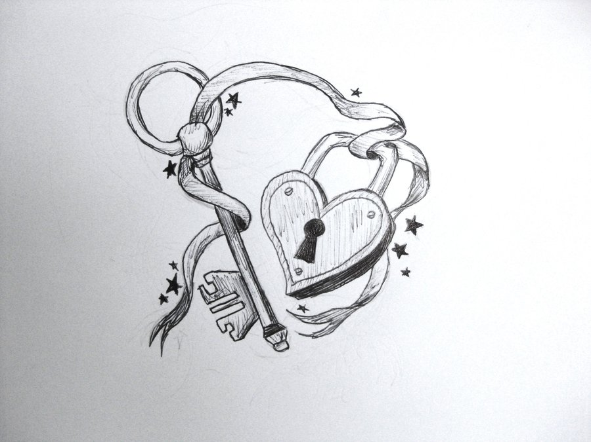
Formalizing the Problem
Ideal Model: pick uniform R ← U_{m} as the key
  Assume P is ε–secure (against certain class of attackers A)
Real Model: use R = h(X) as the key, where
  min-entropy(X) = H∞(X) ≥ k (Pr[X = x]≤${ 2}^{−k}$, for all x)
  h: {0,1}^{n} → {0,1}^{m} is a (possibly probabilistic) KDF
  Goal: minimize k s.t. P is 2ε–secure using R = h(X)
  Equivalently, minimize entropy loss L = k − m
  (If possible, get information-theoretic security)
  Note: we design h but must work for any (n, k)-source X
h
X
X

Slide 5
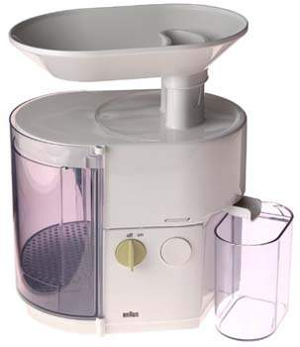
Old Approach: Extractors
Tool: Randomness Extractor [NZ96].
  Input: a weak secret X and a uniformly random seed S.
  Output: extracted key R = Ext(X; S).
  R is uniformly random, even conditioned on the seed S.
    (Ext(X; S), S) ≈ (Uniform, S)
Many uses in complexity theory and cryptography.
  Well beyond key derivation (de-randomization, etc.)
secret: X
Ext
extracted key:
R
seed: S

Slide 6
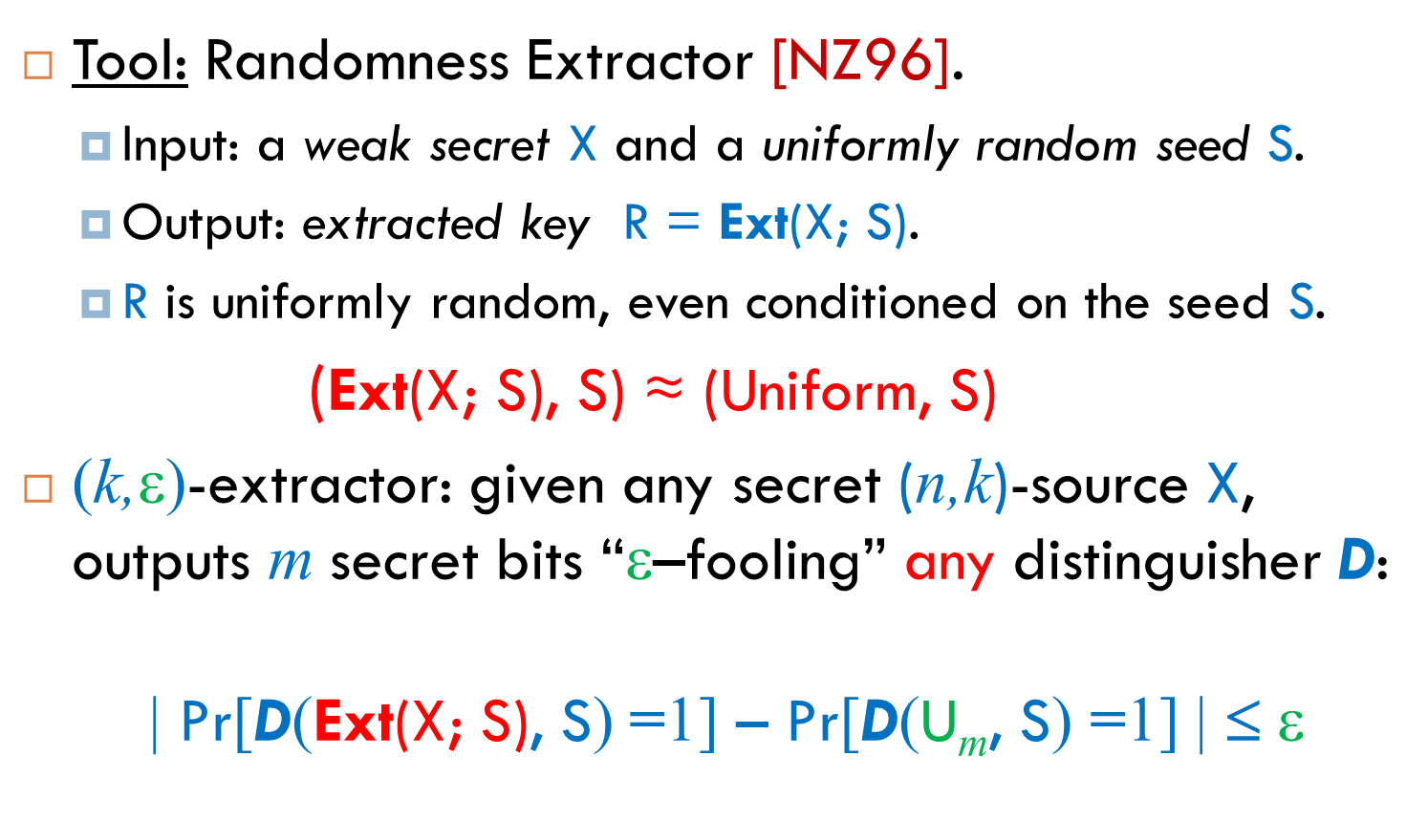
Old Approach: Extractors
Tool: Randomness Extractor [NZ96].
  Input: a weak secret X and a uniformly random seed S.
  Output: extracted key R = Ext(X; S).
  R is uniformly random, even conditioned on the seed S.
    (Ext(X; S), S) ≈ (Uniform, S)
(k,ε)-extractor: given any secret (n,k)-source X, outputs m secret bits “ε–fooling” any distinguisher D:
  | Pr[D(Ext(X; S), S) =1] – Pr[D(U_{m}, S) =1] | $\text{}$ ε
statistical distance

Slide 7






Extractors as KDFs
Lemma: for any ε-secure P needing an m–bit key, (k,ε)-extractor is a KDF yielding security ε’ ≤ 2ε
LHL [HILL]: universal hash functions are (k,ε)-extractors where k = m + 2log(1/ε)
Corollary: For any P, can get entropy loss 2log(1/ε)
RT-bound [RT]: for any extractor, k ≥ m + 2log(1/ε)
  entropy loss 2log(1/ε) seems necessary ☹
  … or is it?

Slide 8






Side-Stepping RT
  Do we need to derive statististically random R?
    Yes for one-time pad ☹…
    No for many (most?) other applications P ☺ !
    Series of works “beating” RT [BDK⁺11,DRV12,DY13,DPW13]
Punch line: Difference between Extraction and Key Derivation !

Slide 9

New Approach/Plan of Attack
Step1. Identify general class of applications P which work “well” with any high-entropy key R
  Interesting in its own right !
Step2. Build good condenser: relaxation of extractor producing high-entropy (but non-uniform!) derived key R = h(X)

Slide 10
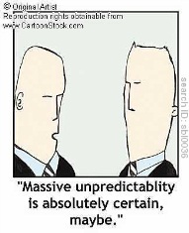
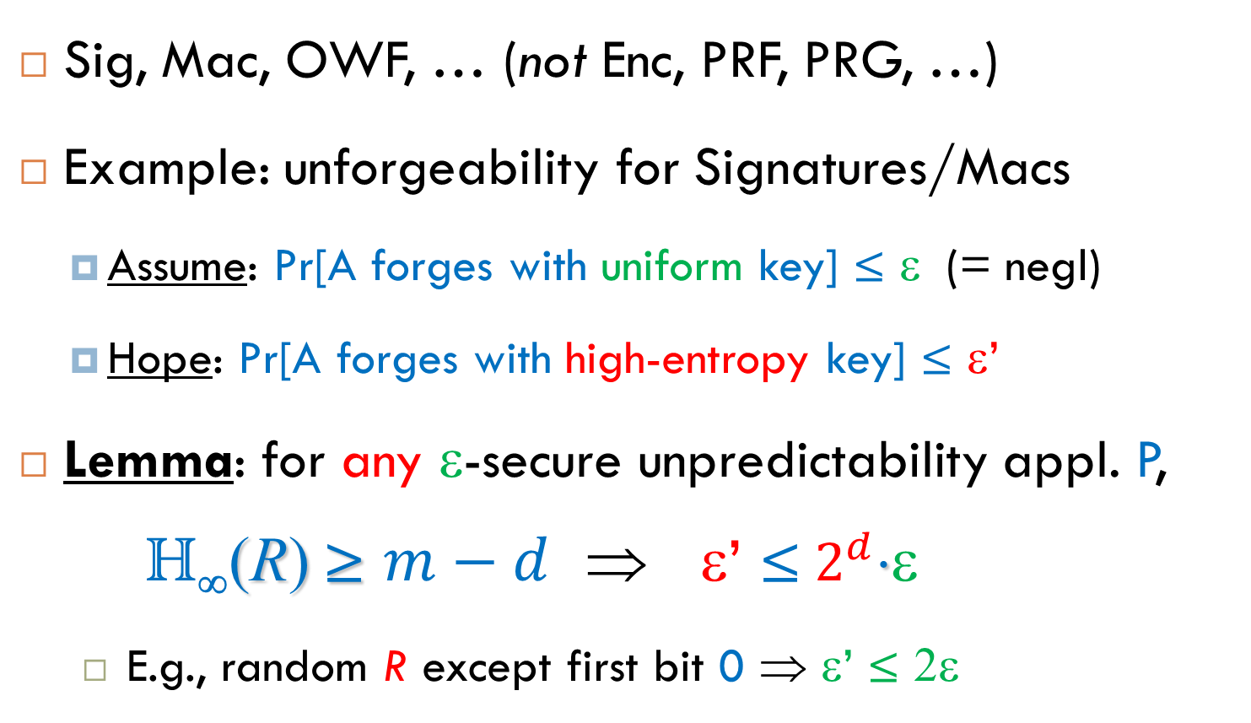
Unpredictability Applications
Sig, Mac, OWF, … (not Enc, PRF, PRG, …)
Example: unforgeability for Signatures/Macs
  Assume: Pr[A forges with uniform key] ≤ ε (= negl)
  Hope: Pr[A forges with high-entropy key] ≤ ε’
    Lemma: for any ε-secure unpredictability appl. P, H∞(R) ≥ $m−d$ ⇒ ε’ ≤${ 2}^{d}$ε
      E.g., random R except first bit 0 ⇒ ε’ ≤ $\text{2}$ε
Entropy deficiency

Slide 11

Plan of Attack
✓
Step1. Argue any unpredictability applic. P works well with (only) a high-entropy key R
  H∞(R) ≥ $m−d$ ⇒ ε’ ≤${ 2}^{d}$ε
Step2. Build good condenser: relaxation of extractor producing high-entropy (but non-uniform!) derived key R = h(X)

Slide 12

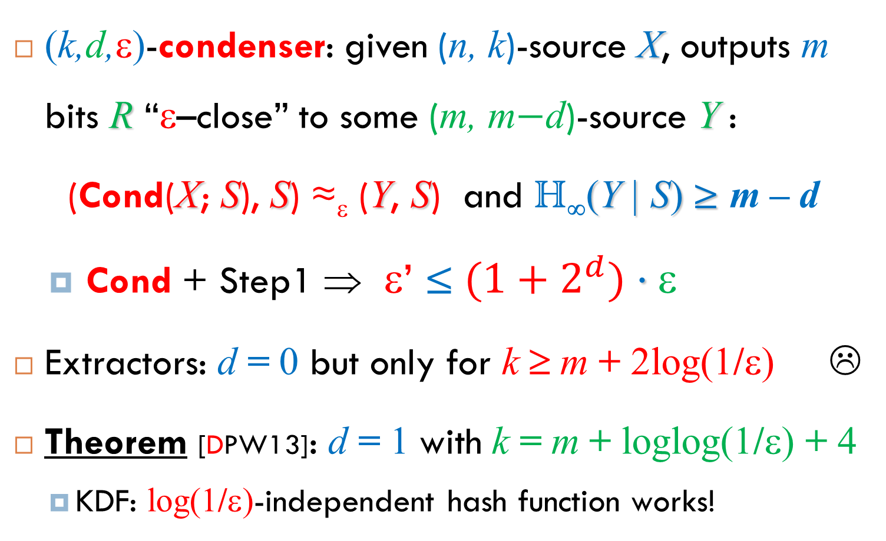
Randomness Condensers
random
(k,d,ε)-condenser: given (n, k)-source X, outputs m bits R “ε–close” to some (m, m$−$d)-source Y :
(Cond(X; S), S) ≈_{ε} (Y, S) and H∞(Y | S) ≥ m – d
  Cond + Step1 ⇒ ε’ ≤${ (1+2}^{d}) $ε
Extractors: d = 0 but only for k ≥ m + 2log(1/ε) ☹
Theorem [DPW13]: d = 1 with k = m + loglog(1/ε) + 4
  KDF: log(1/ε)-independent hash function works!

Slide 13
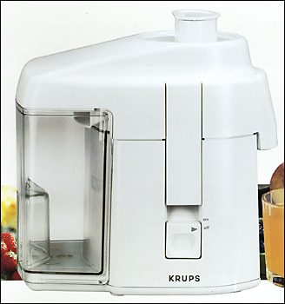

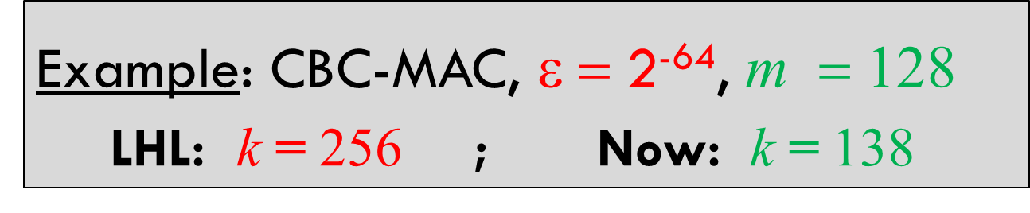
Unpredictability Extractors
Theorem: provably secure KDF with entropy loss loglog(1/ε) + 4 for all unpredictability applications
  call such KDFs Unpredictability Extractors
    Example: CBC-MAC, ε = 2⁻⁶⁴, $\text{m}$ = 128
  LHL: k = 256 ; Now: k = 138

Slide 14
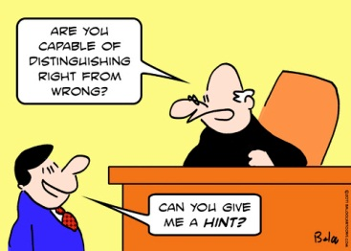
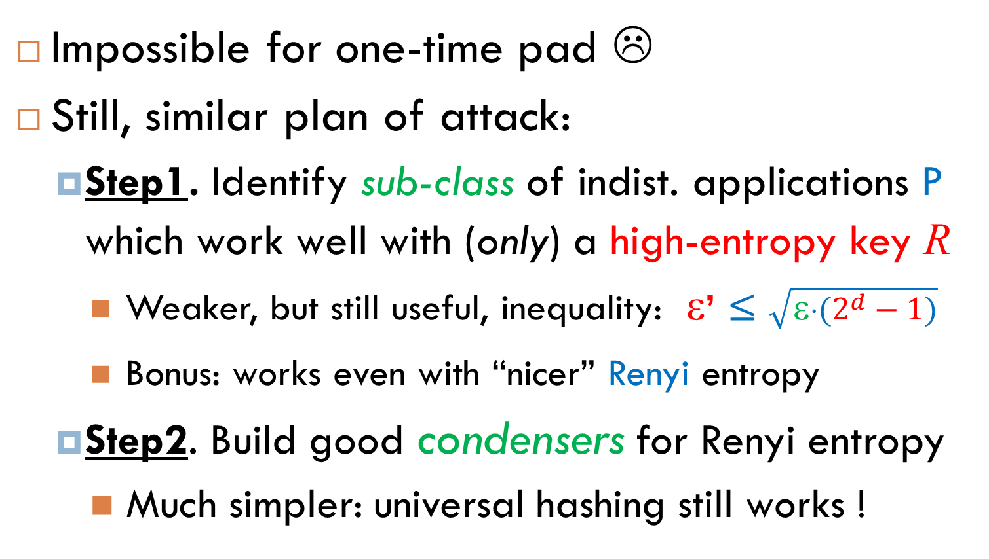
Indistinguishability Apps?
    Impossible for one-time pad ☹
    Still, similar plan of attack:
  Step1. Identify sub-class of indist. applications P which work well with (only) a high-entropy key R
    Weaker, but still useful, inequality: ε’ ≤ $\sqrt{{\text{e}⋅(2}^{d}−1)}$
    Bonus: works even with “nicer” Renyi entropy
  Step2. Build good condensers for Renyi entropy
    Much simpler: universal hashing still works !

Slide 15
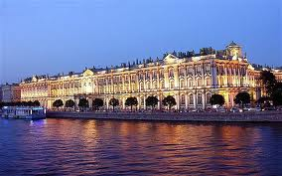
Square-Friendly Applications
Hermitage State
Museum
See [BDK⁺11,DY13] for (natural) definition…
All unpredictability applications are SQF
Non-SQF applications: OTP, PRF, PRP, PRG ☹
[BDK⁺11,DY13]: many natural indistinguishability applications are square-friendly !
  CPA/CCA-enc, weak PRFs, q-wise indep. hash, …
End Result (LHL’): universal hashing is provably secure SQF-KDF with entropy loss log(1/ε)

Slide 16
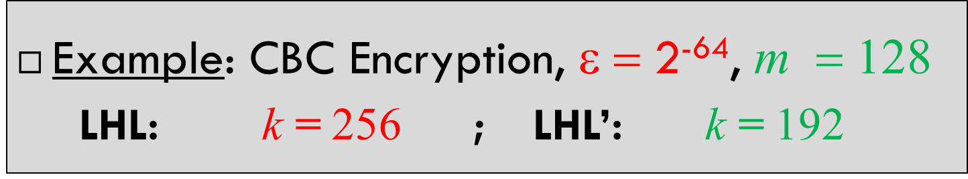
Square-Friendly Applications
Hermitage State
Museum
See [BDK⁺11,DY13] for (natural) definition…
All unpredictability applications are SQF
Non-SQF applications: OTP, PRF, PRP, PRG ☹
[BDK⁺11,DY13]: many natural indistinguishability applications are square-friendly !
  CPA/CCA-enc, weak PRFs, q-wise indep. hash, …
End Result (LHL’): universal hashing is provably secure SQF-KDF with entropy loss log(1/ε)
    Example: CBC Encryption, ε = 2⁻⁶⁴, $\text{m}$ = 128
  LHL: k = 256 ; LHL’: k = 192

Slide 17

Efficient Samplability?
  Theorem [DPW13]: efficient samplability of X does not help to improve entropy loss below
  2log(1/ε) for all applications P (RT-bound)
    Affirmatively resolves “SRT-conjecture” from [DGKM12]
  log(1/ε) for all square-friendly applications P
  loglog(1/ε) for all unpredictability applications P

Slide 18

Computational Assumptions?
  Theorem [DGKM12]: SRT-conjecture ⇒ efficient Ext beating RT-bound for all computationally bounded D ⇒ OWFs exist
  How far can we go with OWFs/PRGs/…?
    One of the main open problems
  Current Best [DY13]: “computational” extractor with entropy loss 2log(1/ε) − log(1/ε_{prg})
    “Computational” condenser?
,DPW13]:

Slide 19

Summary
Difference between extraction and KDF
  loglog(1/ε) loss for all unpredictability apps
  log(1/ε) loss for all square-friendly apps (+ motivation to study “square security”)
Efficient samplability does not help ☹
Good computational extractors require OWFs ☹
Main challenge: better “computational” KDFs

