Slide 1
Vignettes of Benny Chor’s Research
מן המקורות: מה טובו אוהליך בני, מרבצותיך שור
Presented by Oded Goldreich, on Dec 23rd 2021
Notes:
My perspective… Oded (abused by Benny – see photo treated as a dog)

Slide 2
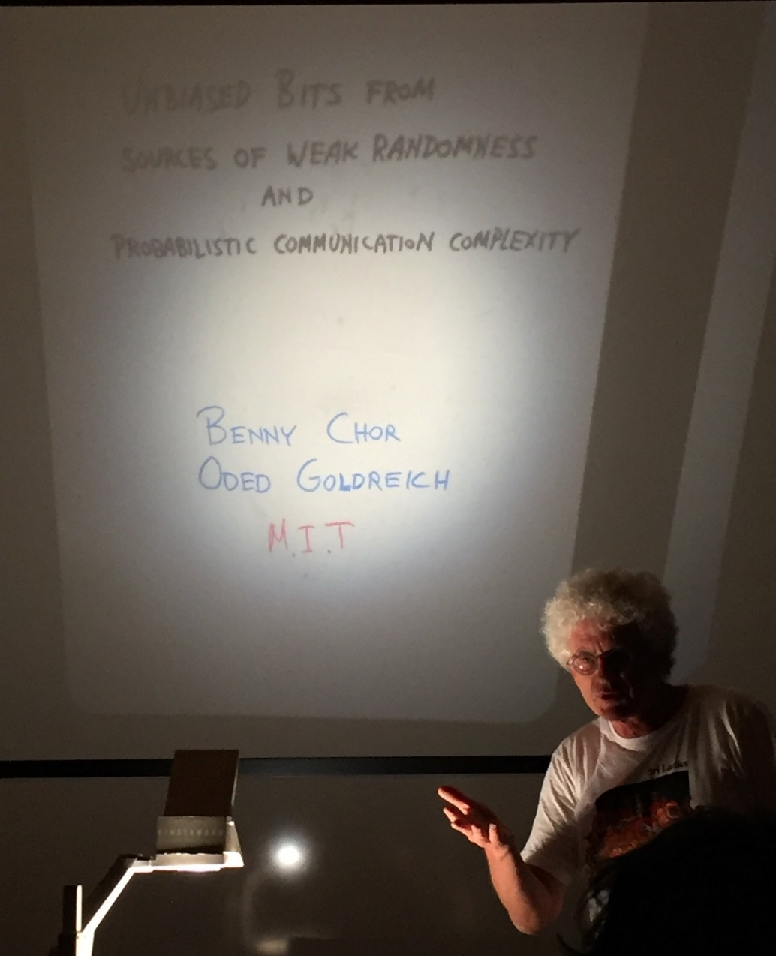
Randomness Extraction (“Unbiased Bits from Sources of Weak Randomness and Probabilistic Communication Complexity” (1985))
Model (for randomness extraction): Probability bounded sources (aka min-entropy sources).
Observation: min-entropy sources are a convex combination of “flat sources”
Result (one of several…): Inner product (mod 2) is a two-source extractor for min-entropy above ½.
Connection: Two-source extractors have high communication complexity.
Def: X has min-entropy k if for every x it holds that Prob[X=x] ≤ 2^{-k}
Notes:
Photo: Benny presenting the original 1985 slides in 2017.

Slide 3
Verifiable Secret Sharing [Chor, Goldwasser, Micali, and Awerbuch (1985)]
Secret Sharing and the need to augment it.
VSS is a major component in all subsequent secure MPCs.
A t-out-of-n secret sharing scheme.
Dealer has a secret s, generates n shares, s₁,…,s_{n}, such that each t of them yield s, but no t-1 of them yield any information about s.
s₁
s₂
What if the dealer is dishonest?
We want each share to be verifiable as authentic
(i.e., it yields the secret if combined with t-1 additional valid/authentic shares).
s₃
s
s₄
[Implementation: A random degree t-1 poly with free term s.]
s₅
This (VSS) is a pivotal notion or a basic tool. Original implementation predates Zero-Knowledge proofs.
Notes:
The shares are distributed among parties. Originally conceived for distributing authority among subordinates.

Slide 4
The Security of RSA Bits [Alexi, Chor, G, and Schnorr (1984)]
The RSA function: x → x³ mod N, where N=PQ for primes P and Q.
Widely assumed to be hard to invert, but does it hide individual bits of x?
easy
x
f(x) (here f(x)= x³ mod N)
HARD
easy
b(x) (here lsb(x))
lsb = least significant bit.
A bit
Notes:
Other bits are easy to compute from f(x); e.g., lsb(f(x)). For RSA, Jacobi Symbol of x (as it equals JS of f(x)). “Wildly”, “One-way function” and “Hardcore predicates”

Slide 5
The Security of RSA Bits: A (technical) detail
Suppose that you are given B_{x}:{0,1}^{n}→{0,1} that for at least 51% of the r’s answers b(x,r)=∑_{i} r_{i}x_{i} mod 2. Can you find x (in poly(n)-time)?
Easy case: If B_{x} answers correctly on 76% of the r’s. For each i, do the following. Select r at random and obtain B_{x}(r)+B_{x}(r⊕0^{i-1}10^{n-i}) mod 2.
With probability at least 1-2⋅0.24 > 0.5, it equals b(x,r)+b(x,r⊕0^{i-1}10^{n-i})=x_{i} (mod 2).
Repeating enough times and taking a majority vote, you get x_{i} (w.h.p.).
Real case (avoiding error doubling): Ask B_{x} only on r⊕0^{i-1}10^{n-I}, for the above r’s.
Obtain the b(x,r)’s by guessing only few (logarithmically many) of them.
(We can afford logarithmically many guesses since the #possibility = #r’s we use.)
How can we do such a guessing? Hint: The r’s are only pairwise independent.
Notes:
Select log-many r’s, guess the b(x,r)’s for them, and consider the XOR of all subsets of these r’s. Use b(x,r)+b(x,s)=b(x,r+s).

Slide 6
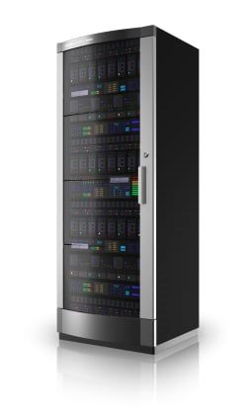
Private Information Retrieval [Chor, G., Kushilevitz, and Sudan (1995)]
user
server(s)
The user is interested in item i in a database stored on the server(s), and wishes to obtain it without revealing i to the server(s). Sending the entire database is way too expensive.
But it is impossible to do better when using only one server. So we use two non-colluding servers.
We can do it with O(n^{1/3}) communication, where n denotes the size of the database.

Slide 7
Private Information Retrieval: A (technical) detail Denote the n-bit database by x. The user wants x_{i}
Simple idea: The user selects a random subset S ⊆ [n], asks one server for ⊕_{j∈S} x_{j} and the other server for ⊕_{j∈S⊕{i}} x_{j}
The user XORs these two bits, obtaining x_{i} Indeed, each server sends only one bit, but the user sends 2n.
Privacy: Each server gets no information about i.
Generalization: The user selects random subsets R,S,T ⊆ [n^{1/3}], asks each of the eight servers for ⊕_{(j,k,l)∈R’×S’×T’} x_{j,k,l} where R’ is either R or R⊕{i₁}, S’ is either S or S⊕{i₂}, T’ is either T or T⊕{i₃}, and i=(i₁,i₂,i₃). Note that XORing the eight results yields x_{i1,i2,i3} = x_{i} [where i=(i1,i2,i3)] Indeed, each server sends only one bit, and the user sends O(n^{1/3}) bits.
But we used eight servers rather than two.
We let each of the “extreme” servers emulated the three servers “neighboring” it.
Specifically, the server receiving (R,S,T) emulates (R⊕{m},S,T) for all values of m, and similarly (R,S⊕{m},S,T) and (R,S,T⊕{m}). Ditto the server receiving (R⊕{i₁},S ⊕{i₂},T ⊕{i₃}).

Slide 8
Private Information Retrieval: A couple (of the many) follow-ups.
Computational PIR (CPIR) [Chor and Gilboa (1997)] The foregoing definition of privacy was information theoretic, and one may hope to gain by relaxing it to a computational one (as is customary in modem cryptography). In particular, the impossibility of a single-server PIR no longer holds. Shafi will survey this research direction.
Searching by keywords [Chor, Gilboa, and Naor (1998)] Known PIR schemes assume that the user knows the physical address of the sought item (represented by the index). But it is desirable to access the database by keywords, which are internally translated (at the database end) to physical addresses, using an appropriate search structure (e.g., a hash table or a binary tree). This work provides a simple, modular way to privately access data by keywords. It combines any conventional search structure with any underlying PIR scheme.

