Slide 1
Probabilistic Proof Systems
Oded Goldreich
Weizmann Institute of Science
Notes:
IASH, Dec 30th, 2024.

Slide 2
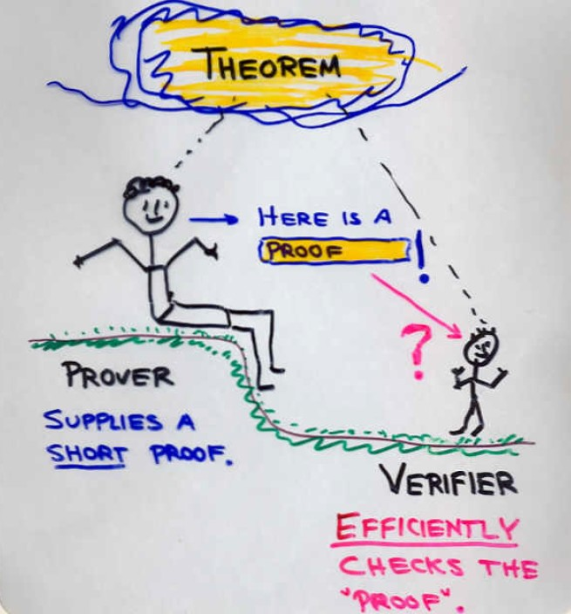
Proofs: The Traditional Take (NP-Proof Systems)
Proofs are defined wrt verification procedure.
Completeness and soundness
Proofs are supposed to facilitate the verifications of claims;
that is, for many claims, verification of proofs is supposedly easier than verification of the claims themselves (w.o. a proof).
“supposed” = this is a conjecture:
The P-vs-NP conjecture.

Slide 3
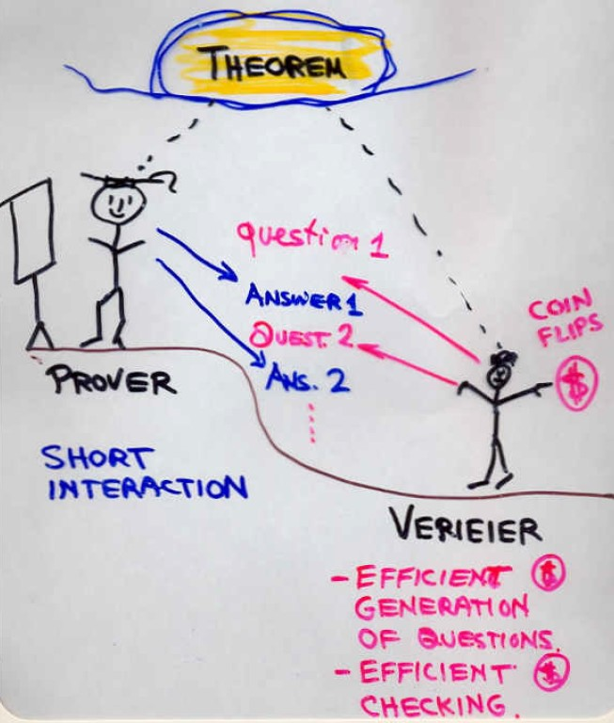
Interactive (and randomized) proofs
Proofs as processes, include interaction
and randomization (of V’s questions).
Completeness and soundness
(probabilistic, error probability)
Randomness is essential;
an interactive proof w.o. randomness
can be converted to a traditional one.
The error probability is explicitly bounded and can be reduced by repetitions.

Slide 4
The power of interactive proof systems
To prove that something exists, we show it.
We can prove that something does not exist,
via an interactive proof.
E.g., there exists an interactive proof that a system of equations in many variables is NOT satisfiable. (For any such system!)
Notes:
A story not told by Ovid. The same story is demonstrated by the Green-Red video. It underlies the THM re GNI.

Slide 5
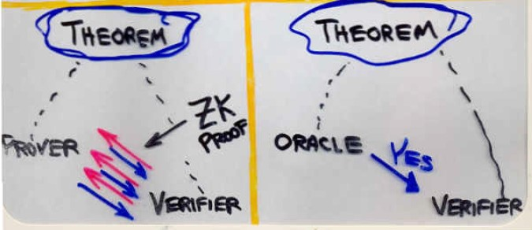
Zero-knowledge proof systems
Typically, proofs yields much beyond their validity.
In contrast, ZK proofs yield nothing beyond.
“Whatever can be efficiently computed after interacting with the prover, can be efficiently computed assuming the claim is correct.”
The verifier in the “ideal” setting can simulate the view of the verifier in the “real” (ZK) setting!
Notes:
Perfect, Statistical (or almost-perfect), and Computational (general).
The existence of a simulator means that, assuming the claim is vaild, we did not gain anything by interacting with the prover. The gain is only being convinced of the validity.

Slide 6
The power of zero-knowledge proof systems
We can prove that something exists by showing it.
Using ZKIP, we can prove that something exist, without showing it; furthermore, without showing any part of it.
There exists a zero-knowledge proof that a system of equations in many variables is satisfiable. (For any such system!)
Notes:
What did I/verifier learn from the two-color interactive proof?

Slide 7
Essential and inessential ingredients
Interaction is essential (both in IP and ZK).
Randomness is essential (both in IP and ZK (for both parties)).
E.g., if the verifier is deterministic,
then IP-systems collapses to NP-systems.
“No point to interact with a predictable person who is computationally weaker.”
Error probability is essential, but can be reduced almost arbitrarily.
Sophisticated question help but are inessential for IP
(i.e., wlog, the verifier may ask totally random questions).

Slide 8
END
Notes:
Last slide

Slide 9
Zero-knowledge proof systems
Typically, proofs yields much beyond their validity.
In contrast, ZK proofs yield nothing beyond.
“Whatever can be efficiently computed after interacting with the prover, can be efficiently computed assuming the claim is correct.”
Formally, for an interactive proof (P,V) and any (valid) claim x,
we consider two distributions:
The output generated by V
(or even by any feasible “knowledge-seeking adversary”)
on input x after interacting with the prover strategy P.
The output of some efficient procedure (“simulator”) on input x.
We require that these distributions are identical / statistically-close / computationally-indistinguishable.
Notes:
Three corresponding types of ZK:
Perfect, Statistical (or almost-perfect), and Computational (general).
The existence of a simulator means that, assuming the claim is vaild, we did not gain anything by interacting with the prover. The gain is only being convinced of the validity.

