Slide 1
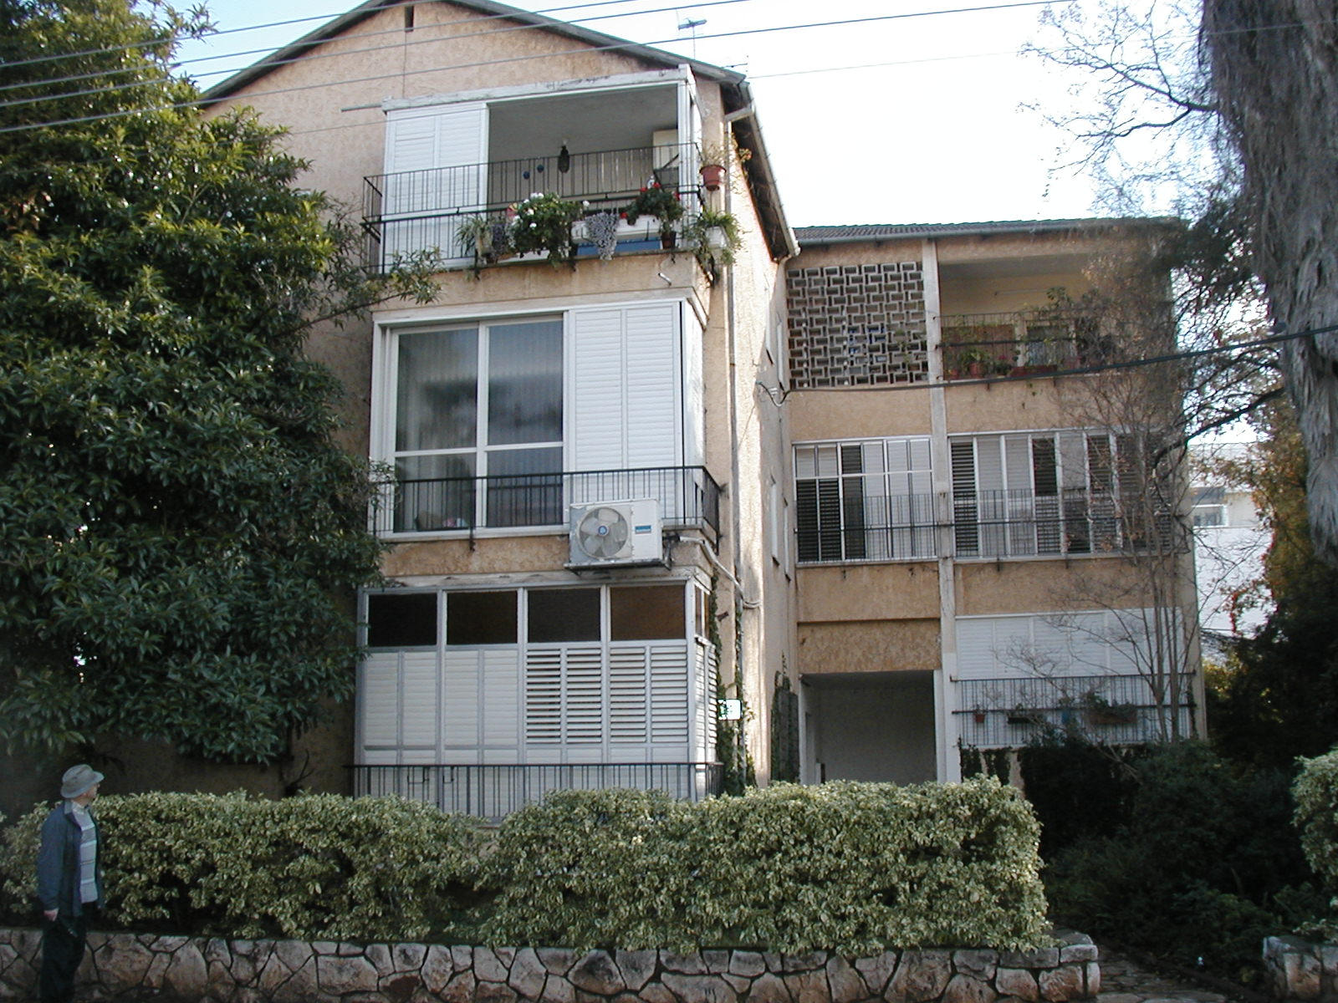
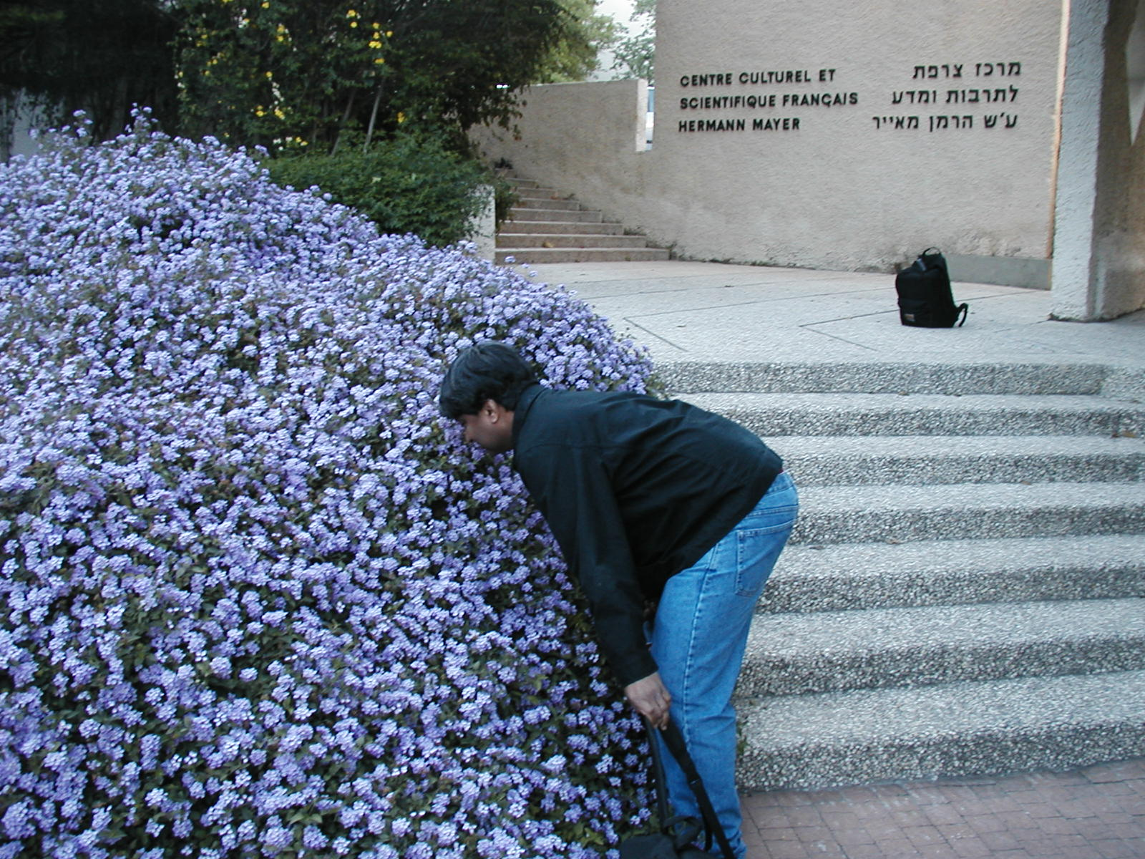
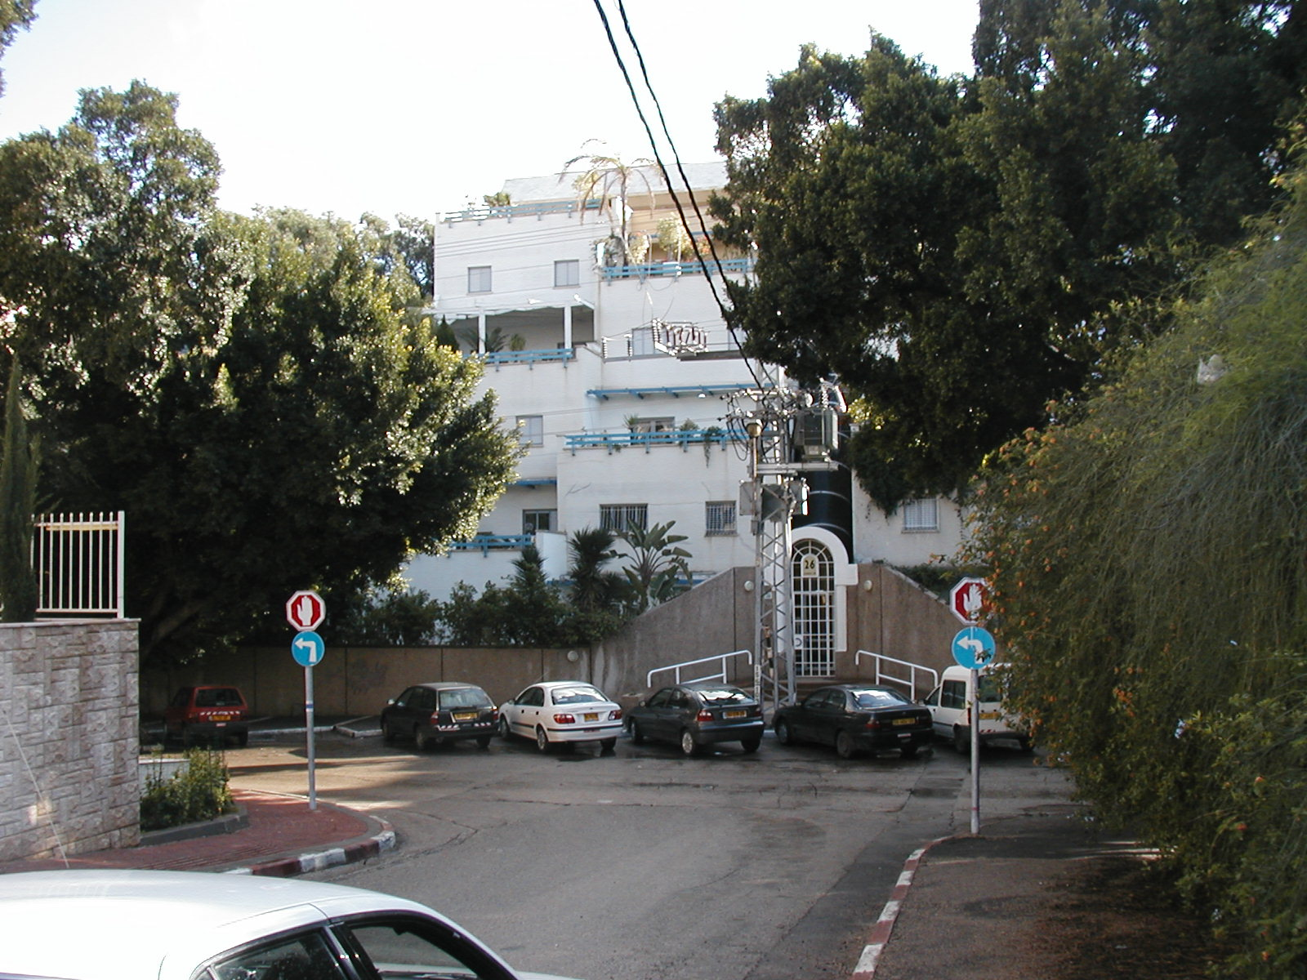
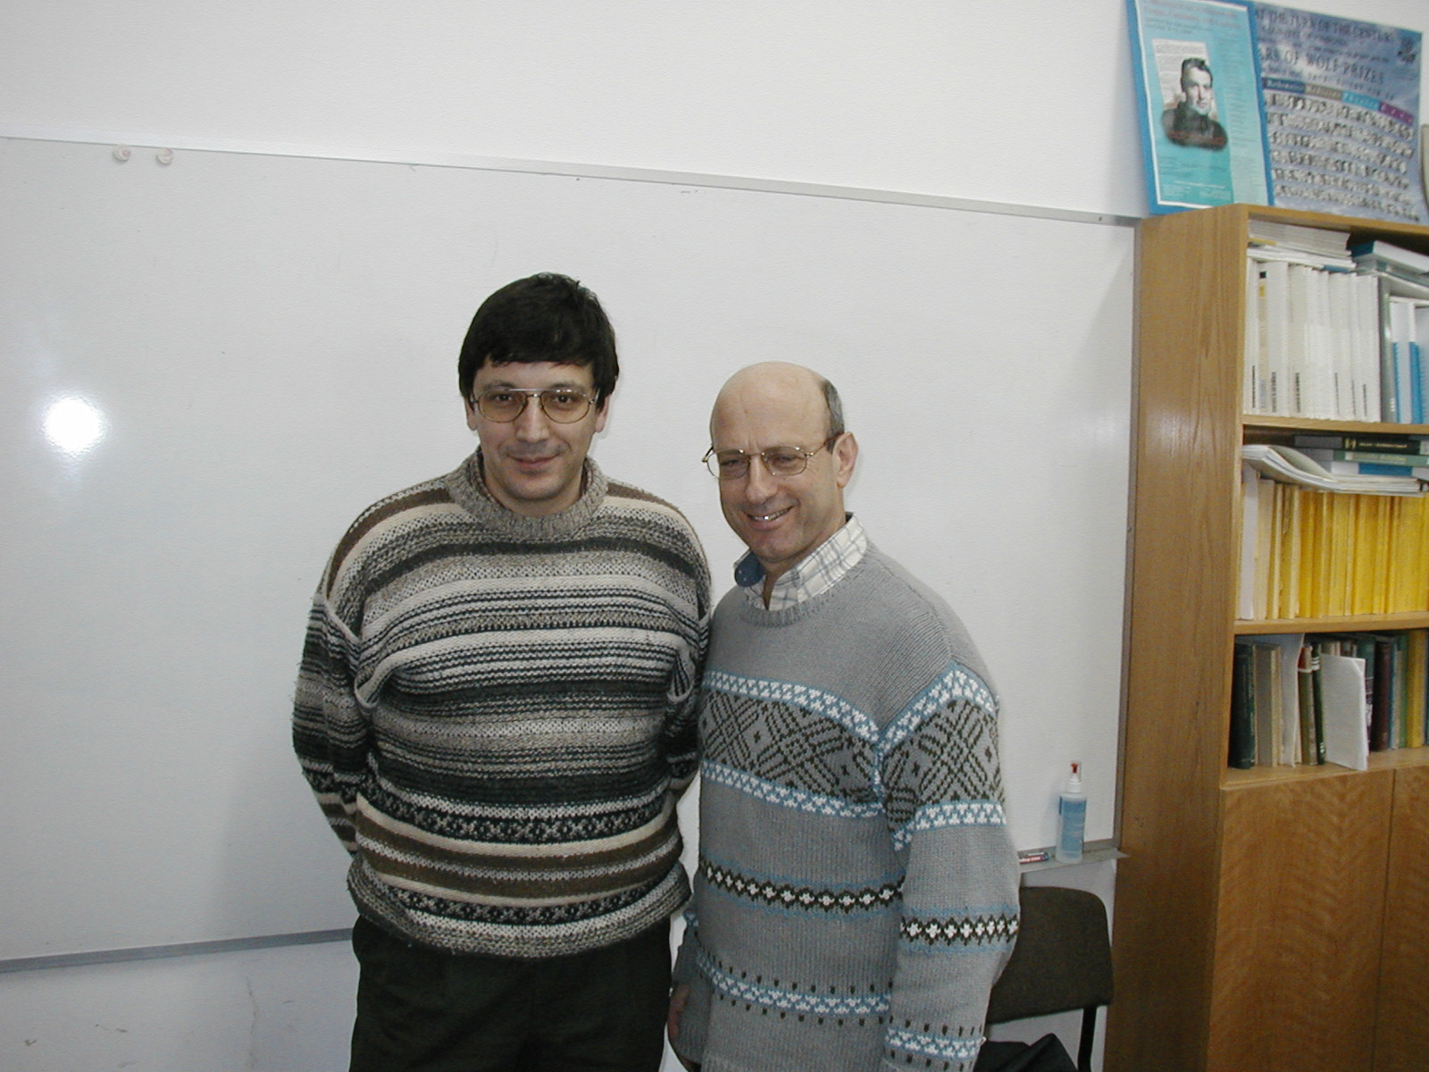
Unitarity, Eisenstein series, and Arthur's conjectures
Stephen D. Miller
Rutgers University
Weizmann Institute
10 June 2020
18 Sivan 5780

Slide 2
The last major challenge (in the rep’n theory of real groups)
Given a real reductive Lie group $G$, fully describe its unitary irreducible representations $\hat{G}$ (preserving Hilbert space structure) – the “unitary dual”
In principle can describe irreducibles, but not which have positive-definitive invariant Hermitian forms
Answer is notorious complicated even for classical groups
Today’s topic: Arthur’s unipotent representations
Related to automorphic forms
and string theory
Thought to be “building blocks” of the unitary dual

Slide 3
Arthur parameters
Let $G=$ split real group, e.g., $SL\left(2,ℝ\right).$
Let $G^{∨}\left(ℂ\right)=$complex points of Langlands dual group, e.g., $PGL\left(2,ℂ\right).$
Weil group $W_{ℝ}=ℂ^{∗}⊔jℂ^{∗}$ inside the quaternions
Arthur parameter: algebraic homomorphism $ψ:SL\left(2,ℂ\right)×W_{ℝ}→G^{∨}\left(ℂ\right)$
+ technical hypothesis (irrelevant hereafter)
Unipotent Arthur parameter: $ψ$ is trivial on the $ℂ^{∗}$-factor of $W_{ℝ}$.
So $ψ{\left(j\right)}^{2}=ψ\left(−1\right)=1$, i.e., $ψ(j)$ has order 1 or 2.
Up to conjugacy, determined by $ψ(j)$ and an algebraic $SL(2,ℂ)$ that commutes with it in $G^{∨}\left(ℂ\right)$.
Meaning of the $SL(2,ℂ)$ for a representation parameterized by $ψ$:
“how far away from tempered” (not really true anyhow) or
(my favorite) “dual wavefront set”, measures how complicated representations are.

Slide 4
Nilpotent orbits ($≈$Jordan canonical form)
Interesting to think of $ψ(SL\left(2,ℂ\right))$ as encoding a nilpotent orbit of $G^{∨}\left(ℂ\right)$ under its adjoint action on its Lie algebra $𝔤^{∨}\left(ℂ\right):$
consider differential $dψ\left(\begin{matrix}0 & 1 \\ 0 & 0\end{matrix}\right)∈𝒪^{∨}$, part of an $𝔰𝔩_{2}$-triple, with neutral element $2λ∈𝔞^{∨}≅𝔞^{∗}$.
The adjoint nilpotent orbit $𝒪^{∨}$ has weighted Dynkin diagram determined by $2λ$.
Up to conjugacy, unipotent parameters for split $G$ determined by
Order 1 or 2 element $ψ\left(j\right)$
Adjoint nilpotent orbit in {+1 eigenspace of $Ad(ψ\left(j\right))$} = a symmetric subalgebra of $𝔤^{∨}\left(ℂ\right)$
The nilpotent orbit $𝒪^{∨}$ carries lots of extra information
e.g., its Spaltenstein dual orbit $𝒪⊂𝔤(ℂ)$ is $≈$ the wavefront set of representations attached to $ψ$ (more later)

Slide 5
From unipotent Arthur parameters to packets
To each parameter, Arthur predicts a packet of interesting unitary representations.
How to define this packet?
Arthur: packets must involve stable combinations of characters
[Adams-Barbasch-Vogan, 1991]: give a definition of packets (for real groups).
Stability satisfied, but stability isn’t enough to define a packet.
Only one easy-to-define member of the packets: the “Langlands element”
quotient of (dominant) principal series with infinitesimal character $λ$, and quadratic character defined by $ψ(j)$
Unlike $L$-packets, Arthur packets can intersect nontrivially!
Notion of weak packet (just as useful for unitarity): union of all packets with same $λ$ (equiv., same $𝒪^{∨}$)
atlas software: method to compute weak packets using cell computations

Slide 6
Wavefront sets and weak packets
Given an irreducible, admissible representation $π$, one can associate various orbits in the nullcone of the Lie algebra $𝔤$ (over $ℝ,ℂ$)
AV(Ann($π$)) = Associated Variety of the Annihilator ideal
Closure of a single complex nilpotent orbit $𝒪$
The orbit $𝒪$ has powerful information about $π$: controls nonvanishing Fourier coefficients, and$\dim\left(𝒪\right)=2 GKdim(π)$
AV$(π)$ and WF$\left(π\right)$: real orbits.
The complex orbit $𝒪$ is related to (possibly several) real orbits (“real forms of $𝒪$”)
Finer information
Beautiful Definition of weak packet: (for technical simplicity, assume $λ$ integral here)
all $π$ with infinitesimal character $λ$ and AV(Ann($π$))$=𝒪$
Recall$𝒪$ (here assumed even) is the Spaltenstein dual of $𝒪^{∨}$, so related to $λ$
Explains why packets can intersect: individual packets have to do with real forms of $𝒪^{∨}$ (in dual picture)
Arthur packets consist of interesting small representations, e.g., minimal representations
Should occur automorphically with lacunary Fourier coefficients, e.g., $θ$-functions

Slide 7
Results for split exceptional groups
Arthur has settled (split) classical groups using trace formula (fundamental lemma)
$C\left(𝒪\right)$ = {component group of centralizer of SL(2) image} is always abelian
List of all unipotent Arthur parameters for exceptional groups now known by [Hundley-M]
341 total
$C(𝒪)$ not always abelian (e.g., $S_{5}$) so new phenomena enter
All packets for exceptional groups recently computed (jointly with Adams, van Leeuwen, Paul, and Vogan)
The famous packets (e.g., minimal or next-to-minimal representation) tend to be singletons.
[M- 2012], [Hundley-M 2019] showed the Langlands element of the packet is always unitary, using Eisenstein series (more later) and, in some cases, the atlas software.
All packet elements should have automorphic realizations, but it is not clear if as cusp forms or Eisenstein series residues.
Conflicting literature predictions, even for $G_{2}$ (but clear statements due Gan-Gurevich-Jiang)

Slide 8
Census of unipotent representations

Slide 9
Example: $split G_{2}\left(ℝ\right)$
1
2
Two packets with $λ=π_{1}$ (Jonathan Fernandes’s Thesis)
One with $ψ(j)$ trivial; its Langlands element is spherical. Packet has 3 elements.
Another with $ψ(j)$ nontrivial. Packet has 2 elements.
They fit together as follows: decompose principal series
9
6
2
8
4
Spherical principal series at $π_{1}$ | Nonspherical principal series at $π_{1}$
parameter(x=9,lambda=[1,1]/1,nu=[1,0]/1) | parameter(x=8,lambda=[3,0]/1,nu=[1,0]/1)
parameter(x=4,lambda=[1,0]/1,nu=[2,-1]/2) | parameter(x=6,lambda=[4,-1]/1,nu=[3,-1]/2)
parameter(x=6,lambda=[4,-1]/1,nu=[3,-1]/2) | parameter(x=2,lambda=[1,0]/1,nu=[0,0]/1)
parameter(x=4,lambda=[1,0]/1,nu=[2,-1]/2) | parameter(x=4,lambda=[1,0]/1,nu=[2,-1]/2)
parameter(x=0,lambda=[1,0]/1,nu=[0,0]/1) | parameter(x=0,lambda=[1,0]/1,nu=[0,0]/1)
Large DS

Slide 10
Wider, more recent interest in $G_{2}$
Similar representations appear via rigid Calabi-Yau’s in string theory
Automorphic forms with integral coefficients, Shimura varieties, Galois representations from algebraic number theory
Role of quaternionic discrete series (Gross-Wallach) highlighted
What tools exist for explicit calculations, ala what appears in analytic SL(2) theory?
Aaron Pollack: methods to look at explicit $K$-types via differential equations
M—Zhuohui Zhang: generalize Wigner’s algebraic theory to $K$-types, intertwining operators.

Slide 11
Example: the most interesting weak packet
Orbit E8(a7) in $𝔢_{8}$
Component group $C\left(𝒪\right)≅S_{5}$, highly nonabelian
(in contrast, always abelian for classical groups.)

Slide 12
Big remaining questions about packets
Identifying all the packet elements (unipotent representations)
Unitarity – every unipotent representation should be unitary
How realized automorphically?
expect interesting family of automorphic functions with highly lacunary Fourier expansions
generalizing $θ$-functions
mostly undiscovered
Expect to be important in number theory, Langlands program
How related by induction?
If the image of $ψ$ is distinguished (not the same as the orbit $𝒪^{∨}$ being distinguished)….
…expect a (non-obvious) relation between Arthur packets on a Levi and G via unitary induction.
Relationships involving cohomological induction?
The atlas software can say something about this.

Slide 13
Eisenstein methods for unitarity
First studied by Langlands (for $G_{2}$) in his Eisenstein Series monograph (1976)
Performs a long calculation, finds the spherical unipotent representation with $λ=π_{1}$
Speh’s representation as an Eisenstein residue (1983)
[Green-M-Vanhove-Russo 2010] explains the cancellation for similar cases on $E_{8}$
in terms of perturbative and decompactification limits in string theory.
[Green-M-Vanhove 2011] circumvent Langlands’ contour shift
study individual Eisenstein series in a way analogous to what was needed for physics calculations.
Prove unitarity of third smallest unipotent representation for $E_{8}$ (after trivial and minimal rep’ns [GRS]).
[M-, 2012] Unitarity of all spherical unipotent representations ($ψ(j)$ trivial) using properties of Riemann $ζ$-function
[Hundley-M, 2019] Unitarity of all Langlands elements of Arthur packets, using intertwining operators

Slide 14
What are Eisenstein series? First, $SL(2)$
Eisenstein introduced the holomorphic modular forms of Im($z$)>$0$ $\sum_{\begin{aligned}\left(m,n\right)∈ℤ^{2} \\ \left(m,n\right)≠(0,0)\end{aligned}}{{\left(mz+n\right)}^{−k}}$
Siegel defined the non-holomorphic analog for $z=x+iy, y>0$
$$E\left(x+iy,s\right) ≔\sum_{\begin{aligned}\left(m,n\right)∈ℤ^{2} \\ \left(m,n\right)≠(0,0)\end{aligned}}{\frac{y^{s}}{{\left|mz+n\right|}^{2s}}}$$
The latter has a Fourier expansion $E\left(x+iy,s\right)=y^{s}+c\left(2s−1\right)y^{1−s}+\sum_{n≠0 }{e^{2πinx} C_{n}(y,s)}$
where $c\left(s\right), C_{n}(y,s)$ given by explicit number-theoretic formulas
Growth controlled by constant term $y^{s}+c\left(2s−1\right)y^{1−s}$
Application: Residue at $s=1$ (or value at $s=0)$ is constant
Note for later: this is square-integrable over modular fundamental domain vs $y^{−2}dx dy$

Slide 15
For more general groups
First consider a spherical principal series $V_{λ }=\left\{f:G→ℂ \right| f\left(bg\right)=χ_{λ+ρ}\left(b\right)f(g)\}$
For $λ−ρ$ strictly dominant (“Godement range”) define $E\left(λ,g\right)=\sum_{γ∈B(ℤ)\backslash G(ℤ)}{e^{(λ+ρ)(H\left(γg\right))}}$
Satisfies functional equations $E\left(λ,g\right)=M\left(w,λ\right)E(wλ,g)$ where and $w∈W$=Weyl group.
Langlands’ constant term formula $\int_{N\left(ℤ\right)\backslash N(ℝ)}{E\left(λ,ng\right)dn=\sum_{w∈W}{M(w,λ)}e^{(wλ+ρ)(H\left(g\right))}}$

Slide 16
Residues at special points
Previous $SL(2)$ example was at $λ=ρ$ : get constant function for any $G$
In general $E\left(−ρ,g\right)≡1$
Residual spectrum gets very interesting for other groups
L² residue if nontrivial contributions satisfy $〈wλ,α_{i}^{∨}〉<0, ∀i$ (Langlands’ condition).
[M-,2012]: specialize deformation $λ=2sπ_{j}−ρ$
Corresponds to maximal parabolic Eisenstein series induced from trivial representation.
Actually, all of Arthur’s spherical examples have this form.
Key computational point: The inner products $〈λ,α_{i}^{∨}〉=−1$ for $i≠j$. This rules out the contributions for nearly all $wW$. (Most $M(w,)=0$since $c(−1)=0$.)
Consequence: unitarity (since $L^{2}$ defines Hilbert space structure) of all spherical Arthur packet members

Slide 17
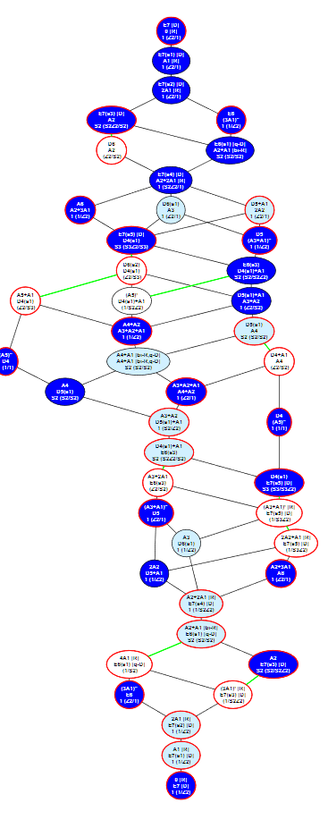
Example: trivial, minimal, and next-to-minimal rep’ns for $E_{7}$ and $E_{8}$
In preceding slide, interesting residues occur at $s=0,\frac{3}{2},\frac{5}{2}$.
They are automorphic realizations for the three biggest dual orbits $𝒪^{∨}$
Their AV(Ann($π$)) are the three smallest orbits $𝒪$
Orbit size forces vanishing Fourier coefficients
E.g., for trivial representation $𝒪=\{0\}$, residue is constant
For minimal, get $θ$-functions [GRS]
All three come up as low order terms the 4-graviton scattering amplitude in maximally supersymmetric string theory.
Their Arthur packets are singletons
Other orbits will give much more complicated unipotent representations.
Are they related to higher order terms in scattering amplitudes?

Slide 18
Non-spherical Eisenstein series (w/ Hundley)
Here one needs careful control of normalized intertwining operators (introduced by Langlands, studied by Shahidi, Winarsky, Arthur)
Difficult reduction to distinguished orbits
Requires atlas software for this, and a small number of cases
Combinatorics still enter in an important way, but very differently fro the spherical case
Proof reduces to checking certain Weyl orbits are indistinguishable from spheres when polynomials of degree $≤2$ are averaged over them
“spherical designs”

Slide 19
The future?
Weak packets give all unipotent representations
These are supposed to be “building blocks” of the unitary dual, and Arthur’s conjecture (that they are all unitary) is a major benchmark
Once (or “if”) that gets done…
…Will it be possible to classify the unitary dual modulo unipotent representations? Of certain groups?
Will that be intricate (i.e., many, many cases) or hard?
Automorphic realizations of unipotent representations should be highly interesting, and as-of-yet not discovered, automorphic forms.
Hopefully develop tools to study details of these realizations

