Slide 1
Beyond Worst Case Analysis of Algorithms
Uriel Feige
Weizmann Institute
Spring 2021

Slide 2
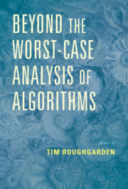
Web access:
https://www.cambridge.org/core/books/beyond-the-worstcase-analysis-of-algorithms/8A8128BBF7FC2857471E9CA52E69AC21
30 chapters packed with information.
Will cover a small but substantial part.

Slide 3
Preliminary selection of chapters
1. Introduction (Roughgarden).
2. Parametrized Algorithms (Fomin, Lokshtanov, Saurabh, Zehavi).
5. Perturbation Resilience (Makarychev, Makarychev).
6. Approximation Stability and Proxy Objectives (Blum).
8. Distributional Analysis (Roughgarden).
9. Introduction to Semi-Random Models (Feige).
11. Random-Order Models (Gupta, Singla).
13. Smoothed Analysis of Local Search (Manthey).

Slide 4
Additional potential chapters
Depending on time limitations, we may either dive deeper into some of the chapters, or add selected chapters from the last two parts of the book.
Part Five - Applications in Machine Learning and Statistics
Part Six - Further Applications
Requests are welcome.

Slide 5
Assumed background
Not a formal requirement, but will be assumed.
Algorithms, and some experience in worst case analysis. (E.g., running time for sorting, some graph algorithms, etc.)
Basic computational complexity (e.g., NP-completeness, reductions).
Basic mathematical background (probability theory, linear algebra).

Slide 6
To get the most out of the course:
Read the relevant chapters (before and/or after class).
Do homework assignments.
Actively participate in discussions.
Develop a critical appreciation of models, definitions, narratives, their value and their contributions, and also their shortcomings and limitations.
Details do matter: understand the concrete level, the algorithms and their analysis.

Slide 7
Credit for course
50% homework assignments.
Around $n=6$ throughout the course.
Grade – average of best $n−1$.
Grader – Tom Ferster.
50% final take home exam.

Slide 8
Chapter 1: Introduction [Tim Roughgarden].

Slide 9
Basic setting
A computational problem: sorting, minimum spanning tree, 3-SAT.
Input instances: lists of numbers, graphs, 3CNF formulas.
Algorithm: maps input instances to solutions.
Criteria for evaluating algorithms
Correctness: optimality, near optimality, probability of success (PAC).
Efficiency: time complexity, space complexity, other resources (randomness).
Other considerations: ease of implementation, interpretability.

Slide 10
Benefits of analyzing algorithms
Theory: a guide in designing algorithms.
Practice:
Is there an algorithm than can possibly solve our problem within our resources?
Among several possible algorithms, which one should we choose? Tradeoffs between quality of solution, efficiency, ease of implementation.
Among several ways of running a given algorithm, which one should we choose? Guidelines for setting of parameters of the algorithm, if it has parameters. How does preprocessing the input (e.g., sorting, random shuffling) affect the efficiency?

Slide 11
Worst case analysis
Performance guarantees that hold for every possible instance that might be encountered.
Benefits:
Guarantees are applicable across all application domains.
Many fundamental problems actually have algorithms with excellent worst case guarantees (sorting, shortest path, minimum spanning tree, fast Fourier transform).
Leads to clean theory, well understood proof techniques, successful classification of many computational problems of interest (theory of NP-completeness, fined grained complexity within P).

Slide 12
Deficiencies of worst case analysis
Might be much too pessimistic compared to performance in practice.
Ranking algorithms by their worst case performance might turn out to be a misleading predictor for their typical performance in practice.
Will present some examples illustrating these points. Beyond serving as examples, they introduce/review relevant background knowledge, so do remember them.

Slide 13
The simplex algorithm and linear programming
Solving a system of linear equations:
$$x_{1}+2x_{2}+x_{3}=7$$
$$3x_{1}−x_{2}+2x_{3}=5$$
$$x_{1}−4x_{3}=9$$
Can be solved efficiently (in polynomial time) using Gaussian elimination.

Slide 14
The simplex algorithm and linear programming
A linear program (LP).
Minimize $3x_{1}−5x_{2}$ subject to:
$$x_{1}+2x_{2}+x_{3}≥7$$
$$3x_{1}−x_{2}+2x_{3}≥5$$
$$x_{1}−4x_{3}≥9$$
$$x_{3}≥0$$
Comes up a lot, and in diverse applications (operations research, economics, computer science).
Gaussian elimination not applicable. (Fourier Motzkin elimination doubly exponential.)

Slide 15
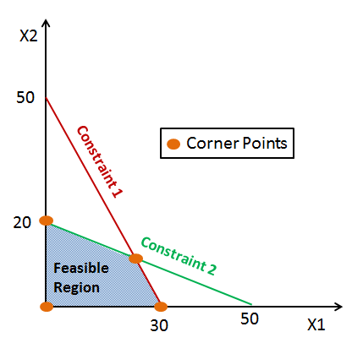
The simplex algorithm and linear programming
The simplex algorithm [Dantzig, 1947] solves linear programs. Has been used extensively (and still is).
However, its worst case running time is exponential [Klee and Minty, 1972].
The Ellipsoid algorithm [Shor; Nemirovski and Yudin 1972] was shown to solve LPs in polynomial time [Khachiyan 1979].
In practice, the simplex algorithm is much faster than the ellipsoid algorithm.
Interior point methods [Karmakar 1984] are both theoretically and practically efficient.
* Image from: https://www.datacamp.com/community/tutorials/linear-programming-with-spreadsheets

Slide 16
Lessons from the simplex example
Worst case analysis predicts that the ellipsoid is a faster algorithm for linear programming than the simplex algorithm.
Practical experience shows that virtually on all input instances of interest, the simplex algorithm is much faster than the ellipsoid algorithm.
Worst case complexity theory did not serve as a reliable guide for practice (in this case).
Is there an alternative theory that can explain the success of the simplex algorithm?

Slide 17
Clustering – how would you cluster these points?

Slide 18
Clustering – how would you cluster these points?

Slide 19
Clustering – how would you cluster these points?

Slide 20
Clustering
Can define formal objective functions to compare between the value of various solutions to a clustering instance. For example:
$k$-median: generate $k$ clusters, minimize sum of distances of points from the centers of their respective clusters.
$k$-means: generate $k$ clusters, minimize sum of squared distances of points from the centers of their respective clusters.
Can you see why they are named $k$-median and $k$-means?

Slide 21
Clustering – worst case analysis
Given a set of points to cluster, optimizing the $k$-means objective is NP-hard, and likewise for the $k$-median objective.
Is this NP-hardness relevant?
We are mainly interested in clustering when clusters are “meaningful”, and essentially unambiguous.
Could it be that clustering is hard only when it does not matter?

Slide 22
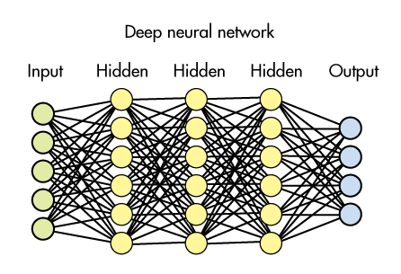
The unreasonable effectiveness of machine learning
Machine learning algorithms achieve great success in a variety of applications.
Worst case analysis does not predict such success.
* Image from: https://www.securityinfowatch.com/video-surveillance/video-analytics/article/21069937/deep-learning-to-the-rescue

Slide 23
Puzzles associated with machine learning
Training error: given a labeled training set and a deep neural network architecture, training a DNN (optimizing the network weights with respect to the training set) is NP-hard.
Generalization error: worst case analysis suggests that the size of the training set needs to be larger than the number of parameters in the DNN, or else the generalization error (on test sets) will be large (due to over-fitting).

Slide 24
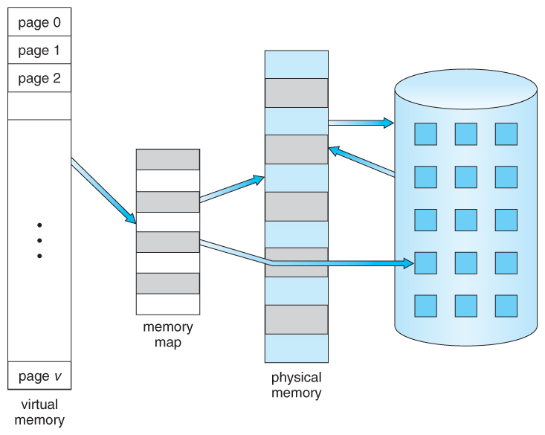
Online paging
* Image from: https://www.cs.uic.edu/~jbell/CourseNotes/OperatingSystems/9_VirtualMemory.html

Slide 25
Online paging
A page fault: the CPU attempts to access a logical page (in its virtual memory) that is not in (the physical) main memory. The page needs to be retrieved from disk.
Page eviction: to make space in main memory to retrieved page.
(Same considerations for cache versus main memory.)
Which page should we evict?
Belady’s furthest in the future eviction policy is optimal. (In particular, if physical memory has $k$ pages and virtual memory has $k+1$ pages, the page fault rate is at most $\frac{1}{k}$.)
However, we need to decide online. (Looking ahead is not practical.)

Slide 26
Deterministic paging policies
Least Recently Used (LRU): evict the page whose last usage was earliest.
First in First Out (FIFO): evict the page that entered memory earliest.
Most recently used (MRU): evict the page used latest.
Last in first out (LIFO): evict the page most recently retrieved.
Worst case analysis does not distinguish among these algorithms. For every eviction policy, in the worst case, the page fault rate is 1.

Slide 27
Comment: swapping versus paging
Swapping of processes: in a multi-processing system, the CPU may preempt a running process, and instead start/resume a process that was waiting in queue.
In needed, evicts pages used by processes that are not currently running, rather than pages of process that are currently running.
Both LRU and FIFO are a proxy to this rule, whereas MRU and LIFO are not.
Swapping is somewhat orthogonal to online paging. It refers to the inter-process memory management, whereas online paging refers to the memory management of a single process.

Slide 28
Beyond worst case analysis
Can a theoretical model predict which deterministic paging policy will have lower page-fault rate?
We shall present one such model.

Slide 29
Correlations, locality of reference
A sequence of page requests is not a sequence of randomly and independently chosen pages.
Program instructions are typically accessed linearly (in portions without branches), or periodically (loops), or recursively (function calls).
Data objects are typically accessed repeatedly (read then write, incrementing a counter), or sequentially (elements of an array).
Locality of reference is the reason why one paging policy is better than another in practice. Hence this is what we would like to model.

Slide 30
A generative model exhibiting locality of reference?
A generative model for the sequence of requests.
For example: the sequence of page requests forms a Markov chain (each new request is a probabilistic function of the previous request), or the output of a hidden Markov chain.
Show that for a wide range of parameters of the Markov chain:
The sequence of page requests exhibits “locality of reference”.
Some paging policies are preferable over others.
There has been work along these lines. We will do something different.

Slide 31
Locality of reference as a parameter
Working set, parametrized by a function $w$.
For every $n$, $w(n)$ is smallest possible window size of page requests that contains $n$ distinct page requests.
$w\left(1\right)=1$.
$w\left(2\right)=2$.
$w\left(n+1\right)≥w\left(n\right)+1$.
For $n$ exceeding the virtual address space, $w\left(n\right)=∞$.
At worse, $w\left(n\right)=n$. Locality of reference is interpreted to mean that $w$ grows much more quickly.

Slide 32
Extracting a single parameter from $w$
Let $k$ denote the size (number of pages) of main memory. Define:
$$α_{w}\left(k\right)=\frac{k−1}{w\left(k+1\right)−2}$$
Note that for every $w$ it holds that $0≤α_{w}\left(k\right)≤1$.
We say that $w$ is convex if for every $n≥2$,
$$w\left(n+1\right)−w\left(n\right)≥w\left(n\right)−w(n−1)$$
Informal justification for convexity: as more pages are being requested, it becomes more likely that the next page request is to a page that was requested in the past.

Slide 33
Theorem [Albers, Favrholdt, Giel 2005]
For every convex $w$, memory size $k$, and deterministic paging algorithm, there are arbitrarily long page request sequences with page fault rate $α_{w}(k)$.
For every convex $w$, memory size $k$, and page request sequence (let $n$ denote its length), the page fault rate of LRU is at most $α_{w}\left(k\right)+o(1)$.
The above statement does not hold for FIFO.
$$α_{w}\left(k\right)=\frac{k−1}{w\left(k+1\right)−2}$$

Slide 34
Proof: forcing page fault rate to be $α_{w}\left(k\right)=\frac{k−1}{w\left(k+1\right)−2}$
$$m_{n}=w\left(n+1\right)−w\left(n\right)$$
Recall: memory can hold up to $k$ pages.
Suppose there are $k+1$ virtual pages, and memory is full (has $k$ pages).
Repeat indefinitely the following strategy that has $k−1$ phases:
In phase $t$, request the page currently not in memory, and do so $m_{t+1}$ times.
$k−1$ page faults.
Length of the basic sequence (which is then repeated): $$m_{2}+…+m_{k}=w\left(k+1\right)−w\left(2\right)=w\left(k+1\right)−2$$

Slide 35
Example. $k=4$
$w\left(1\right)=1$, $w\left(2\right)=2$, $w\left(3\right)=4$, $w\left(4\right)=7$, $w\left(5\right)=10$
$m_{1}=1$, $m_{2}=2$, $m_{3}=3$, $m_{4}=3.$
Memory has pages 1,2,3,4, and not page 5.
Basic request sequence: $2×p_{1}, 3×p_{2},3×p_{3}$.
This sequence is repeated.
55111222 33444555 11222333 …
Smallest window with 4 ($=k$) pages:
$$1+m_{2}+m_{3}+1=2+w\left(4\right)−w\left(2\right)=w(4)$$
Where did we use the assumption that $w$ is convex?

Slide 36
Proof: LRU has fault rate at most $α_{w}\left(k\right)=\frac{k−1}{w\left(k+1\right)−2}$
Consider a sequence $σ$ of requests containing $k−1$ faults, until next fault.
$$σ= XVVXVVVXVV$$
Let P be the previous page, and N be the next page fault.
$$PXVVXVVVXVVN$$
If P, N and the X are all distinct, then $\left|σ\right|≥w\left(k+1\right)−2$.
If two page faults are to the same page, then in between there must have been $k$ other distinct pages (LRU).
Same if the first was P, regardless of whether P was a page fault.
What changes if we use FIFO instead of LRU?

Slide 37
Theorem [Albers, Favrholdt, Giel 2005]
For every convex $w$, memory size $k$, and deterministic paging algorithm, there are arbitrarily long page request sequences with page fault rate $α_{w}(k)$.
For every convex $w$, memory size $k$, and page request sequence (let $n$ denote its length), the page fault rate of LRU is at most $α_{w}\left(k\right)+o(1)$.
The above statement does not hold for FIFO.
$$α_{w}\left(k\right)=\frac{k−1}{w\left(k+1\right)−2}$$

Slide 38
Homework (first part)
Read Chapter 1 in the BWCA book, pages 1-12.
Exercise 1.4: give example in which FIFO has a page fault rate higher than $α_{w}\left(k\right)=\frac{k−1}{w\left(k+1\right)−2}$.
Exercise 1.5: prove that FIFO has page fault rate no higher than $\frac{k}{w\left(k+1\right)−1}$.
Hand in by April 12.

Slide 39
Did the theoretical model serve its purpose?
Does the model (the parameter) make intuitive sense?
What insights did we get from results within the model?
Causation: did the model lead to the insights, or did the insights lead to the model?
Is the model too simple? Is it abstracting away an important feature in practical paging situations? If so, what?
Is the model too complicated? Could the same insights be demonstrated as convincingly by a simpler model, with simpler analysis?

Slide 40
Finding a linear separator
Training examples $(x_{t},y_{t})$ arrive online one by one.
Every training example is a vector $x∈R^{d}$ and a label $y∈\{±1\}$.
The goal is to find a vector $w∈R^{d}$ so that $sign\left(w⋅x\right)=y$ for every $x$.

Slide 41
The perceptron algorithm [Rosenblatt 1958]
Scale all points $x_{t}$ so that they have unit norm (does not change solution).
Start with $w\left(1\right)={y_{1}x}_{1}$.
In step $r≥2$, if:
$sign\left( w\left(r−1\right)⋅x_{r}\right)=y_{r}$, do nothing.
$sign\left( w\left(r−1\right)⋅x_{r}\right)={−y}_{r}$, then $w\left(r\right)=w\left(r−1\right)+y_{r}x_{r}$.
The algorithm moves $w(r−1)$ so as to improve its inner produce with $x_{r}$.

Slide 42
Is the Perceptron a good algorithm?
Suppose that indeed the training set is linearly separable.
Does the perceptron algorithm converge?
If so, how many errors will it make before converging?
Worst case analysis: the number of errors might be unbounded.
A more informative answer uses a parameter $μ$, the margin: the smallest distance between a (normalized) training point and the optimal separating hyperplane.
Intuitively, large $μ$ makes the problem easier.

Slide 43
Homework (second part)
Exercise 1.7 in BWCA: show that the number of errors of the Perceptron algorithm is at most $\frac{1}{μ^{2}}$.

