Slide 1
Chapter 2:
Parameterized Algorithms
Fedor Fomin, Daniel Lokshtanov,
Saket Saurabh, Meirav Zehavi

Slide 2
Basic idea
When standard worst case analysis (expressing running time as a function of size of input instance) is not sufficiently informative:
Identify parameters of interest (like we did with properties of the working set function for online paging, or the margin for the Perceptron algorithm).
With respect to these parameters, perform worst case analysis.
For a good choice of parameter, the corresponding worst case analysis becomes more informative.

Slide 3
Example – minimum vertex cover
Select the smallest number of vertices that cover all edges.
NP-hard.

Slide 4
Example – minimum vertex cover
Select the smallest number of vertices that cover all edges.
NP-hard.

Slide 5
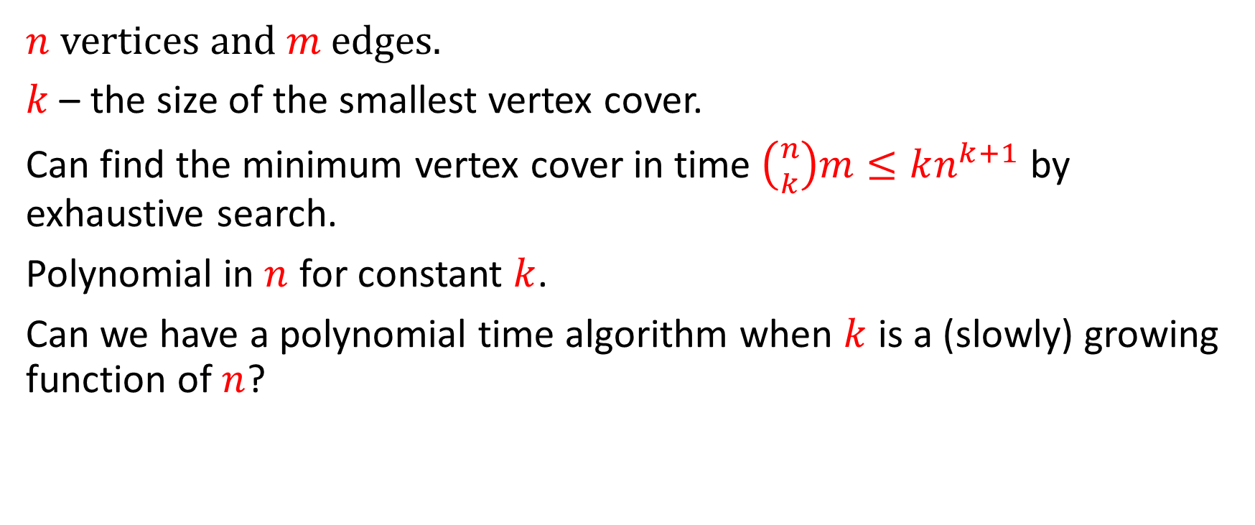
A parameter for vertex cover
$n$ vertices and $m$ edges.
$k$ – the size of the smallest vertex cover.
Can find the minimum vertex cover in time $\left({n \atop k}\right)m≤kn^{k+1}$ by exhaustive search.
Polynomial in $n$ for constant $k$.
Can we have a polynomial time algorithm when $k$ is a (slowly) growing function of $n$?

Slide 6
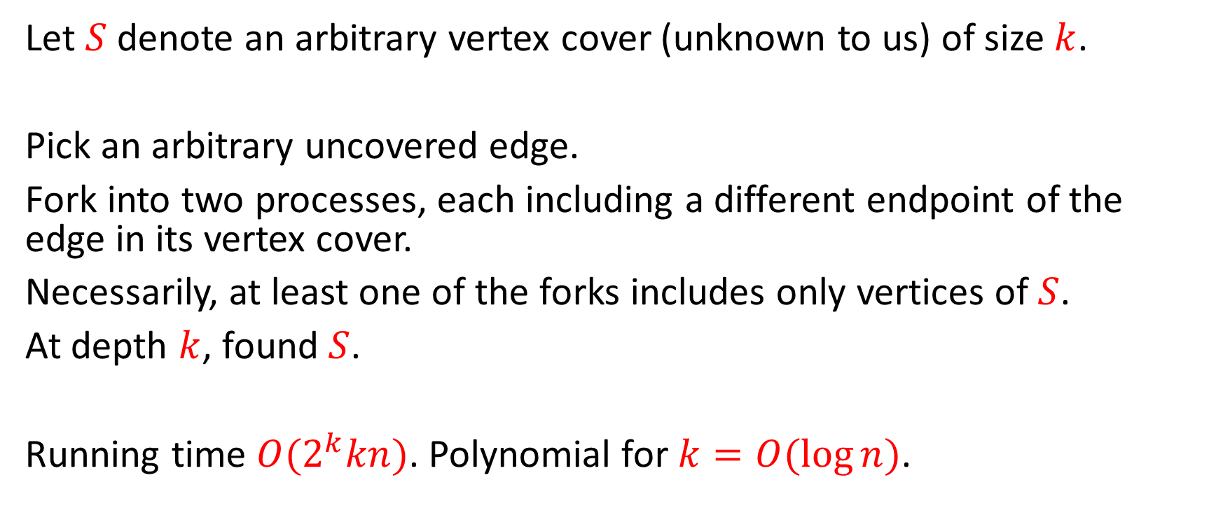
A simple algorithm for min vertex cover
Let $S$ denote an arbitrary vertex cover (unknown to us) of size $k$.
Pick an arbitrary uncovered edge.
Fork into two processes, each including a different endpoint of the edge in its vertex cover.
Necessarily, at least one of the forks includes only vertices of $S$.
At depth $k$, found $S$.
Running time ${O(2}^{k}kn)$. Polynomial for $k=O(\log{n)}$.

Slide 7
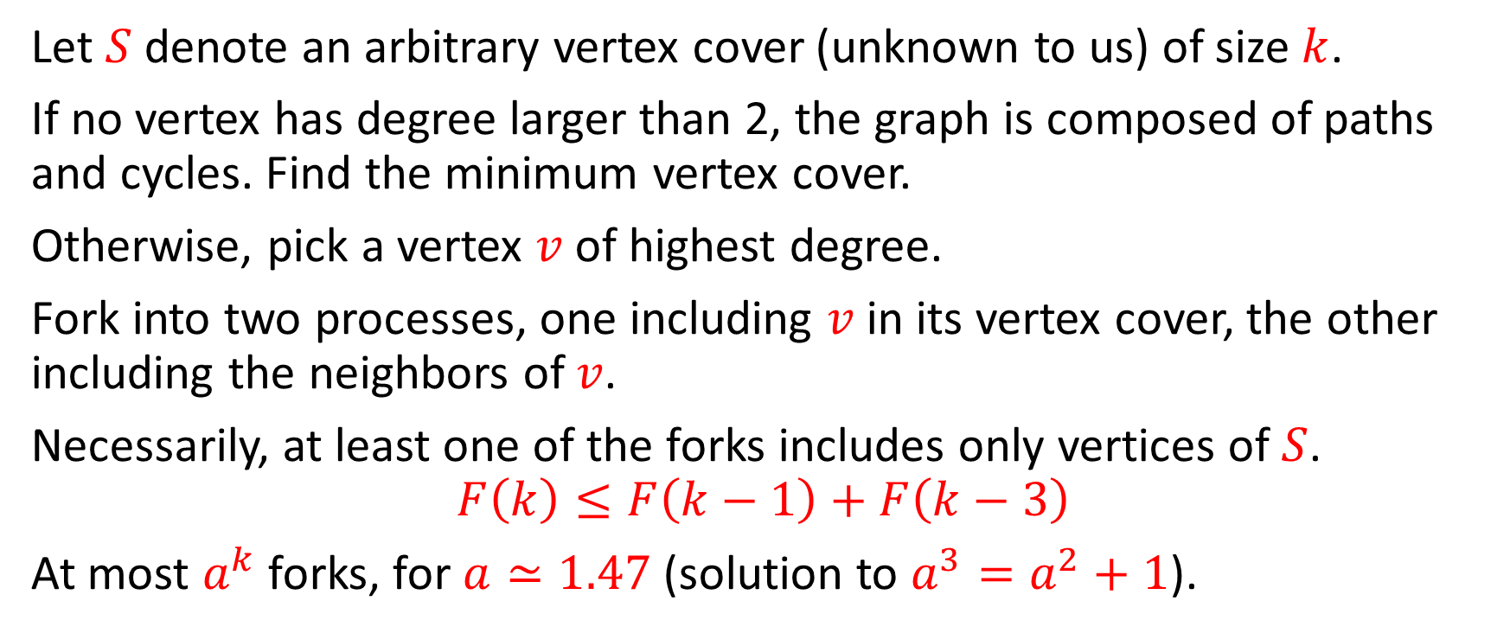
A faster algorithm
Let $S$ denote an arbitrary vertex cover (unknown to us) of size $k$.
If no vertex has degree larger than 2, the graph is composed of paths and cycles. Find the minimum vertex cover.
Otherwise, pick a vertex $v$ of highest degree.
Fork into two processes, one including $v$ in its vertex cover, the other including the neighbors of $v$.
Necessarily, at least one of the forks includes only vertices of $S$.
$$F\left(k\right)≤F\left(k−1\right)+F\left(k−3\right)$$
At most $a^{k}$ forks, for $a≃1.47$ (solution to $a^{3}=a^{2}+1$).

Slide 8
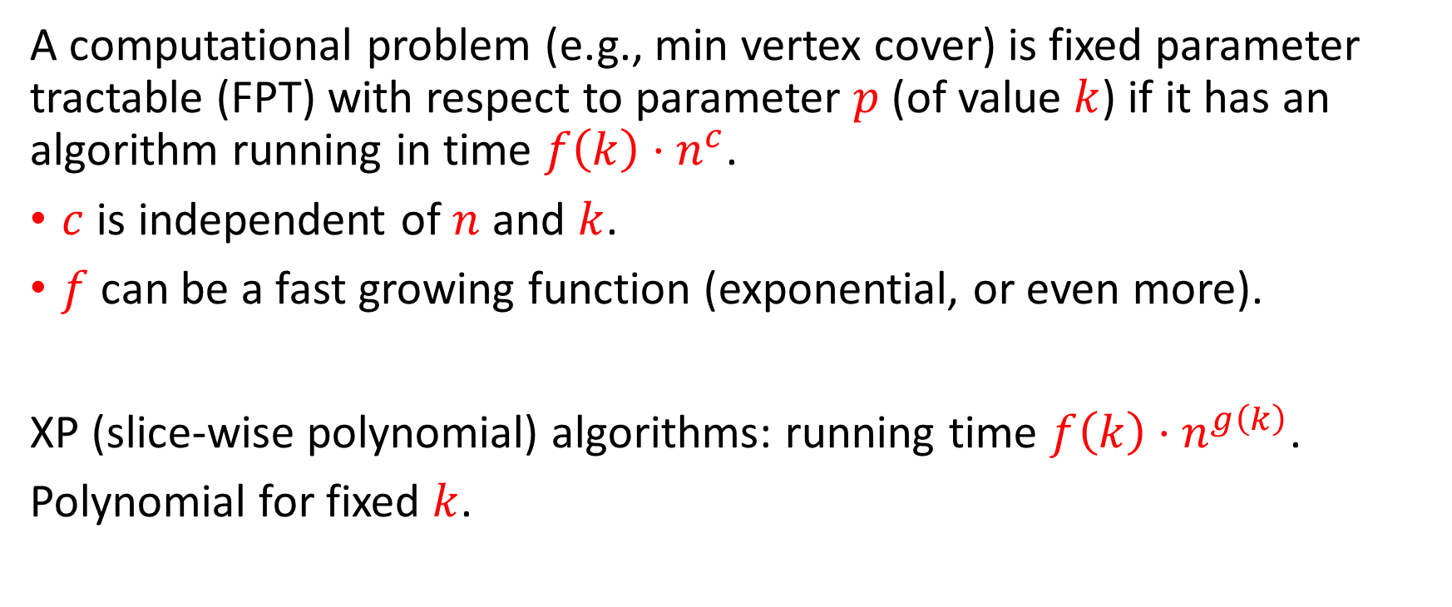
Fixed parameter tractability
A computational problem (e.g., min vertex cover) is fixed parameter tractable (FPT) with respect to parameter $p$ (of value $k$) if it has an algorithm running in time $f\left(k\right)⋅n^{c}$.
$c$ is independent of $n$ and $k$.
$f$ can be a fast growing function (exponential, or even more).
XP (slice-wise polynomial) algorithms: running time $f\left(k\right)⋅n^{g\left(k\right)}$.
Polynomial for fixed $k$.

Slide 9
Some other graph problems

Slide 10
Maximum independent set

Slide 11
Minimum vertex coloring (chromatic number)

Slide 12
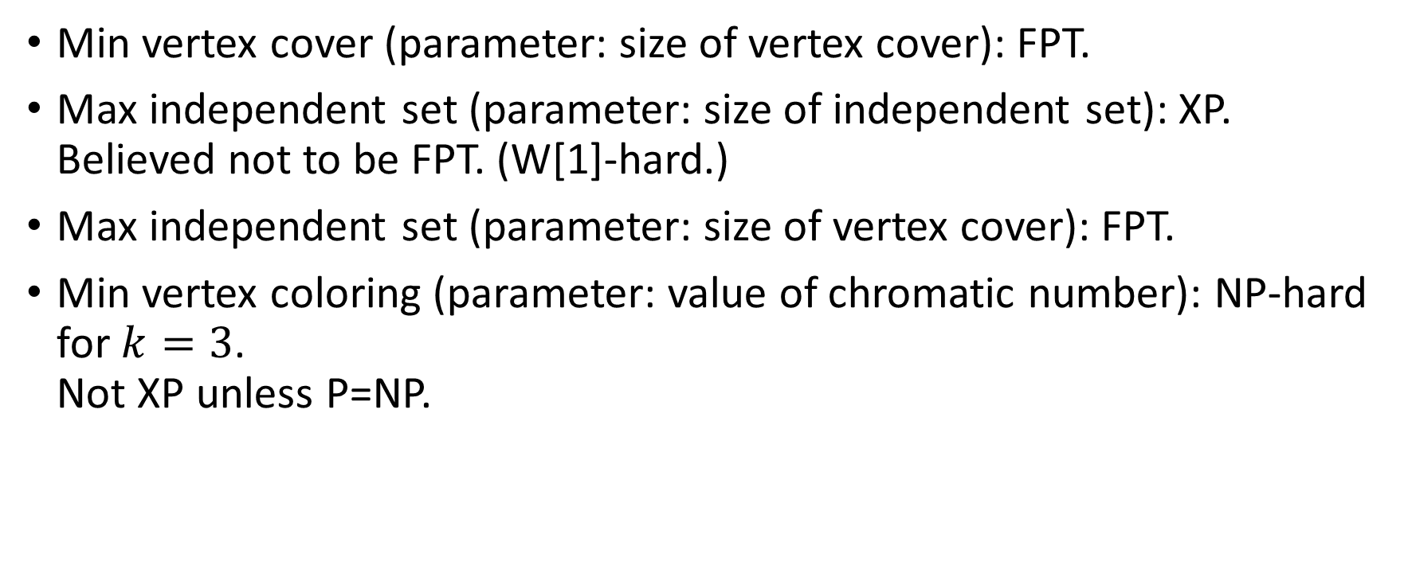
Examples of classifications
Min vertex cover (parameter: size of vertex cover): FPT.
Max independent set (parameter: size of independent set): XP.
Believed not to be FPT. (W[1]-hard.)
Max independent set (parameter: size of vertex cover): FPT.
Min vertex coloring (parameter: value of chromatic number): NP-hard for $k=3$.
Not XP unless P=NP.

Slide 13
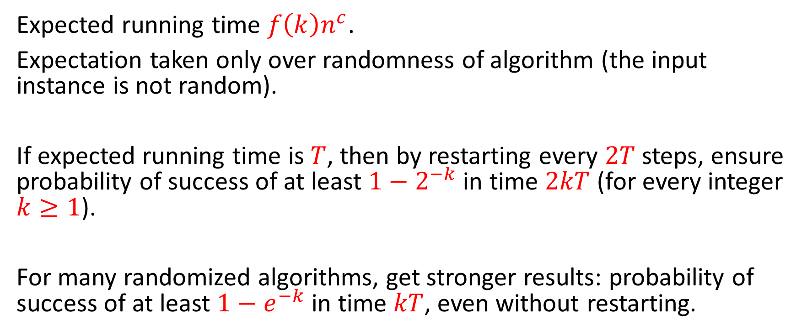
Randomized FPT algorithms
Expected running time $f\left(k\right)n^{c}$.
Expectation taken only over randomness of algorithm (the input instance is not random).
If expected running time is $T$, then by restarting every $2T$ steps, ensure probability of success of at least $1−2^{−k}$ in time $2kT$ (for every integer $k≥1$).
For many randomized algorithms, get stronger results: probability of success of at least $1−e^{−k}$ in time $kT$, even without restarting.

Slide 14
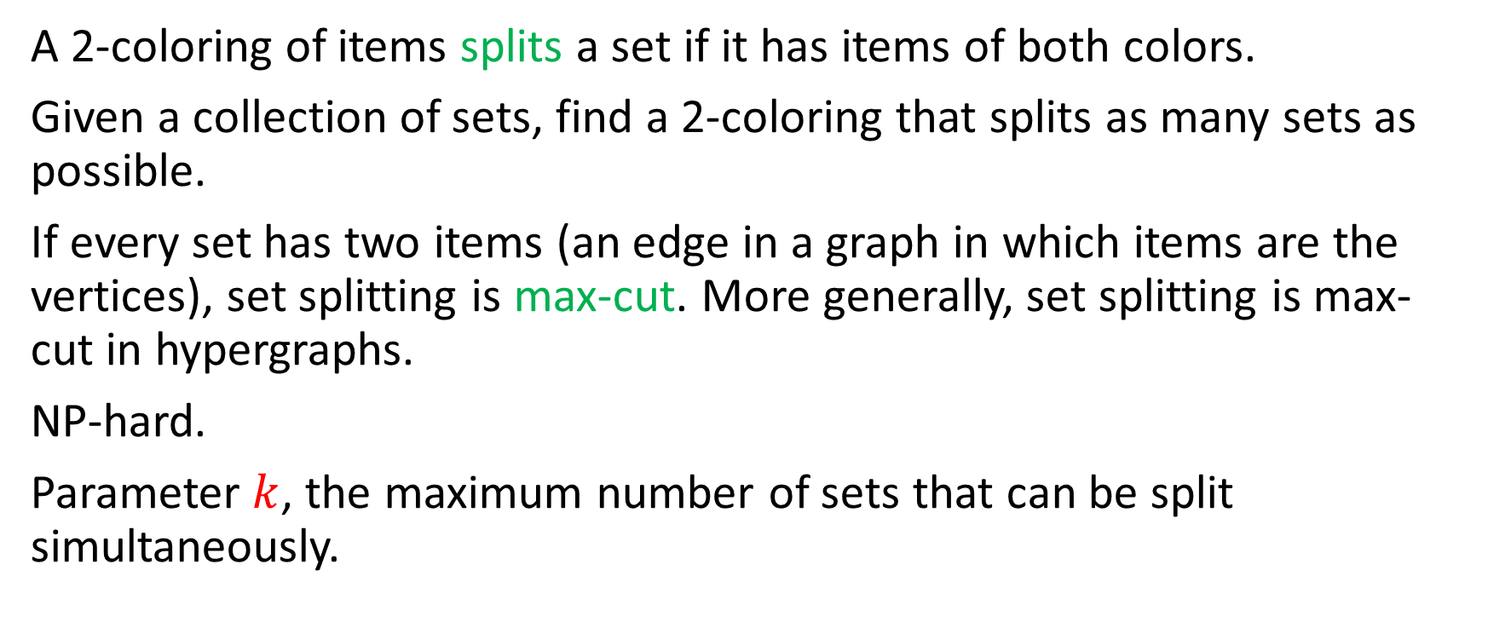
Set splitting
A 2-coloring of items splits a set if it has items of both colors.
Given a collection of sets, find a 2-coloring that splits as many sets as possible.
If every set has two items (an edge in a graph in which items are the vertices), set splitting is max-cut. More generally, set splitting is max-cut in hypergraphs.
NP-hard.
Parameter $k$, the maximum number of sets that can be split simultaneously.

Slide 15
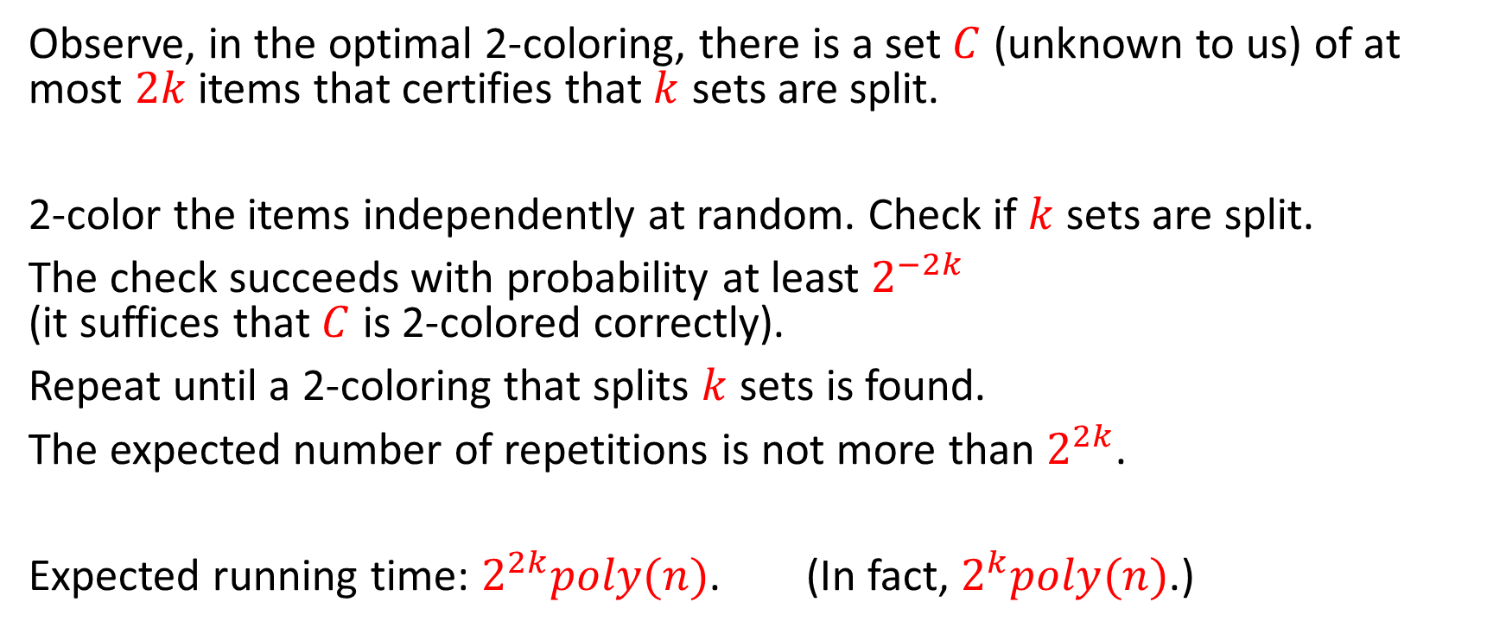
Randomized algorithm for set splitting
Observe, in the optimal 2-coloring, there is a set $C$ (unknown to us) of at most $2k$ items that certifies that $k$ sets are split.
2-color the items independently at random. Check if $k$ sets are split.
The check succeeds with probability at least $2^{−2k}$
(it suffices that $C$ is 2-colored correctly).
Repeat until a 2-coloring that splits $k$ sets is found.
The expected number of repetitions is not more than $2^{2k}$.
Expected running time: $2^{2k}poly(n)$. (In fact, $2^{k}poly(n)$.)

Slide 16
Longest path

Slide 17
Longest path
1
2
3
6
7
4
5

Slide 18
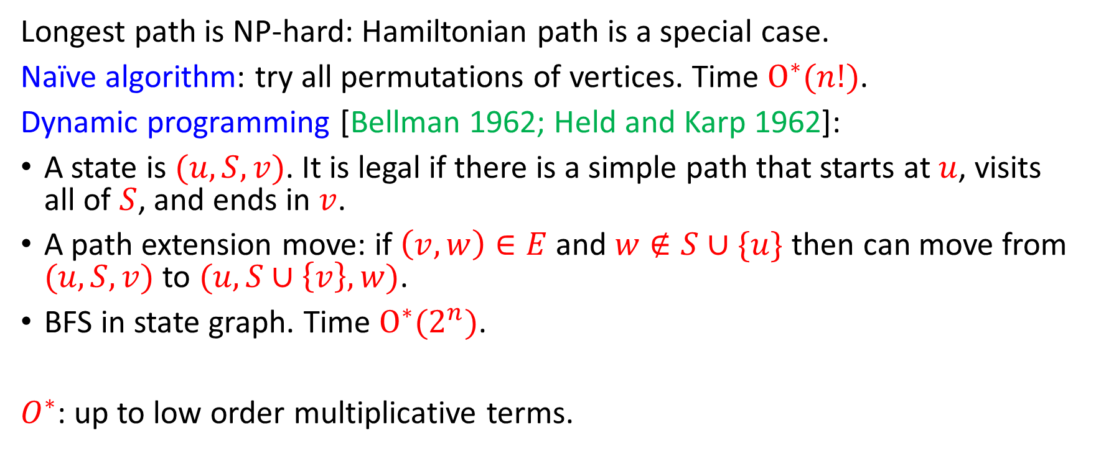
Longest path and Hamiltonicity
Longest path is NP-hard: Hamiltonian path is a special case.
Naïve algorithm: try all permutations of vertices. Time $O^{∗}(n!)$.
Dynamic programming [Bellman 1962; Held and Karp 1962]:
A state is $(u, S, v)$. It is legal if there is a simple path that starts at $u$, visits all of $S$, and ends in $v$.
A path extension move: if $\left(v,w\right)∈E$ and $w∉S∪\{u\}$ then can move from $(u, S, v)$ to $(u, S∪\left\{v\right\}, w)$.
BFS in state graph. Time $O^{∗}(2^{n})$.
$O^{∗}$: up to low order multiplicative terms.

Slide 19
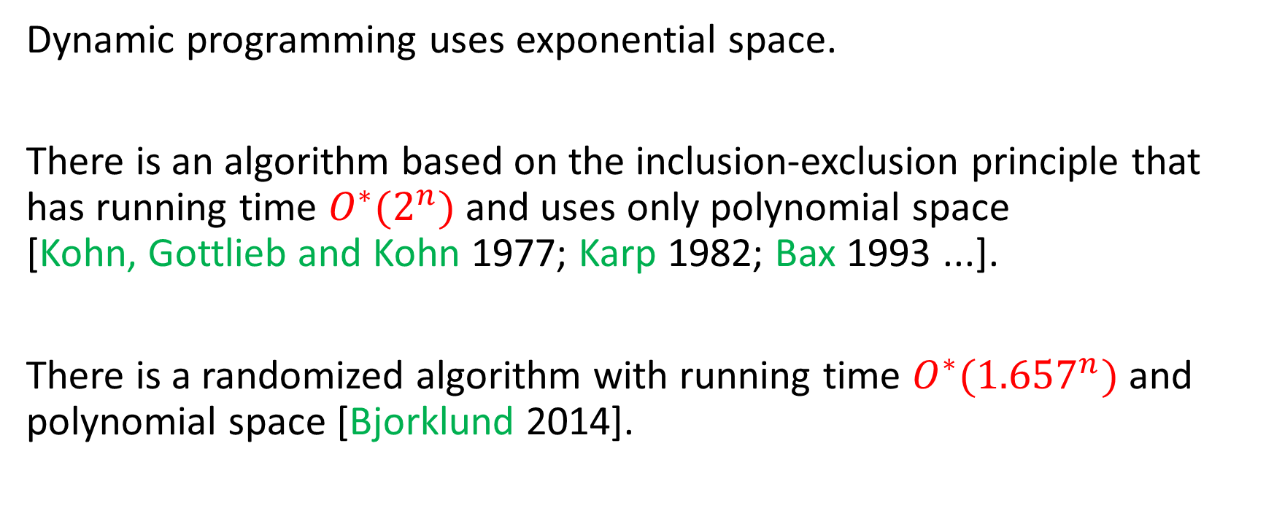
Further comments on Hamilton path
Dynamic programming uses exponential space.
There is an algorithm based on the inclusion-exclusion principle that has running time $O^{∗}(2^{n})$ and uses only polynomial space
[Kohn, Gottlieb and Kohn 1977; Karp 1982; Bax 1993 ...].
There is a randomized algorithm with running time ${O^{∗}(1.657}^{n})$ and polynomial space [Bjorklund 2014].

Slide 20
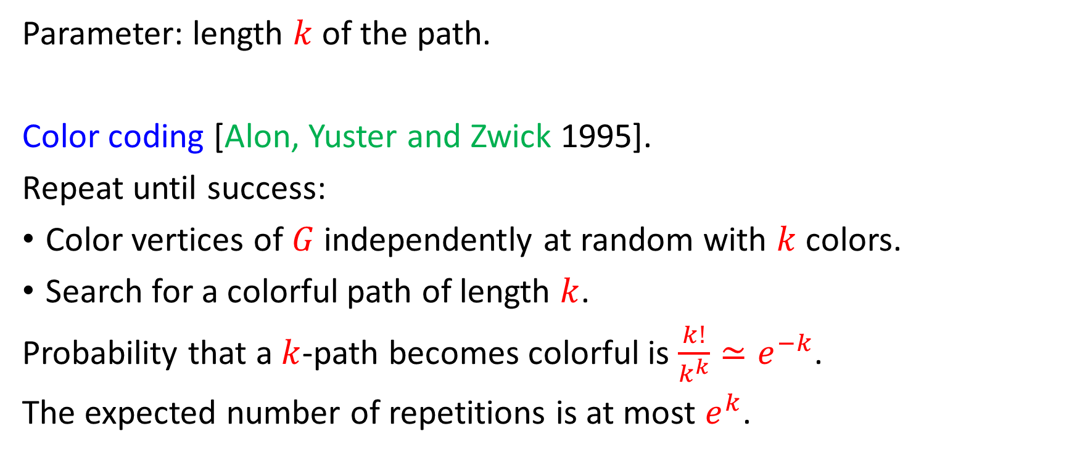
Longest path is fixed parameter tractable
Parameter: length $k$ of the path.
Color coding [Alon, Yuster and Zwick 1995].
Repeat until success:
Color vertices of $G$ independently at random with $k$ colors.
Search for a colorful path of length $k$.
Probability that a $k$-path becomes colorful is $\frac{k!}{k^{k}}≃e^{−k}$.
The expected number of repetitions is at most $e^{k}$.

Slide 21
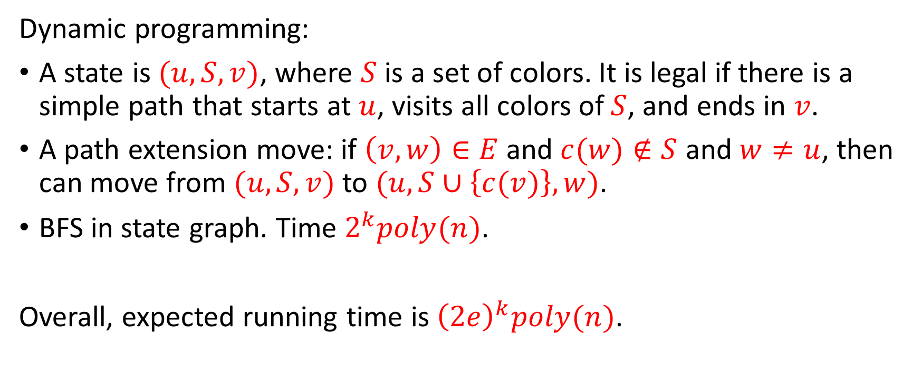

Finding a colorful $k$-path
Dynamic programming:
A state is $(u, S, v)$, where $S$ is a set of colors. It is legal if there is a simple path that starts at $u$, visits all colors of $S$, and ends in $v$.
A path extension move: if $\left(v,w\right)∈E$ and $c(w)∉S$ and $w≠u$, then can move from $(u, S, v)$ to $(u, S∪\left\{c(v)\right\}, w)$.
BFS in state graph. Time $2^{k}poly(n)$.
Overall, expected running time is ${\left(2e\right)}^{k}poly(n)$.

Slide 22
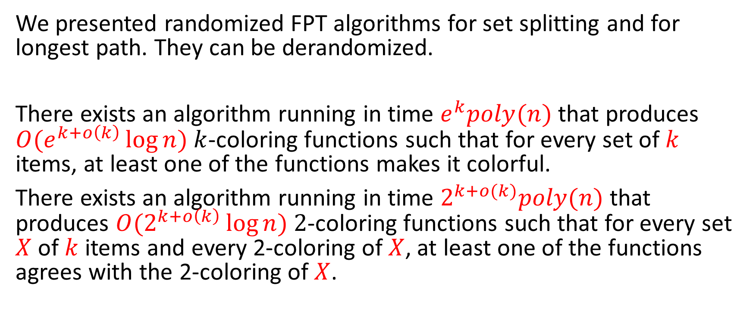
Derandomization
[Naor, Schulman and Srinivasan 1995]
We presented randomized FPT algorithms for set splitting and for longest path. They can be derandomized.
There exists an algorithm running in time $e^{k}poly(n)$ that produces $O(e^{k+o\left(k\right)}\log{n)}$ $k$-coloring functions such that for every set of $k$ items, at least one of the functions makes it colorful.
There exists an algorithm running in time $2^{k+o(k)}poly(n)$ that produces $O(2^{k+o\left(k\right)}\log{n)}$ $2$-coloring functions such that for every set $X$ of $k$ items and every 2-coloring of $X$, at least one of the functions agrees with the 2-coloring of $X$.

Slide 23
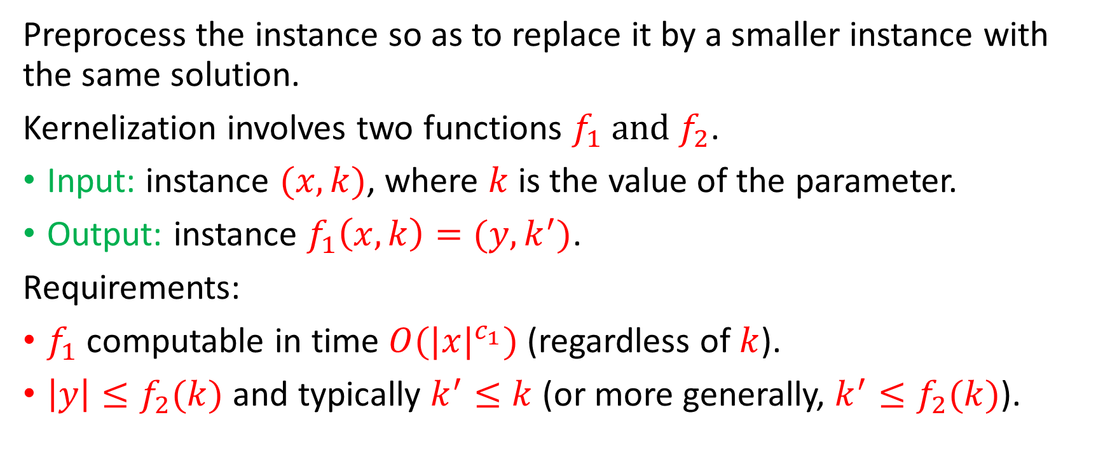
Kernelization
Preprocess the instance so as to replace it by a smaller instance with the same solution.
Kernelization involves two functions $f_{1} and$ $f_{2}$.
Input: instance $(x,k)$, where $k$ is the value of the parameter.
Output: instance $f_{1}\left(x,k\right)=(y,k^{′})$.
Requirements:
$f_{1}$ computable in time $O({|x|}^{c_{1}})$ (regardless of $k$).
$\left|y\right|≤f_{2}(k)$ and typically $k^{′}≤k$ (or more generally, $k^{′}≤f_{2}(k)$).

Slide 24
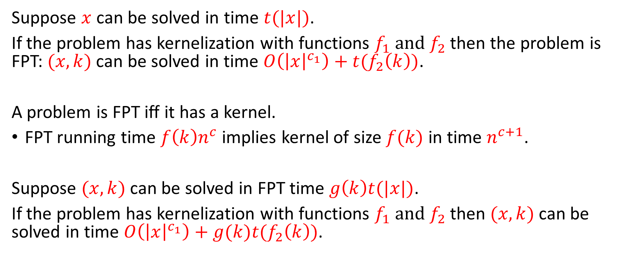
Significance of kernelization
Suppose $x$ can be solved in time $t(|x|)$.
If the problem has kernelization with functions $f_{1} and$ $f_{2}$ then the problem is FPT: $(x,k)$ can be solved in time $O\left({\left|x\right|}^{c_{1}}\right)+t(f_{2}\left(k\right))$.
A problem is FPT iff it has a kernel.
FPT running time $f\left(k\right)n^{c}$ implies kernel of size $f(k)$ in time $n^{c+1}$.
Suppose $(x,k)$ can be solved in FPT time $g\left(k\right)t(|x|)$.
If the problem has kernelization with functions $f_{1} and$ $f_{2}$ then $(x,k)$ can be solved in time $O\left({\left|x\right|}^{c_{1}}\right)+g(k)t(f_{2}\left(k\right))$.

Slide 25
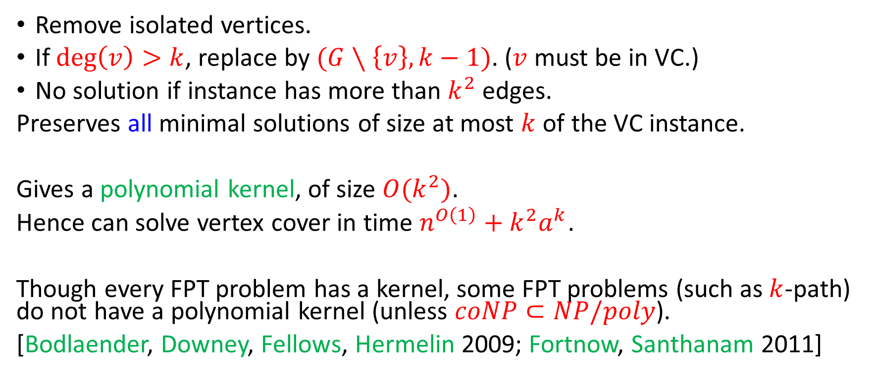
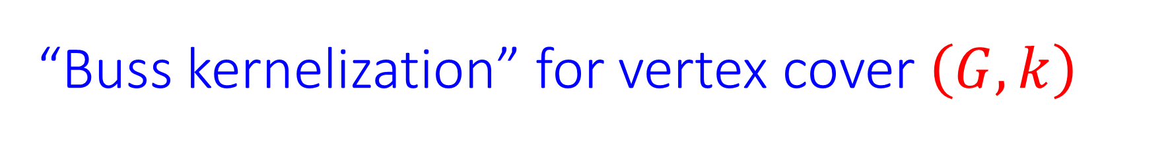
“Buss kernelization” for vertex cover $\left(G,k\right)$
Remove isolated vertices.
If $\deg\left(v\right)>k$, replace by $(G∖\left\{v\right\}, k−1)$. ($v$ must be in VC.)
No solution if instance has more than $k^{2}$ edges.
Preserves all minimal solutions of size at most $k$ of the VC instance.
Gives a polynomial kernel, of size $O(k^{2})$.
Hence can solve vertex cover in time $n^{O\left(1\right)}+k^{2}a^{k}$.
Though every FPT problem has a kernel, some FPT problems (such as $k$-path) do not have a polynomial kernel (unless $coNP⊂NP/poly$).
[Bodlaender, Downey, Fellows, Hermelin 2009; Fortnow, Santhanam 2011]

Slide 26
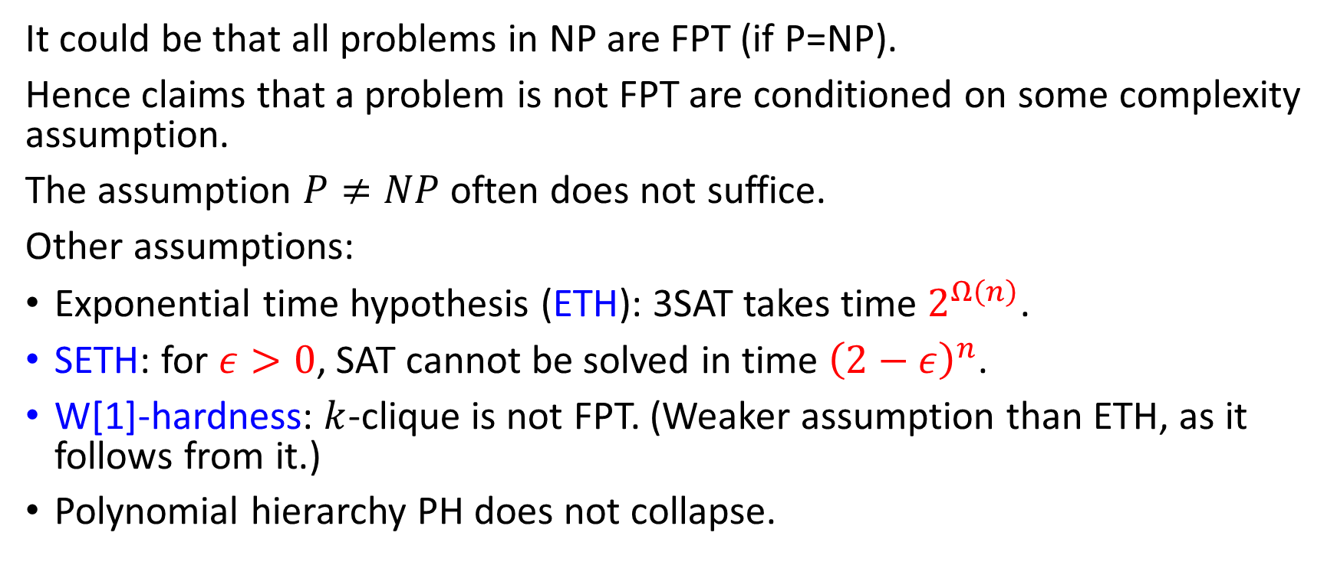
Conditional negative results
It could be that all problems in NP are FPT (if P=NP).
Hence claims that a problem is not FPT are conditioned on some complexity assumption.
The assumption $P≠NP$ often does not suffice.
Other assumptions:
Exponential time hypothesis (ETH): 3SAT takes time $2^{Ω\left(n\right)}$.
SETH: for $ε>0$, SAT cannot be solved in time ${\left(2−ε\right)}^{n}$.
W[1]-hardness: $k$-clique is not FPT. (Weaker assumption than ETH, as it follows from it.)
Polynomial hierarchy PH does not collapse.

Slide 27
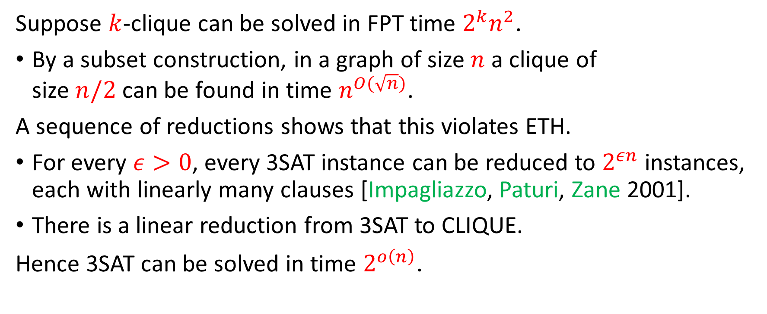
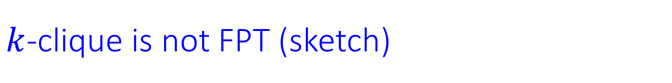
$k$-clique is not FPT (sketch)
Suppose $k$-clique can be solved in FPT time $2^{k}n^{2}$.
By a subset construction, in a graph of size $n$ a clique of
size $n/2$ can be found in time $n^{O(\sqrt{n})}$.
A sequence of reductions shows that this violates ETH.
For every $ε>0$, every 3SAT instance can be reduced to $2^{εn}$ instances, each with linearly many clauses [Impagliazzo, Paturi, Zane 2001].
There is a linear reduction from 3SAT to CLIQUE.
Hence 3SAT can be solved in time $2^{o\left(n\right)}$.

Slide 28
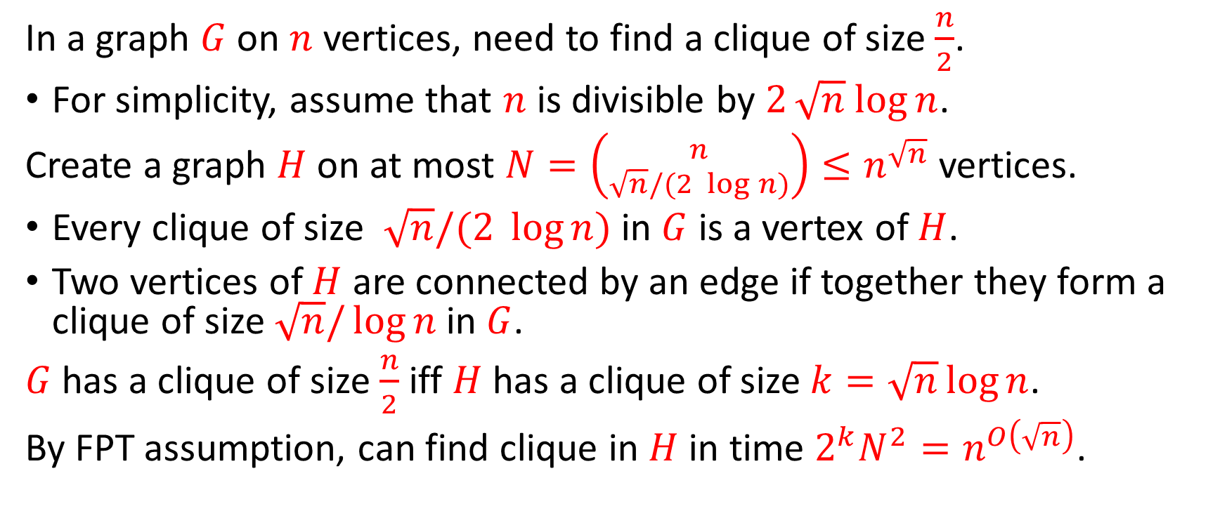
The subset construction
In a graph $G$ on $n$ vertices, need to find a clique of size $\frac{n}{2}$.
For simplicity, assume that $n$ is divisible by $2\sqrt{n} log{n}$.
Create a graph $H$ on at most $N=\left({n \atop \sqrt{n}/(2\log{n)}}\right)≤n^{\sqrt{n}}$ vertices.
Every clique of size $\sqrt{n}/(2\log{n)}$ in $G$ is a vertex of $H$.
Two vertices of $H$ are connected by an edge if together they form a clique of size $\sqrt{n}/\log{n}$ in $G$.
$G$ has a clique of size $\frac{n}{2}$ iff $H$ has a clique of size $k=\sqrt{n}\log{n}$.
By FPT assumption, can find clique in $H$ in time $2^{k}N^{2}=n^{O\left(\sqrt{n}\right)}$.

